Slide 1
TREE

Slide 2
Project ☺
Defined New Data Structure!!
If we can put the data in the middle of an array, then we can do insert_first and delete_first in constant time, but programming languages such as Python and cpp are not able to allocate free space before the beginning of the data, and the navigation is always from the side. Left to right.
Define a data structure that addresses this issue
Things you need to know:
Array
Linked List
Dynamic Array

Slide 3

Why do we use other data structures?
Adversary!!!
A theoretical agent that uses information about the past moves of an on-line algorithm to choose inputs that force the worst-case cost of the algorithm.

Slide 4
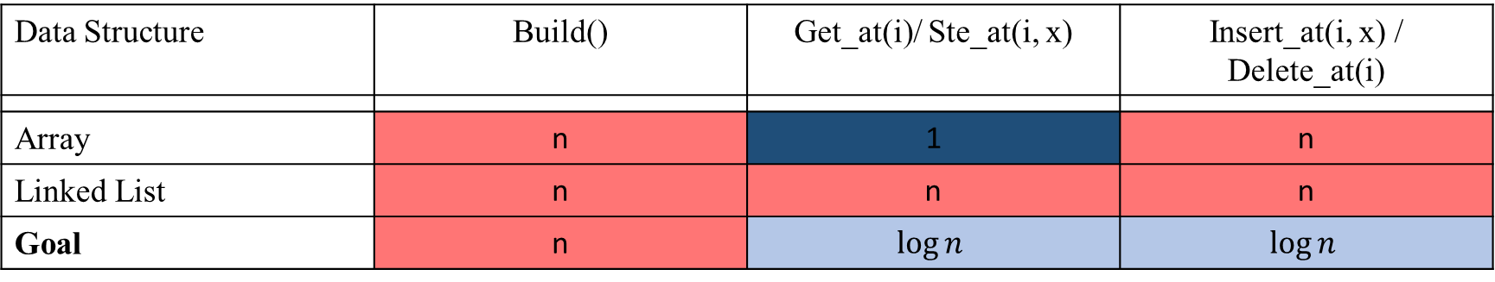
Our Goal
Data Structure | Build() | Get_at(i)/ Ste_at(i, x) | Insert_at(i, x) / Delete_at(i)
Array | n | 1 | n
Linked List | n | n | n
Goal | n | $$\log{n}$$ | $$\log{n}$$

Slide 5
How? Binary Trees!
Pointer-based data structures (like Linked List) can achieve worst-case performance
Binary tree is pointer-based data structure with three pointers
per node Node representation: node.{item, parent, left, right}

Slide 6
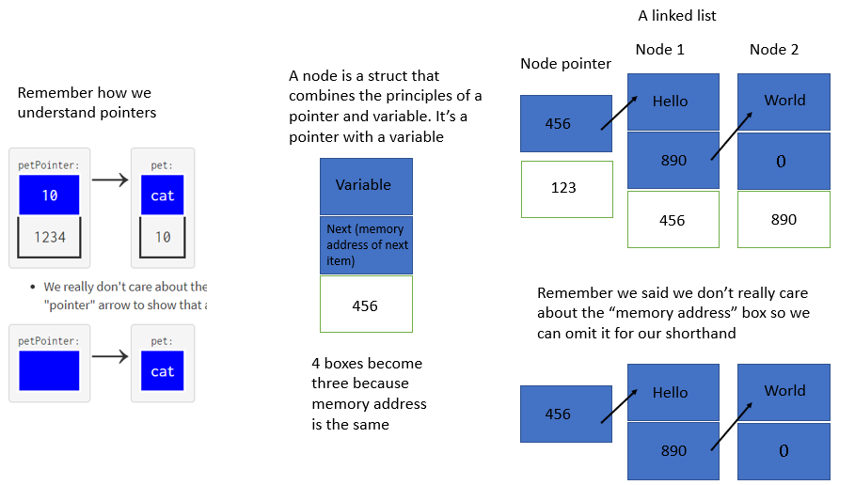
Remember Pointer

Slide 7

One Parent, No Cycles

Slide 8
Building trees programmatically
Each node must have data value
Each node must have left child pointer
Each node must have right child pointer
Each node must have parent pointer

Slide 9
example
___________<A>________
<B> ______<C>______
<D>_____ <E>
<F>
Node | <A> | <B> | <C> | <D> | <E> | <F>
Item | A | B | C | D | E | F
Parent | _ | <A> | <A> | <C> | <C> | <D>
Left | <B> | _ | <D> | _ | _ | _
right | <C> | _ | <E> | <F> | _ | _

Slide 10
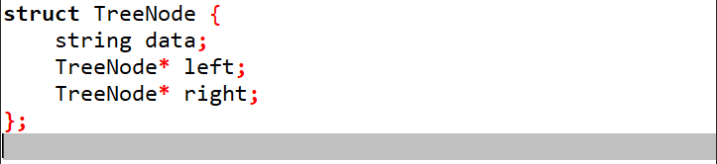
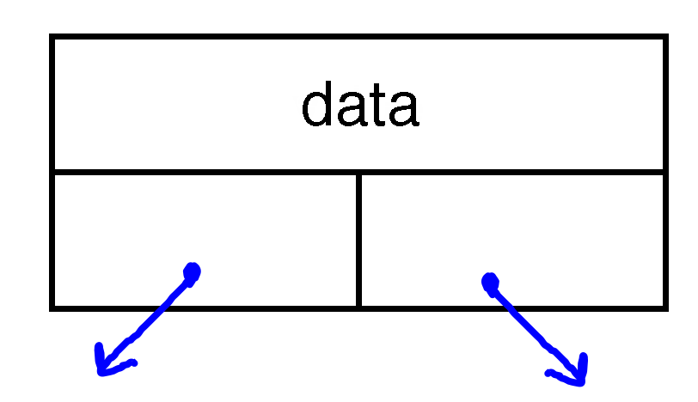

Slide 11
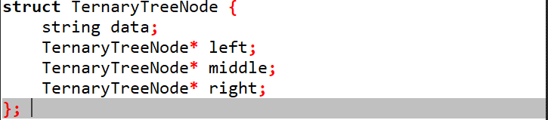
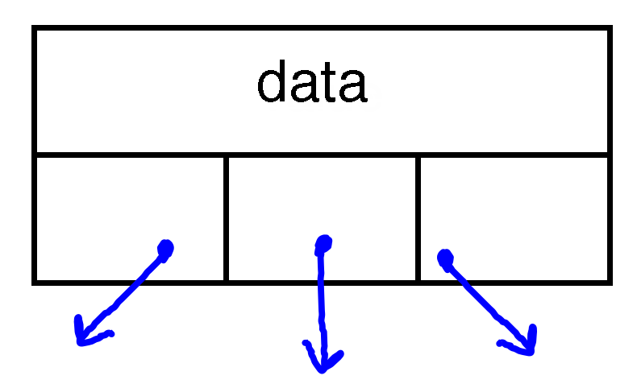

Slide 12
attribute
Node: node->left child -> parent = node
Subtree(X): X and descendants (X as root)
Depth(X): # edges in path from X to the root
Hight(X): # edges in longest downward path from X (max depth in subtree(X)

Slide 13
Tree Traversal Techniques
Preorder Traversal: Visit_ Left_ Right
Inorder Traversal: Left_ Visit_ Right
Postorder Traversal: Right_ Visit_ Left

