Slide 1
Binary Tree Traversals

Slide 2
each element present is "visited" (or accessed) at least once

Slide 3
Number of possible traversals: not a fixed number, depends on the structure
Idea!!!
Recursion tree ☺

Slide 4
types of binary tree traversals
Inorder
Preorder
Postorder

Slide 5
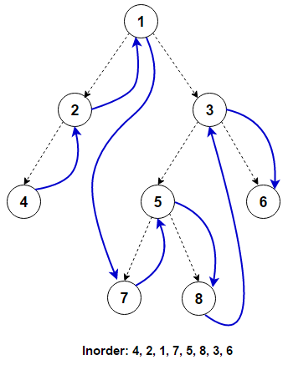
Inorder
LVR (Left, Visit, Right)

Slide 6
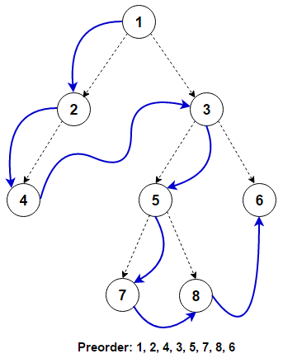
Preorder
VLR (Visit, Left, Right)

Slide 7
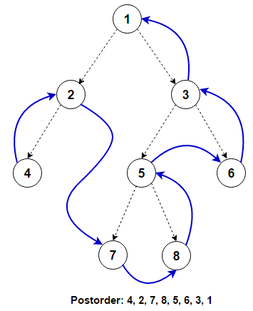
Postorder
LRv (Left, Right, Visit)

Slide 8
Example 1
Given the given Postorder and Inorder, construct its unique binary tree
PostOrder: DECBFA
InOrder: BDCEAF

Slide 9
Example 1
Given the given Postorder and Inorder, construct its unique binary tree
PostOrder: DECBFA
InOrder: BDCEAF
A
B
F
C
D
E

Slide 10
Example 2
Given the given Postorder and Inorder, construct its unique binary tree
PostOrder: ABEFGHDC
InOrder: ABCEDGFH

Slide 11
Example 2
Given the given Postorder and Inorder, construct its unique binary tree
PostOrder: ABEFGHDC
InOrder: ABCEDGFH
Root

Slide 12
Example 2
Given the given Postorder and Inorder, construct its unique binary tree
PostOrder: ABEFGHDC
InOrder: AB C EDGFH
C
Root
AB
EDGFH
Visit
Left
Right

Slide 13

Example 2
Given the given Postorder and Inorder, construct its unique binary tree
PostOrder: AB
InOrder: A B
C
Root
$$∅$$
B
EDGFH
Visit
Left
Right
A

Slide 14
Example 2
Given the given Postorder and Inorder, construct its unique binary tree
PostOrder: EFGHD
InOrder: E D GFH
C
Root
B
D
Visit
Left
Right
A
E
GFH

Slide 15
Example 2
Given the given Postorder and Inorder, construct its unique binary tree
PostOrder: FGH
InOrder: GF H
C
Root
B
D
$$∅$$
E
H
Visit
A
Left
Right
GF

Slide 16

Example 2
Given the given Postorder and Inorder, construct its unique binary tree
PostOrder: FG
InOrder: G F
C
Root
B
D
A
E
H
$$∅$$
Visit
Left
Right
G
F

