Slide 1

HEAP

Slide 2
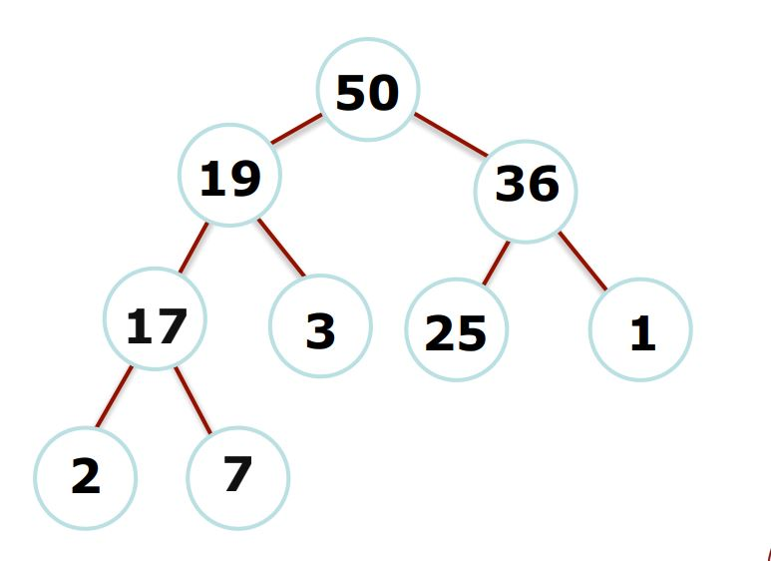
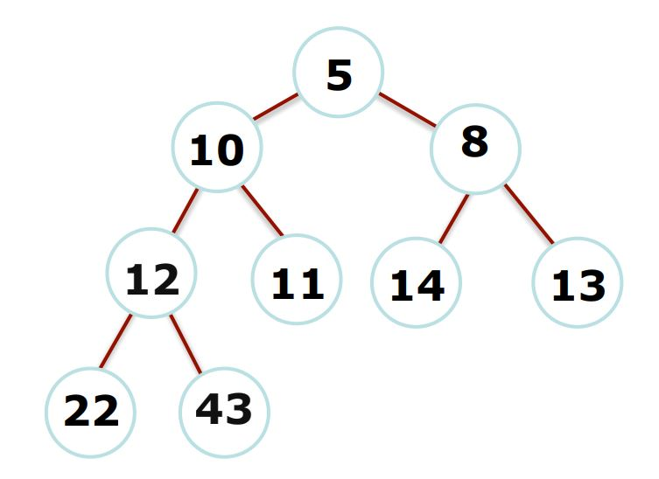
Binary Heap
There are two types of heaps:
Min Heap
(root is the smallest element)
Max Heap
(root is the largest element)

Slide 3
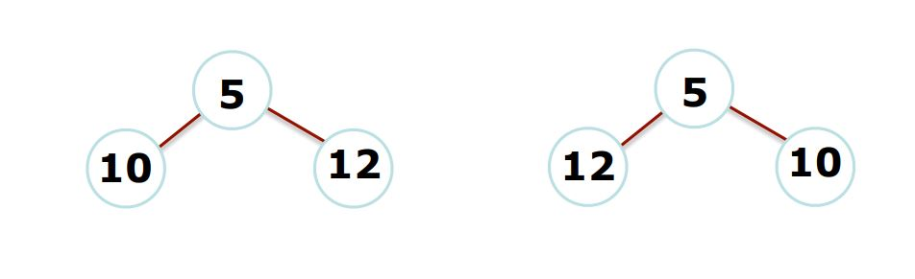
Binary Heap
There are no implied orderings between siblings, so both of the trees below are min-heaps:

Slide 4
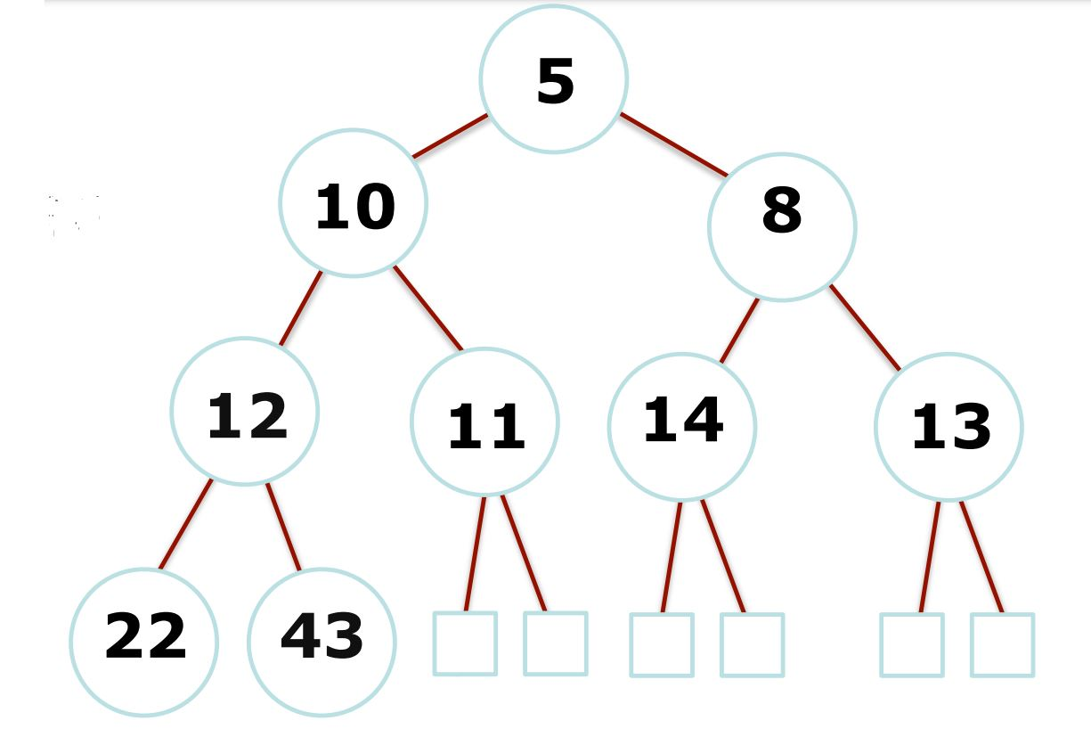
Binary Heap
Heaps are completely filled, with the exception of the bottom level. They are, therefore, "complete binary trees":
complete: all levels filled except the bottom
binary: two children per node (parent)
Maximum number of nodes
Filled from left to right

Slide 5
Binary Heap
What is the best way to store a heap?

Slide 6
Binary Heap
ARRAY!!!
 | 5 | 10 | 8 | 12 | 11 | 14 | 13 | 22 | 43
[0] | [1] | [2] | [3] | [4] | [5] | [6] | [7] | [8] | [9] | [10] | [11]

Slide 7
Binary Heap
The array representation makes determining parents and children a matter of simple arithmetic: •For an element at position i:
•left child is at 2i
•right child is at 2i+1
•parent is at ⌊i/2⌋
•heapSize: the number of elements in the heap.
 | 5 | 10 | 8 | 12 | 11 | 14 | 13 | 22 | 43
[0] | [1] | [2] | [3] | [4] | [5] | [6] | [7] | [8] | [9] | [10] | [11]

Slide 8
Heap Operation
Remember that there are three important priority queue operations:
1.peek(): return an element of h with the smallest key.
2.enqueue(k,e): insert an element e with key k into the heap.
3.dequeue(): removes the smallest element from h.
We can accomplish this with a heap! We will just look at keys for now -- just know that we will also store a value with the key

Slide 9
Heap Operation
See animation at:
https://www.cs.usfca.edu/~galles/visualization/Heap.html

Slide 10
Heap Operation: enqueue(9)
 | 5 | 10 | 8 | 12 | 11 | 14 | 13 | 22 | 43 | 9
[0] | [1] | [2] | [3] | [4] | [5] | [6] | [7] | [8] | [9] | [10] | [11]
Start by inserting the key at the first empty position. 9 This is always at index heap.size()+1.

Slide 11
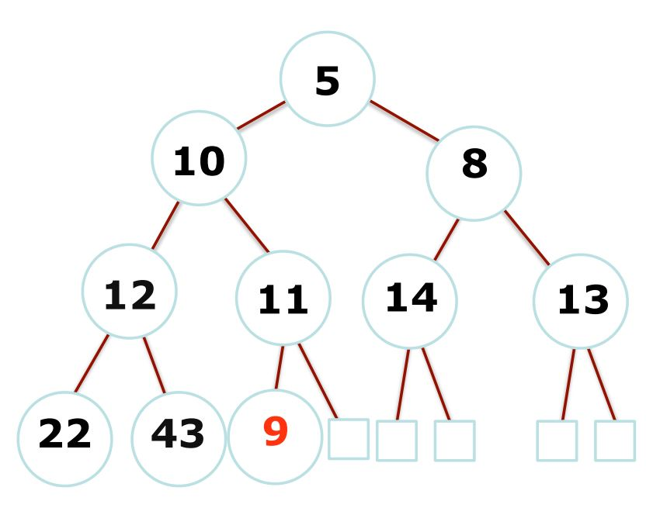
Heap Operation: enqueue(9)
 | 5 | 10 | 8 | 12 | 11 | 14 | 13 | 22 | 43 | 9
[0] | [1] | [2] | [3] | [4] | [5] | [6] | [7] | [8] | [9] | [10] | [11]
Look at parent of index 10, and compare: do we meet the heap property requirement?
No -- we must swap.

Slide 12
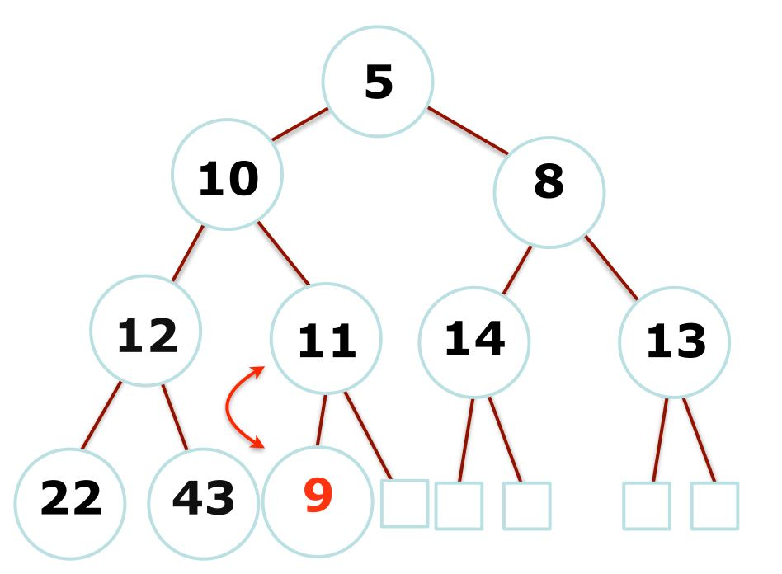
Heap Operation: enqueue(9)
 | 5 | 10 | 8 | 12 | 11 | 14 | 13 | 22 | 43 | 9
[0] | [1] | [2] | [3] | [4] | [5] | [6] | [7] | [8] | [9] | [10] | [11]

Slide 13
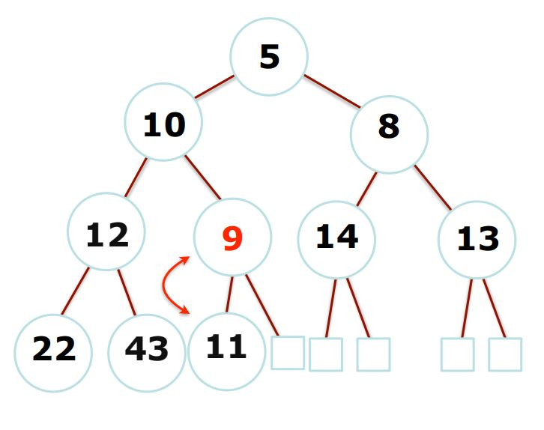
Heap Operation: enqueue(9)
 | 5 | 10 | 8 | 12 | 9 | 14 | 13 | 22 | 43 | 11
[0] | [1] | [2] | [3] | [4] | [5] | [6] | [7] | [8] | [9] | [10] | [11]

Slide 14
Heap Operation: enqueue(9)
 | 5 | 10 | 8 | 12 | 9 | 14 | 13 | 22 | 43 | 11
[0] | [1] | [2] | [3] | [4] | [5] | [6] | [7] | [8] | [9] | [10] | [11]
Look at parent of index 5, and compare: do we meet the heap property requirement?
No -- we must swap. This "bubbling up" won't ever be a problem if the heap is "already a heap" (i.e., already meets heap property for all nodes)

Slide 15
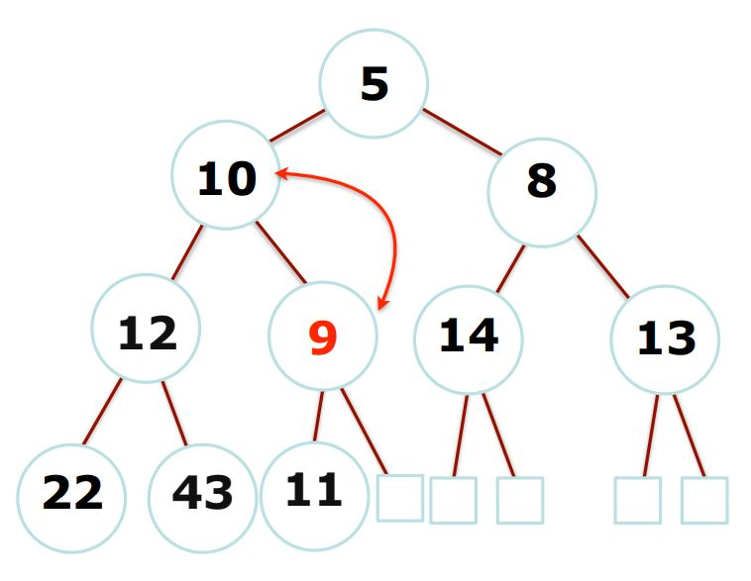
Heap Operation: enqueue(9)
 | 5 | 9 | 8 | 12 | 10 | 14 | 13 | 22 | 43 | 11
[0] | [1] | [2] | [3] | [4] | [5] | [6] | [7] | [8] | [9] | [10] | [11]

Slide 16
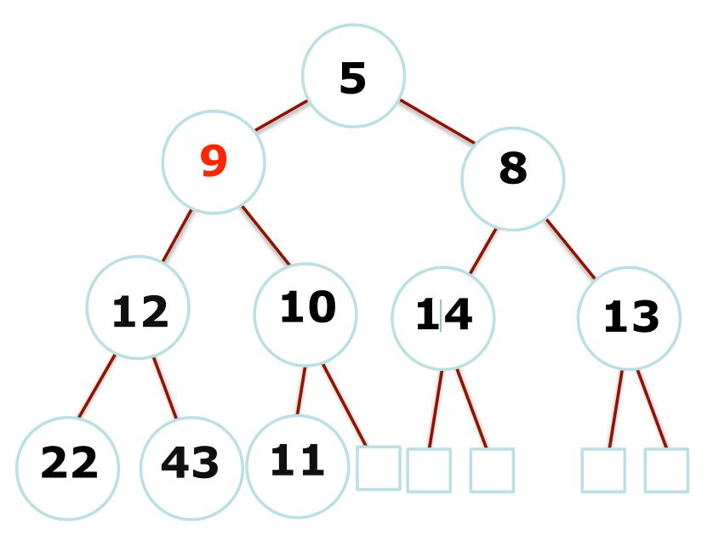
Heap Operation: enqueue(9)
No swap necessary between index 2 and its parent. We're done bubbling up!
 | 5 | 9 | 8 | 12 | 10 | 14 | 13 | 22 | 43 | 11
[0] | [1] | [2] | [3] | [4] | [5] | [6] | [7] | [8] | [9] | [10] | [11]
Complexity? O(log n) - yay!
Average complexity for random inserts: O(1),
see: http://ieeexplore.ieee.org/xpls/abs_all.jsp?arnumber=6312854

Slide 17
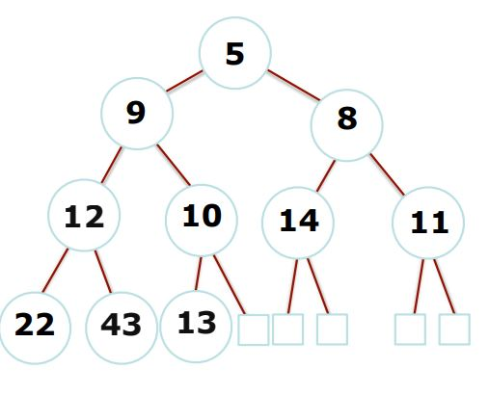
Heap Operation: dequeue()
•How might we go about removing the minimum?
dequeue()
 | 5 | 9 | 8 | 12 | 10 | 14 | 11 | 22 | 43 | 13
[0] | [1] | [2] | [3] | [4] | [5] | [6] | [7] | [8] | [9] | [10] | [11]

Slide 18
Heap Operation: dequeue()
How?!!
Explain in the class

Slide 19
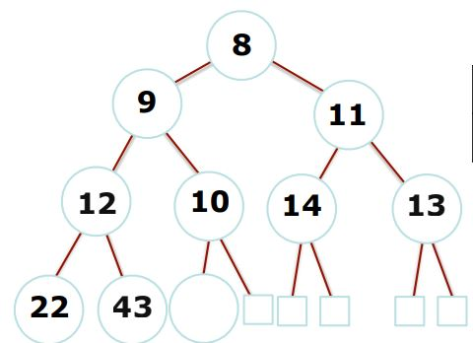
Heap Operation: dequeue()
•How might we go about removing the minimum?
dequeue()
 | 8 | 9 | 11 | 12 | 10 | 14 | 13 | 22 | 43
[0] | [1] | [2] | [3] | [4] | [5] | [6] | [7] | [8] | [9] | [10] | [11]

Slide 20
Heap Operation: dequeue()
•How might we go about removing the minimum?
dequeue()
 | 8 | 9 | 11 | 12 | 10 | 14 | 13 | 22 | 43
[0] | [1] | [2] | [3] | [4] | [5] | [6] | [7] | [8] | [9] | [10] | [11]
Complexity? O(log n) - yay

