Slide 1


NEXT GEN EMPLOYABILITY PROGRAM
CREATING A FUTURE-READY WORKFORCE
Student Name :
BHARATH T
Student ID :
College Name :
STU673c8ada959ae1732020954
REVA UNIVERSITY

Slide 2
CAPSTONE PROJECT SHOWCASE
Project Title
Fundify
Abstract | Problem Statement | Project Overview | Proposed Solution | Technology Used | Modelling & Results | Conclusion | Q&A

Slide 3
Abstract
1
Crowdfunding Platform – Fundify is a full-stack crowdfunding platform designed to connect creators with audiences, enabling seamless project funding.
2
Secure Transactions – The platform integrates the Paytm payment gateway to facilitate secure and efficient financial transactions between users.
3
User-Centric Features – Fundify provides an intuitive interface for project management, real-time communication, analytics, and search & filtering to enhance user experience.
4
Open-Source & Scalable – Built using the MERN stack (MongoDB, ExpressJS, ReactJS, NodeJS), the platform ensures scalability, flexibility, and efficient data management.

Slide 4


Problem Statement
Limited Funding Opportunities – Many creators and innovators struggle to secure financial support due to a lack of accessible and transparent crowdfunding platforms.
Trust & Security Concerns – Users are often hesitant to fund projects due to concerns about fraudulent campaigns, lack of payment security, and unverified creators.
Inefficient Project Discovery – Existing crowdfunding platforms often lack advanced search and filtering options, making it difficult for users to find relevant projects.
Lack of Engagement & Insights – Traditional platforms provide limited real-time communication, analytics, and engagement features, reducing user interaction and project success rates.

Slide 5

Project Overview
Fundify is a full-stack crowdfunding platform designed to connect creators with potential supporters, enabling seamless fundraising for various projects. The platform aims to enhance user engagement, security, and project visibility through modern web technologies.
Key Features:
User-Friendly Interface – A responsive and intuitive platform allowing creators to showcase their projects effectively.
Secure Transactions – Integrated Paytm payment gateway ensures safe and transparent fund transfers.
Project Management – Creators can manage campaigns, track pledges, and update backers in real-time.
Advanced Search & Filtering – Users can easily discover projects based on categories, funding goals, and popularity.
Real-Time Communication – Enables interaction between creators and backers through chat and updates.
Analytics & Insights – Provides data-driven insights to help creators optimize their campaigns for better reach.

Slide 6
Proposed Solution
To address the challenges of traditional crowdfunding, Fundify provides an innovative and user-friendly platform that enhances fundraising efficiency and transparency. The solution is designed to streamline the process for both creators and backers, ensuring secure transactions and effective campaign management.
Key Aspects of the Solution:
Seamless Project Creation & Management
Creators can easily set up campaigns, define funding goals, and manage project updates in a structured dashboard.
Secure Payment Integration
Fundify integrates the Paytm Payment Gateway to ensure smooth and secure transactions between backers and creators.
Enhanced User Engagement
Features like real-time chat, project updates, and interactive dashboards help maintain transparency and build trust.
Advanced Discovery & Filtering
Users can efficiently search and filter projects based on categories, funding status, or trending campaigns, ensuring better project visibility.
Data-Driven Insights
In-built analytics help creators track their campaign performance, optimize funding strategies, and improve audience reach.

Slide 7
Technology used
Fundify is built using the MERN stack (MongoDB, Express.js, React.js, Node.js) along with additional technologies to ensure scalability, security, and a seamless user experience.
1. Frontend (User Interface)
React.js: Used for building an interactive and dynamic user interface.
Material-UI: Provides pre-designed components for a modern and responsive UI.
2. Backend (Server & API Development)
Node.js: Handles the backend logic and API development.
Express.js: Lightweight and fast framework for handling API requests and server-side logic.
3. Database (Data Storage & Management)
MongoDB: NoSQL database used to store user details, project data, and transactions.
Mongoose: ODM (Object Data Modeling) library for managing MongoDB schema and interactions.

Slide 8
4. Payment Processing
Paytm Payment Gateway (RAZOR PAY): Secure online transactions and fund transfers between users.
5. Authentication & Security
JWT (JSON Web Token): Ensures secure authentication and authorization for users.
bcrypt.js: Used for hashing and securing user passwords.
6. Deployment & DevOps
Firebase: Cloud hosting services for improved availability and performance.
This combination of technologies ensures Fundify is a scalable, secure, and user-friendly crowdfunding platform.

Slide 9
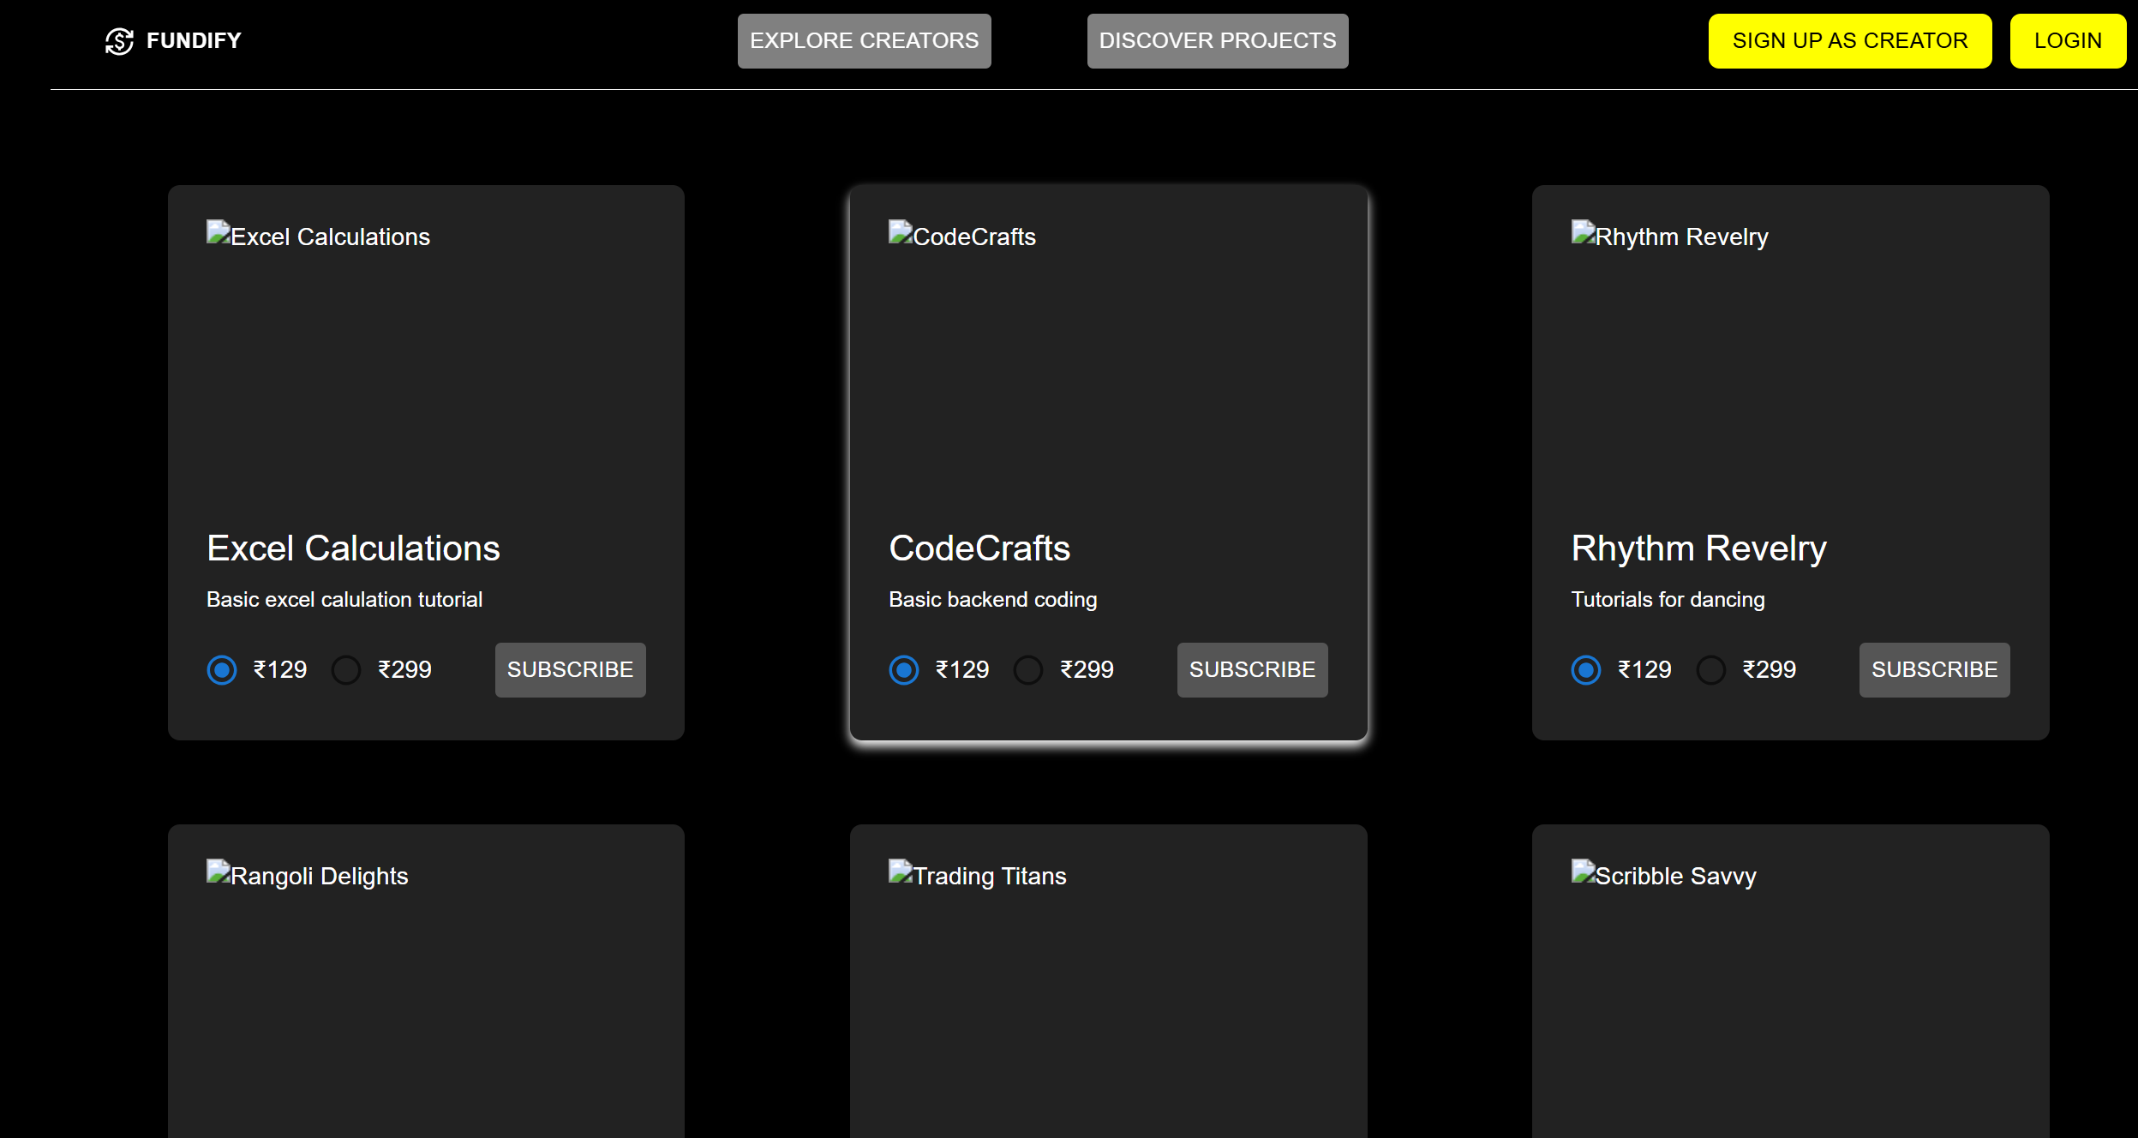
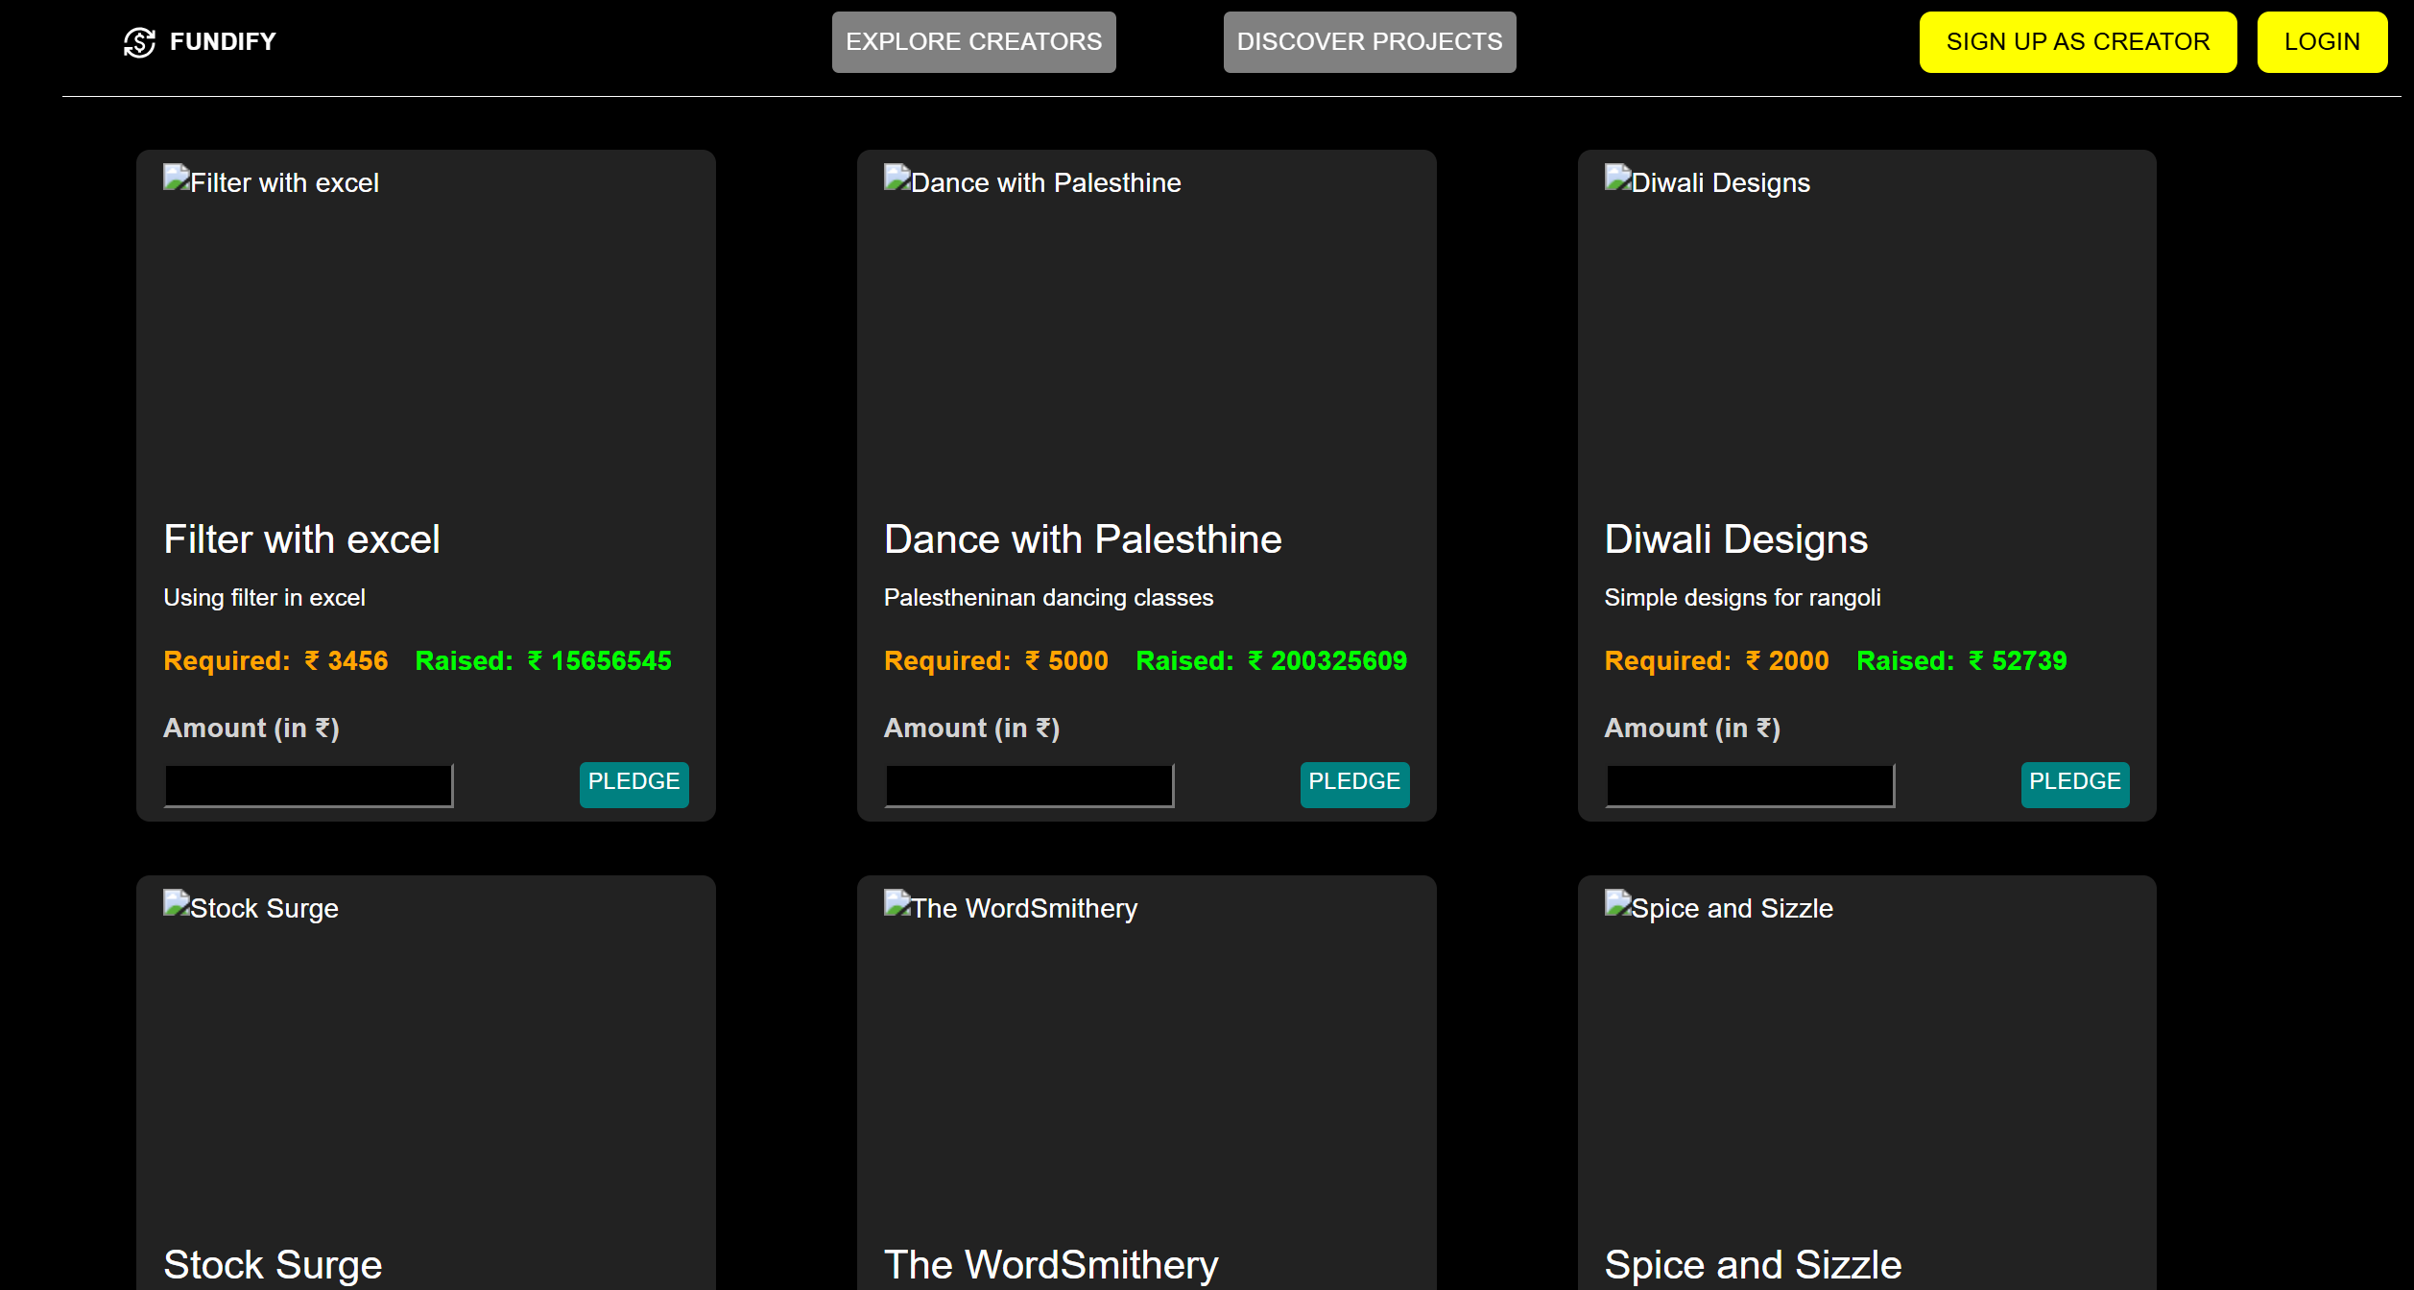
Modelling & Result

Slide 10
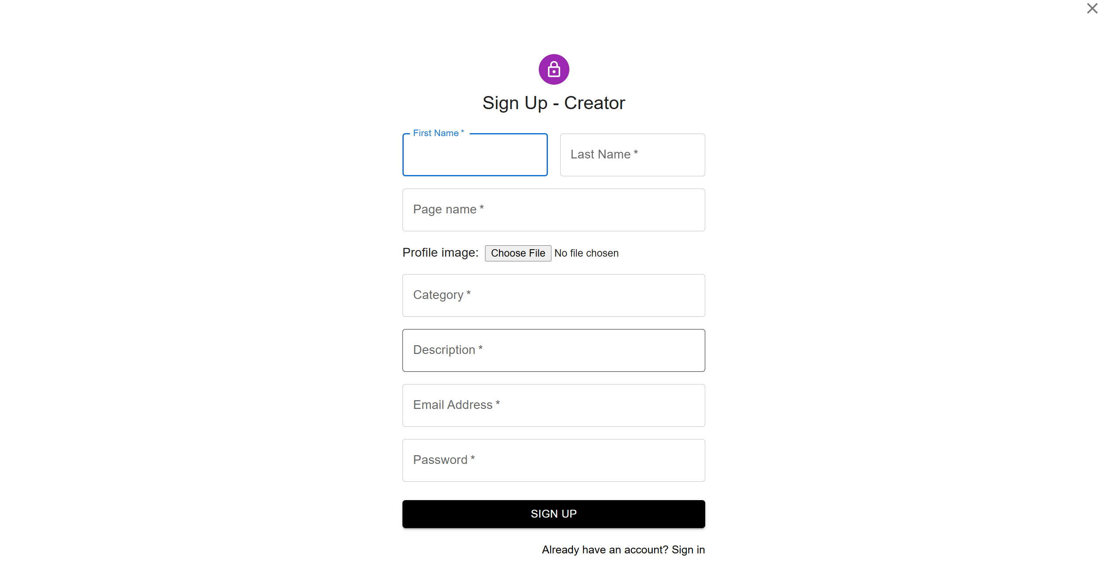
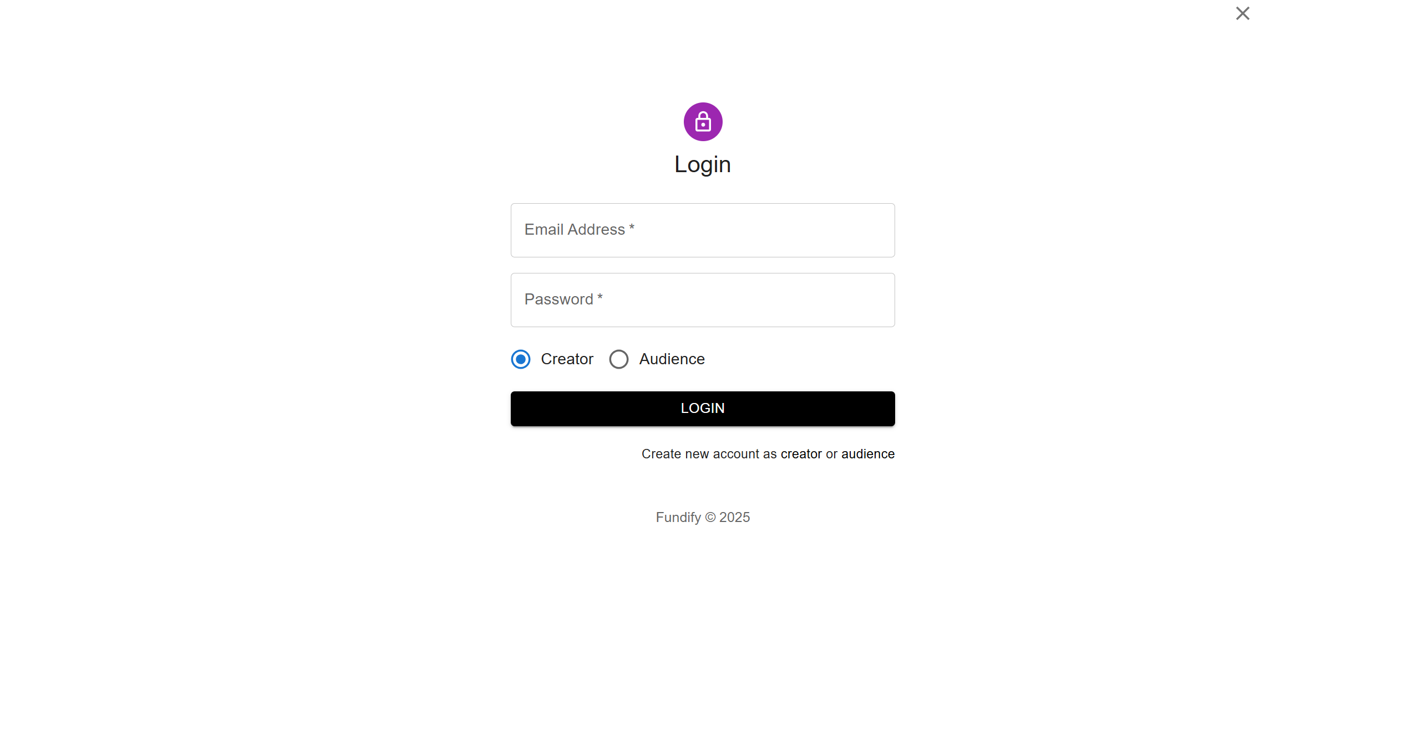
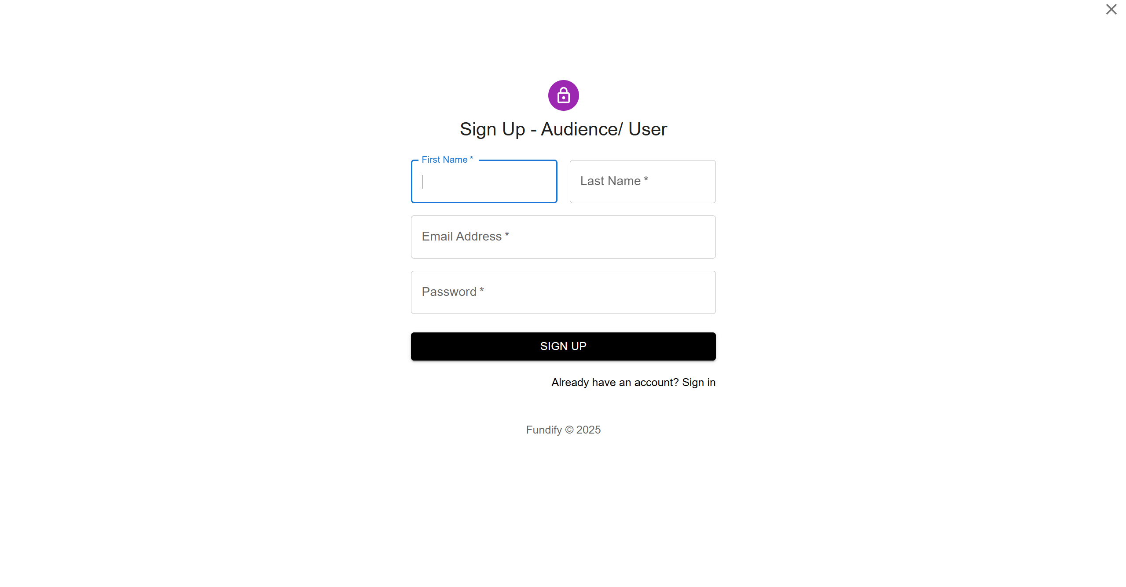
Modelling & Result

Slide 11
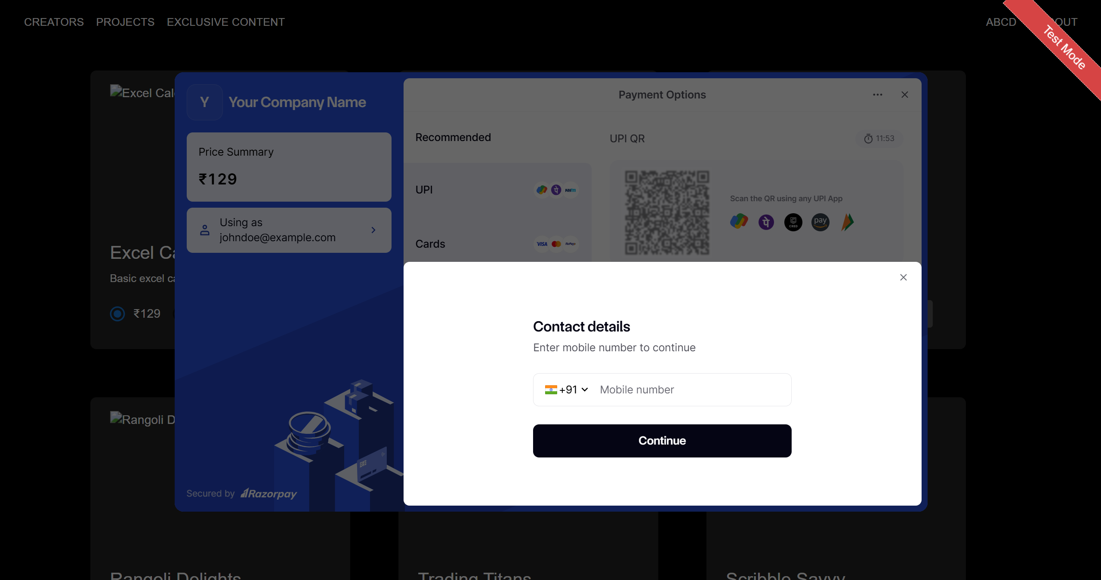
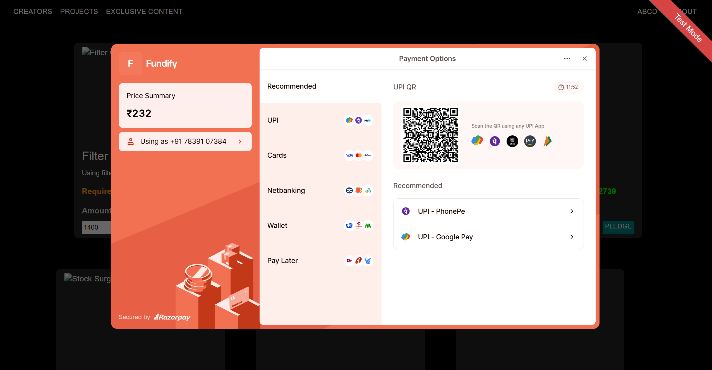
Modelling & Result

Slide 12
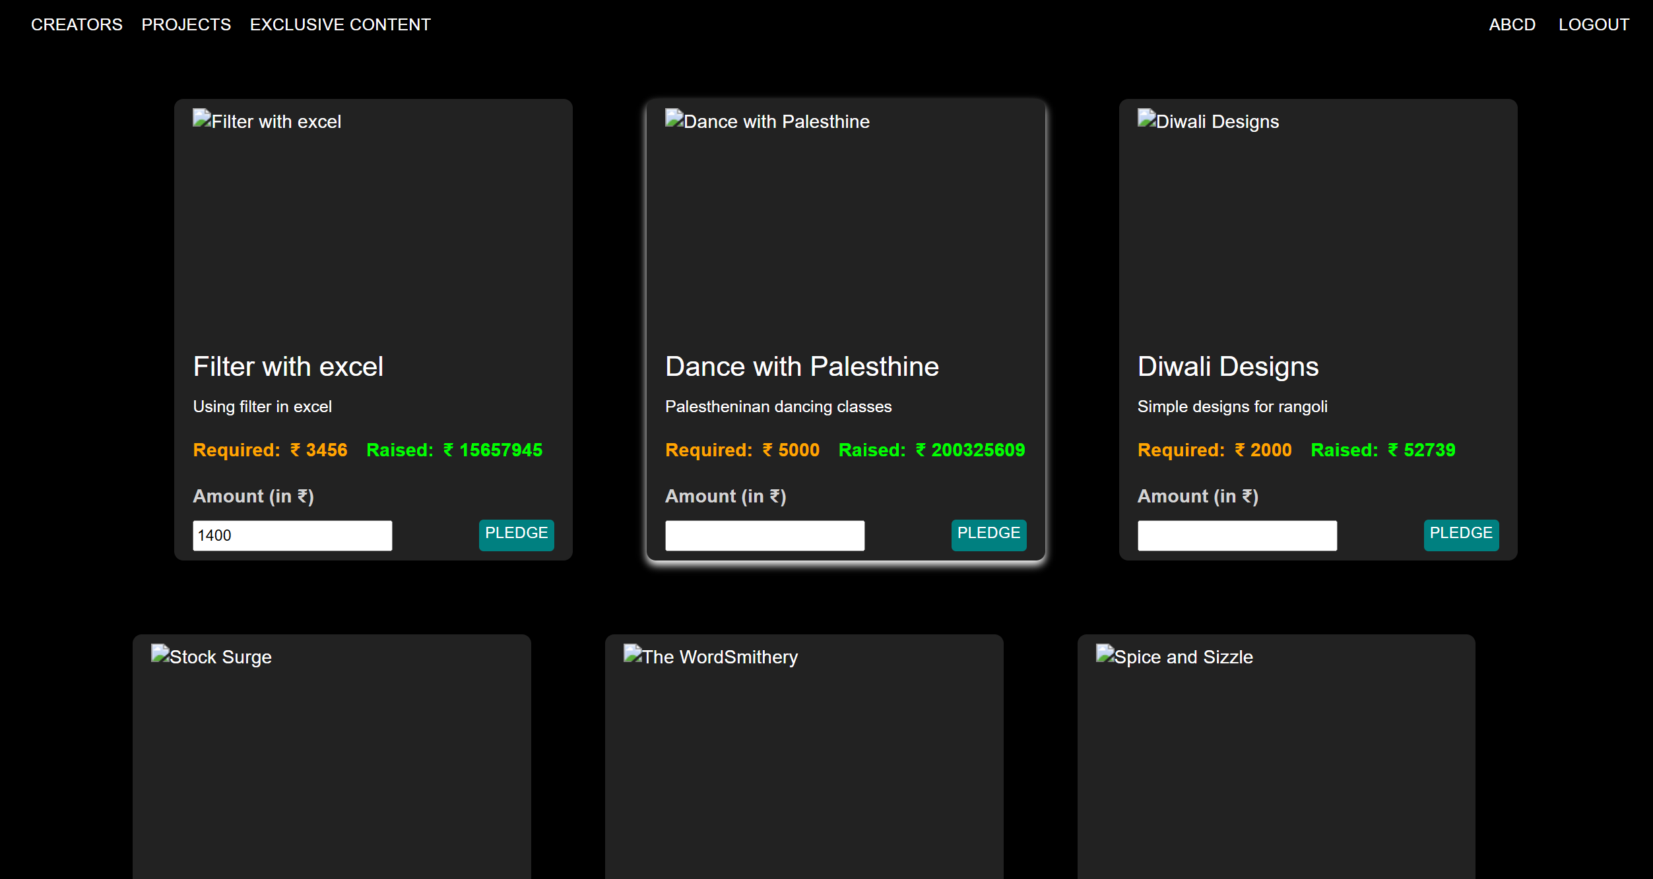
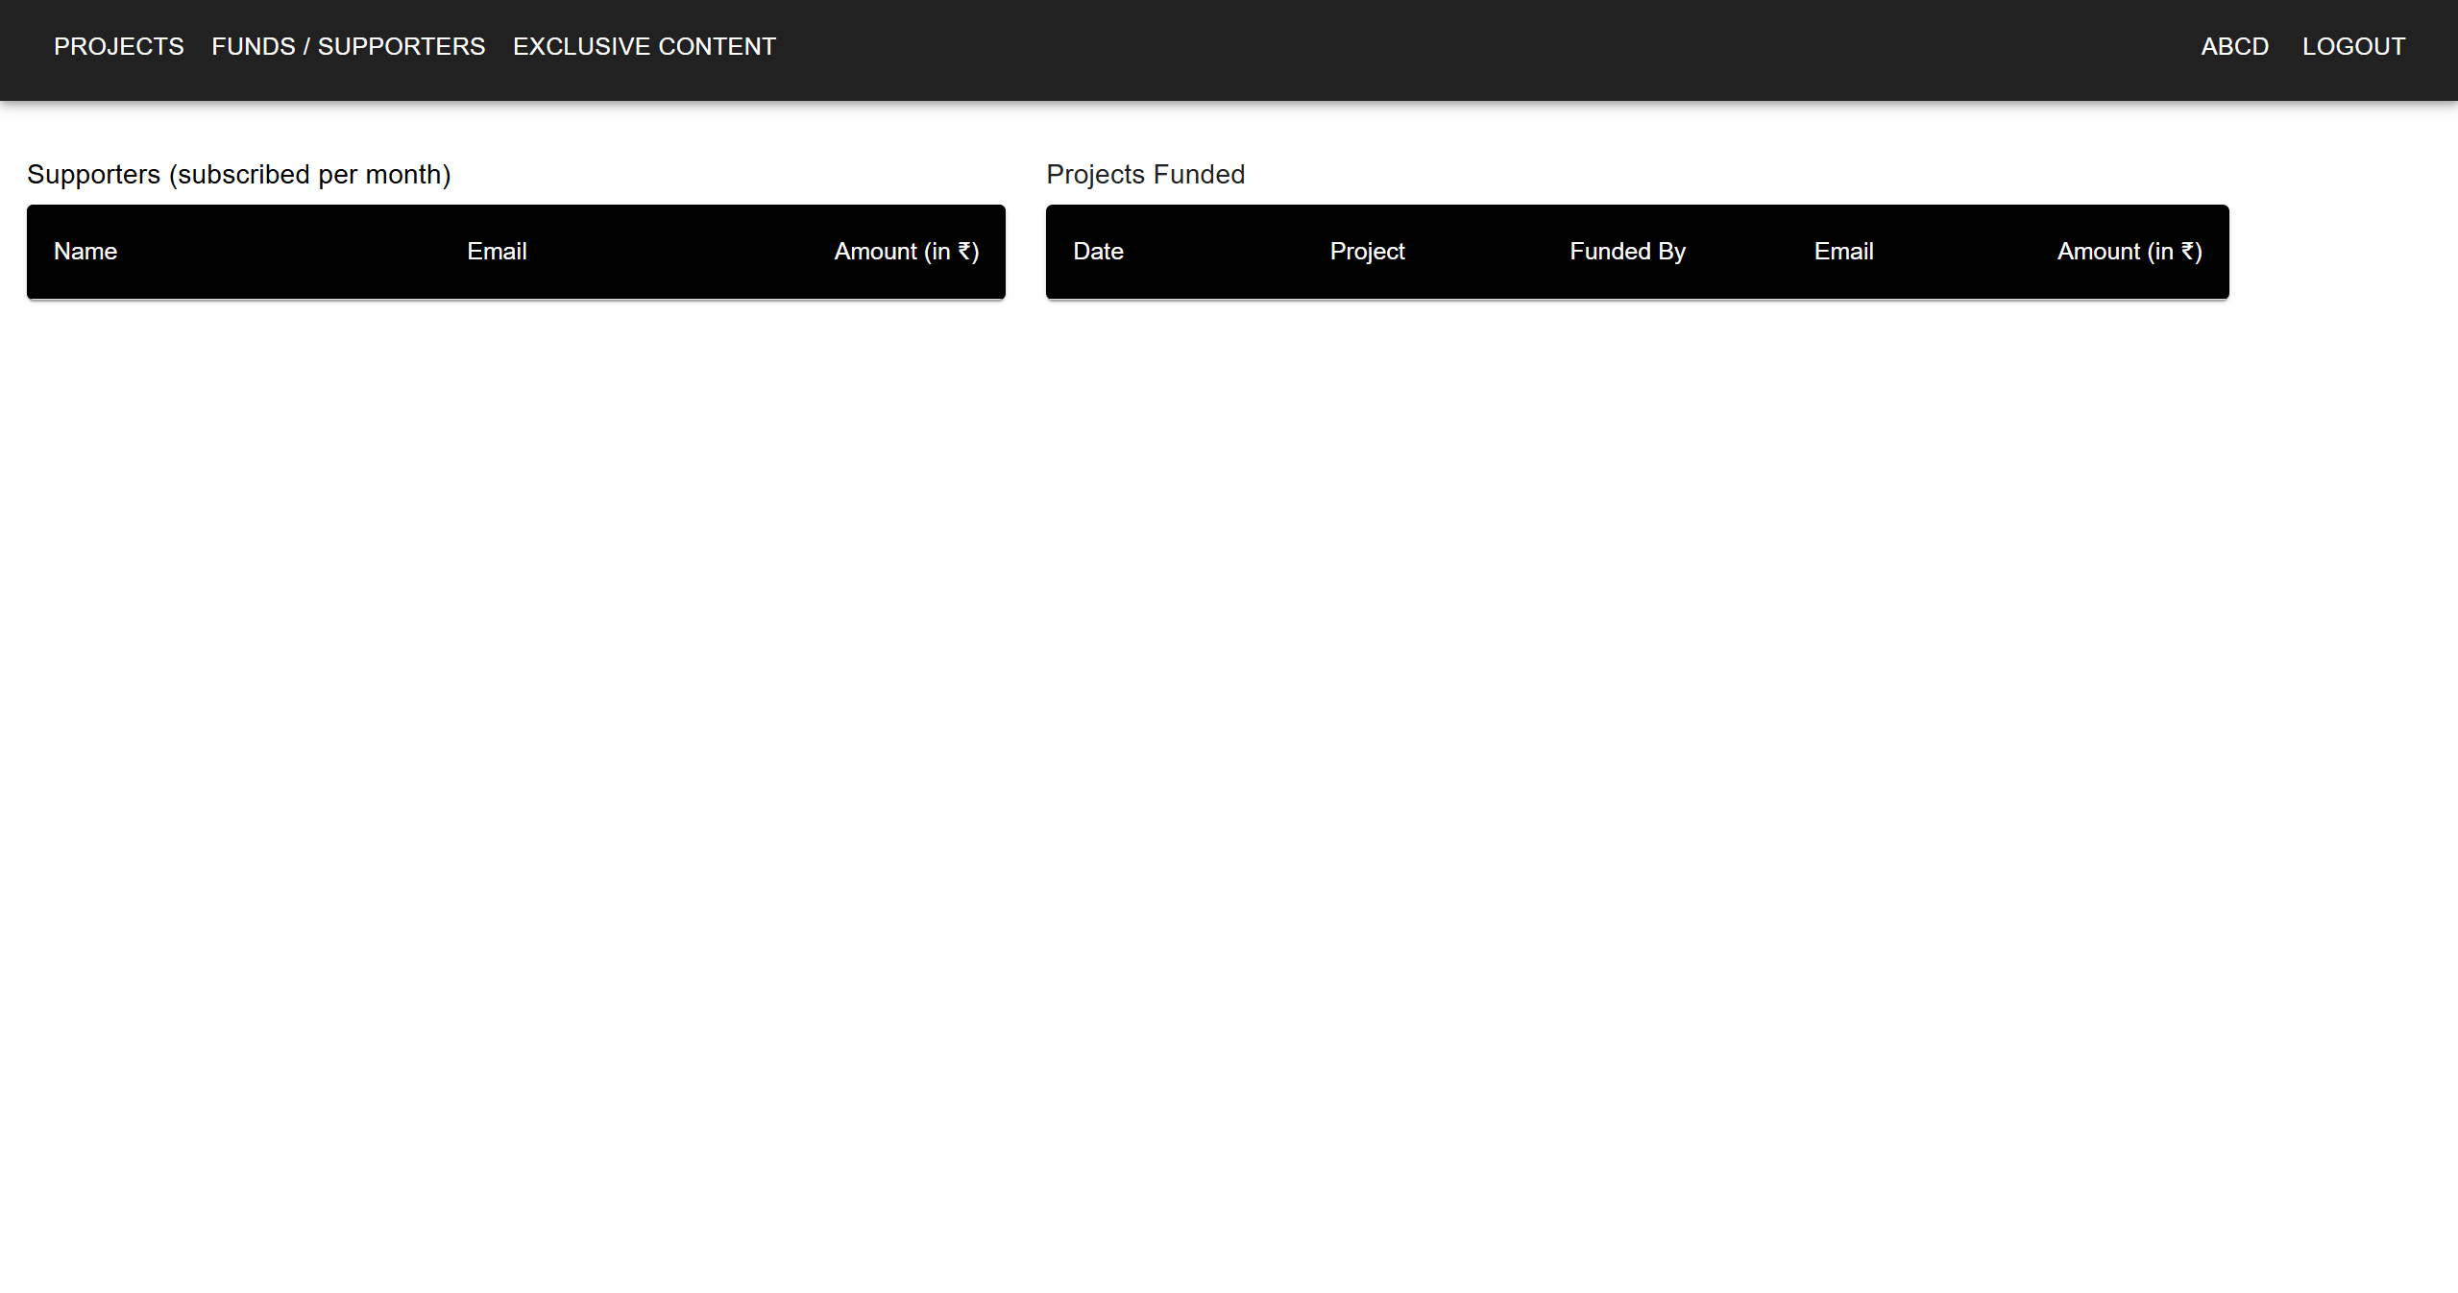
Modelling & Result

Slide 13
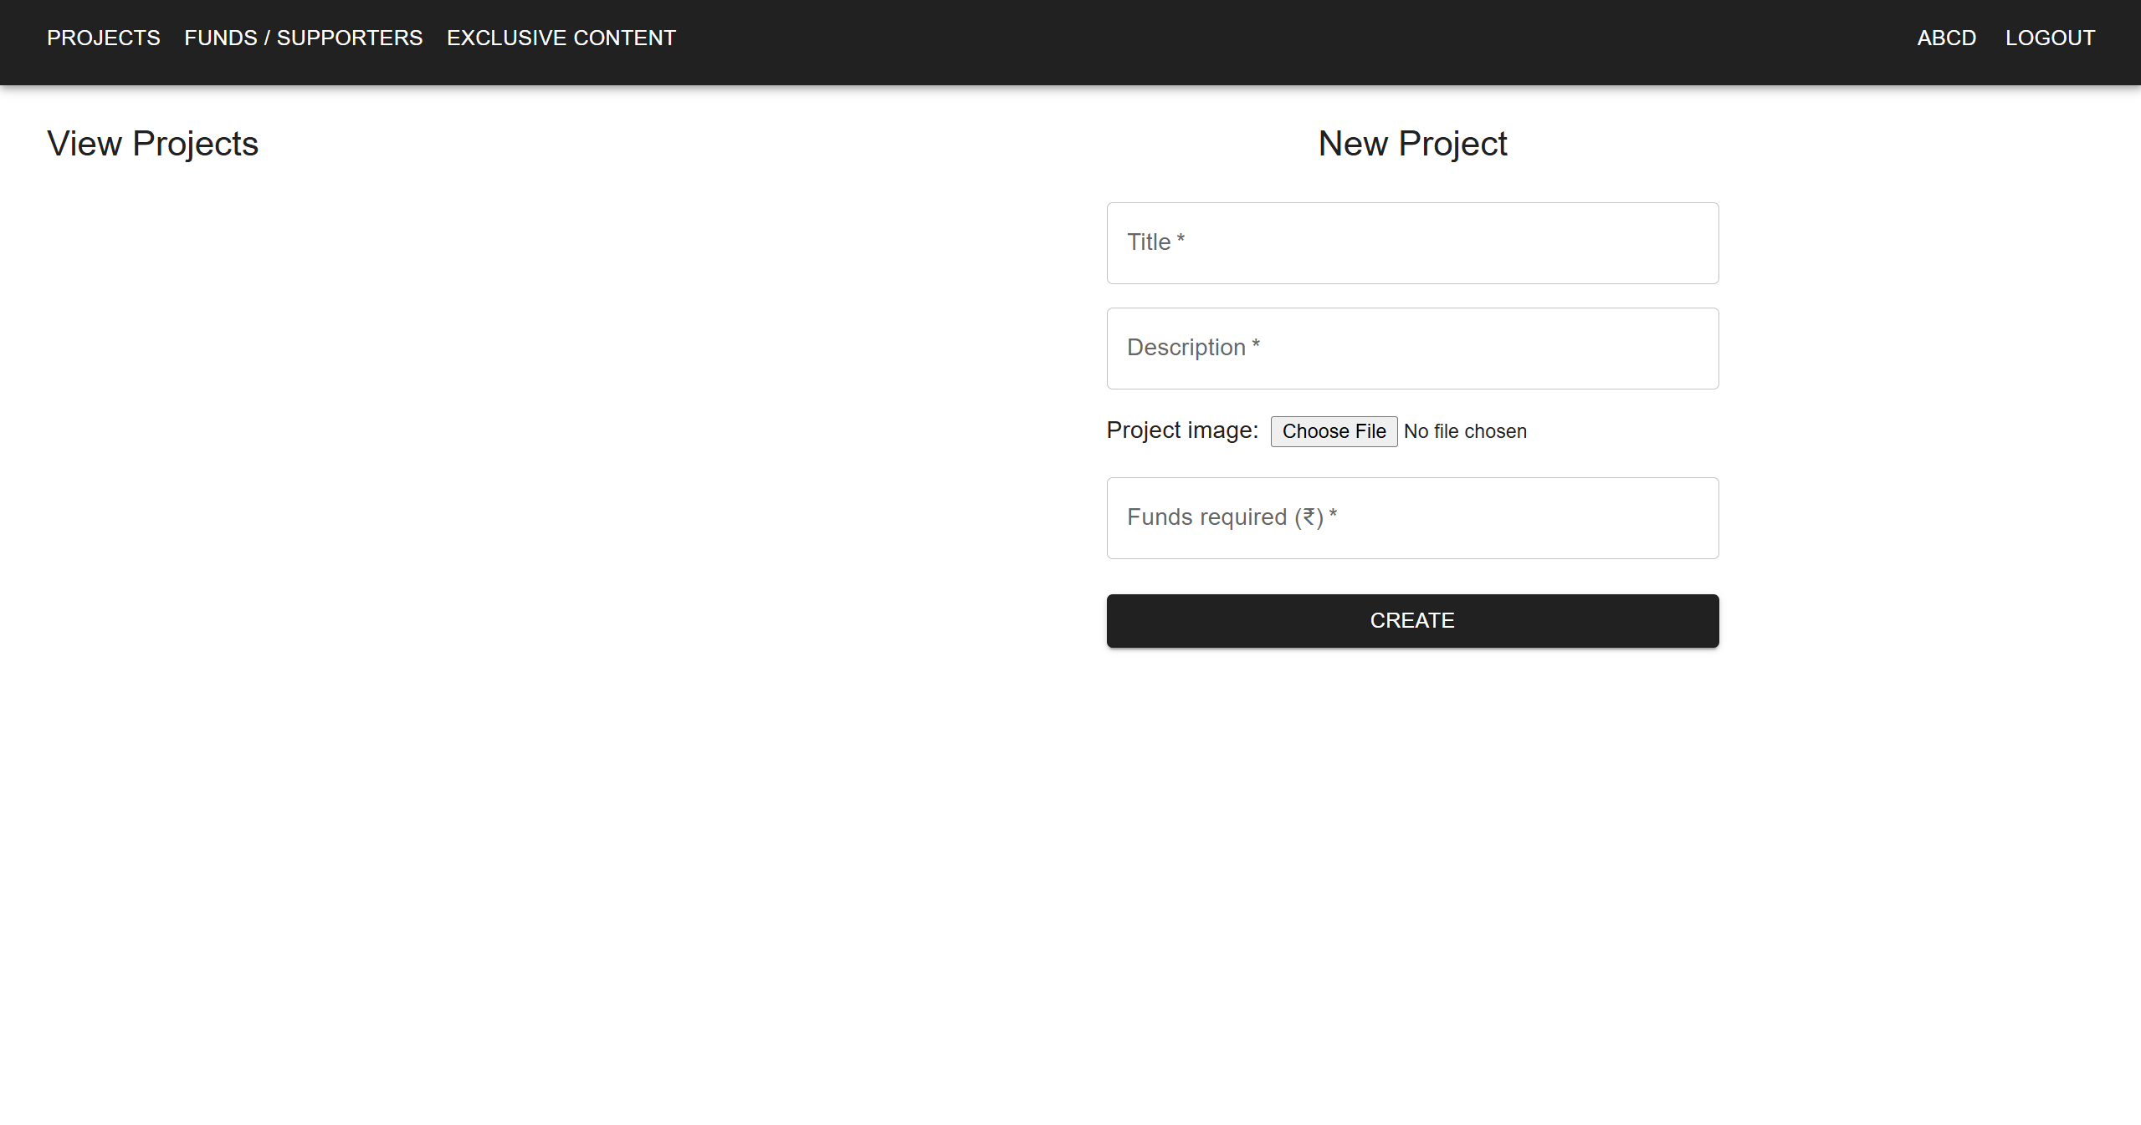
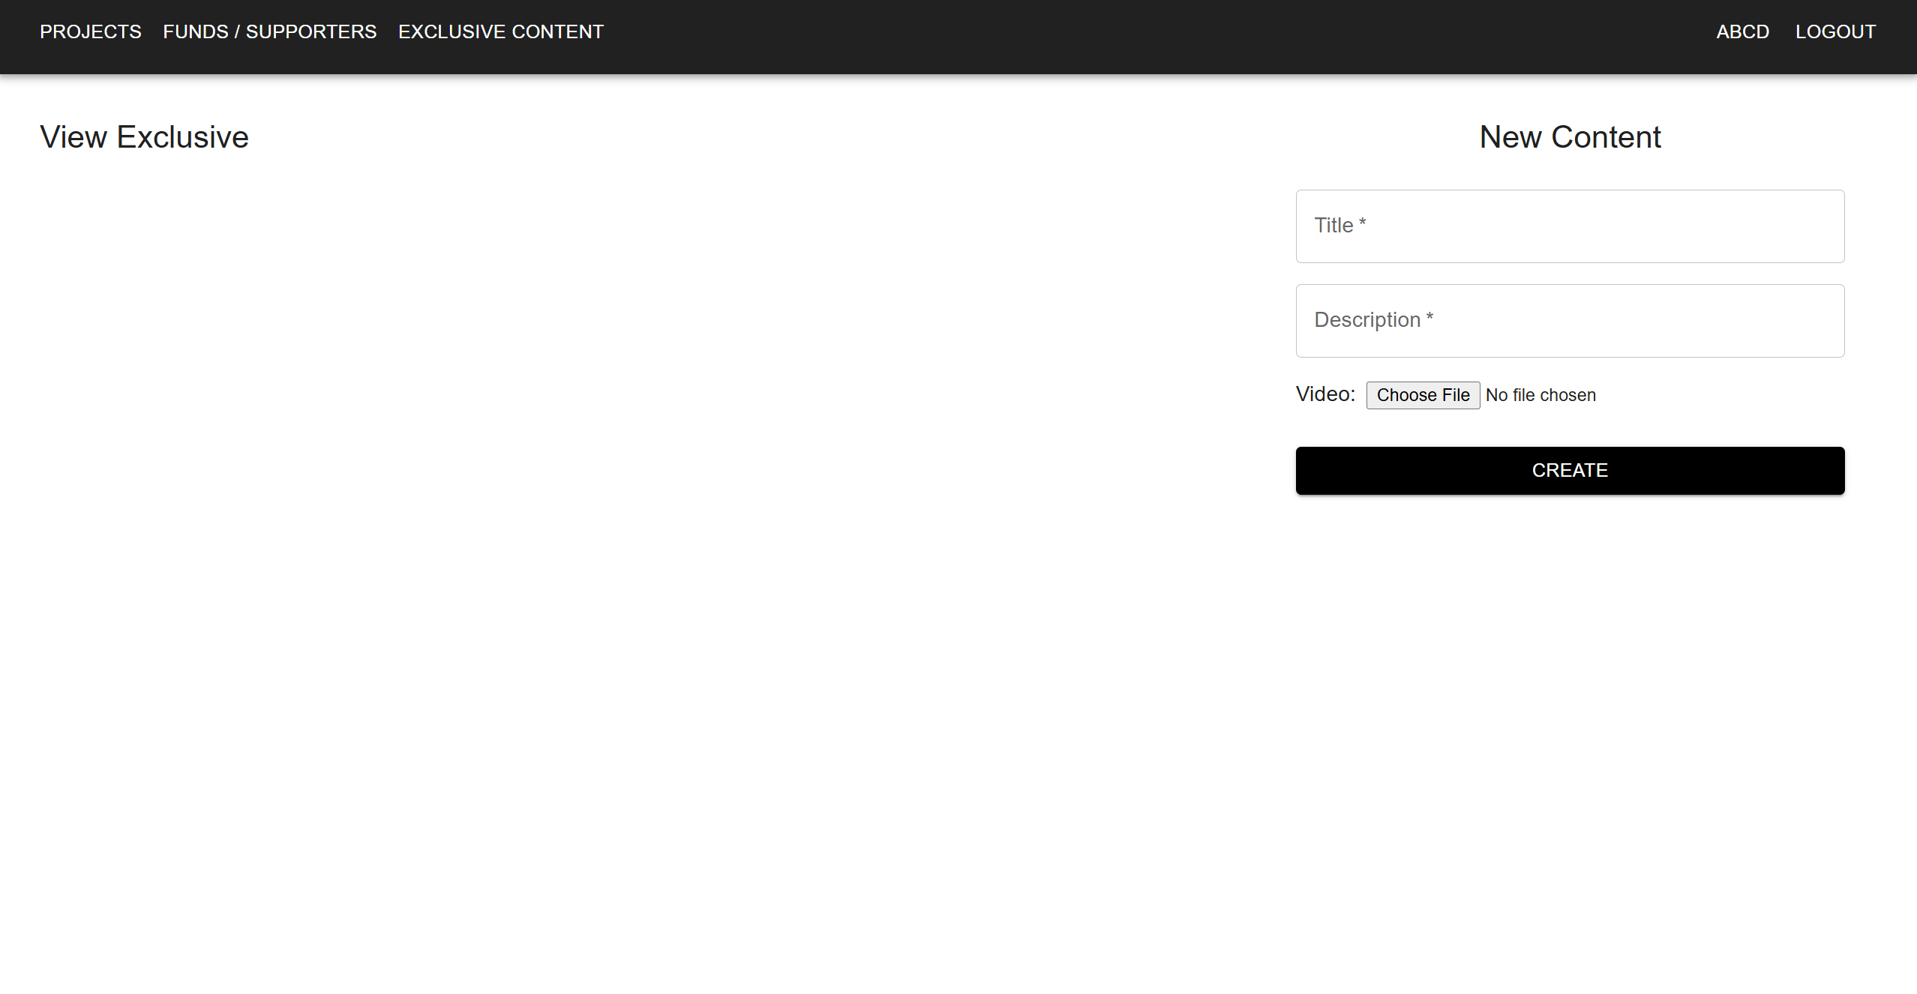
Modelling & Result

Slide 14

Conclusion
Fundify successfully provides a secure, transparent, and user-friendly crowdfunding platform, enabling creators to raise funds efficiently and allowing audiences to support projects seamlessly.
Key Takeaways:
Efficient Crowdfunding: Users can create, manage, and contribute to projects with ease.
Seamless Transactions: Integration of the Paytm Payment Gateway ensures smooth and secure payments.
User-Centric Design: Built with React.js and Material-UI, offering an intuitive interface.
Scalability & Security: Leveraging MongoDB, Node.js, JWT authentication, and Docker ensures robust performance.
With continuous improvements and feature enhancements, Fundify aims to revolutionize digital crowdfunding, making it accessible, transparent, and impactful for all users.

Slide 15


Notes:
Thank You !!

