Slide 1
Subharmonic generator
B2M34IAS
Petr Polášek
3.1.2018

Slide 2
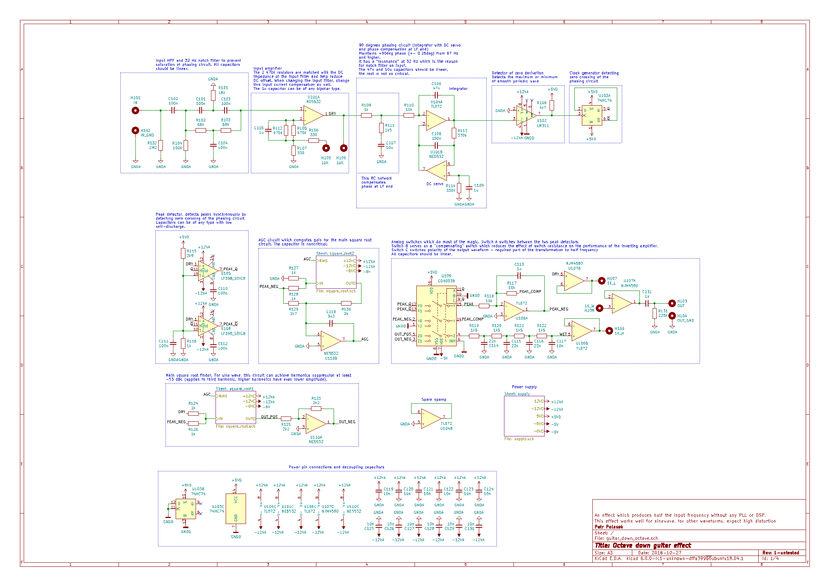
90° phasing circuit - schematic

Slide 3
90° phasing circuit - schematic

Slide 4
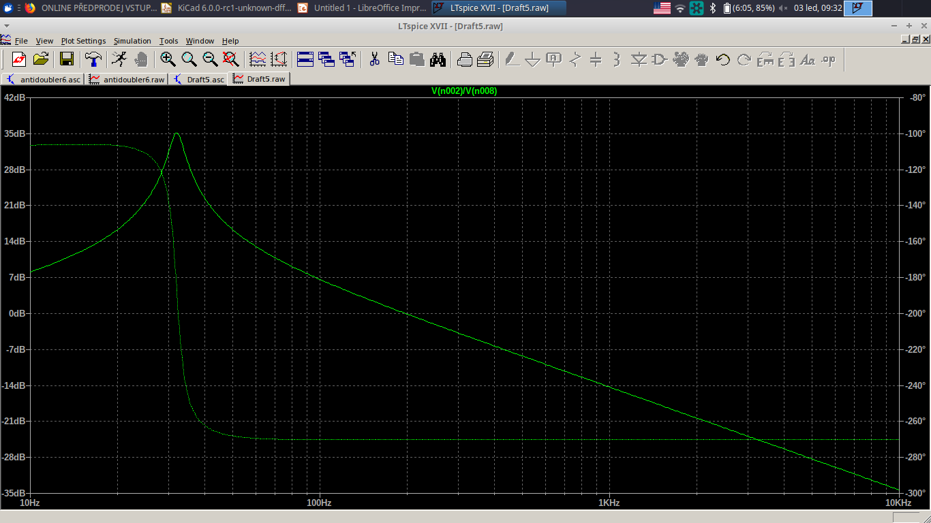
90° phasing circuit - characteristics

Slide 5
90° phasing circuit - schematic

Slide 6
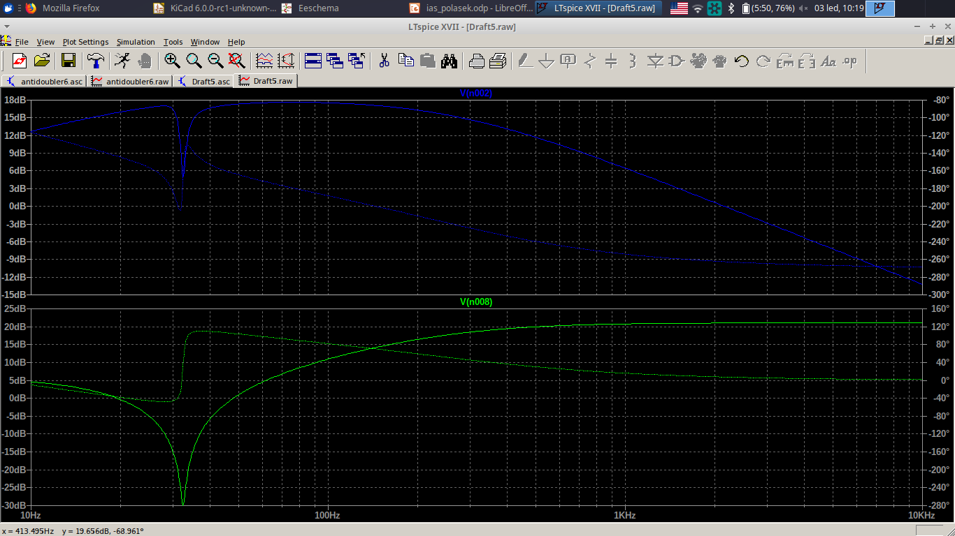
90° phasing circuit – notch filter

Slide 7
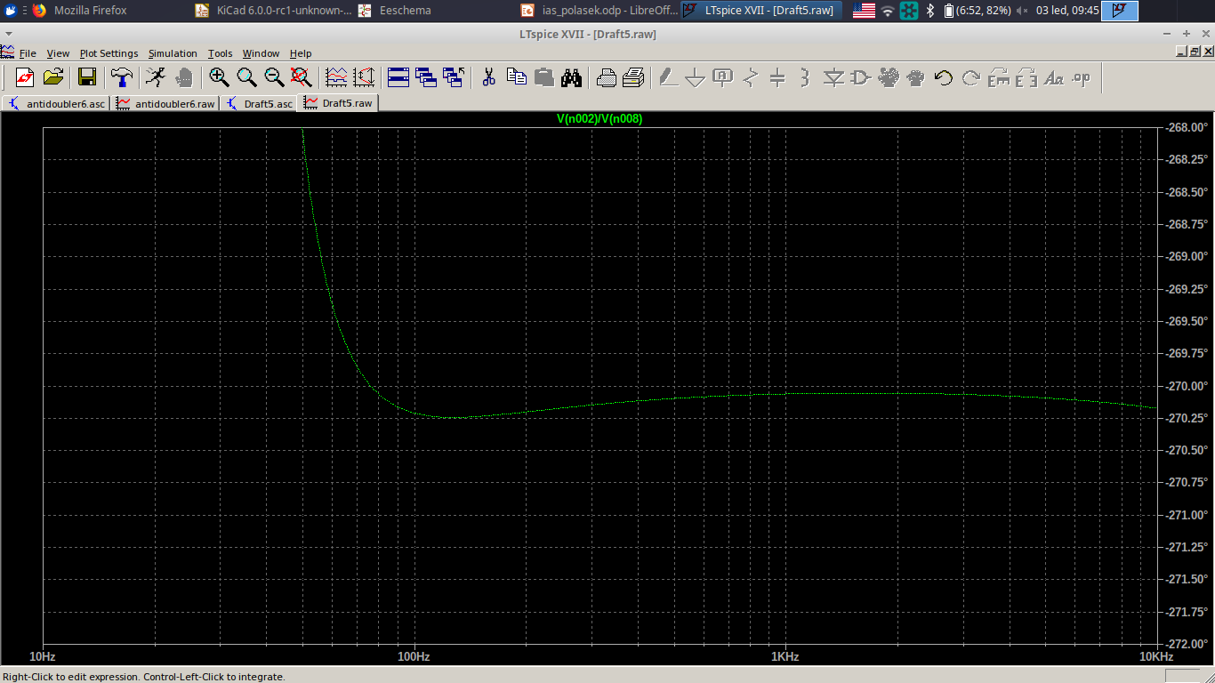
90° phasing circuit – phase accuracy

Slide 8
Extreme detector - schematic

Slide 9
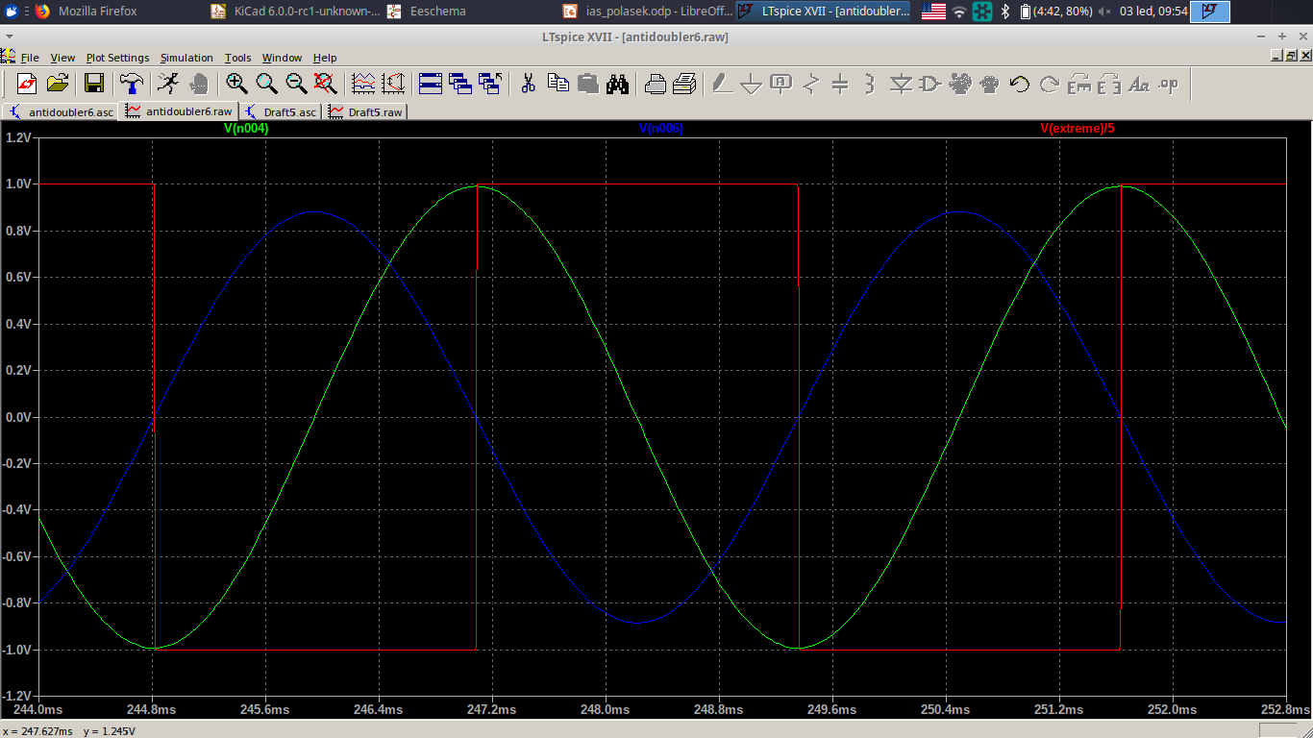
Extreme detector - waveforms

Slide 10
Synchronous extreme detectors

Slide 11
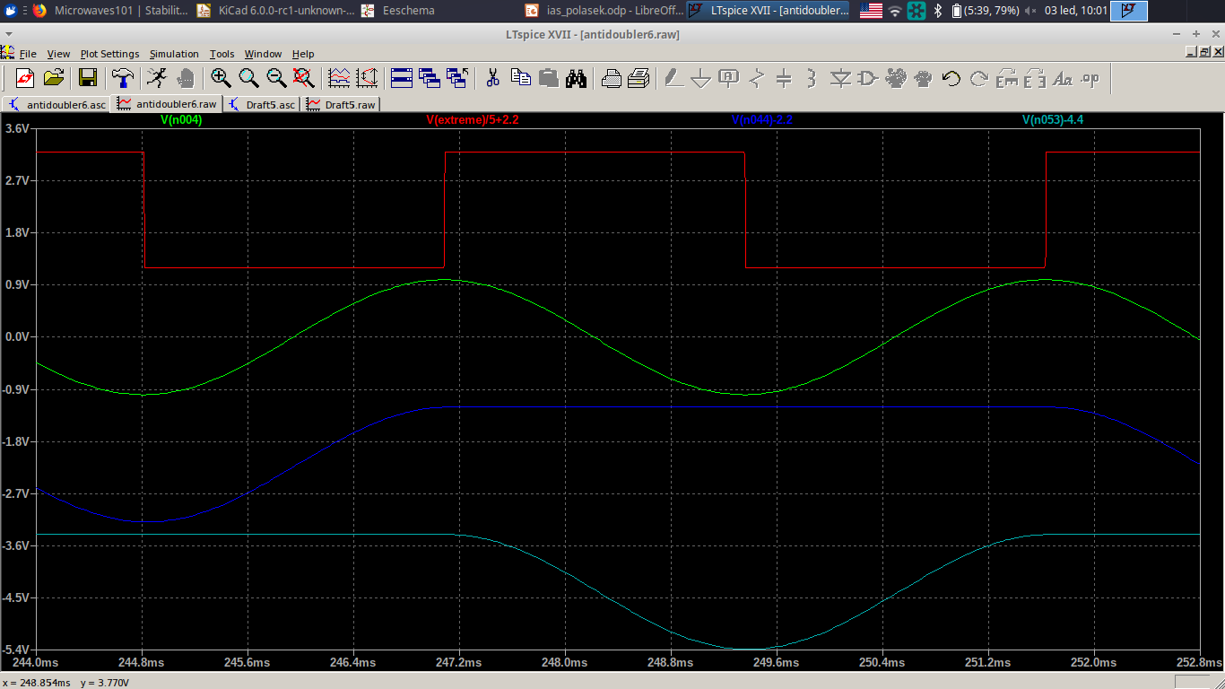
Synchronous extreme detectors

Slide 12
Synchronous extreme detectors

Slide 13
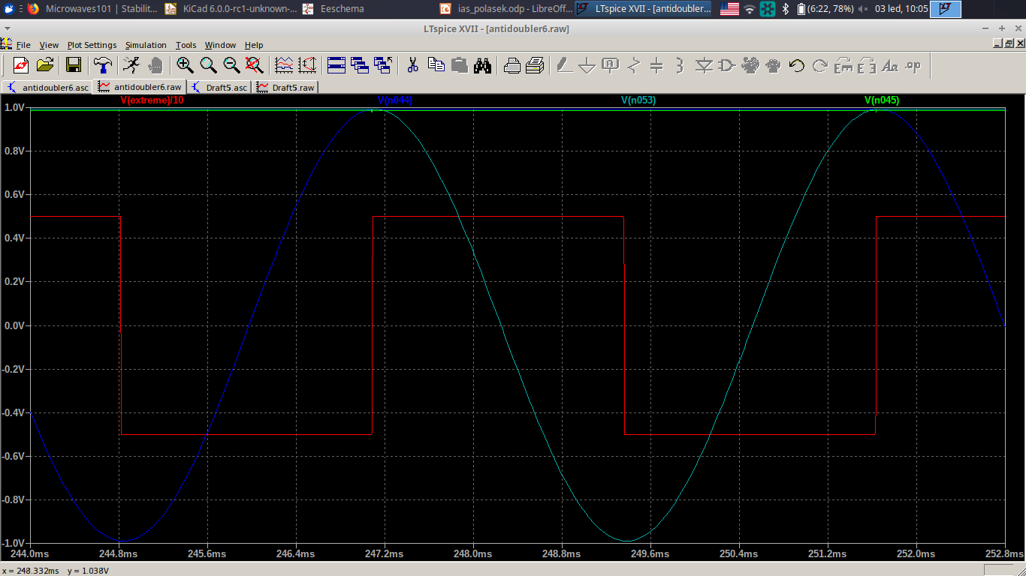
Synchronous extreme detectors

Slide 14
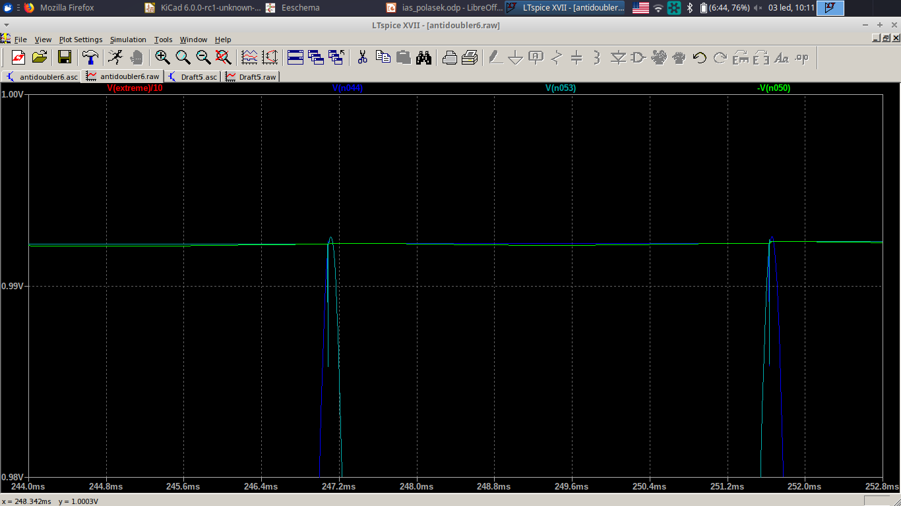
Synchronous extreme detector accuracy

Slide 15
Synchronous extreme detectors
0.35 mV @ 1V
0.03% error

Slide 16
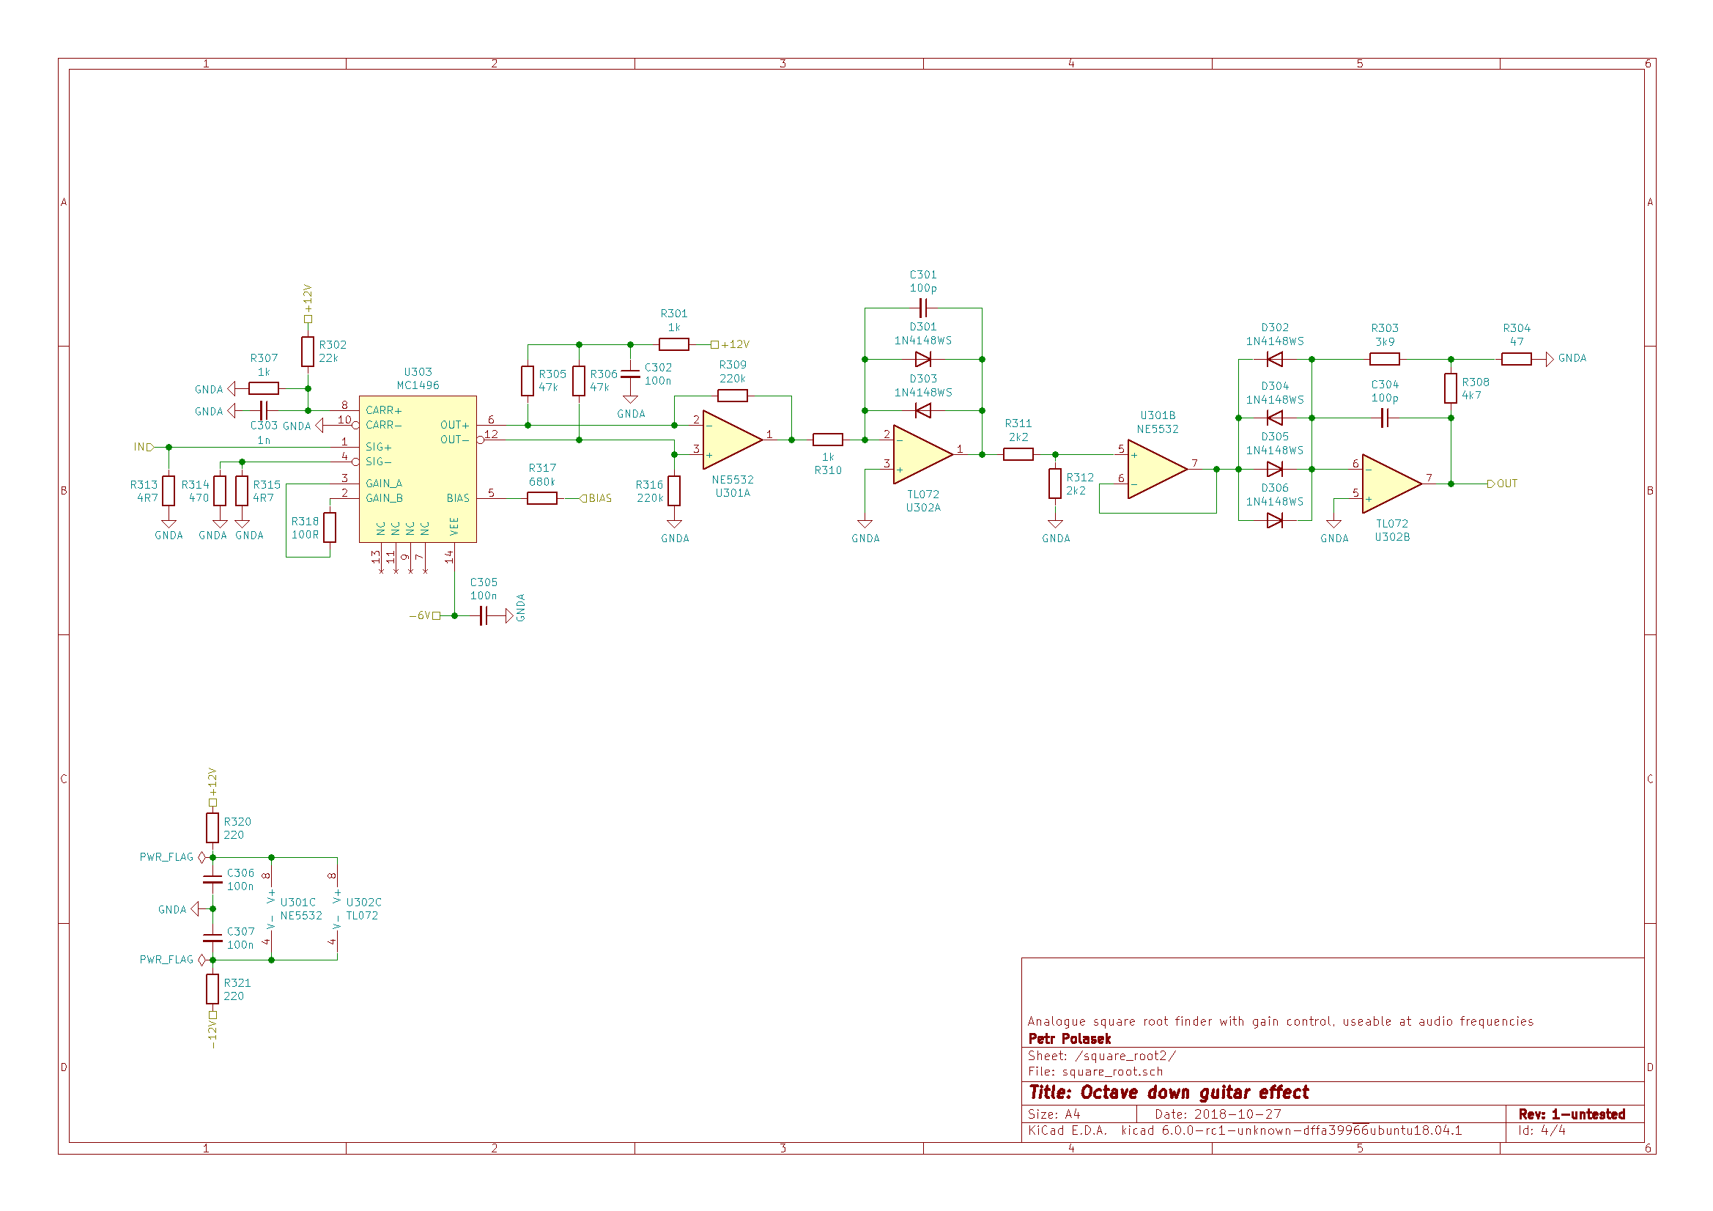
Square root finder - schematic

Slide 17
Square root finder – gain control

Slide 18
Square root finder – square root cell

Slide 19
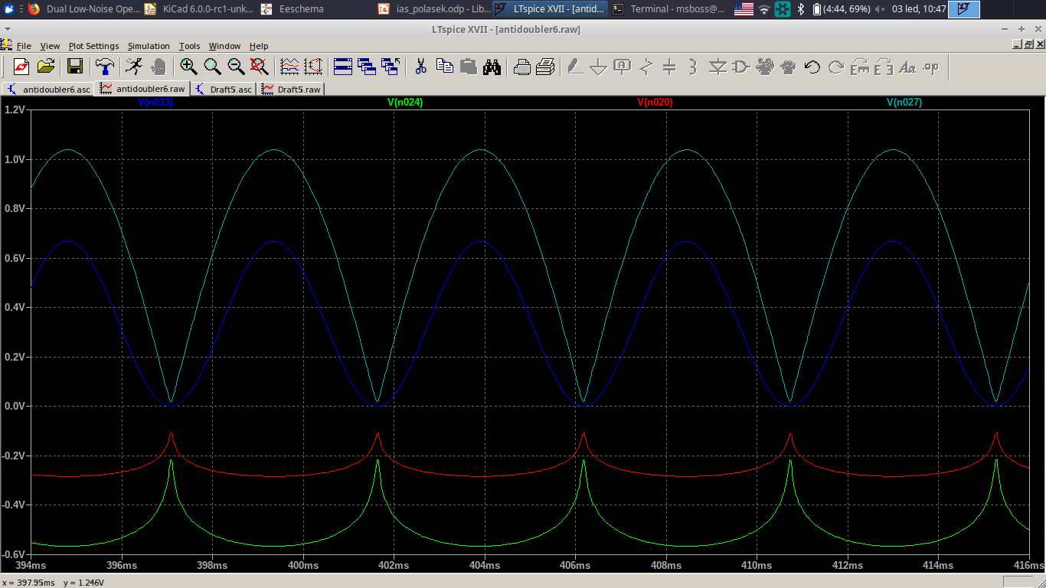
Square root finder - waveforms

Slide 20
Square root finder – AGC feedback

Slide 21
Polarity inverter - schematics

Slide 22
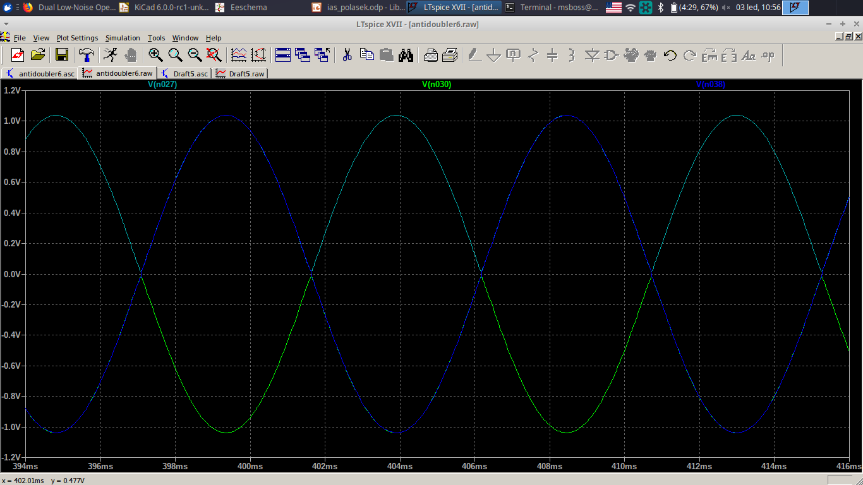
Polarity inverter - waveforms

Slide 23
Polarity inverter - schematics

Slide 24
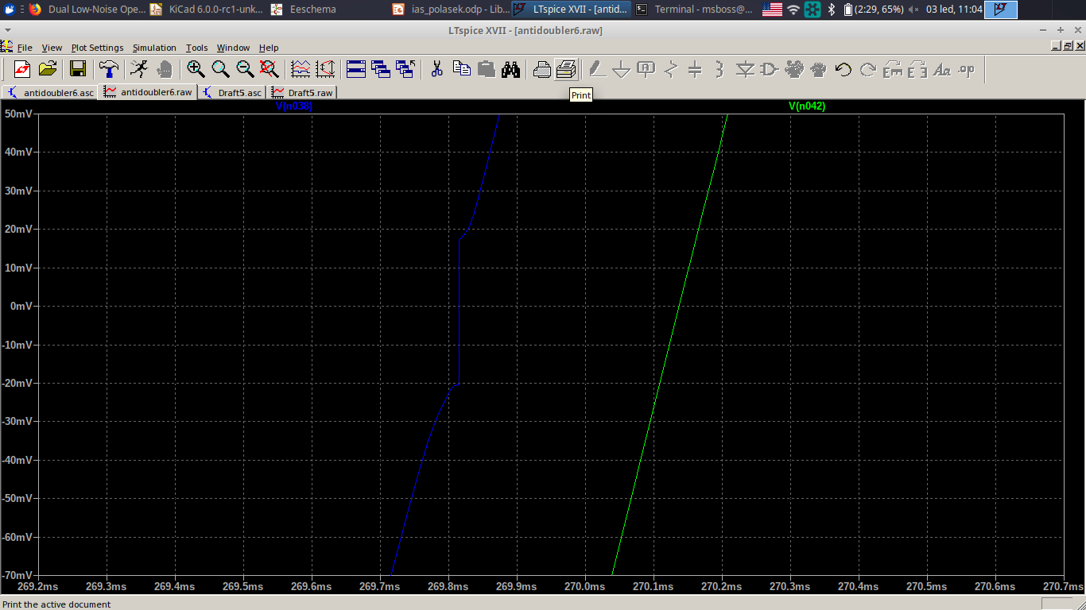
Polarity inverter – crossover distortion

Slide 25
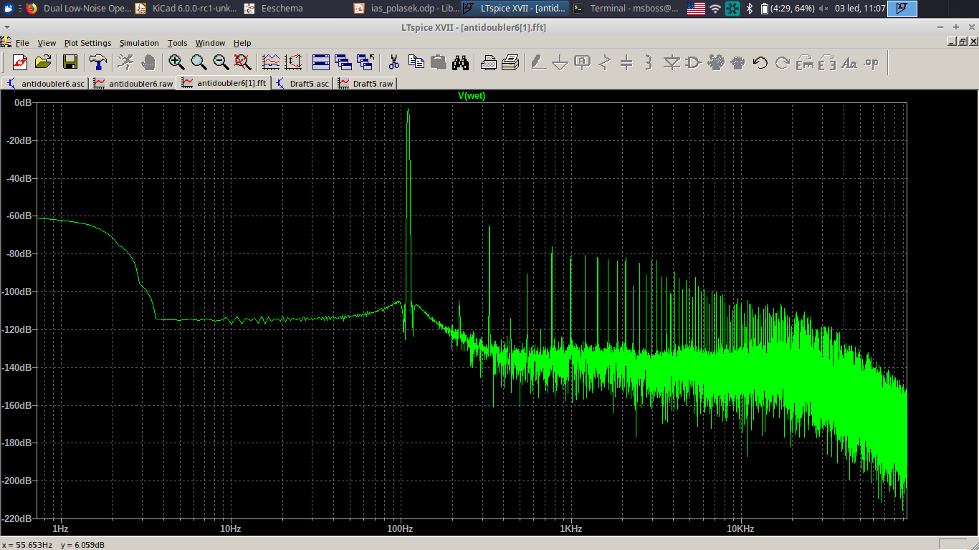
Output signal FFT

Slide 26
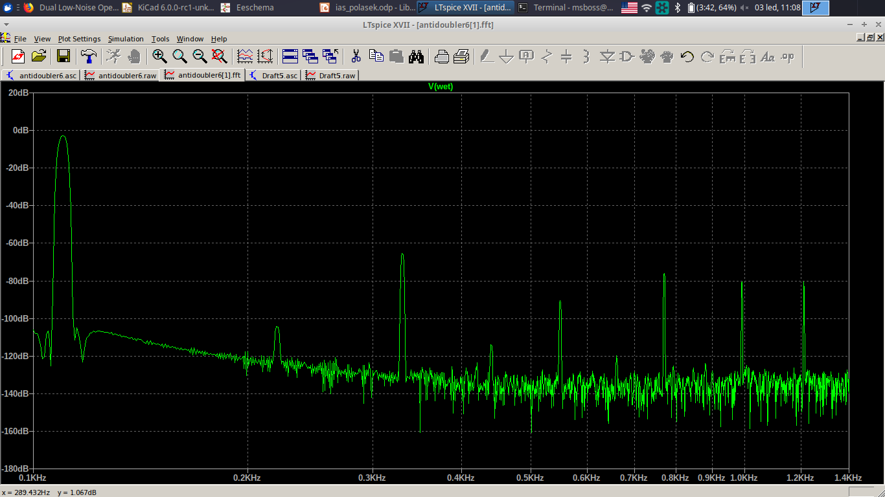
Output signal FFT - magnified
-62.3 dBc @ 3rd harmonic
THD_{R} = 0.43 %
THD_{F} = 2.97 %

