Slide 1
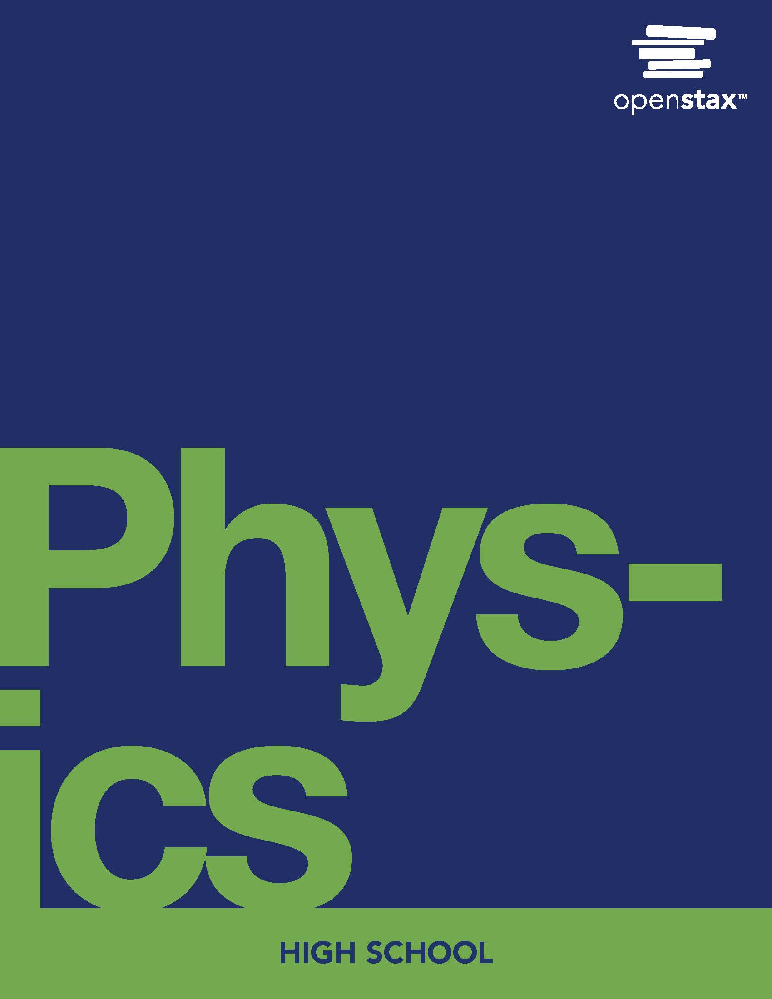
Physics
Chapter 10 Special Relativity

Slide 2
Chapter outline
Postulates of Special Relativity
Consequences of Special Relativity

Slide 3
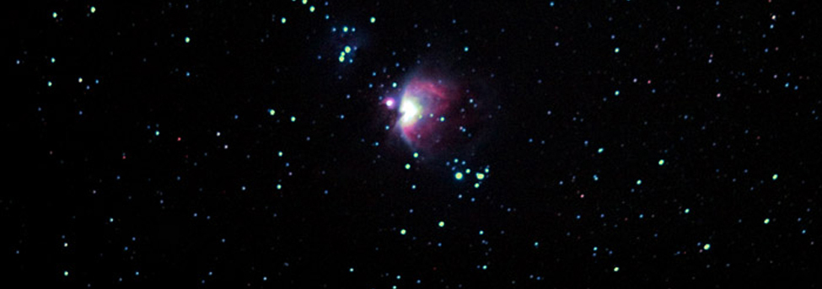
Figure 10.1
Special relativity explains why travel to other star systems, such as these in the Orion Nebula, is unlikely using our current level of technology. (s58y, Flickr)
Notes:
A photo shows a star system, the Orion Nebula.

Slide 4
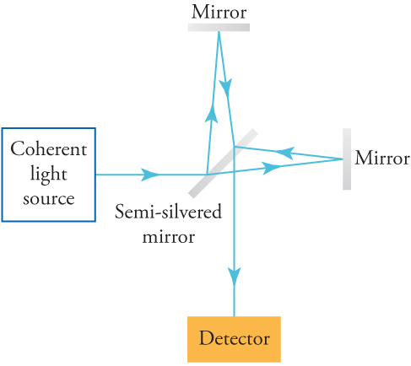
Figure 10.2
This is a diagram of the instrument used in the Michelson–Morley experiment.
Notes:
A drawing shows how light travels from a coherent light source, through a semi-silvered mirror to a mirror, then travels up, then back down towards a detector.

Slide 5
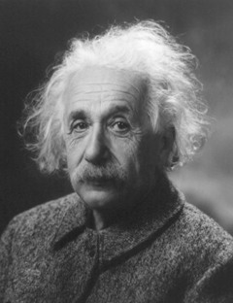
Figure 10.3
Albert Einstein (1879–1955) developed modern relativity and also made fundamental contributions to the foundations of quantum mechanics. (The Library of Congress)
Notes:
A photograph of Albert Einstein.

Slide 6
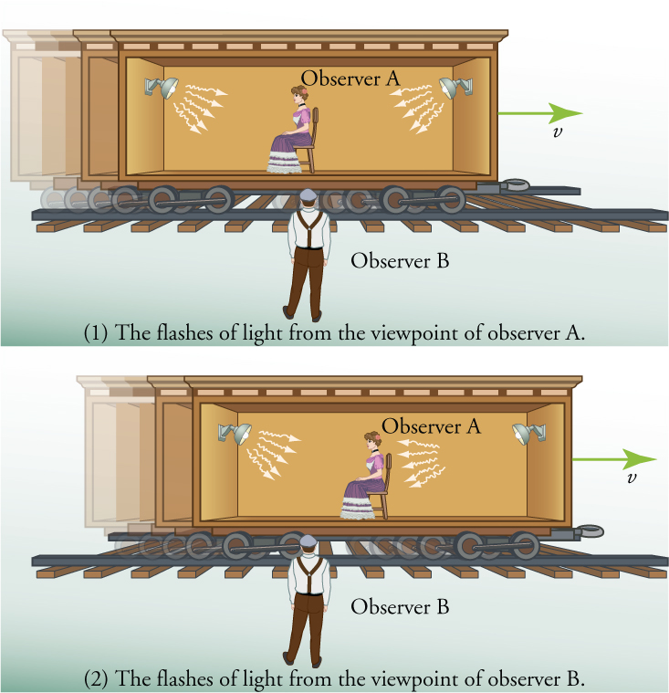
Figure 10.4
Light arriving to observer A as seen by two different observers.
Notes:
There are two illustrations. Both show a man standing beside a railroad track looking at a rail car with an open side. Sitting in the center of the rail car is a woman facing toward the left. Mounted on the wall at either end of the car are light fixtures. In the first illustration, the light that is emitted from the light fixtures is shown as arrows that start at the light fixture and fan out toward the center of the rail car. In the second illustration, the rail car is shown as having moved to the right and the arrows representing the light on the right are shown closer to the woman while the ones coming from the light on the left have not moved.

Slide 7
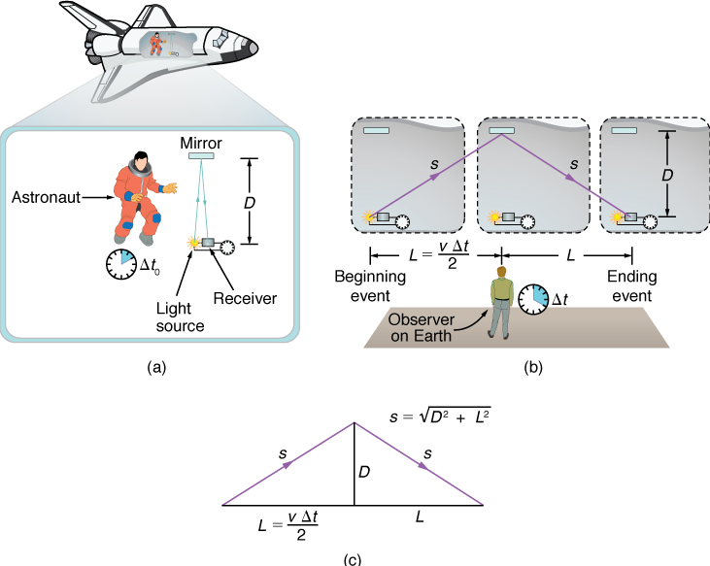
Figure 10.5
(a) An astronaut measures the time Δ t 0 for light to cross her ship using an electronic timer. Light travels a distance 2D in the astronaut’s frame. (b) A person on the earth sees the light follow the longer path 2s and take a longer time Δt .
Notes:
A series of three illustrations the different frames of reference for an astronaut on a flight versus an observer on Earth.

Slide 8
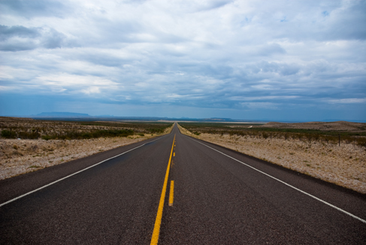
Figure 10.6
People might describe distances differently, but at relativistic speeds, the distances really are different. (Corey Leopold, Flickr)
Notes:
A picture of an empty highway in the desert.

Slide 9
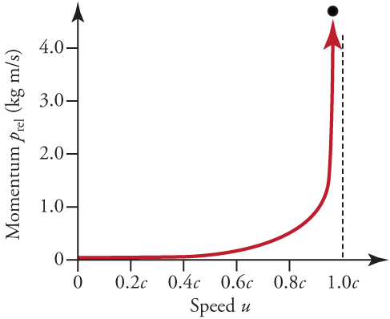
Figure 10.7
Relativistic momentum approaches infinity as the velocity of an object approaches the speed of light.
Notes:
A graph with a line representing momentum (on the y-axis) relative to speed (on the x-axis). The line stays close to 0 from a speed of 0 up to about a speed of 0.6c where it begins to rise gradually. As it approaches 1.0c, however, it rises dramatically and ends going straight up.

Slide 10
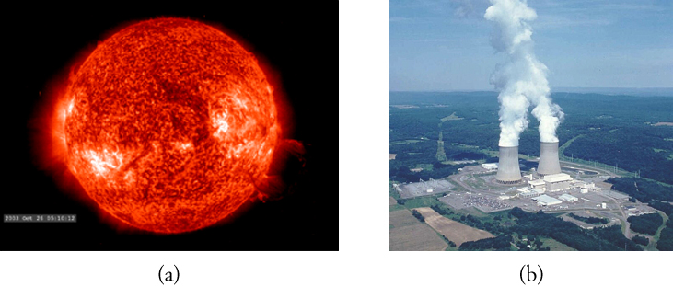
Figure 10.8
The sun (a) and the Susquehanna Steam Electric Station (b) both convert mass into energy. ((a) NASA/Goddard Space Flight Center, Scientific Visualization Studio; (b) U.S. government)
Notes:
A picture of the sun (a) and a power plant (b)

Slide 11
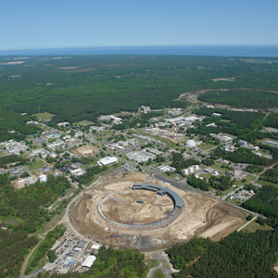
Figure 10.9
Brookhaven National Laboratory. The circular structure houses the RHIC. (energy.gov, Wikimedia Commons)
This OpenStax ancillary resource is © Rice University under a CC BY-NC-SA 4.0 International license; it may be reproduced or modified for noncommercial purposes only but must be attributed to OpenStax, Rice University and any changes must be noted. Any adaptation must be shared under the same type of license.
Notes:
Aerial view of a large building complex.

