Slide 1

Physics
Chapter 11 Thermal Energy, Heat, and Work

Slide 2
Chapter outline
Temperature and Thermal Energy
Heat, Specific Heat, and Heat Transfer
Phase Change and Latent Heat

Slide 3
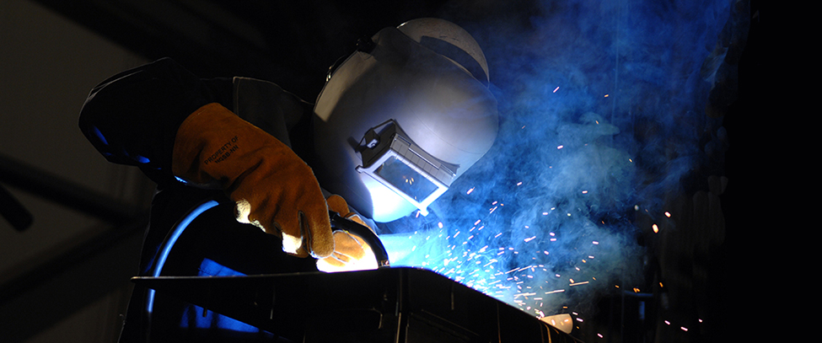
Figure 11.1
The welder’s gloves and helmet protect the welder from the electric arc, which transfers enough thermal energy to melt the rod, spray sparks, and emit high-energy electromagnetic radiation that can burn the retina of an unprotected eye. The thermal energy can be felt on exposed skin a few meters away, and its light can be seen for kilometers (Kevin S. O’Brien, U.S. Navy)
Notes:
Sparks fly as a welder wearing a mask welds.

Slide 4
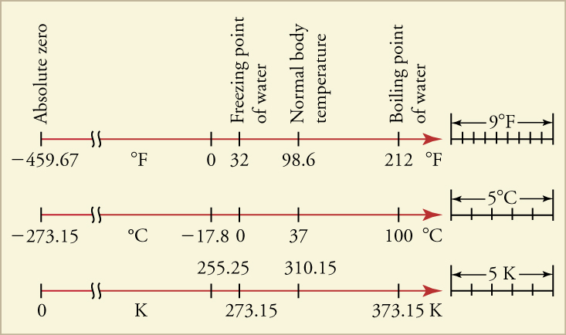
Figure 11.2
Relationships between the Fahrenheit, Celsius, and Kelvin temperature scales, rounded to the nearest degree. The relative sizes of the scales are also shown.
Notes:
Lines representing the temperature ranges from 0 to 373 K are shown for the Fahrenheit, Celsius, and Kelvin scales, with absolute zero, the freezing point of water, normal body temperature, and the boiling point of water marked on all three scales.

Slide 5
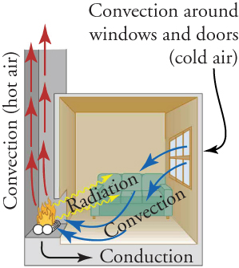
Figure 11.3
In a fireplace, heat transfer occurs by all three methods: conduction, convection, and radiation. Radiation is responsible for most of the heat transferred into the room. Heat transfer also occurs through conduction into the room, but at a much slower rate. Heat transfer by convection also occurs through cold air entering the room around windows and hot air leaving the room by rising up the chimney.
Notes:
Hot air rises up the chimney, cold air comes in through the window, and heat radiates into the room from the fireplace.

Slide 6
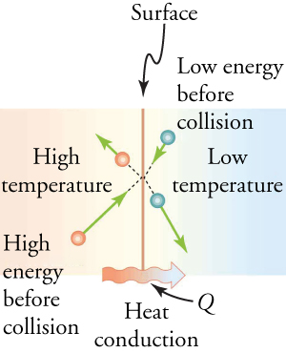
Figure 11.4
The particles in two bodies at different temperatures have different average kinetic energies. Collisions occurring at the contact surface tend to transfer energy from high-temperature regions to low-temperature regions. In this illustration, a particle in the lower-temperature region (right side) has low kinetic energy before collision, but its kinetic energy increases after colliding with the contact surface. In contrast, a particle in the higher-temperature region (left side) has more kinetic energy before collision, but its energy decreases after colliding with the contact surface.
Notes:
A particle in the lower-temperature region collides with a particle in the higher-temperature region. After the collision, the energy (represented by velocity vectors) of the particle in the higher-temperature region decreases, and the energy of the particle in the lower-temperature region increases.

Slide 7
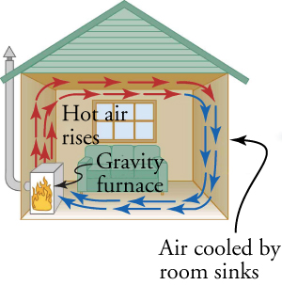
Figure 11.5
Air heated by the so-called gravity furnace expands and rises, forming a convective loop that transfers energy to other parts of the room. As the air is cooled at the ceiling and outside walls, it contracts, eventually becoming denser than room air and sinking to the floor. A properly designed heating system like this one, which uses natural convection, can be quite efficient in uniformly heating a home.
Notes:
Hot air rises from the furnace, circulates along the ceiling, cools, sinks, and returns to be heated again by the furnace, forming a convective loop in a house.

Slide 8
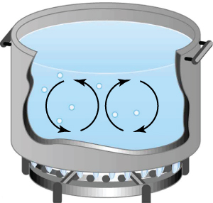
Figure 11.6
Convection plays an important role in heat transfer inside this pot of water. Once conducted to the inside fluid, heat transfer to other parts of the pot is mostly by convection. The hotter water expands, decreases in density, and rises to transfer heat to other regions of the water, while colder water sinks to the bottom. This process repeats as long as there is water in the pot.
Notes:
Heating water circulates in a pot heated on top of a burner on the stove.

Slide 9
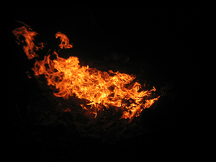
Figure 11.7
Most of the heat transfer from this fire to the observers is through infrared radiation. The visible light transfers relatively little thermal energy. Since skin is very sensitive to infrared radiation, you can sense the presence of a fire without looking at it directly. (Daniel X. O’Neil)
Notes:
Image of a raging fire..

Slide 10
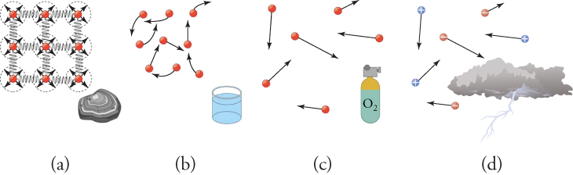
Figure 11.8
(a) Particles in a solid always have the same neighbors, held close by forces represented here by springs. These particles are essentially in contact with one another. A rock is an example of a solid. This rock retains its shape because of the forces holding its atoms or molecules together. (b) Particles in a liquid are also in close contact but can slide over one another. Forces between them strongly resist attempts to push them closer together and also hold them in close contact. Water is an example of a liquid. Water can flow, but it also remains in an open container because of the forces between its molecules. (c) Particles in a gas are separated by distances that are considerably larger than the size of the particles themselves, and they move about freely. A gas must be held in a closed container to prevent it from moving out into its surroundings. (d) The atmosphere is ionized in the extreme heat of a lightning strike.
Notes:
A rock, representing a solid is shown in part (a), along with its tightly bound particles. In part (b), liquid water is shown with its molecules attracted to one another, but not tightly bound. In part (c) oxygen is shown with molecules far apart and bouncing off one another in random directions.

Slide 11
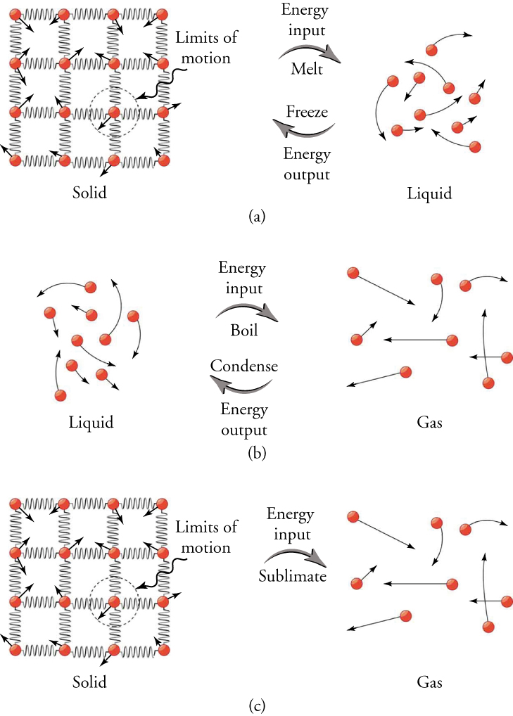
Figure 11.9
(a) Energy is required to partially overcome the attractive forces between particles in a solid to form a liquid. That same energy must be removed for freezing to take place. (b) Particles are separated by large distances when changing from liquid to vapor, requiring significant energy to overcome molecular attraction. The same energy must be removed for condensation to take place. There is no temperature change until a phase change is completed. (c) Enough energy is added that the liquid state is skipped over completely as a substance undergoes sublimation.
Notes:
Energy input (melting) converts solid to liquid. Energy output (freezing) converts liquid to solid. Energy input (boiling) converts liquid to gas. Energy output (condensation) converts gas to liquid. Energy input (sublimation) converts solid to gas.

Slide 12
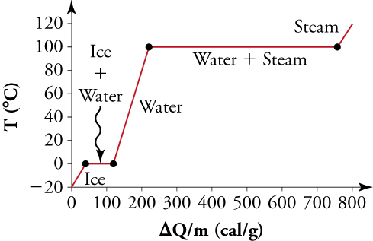
Figure 11.10
A graph of temperature versus added energy. The system is constructed so that no vapor forms while ice warms to become liquid water, and so when vaporization occurs, the vapor remains in the system. The long stretches of constant temperature values at 0 °C and 100 °C reflect the large latent heats of melting and vaporization, respectively.
Notes:
A graph of change in heat per mass on the x-axis and change in temperature on the y-axis is shown. It is level during phase changes, indicating no change in temperature, and rises steeply after phase changes are completed.

Slide 13
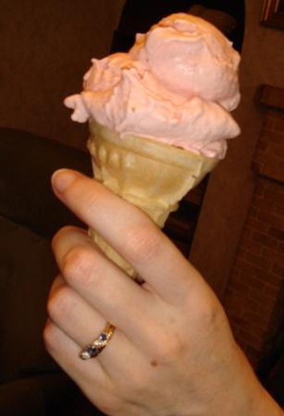
Figure 11.11
With the proper ingredients, some ice and a couple of plastic bags, you could make your own ice cream in five minutes. (ElinorD, Wikimedia Commons)
This OpenStax ancillary resource is © Rice University under a CC BY-NC-SA 4.0 International license; it may be reproduced or modified for noncommercial purposes only but must be attributed to OpenStax, Rice University and any changes must be noted. Any adaptation must be shared under the same type of license.
Notes:
A woman holds a strawberry ice cream cone.

