Slide 1
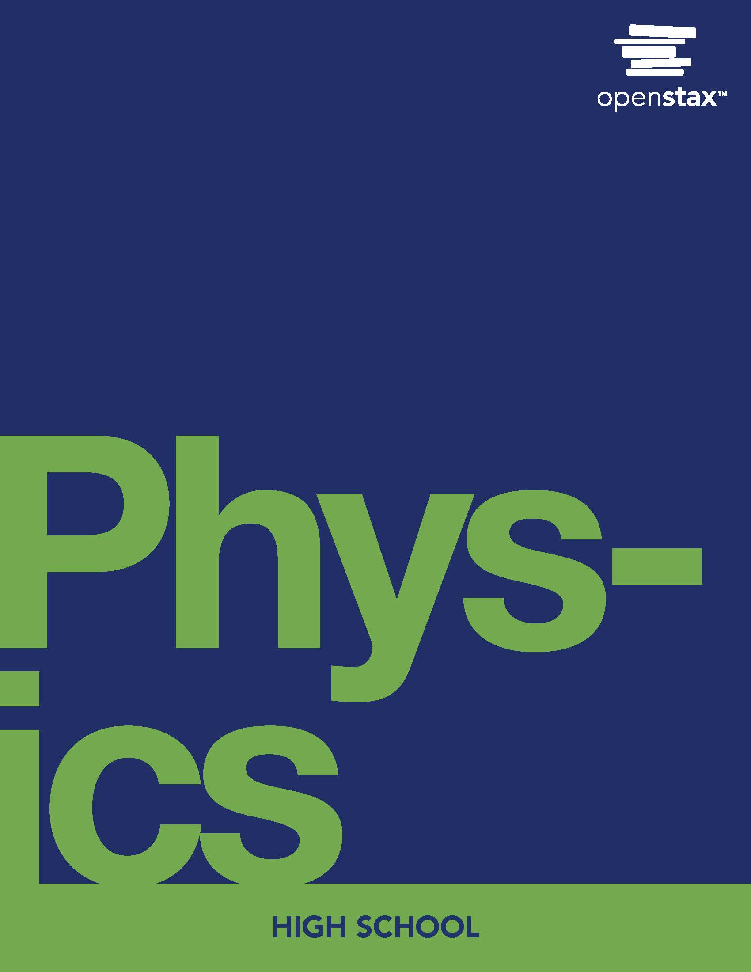
Physics
Chapter 12 Thermodynamics

Slide 2
Chapter outline
Zeroth Law of Thermodynamics: Thermal Equilibrium
First law of Thermodynamics: Thermal Energy and Work
Second Law of Thermodynamics: Entropy
Applications of Thermodynamics: Heat Engines, Heat Pumps, and Refrigerators

Slide 3
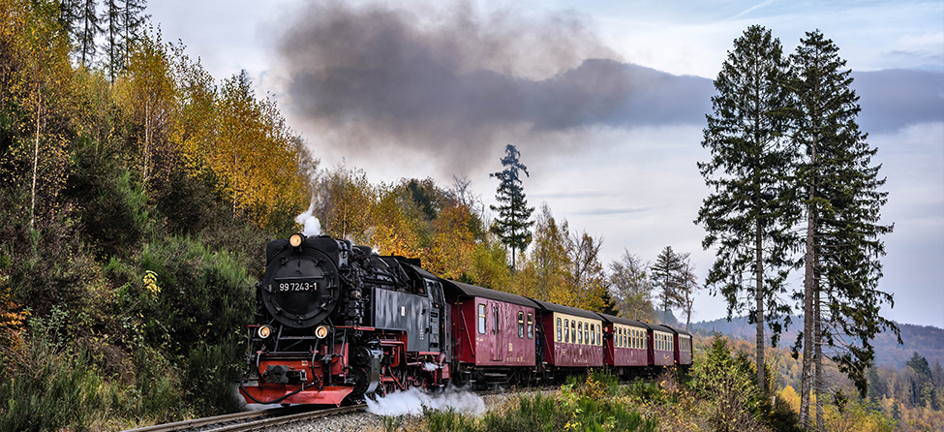
Figure 12.1
A steam engine uses energy transfer by heat to do work. (Modification of work by Gerald Friedrich, Pixabay)
Notes:
Smoke rises from the stack of a train travelling through the mountains

Slide 4
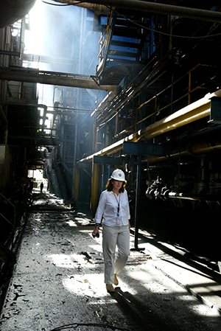
Figure 12.2
An engineer makes a site visit to the Baghdad South power plant.
Notes:
A woman wearing a hardhat walks between steaming pipes.

Slide 5
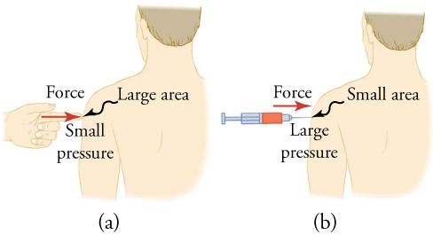
Figure 12.3
(a) Although the person being poked with the finger might be irritated, the force has little lasting effect. (b) In contrast, the same force applied to an area the size of the sharp end of a needle is great enough to break the skin.
Notes:
In part (a), a finger pokes a man’s arm. In part (b), a needle pokes a man’s arm with the same force but over a smaller area, resulting in greater pressure.

Slide 6
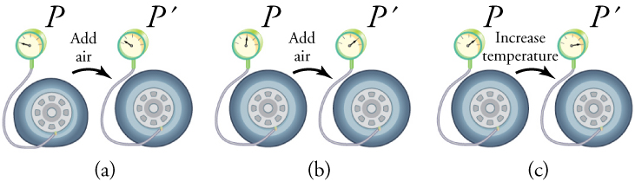
Figure 12.4
(a) When air is pumped into a deflated tire, its volume first increases without much increase in pressure. (b) When the tire is filled to a certain point, the tire walls resist further expansion, and the pressure increases as more air is added. (c) Once the tire is inflated fully, its pressure increases with temperature.
Notes:
In part (a), air is added to a tire, measured using a pressure gauge, and the tire increases in volume. In part (b), more air is added but the volume remains the same, resulting in greater pressure as indicated by the gauge. In part (c), the volume remains nearly constant, so that an increase in temperature increases the pressure.

Slide 7
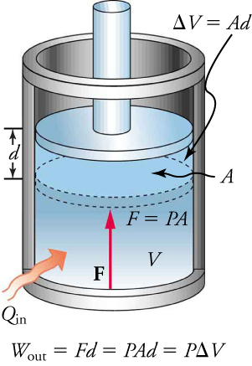
Figure 12.5
An expansion of a gas requires energy transfer to keep the pressure constant. Because pressure is constant, the work done is PΔV .
Notes:
A piston in an engine cylinder with cross-sectional area A moves up a distance d as energy is added, causing the volume to expand by Ad.

Slide 8
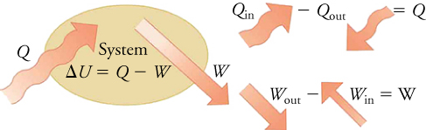
Figure 12.6
The first law of thermodynamics is the conservation of energy principle stated for a system, where heat and work are the methods of transferring energy to and from a system. Q represents the net heat transfer—it is the sum of all transfers of energy by heat into and out of the system. Q is positive for net heat transfer into the system. W out is the work done by the system, and W in is the work done on the system. W is the total work done on or by the system. W is positive when more work is done by the system than on it. The change in the internal energy of the system, ΔU , is related to heat and work by the first law of thermodynamics: ΔU=Q−W.
Notes:
Q is shown adding energy to the system, while W causes energy to leave the system. For the system, the following equations are shown:

Slide 9
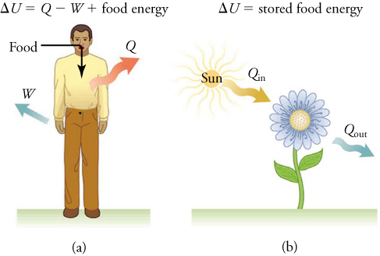
Figure 12.7
(a) The first law of thermodynamics applies to metabolism. Heat transferred out of the body (Q) and work done by the body (W) remove internal energy, whereas food intake replaces it. (Food intake may be considered work done on the body.) (b) Plants convert part of the radiant energy in sunlight into stored chemical energy, a process called photosynthesis.
Notes:
A man takes in energy from food, gives off heat, and does work in part (a). A flower absorbs heat from the Sun and gives off heat in part (b).

Slide 10
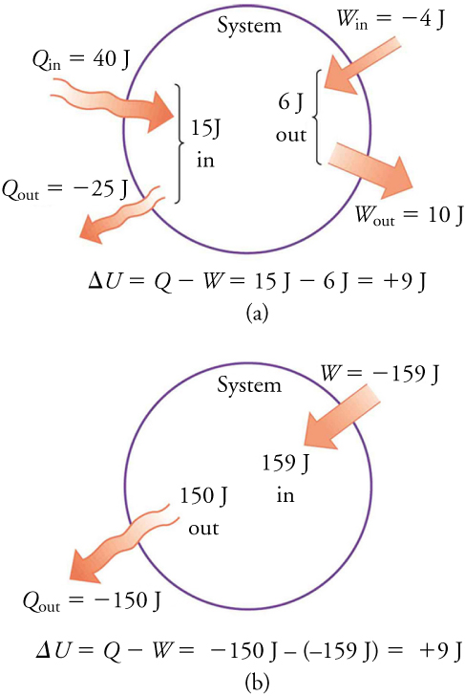
Figure 12.8
Two different processes produce the same change in a system. (a) A total of 15.00 J of heat transfer occurs into the system, while work takes out a total of 6.00 J. The change in internal energy is ΔU = Q – W = 9.00 J. (b) Heat transfer removes 150.00 J from the system while work puts 159.00 J into it, producing an increase of 9.00 J in internal energy. If the system starts out in the same state in (a) and (b), it will end up in the same final state in either case—its final state is related to internal energy, not how that energy was acquired.
Notes:
Two different processes produce the same change in a system. (a) Heat transfers a total of 15.00 J into the system, while work takes out a total of 6.00 J. The change in internal energy is ΔU = Q - W = 9.00 J. (b) Heat removes 150.00 J from the system while work puts 159.00 J into it, producing an increase in internal energy of 9.00 J.

Slide 11
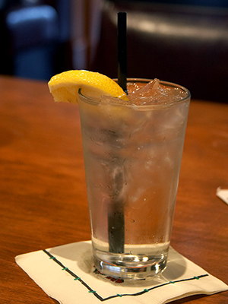
Figure 12.9
The ice in this drink is slowly melting. Eventually, the components of the liquid will reach thermal equilibrium, as predicted by the second law of thermodynamics—that is, after heat transfers energy from the warmer liquid to the colder ice. (Jon Sullivan, PDPhoto.org)
Notes:
Ice water in a glass with a straw and lemon wedge.

Slide 12
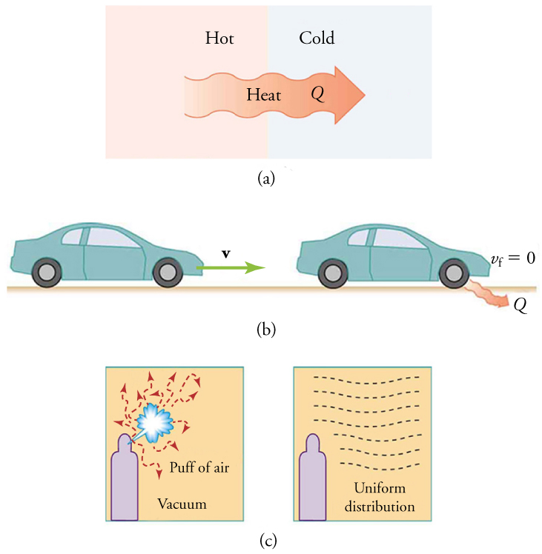
Figure 12.10
Examples of one-way processes in nature. (a) Heat transfer occurs spontaneously from hot to cold, but not from cold to hot. (b) The brakes of this car convert its kinetic energy to increase their internal energy (temperature), and heat transfers this energy to the environment. The reverse process is impossible. (c) The burst of gas released into this vacuum chamber quickly expands to uniformly fill every part of the chamber. The random motions of the gas molecules will prevent them from returning altogether to the corner.
Notes:
In part (a), heat travels from a hotter box to a cooler box. In part (b), a car brakes and releases some heat to the environment. In part (c), a spray bottle releases a puff of air into a vacuum, where the molecules become evenly distributed.

Slide 13
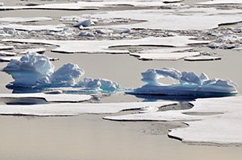
Figure 12.11
These ice floes melt during the Arctic summer. Some of them refreeze in the winter, but the second law of thermodynamics predicts that it would be extremely unlikely for the water molecules contained in these particular floes to reform in the distinctive alligator-like shape they possessed when this picture was taken in the summer of 2009. (Patrick Kelley, U.S. Coast Guard, U.S. Geological Survey)
Notes:
Ice frozen in the shape of an alligator pokes through the surface of the water.

Slide 14
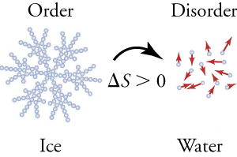
Figure 12.12
When ice melts, it becomes more disordered and less structured. The systematic arrangement of molecules in a crystal structure is replaced by a more random and less orderly movement of molecules without fixed locations or orientations. Its entropy increases because heat transfer occurs into it. Entropy is a measure of disorder.
Notes:
Ice is shown side-by-side with water. Ice has more structure, and water has more disorder. Water molecules are traveling in random directions, and the change in entropy is positive as melting occurs.

Slide 15
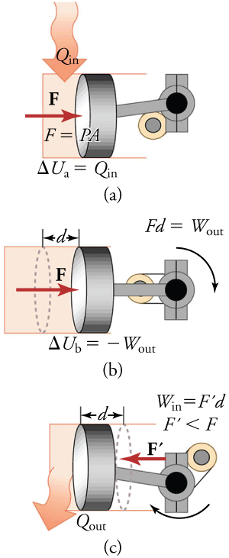
Figure 12.13
(a) Heat transfer to the gas in a cylinder increases the internal energy of the gas, creating higher pressure and temperature. (b) The force exerted on the movable cylinder does work as the gas expands. Gas pressure and temperature decrease during expansion, indicating that the gas’s internal energy has decreased as it does work. (c) Heat transfer of energy to the environment further reduces pressure in the gas, so that the piston can more easily return to its starting position.
Notes:
In part (a), heat transfers energy into the gas in a cylinder. In part (b), force pushes the cylinder. In part (c), heat transfers energy out to the environment.

Slide 16
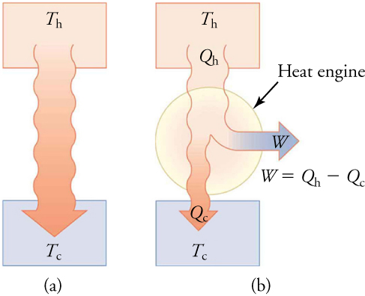
Figure 12.14
(a) Heat transfers energy spontaneously from a hot object to a cold one, as is consistent with the second law of thermodynamics. (b) A heat engine, represented here by a circle, uses part of the energy transferred by heat to do work. The hot and cold objects are called the hot and cold reservoirs. Qh is the heat out of the hot reservoir, W is the work output, and Qc is the unused heat into the cold reservoir.
Notes:
In part (a), heat transfers energy from the hot reservoir to the cold reservoir. In part (b), work is produced as this heat transfers energy from the hot to the cold reservoir. The amount of work generated is Qh – Qc.

Slide 17
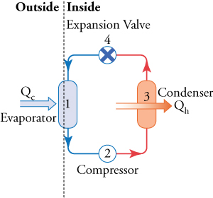
Figure 12.15
A simple heat pump has four basic components: (1) an evaporator, (2) a compressor, (3) a condenser, and (4) an expansion valve. In the heating mode, heat transfers Q c to the working fluid in the evaporator (1) from the colder, outdoor air, turning it into a gas. The electrically driven compressor (2) increases the temperature and pressure of the gas and forces it into the condenser coils (3) inside the heated space. Because the temperature of the gas is higher than the temperature in the room, heat transfers energy from the gas to the room as the gas condenses into a liquid. The working fluid is then cooled as it flows back through an expansion valve (4) to the outdoor evaporator coils.
Notes:
A complete cycle from evaporator to compressor to condenser to expansion valve is shown. Qc is transferred to the evaporator from outdoors, and the condenser releases Qh indoors.

Slide 18
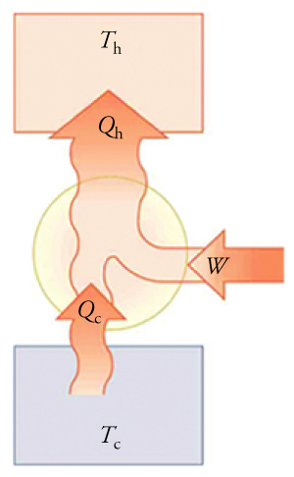
Figure 12.16
Heat pumps, air conditioners, and refrigerators are heat engines operated backward. Almost every home contains a refrigerator. Most people don’t realize that they are also sharing their homes with a heat pump.
This OpenStax ancillary resource is © Rice University under a CC BY-NC-SA 4.0 International license; it may be reproduced or modified for noncommercial purposes only but must be attributed to OpenStax, Rice University and any changes must be noted. Any adaptation must be shared under the same type of license.
Notes:
In a refrigerator, there is heat transfer (Qc) into the system from a cold reservoir, and heat transfer (Qh) out of the system into a hot reservoir, caused by work (W) done on the system.

