Slide 1

Physics
Chapter 13 Waves and Their Properties

Slide 2
Chapter outline
Types of Waves
Wave Properties: Speed, Amplitude, Frequency, and Period
Wave Interaction: Superposition and Interference

Slide 3
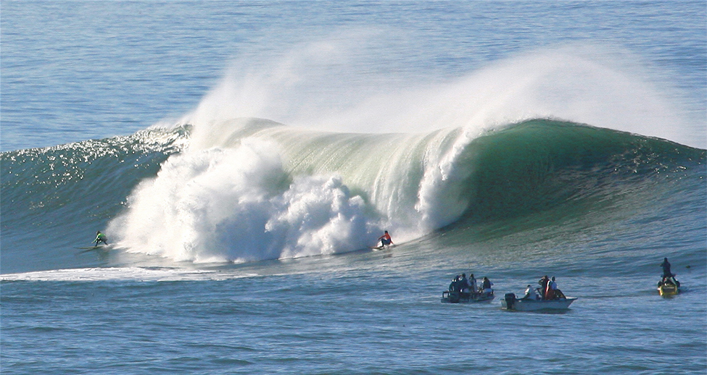
Figure 13.1
Waves in the ocean behave similarly to all other types of waves. (Steve Jurveston, Flickr)
Notes:
An ocean whitecap crashes near two surfers and three boats.

Slide 4
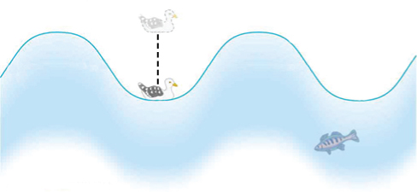
Figure 13.2
An idealized ocean wave passes under a seagull that bobs up and down in simple harmonic motion.
Notes:
A seagull bobs up and down on a sine-wave-shaped periodic ocean wave.

Slide 5
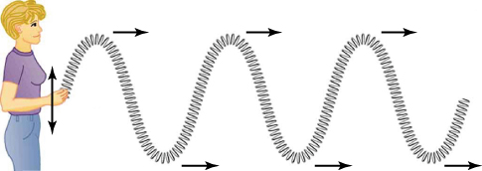
Figure 13.3
In this example of a transverse wave, the wave propagates horizontally and the disturbance in the toy spring is in the vertical direction.
Notes:
A woman moves a slinky up and down, creating transverse waves that propagate horizontally away from her while disturbing the slinky vertically.

Slide 6
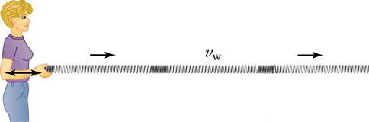
Figure 13.4
In this example of a longitudinal wave, the wave propagates horizontally and the disturbance in the toy spring is also in the horizontal direction.
Notes:
A woman stretches and compresses a slinky horizontally, creating longitudinal waves that propagate horizontally away from her and disturbing the slinky horizontally as well.

Slide 7
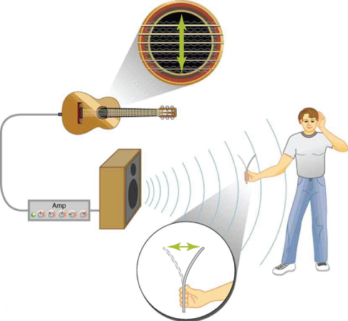
Figure 13.5
The wave on a guitar string is transverse. However, the sound wave coming out of a speaker rattles a sheet of paper in a direction that shows that such sound wave is longitudinal.
Notes:
A guitar string is disturbed vertically but travels horizontally. Sound travels from the guitar, through an amplifier, out of a speaker, and to a piece of paper, which vibrates back and forth with the waves of compression.

Slide 8

Figure 13.6
A surfer negotiates a steep take-off on a winter day in California while his friend watches. (Ljsurf, Wikimedia Commons)
Notes:
A surfer glides down a giant wave while another surfer watches from the wave’s crest.

Slide 9
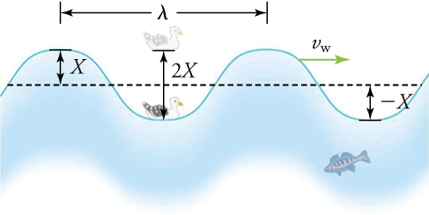
Figure 13.7
The wave has a wavelength λ, which is the distance between adjacent identical parts of the wave. The up-and-down disturbance of the surface propagates parallel to the surface at a speed vw.
Notes:
A seagull bobs up and down on a sinusoidal-shaped periodic ocean wave with a given wave velocity of νw. The wavelength λ is shown as the distance from one crest to the next crest. The amplitude X is shown as the distance between the resting position and the crest. The total distance traveled by the seagull in one cycle or period is shown as 2X.

Slide 10
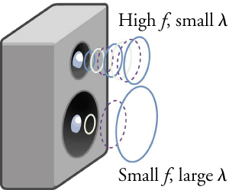
Figure 13.8
Because they travel at the same speed in a given medium, low-frequency sounds must have a greater wavelength than high-frequency sounds. Here, the lower-frequency sounds are emitted by the large speaker, called a woofer, while the higher-frequency sounds are emitted by the small speaker, called a tweeter.
Notes:
A smaller speaker emits a high-frequency sound wave with a small wavelength, while a larger speaker emits a lower-frequency sound wave with a larger wavelength.

Slide 11

Figure 13.9
The destructive effect of an earthquake is a palpable evidence of the energy carried in the earthquake waves. The Richter scale rating of earthquakes is related to both their amplitude and the energy they carry. (Petty Officer 2nd Class Candice Villarreal, U.S. Navy)
Notes:
A town with collapsed buildings after an earthquake.

Slide 12

Figure 13.10
These waves result from the superposition of several waves from different sources, producing a complex pattern. (Waterborough, Wikimedia Commons)
Notes:
Waves ripple across a lake by the mountains.

Slide 13
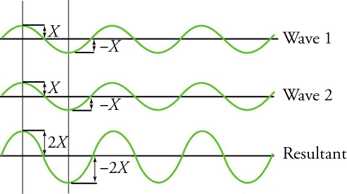
Figure 13.11
The pure constructive interference of two identical waves produces a wave with twice the amplitude but the same wavelength.
Notes:
Wave 1 and wave 2 are perfectly in phase, and their resultant has twice the amplitude of each individual wave.

Slide 14
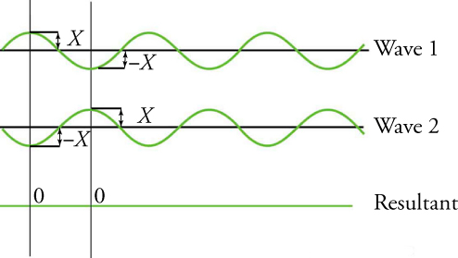
Figure 13.12
The pure destructive interference of two identical waves produces zero amplitude, or complete cancellation.
Notes:
Wave 1 and wave 2 are perfectly out of phase, and their resultant has zero amplitude.

Slide 15
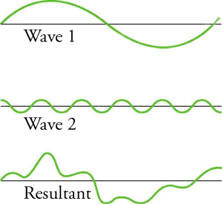
Figure 13.13
The superposition of nonidentical waves exhibits both constructive and destructive interferences.
Notes:
Wave 1 has a large amplitude and a low frequency. Wave 2 has a small amplitude and a high frequency. The resultant is squiggly, without a perfect sinusoidal shape.

Slide 16
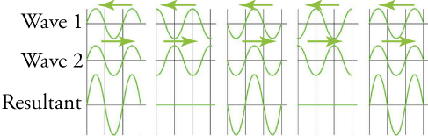
Figure 13.14
A standing wave is created by the superposition of two identical waves moving in opposite directions. The oscillations are at fixed locations in space and result from alternating constructive and destructive interferences.
Notes:
Two identical waves moving in opposite directions alternate between creating no disturbance during destructive interference and doubling the disturbance during constructive interference.

Slide 17
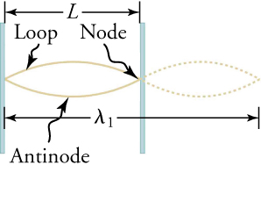
Figure 13.15
The figure shows a string oscillating with its maximum disturbance as the antinode.
Notes:
One antinode and two nodes are created by a single standing wave.

Slide 18
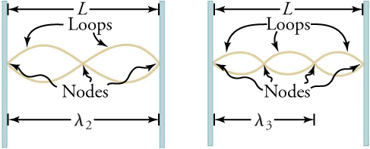
Figure 13.16
The figure shows a string oscillating with multiple nodes.
Notes:
Two antinodes and three nodes are created by two standing waves. Three antinodes and four nodes are created by three standing waves.

Slide 19
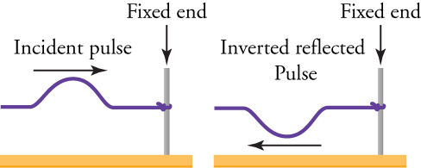
Figure 13.17
A wave is inverted after reflection from a fixed end.
Notes:
A wave travels to the right, hits the fixed end, flips vertically, and travels to the left.

Slide 20
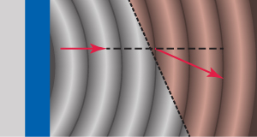
Figure 13.18
A wave refracts as it enters a different medium.
This OpenStax ancillary resource is © Rice University under a CC BY-NC-SA 4.0 International license; it may be reproduced or modified for noncommercial purposes only but must be attributed to OpenStax, Rice University and any changes must be noted. Any adaptation must be shared under the same type of license.
Notes:
A wave bends slightly to the right of its original path as it crosses the line into another medium.

