Slide 1

Physics
Chapter 14 Sound

Slide 2
Chapter outline
Speed of Sound, Frequency, and Wavelength
Sound Intensity and Sound Level
Doppler Effect and Sonic Booms
Sound Interference and Resonance

Slide 3

Figure 14.1
This tree fell some time ago. When it fell, particles in the air were disturbed by the energy of the tree hitting the ground. This disturbance of matter, which our ears have evolved to detect, is called sound. (B.A. Bowen Photography)
Notes:
A fallen tree lies on the ground in a forest.

Slide 4
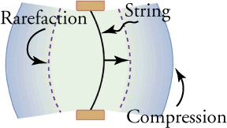
Figure 14.2
A vibrating string moving to the right compresses the air in front of it and expands the air behind it.
Notes:
A string bulges to the right, creating compression ahead of it and rarefaction behind it.

Slide 5
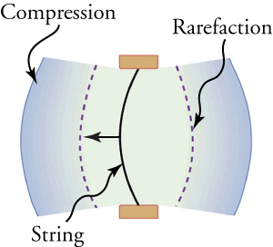
Figure 14.3
As the string moves to the left, it creates another compression and rarefaction as the particles on the right move away from the string.
Notes:
A string bulges to the left, creating compression ahead of it and rarefaction behind it.

Slide 6
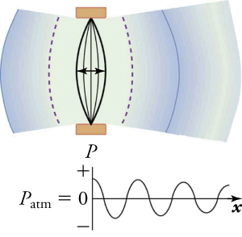
Figure 14.4
After many vibrations, there is a series of compressions and rarefactions that have been transmitted from the string as a sound wave. The graph shows gauge pressure (Pgauge) versus distance x from the source. Gauge pressure is the pressure relative to atmospheric pressure; it is positive for pressures above atmospheric pressure, and negative for pressures below it. For ordinary, everyday sounds, pressures vary only slightly from average atmospheric pressure.
Notes:
A string vibrates back and forth from left to right. The graph of its position is sinusoidal in shape, with amplitude decreasing over time.

Slide 7
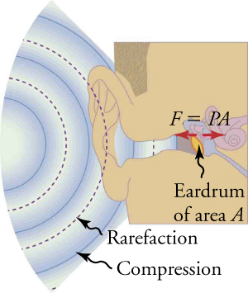
Figure 14.5
Sound wave compressions and rarefactions travel up the ear canal and force the eardrum to vibrate. There is a net force on the eardrum, since the sound wave pressures differ from the atmospheric pressure found behind the eardrum. A complicated mechanism converts the vibrations to nerve impulses, which are then interpreted by the brain.
Notes:
A sound wave with areas of alternating compression and rarefaction enter an ear canal and eardrum.

Slide 8

Figure 14.6
When fireworks explode in the sky, the light energy is perceived before the sound energy. Sound travels more slowly than light does. (Dominic Alves, Flickr)
Notes:
The photograph shows fireworks exploding in the night sky.

Slide 9
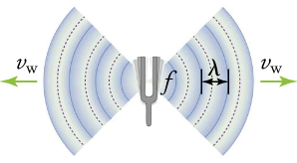
Figure 14.7
A sound wave emanates from a source vibrating at a frequency f, propagates at v, and has a wavelength λ .
Notes:
A tuning fork vibrates back and forth, creating sound waves.

Slide 10
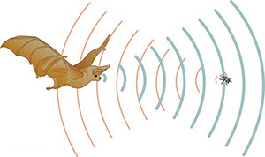
Figure 14.8
A bat uses sound echoes to find its way about and to catch prey. The time for the echo to return is directly proportional to the distance.
Notes:
A bat produces sound waves that bounce off of a fly and back to the bat.

Slide 11
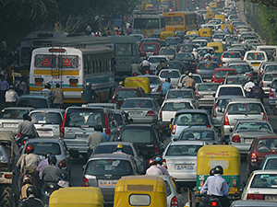
Figure 14.9
Noise on crowded roadways like this one in Delhi makes it hard to hear others unless they shout. (Lingaraj G J, Flickr)
Notes:
Multiple lanes of traffic crowd a busy street.

Slide 12
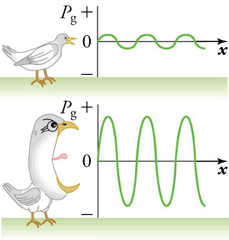
Figure 14.10
Graphs of the pressures in two sound waves of different intensities. The more intense sound is produced by a source that has larger-amplitude oscillations and has greater pressure maxima and minima. Because pressures are higher in the greater-intensity sound, it can exert larger forces on the objects it encounters.
Notes:
This figure has two panels. In the upper panel, a bird chirping at low volume produces sound waves with small amplitudes. In the lower panel, a bird chirping at high volume produces sound waves with large amplitudes.

Slide 13
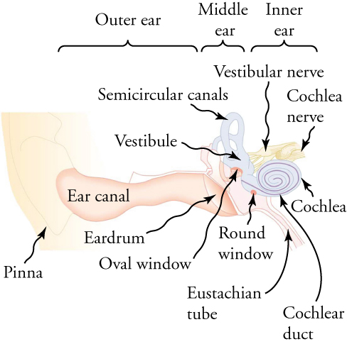
Figure 14.11
The illustration shows the anatomy of the human ear.
Notes:
The outer ear contains the ear canal, the middle ear contains the eardrum and oval window, and the inner ear contains the cochlea.

Slide 14
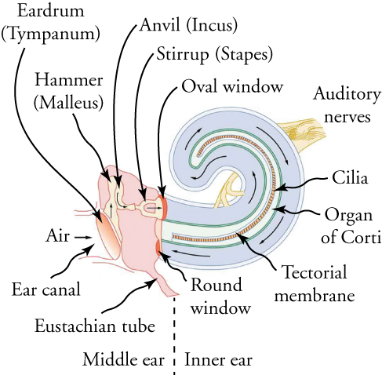
Figure 14.12
The inner ear, or cochlea, is a coiled tube about 3 mm in diameter and 3 cm in length when uncoiled. As the stapes vibrates against the oval window, it creates pressure waves that travel through fluid in the cochlea. These waves vibrate the tectorial membrane, which bends the cilia and stimulates nerves in the organ of Corti. These nerves then send information about the sound to the brain.
Notes:
The cochlea is a coiled tube with cilia inside, located in the inner ear.

Slide 15

Figure 14.13
Playing music, also known as “rocking out”, involves creating vibrations using musical instruments. (John Norton)
Notes:
A man plays the guitar while his friends sing along around a campfire.

Slide 16
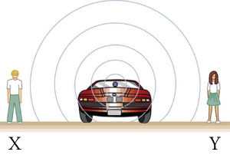
Figure 14.14
Sounds emitted by a source spread out in spherical waves. Because the source, observers, and air are stationary, the wavelength and frequency are the same in all directions and to all observers.
Notes:
Sounds emitted by a stationary car spread out in spherical waves as stationary observers listen on both sides.

Slide 17
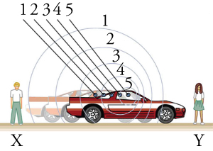
Figure 14.15
Sounds emitted by a source moving to the right spread out from the points at which they were emitted. The wavelength is reduced and, consequently, the frequency is increased in the direction of motion, so that the observer on the right hears a higher-pitch sound. The opposite is true for the observer on the left, where the wavelength is increased and the frequency is reduced.
Notes:
Sound waves are compressed ahead of the motion of a car and stretched out in the wake of the motion of the car as stationary observers listen on both sides.

Slide 18
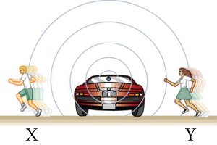
Figure 14.16
The same effect is produced when the observers move relative to the source. Motion toward the source increases frequency as the observer on the right passes through more wave crests than she would if stationary. Motion away from the source decreases frequency as the observer on the left passes through fewer wave crests than he would if stationary.
Notes:
One observer runs away from the sound source (a car) while another runs toward it.

Slide 19
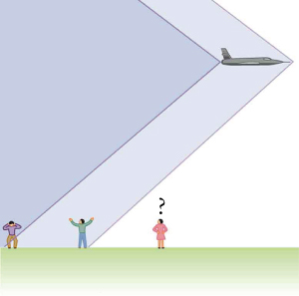
Figure 14.17
Two sonic booms, created by the nose and tail of an aircraft, are observed on the ground after the plane has passed by.
Notes:
The first sonic boom trails behind the nose of the aircraft and the second trails behind the tail.

Slide 20
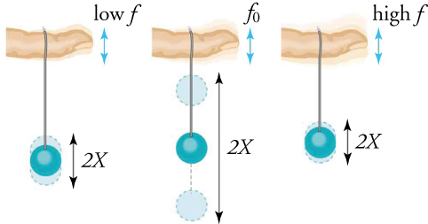
Figure 14.18
The paddle ball on its rubber band moves in response to the finger supporting it. If the finger moves with the natural frequency of the ball on the rubber band, then a resonance is achieved, and the amplitude of the ball’s oscillations increases dramatically. At higher and lower driving frequencies, energy is transferred to the ball less efficiently, and it responds with lower-amplitude oscillations.
Notes:
A ball bobs up and down with the greatest amplitude when the finger drives its oscillation at the fundamental frequency.

Slide 21

Figure 14.19
Some types of headphones use the phenomena of constructive and destructive interference to cancel out outside noises.
Notes:
Shown is a pair of adjustable, black, over-the-ear headphones.

Slide 22
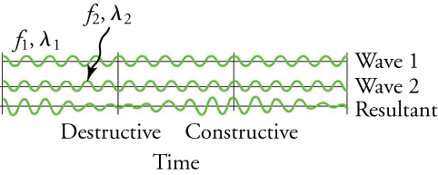
Figure 14.20
Beats are produced by the superposition of two waves of slightly different frequencies but identical amplitudes. The waves alternate in time between constructive interference and destructive interference, giving the resulting wave a time-varying amplitude.
Notes:
Wave 1 and wave 2 have different frequencies, and produce a resultant wave with varying amplitude.

Slide 23
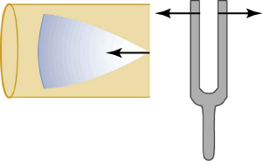
Figure 14.21
Resonance of air in a tube closed at one end, caused by a tuning fork. A disturbance moves down the tube.
Notes:
The vibration from a tuning fork sends a wave disturbance through the air down the tube.

Slide 24
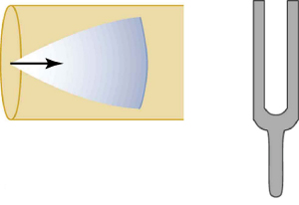
Figure 14.22
Resonance of air in a tube closed at one end, caused by a tuning fork. The disturbance reflects from the closed end of the tube.
Notes:
The vibration from a tuning fork reflects back off the closed end of the tube.

Slide 25
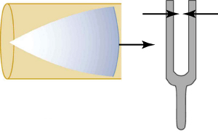
Figure 14.23
Resonance of air in a tube closed at one end, caused by a tuning fork. If the length of the tube L is just right, the disturbance gets back to the tuning fork half a cycle later and interferes constructively with the continuing sound from the tuning fork. This interference forms a standing wave, and the air column resonates.
Notes:
The disturbance is at maximum displacement as it reaches the opening of the tube.

Slide 26
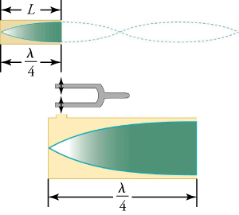
Figure 14.24
The same standing wave is created in the tube by a vibration introduced near its closed end.
Notes:
When there is one node at the closed end, and one antinode at the open end, this forms one quarter of the complete wave cycle (and therefore, one quarter of the wavelength).

Slide 27
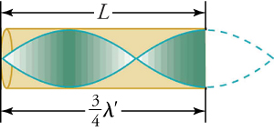
Figure 14.25
Another resonance for a tube closed at one end. This has maximum air displacements at the open end, and none at the closed end. The wavelength is shorter, with three-fourths λ′ equaling the length of the tube, so that λ′ = 4L/3 . This higher-frequency vibration is the first overtone.
Notes:
A closed pipe resonator with ¾ wavelength is shown. It has two nodes and two antinodes inside of the tube.

Slide 28
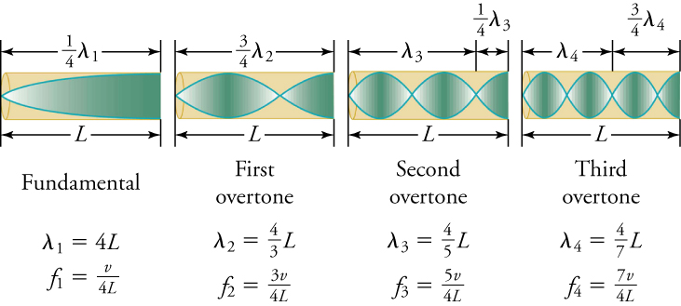
Figure 14.26
The fundamental and three lowest overtones for a tube closed at one end. All have maximum air displacements at the open end and none at the closed end.
Notes:
The fundamental has a wavelength of 4L, and a frequency of v/4L. The first overtone has a wavelength of 4L/3 and a frequency of 3v/4L. The second overtone has a wavelength of 4L/5 and a frequency of 5v/4L. The third overtone has a wavelength of 4L/7 and a frequency of 7v/4L.

Slide 29
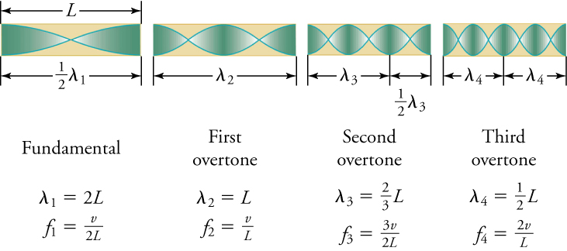
Figure 14.27
The resonant frequencies of a tube open at both ends are shown, including the fundamental and the first three overtones. In all cases the maximum air displacements occur at both ends of the tube, giving it different natural frequencies than a tube closed at one end.
This OpenStax ancillary resource is © Rice University under a CC BY-NC-SA 4.0 International license; it may be reproduced or modified for noncommercial purposes only but must be attributed to OpenStax, Rice University and any changes must be noted. Any adaptation must be shared under the same type of license.
Notes:
The fundamental frequency is v/2L and has a wavelength of 2L. The first overtone has a wavelength of L and a frequency of v/L. The second overtone has a wavelength of 2L/3 and a frequency of 3v/2L. The third overtone has a wavelength of ½L and a frequency of 2v/L.

