Slide 1

Physics
Chapter 15 Light

Slide 2
Chapter outline
The Electromagnetic Spectrum
The Behavior of Electromagnetic Radiation

Slide 3
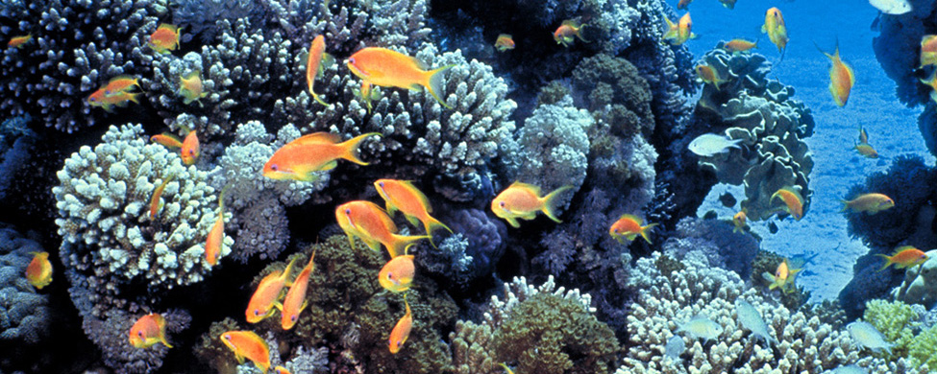
Figure 15.1
Human eyes detect these orange sea goldie fish swimming over a coral reef in the blue waters of the Gulf of Eilat, in the Red Sea, using visible light. (credit: David Darom, Wikimedia Commons)
Notes:
The figure is a photograph of small, colorful fish swimming around a coral reef.

Slide 4
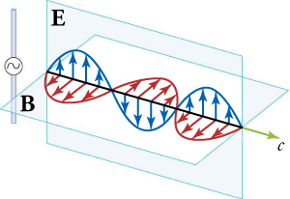
Figure 15.2
A part of the electromagnetic wave sent out from an oscillating charge at one instant in time. The electric and magnetic fields (E and B) are in phase, and they are perpendicular to each other and to the direction of propagation. For clarity, the waves are shown only along one direction, but they propagate out in other directions too.
Notes:
The diagram shows two intersecting planes: a vertical plane labeled “E” and a horizontal plane labeled “B”. The line of intersection is drawn as an arrow, with the letter “c” next to the arrowhead. Within the vertical plane are the crest, trough, and crest of a blue wave, enclosing arrows that point from the baseline to the line of the wave. Likewise, within the horizontal plane are the crest, trough, and crest of a red wave, enclosing arrows that point from the baseline to the line of the wave. To the left of the intersecting planes is a thin vertical bar with a small circle in the middle and a wave symbol within the circle.

Slide 5
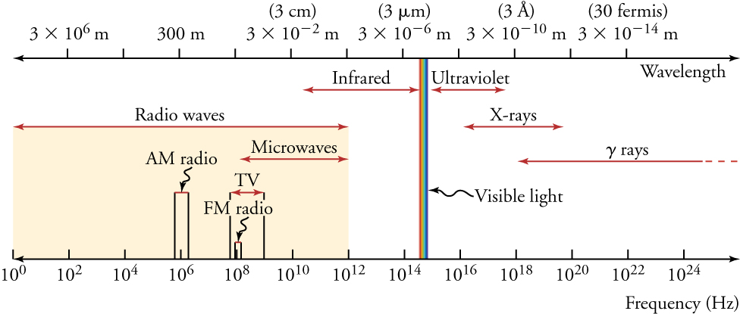
Figure 15.3
The electromagnetic spectrum, showing the major categories of electromagnetic waves. The range of frequencies and wavelengths is remarkable. The dividing line between some categories is distinct, whereas other categories overlap.
Notes:
This figure shows the electromagnetic spectrum between two parallel, horizontal lines. The lower line, labeled “Frequency (Hz)”, is calibrated in increments that increase by 100-fold, starting from 10 superscript 0 at the extreme left and ending beyond 10 superscript 24 on the extreme right. The upper line, labeled “Wavelength”, is calibrated in increments that decrease by 100-fold, starting from 3 times 10 superscript 6 on the left and ending with 3 times 10 superscript minus 14 on the right. Each wavelength measure has the unit “m” after it. The various categories of the spectrum are written between the parallel lines, with a double-headed arrow showing the range of each category. Starting from the left, they are: “Radio waves”, “Infrared”, “Visible light”, “Ultraviolet”, “X rays”, and “gamma rays”. Within the range for “Radio waves” are the subcategories labeled as “AM radio”, “TV”, and “Microwaves”. Within the range for “TV” is the subcategory FM radio.

Slide 6
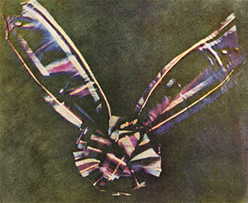
Figure 15.4
Maxwell and Sutton’s photograph of a colored ribbon. This was the first durable color photograph. The plaid tartan of the Scots made a colorful photographic subject.
Notes:
Photograph of a tartan ribbon tied like a bow.

Slide 7
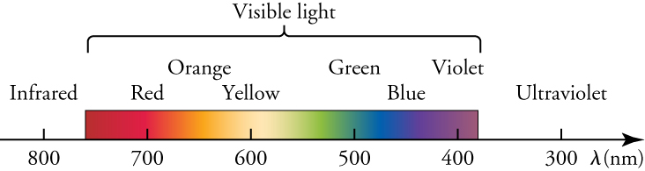
Figure 15.5
A small part of the electromagnetic spectrum that includes its visible components. The divisions between infrared, visible, and ultraviolet are not perfectly distinct, nor are the divisions between the seven rainbow colors
Notes:
This diagram focuses on the visible section of the electromagnetic spectrum. A horizontal arrow represents wavelengths of light decreasing from left to right. The arrow is calibrated with numbers ranging from 800 on the left to 300 on the right, and the line is labeled with the Greek letter lambda, followed by the letters n m in parentheses. Above the arrow is a colored band stretching from about 760 up to about 420. The band, labeled as “Visible light”, shows colors labeled as “Red”, “Orange”, “Yellow”, “Green”, “Blue”, and “Violet”. To the left of the band is a region labeled as “Infrared”, above the 800 mark. To the right of the band is a region labeled as “Ultraviolet”, above the 300 mark.

Slide 8
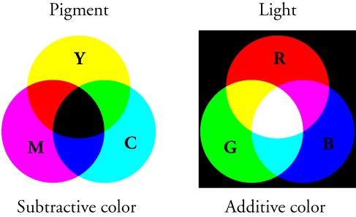
Figure 15.6
Mixing colored pigments follows the subtractive color wheel, and mixing colored light follows the additive color wheel.
Notes:
The figure shows two panels arranged side by side. Each panel consists of three overlapping circles, arranged such that the intersection of any two circles passes through the center of the third circle. The left panel, labeled “Pigment” at the top and “Subtractive color” at the bottom, has the three circles on a white background. The top circle is labeled “Y” and colored yellow; the bottom left circle is labeled “M” and colored magenta; the bottom right circle is labeled “C” and colored cyan. The areas of overlap of pairs of circles are colored red, dark blue, and green, and the area of overlap of all three circles is black. The right panel, labeled “Light” at the top and “Additive color” at the bottom, has the three circles on a black background. The top circle is labeled “R” and colored red; the bottom left circle is labeled “G” and colored green; the bottom right circle is labeled “B” and colored dark blue. The areas of overlap of pairs of circles are colored yellow, cyan, and magenta, and the area of overlap of all three circles is white.

Slide 9
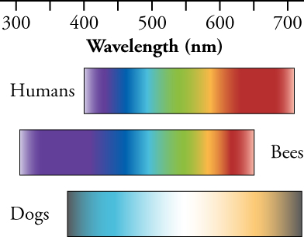
Figure 15.7
Humans, bees, and dogs see colors differently. Dogs see fewer colors than humans, and bees see a different range of colors.
Notes:
This figure shows three parallel, horizontal bands of colors, labeled “Humans”, “Bees”, and “Dogs”. Each band starts with the blue color on the left and ends with the red color on the right. Above the bands is a horizontal line calibrated with numbers ranging from 300 on the left to 700 on the right, and the line is labeled as “Wavelength”, followed by the letters n m in parentheses.

Slide 10
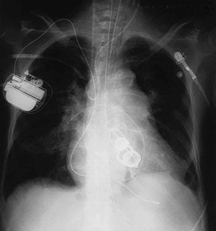
Figure 15.8
This shadow X-ray image shows many interesting features, such as artificial heart valves, a pacemaker, and wires used to close the sternum. (credit: P.P. Urone)
Notes:
This figure is an X-ray of a person's chest cavity. It includes the outlines of artificial heart valves, a pacemaker, and some wires.

Slide 11
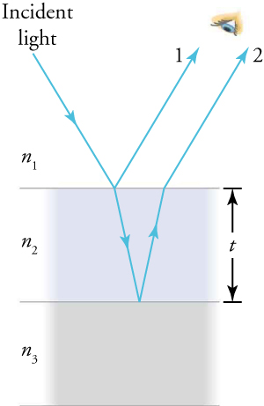
Figure 15.9
Light striking a thin film is partially reflected (ray 1) and partially refracted at the top surface. The refracted ray is partially reflected at the bottom surface and emerges as ray 2. These rays will interfere in a way that depends on the thickness of the film and the indices of refraction of the various media.
Notes:
This diagram shows three areas separated by two parallel, horizontal lines. The distance between the two lines is labeled “t”. The top area, labeled n subscript 1, has a white background. The middle area, labeled n subscript 2, has a hazy bluish background. The bottom area, labeled n subscript 3, has a hazy gray background. An arrow labeled “Incident light” starts from the top left of the white area, points in a southeasterly direction, and ends on the upper horizontal line. At that point, two arrows emerge: one of them, labeled number 1, travels back through the white area in the northeast direction; the other travels through the bluish area in a south-southeast direction until it reaches the lower horizontal line. At the point where the lower arrow ends, another arrow begins, pointing in the north-northeast direction until it reaches the upper horizontal line. From that junction, a new arrow emerges, labeled number 2, traveling in the white area and parallel to the arrow labeled number 1. A human eye observes the arrows marked 1 and 2.

Slide 12
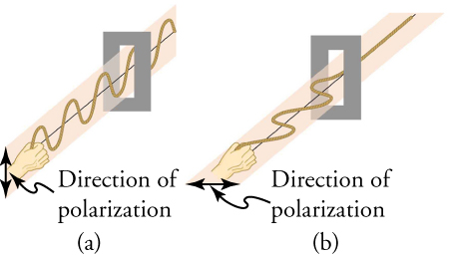
Figure 15.10
The transverse oscillations in one rope are in a vertical plane, and those in the other rope are in a horizontal plane. The first is said to be vertically polarized, and the other is said to be horizontally polarized. Vertical slits pass vertically polarized waves and block horizontally polarized waves.
Notes:
This figure has two panels arranged side by side. The left panel, labeled “(a)”, shows a hand holding one end of a wave moving in a vertical plane and passing through a vertically oriented slit. Next to the hand is a double-headed vertical arrow labeled “Direction of polarization”. The right panel, labeled “(b)”, shows a hand holding one end of a wave moving in a horizontal plane and passing through a horizontally oriented slit. Next to the hand is a double-headed horizontal arrow labeled “Direction of polarization.

Slide 13
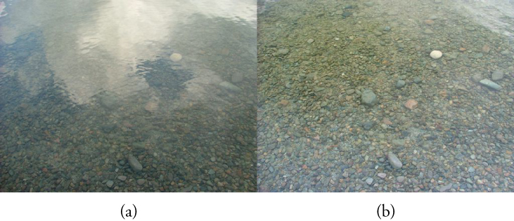
Figure 15.11
These two photographs of a river show the effect of a polarizing filter in reducing glare in light reflected from the surface of water. Part (b) of this figure was taken with a polarizing filter and part (a) was taken without. As a result, the reflection of clouds and sky observed in part (a) is not observed in part (b). Polarizing sunglasses are particularly useful on snow and water.
Notes:
This figure shows two photographs arranged side by side. The left photograph, labeled “(a)”, shows a river bed that looks hazy because of interfering gray and white patches. The right photograph, labeled “(b)”, shows the same area of the river bed with almost no interfering gray patches, so that the pebbles on the bed are clearly visible.

Slide 14
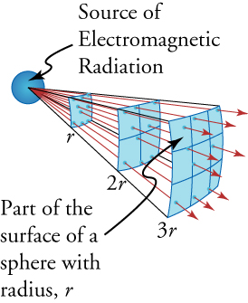
Figure 15.12
The diagram shows why the illuminance varies inversely with the square of the distance from a source of light.
This OpenStax ancillary resource is © Rice University under a CC BY-NC-SA 4.0 International license; it may be reproduced or modified for noncommercial purposes only but must be attributed to OpenStax, Rice University and any changes must be noted. Any adaptation must be shared under the same type of license.
Notes:
This diagram shows a small sphere on the left, labeled “Source of Electromagnetic Radiation”, and a series of arrows emerging from it, pointing rightward. Three curved surfaces are separated from the sphere by distances labeled as “r”, “2r”, and “3r”. One of these surfaces is labeled “Part of the surface of a sphere with radius r”. The arrows penetrate these three surfaces and move farther and farther apart as they move away from the sphere.

