Slide 1

Physics
Chapter 17 Diffraction and Interference

Slide 2
Chapter outline
Understanding Diffraction and Interference
Applications of Diffraction, Interference, and Coherence

Slide 3
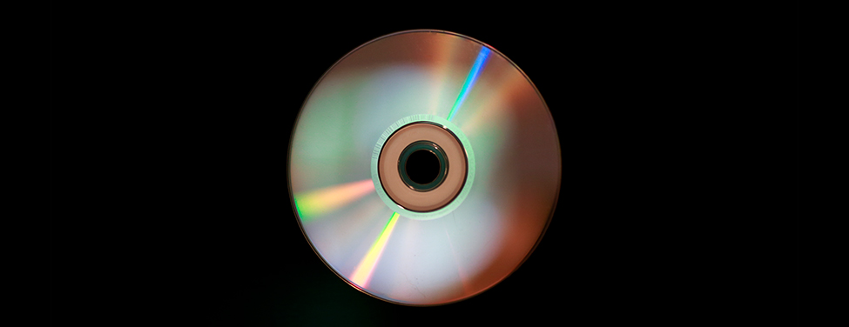
Figure 17.1
The colors reflected by this compact disc vary with angle and are not caused by pigments. Colors such as these are direct evidence of the wave character of light. (credit: Reggie Mathalone)
Notes:
Photograph of a compact disc, showing arcs of rainbow colors produced by diffraction.

Slide 4
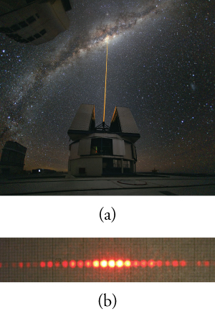
Figure 17.2
(a) The light beam emitted by a laser at the Paranal Observatory (part of the European Southern Observatory in Chile) acts like a ray, traveling in a straight line. (credit: Yuri Beletsky, European Southern Observatory) (b) A laser beam passing through a grid of vertical slits produces an interference pattern—characteristic of a wave. (credit: Shim’on and Slava Rybka, Wikimedia Commons)
Notes:
(a) Photo of a laser beam directed vertically from an observatory into a night sky. (b) Photo of a horizontal line of about twenty closely spaced red dots. The five dots in the center are much brighter than the others.

Slide 5

Figure 17.3
Incoming waves (at the top of the picture) pass through the gaps in the rocks and create an interference pattern (in the foreground).
Notes:
Drawing of two groups of rocks on a beach. Waves from the top of figure produce three sets of curved wavefronts that expand outward as they pass through gaps between the rocks.

Slide 6
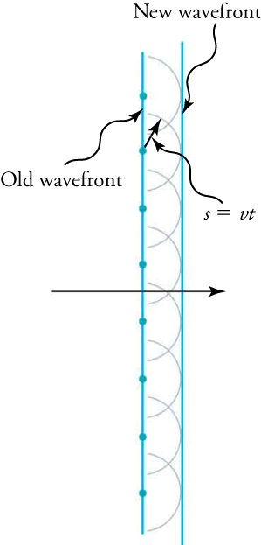
Figure 17.4
Huygens’s principle applied to a straight wavefront. Each point on the wavefront emits a semicircular wavelet that moves a distance s=vt . The new wavefront is a line tangent to the wavelets.
Notes:
Drawing with vertical lines labeled “old wavefront” (on the left) and “new wavefront” (on the right). Semicircular wavelets expand to the right from points on the old wavefront. The new wavefront is the tangent to those circles. The two wavefronts are separated by a distance s. A formula states “s is the product of the wave speed v and time t.”

Slide 7
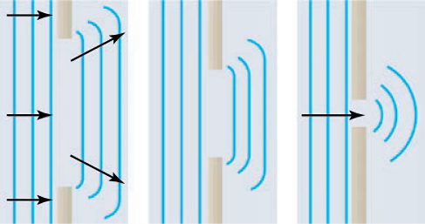
Figure 17.5
Huygens’s principle applied to a straight wavefront striking an opening. The edges of the wavefront bend after passing through the opening, a process called diffraction. The amount of bending is more extreme for a small opening, consistent with the fact that wave characteristics are most noticeable for interactions with objects about the same size as the wavelength.
Notes:
Three drawings of evenly spaced parallel vertical lines represent straight wavefronts moving to the right and passing through three openings in a barrier. The drawing on the left shows vertical straight lines to the left of a wide opening, overlaid with horizontal arrows pointing to the right, and three parallel lines to the right of the opening. The lines to the right of the opening are roughly the same length as the opening. The upper and lower ends of the lines to the right are swept to the left, forming small curves, but the lines are mostly straight. The small curves at the top are overlaid with an arrow pointing to the right and slightly upward; the small curves at the bottom are overlaid with an arrow pointing to the right and slightly downward. The drawing in the middle shows vertical straight lines to the left of a narrower opening and three parallel lines to the right of the opening. The lines to the right of the opening are roughly the same length as the opening, which is smaller than the opening in the drawing on the left. The upper and lower ends of the lines to the right of the opening are swept to the left, forming small curves, but the lines are mostly straight. The drawing on the right shows vertical straight lines to the left of a very narrow opening, overlaid with one horizontal arrows pointing to the right, and three concentric circular arcs to the right of the opening.

Slide 8
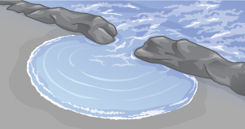
Figure 17.6
Ocean waves pass through an opening in a reef, resulting in a diffraction pattern. Diffraction occurs because the opening is similar in width to the wavelength of the waves.
Notes:
Drawing of ocean waves passing through a narrow gap in a reef. The waves form semicircular wavelets on the beach, which are centered on the gap in the reef.

Slide 9
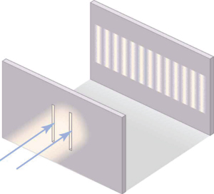
Figure 17.7
Young’s double-slit experiment. Here, light of a single wavelength passes through a pair of vertical slits and produces a diffraction pattern on the screen—numerous vertical light and dark lines that are spread out horizontally. Without diffraction and interference, the light would simply make two lines on the screen.
Notes:
Drawing of a beam of light diffracted by two slits. Two arrows pointing upward and to the right have their points at the vertical slits. A pattern is on a second screen, upward and to the right, consists of about 14 vertical bright bands that are the same height as the slits but have a horizontal spacing closer than the slits.

Slide 10
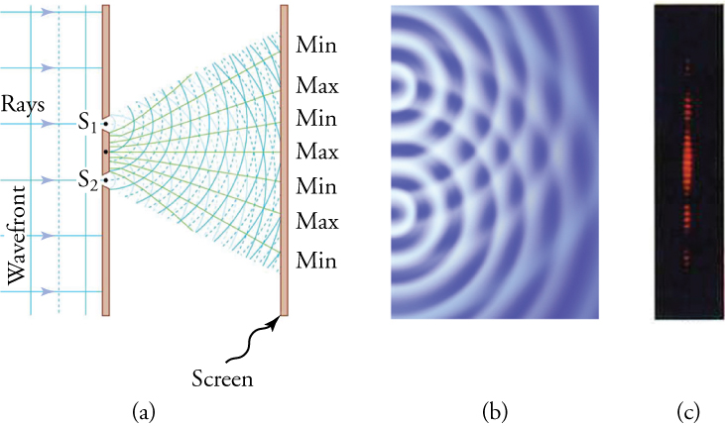
Figure 17.8
Double slits produce two sources of waves that interfere. (a) Light spreads out (diffracts) from each slit, because the slits are narrow. The waves overlap and interfere constructively (bright lines) and destructively (dark regions). You can only see the effect if the light falls onto a screen and is scattered into your eyes. (b) The double-slit interference pattern for water waves is nearly identical to that for light. Wave action is greatest in regions of constructive interference and least in regions of destructive interference. (c) When light that has passed through double slits falls on a screen, we see a pattern such as this.
Notes:
(a) Drawing of vertical lines to the left of a screen with two slits, labeled “S-one” and “S-two.” Vertical lines on the left are labeled “Wavefront.” They are overlaid with arrows labeled “Rays.” Two sets of overlapping circular arcs expand outward from the two slits to a screen at the right. The screen on the right is labeled “Screen.” Each set consists of alternating solid and dotted lines. A line from the point on the screen midway between the two slits extends to the center of the screen on the right, toward a label “Max.” Above the Max are other labels on the screen. They are “Min,” “Max,” and another “Min.” Lines run from the screen at the left to those labels at the right. The screen at the right also has a symmetrical arrangement of lines and labels “Min” and “Max” below the central Max. (b) Drawing of semicircles waves moving to the right from two points. (c) A vertical band of closely spaced horizontal red bands. There are about nine bands in the center with a dark space below, four bands that are somewhat dimmer, another dark space, and a still dimmer group of three bands. A symmetrical pattern of red bands and dark spaces and minima appears above the central maximum.

Slide 11
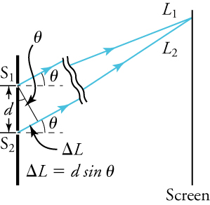
Figure 17.9
The paths from each slit to a common point on the screen differ by an amount d sin θ , assuming the distance to the screen is much greater than the distance between the slits (not to scale here).
Notes:
Drawing showing two vertical screens. The screen the left has two slits labeled “S-one” and “S-two.” The screen on the right is labeled “Screen.” Two arrows labeled “L-one” and “L-two” point upward and to the right. They begin at their respective slits and meet at the screen on the right. The distance between slits S-one and S-two is labeled “d,” and that distance is the hypotenuse of a right triangle. The shorter leg of the right triangle is labeled “delta-L.” It extends from the lower slit, S-two, upward and to the right along the arrow leaving slit S-two. The longer leg of the triangle is a line perpendicular to the two light rays and having one end at the upper slit, S-one. The angle of the vertex of the triangle located at slit S-one is labeled “theta.” A formula states “the distance delta-L as the product of the distance d and the sine of the angle theta.”

Slide 12
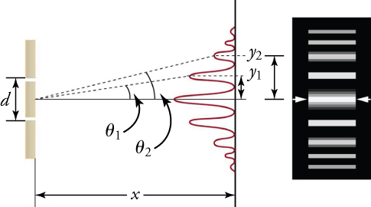
Figure 17.10
The interference pattern for a double slit has an intensity that falls off with angle. The photograph shows multiple bright and dark lines, or fringes, formed by light passing through a double slit.
Notes:
Two drawings showing diffraction by two slits. The first drawing, on the left shows, two vertical screens. The screen on the left has two slits separated by a vertical distance labeled “d.” A second screen is shown a to the right of the screen with the slits, separated by a horizontal distance labeled “x.” The vertical screen at the right shows a graph of a series of peaks and valleys that grow horizontally to the left. The tallest peak is at the center, with valleys and successively smaller peaks arranged symmetrically above and below it. A horizontal line runs from the point midway between the slits in the screen at the left through the central peak of the graph. A dotted line runs from that midway point through the first peak above the center. A second dotted line runs from the midway point through the second maximum. Those dotted lines make angles labeled “theta-one” and “theta-two” with the horizontal line. The peaks above the center are distances labeled “y-one” and “y-two” above the center. The second drawing, on the right shows, a vertical array of horizontal bright bands on a black background. They are aligned with the peaks of the graph in the first drawing. The bands are all of the same length but are of differing widths. The widest band is in the center and successively narrower bands are arranged symmetrically above and below it.

Slide 13
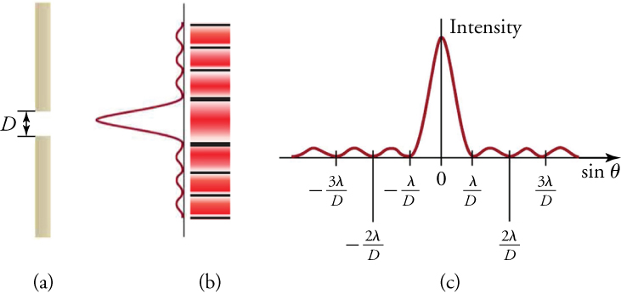
Figure 17.11
(a) Single-slit diffraction pattern. Monochromatic light passing through a single slit produces a central maximum and many smaller and dimmer maxima on either side. The central maximum is six times higher than shown. (b) The drawing shows the bright central maximum and dimmer and thinner maxima on either side. (c) The location of the minima are shown in terms of λ and D.
Notes:
(a) A drawing of a single slit in a vertical screen. The slit has width labeled “D.” (b) Drawing showing two patterns. On the left, a graph has a series of peaks and valleys that grow horizontally to the left. The central peak is largest, with much smaller peaks arranged symmetrically above and below it. To the right of the graph, a second pattern is a vertical array of horizontal bright bands separated by dark bands. They are aligned with the peaks of the graph in the first drawing. The bands are all of the same length but are of differing widths. The widest band is in the center and narrower bands are arranged symmetrically above and below it. (c) A version of the graph of the pattern in drawing (b) rotated so that the peaks grow upward from a horizontal axis. The height of the peaks is labeled “Intensity,” and the central peak is much higher and wider than the other peaks. The horizontal axis is labeled as the “sine of theta,” and the largest, central peak is located at a point on the horizontal axis labeled “zero.” Three valleys are located to the right of the central maximum at distances that are labeled “lambda divided by D,” “two lambda divided by D,” and “three lambda divided by D.” Three other valleys are located to the left of the center at distances that are labeled “negative lambda divided by D,” “negative two lambda divided by D,” and “negative three lambda divided by D.”

Slide 14
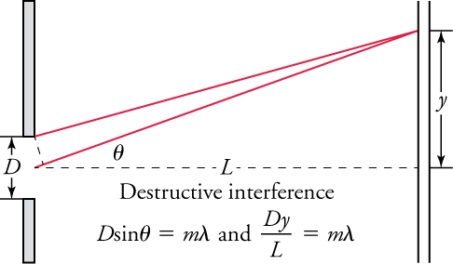
Figure 17.12
Equations for a single-slit diffraction pattern, where λ is the wavelength of light, D is the slit width, θ is the angle between a line from the slit to a minimum and a line perpendicular to the screen, L is the distance from the slit to the screen, y is the distance from the center of the pattern to the minimum, and m is a nonzero integer indicating the order of the minimum.
Notes:
Drawing entitled “Destructive interference.” It shows two screens, one on the left having a slit with width labeled “D.” The distance from the slit to the screen on the right is labeled “L.” It is represented as a dashed line that runs through the center of the slit and is perpendicular to both screens. A solid line extends upward and to the right from the center of the slit to strike the screen on the right. That line forms an angle labeled “theta” with the horizontal dashed line. A second solid line, from the top of the slit, extends upward and to the right to strike the same point as the first solid line. That point is a distance labeled “y” above the horizontal dashed line. A formula states that “D times the sine of the angle theta is equal to m times the wavelength lambda.” A second formula states that “D times y divided by L is equal to m times lambda.”

Slide 15
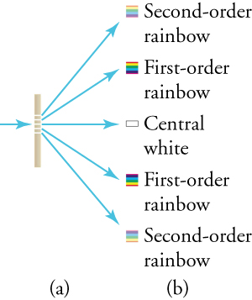
Figure 17.13
A diffraction grating consists of a large number of evenly-spaced parallel slits. (a) Light passing through the grating is diffracted in a pattern similar to a double slit, with bright regions at various angles. (b) The pattern obtained for white light incident on a grating. The central maximum is white, and the higher-order maxima disperse white light into a rainbow of colors.
Notes:
(a) Drawing of a vertical screen with five equally spaced horizontal slits that take up the middle third. A single blue arrow to the left of the barrier point to the right. Five blue arrows from the five slits point to the right, to five small diagrams arranged vertically. (b) Five small diagrams arranged vertically. The middle diagram is a white rectangle. It is labeled “Central white.” Above it is a square with colored bands; from the top, they are red, yellow, green, blue, and purple. The square is labeled “First-order rainbow.” Above the first rainbow is another small square, with the same colors as the one below, but fainter. It is labeled “Second-order rainbow.” Below the central white square is another square with colored bands. They are purple, blue, green, yellow, and red (the opposite order from the upper rainbows), and the square is labeled “First-order rainbow.” The lowest of the five diagrams is a fainter version of the square above it. It is labeled “Second-order rainbow.”

Slide 16
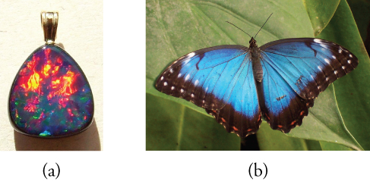
Figure 17.14
(a) This Australian opal and (b) the butterfly wings have rows of reflectors that act like reflection gratings, reflecting different colors at different angles. (credit: (a) Opals-On-Black.com, via Flickr (b) whologwhy, Flickr)
Notes:
(a) Photograph of an opal, with a rounded triangular shape. Most of the upper portion of the triangle is red and yellow. The lower portion is blue, green, and purple. (b) Photograph of a butterfly on a leaf. The wings are blue with white spots at the points of the wings and black bands at the rear edges of the wings.

Slide 17
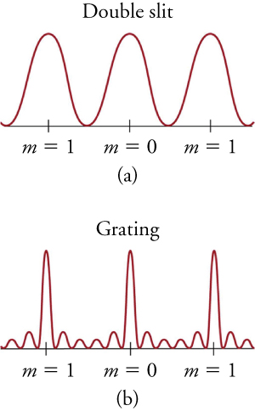
Figure 17.15
Idealized graphs of the intensity of light passing through a double slit (a) and a diffraction grating (b) for monochromatic light. Maxima can be produced at the same angles, but those for the diffraction grating are narrower, and hence sharper. The maxima become narrower and the regions between become darker as the number of slits is increased.
Notes:
(a) Graph labeled “double slit.” A sine curve with three peaks is plotted with its troughs on a horizontal axis. Three points on the axis are labeled, corresponding to three maxima. Left to right, the points are labeled “m equals 1,” m equals zero,” and “m equals 1.” (b) Graph labeled “grating.” A curve with three tall narrow peaks is plotted with its troughs on a horizontal axis. On either side of the three peaks are two much smaller peaks (the larger peaks are separated by a total of four smaller peaks). Three points on the axis are labeled, corresponding to three maxima. Left to right, the points are labeled “m equals 1,” m equals zero,” and “m equals 1.”

Slide 18

Figure 17.16
For its size, this CD holds a surprising amount of information. Likewise, the CD player it is in houses a surprising number of electronic devices.
Notes:
Drawing of a portable CD player. Its cover is open, showing a CD that has a red sector on the lower left, of about 90 degrees, a blue sector on the upper right of about 120 degrees, and a yellow sector between them of about 30 degrees.

Slide 19
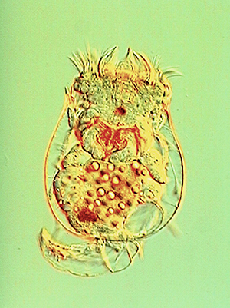
Figure 17.17
This aquatic organism was photographed with a DIC microscope. (credit: Public Library of Science)
Notes:
Photo of freshwater alga. A flat green object with a rough texture is divided into forking branches. The largest resembles the letter Y with a very thick stem, tipped to the left so the stem is horizontal. Both arms of the Y fork into two very small branches. Joined to the base of the stem of the Y are other pairs of branches that resemble the letter V, one above and one below, and both angled slightly to the left. Each arm of the V splits into two branches, and then again into very small branches. A mirror image of the Y and two V’s is to the right and the two Y stems are joined.

Slide 20
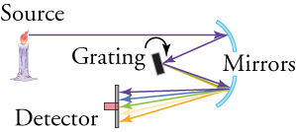
Figure 17.18
The diagram shows the function of a diffraction grating in a spectroscope.
Notes:
Drawing of a spectroscope. Drawing shows a flame, two mirrors, grating and detector. A yellow flame at the upper left is labeled “source.” A horizontal arrow from the source extends to a small circular arc, which is concave to the left and slightly downward. The arc is one of two that are labeled “mirrors.” A second arrow extends to the left and downward from the point where the first arrow strikes the mirror, and in turn strikes a rectangular object that is tilted from vertical slightly to the left. The object is labeled “grating.” From the point where the second arrow strikes the grating, a number of colored arrows fan out downward and to the right, forming a narrow triangle. Those arrows in turn strike the second circular arc, labeled as one of the “mirrors,” which is concave to the left and slightly upward. From the second mirror, five colored arrows fan out to the left and slightly downward to form a wider triangle, and they strike a vertical surface labeled “detector.” The purple arrow strikes the top of the detector and the blue arrow slightly below it. The green arrow strikes the middle of the detector, the yellow arrow slightly lower, and the red arrow the bottom of the detector.

Slide 21
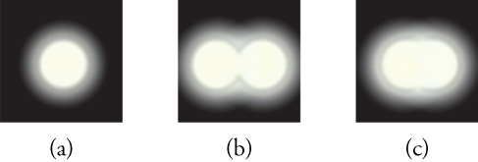
Figure 17.19
(a) Monochromatic light passed through a small circular aperture produces this diffraction pattern. (b) Two point light sources that are close to one another produce overlapping images because of diffraction. (c) If they are closer together, they cannot be resolved, that is, distinguished.
Notes:
(a) A white circle on a black background is surrounded by a ring that fades outward from gray to black. (b) Two circles, one on the left and one on the right, are surrounded by gray rings. Their circumferences touch, but the circles are distinguishable. (c)Two circles, with surrounding gray rings, have moved closer together and now are indistinguishable. They form a horizontal oval.

Slide 22
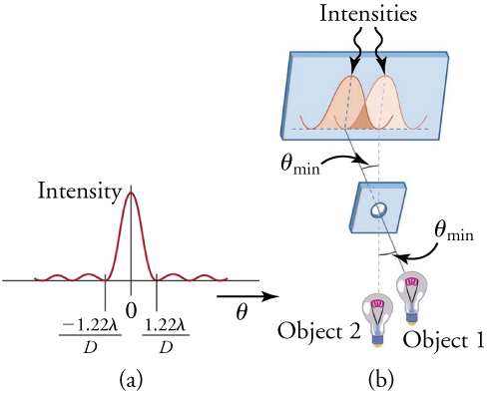
Figure 17.20
(a) Graph of intensity of the diffraction pattern for a circular aperture. Note that, similar to a single slit, the central maximum is wider and brighter than those to the sides. (b) Two point objects produce overlapping diffraction patterns. Shown here is the Rayleigh criterion for their being just resolvable. The central maximum of one pattern lies on the first minimum of the other.
This OpenStax ancillary resource is © Rice University under a CC BY-NC-SA 4.0 International license; it may be reproduced or modified for noncommercial purposes only but must be attributed to OpenStax, Rice University and any changes must be noted. Any adaptation must be shared under the same type of license.
Notes:
(a) A graph with five peaks. The valleys are on a horizontal axis. The central peak is largest, and it is labeled “intensity.” Four much smaller peaks are arranged symmetrically, two to the left and two to the right. An arrow below the horizontal axis points to the right and is labeled “theta.” Three points are labeled on the horizontal axis, “zero” for the central peak, “negative 1.22 lamda divided by D” for the valley on its left, and “1.22 lamda divided by D” for the valley on its right. (b) A drawing shows two lightbulbs at the bottom. One is labeled “Object 1,” and it is to the right and slightly above the other, labeled “Object 2.” In the middle of the drawing is a vertical screen with a circular hole in it. At the top of the drawing is a vertical screen with two wide peaks graphed on it, which are labeled “Intensities.” A line from Object 1 extends through the hole in the screen and strikes the horizontal axis of the graph directly below the left peak on the graph. Another line from Object two extends through the hole in the screen and strikes the horizontal axis of the graph directly below the right peak on the graph. The angle formed when the two lines cross (where they pass through the hole in the middle screen) is labeled “theta min.”

