Slide 1

Physics
Chapter 18 Static Electricity

Slide 2
Chapter outline
Electrical Charges, Conservation of Charge, and Transfer of Charge
Coulomb's law
Electric Field
Electric Potential
Capacitors and Dielectrics

Slide 3
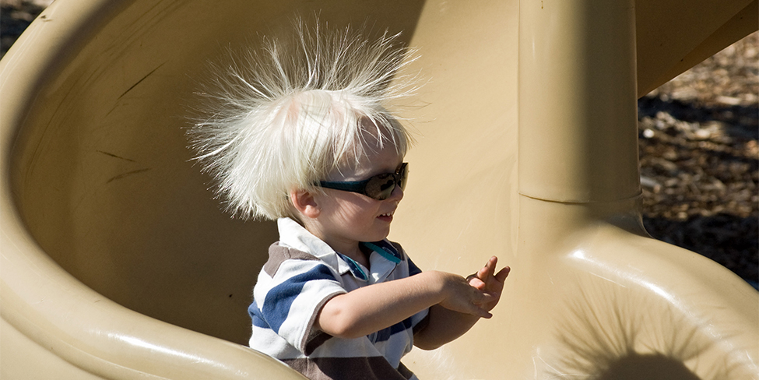
Figure 18.1
This child’s hair contains an imbalance of electrical charge (commonly called static electricity), which causes it to stand on end. The sliding motion stripped electrons away from the child’s body, leaving him with an excess of positive charges, which repel each other along each strand of hair. (credit: Ken Bosma, Wikimedia Commons)
Notes:
A photo shows a child sliding down a spiral-shaped slide, with his straight hair standing on end.

Slide 4
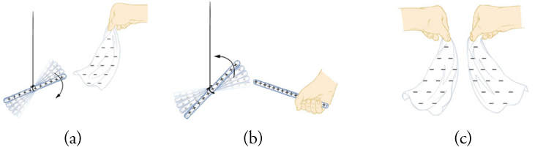
Figure 18.2
A glass rod becomes positively charged when rubbed with silk, whereas the silk becomes negatively charged. (a) The glass rod is attracted to the silk, because their charges are opposite. (b) Two similarly charged glass rods repel. (c) Two similarly charged silk cloths repel.
Notes:
This figure has three parts. Part a: It shows a glass rod suspended from its middle by a string and a nearby silk cloth held from its upper edge by a hand. The glass rod has a series of plus signs, and the silk cloth has many minus signs. There are several faded images of the glass rod and a downward pointing arrow, suggesting the rod's movement toward the cloth. The lower edge of the cloth bends toward the rod. Part b: It shows two glass rods near each other, each with a series of plus signs. One rod is held from one end by a hand, and the other rod is suspended from its middle by a string. There are several faded images of the suspended rod and an upward pointing arrow, suggesting its movement away from the handheld rod. Part c: It shows two silk cloths held by hand near each other, each with a number of minus signs. The lower edges of the cloths curve away from each other.

Slide 5
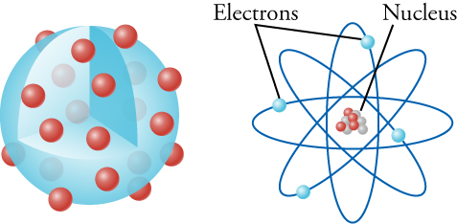
Figure 18.3
The left drawing shows Thompson’s plum-pudding model, in which the electrons swim around in a nebulous mass of positive charge. The right drawing shows Rutherford’s model, in which the electrons orbit around a tiny, massive nucleus. Note that the size of the nucleus is vastly exaggerated in this drawing. Were it drawn to scale with respect to the size of the electron orbits, the nucleus would not be visible to the naked eye in this drawing. Also, as far as science can currently detect, electrons are point particles, which means that they have no size at all!
Notes:
This figure has two drawings, side by side. The drawing on the left shows a large blue sphere, one-eighth of which has been cut out. A number of small red spheres are on the surface of the blue sphere and within the cut-away part of the blue sphere. Also, a number of faded red spheres lie within the blue sphere. The drawing on the right shows four ellipses evenly spaced around a common center, with a small blue sphere in each ellipse. Near the top is the word “Electrons,” with two lines connecting that word to two of the blue spheres. The common center contains a clump of four small red spheres and five small gray spheres. Near the top is another word, “Nucleus,” with a line connecting that word to the clump of spheres at the center.

Slide 6
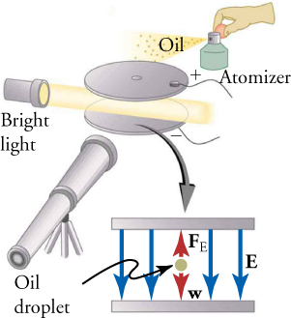
Figure 18.4
The oil-drop experiment involved spraying a fine mist of oil between two metal plates charged with opposite charges. By knowing the mass of the oil droplets and adjusting the electric charge on the plates, the charge on the oil drops can be determined with precision.
Notes:
This figure is a two-part drawing. One part consists of two circular plates held parallel to each other, with a beam of light shining between them. Each plate has a wire attached to it. The upper plate, with a tiny hole at its center, is marked with a plus sign, and the lower plate is marked with a minus sign. A small spray bottle, labeled “Atomizer,” is held by a hand near and just above the upper plate. The hand squeezes a bulb on the Atomizer, and a spray labeled “Oil” emerges just above the upper plate. The beam of light emerges from a source labeled “Bright light.” The drawing includes a telescope-like device aimed for viewing between the circular plates. The second part of the drawing, located slightly below the first part, shows an edge-on view of the two plates. A downward pointing arrow connects the plates in the first part of the drawing to those in the second part. In the latter drawing, four vertical blue arrows point from the upper to the lower plate, and the arrow on the extreme right is labeled as E. A gray sphere between the two plates is labeled “Oil droplet.” A short red arrow, labeled F subscript E, points from the sphere to the upper plate, and another short red arrow, labeled w, points from the sphere to the lower plate.

Slide 7
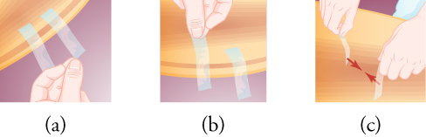
Figure 18.5
This image has three parts. Part a shows two pieces of sticky tape attached to the edge of an arc-shaped object, with someone's fingers near the end of one tape. Part b shows someone's fingers lifting one tape piece away from the arc-shaped object, while the other tape piece remains attached to the object. Part c shows a left hand and a right hand, each holding a piece of tape from one end. Two short red arrows, each starting from the free end of a piece of tape, point toward each other.
Notes:
This image has three parts. Part a shows two pieces of sticky tape attached to the edge of an arc-shaped object, with someone's fingers near the end of one tape. Part b shows someone's fingers lifting one tape piece away from the arc-shaped object, while the other tape piece remains attached to the object. Part c shows a left hand and a right hand, each holding a piece of tape from one end. Two short red arrows, each starting from the free end of a piece of tape, point toward each other.

Slide 8
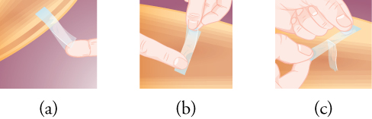
Figure 18.6
This image has three parts. Part a shows two pieces of sticky tape, with one stuck over the other, and with the lower tape attached to the edge of an arc-shaped object. The two tapes are slightly separated from each other at one end. In part b, someone's hand holds the two pieces of tape from the end where they are separated, while a finger touches the other end. Part c shows two hands pulling the two pieces of tape apart.
Notes:
This image has three parts. Part a shows two pieces of sticky tape, with one stuck over the other, and with the lower tape attached to the edge of an arc-shaped object. The two tapes are slightly separated from each other at one end. In part b, someone's hand holds the two pieces of tape from the end where they are separated, while a finger touches the other end. Part c shows two hands pulling the two pieces of tape apart.

Slide 9
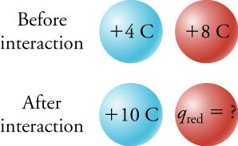
Figure 18.7
Two spheres, one blue and one red, initially have +4 C and +8 C of charge, respectively. After the two spheres interact, the blue sphere has a charge of +10 C. The law of conservation of charge allows us to find the final charge q red on the red sphere.
Notes:
This figure has two rows, one below the other. The upper row is labeled “Before interaction”, and the lower row is labeled “After interaction”. Each row has a blue sphere and a red sphere next to each other. In the upper row, the blue sphere is marked as “plus 4 C” and the red sphere is marked as “plus 8 C”. In the lower row, the blue sphere is marked as “plus 10 C” and the red sphere is marked as “q subscript red = ?”

Slide 10
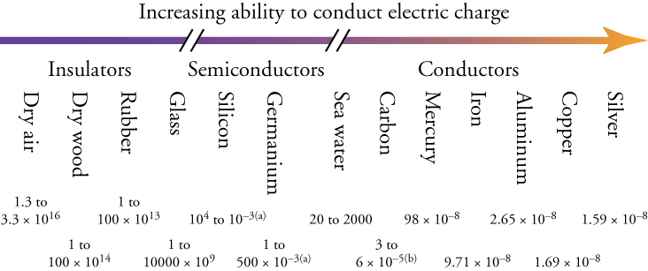
Figure 18.8
Materials can be arranged according to their ability to conduct electric charge. The slashes on the arrow mean that there is a very large gap in conducting ability between conductors, semiconductors, and insulators, but the drawing is compressed to fit on the page. The numbers below the materials give their resistivity in Ω•m (which you will learn about below). The resistivity is a measure of how hard it is to make charge move through a given material.
Notes:
Thirteen materials are arranged in a horizontal series, according to their ability to conduct electric charge. The materials, ranging from the least conductive on the left to the most conductive on the right, are: “Dry air”, “Dry wood”, “Rubber8, “Glass”, “Silicon”, “Germanium”, “Sea water”, “Carbon”, “Mercury”, “Iron”, “Aluminum”, “Copper”, and “Silver”. Above the names of the materials is a long, horizontal arrow pointing rightward. The arrow is broken in two places, producing three segments. The left segment, labeled “Insulators”, is above the materials Dry air to Glass; the middle segment, labeled “Semiconductors”, is above Silicon and Germanium; and the right segment, labeled “Conductors”, is above the materials Sea water to Silver. Below the names of the materials are numbers that give the resistivity of each material in ohm-meter.

Slide 11
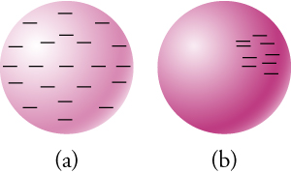
Figure 18.9
(a) A conducting sphere with excess negative charge (i.e., electrons). The electrons repel each other and spread out to cover the outer surface of the sphere. (b) An insulating sphere with excess negative charge. The electrons cannot move, so they remain in their original positions.
Notes:
This figure has two parts, each consisting of a sphere. In Part a, there are minus signs distributed relatively evenly around the sphere. In Part b, there are minus signs concentrated in the upper right quadrant of the face of the sphere.

Slide 12
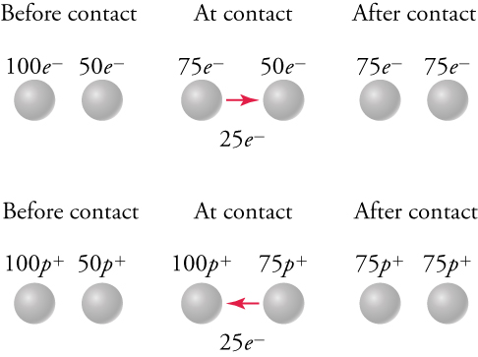
Figure 18.10
In the top row, a metal sphere with 100 excess electrons transfers 25 electrons to a metal sphere with an excess of 50 electrons. After the transfer, both spheres have 75 excess electrons. In the bottom row, a metal sphere with 100 excess protons receives 25 electrons from a ball with 50 excess protons. After the transfer, both spheres have 75 excess protons.
Notes:
This figure consists of two rows, and each row is divided into three columns labeled as “Before contact”, “At contact”, and “After contact”. Each column contains two small spheres. First consider the top row: In the “Before contact” column, the left sphere is labeled “100 e superscript minus”, the right sphere is labeled “50 e superscript minus”. In the “At contact” column, the left sphere is labeled “75 e superscript minus”, the right sphere is labeled “50 e superscript minus”. An arrow points from the left sphere to the right one and is labeled “25 e superscript minus”. In the “After contact” column, the left sphere is labeled “75 e superscript minus”, the right sphere is labeled “75 e superscript minus”. Next consider the bottom row: In the “Before contact” column, the left sphere is labeled “100 p superscript plus”, the right sphere is labeled “50 p superscript plus”. In the “At contact” column, the left sphere is labeled “100 p superscript plus”, the right sphere is labeled “75 p superscript plus”. An arrow points from the right sphere to the left one and is labeled “25 e superscript minus”. In the “After contact” column, the left sphere is labeled “75 p superscript plus”, the right sphere is labeled “75 p superscript plus”.

Slide 13
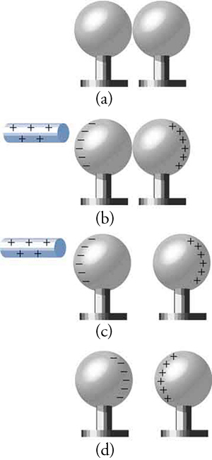
Figure 18.11
(a) Two neutral conducting spheres are touching each other, so the charge is evenly spread over both spheres. (b) A positively charged rod approaches, which attracts negative charges, leaving excess positive charge on the right sphere. (c) The spheres are separated. Each sphere now carries an equal magnitude of excess charge. (d) When the positively charged rod is removed, the excess negative charge on the left sphere is attracted to the excess positive charge on the right sphere.
Notes:
This figure has four parts, each consisting of a pair of spheres adjacent to each other. Each sphere is on a short pedestal, and all spheres and pedestals are equal in size. In Parts (a) and (b), the pair of spheres are touching each other, but in Parts (c) and (d), the pair of spheres are slightly separated from each other. In Part (a), there is no charge on either sphere. In Part (b), a rod marked with plus signs is shown close to the left sphere, which in turn has minus signs along its left edge. The right sphere has plus signs along its right edge. Part (c) is similar to Part (b), except for separation between the pair of spheres. In Part (d), minus signs are aligned along the right edge of the left sphere, and plus signs are aligned along the left edge of the right sphere. There is no rod in Part (d).

Slide 14
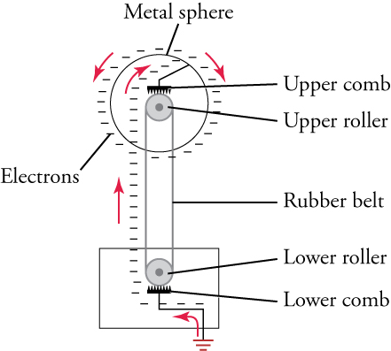
Figure 18.12
Van de Graaff generators transfer electrons onto a metallic sphere, where the electrons distribute themselves uniformly over the outer surface.
Notes:
This is a diagram in which two small circles are arranged vertically and are labeled “Upper roller” and “Lower roller”. The two circles are connected by a band labeled “Rubber belt”. A comb-shaped structure touches each circle, and these structures are labeled “Upper comb” and “Lower comb”. The upper circle is in the center of a larger circle labeled “Metal sphere”, and the lower circle is enclosed in a rectangle. A bent line connects the upper comb to the larger circle, and another bent line connects the lower comb to the rectangle and to the ground below the rectangle. A series of minus signs, labeled “Electrons”, is accompanied by a series of arrows, suggesting the flow of electrons from within the rectangle and the lower circle to the upper circle and then to the larger circle.

Slide 15
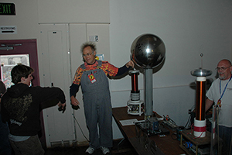
Figure 18.13
The man touching the Van de Graaff generator has excess charge, which spreads over his hair and repels hair strands from his neighbors. (credit: Jon “ShakataGaNai” Davis)
Notes:
This is a photograph of a man touching the large sphere of a Van de Graaff generator, causing his hair to stand on end. The picture also shows two observers, one of whom has extended his right arm toward the man touching the generator.

Slide 16
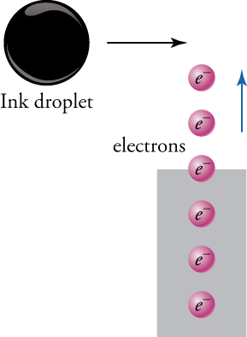
Figure 18.14
Electrons from an electron gun charge a passing ink droplet.
Notes:
Six small purple spheres, each marked as “e superscript minus”, are arranged vertically and labeled as “electrons”. The three lowest spheres are enclosed in a rectangle, the fourth one above them is crossing the upper edge of the rectangle, and the two uppermost spheres are outside the rectangle. An arrow next to the two uppermost spheres is pointing upward, suggesting the direction of movement of the purple spheres. A much larger black sphere, labeled “Ink droplet”, is above and to the left of the column of purple spheres, and an arrow pointing toward the right suggests the direction of movement of the black sphere.

Slide 17
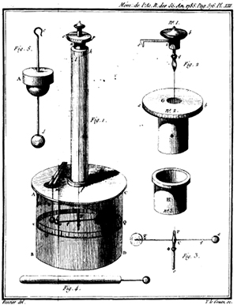
Figure 18.15
A drawing of Coulomb’s torsion balance, which he used to measure the electrical force between charged spheres. (credit: Charles-Augustin de Coulomb)
Notes:
This figure consists of seven drawings, the largest of which is labeled “Fig. 1”. The largest structure appears as follows: there is a cap at the top, and below that are a disc, a long cylinder, a wider disc, and a shorter cylinder. The six smaller drawings show the parts from which the large structure is assembled. One part, labeled “Fig. 5” and placed nearest the upper left corner, consists of a vertical rod with a hook at the top, a sphere at the bottom, and a disc over a hemisphere near the middle. Another part, labeled “Fig. 4”, lies parallel to the bottom edge of the figure. It consists of a rod with a short line and a small sphere attached to one end. Three parts, labeled “Fig. 2”, are arranged in a column on the right side of the figure. Of these, the upper part consists of a cap-shaped structure with a horizontal projection and a vertical projection; the middle part consists of a cylinder with a wider discover it; and the lower part consists of another cylinder with a lip. The final part, labeled “Fig. 3” and placed near the bottom right corner of the figure, is a T-shaped structure with a small sphere at each end of the horizontal line.

Slide 18
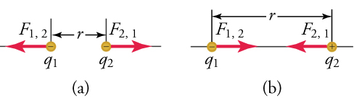
Figure 18.16
The magnitude of the electrostatic force F between point charges q1 and q2 separated by a distance r is given by Coulomb’s law. Note that Newton’s third law (every force exerted creates an equal and opposite force) applies as usual—the force (F1,2) on q1 is equal in magnitude and opposite in direction to the force (F2,1) it exerts on q2. (a) Like charges. (b) Unlike charges.
Notes:
This figure has two parts. Part a shows two small spheres of equal size, labeled “q subscript 1” and “q subscript 2”, separated by a distance marked as “r”. Each sphere contains a minus sign. Two arrows, labeled “F subscript 1,2” and “F subscript 2,1”, point from the spheres away from each other. Part b also shows two small spheres of equal size, labeled “q subscript 1” and “q subscript 2”, separated by a larger distance marked as “r”. One of these spheres contains a minus sign and the other contains a plus sign. Two arrows, labeled 7F subscript 1,2” and “F subscript 2,1”, point from the spheres toward each other.

Slide 19
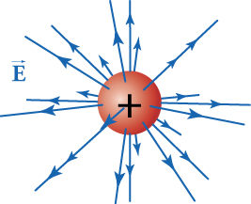
Figure 18.17
Three-dimensional representation of the electric field generated by a positive charge.
Notes:
This figure shows a sphere with a plus sign at its center and arrows of varying lengths pointing in every direction away from it. Between the arrows to the left of the sphere is the letter E with an arrow above the letter, indicating that E is a vector.

Slide 20
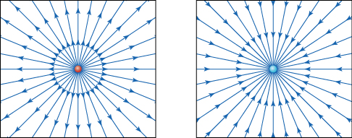
Figure 18.18
Electric field lines from two point charges. The red point on the left carries a charge of +1 nC, and the blue point on the right carries a charge of –1 nC. The arrows point in the direction that a positive test charge would move. The field lines are denser as you approach the point charge.
Notes:
This figure has two parts, each enclosed in a square. At the center of the square on the left is a tiny red circle from which emanate numerous arrows that end on the sides of the square. At the center of the square on the right is a tiny blue circle, and numerous arrows that start from the sides of the square point toward and end at this circle.

Slide 21
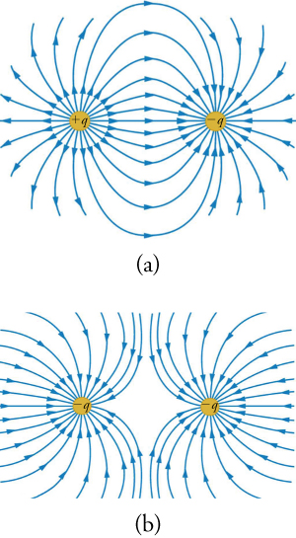
Figure 18.19
(a) The electric field generated by a positive point charge (left) and a negative point charge of the same magnitude (right). (b) The electric field generated by two equal negative charges.
Notes:
This figure has two parts, each of which displays two small circles and numerous curved arrows. In Part a, the circle on the left is marked “plus q” and the one on the right is marked “minus q”. Numerous curved arrows emanate from the circle on the left, and many of them terminate on the circle on the right. In Part b, both circles are marked “minus q”. Numerous curved arrows coming from outside these circles terminate on them. Between the two circles is a gap, because the arrows terminating on the left circle do not touch those terminating on the right circle.

Slide 22
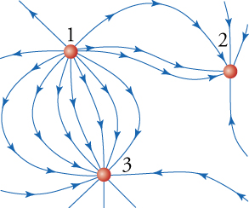
Figure 18.20
Map of electric field due to three charged particles.
Notes:
This diagram shows three small circles and various curved arrows pointing toward or away from them. A circle near the top left corner is labeled “1”, another located east of it is labeled “2”, and a third located roughly south of the first circle is labeled “3”. Some curved arrows emanating from circle 1 terminate on circle 2, and other curved arrows emanating from circle 1 terminate on circle 3.

Slide 23
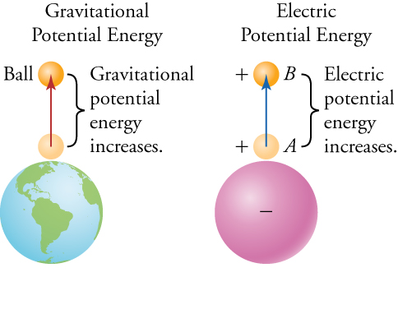
Figure 18.21
On the left, the gravitational field points toward Earth. The higher the ball is in the gravitational field, the higher the potential energy is of the Earth-ball system. On the right, the electric field points toward a negative charge. The farther the positive charge is from the negative charge, the higher the potential energy is of the two-charge system.
Notes:
This figure has two columns. The left column is labeled “Gravitational Potential Energy”, and the right column is labeled “Electric Potential Energy”. In the left column, a large sphere represents planet Earth, as it shows features of land and water. Above it are two small balls, with an arrow pointing from the lower to the upper ball. The gap between the two small balls is labeled “Gravitational potential energy increases.” In the right column, a large sphere is marked with a minus sign at its center. Above it are two small balls, each marked with a plus sign, and an arrow points from the lower to the upper ball. The gap between the two small balls is labeled “Electric potential energy increases.”

Slide 24
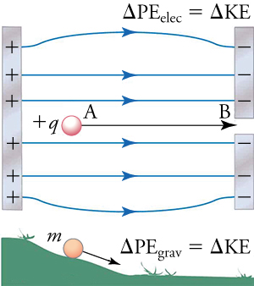
Figure 18.22
In the top picture, a mass accelerates due to a constant electric field. In the bottom picture, the mass accelerates due to a constant gravitational field.
Notes:
This figure is divided into two parts. The upper part shows a vertical strip on the left marked with plus signs and two vertical strips on the right marked with minus signs. A series of horizontal arrows point from the left strip to the strips on the right. A small sphere, labeled “plus q”, is located between these arrows and near the strip on the left. Another horizontal arrow, with ends labeled “A” and “B”, points from the sphere toward a gap between the strips on the right. Above this drawing is an equation: delta P E subscript elec equals delta K E. The lower part of the figure shows a small sphere, labeled “m”, on the slope of a small green hill. An arrow points from the sphere downward, parallel to the slope of the hill. To the right of the hill is a flat green area. Above the flat area is an equation: delta P E subscript grav equals delta K E.

Slide 25
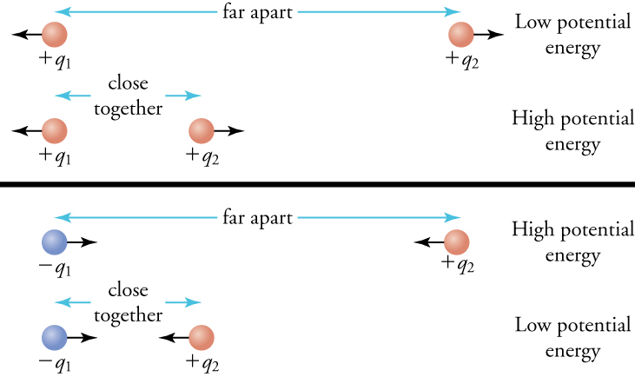
Figure 18.23
The potential energy depends on the sign of the charges and their separation. The arrows on the charges indicate the direction in which the charges would move if released. When charges with the same sign are far apart, their potential energy is low, as shown in the top panel for two positive charges. The situation is the reverse for charges of opposite signs, as shown in the bottom panel.
Notes:
This figure has two panels. The upper panel shows a pair of red spheres, labeled “plus q subscript 1” and “plus q subscript 2”, separated horizontally by a distance marked “far apart”, and a label to their right says “Low potential energy”. Below them is a similar pair of spheres, but they are at a distance marked “close together”, and a label to their right says “High potential energy”. The lower panel shows a blue sphere on the left labeled “minus q subscript 1” and a red sphere on the right labeled “plus q subscript 2”. They are separated horizontally by a distance marked “far apart”, and a label to their right says “High potential energy”. Below them is a similar pair of spheres, but they are at a distance marked “close together”, and a label to their right says “Low potential energy”.

Slide 26
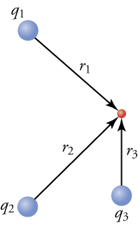
Figure 18.24
The potential at the red point is simply the sum of the potentials due to each individual charge.
Notes:
This figure shows three small blue spheres distributed around a much smaller red sphere. One blue sphere, labeled “q subscript 1”, lies roughly northwest of the red sphere, and an arrow labeled “r subscript 1” points from the blue sphere to the red one. A second blue sphere, labeled “q subscript 2”, lies roughly southwest of the red sphere, and an arrow labeled “r subscript 2” points from this blue sphere to the red one. The third blue sphere, labeled “q subscript 3”, lies directly south of the red sphere, and an arrow labeled “r subscript 3” points from this blue sphere to the red one.

Slide 27
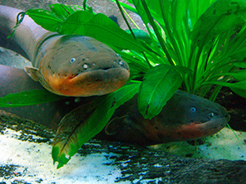
Figure 18.25
An electric eel in its natural environment. (credit: Steven G. Johnson)
Notes:
This is a photograph showing the head of an electric eel just above water, next to the leaves of a plant growing in the water.

Slide 28
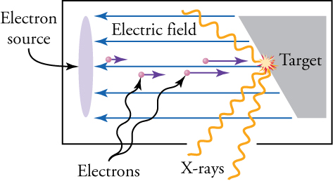
Figure 18.26
In an X-ray tube, a large current flows through the electron source, causing electrons to be ejected from the electron source. The ejected electrons are accelerated toward the target by the electric field. When they strike the target, X-rays are produced.
Notes:
This diagram shows a vertically oriented ellipse labeled “Electron source” on the left, and a trapezoid labeled “Target” on the right. Between them, in the middle section of the diagram, there are four tiny spheres labeled “Electrons”, each of which has a short, rightward pointing arrow attached to it. Five long, horizontal arrows point from the trapezoid to the ellipse, and a label between them says “Electric field”. Near the middle of the left edge of the trapezoid is a yellow circle from which emerge three long, orange, wavy lines, as well as a number of short yellow and red lines. The long wavy lines are labeled “X-rays”.

Slide 29
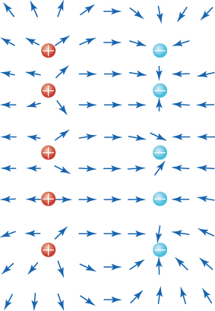
Figure 18.27
The red dots are positive charges, and the blue dots are negative charges. The electric-field direction is shown by the red arrows. Notice that the electric field between the positive and negative dots is fairly uniform.
Notes:
This diagram shows five red dots forming a vertical column on the left side and five blue dots forming a second vertical column on the right side. Each red dot is marked with a “plus” symbol, and each blue dot is marked with a “minus” symbol. Surrounding these dots are small arrows pointing in various directions. Between the two columns of dots, most of the arrows point rightward, from the red dots toward the blue ones. The arrows around each red dot point away from it, and most arrows around each blue dot point toward it.

Slide 30
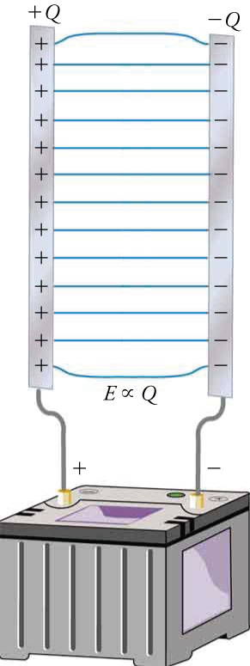
Figure 18.28
Two parallel metal plates are charged with opposite charge, by connecting the plates to the opposite terminals of a battery. The magnitude of the charge on each plate is the same.
Notes:
This figure shows two parallel strips in vertical orientation connected to the terminals of a battery. The strip on the left has a series of “plus” signs and is labeled “plus Q”. It is connected to the battery terminal marked with a “plus” sign. The strip on the right has a series of “minus” signs and is labeled “minus Q”. It is connected to the battery terminal marked with a “minus” sign. Between the strips is a series of horizontal lines, and below these lines is a label that says, “E is proportional to Q”, using a proportionality sign.

Slide 31
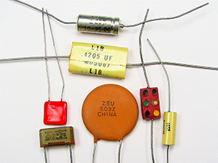
Figure 18.29
Some typical capacitors. (credit: Windell Oskay)
Notes:
This is a photograph showing seven small capacitors, of varying shapes and colors, usually found in electronic circuits.

Slide 32
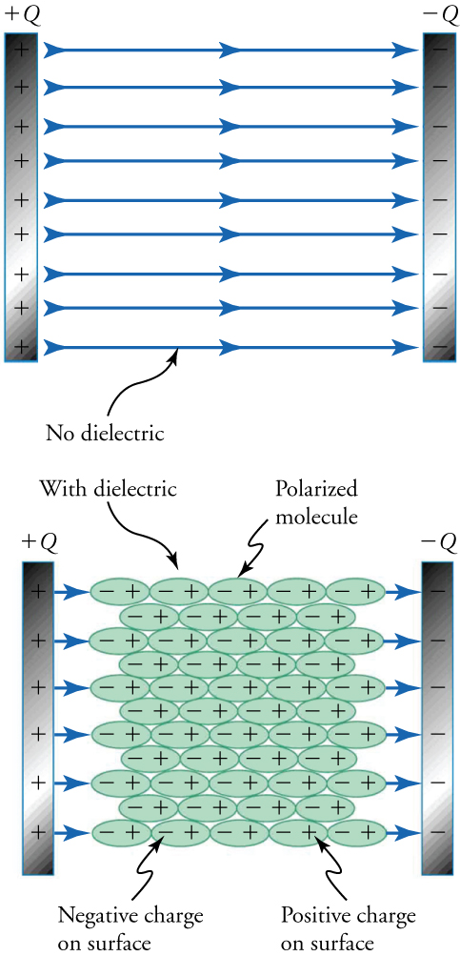
Figure 18.30
The top and bottom capacitors carry the same charge Q. The top capacitor has no dielectric between its plates. The bottom capacitor has a dielectric between its plates. The molecules in the dielectric are polarized by the electric field of the capacitor.
Notes:
This figure has two panels. The upper panel shows two parallel strips in vertical orientation. The strip on the left has a series of “plus” signs and is labeled “plus Q”. The strip on the right has a series of “minus” signs and is labeled “minus Q”. Between the strips is a series of horizontal arrows pointing from left to right, and below the arrows is a label that says “No dielectric”. The lower panel shows two similar strips, with the strip on the left containing “plus” signs and labeled “plus Q”, and the one on the right containing “minus” signs and labeled “minus Q”. Between the strips is a grid of elliptical shapes of equal size, each containing a “minus” sign on the left and a “plus” sign on the right. The whole group of ellipses is labeled “With dielectric”, and one ellipse is labeled “Polarized molecule”. A label pointing to a minus sign within an ellipse says “Negative charge on surface”, and another label pointing to a plus sign within an ellipse says “Positive charge on surface”. Also, a series of short, rightward pointing arrows lie on each side of the grid of ellipses.

Slide 33
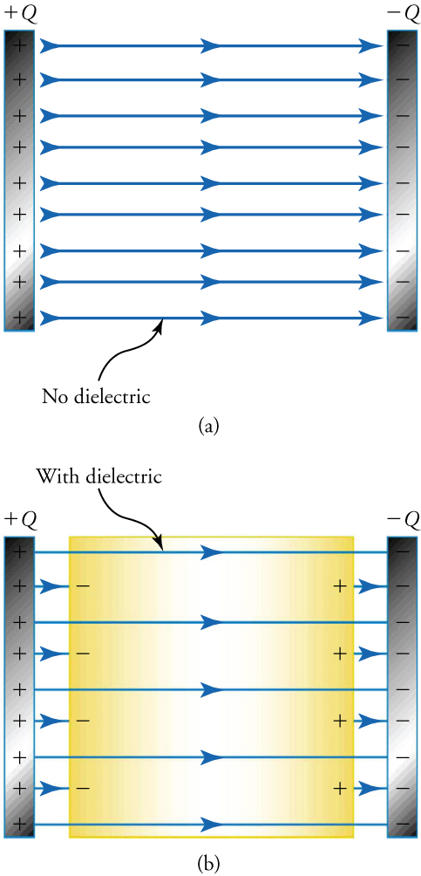
Figure 18.31
The top and bottom capacitors carry the same charge Q. The top capacitor has no dielectric between its plates. The bottom capacitor has a dielectric between its plates. Because some electric-field lines terminate and start on polarization charges in the dielectric, the electric field is less strong in the capacitor. Thus, for the same charge, a capacitor stores less energy when it contains a dielectric.
This OpenStax ancillary resource is © Rice University under a CC BY-NC-SA 4.0 International license; it may be reproduced or modified for noncommercial purposes only but must be attributed to OpenStax, Rice University and any changes must be noted. Any adaptation must be shared under the same type of license.
Notes:
This figure has two panels. The upper panel shows two parallel strips in vertical orientation. The strip on the left has a series of plus signs and is labeled “plus Q”. The strip on the right has a series of minus signs and is labeled “minus Q”. Between the strips is a series of horizontal arrows pointing from left to right, and below the arrows is a label that says “No dielectric”. The lower panel shows two similar strips, with the strip on the left containing plus signs and labeled “plus Q”, and the one on the right containing minus signs and labeled “minus Q”. Between the strips is a rectangle labeled “With dielectric”, with a few minus signs along its left edge and a few plus signs along its right edge. Also, between the strips are several long arrows pointing rightward and going from the left strip to the right one. In addition, a series of short, rightward pointing arrows lie between the left strip and the rectangle and between the rectangle and the right strip.

