Slide 1

Physics
Chapter 19 Electrical Circuits

Slide 2
Chapter outline
Ohm's law
Series Circuits
Parallel Circuits
Electric Power

Slide 3
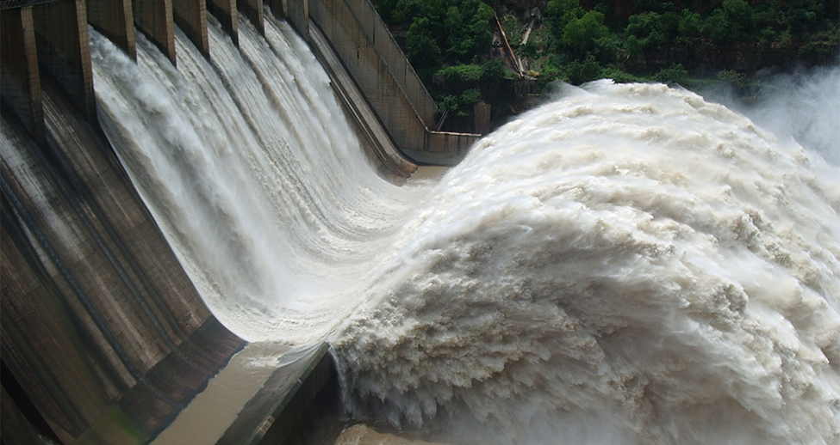
Figure 19.1
Electric energy in massive quantities is transmitted from this hydroelectric facility, the Srisailam power station located along the Krishna River in India, by the movement of charge—that is, by electric current. (credit: Chintohere, Wikimedia Commons)
Notes:
Water is shown flowing through a hydroelectric facility.

Slide 4
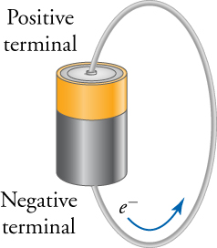
Figure 19.2
A battery has a wire connecting the positive and negative terminals, which allows electrons to move from the negative terminal to the positive terminal.
Notes:
Electrons move from the negative terminal to the positive terminal of a battery.

Slide 5
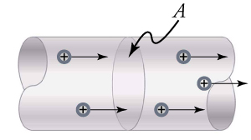
Figure 19.3
The electric current moving through this wire is the charge that moves past the cross-section A divided by the time it takes for this charge to move past the section A.
Notes:
Positive charges move through a section of wire of cross-section A.

Slide 6
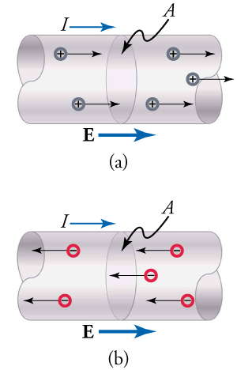
Figure 19.4
(a) The electric field points to the right, the current moves to the right, and positive charges move to the right. (b) The equivalent situation but with negative charges moving to the left. The electric field and the current are still to the right.
Notes:
In part (a), positive charges move in the same direction as the current and electric field. In part (b), negative charges move against the direction of the current and electric field.

Slide 7
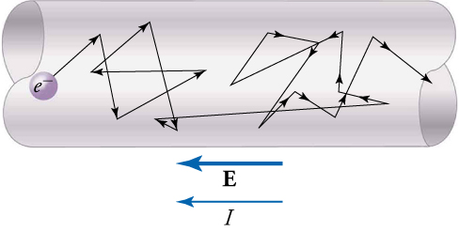
Figure 19.5
Free electrons moving in a conductor make many collisions with other electrons and atoms. The path of one electron is shown. The average velocity of free electrons is in the direction opposite to the electric field. The collisions normally transfer energy to the conductor, so a constant supply of energy is required to maintain a steady current.
Notes:
The random path and collisions of an electron moving in an electrical conductor opposite the current and electric field.

Slide 8
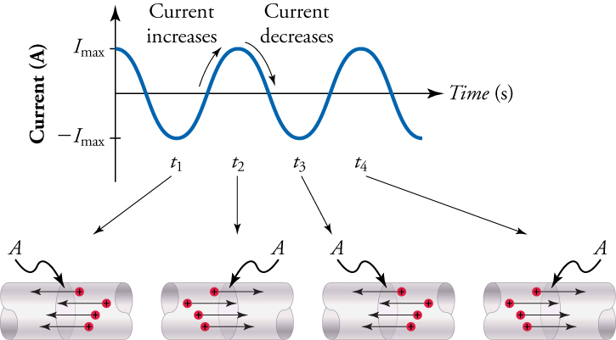
Figure 19.6
With alternating current, the direction of the current reverses at regular time intervals. The graph on the top shows the current versus time. The negative maxima correspond to the current moving to the left. The positive maxima correspond to current moving to the right. The current alternates regularly and smoothly between these two maxima.
Notes:
A graph showing alternating current in which the current increases and decreases at regular intervals, and the direction of the current changing from one direction to another (arrows pointing left or right)

Slide 9
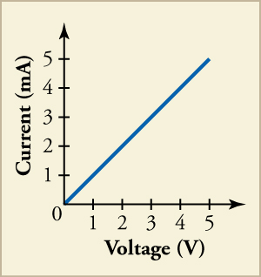
Figure 19.7
The line shows the current as a function of voltage. Notice that the current is given in milliamperes. For example, at 3 V, the current is 0.003 A, or 3 mA.
Notes:
The graph shows current in milliamperes on the y-axis and voltage in volts on the x-axis with a straight line such that at 3V, the current is 3 mA.

Slide 10
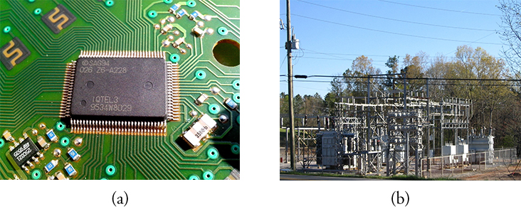
Figure 19.8
The photo on the left shows a chip that contains complex integrated electric circuitry. Chips such as this are at the heart of devices such as computers and cell phones. The photograph on the right shows some typical electric circuitry required for high-power electric power transmission.
Notes:
Part (a) shows a circuit board with a small “chip.” Part (b) shows a high-power electric power transmission station.

Slide 11
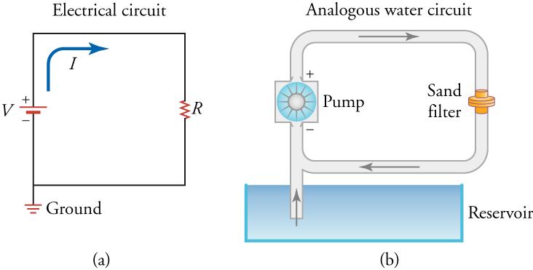
Figure 19.9
On the left is a circuit diagram showing a battery (in red), a resistor (black zigzag element), and the current I. On the right is the analogous water circuit. The pump is like the battery, the sand filter is like the resistor, the water current is like the electrical current, and the reservoir is like the ground.
Notes:
Part (a) shows a circuit diagram with a zigzag line of a resistor, a battery, and current. Part (b) shows an analogous water circuit with a pump (similar to a battery) and a sand filter (similar to the resistor).

Slide 12
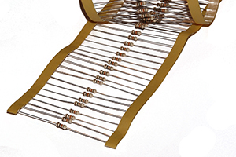
Figure 19.10
Some typical resistors. The color bands indicate the value of the resistance of each resistor.
Notes:
Typical resistors of various color values are shown.

Slide 13
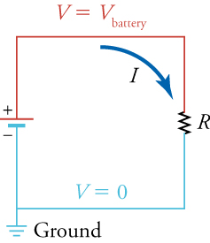
Figure 19.11
The voltage in the red wire is constant at V= V battery from the positive terminal of the battery to the top of the resistor. The voltage in the blue wire is constant at V= V ground =0 from the bottom of the resistor to the negative terminal of the battery.
Notes:
A circuit diagram showing a battery and resistor at constant voltage: V=Vbattery and V=Vground=0.

Slide 14
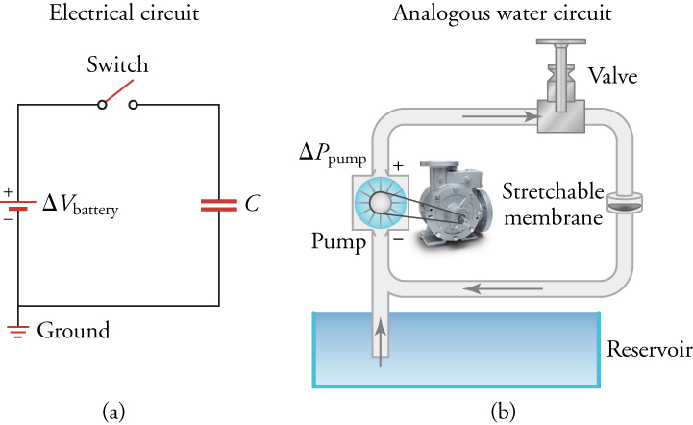
Figure 19.12
On the left is an electrical circuit containing a battery, a switch, and a capacitor. On the left is the analogous water circuit with a pump, a valve, and a stretchable membrane. The pump is like the battery, the valve is like the switch, and the stretchable membrane is like the capacitor. When the switch is closed, electrical current flows as the capacitor charges and its voltage increases. Likewise in the water circuit, when the valve is open, water current flows as the stretchable membrane stretches and the water pressure behind it increases.
Notes:
Part (a) is a circuit diagram with a battery, switch, and capacitor. Part (b) is an analogous water circuit with a pump (like a battery), a valve (like a switch), and a stretchable membrane (like a capacitor).

Slide 15
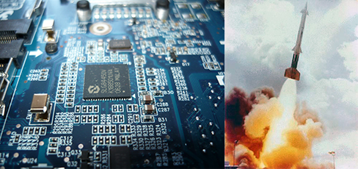
Figure 19.13
The systems that electrical engineers work on range from microprocessor circuits (left)] to missile systems (right).
Notes:
The left shows a microprocessor chip; the right shows a missile being launched.

Slide 16
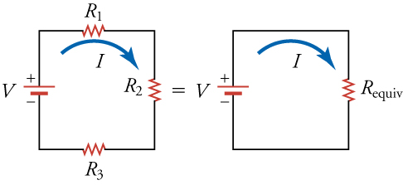
Figure 19.14
On the left is an electric circuit with three resistors R1, R2, and R3 connected in series. On the right is an electric circuit with one resistor Requiv that is equivalent to the combination of the three resistors R1, R2, and R3.
Notes:
The left circuit diagram shows three resistors and a battery connected in series. The right circuit diagram shows one resistor that is equivalent to the combination of the three resistors shown on the left.

Slide 17
Figure 19.15
An image is shown with a continuous line. The line starts out straight and black, becomes red and up and down pointed, and goes back to straight and black.
Notes:
An image is shown with a continuous line. The line starts out straight and black, becomes red and up and down pointed, and goes back to straight and black.

Slide 18
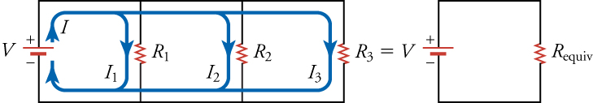
Figure 19.16
The left circuit diagram shows three resistors in parallel. The voltage V of the battery is applied across all three resistors. The currents that flow through each branch are not necessarily equal. The right circuit diagram shows an equivalent resistance that replaces the three parallel resistors.
Notes:
On the left is a circuit diagram with three resistors connected in parallel. On the right is a circuit diagram with only one resistor that has equivalent resistance to the three resistors shown on the left.

Slide 19
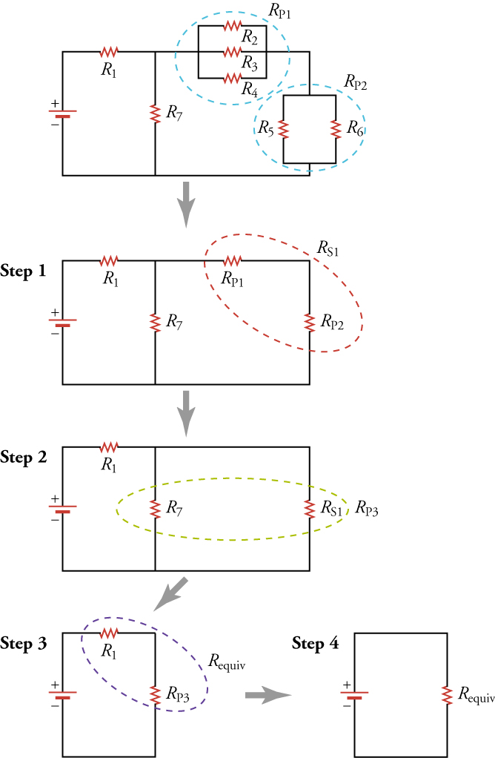
Figure 19.17
This combination of seven resistors has both series and parallel parts. Each is identified and reduced to an equivalent resistance, and these are further reduced until a single equivalent resistance is reached.
Notes:
Four steps are shown to simplify a complex circuit diagram of seven resistors to one with only a single equivalent resistor. Initially, two groups of parallel resistors, circled by the blue dashed loop, are combined; then, two resistors in series, circled by the red dashed loop, are combined, which is then combined with a resistor in parallel, circled by the green dashed loop; finally, two resistors in series are combined, circled by the purple dashed loop, yielding the final diagram.

Slide 20
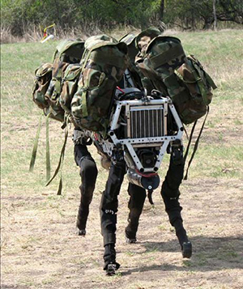
Figure 19.18
Robots come in many shapes and sizes, from the classic humanoid type to dogbots to small cubes that self-assemble to perform a variety of tasks.
Notes:
A “dogbot” in the general shape of a dog is shown

Slide 21
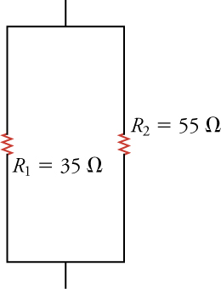
Figure 19.19
This shows a vertical parallel circuit. In the middle of either side there are resistors. The left resistor is labeled R1 = 35Ω. The right resistor is labeled R1 = 55Ω
Notes:
This shows a vertical parallel circuit. In the middle of either side there are resistors. The left resistor is labeled R1 = 35Ω. The right resistor is labeled R1 = 55Ω

Slide 22
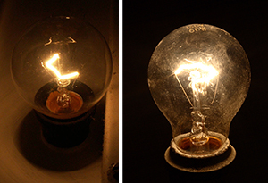
Figure 19.20
On the left is a 25-W light bulb, and on the right is a 60-W light bulb. Why are their power outputs different despite their operating on the same voltage?
Notes:
The left image shows a 25-W light bulb, whereas the right image shows a 60-W light bulb.

Slide 23
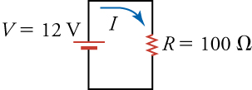
Figure 19.21
A simple circuit that consumes electric power.
Notes:
A circuit diagram with one resistor and one battery is shown.

Slide 24
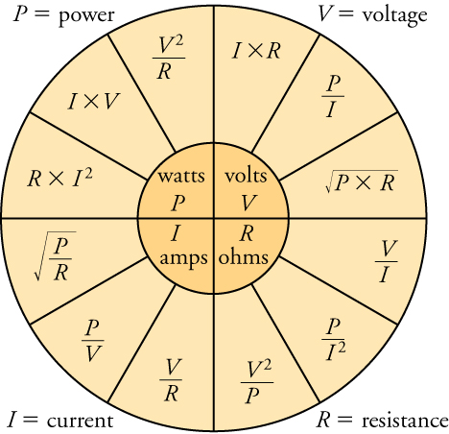
Figure 19.22
The formula wheel shows how volts, resistance, current, and power are related. The quantities in the inner quarter circles equal the quantities in the corresponding outer quarter circles.
This OpenStax ancillary resource is © Rice University under a CC BY-NC-SA 4.0 International license; it may be reproduced or modified for noncommercial purposes only but must be attributed to OpenStax, Rice University and any changes must be noted. Any adaptation must be shared under the same type of license.
Notes:
A formula wheel relating power, voltage, current, and resistance.

