Slide 1

Physics
Chapter 2 Motion in One Dimension

Slide 2
Chapter outline
Relative Motion, Distance, and Displacement
Speed and Velocity
Position vs. Time Graphs
Velocity vs. Time Graphs

Slide 3
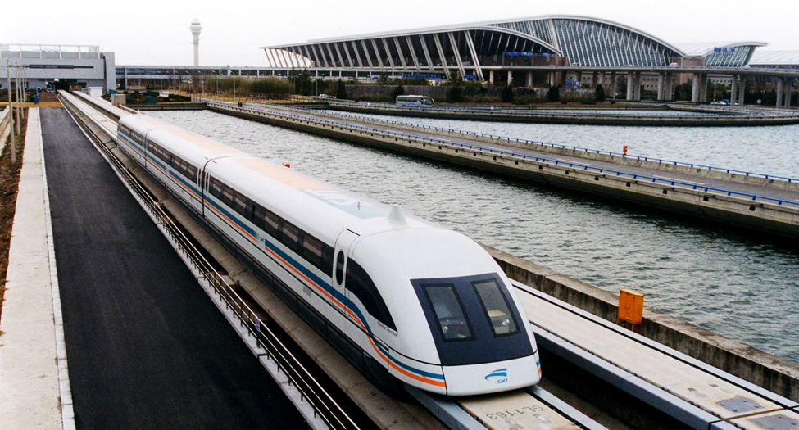
Figure 2.1
Shanghai Maglev. At this rate, a train traveling from Boston to Washington, DC, a distance of 439 miles, could make the trip in under an hour and a half. Presently, the fastest train on this route takes over six hours to cover this distance. (Alex Needham, Public Domain)
Notes:
A photograph shows a maglev train traveling past an airport.

Slide 4

Figure 2.2
Are clouds a useful reference frame for airplane passengers? Why or why not? (Paul Brennan, Public Domain)
Notes:
A photograph of an airplane flying in an upward direction is shown. The sky is partly cloudy.

Slide 5
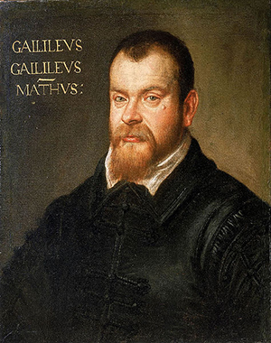
Figure 2.3
Galileo Galilei (1564–1642) studied motion and developed the concept of a reference frame. (Domenico Tintoretto)
Notes:
A painting of Galileo Galilei is shown.

Slide 6
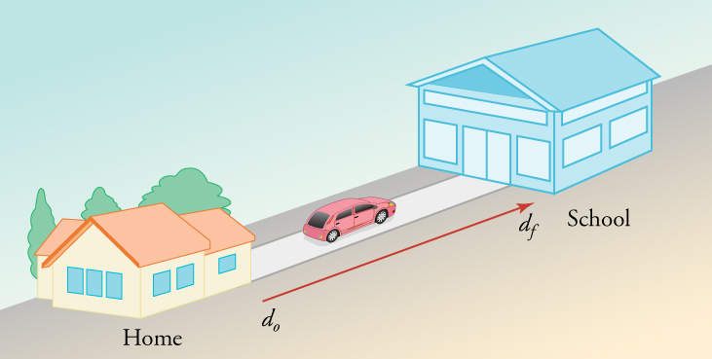
Figure 2.4
Your total change in position is measured from your house to your school.
Notes:
A drawing is shown of a house on the left facing a school on the right. A vector between points from the house to the school is labeled d o on the left and d f on the right. A car is shown driving from the house to the school.

Slide 7
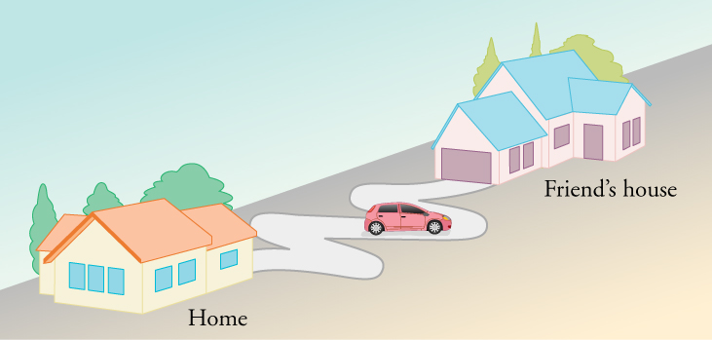
Figure 2.5
A short line separates the starting and ending points of this motion, but the distance along the path of motion is considerably longer.
Notes:
A diagram is shown of a house on the left labeled home and another house on the right labeled Friend's house. The driveways of the houses are facing each other and a curvy road connects the driveways. A car is on the curvy road about half-way between the two houses.

Slide 8
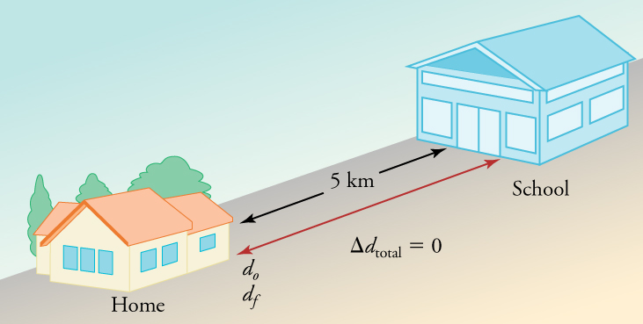
Figure 2.6
The total distance that your car travels is 10 km, but the total displacement is 0.
Notes:
A drawing is shown of a house on the left facing a school on the right. The distance between the two is labeled five miles. A double-arrow vector between the house and the school is labeled do on the left and df on the right. The equation change in d total equals zero is shown below the vector.

Slide 9

Figure 2.7
The Mars Climate Orbiter disaster illustrates the importance of using the correct calculations in physics. (NASA)
Notes:
An image of the Mars Climate Orbiter is shown hovering above Mars.

Slide 10
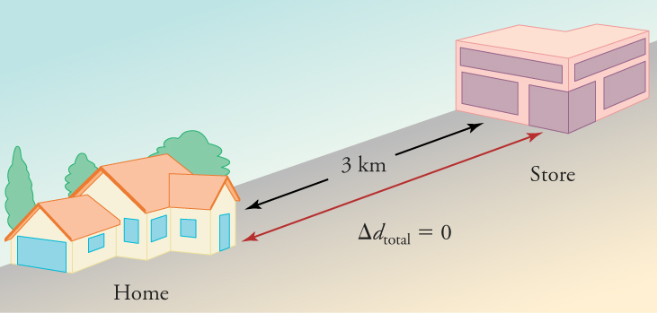
Figure 2.8
During a 30-minute round trip to the store, the total distance traveled is 6 km. The average speed is 12 km/h. The displacement for the round trip is zero, because there was no net change in position.
Notes:
A drawing is shown of a house on the left and a store on the right. The distance between the two is labeled three kilometers. A double-arrow vector between the house and the store is labeled with the equation change in d total equals zero.

Slide 11
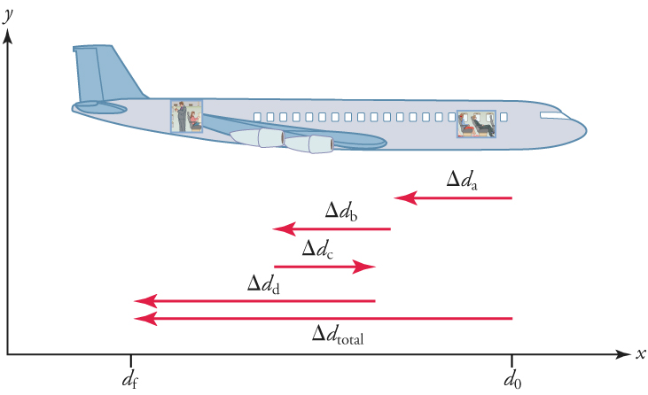
Figure 2.9
The diagram shows a more detailed record of an airplane passenger heading toward the back of the plane, showing smaller segments of his trip.
Notes:
A drawing of an airplane facing to the right is shown, and is set in quadrant one of a coordinate plane. The x-axis is labeled df and then do. The distance between df and do is labeled with a left-pointing vector, change in d total. Four other vectors are shown below the airplane. Vector change in d a points to the left and is short. Vector change in d b points to the left and is also short. Vector change in d c points to the right and is short. Vector change in d d points to the left and is longer.

Slide 12
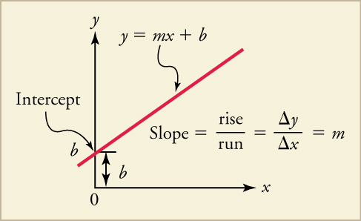
Figure 2.10
The diagram shows a straight-line graph. The equation for the straight line is y equals mx + b.
Notes:
A line graph is shown. The plotted line has a positive slope. The point of intersection with the y-axis is labeled intercept, b. The distance between the graphed line and the x-axis at the intercept is also labeled b. The line is labeled with the equation y equals m x plus b. The equation slope equals rise over run equals change in x over change in y equals m is also shown.

Slide 13
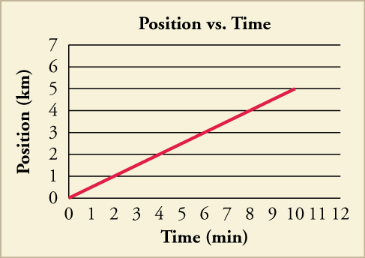
Figure 2.11
A graph of position versus time for the drive to school is shown. What would the graph look like if we added the return trip?
Notes:
A line graph of position versus time is shown. The scale on the x-axis is from zero to twelve in increments of one, and is labeled time in minutes. The scale on the y-axis is from zero to twelve in increments of one and is labeled position in kilometers. A line of the equation y equals point five x is graphed and ends at ten minutes.

Slide 14
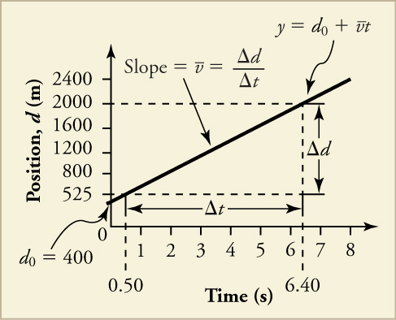
Figure 2.12
The diagram shows a graph of position versus time for a jet-powered car on the Bonneville Salt Flats.
Notes:
A line graph is shown. The x-axis is labeled time in seconds and has a scale from zero to eight in increments of one. The y-axis is labeled position, d, in meters and has a scale from zero to two thousand four hundred in increments of four hundred. A line is plotted that intersects the following data points: zero, four hundred (labeled d 0 equals four hundred), point five, five hundred twenty-five; and six point four, two thousand (labeled y equals d o plus bar over v times t). The line is labeled Slope equals bar over v equals change in d over change in t. The distance between points point five, five hundred twenty-five and six point four, two thousand is labeled change in t. The distance between points six point four, five hundred twenty-five and six point four, two thousand is labeled change in d.

Slide 15
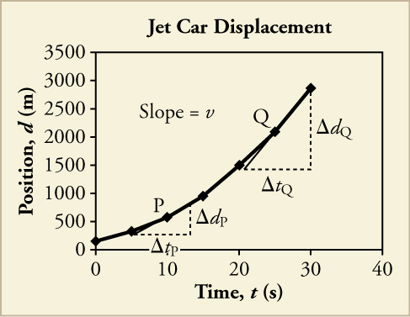
Figure 2.13
The diagram shows a graph of the position of a jet-powered car during the time span when it is speeding up. The slope of a distance versus time graph is velocity. This is shown at two points. Instantaneous velocity at any point is the slope of the tangent at that point.
Notes:
A line graph titled Jet Car Displacement is shown. The x-axis is labeled time, t, in seconds and has a scale from zero to forty on increments of ten. The y-axis is labeled displacement, x, in meters and has a scale from zero to three thousand five hundred in increments of five hundred. The following approximate data points are plotted, resulting in a line that curves upward: eight, two hundred fifty; ten, five hundred; fifteen, one thousand; twenty, one thousand five hundred; twenty-five, two thousand; thirty, three thousand. A right triangle is drawn at points eight, two hundred fifty; twelve, two hundred fifty, and twelve seven hundred fifty. The legs are labeled change in tp and change in dp. Point ten, five hundred is labeled P. Another right triangle is drawn at points twenty, one thousand five hundred; thirty, one thousand five hundred, and thirty, three thousand. The legs are labeled change in tq and change in dq. Point twenty-five, two thousand is labeled Q.

Slide 16
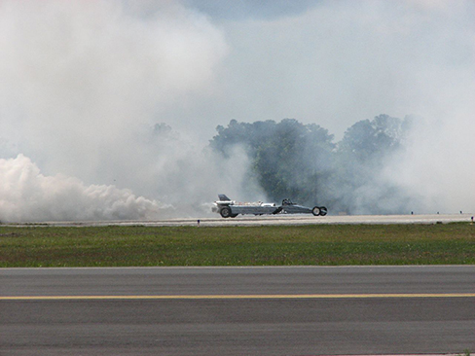
Figure 2.14
A U.S. Air Force jet car speeds down a track. (Matt Trostle, Flickr)
Notes:
A photograph of a United States Air Force jet car is shown speeding down a track. Smoke is billowing from the back end.

Slide 17
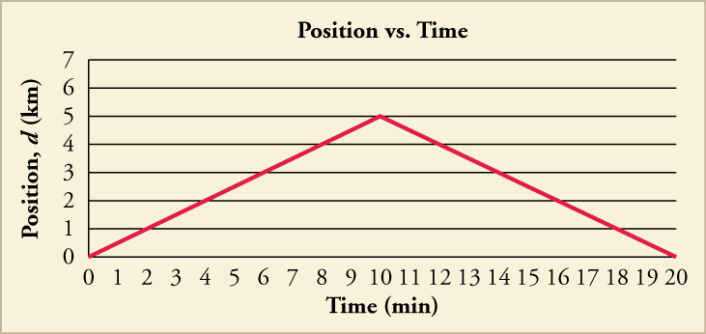
Figure 2.15
A graph of position versus time for the drive to and from school is shown.
Notes:
A line graph titled Position versus Time is shown. The x-axis is labeled time in minutes and has a scale from zero to twenty in increments of one. The y-axis is labeled position, d, in kilometers and has a scale from zero to twelve in increments of one. The line intersects the following data points to form a line that slopes upward and then downward: zero, zero; two, one; four, two; ten, five; twelve, four; fourteen, three; twenty, zero.

Slide 18
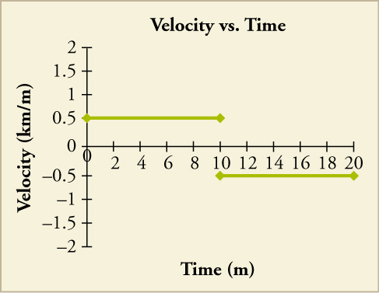
Figure 2.16
Graph of velocity versus time for the drive to and from school.
Notes:
A graph that shows time in minutes on the x-axis and velocity in kilometers per minute on the y axis. A horizontal line is show at a velocity of 0.5 that runs from 0 to 10 minutes. Another horizontal line is shown at a velocity of –0.5 that runs from 10 to 20 minutes.

Slide 19
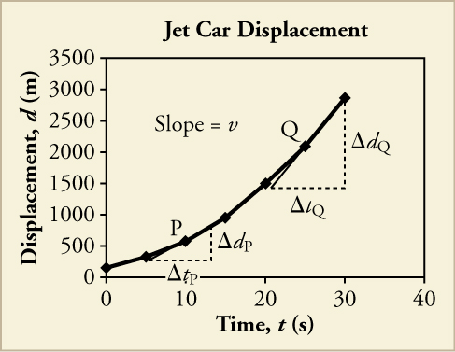
Figure 2.17
A graph is shown of the position of a jet-powered car during the time span when it is speeding up. The slope of a d vs. t graph is velocity. This is shown at two points. Instantaneous velocity at any point is the slope of the tangent at that point.
Notes:
A line graph titled Jet Car Displacement is shown. The x-axis is labeled time, t, in seconds and has a scale from zero to forty on increments of ten. The y-axis is labeled displacement, x, in meters and has a scale from zero to three thousand five hundred in increments of five hundred. The following approximate data points are plotted, resulting in a line that curves upward: eight, two hundred fifty; ten, five hundred; fifteen, one thousand; twenty, one thousand five hundred; twenty-five, two thousand; thirty, three thousand. A right triangle is drawn at points eight, two hundred fifty; twelve, two hundred fifty, and twelve seven hundred fifty. The legs are labeled change in tp and change in dp. Point ten, five hundred is labeled P. Another right triangle is drawn at points twenty, one thousand five hundred; thirty, one thousand five hundred, and thirty, three thousand. The legs are labeled change in tq and change in dq. Point twenty-five, two thousand is labeled Q.

Slide 20
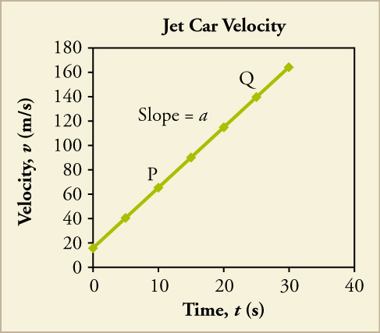
Figure 2.18
The graph shows the velocity of a jet-powered car during the time span when it is speeding up.
Notes:
A line graph titled Jet Car Velocity is shown. The x-axis is labeled time, t, in seconds and has a scale from zero to forty on increments of ten. The y-axis is labeled velocity, v, in meters per second and has a scale from zero to one hundred eighty in increments of twenty. A straight line with a positive slope is plotted that intersects the following approximate points: zero, eighteen; ten, sixty (labeled P); fifteen, ninety; twenty, one hundred twenty; twenty five, one hundred fifty (labeled Q); thirty, one hundred sixty. Slope equals a is shown above the graphed lined.

Slide 21
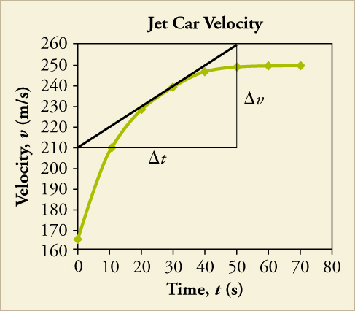
Figure 2.19
The graph shows a more accurate graph of the velocity of a jet-powered car during the time span when it is speeding up.
Notes:
A line graph titled Jet Car Velocity is shown. The x-axis is labeled time, t, in seconds and has a scale from zero to eighty on increments of ten. The y-axis is labeled velocity, v, in meters per second and has a scale from one hundred sixty to two hundred sixty in increments of ten. The following approximate data points are plotted and connected to form a line that curves upward, and then becomes flat: zero, one hundred sixty five; ten, two hundred ten; twenty, two hundred thirty; thirty, two hundred forty; forty, two hundred forty-five; fifty, two hundred forty-five; sixty, two hundred forty-five; seventy, two hundred forty-five. A right triangle is drawn, with a hypotenuse that intersects points twenty, two hundred thirty and thirty, two hundred forty. The bottom leg of the triangle has ends at points zero, two hundred ten and fifty, two hundred ten and is labeled change in t. The upright leg has ends at points fifty, two hundred ten and fifty, two hundred sixty and is labeled change in v.

Slide 22
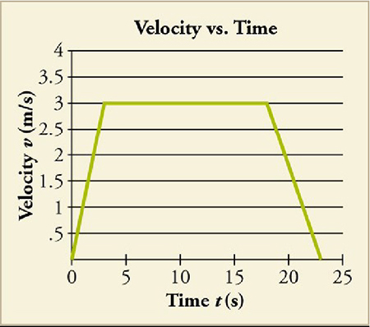
Figure 2.20
no alt text
Notes:
no alt text

Slide 23
Figure 2.21
no alt text
This OpenStax ancillary resource is © Rice University under a CC BY-NC-SA 4.0 International license; it may be reproduced or modified for noncommercial purposes only but must be attributed to OpenStax, Rice University and any changes must be noted. Any adaptation must be shared under the same type of license.
Notes:
no alt text

