Slide 1
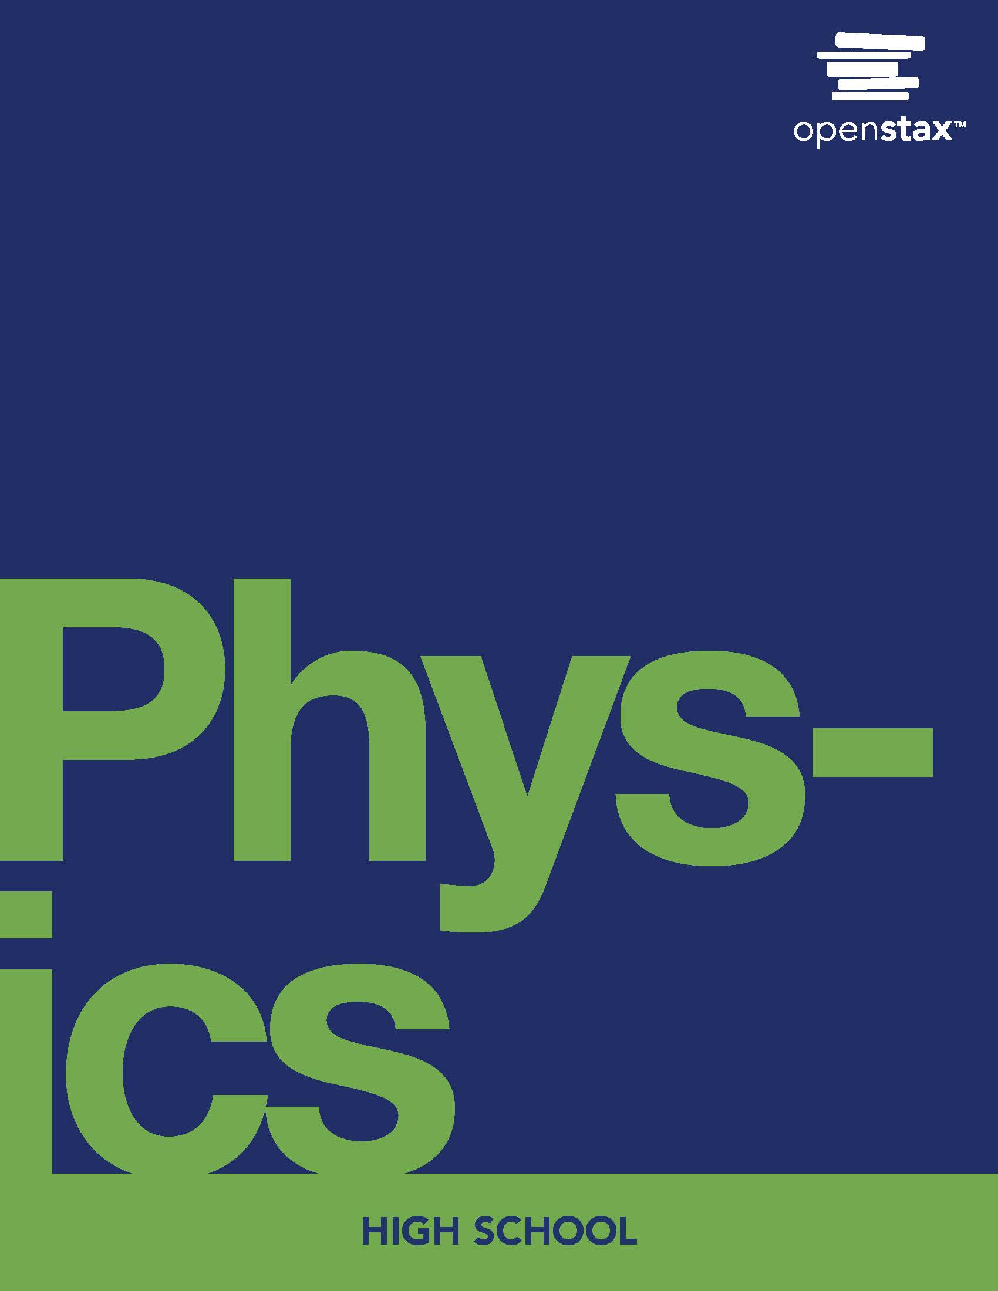
Physics
Chapter 21 The Quantum Nature of Light

Slide 2
Chapter outline
Planck and Quantum Nature of Light
Einstein and the Photoelectric Effect
The Dual Nature of Light

Slide 3

Figure 21.1
In Lewis Carroll’s classic text Alice’s Adventures in Wonderland, Alice follows a rabbit down a hole into a land of curiosity. While many of her interactions in Wonderland are of surprising consequence, they follow a certain inherent logic. (credit: modification of work by John Tenniel, Wikimedia Commons)
Notes:
An image from the book Alice in Wonderland is shown. Alice is attending a tea party with the Mad Hatter and the White Rabbit.

Slide 4
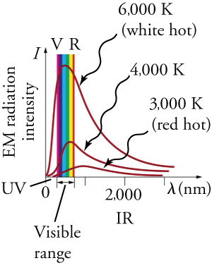
Figure 21.2
Graphs of blackbody radiation (from an ideal radiator) at three different radiator temperatures. The intensity or rate of radiation emission increases dramatically with temperature, and the peak of the spectrum shifts toward the visible and ultraviolet parts of the spectrum. The shape of the spectrum cannot be described with classical physics.
Notes:
A graph plotting radiation intensity against wavelength is shown. On the graph, there are three lines, each one corresponding to the temperature of a different radiator. Each of the three lines curves sharply upward and then gradually back downward. This shows two things: First, for each temperature, there is energy emitted across the electromagnetic section. Second, there is a peak wavelength, where the radiation intensity is greatest. On the graph it can be seen that as temperatures get hotter, the peak wavelength shifts to the left of the visible spectrum.

Slide 5
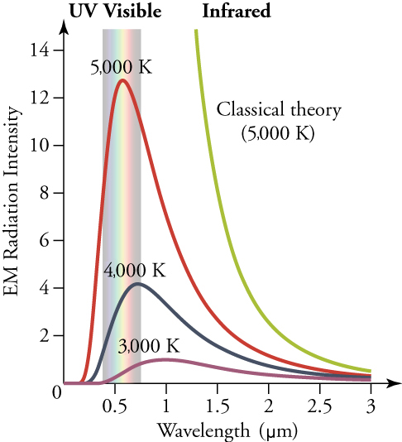
Figure 21.3
The graph above shows the true spectral measurements by a blackbody against those predicted by the classical theory at the time. The discord between the predicted classical theory line and the actual results is known as the ultraviolet catastrophe.
Notes:
A graph plotting intensity of spectral radiation (or, loosely speaking, brightness) vs wavelength is shown. There is another line shown, called ‘Classical Theory.’ This line starts at the right of the graph and curves sharply upward and to the left. It appears to reach an infinite value around 1.2 micrometers.

Slide 6
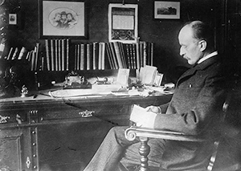
Figure 21.4
The German physicist Max Planck had a major influence on the early development of quantum mechanics, being the first to recognize that energy is sometimes quantized. Planck also made important contributions to special relativity and classical physics. (credit: Library of Congress, Prints and Photographs Division, Wikimedia Commons)
Notes:
A photo of Max Planck sitting at a desk is shown. The photo is taken from his side and he appears to be reading a document.

Slide 7
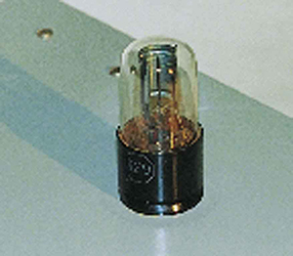
Figure 21.5
The photoelectric effect can be observed by allowing light to fall on the metal plate in this evacuated tube. Electrons ejected by the light are collected on the collector wire and measured as a current. A retarding voltage between the collector wire and plate can then be adjusted so as to determine the energy of the ejected electrons. (credit: P. P. Urone)
Notes:
A picture of a lightmeter is shown. There is a clear bulb placed on top of a black base. Inside the bulb is a metal plate attached to a wire. The wire drops into the black base and is no longer visible to the viewer.

Slide 8
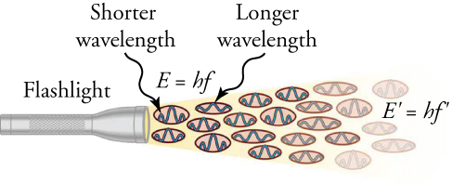
Figure 21.6
An EM wave of frequency f is composed of photons, or individual quanta of EM radiation. The energy of each photon is E=hf, where h is Planck’s constant and f is the frequency of the EM radiation. Higher intensity means more photons per unit area per second. The flashlight emits large numbers of photons of many different frequencies, hence others have energy E ′ =h f ′ , and so on.
Notes:
A drawing is shown of a flashlight with a beam projected out of it. Within the beam are a series of ovals that have wavelengths drawn within them. Each of these ovals corresponds to a photon. Near some of the photons is written the equation E = hf while near other photons is written the equation E' = hf' . The symbols f and f' correspond to different frequencies (or colors) of light. The visible white light from the flashlight is a result of the combination of these different frequencies.

Slide 9
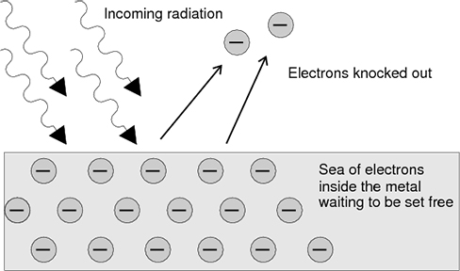
Figure 21.7
Incident radiation strikes a clean metal surface, ejecting multiple electrons from it. The manner in which the frequency and intensity of the incoming radiation affect the ejected electrons strongly suggests that electromagnetic radiation is quantized. This event, called the photoelectric effect, is strong evidence for the existence of photons.
Notes:
Four arrows representing ‘incoming radiation’ are shown striking a metal surface full of negative electrons. The metal surface is labeled ‘Sea of electrons inside the metal waiting to be set free.’ Leaving the metal surface are two new arrows, traveling upward and in the direction opposite the radiation strike. These arrows show the trajectory of two ejected electrons and are accompanied by the label ‘Electrons knocked out.’

Slide 10
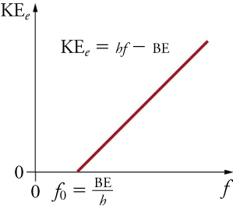
Figure 21.8
A graph of the kinetic energy of an ejected electron, KEe, versus the frequency of EM radiation impinging on a certain material. There is a threshold frequency below which no electrons are ejected, because the individual photon interacting with an individual electron has insufficient energy to break it away. Above the threshold energy, KEe increases linearly with f, consistent with KEe = hf − BE. The slope of this line is h, so the data can be used to determine Planck’s constant experimentally.
Notes:
A graph shows the maximum kinetic energy of an electron plotted against the frequency of light. On the graph is a diagonal line, leaving the horizontal axis at a non-zero x-intercept labeled f0. The label f0 is accompanied with the equation f0 = BE/h. Also on the graph is the equation KEe = hf - BE. This equation explains the diagonal line, showing that as frequency increases, the electron's maximum kinetic energy does as well. However, this takes place only when the frequency is greater than f0, or BE/h.

Slide 11
Table 21.1 Table of Expected Results
 | Classical Wave Model | Modern Photon Model
Threshold Frequency
Electron Ejection Delay
Intensity of EM Radiation
Speed of Ejected Electrons
Relationship between Kinetic Energy and Binding Energy

Slide 12
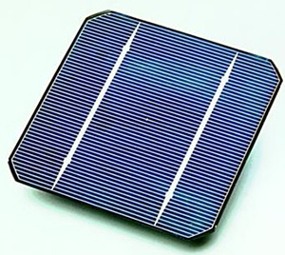
Figure 21.9
A solar cell is an example of a photovoltaic cell. As light strikes the cell, the cell absorbs the energy of the photons. If this energy exceeds the binding energy of the electrons, then electrons will be forced to move in the cell, thereby producing a current. This current may be used for a variety of purposes. (credit: U.S. Department of Energy)
Notes:
There is an image of a blue solar cell. The solar cell is square, with diagonal notches removed from each corner.

Slide 13
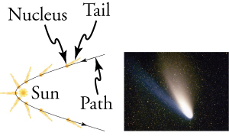
Figure 21.10
The tails of the Hale-Bopp comet point away from the Sun, evidence that light has momentum. Dust emanating from the body of the comet forms this tail. Particles of dust are pushed away from the Sun by light reflecting from them. The blue, ionized gas tail is also produced by photons interacting with atoms in the comet material. (credit: Geoff Chester, U.S. Navy, via Wikimedia Commons)
Notes:
There are two images shown. The left image is a drawing of a comet’s path around the sun. The comet’s path is shown with a black line, while the comet is drawn in orange for nine successive moments in time. In each comet drawing, the tail of the comet is seen pointing away from the sun. The right image is a photograph of a comet. In the image, the comet is seen with two tails: one bright white and one a faint blue.

Slide 14
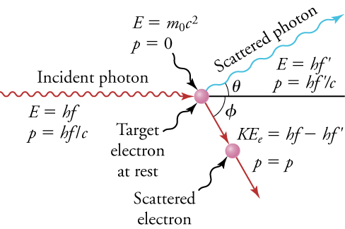
Figure 21.11
The Compton effect is the name given to the scattering of a photon by an electron. Energy and momentum are conserved, resulting in a reduction of both for the scattered photon.
Notes:
The image shows a collision between a photon of light and an electron. The photon of light is shown travelling downward and to the right toward a stationary electron, and then is shown rebounding upward and to the right after the drawn collision. The electron is shown stationary and the moving downward after the collision. Also in the image are the equations E = hf and E' = hf', which correspond to the energy of the photon before and after the collision. Near the electron is the equation KEe = E - E', showing the effect the collision has on the electron’s energy.

Slide 15
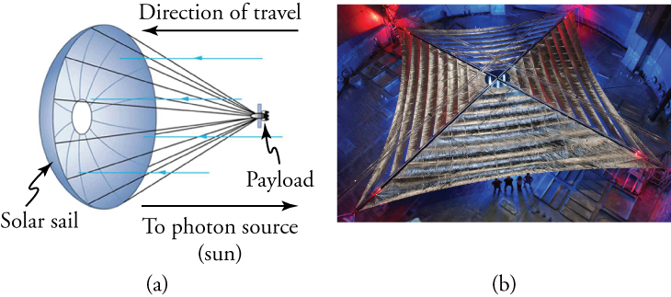
Figure 21.12
(a) Space sails have been proposed that use the momentum of sunlight reflecting from gigantic low-mass sails to propel spacecraft about the solar system. A Russian test model of this (the Cosmos 1) was launched in 2005, but did not make it into orbit due to a rocket failure. (b) A U.S. version of this, labeled LightSail-1, is scheduled for trial launches in 2016. It will have a 40 m2 sail. (credit: Kim Newton/NASA)
Notes:
There are two images shown. The image on the left is a drawing of a solar sail, which looks like a large parachute carrying a payload (the spacecraft). The solar sail is moving to the left. Blue arrows show photons from the sun moving from the right and striking the solar sail. The image on the right is an overhead photo of the very large solar sail unfurled. There are four people shown at the bottom of the picture for scale. They are approximately one-sixth of the width of the sail.

Slide 16
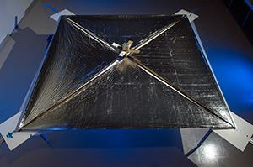
Figure 21.13
NASA’s NanoSail-D, a precursor to LightSail-1, with its sails deployed. The Planetary Society will be launching LightSail-1 in early 2016. (credit: NASA/MSFC/D, Wikimedia Commons)
Notes:
An image of the NanoSail is shown. The sail is shown fully unfurled, with the satellite in the center. The width of the satellite is approximately one-eighth the width of the sail.

Slide 17
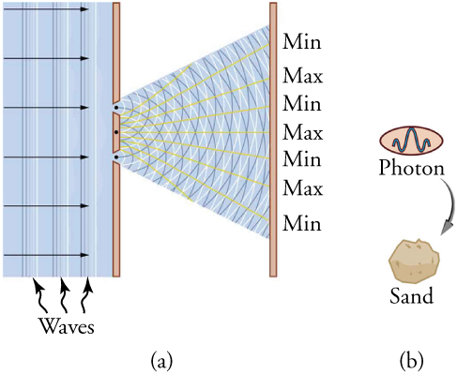
Figure 21.14
(a) The interference pattern for light through a double slit is a wave property understood by analogy to water waves. (b) The properties of photons having quantized energy and momentum and acting as a concentrated unit are understood by analogy to macroscopic particles.
This OpenStax ancillary resource is © Rice University under a CC BY-NC-SA 4.0 International license; it may be reproduced or modified for noncommercial purposes only but must be attributed to OpenStax, Rice University and any changes must be noted. Any adaptation must be shared under the same type of license.
Notes:
There are two drawings shown. On the left is a drawing of light striking a barrier with two slits. As the light passes through the slits, it creates an interference pattern. The interference pattern projects onto a screen, where the terms max and min are used to show the locations of constructive and destructive wave interference. On the right is an enlarged drawing of a grain of sand. There is an arrow pointing to the grain of sand, with a picture of a photon at the other end of the arrow.

