Slide 1

Physics
Chapter 23 Particle Physics

Slide 2
Chapter outline
The Four Fundamental Forces
Quarks
The Unification of Forces

Slide 3
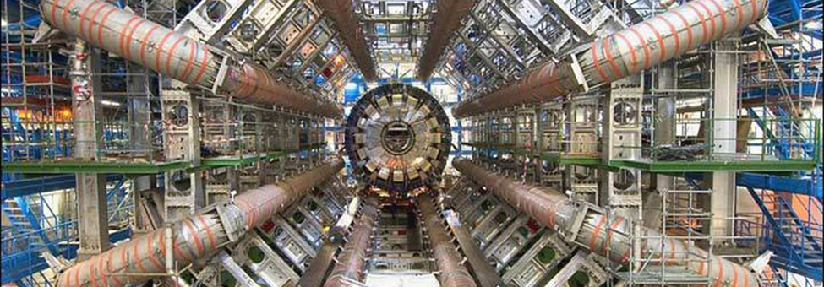
Figure 23.1
Part of the Large Hadron Collider (LHC) at CERN, on the border of Switzerland and France. The LHC is a particle accelerator, designed to study fundamental particles. (credit: Image Editor, Flickr)
Notes:
The photograph shows a series of tubes and structural elements that make up the Large Hadron Collider. The five staircases on the sides of the collider show the very large size of the experimental device.

Slide 4
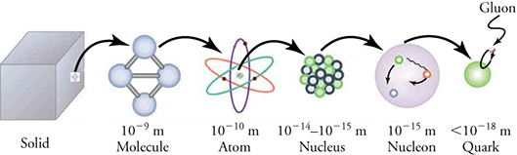
Figure 23.2
A solid, a molecule, an atom, a nucleus, a nucleon (a particle that makes up the nucleus—either a proton or a neutron), and a quark.
Notes:
A sequence of six images is shown: a solid, a molecule, an atom, a nucleus, a nucleon (a particle that makes up the nucleus—either a proton or a neutron), and a quark. Each image in the sequence is connected to the next one by an arrow from the prior image, showing that the ones on the right are smaller and smaller constructs of each preceding one on the left. In other words, the solid is made of molecules, the molecule is made of atoms, and so on.

Slide 5
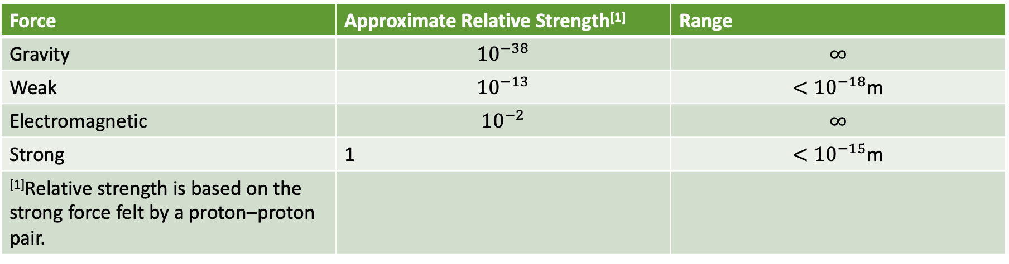
Table 23.1 Relative strength and range of the four fundamental forces
Force | Approximate Relative Strength^{[1]} | Range
Gravity | $${10}^{−38}$$ | $$∞$$
Weak | $${10}^{−13}$$ | $$<{10}^{−18}\text{m}$$
Electromagnetic | $${10}^{−2}$$ | $$∞$$
Strong | 1 | $$<{10}^{−15}\text{m}$$
^{[1]}Relative strength is based on the strong force felt by a proton–proton pair.

Slide 6
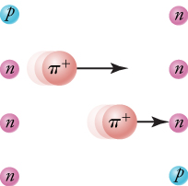
Figure 23.3
The strong nuclear force is transmitted between a proton and neutron by the creation and exchange of a pion. The pion, created through a temporary violation of conservation of mass-energy, travels from the proton to the neutron and is recaptured. It is not directly observable and is called a virtual particle. Note that the proton and neutron change identity in the process. The range of the force is limited by the fact that the pion can exist for only the short time allowed by the Heisenberg uncertainty principle. Yukawa used the finite range of the strong nuclear force to estimate the mass of the pion; the shorter the range, the larger the mass of the carrier particle.
Notes:
This figure shows a sequence of four images in four rows. In the first row, a proton and a neutron are pictured. The proton is on the left and the neutron is on the right. In the second row, a pion leaves the proton and travels toward the neutron, as represented by an arrow. As a result, the proton is now a neutron. In the third row, the pion is still traveling toward the neutron on the right. This image consists of the pion and two neutrons. In the fourth row, a proton is on the right with a neutron on the left. This shows that the pion has been absorbed by the right-side neutron, which has turned into a proton as a result.

Slide 7
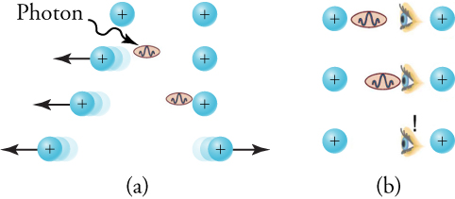
Figure 23.4
The image in part (a) shows the exchange of a virtual photon transmitting the electromagnetic force between charges, just as virtual pion exchange carries the strong nuclear force between nucleons. The image in part (b) shows that the photon cannot be directly observed in its passage because this would disrupt it and alter the force. In this case, the photon does not reach the other charge.
Notes:
There are two sequences of images in two columns labeled (a) and (b). In part (a), the sequence begins with a photon leaving a proton on the left and moving toward another proton on the right. When it leaves, it propels the left-side proton leftward. Later in the sequence, the photon is received by the proton on the right. Upon receiving the photon, the right-side proton is propelled to the right. Thus the sequence begins with two stationary protons and finishes with two protons traveling in opposite directions. In part (b), the sequence of images shows that the photon cannot be observed. An eye is drawn between two protons. When the photon leaves the left-side proton, it is intercepted by the eye and does not reach the right-side proton. Because this cannot occur, this sequence is evidence of the photon’s virtual nature.

Slide 8
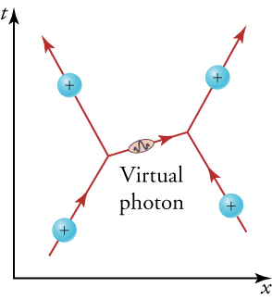
Figure 23.5
The Feynman diagram for the exchange of a virtual photon between two positively charged particles illustrates how electromagnetic force is transmitted on a quantum mechanical scale. Time is graphed vertically, while the distance is graphed horizontally. The two positively charged particles are seen to repel each other by the photon exchange.
Notes:
The diagram shows two positively charged particles traveling upward toward each other. As one positively charged particle (on the left) expels a virtual photon to the right, the charge is projected upward and to the left. The virtual photon is received by the positively charged particle on the right. As a result, this positively charged particle is projected upward and to the right.

Slide 9
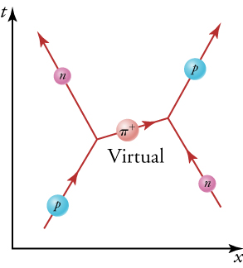
Figure 23.6
The image shows a Feynman diagram for the exchange of a π+ (pion) between a proton and a neutron, carrying the strong nuclear force between them. This diagram represents the situation shown more pictorially in Figure 23.3.
Notes:
The diagram shows a proton and a neutron traveling upward toward each other. As the proton expels a virtual pion to the right, it is projected upward and to the left. As a result of expelling this pion, the particle traveling upward and to the left is now a neutron. The virtual pion is received by the neutron on the right. As a result, this particle is projected upward and to the right and is now a proton.

Slide 10
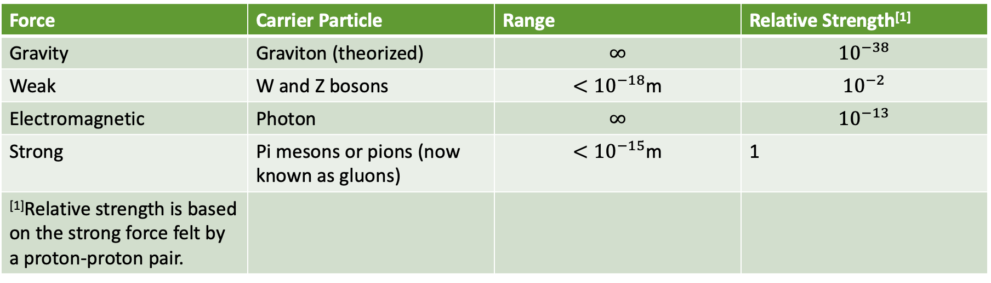
Table 23.2 Carrier particles and their relative masses compared to pions for the four fundamental forces
Force | Carrier Particle | Range | Relative Strength^{[1]}
Gravity | Graviton (theorized) | $$∞$$ | $${10}^{−38}$$
Weak | W and Z bosons | $$<{10}^{−18}\text{m}$$ | $${10}^{−2}$$
Electromagnetic | Photon | $$∞$$ | $${10}^{−13}$$
Strong | Pi mesons or pions (now known as gluons) | $$<{10}^{−15}\text{m}$$ | 1
^{[1]}Relative strength is based on the strong force felt by a proton-proton pair.

Slide 11
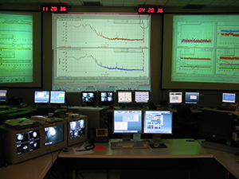
Figure 23.7
In searching for gravitational waves, scientists are using the Laser Interferometer Gravitational-Wave Observatory (LIGO). Here we see the control room of LIGO in Hanford, Washington.
Notes:
The image shows the LIGO Hanford control room. There are desktop computers and large screens showing a variety of graphs, likely showing spectra collected from stars.

Slide 12
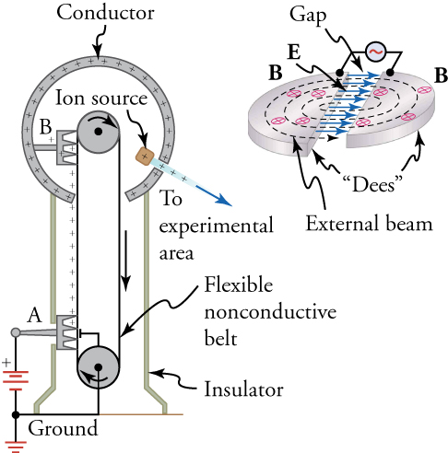
Figure 23.8
On the left is an artist’s rendition of the popular physics demonstration tool, the Van de Graaff generator. A battery (A) supplies excess positive charge to a pointed conductor, the points of which spray the charge onto a moving insulating belt near the bottom. The pointed conductor (B) on top in the large sphere picks up the charge. (The induced electric field at the points is so large that it removes the charge from the belt.) This can be done because the charge does not remain inside the conducting sphere but moves to its outer surface. An ion source inside the sphere produces positive ions, which are accelerated away from the positive sphere to high velocities. On the right is a cyclotron. Cyclotrons use a magnetic field to cause particles to move in circular orbits. As the particles pass between the plates of the Dees, the voltage across the gap is oscillated to accelerate them twice in each orbit.
Notes:
There are two images. On the left is an image of a Van de Graaff generator. On the right is a drawing of a cyclotron. This is created by two semi-circles separated by a gap. In this gap are arrows representing the direction of an alternating electric field. Within the two semi-circles are x symbols showing that the magnetic field is projected upward through the semi-circles. A particle is shown spiraling in an expanding circular pattern from the center of the semi-circles and outward.

Slide 13
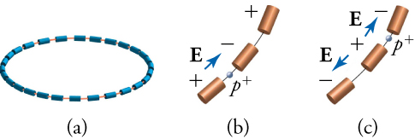
Figure 23.9
(a) A synchrotron has a ring of magnets and accelerating tubes. The frequency of the accelerating voltages is increased to cause the beam particles to travel the same distance in a shorter time. The magnetic field should also be increased to keep each beam burst traveling in a fixed-radius path. Limits on magnetic field strength require these machines to be very large in order to accelerate particles to very high energies. (b) A positively charged particle is shown in the gap between accelerating tubes. (c) While the particle passes through the tube, the potentials are reversed so that there is another acceleration at the next gap. The frequency of the reversals needs to be varied as the particle is accelerated to achieve successive accelerations in each gap.
Notes:
There are three images. The image on the left is a series of magnets connected in a circle by a line. This line shows the direction of an accelerating circulating particle. The next two images are close-ups of a particle traveling from one magnet to the next. In the center image the particle (a proton) is traveling from one tube to the next because an electric field is pushing it in that direction. The electric field is shown by an arrow pointing from a positive charge over the tube the proton is leaving and negative charge over the tube the proton is entering. In the right picture, the proton is leaving the tube it had just entered and is about to enter the next tube in its path. It can be seen that the electric field has switched directions, as the charge over the tube it had previously entered is now positive and the tube it is about to enter is now negative.

Slide 14
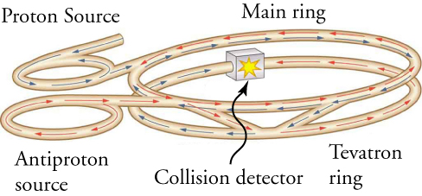
Figure 23.10
This schematic shows the two rings of Fermilab’s accelerator and the scheme for colliding protons and antiprotons (not to scale).
Notes:
The image shows a long circulating tube, shaped like a pair of parallel rings, one pair of rings being much smaller than the other. One end of the tube, extending out from one of the small rings, is labeled proton source; the other end of the tube, near the other small ring, is labeled antiproton source. There are arrows representing the direction of particle travel, with blue arrows pointing toward the center of the tube from the proton source, and red arrows pointing toward the center of the tube from the antiproton source. The arrows meet at a box in the center of the tube structure. The box is labeled ‘Collision detector’ and has an explosion symbol on it.

Slide 15
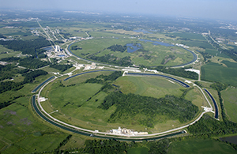
Figure 23.11
The Fermi National Accelerator Laboratory, near Batavia, Illinois, was a subatomic particle collider that accelerated protons and antiprotons to attain energies up to 1 Tev (a trillion electronvolts). The circular ponds near the rings were built to dissipate waste heat. This accelerator was shut down in September 2011. (credit: Fermilab, Reidar Hahn)
Notes:
An aerial view of the Fermi National Accelerator Laboratory is shown.

Slide 16
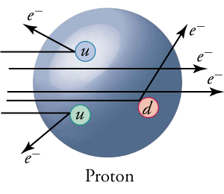
Figure 23.12
Scattering of high-energy electrons from protons at facilities like SLAC produces evidence of three point-like charges consistent with proposed quark properties. This experiment is analogous to Rutherford’s discovery of the small size of the nucleus by scattering α particles. High-energy electrons are used so that the probe wavelength is small enough to see details smaller than the proton.
Notes:
The image shows a large blue sphere representing a proton with three small spheres within it. The three small spheres are labeled ‘u’, ‘u’, and ‘d’, and are colored blue, green, and red, respectively. These three smaller spheres represent up and down quarks. From the left to the right of the image are arrows representing the trajectory of electrons. Some of the electrons pass through the proton, while others are shown striking the quarks and scattering away.

Slide 17
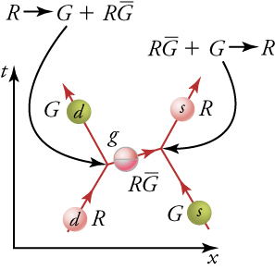
Figure 23.13
The exchange of gluons between quarks carries the strong force and may change the color of the interacting quarks. While the colors of the individual quarks change, their flavors do not.
Notes:
The diagram shows two quarks, a down quark and a strange quark, traveling toward each other. As the down quark expels a gluon, it changes color from red to green. As the strange quark receives the gluon, it changes color from green to red. The gluon is colored red and magenta and is labeled ‘red-antigreen’.

Slide 18
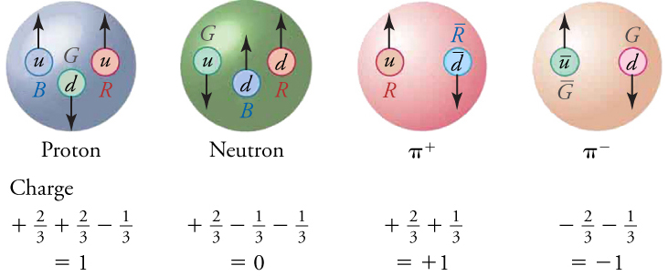
Figure 23.14
All baryons, such as the proton and neutron shown here, are composed of three quarks. All mesons, such as the pions shown here, are composed of a quark–antiquark pair. Arrows represent the spins of the quarks. The colors are such that they need to add to white for any possible combination of quarks.
Notes:
There are four pictures in this figure, each showing the structure of a hadron. The proton on the left is composed of three quarks (two up and one down). The colors of the quarks are blue, green, and red. The second picture is of a neutron, which is composed of three quarks (one up and two down). The colors of its quarks are green, blue, and red. The third image is of a positive pion, which is composed of two quarks (up and anti-down). The colors of its quarks are red and anti-red. The final picture is of a negative pion, which is composed of two quarks (anti-up and down). The colors of its quarks are green and anti-green. Underneath each quark is a summation of the quarks fractional charge. The summation of quark charges for both the proton and positive pion is +1. The summation of quark charges for the neutron is zero. The summation of quark charges for the negative pion is -1.

Slide 19
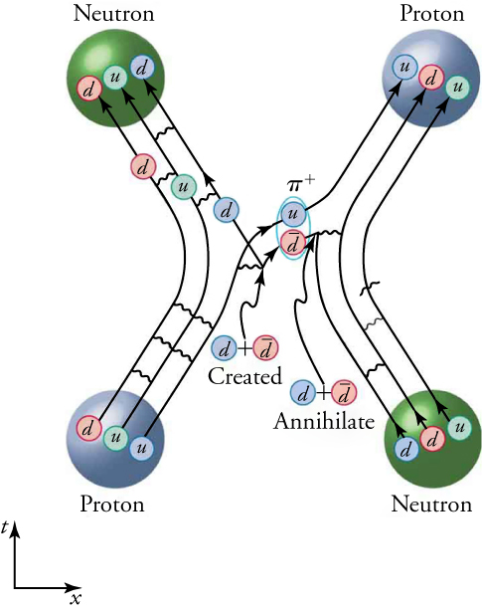
Figure 23.15
This Feynman diagram shows the interaction between a proton and a neutron, corresponding to the interaction shown in Figure 23.6. This diagram, however, shows the quark and gluon details of the strong nuclear force interaction.
Notes:
This is a complex picture of the relationship between individually colored quarks in the strong nuclear force, during the interaction between a proton and a neutron.

Slide 20
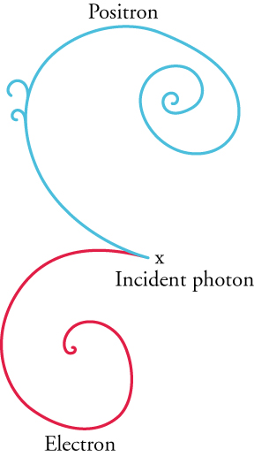
Figure 23.16
The image above is from the Fermilab 15 foot bubble chamber and shows the production of an electron and positron (or antielectron) from an incident photon. This event is titled pair production and provides evidence of antimatter, as the two repel each other.
Notes:
The image shows two spirals originating from the same spot, with one directed upward and one directed downward. The spot from which the spirals originate is labeled ‘incident photon.’ The upward spiral is the positron, while the downward spiral is labeled ‘electron.’

Slide 21
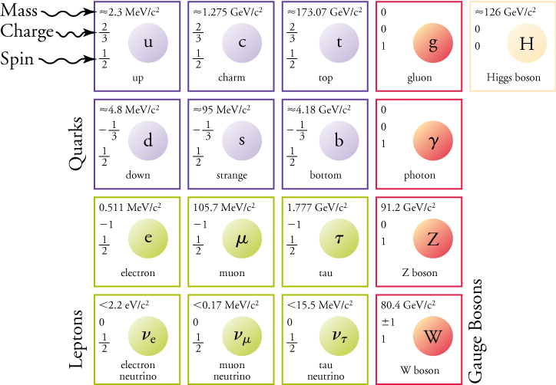
Figure 23.17
The Standard Model of elementary particles shows an organized view of all fundamental particles, as currently known: six quarks, six leptons, and four gauge bosons (or carrier particles). The Higgs boson, first observed in 2012, is a new addition to the Standard Model.
Notes:
The image is of seventeen boxes, sixteen of which are in a four-by-four grid. (The seventeenth box, in yellow and off to the side, is of the Higgs boson.) Spheres in purple are quarks, spheres in green are leptons, and spheres in red are gauge bosons.

Slide 22
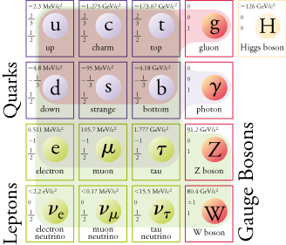
Figure 23.18
The revised Standard Model shows the interaction between gauge bosons and other fundamental particles. These interactions are responsible for the fundamental forces, three of which are described through the chart’s shaded areas.
Notes:
The sixteen boxes shown before are now shaded due to force. A red shade extends from the gluon and colors all purple quarks. A blue shade extends from the photon and colors all quarks and the first row of leptons (the electron, muon, and tau). A green shade extends from the Z and W bosons and colors all quarks and leptons. As the background colors overlap, the red shade appears brown, and the blue shade appears dark green.

Slide 23
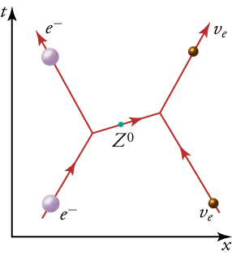
Figure 23.19
The exchange of a virtual Z 0 particle (boson) carries the weak nuclear force between an electron and a neutrino in this Feynman diagram. This diagram is similar to the diagrams in Figure 23.6 and Figure 23.5 for the electromagnetic and strong nuclear forces.
Notes:
The diagram shows an electron and electron neutrino traveling upward toward each other. As the electron expels a Z boson to the right, it is projected upward and to the left. The boson is received by the electron neutrino on the right. As a result, this particle is projected upward and to the right.

Slide 24
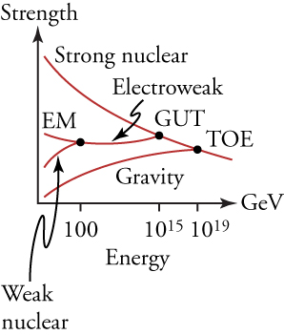
Figure 23.20
The relative strengths of the four basic forces vary with distance, and, hence, energy is needed to probe small distances. At ordinary energies (a few eV or less), the forces differ greatly. However, at energies available in accelerators, the weak nuclear and electromagnetic (EM) forces become unified. Unfortunately, the energies at which the strong nuclear and electroweak forces become the same are unreachable in any conceivable accelerator. The universe may provide a laboratory, and nature may show effects at ordinary energies that give us clues about the validity of this graph.
Notes:
This graph plots the strengths of different forces (on the vertical axis) against their energies (on the horizontal axis). The graph shows a series of distinct lines, labeled gravity, weak nuclear, electromagnetic (EM), and strong nuclear, converging from the left to the right. The lines labeled EM and weak nuclear converge at an energy of 100 GeV and form a new line labeled electroweak. The lines labeled electroweak and strong nuclear converge at 1015 GeV. The location of their convergence is labeled GUT. The lines labeled strong nuclear and gravity converge at 1019 GeV. The location of their convergence is labeled TOE (Theory of Everything). The gravity line always trends upward as energy increases, while the line labeled strong nuclear always trends downward. Prior to their convergence, the EM line trended downward while the weak nuclear line trended upward. After their convergence, the electroweak line remained relatively horizontal.

Slide 25
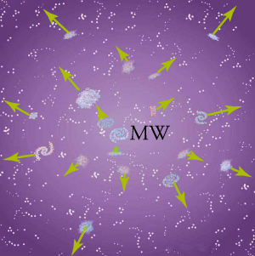
Figure 23.21
Galaxies are flying apart from one another, with the more distant ones moving faster, as if a primordial explosion expelled the matter from which they formed. The most distant known galaxies move nearly at the speed of light relative to us.
Notes:
The drawing shows galaxies fleeing from the center of the image, labeled MW for Milky Way. Galaxies further from the center have longer arrows pointing outward than galaxies near the center. This shows that the universe is expanding.

Slide 26
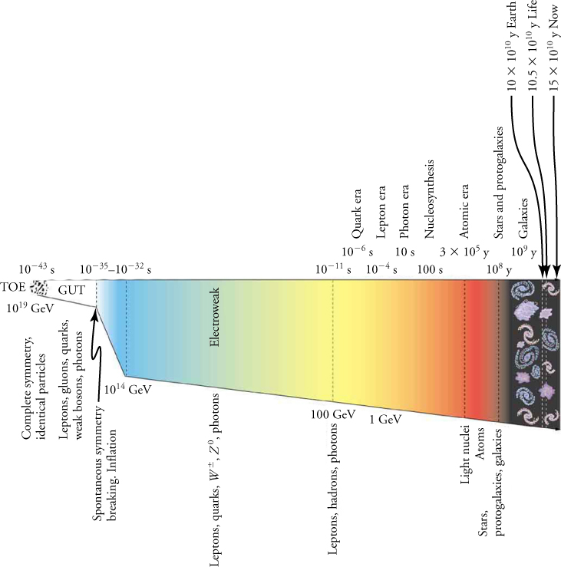
Figure 23.22
The evolution of the universe from the Big Bang onward (from left to right) is intimately tied to the laws of physics, especially those of particle physics at the earliest stages. Theories of the unification of forces at high energies may be verified by their shaping of the universe and its evolution.
This OpenStax ancillary resource is © Rice University under a CC BY-NC-SA 4.0 International license; it may be reproduced or modified for noncommercial purposes only but must be attributed to OpenStax, Rice University and any changes must be noted. Any adaptation must be shared under the same type of license.
Notes:
The timeline runs left to right, from 10-43 seconds to 15x1010 years (labeled as ‘now’). Concurrent with the timeline are energy levels, which begin at 1019 GeV. Additional information includes eras of evolution and the types of particles that are produced within each era. The right side of the image shows small galaxies, corresponding to a time period on the order of 109 years.

