Slide 1

Physics
Chapter 4 Forces and Newton’s Laws of Motion

Slide 2
Chapter outline
Force
Newton's First Law of Motion: Inertia
Newton's Second Law of Motion
Newton's Third Law of Motion

Slide 3
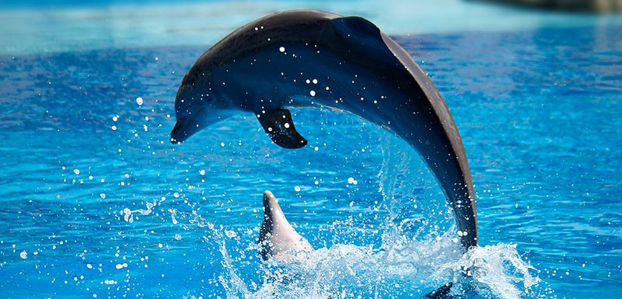
Figure 4.1
Newton’s laws of motion describe the motion of the dolphin’s path. (Credit: Jin Jang)
Notes:
A dolphin is jumping out of water in a curved path over the water.

Slide 4
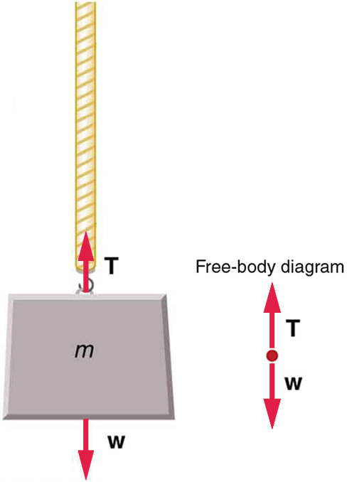
Figure 4.2
An object of mass, m, is held up by the force of tension.
Notes:
An object labeled m for mass is attached to a rope. A force vector labeled T for tension is pointing upward from the object and a force vector labeled W for weight of the object is pointing downward from the object. A free body diagram illustrates the T and W force vectors.

Slide 5
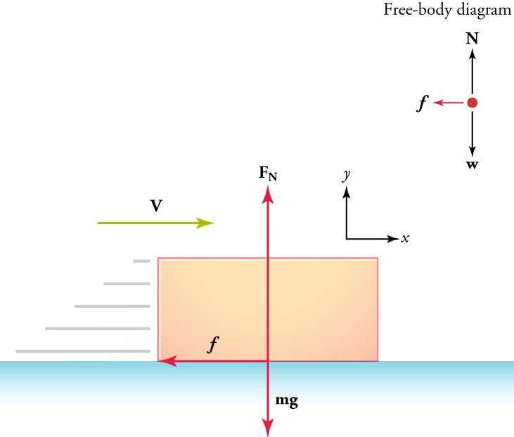
Figure 4.3
For a box sliding across a floor, friction acts in the direction opposite to the velocity.
Notes:
A rectangular box is on a flat surface. A velocity vector indicates that the box is moving to the right. A friction force vector at the center of the box points to the left. A Newton force vector at the center of the box points upward. A weight force vector at the center of the box is labeled in milligrams and points downward. A free body diagram illustrates the three vectors, and x and y-axes are shown for reference.

Slide 6
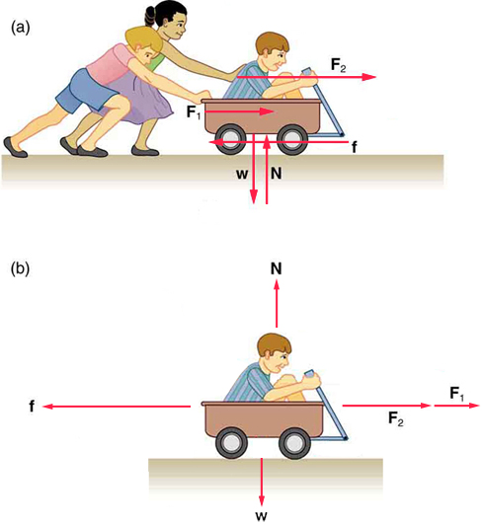
Figure 4.4
(a) The wagon and rider form a system that is acted on by external forces. (b) The two children pushing the wagon and child provide two external forces. Friction acting at the wheel axles and on the surface of the tires where they touch the ground provide an external force that act against the direction of motion. The weight W and the normal force N from the ground are two more external forces acting on the system. All external forces are represented in the figure by arrows. All of the external forces acting on the system add together, but because the wagon moves at a constant velocity, all of the forces must add up to zero.
Notes:
Two diagrams are shown. In the top diagram, two children are pushing a third child who is sitting in a wagon. The forces exerted by the children pushing the wagon are labeled F1 and F2 and point to the right in the direction that the wagon is facing. A friction force vector below the wagon points to the left. A Newton force vector below the wagon points upward. A weight force vector below the wagon points downward. In the bottom diagram, only the child in the wagon is shown. The F1 and F2 vectors are shown ahead of the wagon pointing to the right. The Newton force vector is above the wagon and is pointing upward. The weight force vector is below the wagon and points downward.

Slide 7
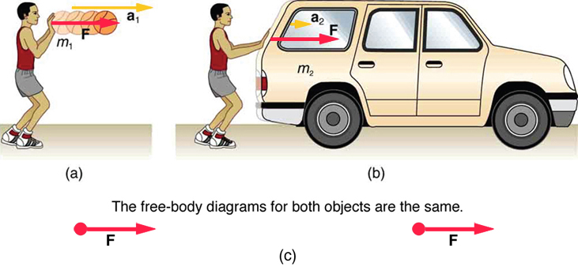
Figure 4.5
The same force exerted on systems of different masses produces different accelerations. (a) A boy pushes a basketball to make a pass. The effect of gravity on the ball is ignored. (b) The same boy pushing with identical force on a stalled car produces a far smaller acceleration (friction is negligible). Note that the free-body diagrams for the ball and for the car are identical, which allows us to compare the two situations.
Notes:
Three diagrams are shown: a, b, and c. Diagram a shows standing person facing to the right, pushing forward on a basketball. The basketball is labeled m one for mass one. A force vector is labeled F and is pointing to the right. An acceleration vector is labeled a one and is also pointing to the right. Diagram b shows the same person in the same standing position, pushing forward with the same force, but on a car. The car is labeled m two for mass two. A force vector is labeled F and is pointing to the right. An acceleration vector is labeled a two and is also pointing to the right. Diagram c shows free body diagrams for diagrams a and b, illustrating that the free body diagrams are identical because the forces acting on both masses were the same.

Slide 8
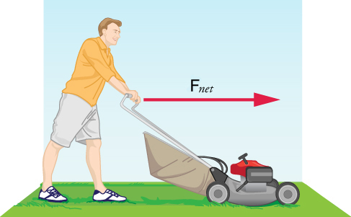
Figure 4.6
A man is facing to the right and is pushing a lawn mover forward. The force exerted on the lawn mower is labeled with a right-facing vector, F net.
Notes:
A man is facing to the right and is pushing a lawn mover forward. The force exerted on the lawn mower is labeled with a right-facing vector, F net.

Slide 9
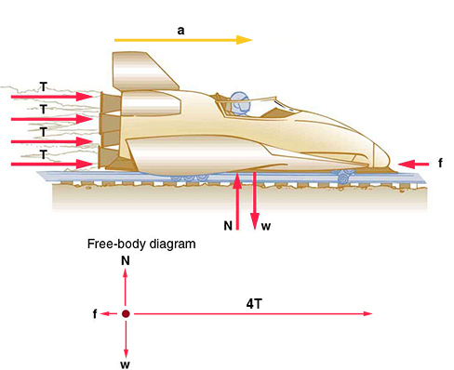
Figure 4.7
An accelerating right-facing rocket sled is shown on tracks. Four thrust force vectors are behind the sled and are pointing to the right. An acceleration vector is above the sled and is pointing to the right. A friction force vector is in front of the sled and is pointing to the left. A Newton vector is below the sled and is pointing upward. A weight vector is also below the sled and is pointing downward. A free body diagram illustrates the force vectors.
Notes:
An accelerating right-facing rocket sled is shown on tracks. Four thrust force vectors are behind the sled and are pointing to the right. An acceleration vector is above the sled and is pointing to the right. A friction force vector is in front of the sled and is pointing to the left. A Newton vector is below the sled and is pointing upward. A weight vector is also below the sled and is pointing downward. A free body diagram illustrates the force vectors.

Slide 10
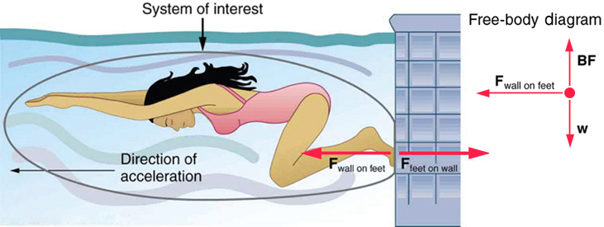
Figure 4.8
When the swimmer exerts a force F feet on wall on the wall, she accelerates in the direction opposite to that of her push. This means that the net external force on her is in the direction opposite to F feet on wall . This opposition is the result of Newton’s third law of motion, which dictates that the wall exerts a force F wall on feet on the swimmer that is equal in magnitude but that acts in the direction opposite to the force that the swimmer exerts on the wall.
Notes:
A swimmer is underwater and is facing to the left. Her feet are on a wall and she is using her feet to get ready to push forward off the wall. She will accelerate in a direction opposite to the force of her feet pushing on the wall. This opposition is the result of Newton’s third law of motion, which dictates that the wall exerts a force on the swimmer that is equal in magnitude but that acts in the direction opposite to the force that the swimmer exerts on the wall. A free body diagram is shown to illustrate the force of the wall on the feet, the buoyancy force pushing upward on the girl, and the weight of the girl pushing downward.

Slide 11
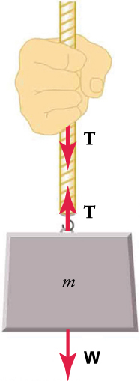
Figure 4.9
When a perfectly flexible connector (one requiring no force to bend it) such as a rope transmits a force T, this force must be parallel to the length of the rope, as shown. The pull that such a flexible connector exerts is a tension. The rope pulls at one end on the hand with equal magnitude force but in opposite directions to the hand’s pull. At the other end, it pulls on the mass with equal magnitude force and in the opposite direction to the mass’s pull. These are examples of Newton’s third law. If we neglect the weight of the rope, or if the system is at rest, Newton’s second law then leads to the forces at the two ends being equal.
Notes:
A hand is pulling downward on a rope with an object labeled m for mass attached to the bottom of the rope. A tension force vector from the hand points downward and another tension force vector from the object points upward. A weight force vector from the object points downward. The rope is the medium that transmits between the two objects' forces of equal magnitude but that act in opposite directions.

Slide 12
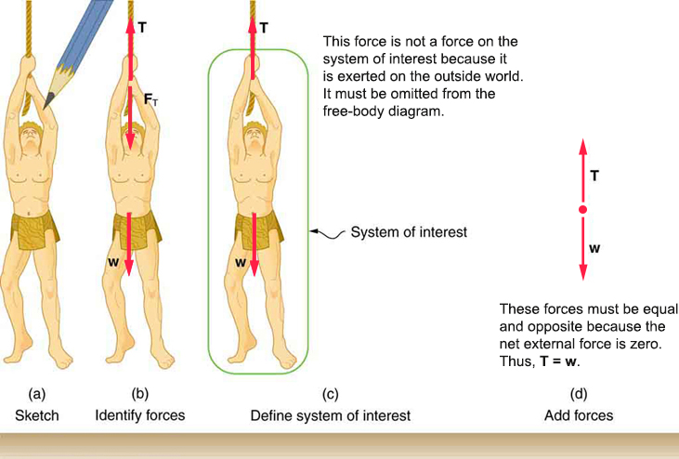
Figure 4.10
(a) A sketch of Tarzan hanging motionless from a vine. (b) Arrows are used to represent all forces. T is the tension exerted on Tarzan by the vine, F T is the force exerted on the vine by Tarzan, and W is Tarzan’s weight (i.e., the force exerted on Tarzan by Earth’s gravity). All other forces, such as a nudge of a breeze, are assumed to be negligible. (c) Suppose we are given Tarzan’s mass and asked to find the tension in the vine. We define the system of interest as shown and draw a free-body diagram, as shown in (d). F T is no longer shown because it does not act on the system of interest; rather, F T acts on the outside world. (d) The free-body diagram shows only the external forces acting on Tarzan. For these to sum to zero, we must have T=W .
Notes:
Four diagrams are shown: a, b, c, and d. Diagram a shows a sketch of Tarzan hanging motionless from a vine. Diagram b shows the same sketch as diagram a, but includes force vectors. A tension force vector points upward from Tarzan's hands to show tension exerted on Tarzan by the vine. Another tension force vector points downward from Tarzan's hands to show the force exerted on the vine by Tarzan. A weight force vector points from Tarzan downward to show the force exerted on Tarzan by Earth’s gravity. All other forces, such as a nudge of a breeze, are assumed to be negligible. Diagram c shows a system of interest in the event that Tarzan’s mass is known and we are asked to find the tension in the vine. This diagram shows the same sketch as diagram b, but it does not include the tension force vector downward from Tarzan's hands to show the force exerted on the vine by Tarzan because this force does not act on the system of interest. It only acts on the outside world. Diagram d shows a free-body diagram with only the external forces acting on Tarzan, with force T, tension, pointing upward and equal to force w, weight, pointing downward.

Slide 13
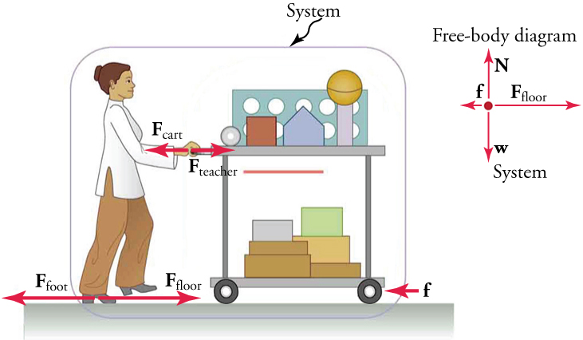
Figure 4.11
A teacher is standing and facing to the right. She is pushing a cart with various items on it including books and boxes. The teacher and cart are labeled, "System." A force vector labeled F teacher shows the force of the teacher's push on the cart and points to the right. A force vector of equal length labeled F cart show the force exerted by the cart and points to the left. A friction force vector at the bottom area of the cart points to the left. A force vector labeled F floor shows the force of the floor on the teacher's feet and points to the right. A force vector of equal length labeled F foot show the force exerted by teacher foot as she walks and points to the left. A free-body diagram of the system illustrates the friction force pointing to the left, the weight force pointing downward, the Newton force pointing upward, and the F floor force pointing to the right.
This OpenStax ancillary resource is © Rice University under a CC BY-NC-SA 4.0 International license; it may be reproduced or modified for noncommercial purposes only but must be attributed to OpenStax, Rice University and any changes must be noted. Any adaptation must be shared under the same type of license.
Notes:
A teacher is standing and facing to the right. She is pushing a cart with various items on it including books and boxes. The teacher and cart are labeled, "System." A force vector labeled F teacher shows the force of the teacher's push on the cart and points to the right. A force vector of equal length labeled F cart show the force exerted by the cart and points to the left. A friction force vector at the bottom area of the cart points to the left. A force vector labeled F floor shows the force of the floor on the teacher's feet and points to the right. A force vector of equal length labeled F foot show the force exerted by teacher foot as she walks and points to the left. A free-body diagram of the system illustrates the friction force pointing to the left, the weight force pointing downward, the Newton force pointing upward, and the F floor force pointing to the right.

