Slide 1

Physics
Chapter 6 Circular and Rotational Motion

Slide 2
Chapter outline
Angle of Rotation and Angular Velocity
Uniform Circular Motion
Rotational Motion

Slide 3
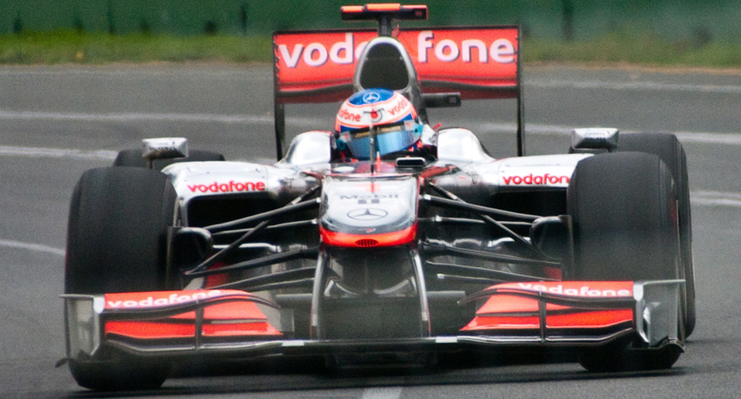
Figure 6.1
This Australian Grand Prix Formula 1 race car moves in a circular path as it makes the turn. Its wheels also spin rapidly. The same physical principles are involved in both of these motions. (Richard Munckton).
Notes:
The picture is a race car with large wheels turning on a track.

Slide 4

Figure 6.2
All points on a CD travel in circular paths. The pits (dots) along a line from the center to the edge all move through the same angle Δθ in time Δt .
Notes:
The diagram shows a picture of a CD with about an eighth of the shiny surface peeled away to display the inside of the CD with pits (dots) arranged in lines from the center. An angle theta is marked from one line of dots to another.

Slide 5
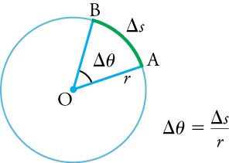
Figure 6.3
The radius (r) of a circle is rotated through an angle Δθ . The arc length, Δs , is the distance covered along the circumference.
Notes:
The diagram shows a circle with the center marked O, a radius r ending on the circumference at A, an arc change of s starting at A and ending at B. The angle for the arc is change of theta. A formula to the right of the circle says change of theta is equal to change of s divided by r.

Slide 6
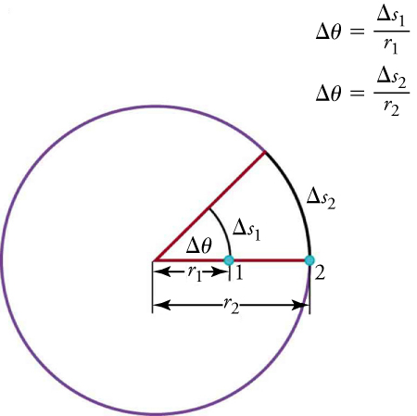
Figure 6.4
Points 1 and 2 rotate through the same angle ( Δθ ), but point 2 moves through a greater arc length ( Δ s 2 ) because it is farther from the center of rotation.
Notes:
The picture shows a circle with a radius r2 going from the center, through a point 1 half-way on the radius and point 2 on the circumference. The distance from center to point 1 is labeled r1. A second radius line is drawn with an angle of change in theta. The arc from point 1 to the second radius is labeled change s1. The arc at point 2 is labeled change s2. There are two formulas to the right of the diagram: theta is equal to change of s1 over r1 and theta is equal to change of s2 over r2.

Slide 7
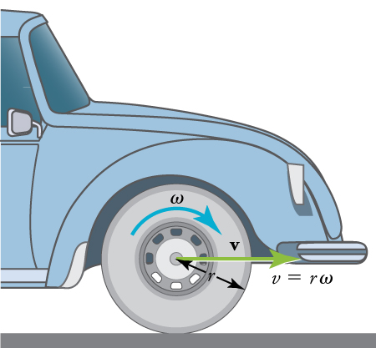
Figure 6.5
A car moving at a velocity, v, to the right has a tire rotating with angular velocity ω . The speed of the tread of the tire relative to the axle is v, the same as if the car were jacked up and the wheels spinning without touching the road. Directly below the axle, where the tire touches the road, the tire tread moves backward with respect to the axle with tangential velocity v=rω , where r is the tire radius. Because the road is stationary with respect to this point of the tire, the car must move forward at the linear velocity v. A larger angular velocity for the tire means a greater linear velocity for the car.
Notes:
The diagram shows an illustration of the front part of a car. The diagram shows an arrow on the wheel pointing clockwise and labeled omega (angular velocity). There is a green arrow pointing toward the front of the car labeled v (velocity). The radius of the wheel is labeled r. To the right of the wheel is an equation v equals r times omega.

Slide 8
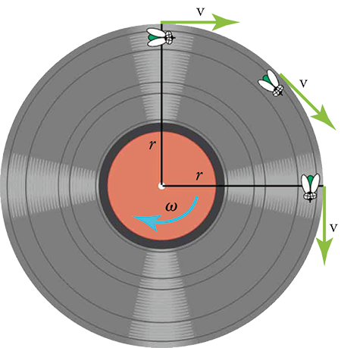
Figure 6.6
As the fly on the edge of an old-fashioned vinyl record moves in a circle, its instantaneous velocity is always at a tangent to the circle. The direction of the angular velocity is into the page this case.
Notes:
The figure shows an illustration of a vinyl record with an arrow omega (angular velocity) pointing in a clockwise direction. There are two lines for the radius, marked r, one going from the center up and the other going from the center to the right. There are three flies on the record. One is positioned at the top of the record on the vertical radius. A v (velocity) arrow points to the right. A second fly is half-way around the circumference toward the horizontal radius and an arrow v is pointing tangential to the fly. The third fly is on the circumference at the horizontal radius and an arrow v is pointing down.

Slide 9
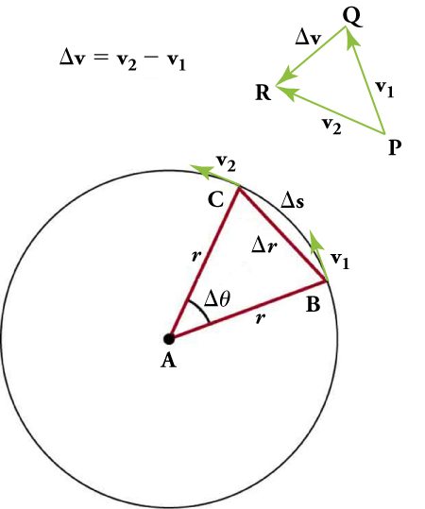
Figure 6.7
The directions of the velocity of an object at two different points are shown, and the change in velocity Δv is seen to point approximately toward the center of curvature (see small inset). For an extremely small value of Δs , Δv points exactly toward the center of the circle (but this is hard to draw). Because a c =Δv/Δt , the acceleration is also toward the center, so ac is called centripetal acceleration.
Notes:
The diagram shows a formula: change in v is equal to v2 minus v1. There are three rays positioned on a triangle with points P, Q, and R. The ray between P and Q is labeled v1. The ray between P and R is labeled v2 and the ray opposite P between Q and R is labeled change in v. Below the formula and triangle is a circle with center A and two radii labeled r with the angle between them labeled change in theta. The points on the circumference for the two radii are labeled B and C with a line segment of change in r indicated for the distance between the two points. The arc going from B to C along the circumference is labeled change of s and the velocity arrow at point B is labeled v1 and at C is labeled v2.

Slide 10
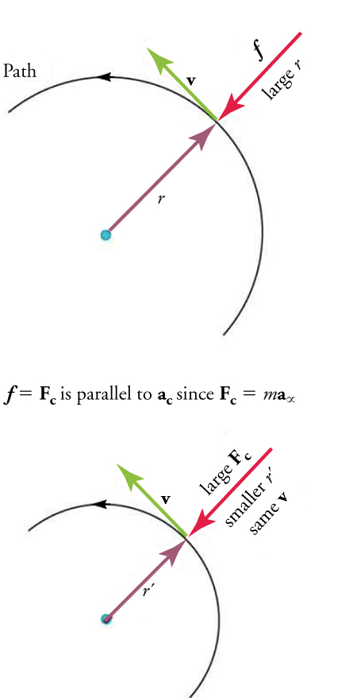
Figure 6.8
In this figure, the frictional force f serves as the centripetal force Fc. Centripetal force is perpendicular to tangential velocity and causes uniform circular motion. The larger the centripetal force Fc, the smaller is the radius of curvature r and the sharper is the curve. The lower curve has the same velocity v, but a larger centripetal force Fc produces a smaller radius r ′ .
Notes:
The figure shows a semicircle with an arrow indicating a counterclockwise Path with radius labeled r, and arrow pointing from the outside of the circle towards the radius arrow. The arrow opposite the radius is labeled large r and has an f indicating force. The arrow tangential to the circle between the radius and large r arrows is labeled v (velocity). Below the first semicircle is a formula: f equals Fc is parallel to ac since Fc equals m times a alpha. Another semicircle with the same directional path is drawn below formula with a radius r prime, velocity v, large Fc pointing toward the r prime radius arrow and a label below the large Fc showing smaller r prime and same v.

Slide 11
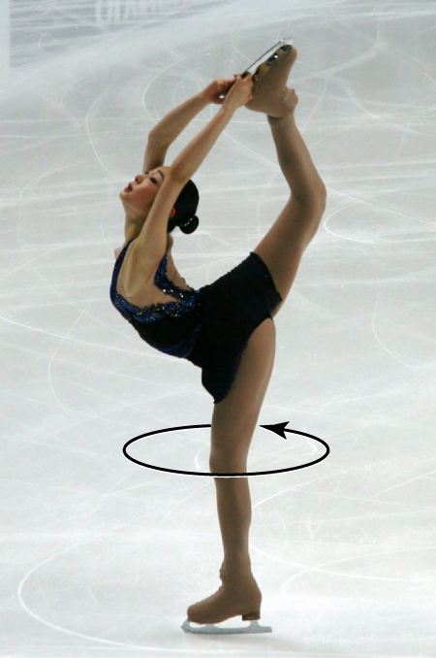
Figure 6.9
A figure skater spins in the counterclockwise direction, so her angular velocity is normally considered to be positive. (Luu, Wikimedia Commons)
Notes:
The diagram shows a picture of an ice skater with an arrow pointing around her leg indicating that she is spinning in a counterclockwise direction.

Slide 12
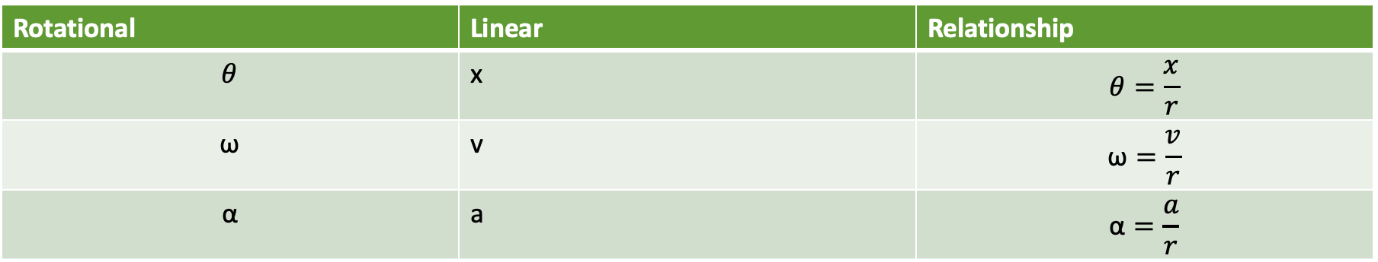
Table 6.2 Rotational and Linear Variables
Rotational | Linear | Relationship
$$θ$$ | x | $$θ=\frac{x}{r}$$
$$\text{ω}$$ | v | $$\text{ω}=\frac{v}{r}$$
$$\text{α}$$ | a | $$\text{α}=\frac{a}{r}$$

Slide 13
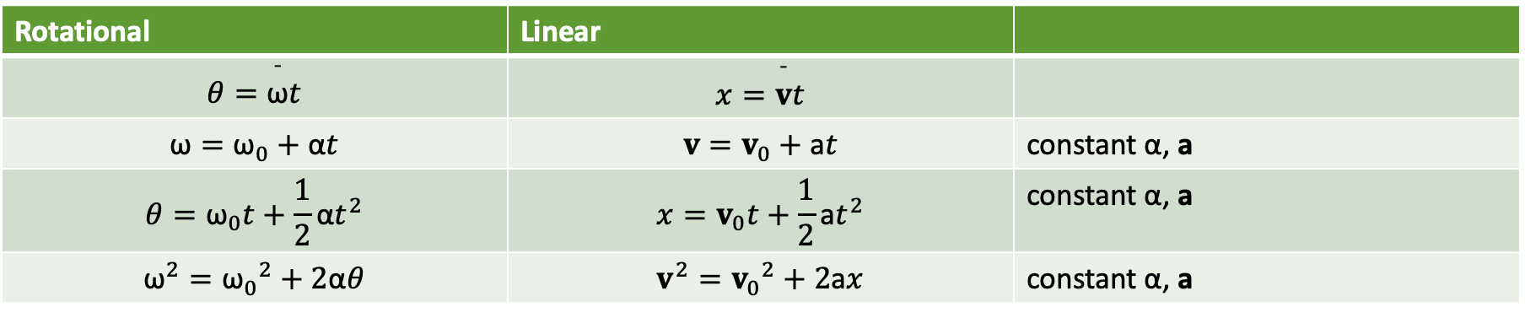
Table 6.3 Equations for Rotational Kinematics
Rotational | Linear
$$θ=\overset{¯}{\text{ω}}t$$ | $$x=\overset{¯}{v}t$$
$$\text{ω}={\text{ω}}_{0}+\text{α}t$$ | $$v=v_{0}+\text{a}t$$ | constant $\text{α}$, a
$$θ={\text{ω}}_{0}t+\frac{1}{2}\text{α}t^{2}$$ | $$x=v_{0}t+\frac{1}{2}\text{a}t^{2}$$ | constant $\text{α}$, a
$${\text{ω}}^{2}={\text{ω}}_{0}​^{2}+2\text{α}θ$$ | $$v^{2}=v_{0}​^{2}+2\text{a}x$$ | constant $\text{α}$, a

Slide 14
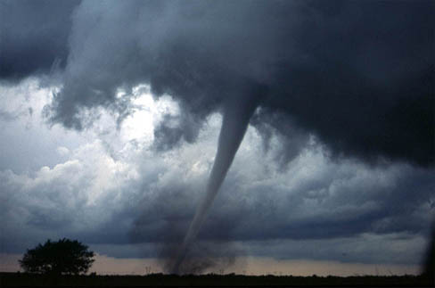
Figure 6.10
Tornadoes descend from clouds in funnel-like shapes that spin violently. (Daphne Zaras, U.S. National Oceanic and Atmospheric Administration)
Notes:
The figure shows a photograph of a dark tornado funnel cloud touching the ground and kicking up a lot of debris.

Slide 15
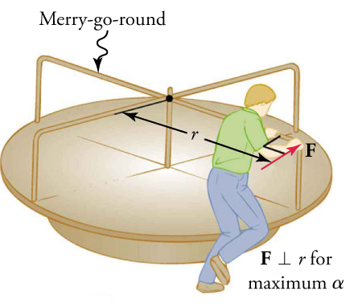
Figure 6.11
A man pushes a merry-go-round at its edge and perpendicular to the lever arm to achieve maximum torque.
This OpenStax ancillary resource is © Rice University under a CC BY-NC-SA 4.0 International license; it may be reproduced or modified for noncommercial purposes only but must be attributed to OpenStax, Rice University and any changes must be noted. Any adaptation must be shared under the same type of license.
Notes:
The figure shows an illustration of a merry-go-round with a radius of r and a man pushing on a bar on the circumference with an arrow indicating a force of F. To the right of the diagram, it is noted that F is perpendicular to r for maximum alpha.

