Slide 1
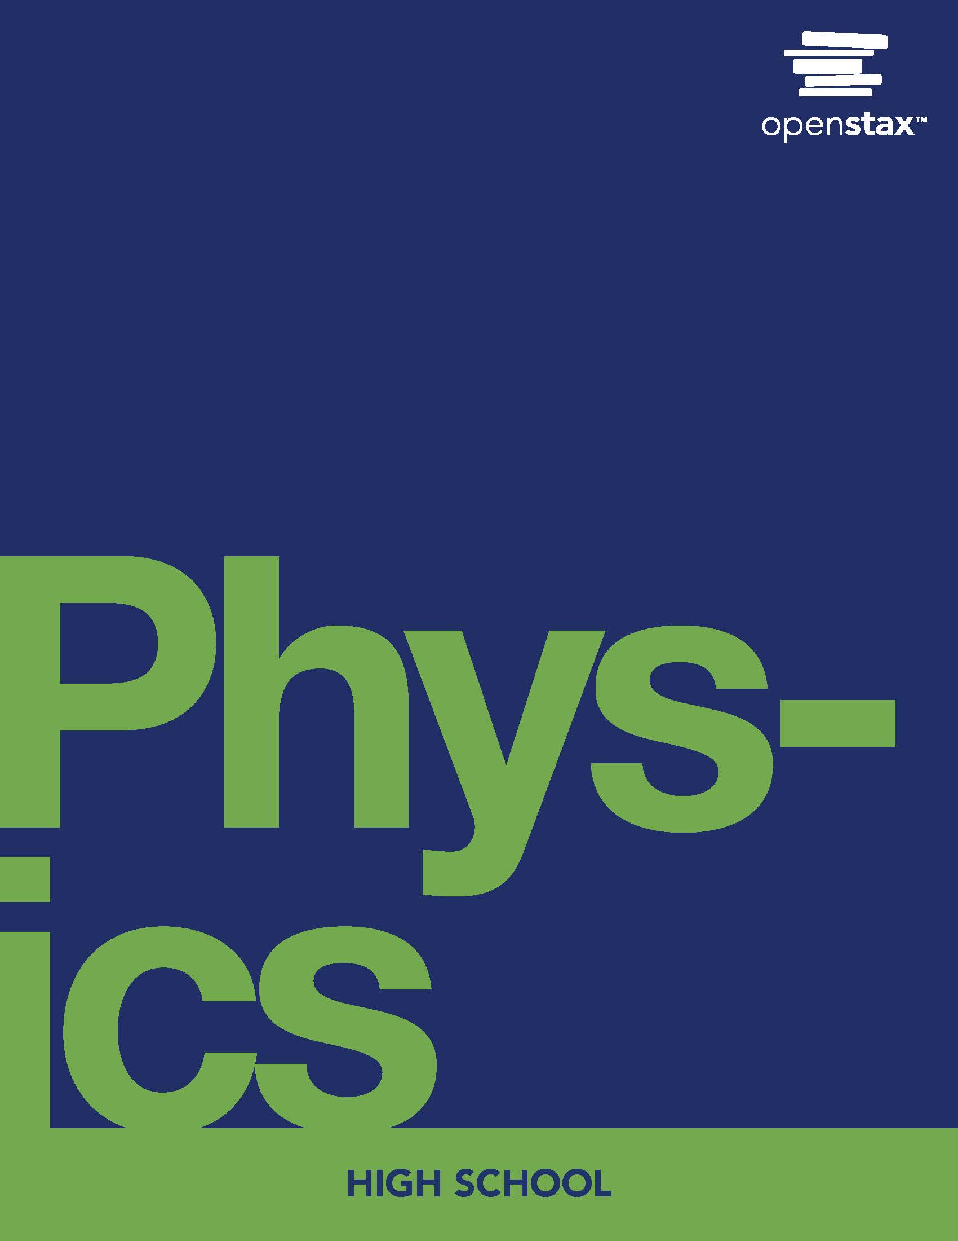
Physics
Chapter 7 Newton's Law of Gravitation

Slide 2
Chapter outline
Kepler's Laws of Planetary Motion
Newton's Law of Universal Gravitation and Einstein's Theory of General Relativity

Slide 3
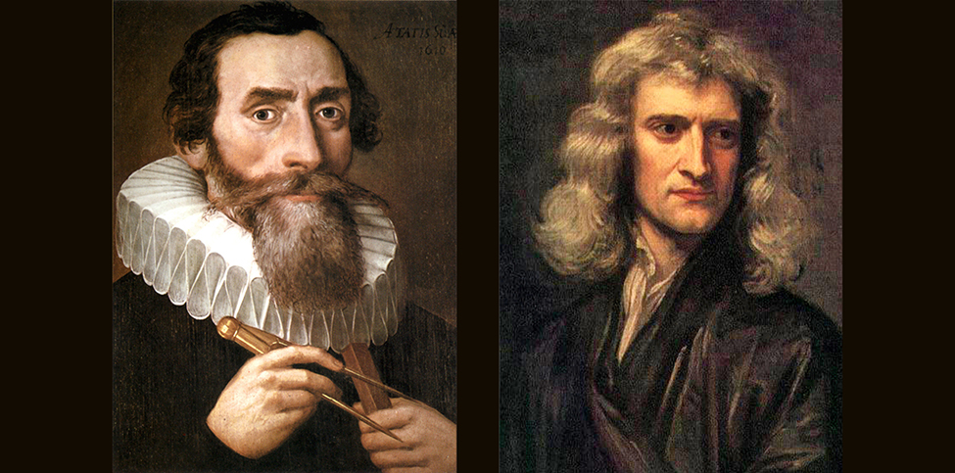
Figure 7.1
Johannes Kepler (left) showed how the planets move, and Isaac Newton (right) discovered that gravitational force caused them to move that way. ((left) unknown, Public Domain; (right) Sir Godfrey Kneller, Public Domain)
Notes:
Two photos show men in old-fashioned dress.

Slide 4
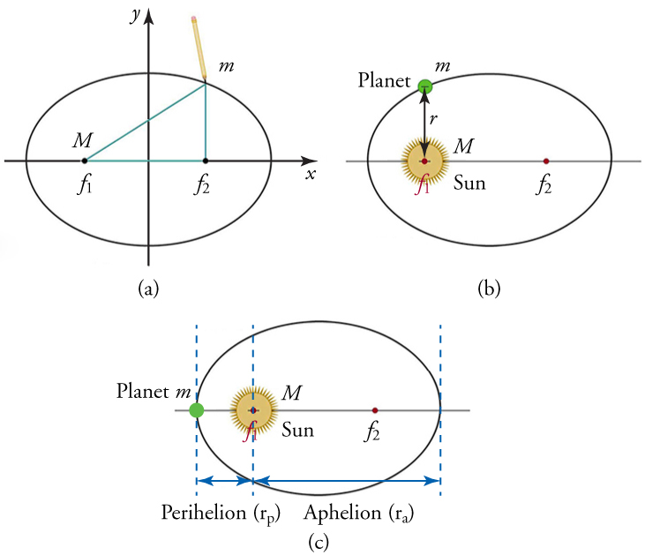
Figure 7.2
(a) An ellipse is a closed curve such that the sum of the distances from a point on the curve to the two foci (f1 and f2) is constant. (b) For any closed orbit, m follows an elliptical path with M at one focus. (c) The aphelion (ra) is the furthest distance between the planet and the sun, while the perihelion (rp) is the closest distance from the sun.
Notes:
Three ellipses are shown. In image (a) the ellipse is divided into quadrants. In image (b) the sun and a planet are shown. In image (c), the sun and planet are shown, and the aphelion and perihelion.

Slide 5
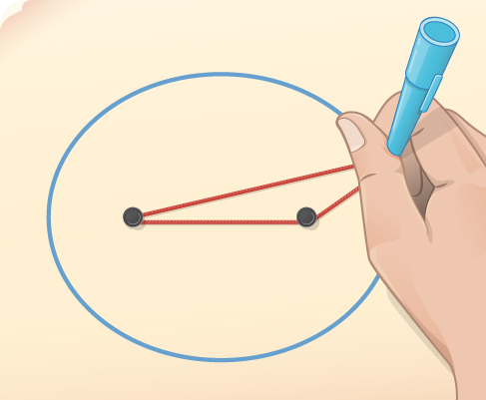
Figure 7.3
You can draw an ellipse as shown by putting a pin at each focus, and then placing a loop of string around a pen and the pins and tracing a line on the paper.
Notes:
A picture shows a hand holding a pen, drawing a blue ellipse, with 2 black pins inside the ellipse. A red string is attached to the pins. The pen is held inside the red string, to draw the ellipse.

Slide 6
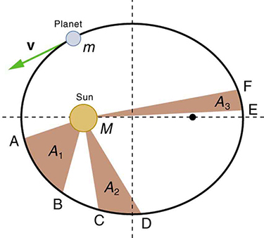
Figure 7.4
The shaded regions have equal areas. The time for m to go from A to B is the same as the time to go from C to D and from E to F. The mass m moves fastest when it is closest to M. Kepler’s second law was originally devised for planets orbiting the sun, but it has broader validity.
Notes:
A diagram shows a circle, divided into quadrants. The sun (labeled M) is inside the circle. The circle represents a planet’s orbit around the sun. The planet is labeled m. Shaded regions are labeled A1, A2, and A3

Slide 7
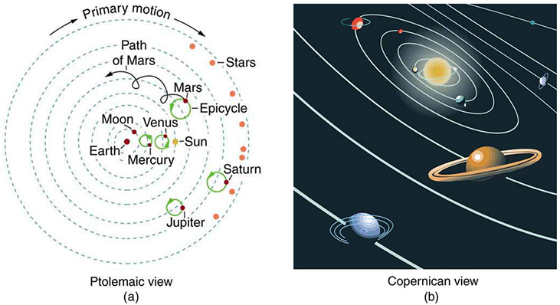
Figure 7.5
(a) The Ptolemaic model of the universe has Earth at the center with the moon, the planets, the sun, and the stars revolving about it in complex circular paths. This geocentric (Earth-centered) model, which can be made progressively more accurate by adding more circles, is purely descriptive, containing no hints about the causes of these motions. (b) The Copernican heliocentric (sun-centered) model is a simpler and more accurate model.
Notes:
Image a shows the Ptolemaic view of the solar system. This view shows Earth at the center of the solar system with all other planets orbiting clockwise, the moon circling the Earth, Mercury and Venus which go in wide circles as it orbits, which are called Epicycles. The Sun orbits earth between Venus and Mars. Mars circles opposite of the others, its own path shown with a looping arrow. Jupiter and Saturn come next. On the outside of the solar system are stars. Image b shows the Copernican view of the solar system which is the more traditional view of the solar system with the Sun in the center and the other planets orbiting the sun.

Slide 8
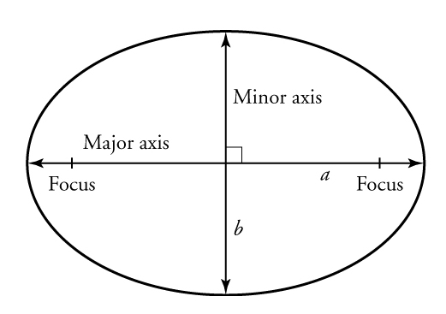
Figure 7.6
The major axis is the length of the ellipse, and the minor axis is the width of the ellipse. The semi-major axis is half the major axis, and the semi-minor axis is half the minor axis.
Notes:
A drawing shows as ellipse, divided into quadrants. The horizontal line is labeled major axis; the vertical line is labeled minor axis. A focus point is marked at each end of the major axis.

Slide 9
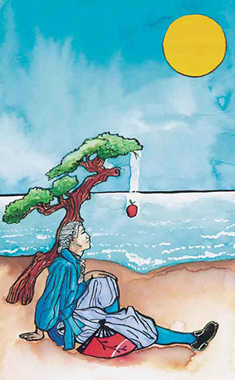
Figure 7.7
The popular legend that Newton suddenly discovered the law of universal gravitation when an apple fell from a tree and hit him on the head has an element of truth in it. A more probable account is that he was walking through an orchard and wondered why all the apples fell in the same direction with the same acceleration. Great importance is attached to it because Newton’s universal law of gravitation and his laws of motion answered very old questions about nature and gave tremendous support to the notion of underlying simplicity and unity in nature. Scientists still expect underlying simplicity to emerge from their ongoing inquiries into nature.
Notes:
A painting shows a man sitting under a tree, from which an apple is falling.

Slide 10
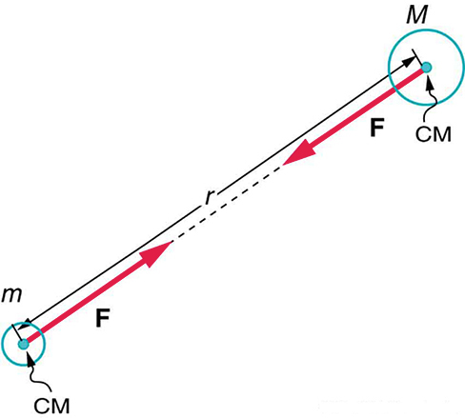
Figure 7.8
Gravitational attraction is along a line joining the centers of mass (CM) of the two bodies. The magnitude of the force on each body is the same, consistent with Newton’s third law (action-reaction).
Notes:
A figure shows a small circle and a large circle. A black line goes from one circle to the other. A red line with an arrow extends outward from each circle. The red lines have arrows on one end, pointing away from the circles, towards the midpoint of the space in between the circles.

Slide 11
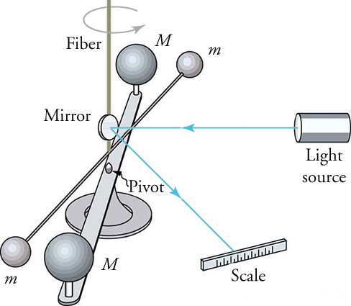
Figure 7.9
Cavendish used an apparatus like this to measure the gravitational attraction between two suspended spheres (m) and two spheres on a stand (M) by observing the amount of torsion (twisting) created in the fiber. The distance between the masses can be varied to check the dependence of the force on distance. Modern experiments of this type continue to explore gravity.
Notes:
Apparatus consisting of two large spheres, one on each end of a horizontal rod centered on a pivot. Two smaller spheres are at the extremity of a smaller horizontal rod also centered on same pivot point. Light source shines laser beam that hits mirror and reflects onto scale to show pivot angle of spheres.

Slide 12
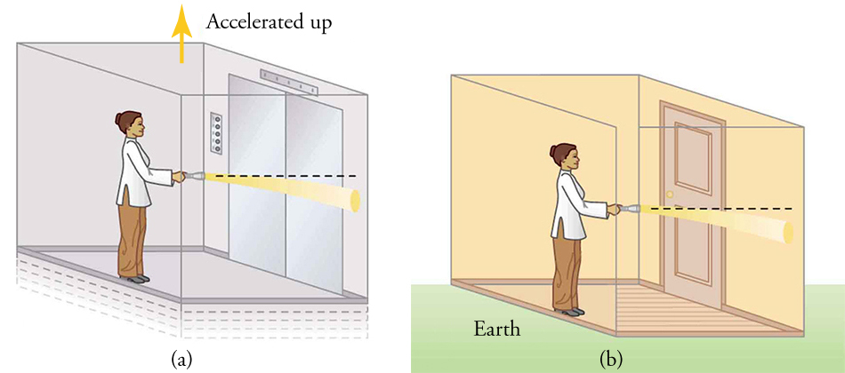
Figure 7.10
(a) A beam of light emerges from a flashlight in an upward-accelerating elevator. Since the elevator moves up during the time the light takes to reach the wall, the beam strikes lower than it would if the elevator were not accelerated. (b) Gravity must have the same effect on light, since it is not possible to tell whether the elevator is accelerating upward or is stationary and acted upon by gravity.
Notes:
Left panel shows a person in an elevator who shines a light beam on the wall. Beam of light bends down. Elevator is labelled “accelerated up.” Right panel shows same picture, but person is in a room on Earth.

Slide 13
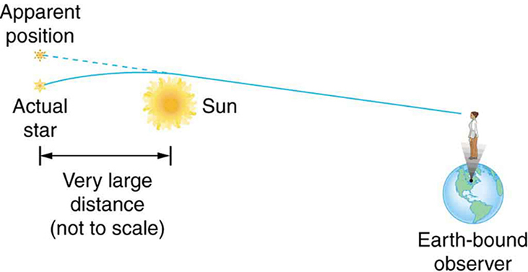
Figure 7.11
This schematic shows how light passing near a massive body like the sun is curved toward it. The light that reaches the Earth then seems to be coming from different locations than the known positions of the originating stars. Not only was this effect observed, but the amount of bending was precisely what Einstein predicted in his general theory of relativity.
Notes:
Schematic drawing of sun at left and Earth at right. A person is standing on Earth. Two stars to left of sun. Lines drawn from starts to person’s eyes. Lower star has curved solid line, and upper star has straight dashed line.

Slide 14
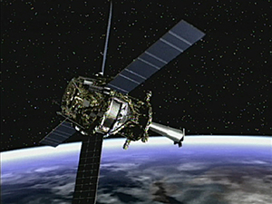
Figure 7.12
Artist concept of Gravity Probe B spacecraft in orbit around the Earth. (credit: NASA/MSFC)
This OpenStax ancillary resource is © Rice University under a CC BY-NC-SA 4.0 International license; it may be reproduced or modified for noncommercial purposes only but must be attributed to OpenStax, Rice University and any changes must be noted. Any adaptation must be shared under the same type of license.
Notes:
Photo shows satellite in space.

