Slide 1

Physics
Chapter 8 Momentum

Slide 2
Chapter outline
Linear Momentum, Force, and Impulse
Conservation of Momentum
Elastic and Inelastic Collisions

Slide 3
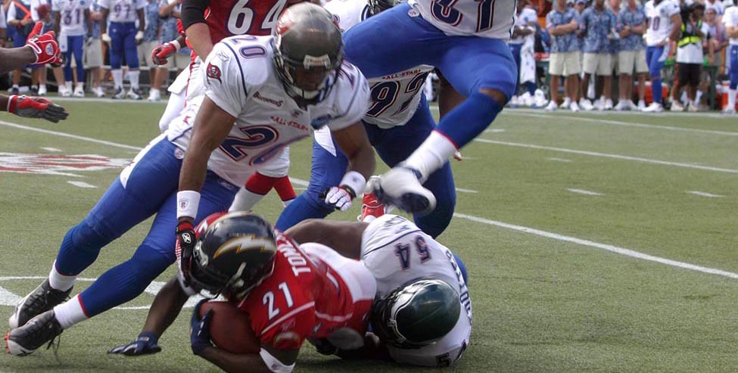
Figure 8.1
NFC defensive backs Ronde Barber and Roy Williams along with linebacker Jeremiah Trotter gang tackle AFC running back LaDainian Tomlinson during the 2006 Pro Bowl in Hawaii. (United States Marine Corps)
Notes:
A photograph shows a football game with four football players trying to tackle a fifth player. A crowd is shown in the background.

Slide 4
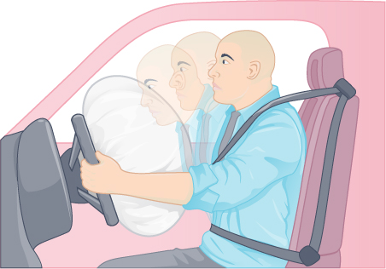
Figure 8.2
Vehicles have safety features like airbags and seat belts installed.
Notes:
An illustration is shown of a man sitting in a car seat behind the wheel, wearing a seat belt. An airbag has been deployed from the wheel. The illustration indicates that the man's body is moving toward the airbag.

Slide 5
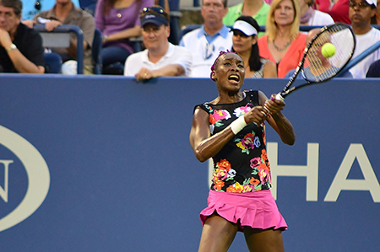
Figure 8.3
Venus Williams playing in the 2013 US Open (Edwin Martinez, Flickr)
Notes:
Serena Williams is a famous tennis player. In this image she is hitting a tennis ball with a tennis racket.

Slide 6
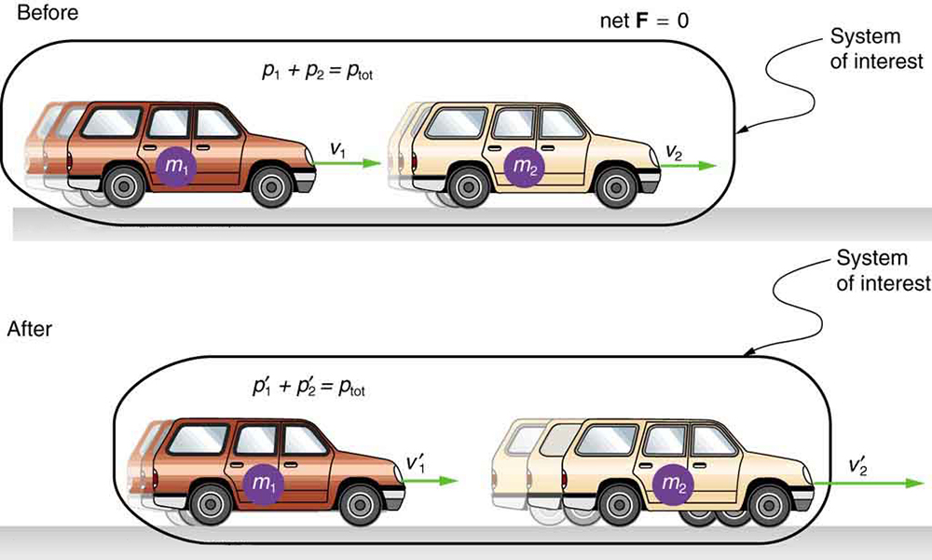
Figure 8.4
Car of mass m1 moving with a velocity of v1 bumps into another car of mass m2 and velocity v2. As a result, the first car slows down to a velocity of v′1 and the second speeds up to a velocity of v′2. The momentum of each car is changed, but the total momentum ptot of the two cars is the same before and after the collision if you assume friction is negligible.
Notes:
Revise alt text to: An illustration shows before and after diagrams of two cars, one in front of the other. The car in the back is labeled m one and the car in the front is labeled m two. Both diagrams are labeled System of Interest. In the before diagram, a velocity vector points from the car in the back to the car in the front. A second velocity vector of equal magnitude points from the car in the front to the right. Two equations are shown: p one plus p two equals p total and net F equals zero. In the after diagram, the velocity vector pointing from the car in the back is shorter. The velocity vector pointing from the car in the front is longer. They are labeled v one prime and v two prime. The equation p one prime plus p two prime equals p total is shown.

Slide 7
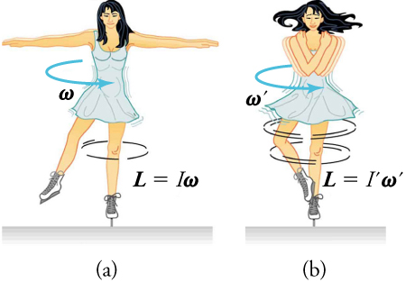
Figure 8.5
(a) An ice skater is spinning on the tip of her skate with her arms extended. In the next image, (b), her rate of spin increases greatly when she pulls in her arms.
Notes:
An illustration shows an ice skater in two positions. She is spinning on the tip of her skate with her arms extended in the first position. In the second position, her arms are pulled in as she is spinning. In the first position, an arrow labeled w shows the direction of her spin and the equation L equals I times w is shown. In the second position, an arrow labeled w prime shows the direction of her spin and the equation L equals I prime times w prime is shown.

Slide 8
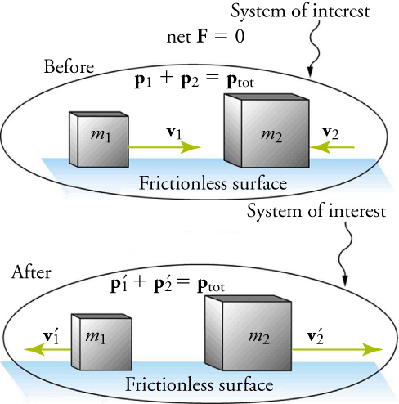
Figure 8.6
The diagram shows a one-dimensional elastic collision between two objects.
Notes:
An illustration shows before and after diagrams of two boxes moving toward each other on a frictionless surface. The box on the left is labeled m one and the box on the right is labeled m two. Both diagrams are labeled System of Interest. In the before diagram, a velocity vector, v one, points from m one toward m two. A second, shorter velocity vector, v two, points from the left side of m two toward m one. Two equations are shown: p one plus p one equals p total and net F equals zero. In the after diagram, both velocity vectors point away from each mass, m one and m two. The vector on the left is shorter than the one on the right. The equation p one prime plus p one prime equals p total is shown.

Slide 9
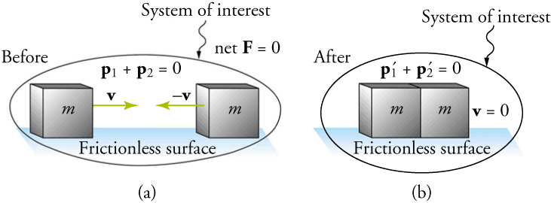
Figure 8.7
A one-dimensional inelastic collision between two objects. Momentum is conserved, but kinetic energy is not conserved. (a) Two objects of equal mass initially head directly toward each other at the same speed. (b) The objects stick together, creating a perfectly inelastic collision. In the case shown in this figure, the combined objects stop; This is not true for all inelastic collisions.
Notes:
An illustration shows before and after diagrams of two boxes moving toward each other on a frictionless surface. Both boxes are labeled m. Both diagrams are labeled System of Interest. In the before diagram, a velocity vector, v, points from the left box to the right box. A second vector of equal magnitude, negative v, points from right box toward the left box. Two equations are shown: p one plus p two equals zero and net F equals zero. In the after diagram, the boxes are touching. The equations p one prime plus p two prime equals zero and v equals zero are shown.

Slide 10
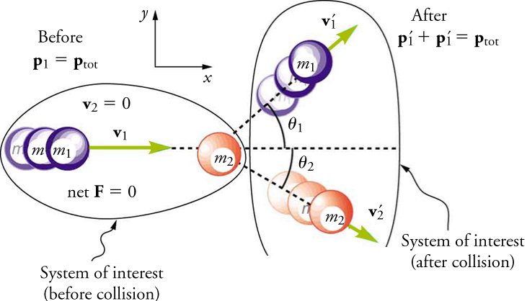
Figure 8.8
A two-dimensional collision with the coordinate system chosen so that m2 is initially at rest and v1 is parallel to the x-axis.
Notes:
An illustration shows before and after diagrams of two balls, one moving toward the other. The first ball is labeled m one and the second ball is labeled m two. Both diagrams are labeled System of Interest, but the diagram on the left specifies before collision and the diagram on the right specifies after collision. In the before diagram, a velocity vector, v one, points from m one to m two. The following are also shown: v two equals zero, net F equals zero, and p one equals p total. In the after diagram, m one is moving in an upward direction and m two is moving in a downward direction. Vectors labeled v one prime and v two prime show their directional movements. M one and m two are shown forming angles with the x-axis. The equation p one prime plus p one prime equals p total is shown.

Slide 11
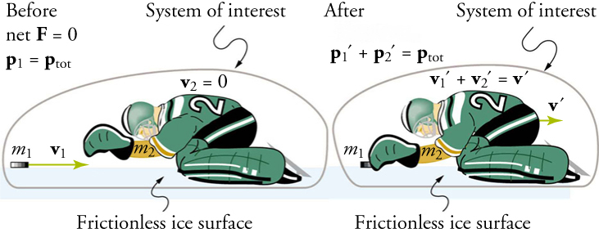
Figure 8.9
An ice hockey goalie catches a hockey puck and recoils backward in an inelastic collision.
Notes:
An illustration shows before and after diagrams of a hockey puck and an ice hockey player on a frictionless ice surface. The hockey puck is labeled m one and the hockey player is labeled m two. Both diagrams are labeled System of Interest. In the before diagram, a velocity vector, v one, points from the puck to the player. The following are shown: p one equals p total, v two equals zero, and net F equals zero. In the after diagram, the hockey puck has made contact with the player. A velocity vector, v prime, points from the hockey player to the right. The equation p one prime plus p two prime equals p total is shown. The equation v one prime plus v two prime equals v prime is also shown.

Slide 12
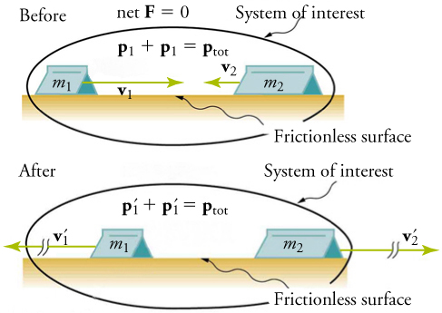
Figure 8.10
Two carts collide with each other in an elastic collision.
Notes:
An illustration shows before and after diagrams of two carts moving toward each other on a frictionless surface. The cart on the left is labeled m one and the car on the right is labeled m two. Both diagrams are labeled System of Interest. In the before diagram, a velocity vector, v one, points from the cart on the left to the cart on the right. A second, shorter velocity vector, v two, points from the cart on the right to the cart on the left. Two equations are shown: p one plus p one equals p total and net F equals zero. In the after diagram, the velocity vectors are equal in magnitude and point away from the carts. They are labeled v one prime and v two prime. The equation p one prime plus p one prime equals p total is shown.

Slide 13
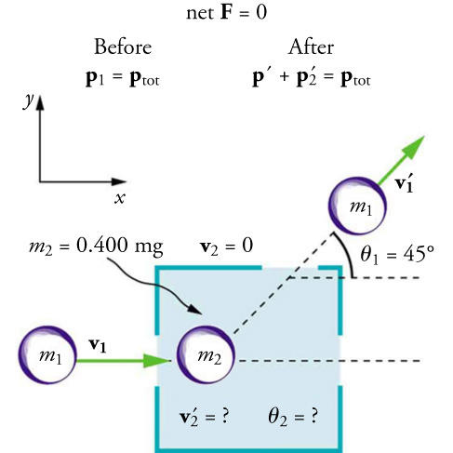
Figure 8.11
The incoming object of mass m1 is scattered by an initially stationary object. Only the stationary object’s mass m2 is known. By measuring the angle and speed at which the object of mass m1 emerges from the room, it is possible to calculate the magnitude and direction of the initially stationary object’s velocity after the collision.
This OpenStax ancillary resource is © Rice University under a CC BY-NC-SA 4.0 International license; it may be reproduced or modified for noncommercial purposes only but must be attributed to OpenStax, Rice University and any changes must be noted. Any adaptation must be shared under the same type of license.
Notes:
An illustration shows before and after diagrams of two balls, one moving toward the other. The first ball is labeled m one and the second ball is labeled m two and point four kilograms. In the before diagram, a velocity vector, v one, points from m one to m two. In the after diagram, m one is moving in an upward direction with a velocity vector, v one prime, indicating its direction. It forms an angle of forty-five degrees with the x-axis. The following are also shown: before, p one equal p total; after, prime plus p two prime equals p total; net F equals zero; v two equals zero; v two prime is unknown; angle two is unknown.

