Slide 1

Physics
Chapter 9 Work, Energy, and Simple Machines

Slide 2
Chapter outline
Work, Power, and the Work–Energy Theorem
Mechanical Energy and Conservation of Energy
Simple Machines

Slide 3
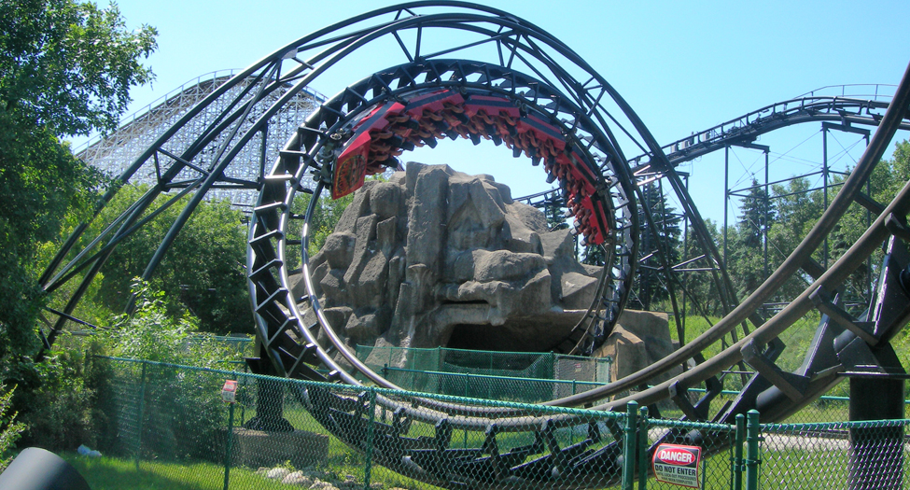
Figure 9.1
People on a roller coaster experience thrills caused by changes in types of energy. (Jonrev, Wikimedia Commons)
Notes:
A photograph shows a roller coaster cart in an upside down position inside a roller coaster loop of a track

Slide 4
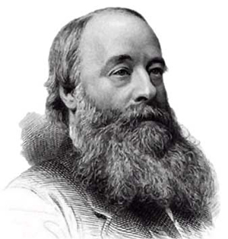
Figure 9.2
The joule is named after physicist James Joule (1818–1889). (C. H. Jeens, Wikimedia Commons)
Notes:
A black and white photograph of James Joule is shown.

Slide 5
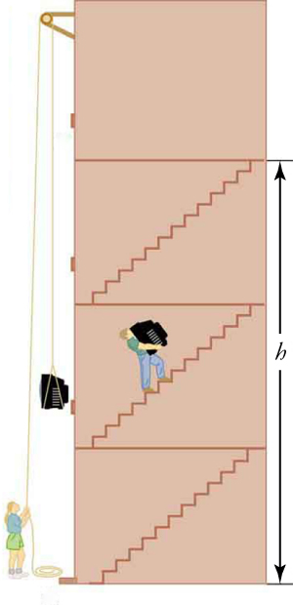
Figure 9.3
No matter how you move a TV to the fourth floor, the amount of work performed and the potential energy gain are the same.
Notes:
A cross-section view of a four-story elevator is shown. The first three floors are labeled with h. A person is carrying a television up a flight of stairs on the second floor. Another person is standing on the ground floor, using a pulley to move a television up the floors.

Slide 6
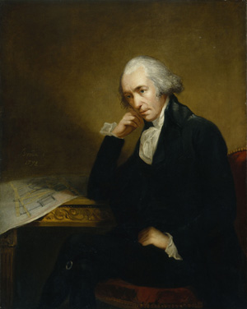
Figure 9.4
Is James Watt thinking about watts? (Carl Frederik von Breda, Wikimedia Commons)
Notes:
A painting of James Watt is shown.

Slide 7
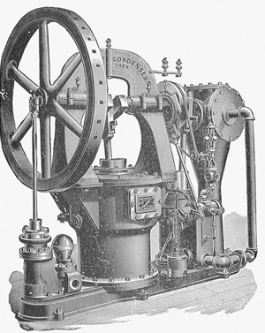
Figure 9.5
A late version of the Watt steam engine. (Nehemiah Hawkins, Wikimedia Commons)
Notes:
A black and white illustration of an early steam engine is shown.

Slide 8
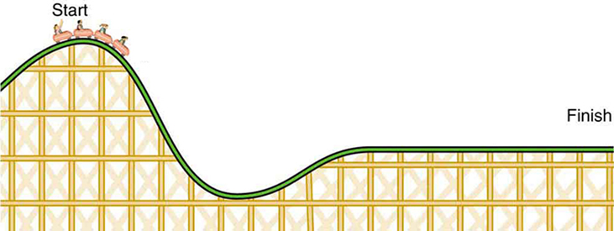
Figure 9.6
During this roller coaster ride, there are conversions between potential and kinetic energy.
Notes:
An illustration shows a side view of a roller coaster. People in a cart are at the top of a hill, and the cart is labeled Start. The cart is heading towards a downward slope. The opposite end of the roller coaster is flat and is labeled Finish.

Slide 9
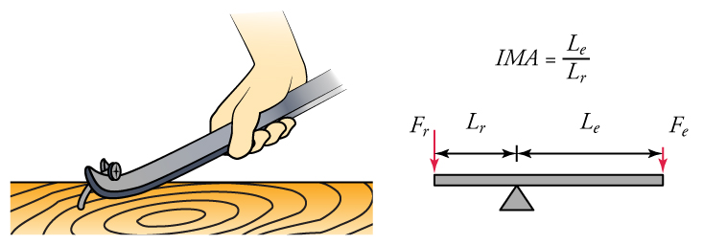
Figure 9.7
(a) A pry bar is a type of lever. (b) The ideal mechanical advantage equals the length of the effort arm divided by the length of the resistance arm of a lever.
Notes:
Two diagrams are shown side by side. The diagram on the left shows a drawing of a hand pulling a mail out of wood using a lever. The diagram on the right shows an illustration of a lever and a fulcrum. The fulcrum is closer to the left side of the lever than the right side. The distance of the left side of the lever is labeled L subscript r and the distance of the right side is labeled L subscript e. A force vector is pointing down on the left side and is labeled F subscript r, and a force vector is pointing down on the right side and is labeled F subscript e. The equation IMA equals L subscript e over L subscript r is also shown.

Slide 10
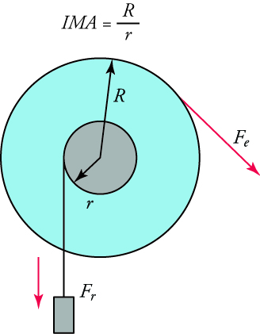
Figure 9.8
Force applied to a wheel exerts a force on its axle.
Notes:
A diagram of a wheel is shown. The equation IMA equals capital R over lowercase r. A small grey circle is inside a larger blue circle. An arrow labeled lowercase r points from the center of the smaller circle to its edge. An arrow labeled capital R points from the center of the smaller circle to the edge of the larger circle. A mass is attached to the smaller circle and has a force vector, F subscript r, pointing downward from it. Another force vector, F subscript e, points downward and to the right from the edge of the larger circle.

Slide 11
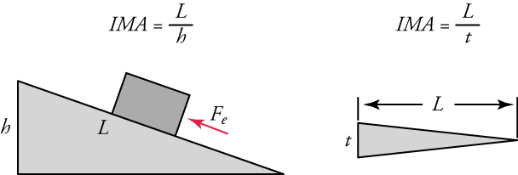
Figure 9.9
An inclined plane is shown on the left, and a wedge is shown on the right.
Notes:
Two diagrams are shown side-by-side. On the left, an inclined plane is shown. Its horizontal surface distance is labeled L and its height is labeled h. A box is shown on the surface with a force vector that points up the plane. The equation IMA equals L over h is shown. On the right, a wedge is shown. Its horizontal surface distance is labeled L. Its height is labeled t. The equation IMA equals L over t is also shown.

Slide 12
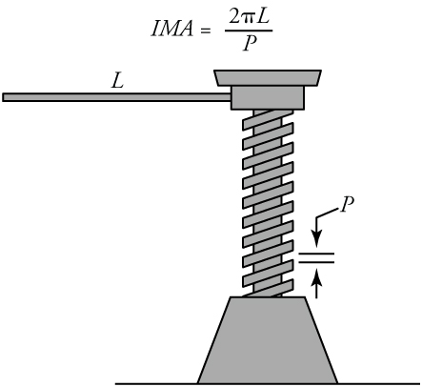
Figure 9.10
The screw shown here is used to lift very heavy objects, like the corner of a car or a house a short distance.
Notes:
An illustration of a screw is shown. It has a long lever, labeled L. P is pitch, the distance between the threads.

Slide 13
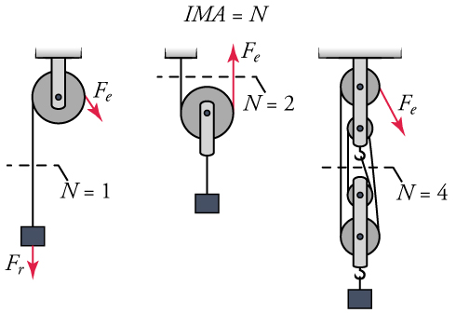
Figure 9.11
Three pulley systems are shown here.
Notes:
Three pulley systems are shown in side-by-side diagrams. The first consists of a single pulley and is shown holding a mass. The mass is labeled with a force vector, F r, that also points downward. Another force vector, F e, is shown pointing downward from the pulley. N equals one is also shown. The second pulley system consists of a single pulley holding a mass. A force vector, F e, points upward from the pulley. N equals two is shown. The last pulley system shows four pulleys holding a mass with a hook. A force vector, F e, points downward from the pulley. N equals four is shown.

Slide 14
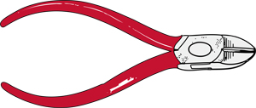
Figure 9.12
Wire cutters are a common complex machine.
This OpenStax ancillary resource is © Rice University under a CC BY-NC-SA 4.0 International license; it may be reproduced or modified for noncommercial purposes only but must be attributed to OpenStax, Rice University and any changes must be noted. Any adaptation must be shared under the same type of license.
Notes:
An illustration shows a pair of hand-held wire cutters.

