Slide 1
Azure Machine Learning

Slide 2
What is Machine Learning ?
Using known data, develop a model to predict unknown data.
Notes:
Basic definition:
Machine learning develops algorithms for making predictions (statistical sense) from data *
Learning models from available training data, to make good predictions on unseen test data

Slide 3
Microsoft & Machine Learning
1997
2008
2009
2010
2014
2015
Hotmail launches
Which email is junk?
Bing maps launches
What’s the best way to home?
Bing search launches
Which searches are most relevant?
Kinect launches
What does that motion “mean”?
Skype Translator launches
What is that person saying?
Azure Machine Learning GA
What will happen next?
Notes:
More than a decade, Microsoft is using ML in its services.

Slide 4
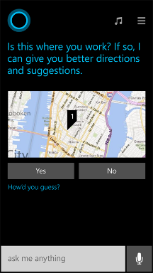
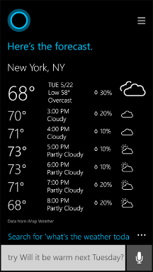
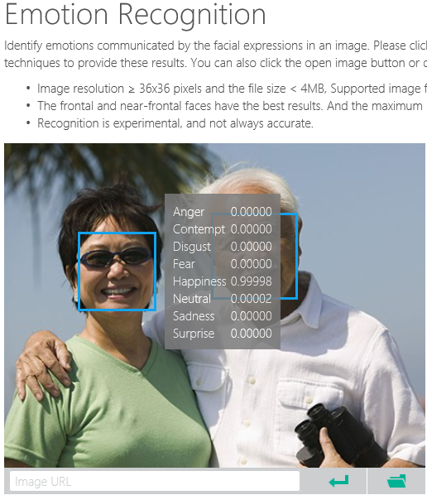
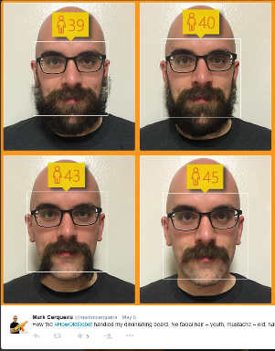
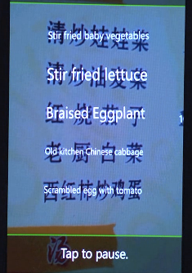
Why Machine Learning?
Notes:
Smart applications, services, platforms…
Digital Smart Personal Assistant
Image / Text / Data analyze

Slide 5
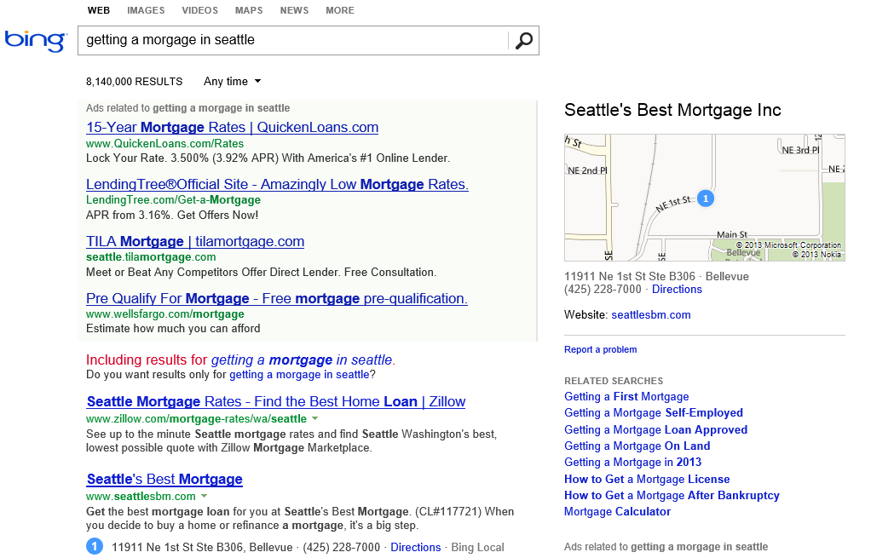
What is the probability of a click on each ad?
What language?
What is the intent?
Machine learning enables nearly every value proposition of web search.
Which ads to show, and in what order?
Are any of these pages malicious?
Misspelled?
What pages should we index?
What ad pricing will optimize revenue?
Which links are most likely to get clicked?
Notes:
The first “killer commercial application” of ML on Big Data was web search. With ML, we can use all of the billions of queries and associated clicks that we collect each month as training data for an ML system. That way, the system can learn, for each query, which web pages are likely the most relevant.
But the impact of ML goes beyond page relevance. With billions of queries, we can learn common misspellings and the native language of the user. We can discern the intent of the user – shopping? research? entertainment? ML can learn what kinds of pages are malicious.
ML also is able to learn, for each query, what kinds of ads are most likely to be clicked, and also learn how best to show the ads.
And even before we get to a real user, ML can be used to figure out what parts of the web are worth scanning, and what pricing for ads will optimize revenues.

Slide 6
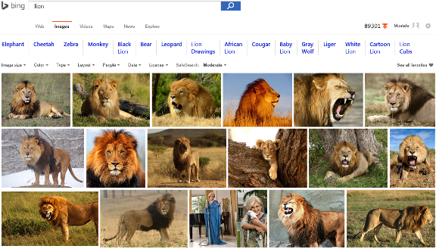
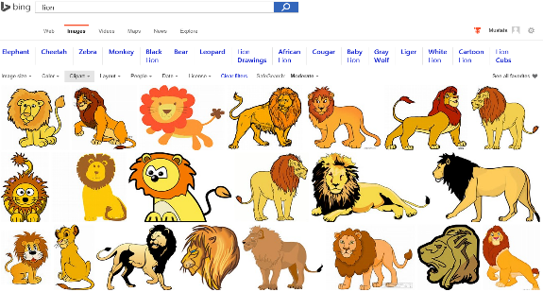
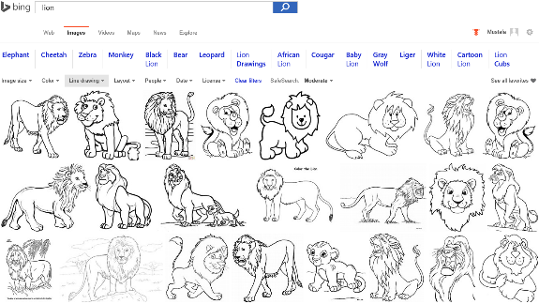
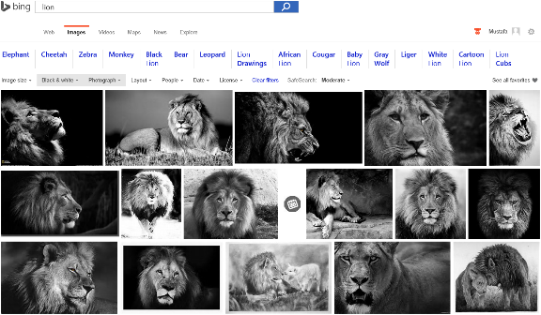
Image Analyze
Notes:
Search “lions” on Bing and change Image type etc. filters…
Behind the ML service categorizes the image db and returns the result.

Slide 7

Accent Color: Which border color is the best?
Notes:
Some another application on computer vision that meets with the machine learning

Slide 8
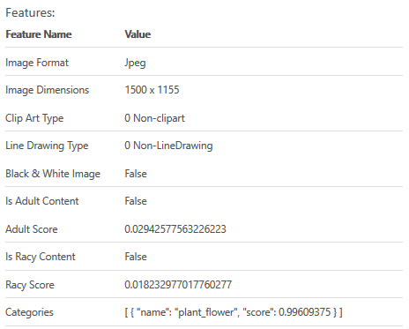

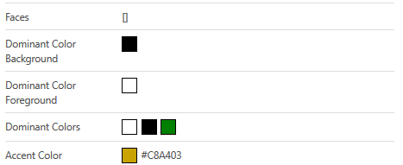
Accent Color: Analyze Image
Notes:
Goto https://www.projectoxford.ai/demo/visions#Analysis and analyze this image to find its accent color

Slide 9
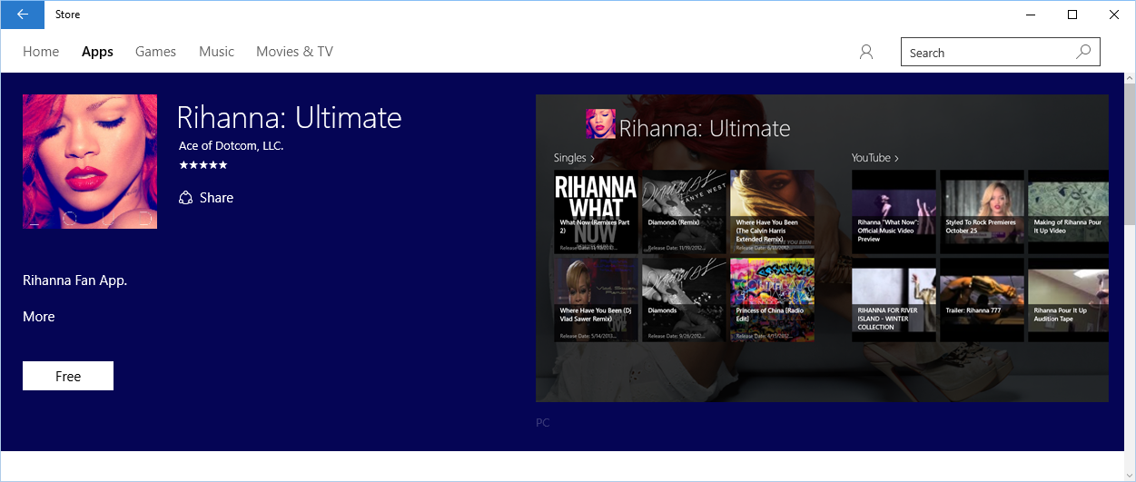
Accent Color: Windows 10 Store
Notes:
How to use accent color, case study.

Slide 10
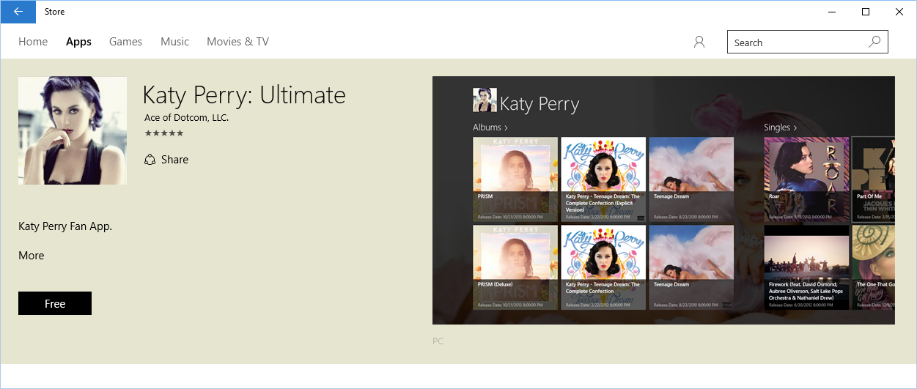
Accent Color: Windows 10 Store
Notes:
How to use accent color, case study.

Slide 11
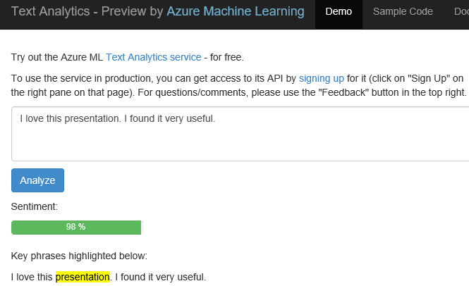
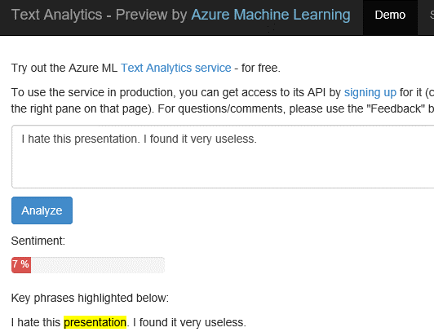
Text Analytics: User reviews
Positive
Negative
Notes:
Ready to use ML API published on Azure Datamarket place. A showcase of production ML solution in action (This can be used i.e. in shopping websites to see user reviews about a product etc.)
Test by yourself some of the reviews comments on Expedia or other online shopping sites. Copy/paste user comments to see the analyze result. If sentiment result shows higher percentage number, it means it is positive. If the percentage is low than it is a negative comment.
https://text-analytics-demo.azurewebsites.net/

Slide 12

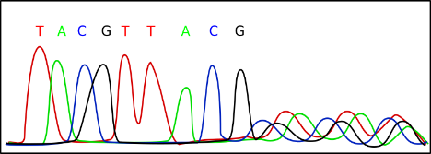
Data Science
Data Science is far too complex
Cost of accessing/using efficient ML algorithms is high
Comprehensive knowledge required on different tools/platforms to develop a complete ML project
Difficult to put the developed solution into a scalable production stage
Need a simpler/scalable method:
Azure Machine Learning Service
Notes:
Actually it is the science on data

Slide 13

Microsoft Azure Machine Learning
Make machine learning accessible to every enterprise, data scientist, developer, information worker, consumer, and device anywhere in the world.

Slide 14
From data to decisions and actions
Data
Recommendations
What should I do?
Decision
Action
Decision automation
Decision support
Predictions
What will happen?
Interactive dashboards
Why did it happen?
Static reports
What happened?
Manual process
Value
Notes:
Azure ML aims to transform your data in to an intelligent action

Slide 15






Transform data into intelligent action
Information Management
Big Data Stores
Machine Learning and Analytics
Dashboards and Visualizations
Business apps
Power BI
Azure
Data Factory
Azure
Machine Learning
Personal Digital Assistant
Azure
Data Lake
Cortana
People
Custom apps
Azure
Data Catalog
Azure
HDInsight (Hadoop)
Perceptual Intelligence
Azure
SQL Data Warehouse
Face, vision
Speech, text
Azure
Event Hub
Azure
Stream Analytics
Business Scenarios
Sensors and devices
Recommendations,
customer churn,
forecasting, etc.
Automated Systems
DATA
INTELLIGENCE
ACTION

Slide 16
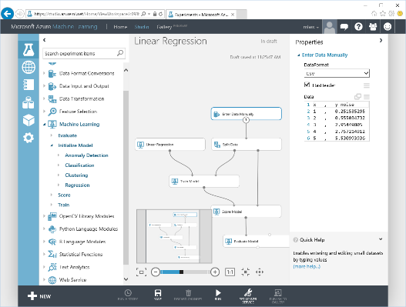
Microsoft Azure Machine Learning
Web based UI accessible from different browsers
Share|collaborate to any other ML workspace
Drag&Drop visual design|development
Wide range of ML Algorithms catalog
Extend with OSS R|Python scripts
Share|Document with IPython|Jupyter
Deploy|Publish|Scale rapidly (APIs)
Notes:
Lets look at some of the features of ML Studio

Slide 17
Microsoft Azure Machine Learning Built for a cloud-first, mobile-first world
Fully managed
Integrated
Flexible
Deploy in minutes
No software to install, no hardware to manage, all you need is an Azure subscription.
Drag, drop and connect interface. Data sources with just a drop down; run across any data.
Built-in collection of best of breed algorithms with no coding required. Drop in custom R or use popular CRAN packages.
Operationalize models as web services with a single click. Monetize in Machine Learning Marketplace.

Slide 18
Microsoft Azure Machine Learning
ML Algorithms
Best of MS
ML Studio
Data Scientist
ML Operationalization
IT Professional
ML APIs Marketplace
ISVs & Developers
Notes:
How customers generally benefit from Azure ML

Slide 19
Azure Machine Learning Ecosystem
Provision Workspace
Build ML Model
Deploy as Web Service
Publish an App
Get/Prepare Data
Publish Web Service
Get Azure Subscription
Create Workspace
Evaluate Model Results
Build/Edit Experiment
Azure Data
Marketplace
Create/Update Model
Notes:
Stages to develop end to end Azure ML solution. First you need an AML workspace... then you build a model under AML Studio, then publish it as web service and as an app (see text analytics demo in prior slides)

Slide 20
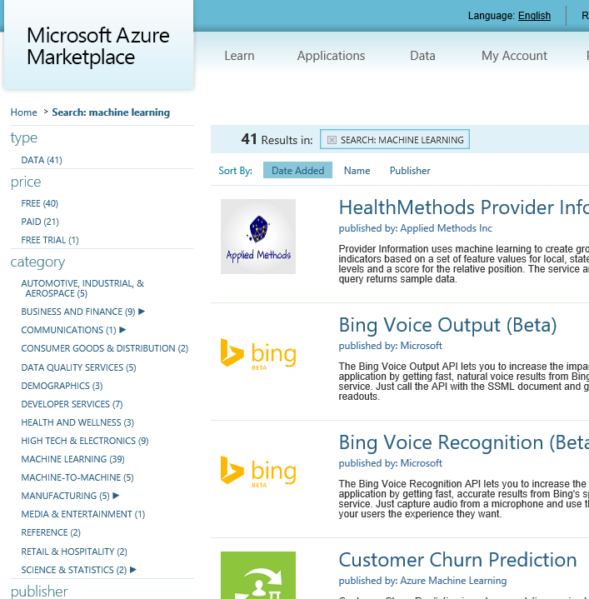
API examples
Green Score, Wealth Score, Giving Score
Frequently Bought Together API
Recommendations API
Anomaly Detection API
Lexicon Based Sentiment Analysis
Forecasting: Exponential Smoothing
Forecasting: ETS+STL
Forecasting: AutoRegressive Integrated Moving Average (ARIMA)
Binary Classifier API
Cluster Model API
Survival Analysis API
Multivariate Linear Regression API
Survival Analysis API
Multivariate Linear Regression API
Normal Distribution Quantile Calculator
Binomial Distribution Quantile Calculator
And more on datamarket.azure.com
Notes:
https://datamarket.azure.com/browse?query=machine+learning
Some of the ready to use ML Api available for end users.
Recently announced most of them as Microsoft Cognitive Services that is available under Microsoft Azure (new) portal. Search available services with “cognitive” keyword under new portal.
You can create i.e. face recognition service under Azure portal to be used in apps.

Slide 21
Azure Machine Learning Service Data -> Predictive model -> Operational web API in minutes
Data
Clients
API
ML STUDIO
Model is now a web service that is callable
Blobs and Tables
Hadoop (HDInsight)
Relational DB (Azure SQL DB)
Integrated development environment for Machine Learning
Monetize the API through our marketplace
Notes:
With the cloud, you can bring in data sources with the ease of a drop down or drop your on-premises data set into the built in storage space. Users can then model in our development environment – Machine Learning Studio – where we’re offering R, Python and SQLite as first class citizens in addition to our world-class Microsoft algorithms.
The second issue – and often the primary one – is putting finished work into production in a way others can use. We’ve heard from many data scientists that they model in R on a Linux stack but then have to hand over their work to developers who need to translate that into another language to actually make it work. This time consuming and unnecessary process has been eliminated with our system, as the model is with a click transformed into a web service end-point that can run over any data, anywhere and connect to any solution or client.
Next, not only can this model be put into production for your company, it can be made available for the world on our Machine Learning Marketplace. Microsoft hosts your solution and markets it for you, while you have the freedom to brand and monetize as you see fit. We also offer a number of Microsoft solutions here.

Slide 22
What is Machine Learning ?
Using known data, develop a model to predict unknown data.
Known Data: Big enough archive, previous observations, past data
Unknown Data: Missing, Unseen, not existing, future data
Model: Known data + Algorithms (ML algorithms)
Notes:
Basic definition:
Machine learning develops algorithms for making predictions (statistical sense) from data *
Learning models from available training data, to make good predictions on unseen test data
Highlight the keywords: Known Data, Model, Unknown Data and the Prediction (statistically…)

Slide 23
EXAMPLE

Slide 24




Known data
Model
Unknown data
…
…
…
…
…
1990
50°F
30°F
68°F
95°F
48°F
29°F
70°F
98°F
2000
Weather forecast sample
2010
49°F
27°F
67°F
96°F
2020
?
?
?
?
Using known data, develop a model to predict unknown data.
Notes:
Weather forecast sample:
- You have previous weather data
- You build your ML model based on existing data
- Based on the model you developed, make good predictions about future

Slide 25



Model (Regression)
90°F
1990
50°F
30°F
68°F
95°F
Predict 2020 Summer
2000
48°F
29°F
70°F
98°F
2010
49°F
27°F
67°F
96°F
-26°F
Using known data, develop a model to predict unknown data.
Notes:
Using appropriate algorithms with the existing data, we generate a mathematical model, formulation or define a pattern to predict future, unknown values
Highlight the keywords: Known Data, Model, Unknown Data and the Prediction (statistically…)

Slide 26
EXAMPLE

Slide 27
Model (Decision Tree)
Age<30
Income > $50K
Xbox-One Customer
Not Xbox-One Customer
Days Played > 728
Income > $50K
Xbox-One Customer
Not Xbox-One Customer
Xbox-One Customer
Notes:
More samples on: https://azure.microsoft.com/en-us/documentation/articles/machine-learning-algorithm-choice/

Slide 28
EXAMPLE

Slide 29

Model (Classification)
Classify a news article as (politics, sports, technology, health, …)
Politics
Sports
Tech
Health
Using known data, develop a model to predict unknown data.

Slide 30
Known data (Training data)
Documents
Labels
Tech
Health
Documents consist of unstructured text. Machine learning typically assumes a more structured format of examples
Politics
Politics
Process the raw data
Sports
Using known data, develop a model to predict unknown data.

Slide 31
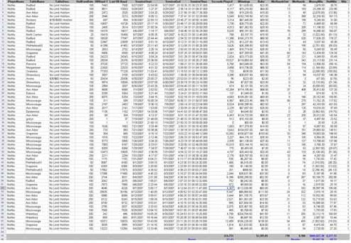
Known data (Training data)
Documents
Labels
Process each data instance to represent it as a feature vector
Tech
Documents
Labels
Health
Feature
Politics
Politics
Sports
Using known data, develop a model to predict unknown data.

Slide 32
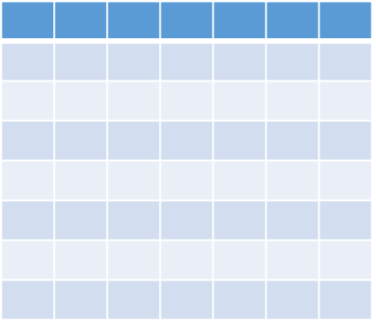
Feature vector
i.e.
Blood Pressure
Age
Height/Weight
Hearth Rate
{40, (180, 82), (11,7), 70, …..} : Healthy
Known data
Features
Label
Data instance
Feature Vector
Notes:
Just a brief info about some keywords used in ML

Slide 33




Developing a Model
Training data
Base Model
Documents
Labels
Feature Vectors
Tech
Adjust
Parameters
Health
Politics
Train the Model
Politics
Sports
Using known data, develop a model to predict unknown data.

Slide 34


Model’s Performance
True
labels
Predicted
labels
Detach
Model’s
Performance
Difference between “True Labels” and “Predicted Labels”
+/-
Known data with true labels
Tech
+/-
Tech
Health
Health
Politics
Politics
Politics
Politics
Tech
Health
Test data 20%
+/-
Sports
Sports
Politics
Politics
Split
Compare prediction
with true labels
Test trained model with features
Training data 80%
Tech
Health
Politics
Train the Model
Sports
Politics
Sports
Notes:
Ratio of the Test/Training data is trivial. Depends on model, data size, quality etc.
Split is random (i.e. which %80 portion of the data?)
There is no rule to split into %80 & %20 … it might be %50 & %50 etc depending on the problem, model, case.
If you are not happy with the Model’s performance than adjust the parameters and re-train the model. Or change the algorithm (training approach) behind the method…

Slide 35
Steps to Build a Machine Learning Solution
1
Problem Framing
2 Get/Prepare Data
3
Develop Model
4
Deploy Model
5
Evaluate / Track Performance
3.1
Analysis/ Metric definition
3.2
Feature Engineering
3.3
Model Training
3.4
Parameter Tuning
3.5
Evaluation

Slide 36
Confusion
Statistics
Develops methods|models that explains data
Data Mining
Find previously unknown schema, patterns in data
Artificial Intelligence
Procedure of programing a computer to behave intelligent
Predictive Analytics
Using Machine Learning techniques to predict future

Slide 37

Example use cases
Finance and risk
Sales and marketing
Customer and channel
Operations and workforce
Revenue Forecasting
Sales forecasting
User segmentation
Agent allocation
$$$
Portfolio optimization
Demand forecasting
Personalized offers
Warehouse efficiency
Investment modelling
Sales lead scoring
Product recommendation
Smart buildings
$$$
Fraud detection
Marketing mix optimization
Predictive maintenance
Risk management
Supply chain optimization
Notes:
Confidential…
+ notes From the book: AzureMachineLearning – AzureFundamentals
Many examples of predictive analytics can be found literally everywhere today in our society:
Spam/junk email filters These are based on the content, headers, origins, and even user behaviors (for example, always delete emails from this sender).
Mortgage applications Typically, your mortgage loan and credit worthiness is determined by advanced predictive analytic algorithm engines.
Various forms of pattern recognition These include optical character recognition (OCR) for routing your daily postal mail, speech recognition on your smart phone, and even facial recognition for advanced security systems.
Life insurance Examples include calculating mortality rates, life expectancy, premiums, and payouts.
Medical insurance Insurers attempt to determine future medical expenses based on historical medical claims and similar patient backgrounds.
Liability/property insurance Companies can analyze coverage risks for automobile and home owners based on demographics.
Credit card fraud detection This process is based on usage and activity patterns. In the past year, the number of credit card transactions has topped 1 billion. The popularity of contactless payments via near-field communications (NFC) has also increased dramatically over the past year due to smart phone integration.
Airline flights Airlines calculate fees, schedules, and revenues based on prior air travel patterns and flight data.
Web search page results Predictive analytics help determine which ads, recommendations, and display sequences to render on the page.
Predictive maintenance This is used with almost everything we can monitor: planes, trains, elevators, cars, and yes, even data centers.
Health care Predictive analytics are in widespread use to help determine patient outcomes and future care based on historical data and pattern matching across similar patient data sets.

Slide 38


Machine Learning Algorithms
ML Algorithm defines how your model will react
Which Algorithm to use? Depends on:
Data Quality
Data Size
What you want to predict
Time constraint
Computation power
Memory limits

Slide 39
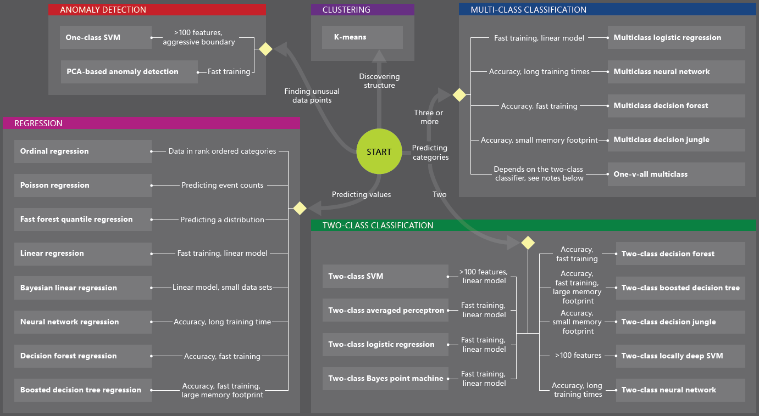
Machine Learning Algorithms
You can develop solutions by using
Custom algorithms written in R | Python
Ready to use ML services from data market
Existing algorithms

Slide 40
Machine Learning Algorithms
Two major category of algorithms
Supervised
Unsupervised
Most commonly used machine learning algorithms are supervised (requires labels)
Supervised learning examples
This customer will like coffee
This network traffic indicates a denial of service attack
Unsupervised learning examples
These customers are similar
This network traffic is unusual
Notes:
How to choose algorithms for Microsoft Azure Machine Learning
https://azure.microsoft.com/en-us/documentation/articles/machine-learning-algorithm-choice/

Slide 41
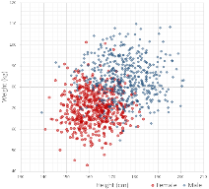
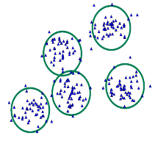
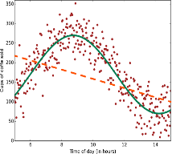
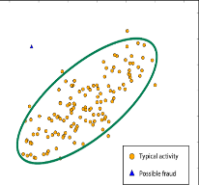
Common Classes of Algorithms (Supervised|Unsupervised)
Classification
Clustering
Regression
Anomaly Detection
Notes:
More samples on: https://azure.microsoft.com/en-us/documentation/articles/machine-learning-algorithm-choice/
Mention about Classification, Regression etc.

Slide 42
Why you need to know these algorithms?
If you want to answer a YES|NO question, it is classification
If you want to predict a numerical value, it is regression
If you want to group data into similar observations, it is clustering
If you want to recommend an item, it is recommender system
If you want to find anomalies in a group, it is anomaly detection
and many other ML algorithms for specific problem

Slide 43
Classification
Scenarios:
Which customer are more likely to buy, stay, leave (churn analysis)
Which transactions|actions are fraudulent
Which quotes are more likely to become orders
Recognition of patterns: speech, speaker, image, movement, etc.
Algorithms: Boosted Decision Tree, Decision Forest, Decision Jungle, Logistic Regression, SVM, ANN, etc.
Classification

Slide 44
Clustering
Scenarios:
Customer segmentation: divide a customer base into groups of individuals that are similar in specific ways relevant to marketing, such as age, gender, interests, spending habits, etc.
Market segmentation
Quantization of all sorts, such as, data compression, color reduction, etc.
Pattern recognition
Algorithms: K-means
Clustering

Slide 45
Regression
Scenarios:
Stock prices prediction
Sales forecasts
Premiums on insurance based on different factors
Quality control: number of complaints over time based on product specs, utilization, etc.
Workforce prediction
Workload prediction
Algorithms: Bayesian Linear, Linear Regression, Ordinal Regression, ANN, Boosted Decision Tree, Decision Forest
Regression

Slide 46
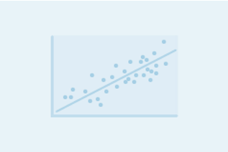
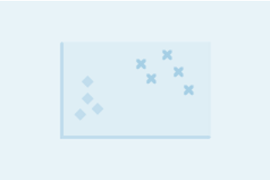
Regression versus Classification
Does your customer want to predict|estimate a number (regression) or apply a label|categorize (classification)?
Regression problems
Estimate household power consumption
Estimate customer’s income
Classification problems
Power station will|will not meet demand
Customer will respond to advertising

Slide 47
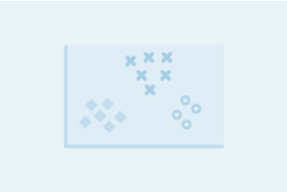
Binary versus Multiclass Classification
Does your customer want a yes|no answer?
Binary examples
click prediction
yes|no
over|under
win|loss
Multiclass examples
kind of tree
kind of network attack
type of heart disease

Slide 48
Azure Machine Learning Templates|APIs
An ML Template
Represent best practices of solving an ML problem in a specific domain
Has a data schema applicable to the specific domain
Has domain specific data processing and feature engineering
Uses training algorithms fit to the specific domain
Has domain specific evaluation metric where applicable
Consists of preconfigured ML modules and R scripts to enable e2e solution
Enables user to easily create a custom solution
With user data
With minor adjustment of parameters
Notes:
096_XUE

Slide 49








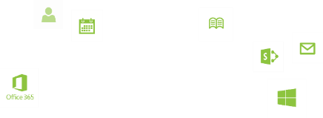


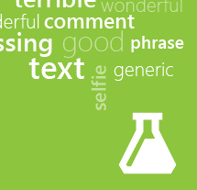



Machine Learning APIs
Face API
Speech API
Vision API
Anomaly
Detection
Customer Churn Prediction
Product Recommendations
Basket Analysis
Text Analytics
Notes:
Conf

Slide 50




COGNITIVE SERVICES
Vision APIs
Face APIs
Speech APIs
LUIS
(Language Understanding Intelligent Service)
Speech Recognition
Analyze Image
Face Detection
Detect Intent
Text to Speech
Generate Thumbnail
Face Grouping
Determine Entities
OCR
Face Identification
Speech Intent Recognition
Improve Models
Notes:
to be replaced with Microsoft Cognitive services.

