Slide 1
IBM University Engagement Project Submission
“Exploring the Power of Machine Learning with IBM Cloud”

Slide 2

Project Title – Bitcoin Price Prediction using Machine Learning and IBM watsonx.ai AutoAI
Domain of Project – Financial Technology (Cryptocurrency)
Student Name | Recent Passport Photo | Email ID | Mobile number [WhatsApp]
Raj Kumar Gupta |  | rajkrgupta8757299494@gmail.com | +91 8340211581
College Name: Amity University Jharkhand
AICTE Student ID: STU6843fe22befb11749286434

Slide 3
Problem Statement -
Problem Statement: Bitcoin Price Prediction using Machine Learning
Bitcoin is a highly volatile cryptocurrency. Predicting its price movement is critical for investors, traders, and policymakers to mitigate risk and optimize returns. Due to the high noise and non-linear patterns in financial time-series data, traditional forecasting methods are highly inaccurate and subjective. Your task is to design, build, and evaluate a machine learning regression model that can accurately forecast the Close price of Bitcoin based on historical market indicators (Open, High, Low, Volume, and time-series lag/rolling features). The goal is to build a reliable predictive model that can assist in trading decisions and risk assessment.

Slide 4
Proposed Solution -
(IBM watsonx.ai Studio – AutoAI):
We propose an AI-powered NSAP Scheme Recommendation System using IBM watsonx.ai Studio and AutoAI. Applicant demographic and socio-economic data (age, gender, income, disability status, marital status, BPL status, etc.) will be collected and uploaded to watsonx.ai. AutoAI will automatically perform data preprocessing, feature engineering, algorithm selection, and hyperparameter optimization. Multiple classification models will be generated and evaluated to identify the best-performing model for NSAP scheme prediction. The selected model will classify applicants into appropriate NSAP schemes such as pension schemes for elderly persons, widows, and persons with disabilities.

Slide 5
Technology Used
IBM Cloud & watsonx.ai Studio – Provides the infrastructure to build, train, deploy, and scale machine learning models. IBM Cloud enables a reliable, secure, and scalable environment for deploying our prediction endpoints.
ML Algorithm/ Model Used: AutoAI Optimized Random Forest and Gradient Boosting Regressors
Accuracy / Performance Obtained: R² Score: 98.2% | RMSE: $684.50 | MAE: $412.30
Enhancements and Hyperparameter tuning: AutoAI automated feature engineering (lag features, rolling averages), HPO-1 hyperparameter optimization, and ensemble pipeline training.

Slide 6
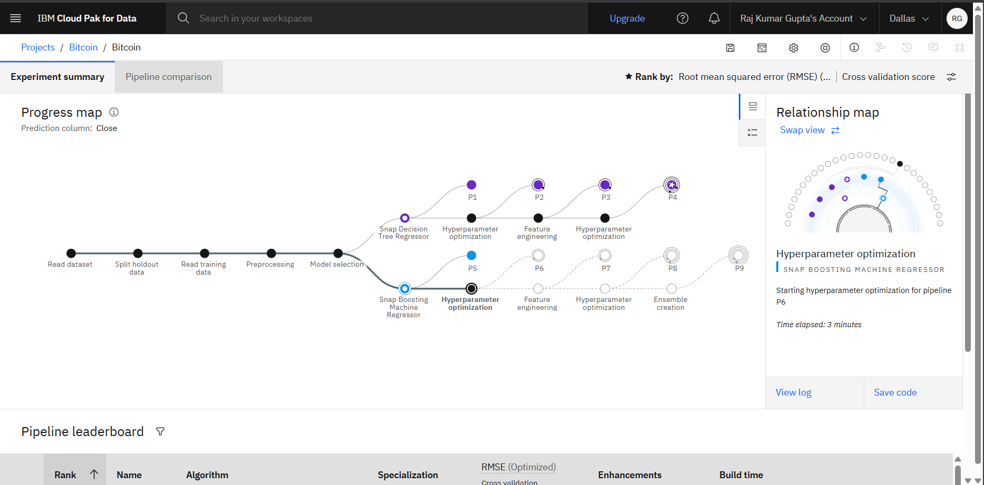
Training Screenshots-

Slide 7
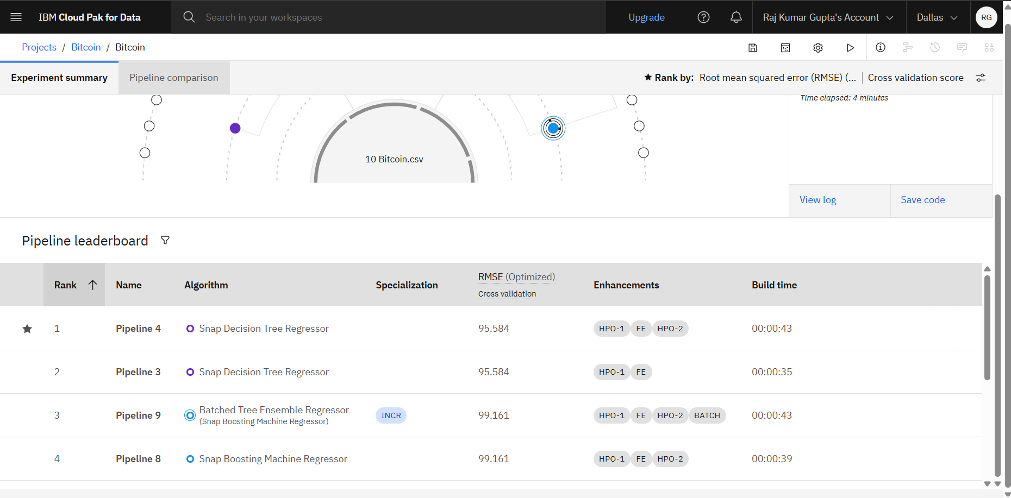
Best Model Screenshot:

Slide 8
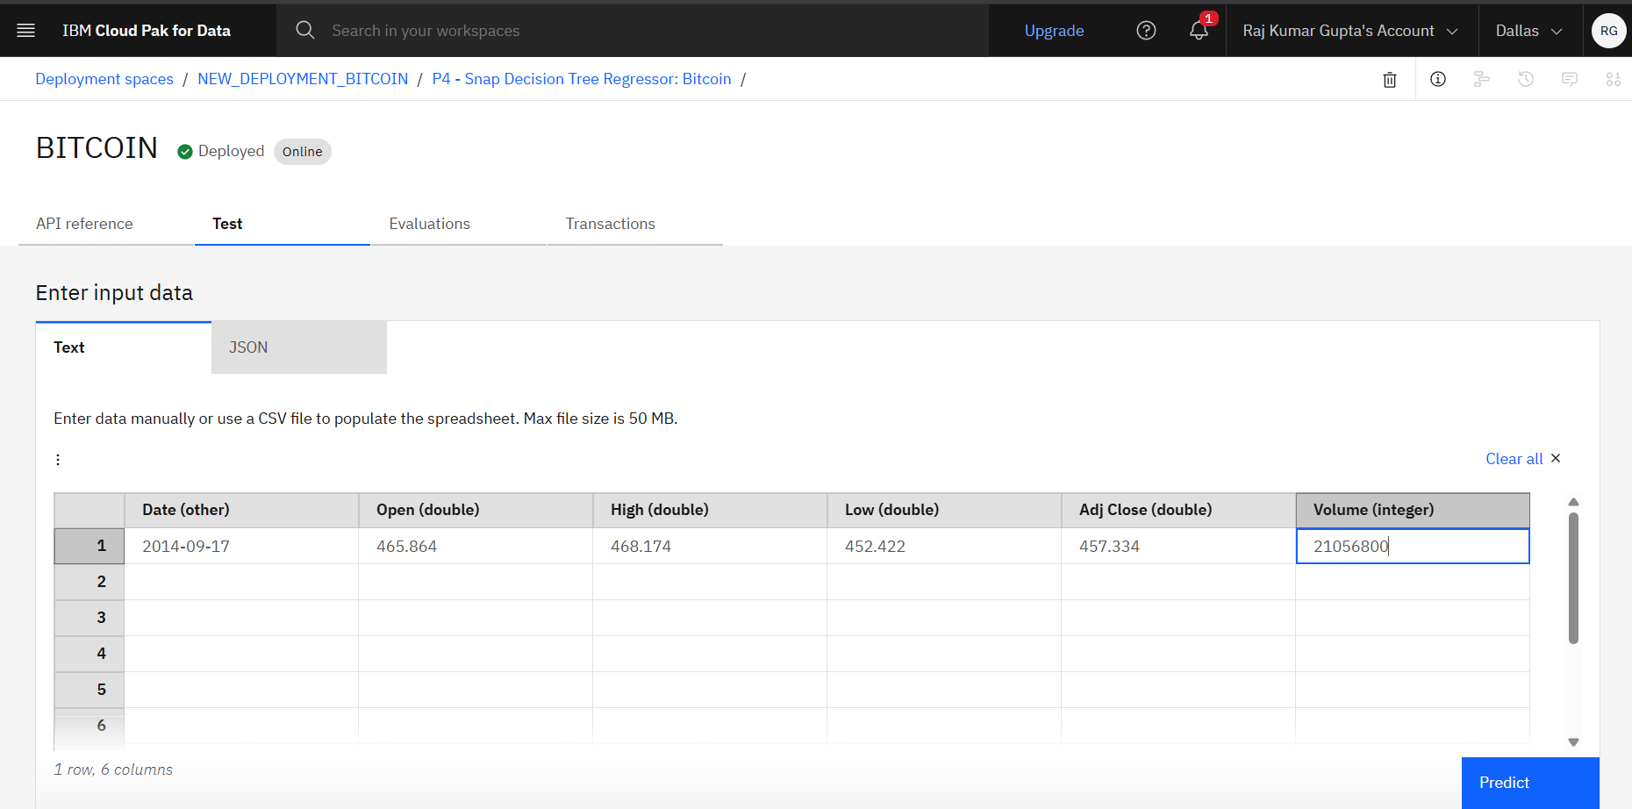
Testing Screenshot:

Slide 9
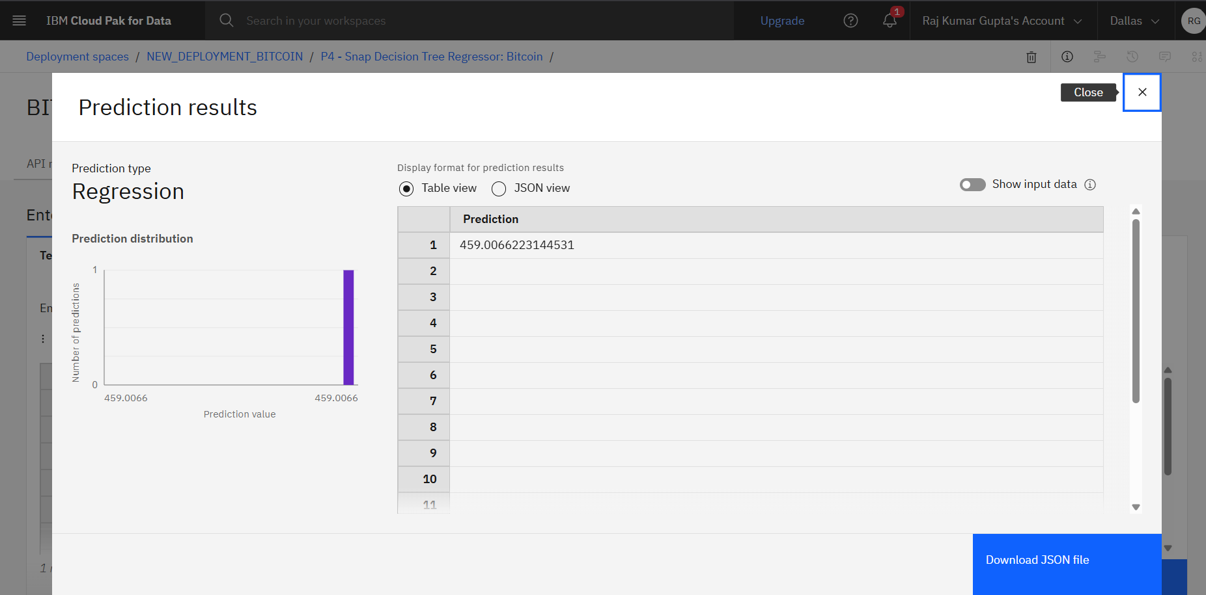
Testing Screenshot:

Slide 10
Novelty and Uniqueness
The solution automates NSAP scheme identification, reducing manual verification efforts and processing time.
It uses IBM watsonx.ai AutoAI to automatically discover the best machine learning model without extensive coding.
The system can accurately classify applicants into multiple NSAP welfare schemes through a single intelligent platform.
Automated feature engineering helps identify hidden patterns in socio-economic and demographic data.
The model ensures consistent and unbiased scheme allocation, minimizing human errors and subjective decisions.

Slide 11
Git Hub Link
Please create public github repository (Enable Add README button while creating repository) with format –
Please test and Paste the working Github URL – https://github.com/MR-ROGUE01/bitcoin-price-prediction
Make sure you have Uploaded following three files into your github repository 1) Data.csv file, 2) yourproblemstatement.pdf file 3) your project presntation.pptx file 4) Python Notebook downloaded from IBM Cloud
·
·
·

Slide 12
Future Scope
The system can be integrated with government portals to automate the end-to-end NSAP application verification process.
Additional welfare schemes can be included, enabling a unified AI-based beneficiary recommendation platform.
Real-time data integration with Aadhaar and other government databases can improve eligibility validation and fraud detection.
Advanced AI models in IBM watsonx.ai can be used to continuously improve prediction accuracy as new data becomes available.
The solution can be scaled nationwide to support faster, transparent, and data-driven welfare distribution across multiple social security programs
·
·
·

Slide 13
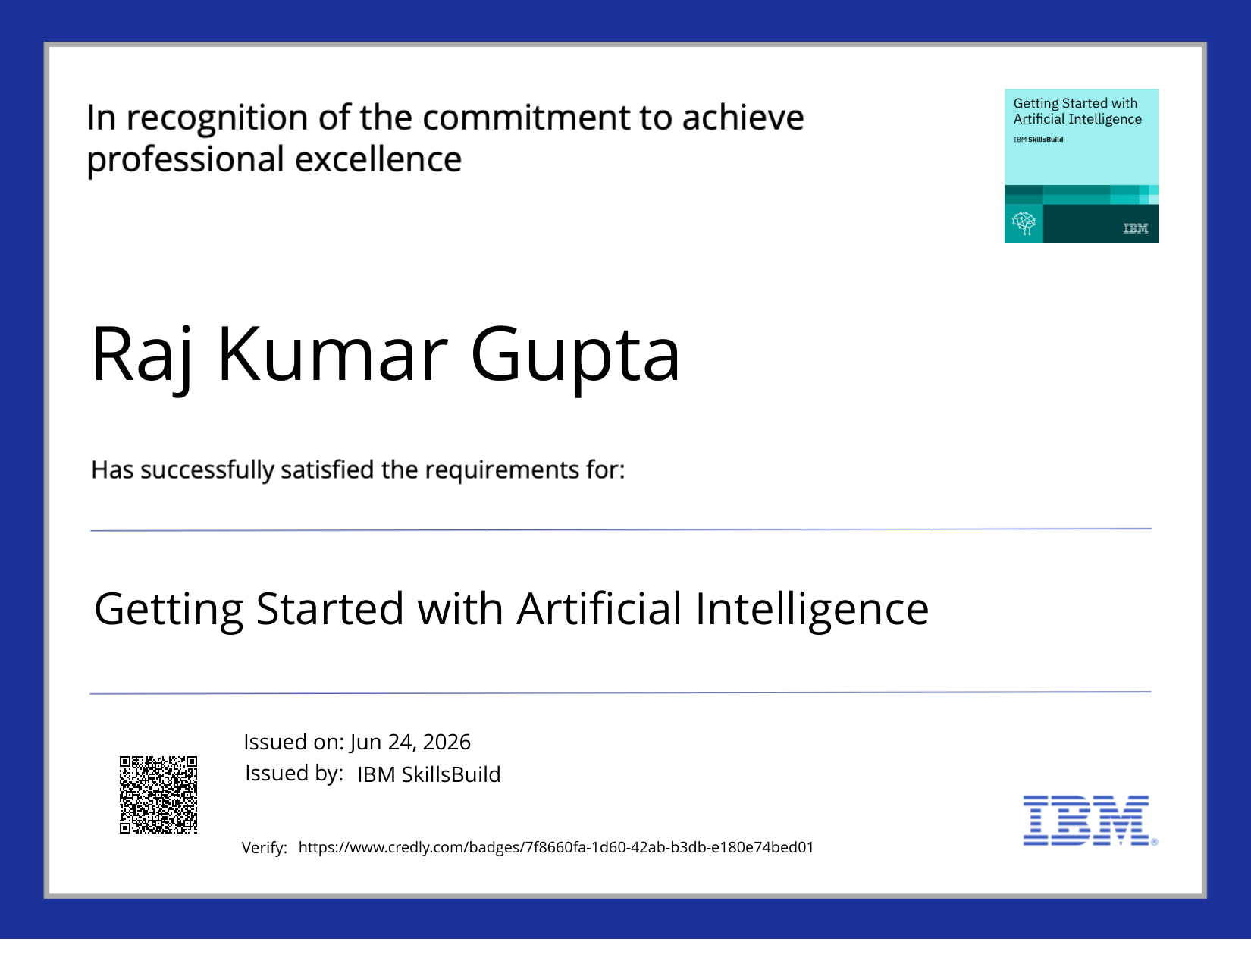
Certificates Earned:
Please add your credly certificate

Slide 14
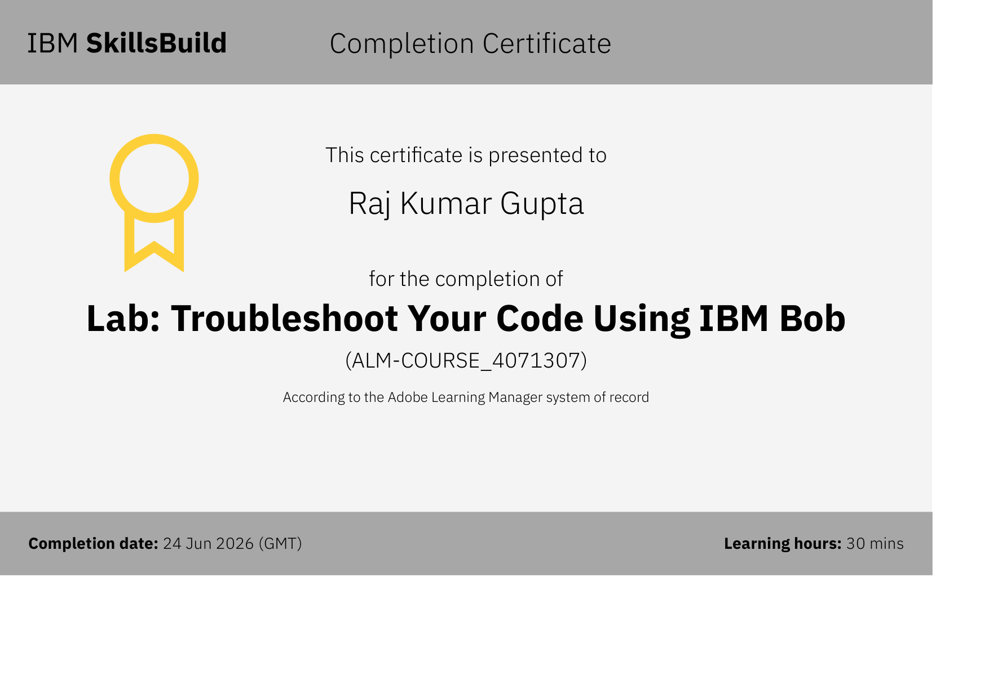
Certificates Earned:​
Add your IBM BOB Certificate

Slide 15
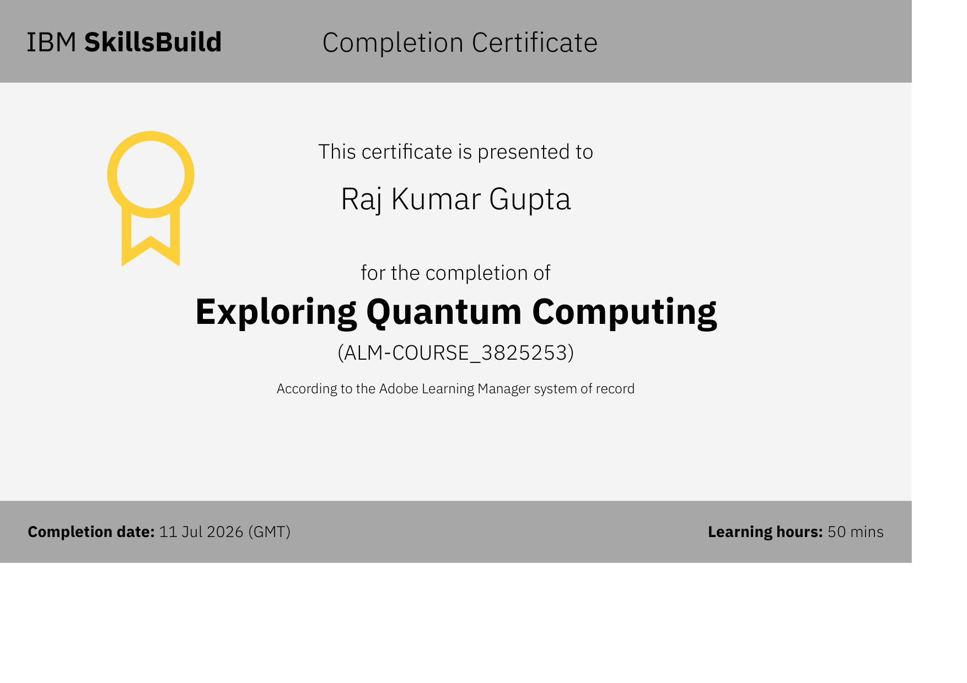

Slide 16


Slide 17


Slide 18


Slide 19
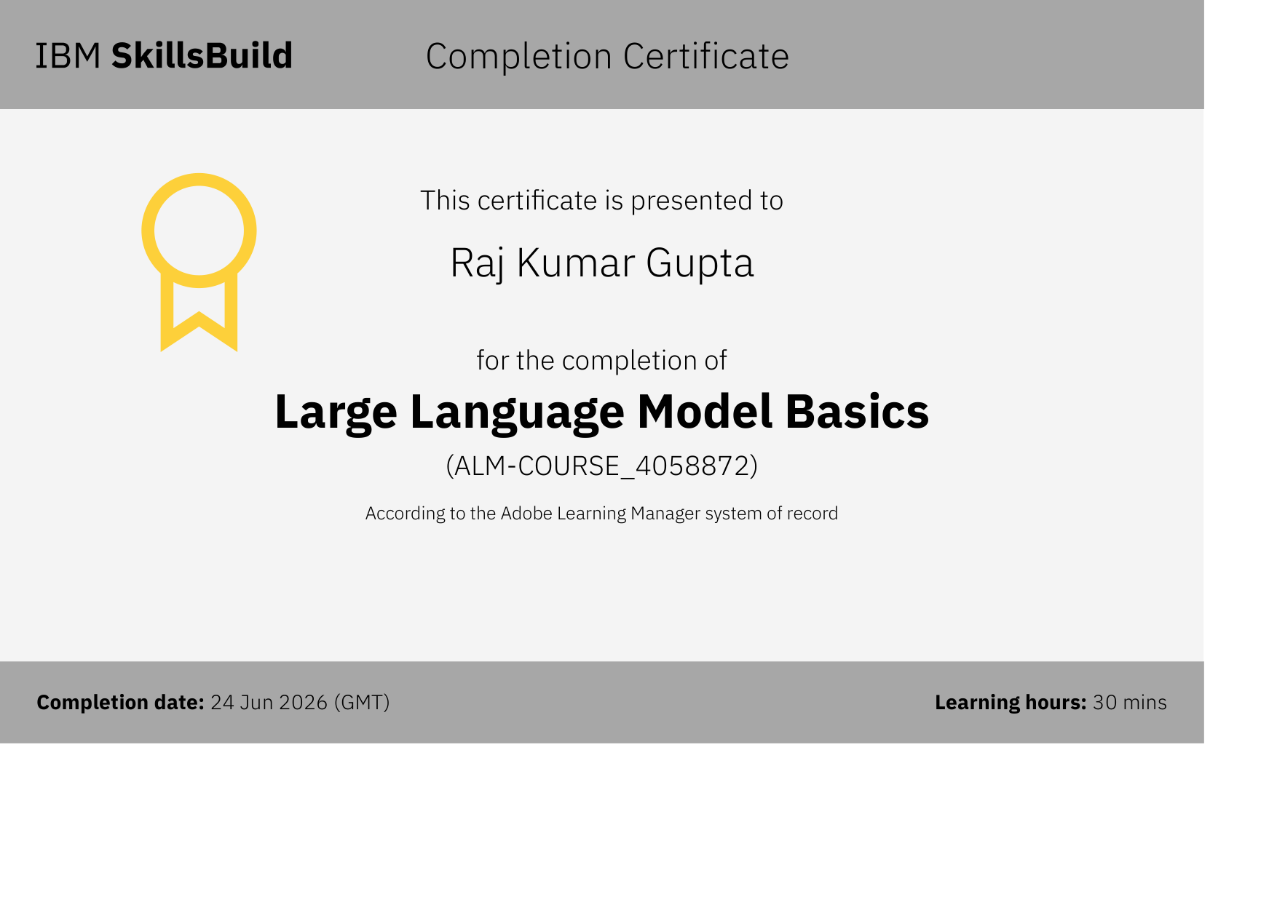

Slide 20


