Slide 1


Slide 2
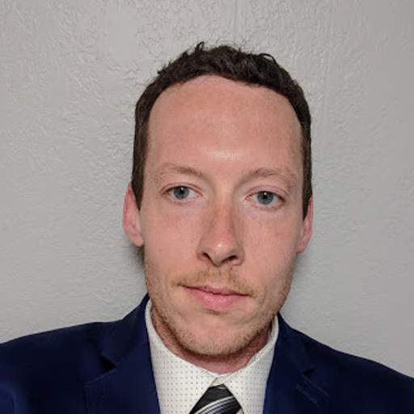
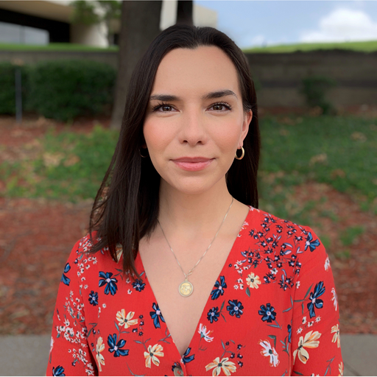
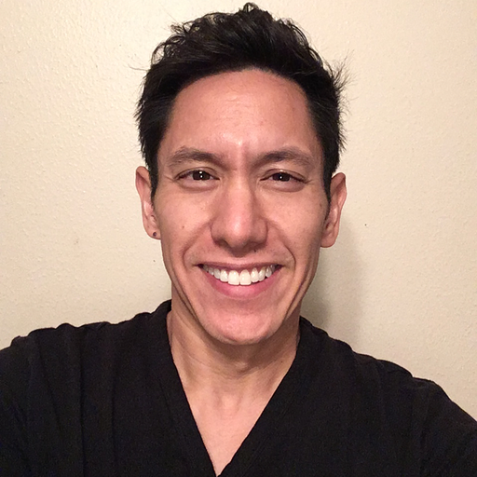
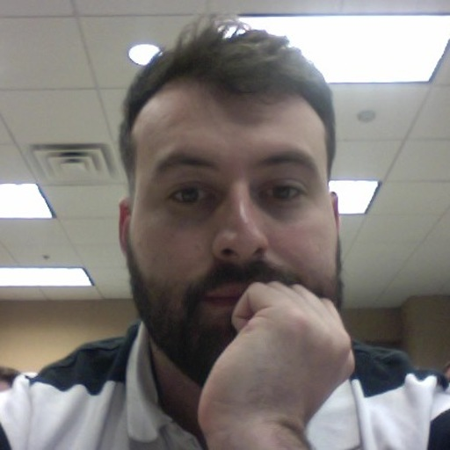
Team members
Mike Stanley
Jessica Hoxworth
Anthony Pricer
Mark Sterrenberg

Slide 3
proposal
A crime lookup application that allows users to search for crimes that have occurred near their area

Slide 4
Future enhancements
Be able to access crime information real-time so viewers could see crimes
Add more security protocols surrounding API-keys and a person’s mysql credentials to ensure that if someone accidentally commits their credentials they are protected from malicious use
Adding ways to communicate with local law enforcement, emergency services, etc
Adding social media profiles and potential login to application via social media

Slide 5




nEW technology used
JsonWebToken
BCrypt
Cheerio
DotEnv
CORS, Request and Cookie Parser npm

Slide 6
System demo
Notes:
Mike Stanley will do demo

Slide 7
Questions?

