Slide 1


Slide 2
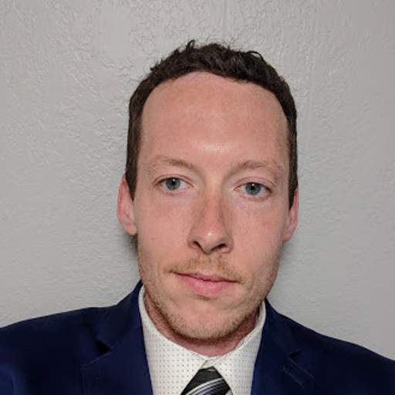
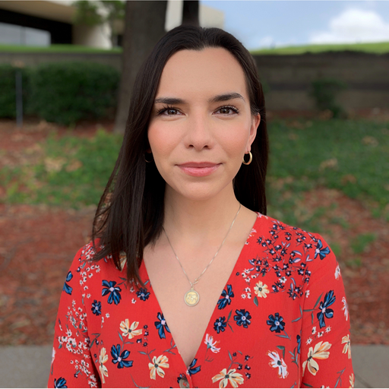
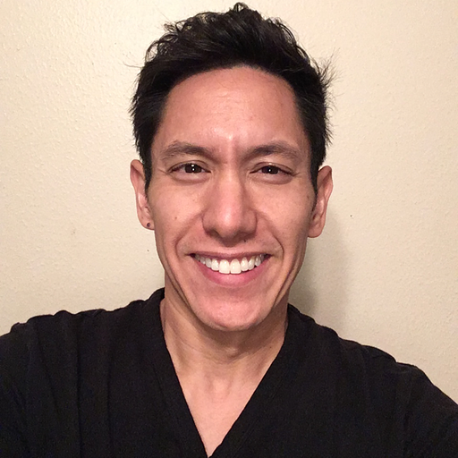
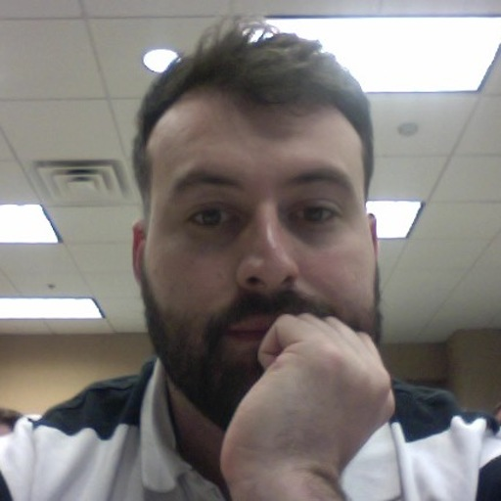
Team members
Mike Stanley
Jessica Hoxworth
Anthony Pricer
Mark Sterrenberg

Slide 3
Motivation
A crime lookup application that allows users to search for crimes that have occurred near their area. We found many websites with the functionality but were not mobile responsive or converted into an application

Slide 4
End result
A mobile responsive application that allows users to see crimes in their immediate area

Slide 5
Individual responsibilities
Mike
Worked primarily on the backend and some front-end functionality with regards to social media
Mark, Anthony and Jessica
Focused primarily on implementing the User interface and drafting up the presentation materials

Slide 6




nEW technology used
JsonWebToken
BCrypt
Cheerio
DotEnv
Photoshop, handlebars, CORS, Request and Cookie Parser npm

Slide 7
challenges
Main issue that we had was getting the spotcrime api to work with Heroku

Slide 8
Improvements
Be able to access crime information real-time so viewers could see crimes
Add more security protocols surrounding API-keys and a person’s mysql credentials to ensure that if someone accidentally commits their credentials they are protected from malicious use
Adding ways to communicate with local law enforcement, emergency services, etc
Adding social media profiles and potential login to application via social media

Slide 9
System demo
Notes:
Mike Stanley will do demo

Slide 10
Questions?

