Slide 1
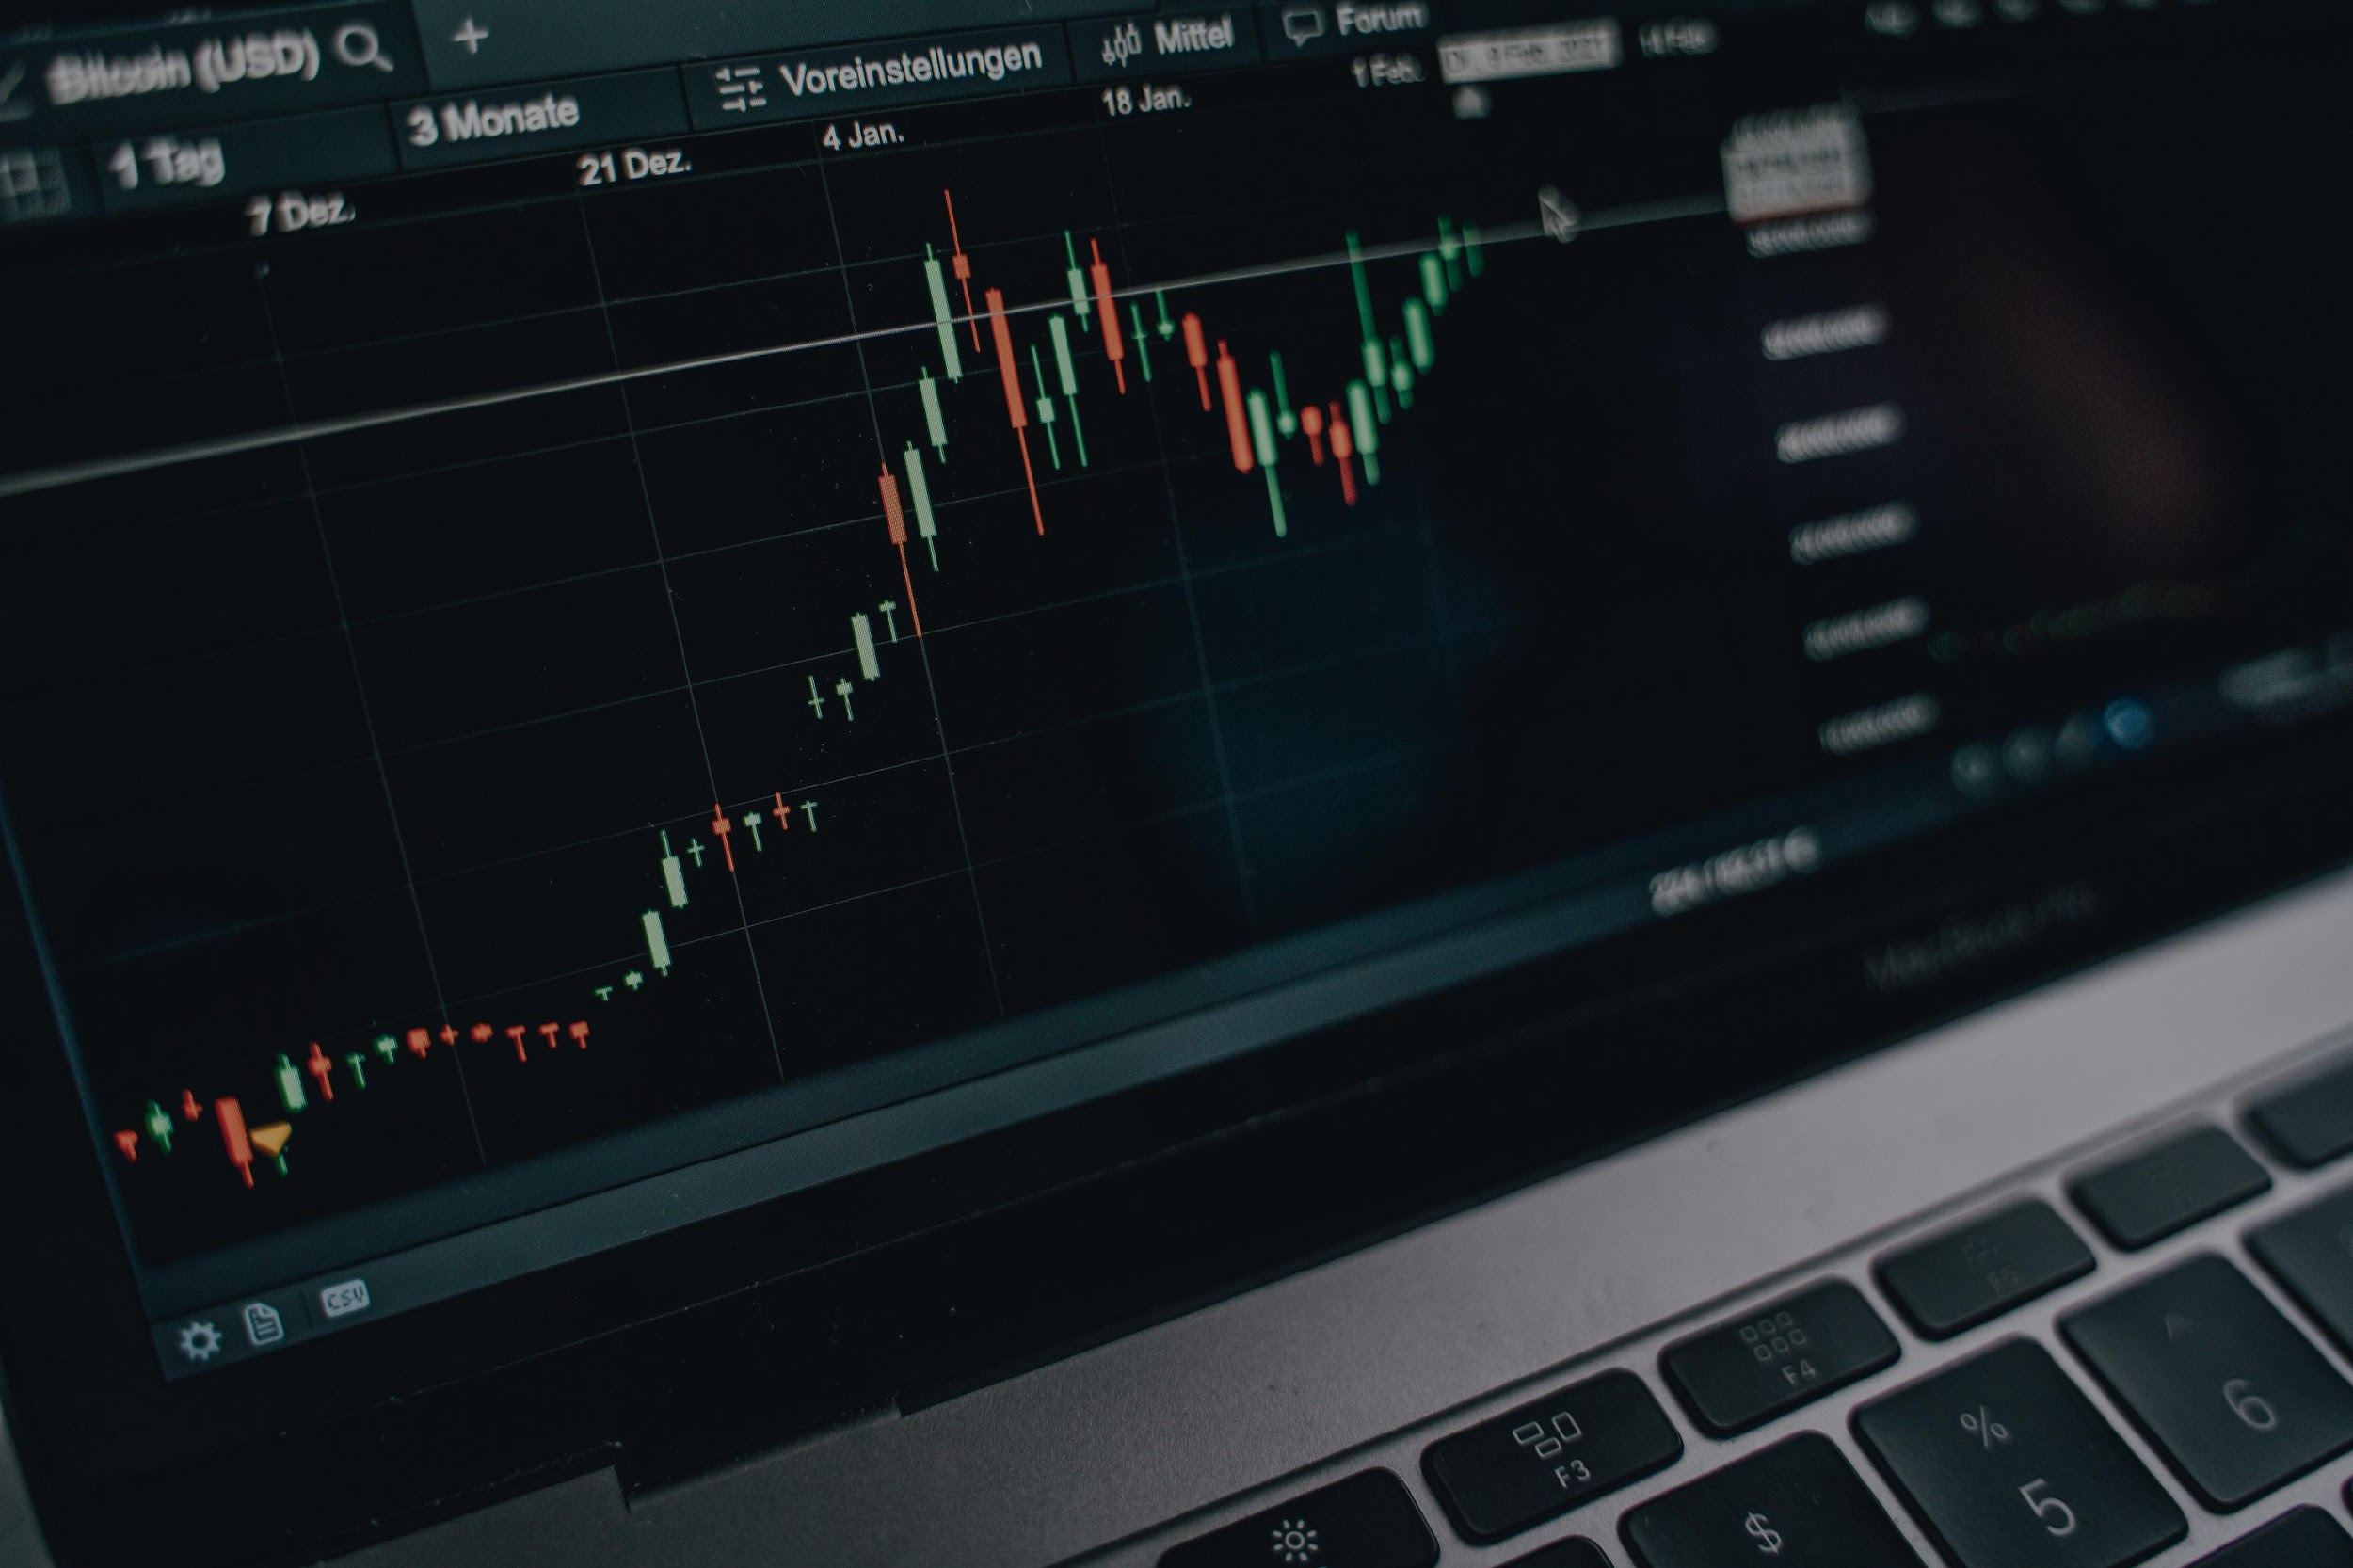
Final Project
Part B
BMSO 758F Group 4:
Michael Lindale
Matthew Rutigliano
Taylor Sheridan

Slide 2

Agenda
Objective
Constraints
Instrument Comparison
Instrument Selection
Equal Weight Portfolio
Optimal Weight Portfolio
All Technical Portfolios
$. 708.006.789.859.77
BMSO 758F - Group 4: Lindale, Rutigliano, Sheridan 2

Slide 3
Objective
Create an optimal portfolio of 8 instruments from the following choices
Equity (choose 5 of 6)
Apple (AAPL), a technology company
Exelon Corp (EXC), a utilities company
General Electric (GE), a diversified high-tech industrial company
Intel (INTC), a technology company
Pfizer (PFE), a pharmaceutical company
S&P 500 ETF (SPY), the broad market ETF
Fixed Income (choose 1 of 2)
Fidelity Investment Grade Bond Index (FBNDX)
Vanguard Total Bond Market Index (VBTIX)
Commodity (choose 1 of 2)
S&P GSCI Broad Commodity Index (SPGSCI)
Platinum (XPT)
Currency (choose 1 of 2)
Canadian Dollar (CAD)
British Pound (GBP)
BMSO 758F - Group 4: Lindale, Rutigliano, Sheridan 3

Slide 4
Constraints
Use Benchmark Instrument (BMK) or 1 of 3 technical strategies
MA crossover strategy which goes “flat” (MAFlat) OR
MA crossover strategy which goes “short” (MAShort) OR
Bollinger Band strategy (BB)
Must use each of the technical strategies at least once
MA crossover - all instruments should use the same fastWindow, slowWindow
Bollinger Band - all your instruments should use the same bbWindow, stdevBand
Bollinger Band - bbWindow should >= 20
Portfolio Sharpe should exceed 1.0
Portfolio Beta (to SPY) should be <= +0.5
BMSO 758F - Group 4: Lindale, Rutigliano, Sheridan 4

Slide 5
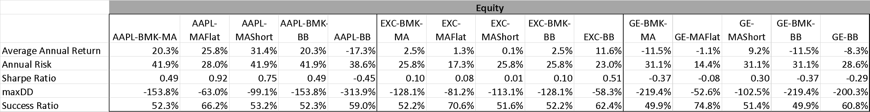
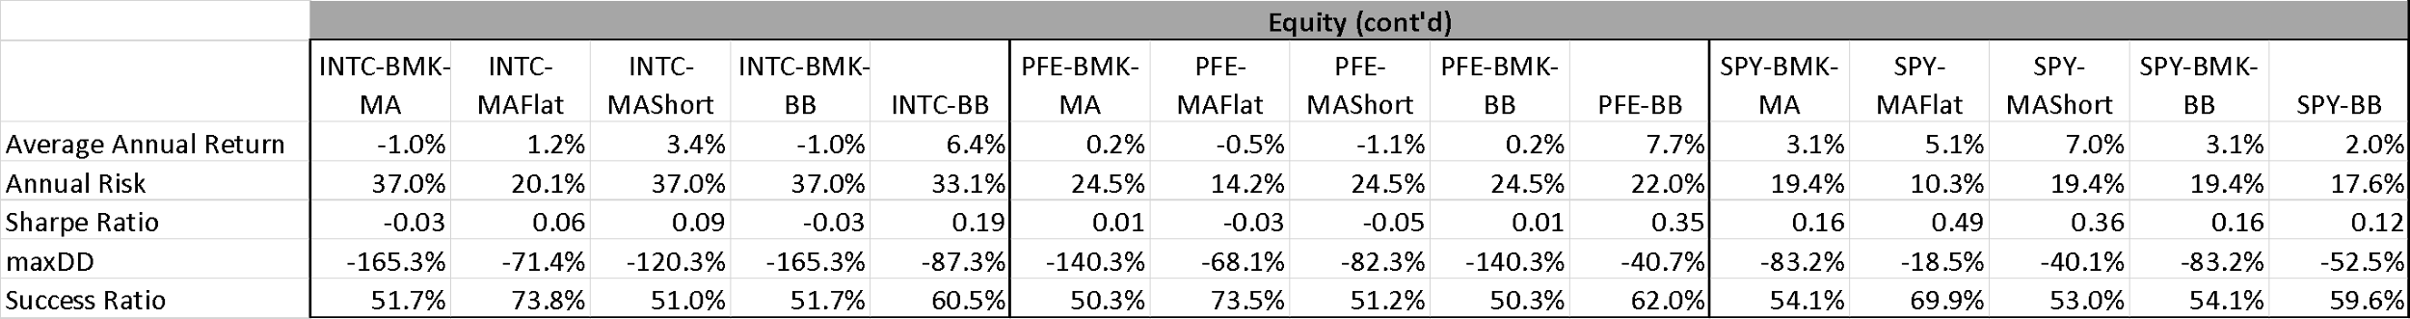
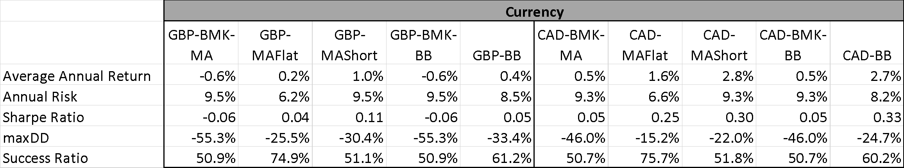
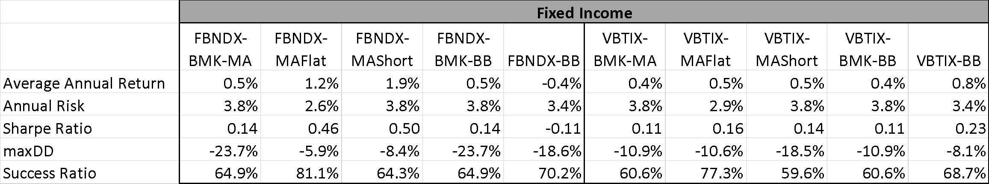

Instrument Comparison
BMSO 758F - Group 4: Lindale, Rutigliano, Sheridan 5

Slide 6
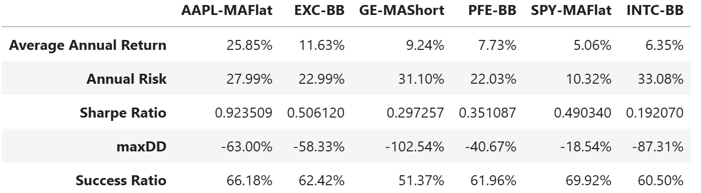
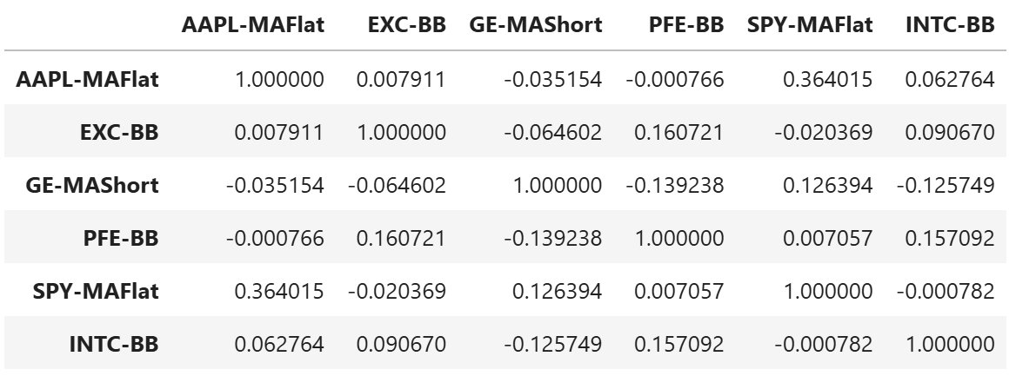
Instrument Selection (Q7)
In order to generate the highest Sharpe Ratio in the portfolio, individual instruments’ Sharpe Ratios were compared
For equity instruments, the maximum Sharpe Ratio for each underlying instrument was chosen for comparison amongst it’s peers
In other words, the highest AAPL Sharpe Ratio was compared against the highest EXC Sharpe Ratio, and so on…
The highest five Sharpe Ratios (of the six that were compared) were chosen for the portfolio
Correlation and performance was analyzed for 5 selections, as well as the non-selection
The Sharpe Ratio for the non-chosen instrument was both lower, and not noticeably different in correlation than the chosen instruments, and as a result, no re-calculation of the five chosen equity instruments was made
BMSO 758F - Group 4: Lindale, Rutigliano, Sheridan 6

Slide 7
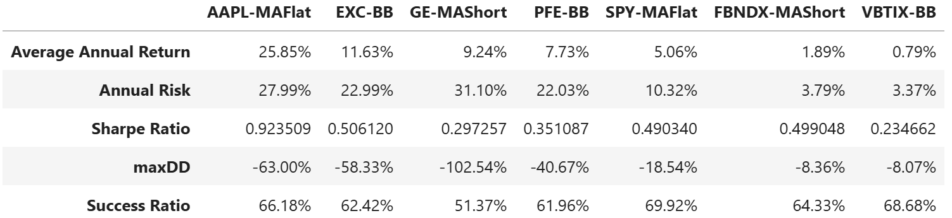
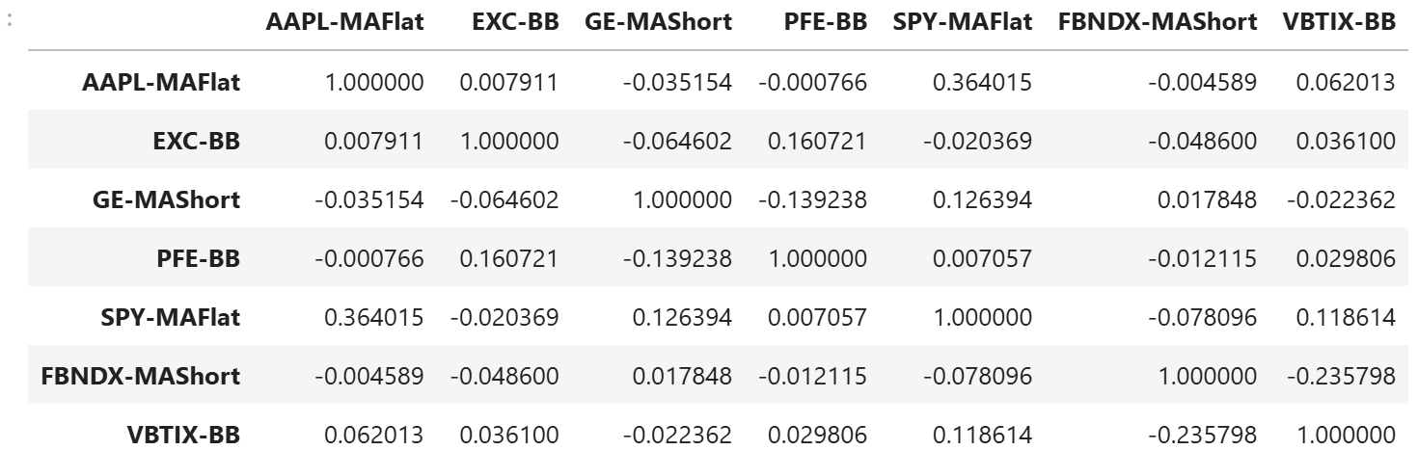
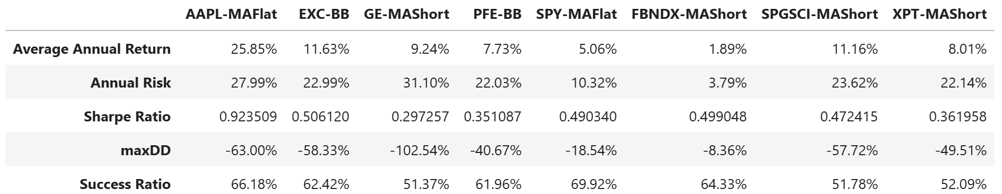
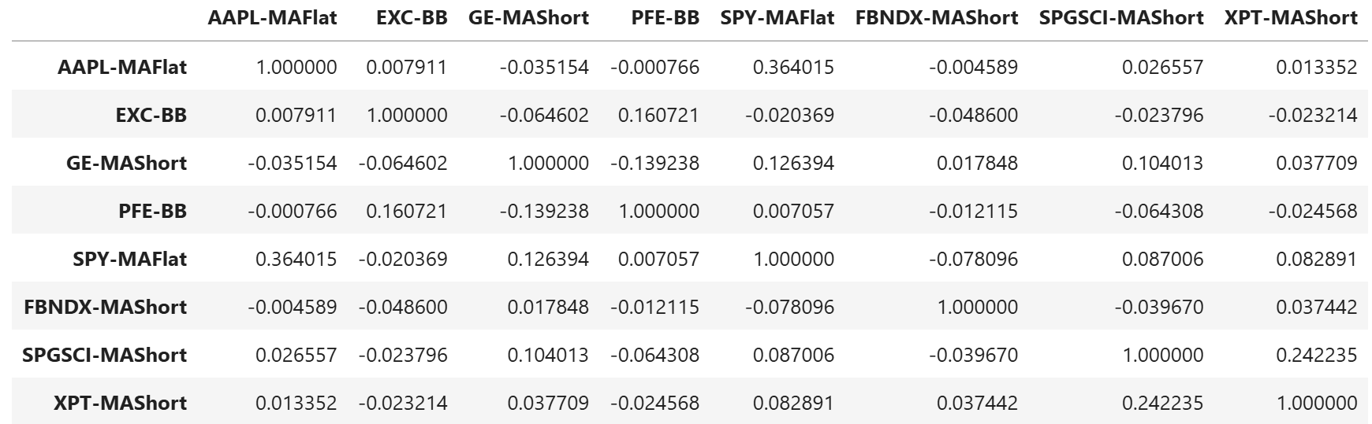
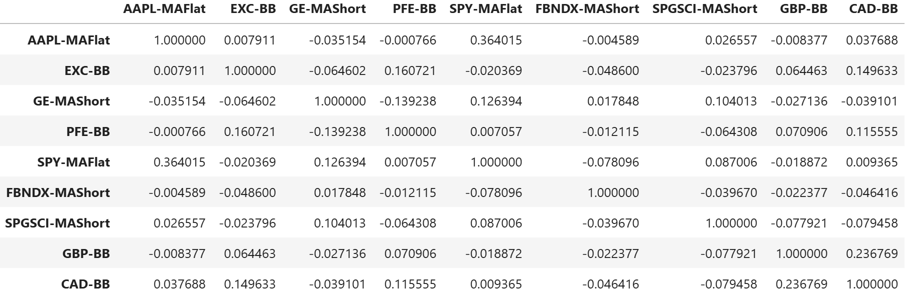
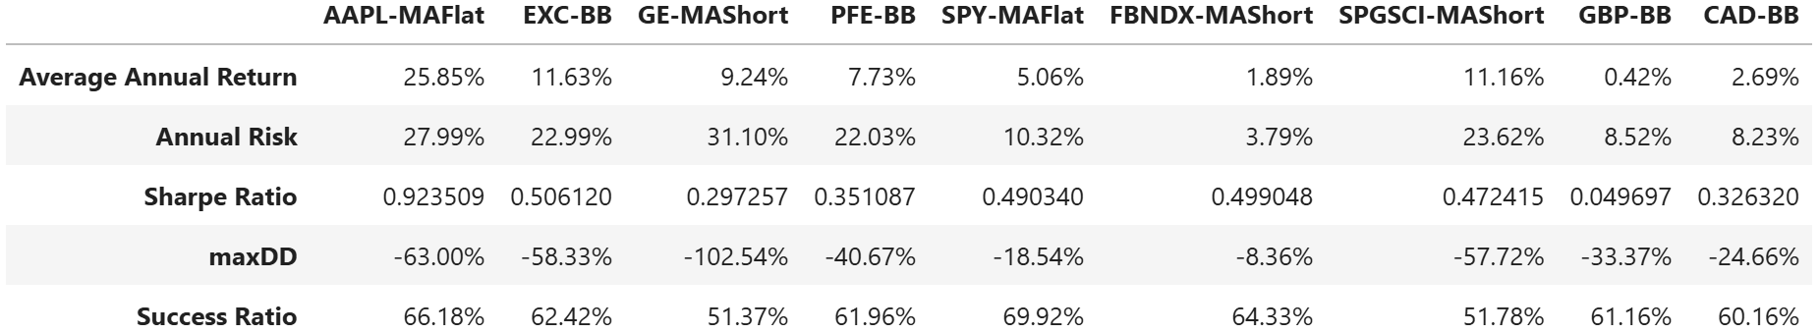
Instrument Selection (Q7) continued
In order to generate the highest Sharpe Ratio in the portfolio, individual instruments’ Sharpe Ratios were compared
The same process was performed for subsequent instrument categories
Fixed Income
Commodity
Currency
After exploring correlation against previously-chosen portfolio instruments, it was decided to choose a less-than-optimal-Sharpe instrument for the Currency
BMSO 758F - Group 4: Lindale, Rutigliano, Sheridan 7

Slide 8
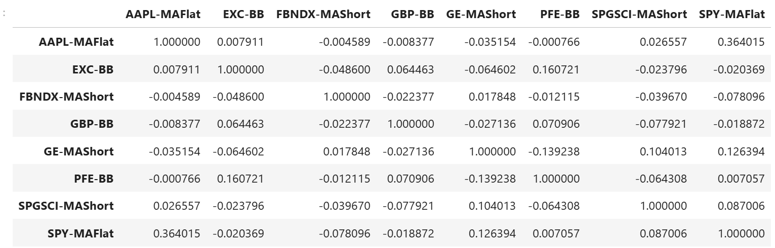
Portfolio Member Correlation (Q9)
Portfolio instruments were picked based on low correlations to each other member
Average absolute correlation = 0.062, indicating low overall correlation between instruments
BMSO 758F - Group 4: Lindale, Rutigliano, Sheridan 8

Slide 9
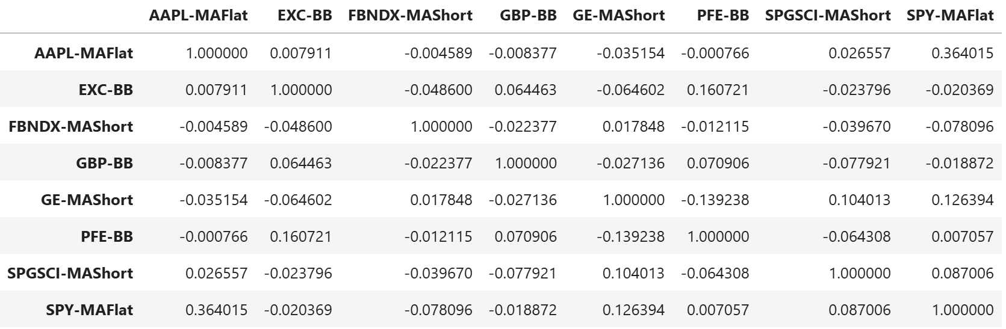
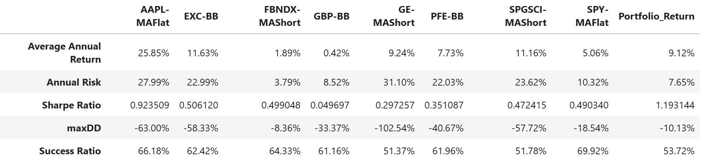
Equal Weight Portfolio (Q10)
Equal-Weighted portfolio performance is highlighted above
Portfolio outperforms all of the individual instruments
BMSO 758F - Group 4: Lindale, Rutigliano, Sheridan 8

Slide 10
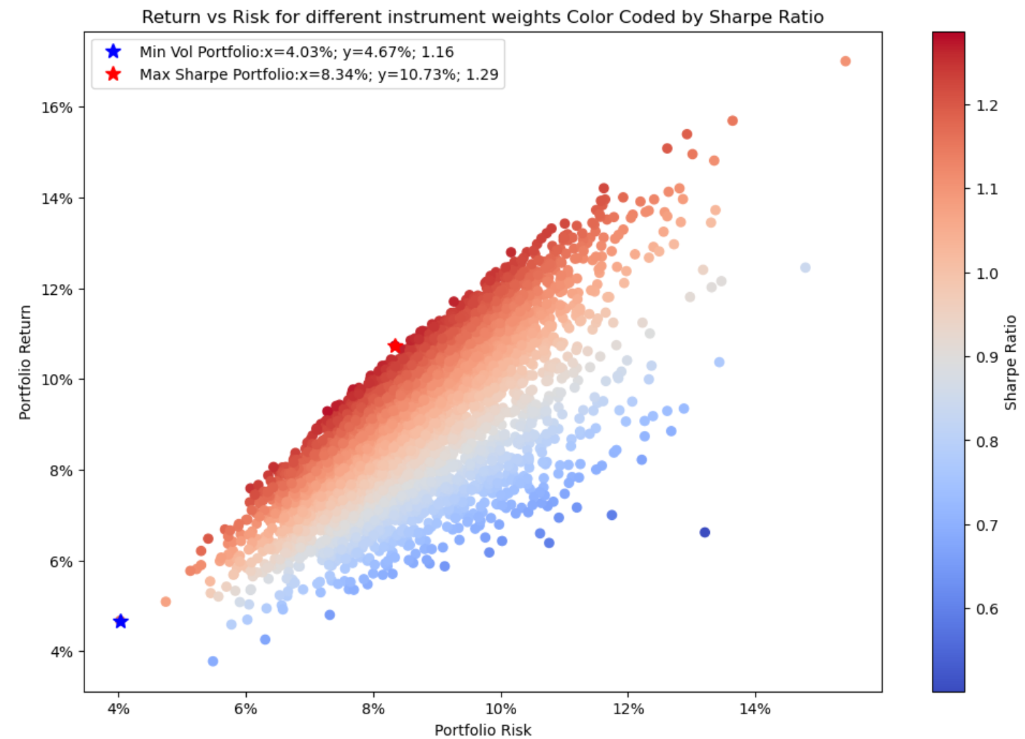
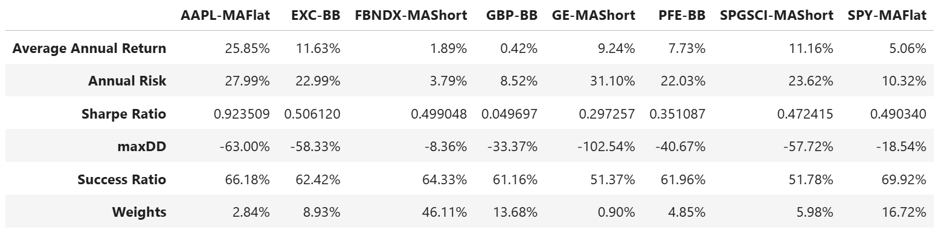
Weighted Portfolio – Min Volatility (Q13)
The portfolio-risk-minimizing weights for each instrument is listed above
The lowest risk instrument dominates this portfolio (46%)
Next two highest weights are heavily weighted to second and third lowest risk
Lower risk drives down annual return and Sharpe ratio
This portfolio is denoted by blue star on chart
BMSO 758F - Group 4: Lindale, Rutigliano, Sheridan 9

Slide 11
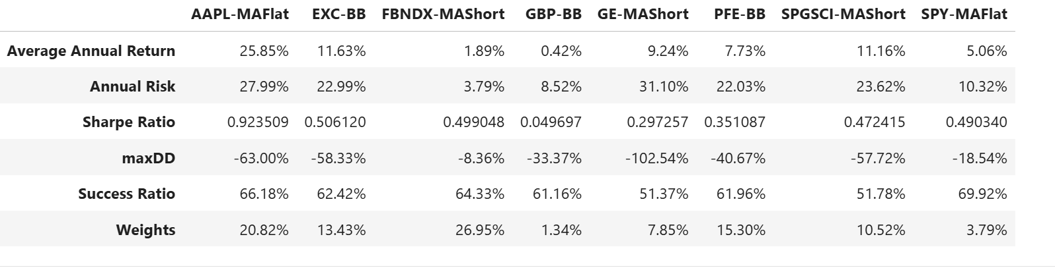
Weighted Portfolio – Max Sharpe (Q14)
The portfolio-Sharpe-maximizing weights for each instrument is listed above
The two highest weighted instruments have the first and third highest Sharpe Ratios, and the second highest standalone Sharpe Ratio instrument is in the top 4 weights
Portfolio weighting higher Sharpe Ratios with more preference, using lower Sharpe instruments to limit the risk due to lower correlation
This portfolio denoted by red star on chart
BMSO 758F - Group 4: Lindale, Rutigliano, Sheridan 9

Slide 12
Optimal Weight Portfolio – Sharpe Ratio (Q15)
The optimally weighted portfolio has an annual portfolio return of 10.73% and an annual risk of 8.34%
The Sharpe Ratio of the optimally-weighted portfolio is 1.29
This weighted portfolio Sharpe (1.29) does outperform the equal weight portfolio Sharpe Ratio (1.19)
BMSO 758F - Group 4: Lindale, Rutigliano, Sheridan 10

Slide 13
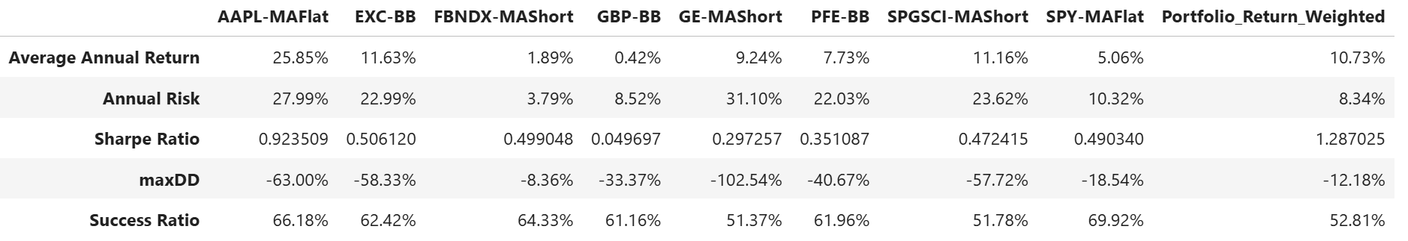
Optimal Weight Portfolio - Performance (Q16)
Portfolio has higher returns than all but 3 of the individual components, and less risk than all but one
Leads to a much larger Sharpe Ratio than any component by over 0.35 points (when compared to the highest Sharpe component)
Portfolio maxDD is lower than all but 1 component, driven by the use of non-correlated instruments to limit the negative returns that any one component may drive.
BMSO 758F - Group 4: Lindale, Rutigliano, Sheridan 11

Slide 14
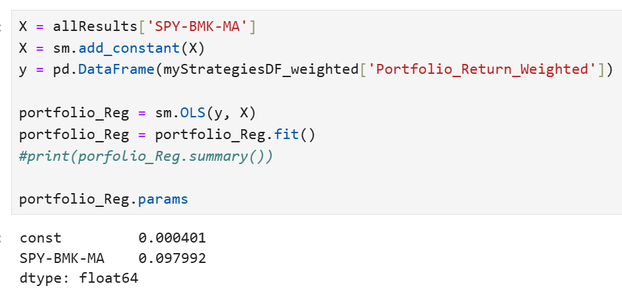
Optimal Weight Portfolio - Beta (Q17)
Portfolio beta of 0.098 conforms to the requirement that it be < 0.5.
BMSO 758F - Group 4: Lindale, Rutigliano, Sheridan 12

Slide 15
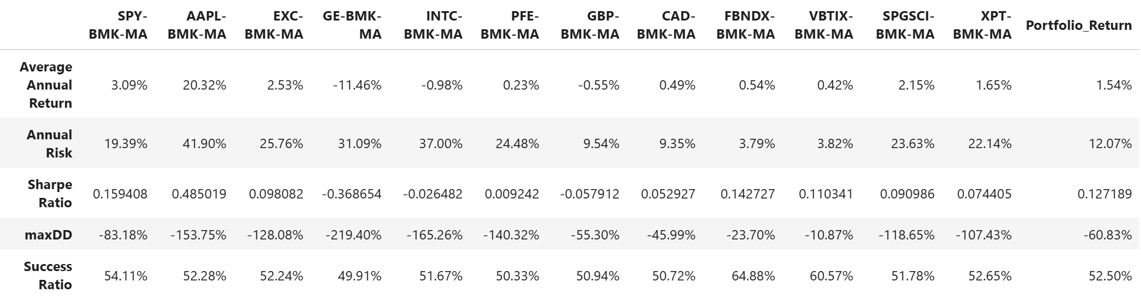
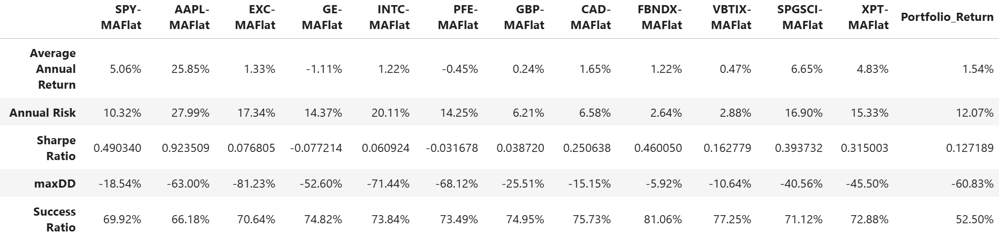
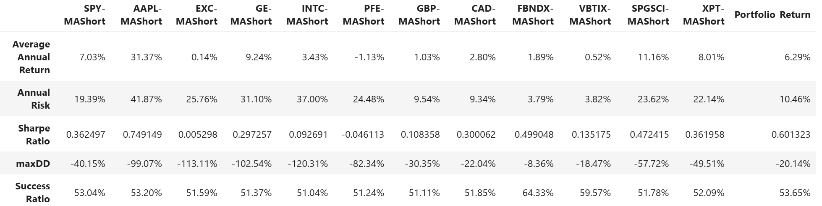
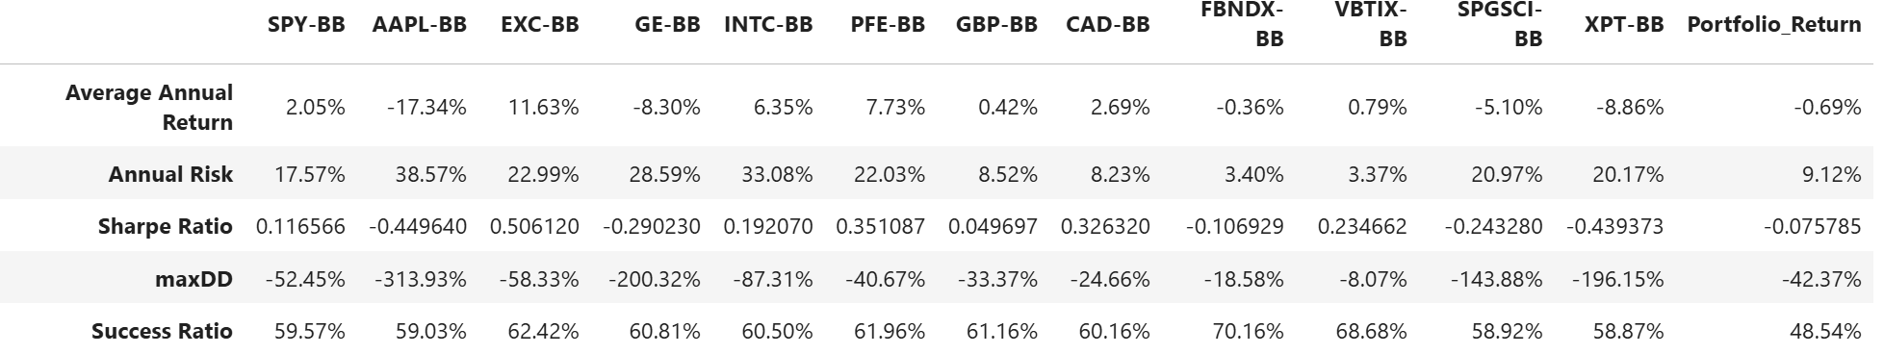
All Technical Portfolios (Q18)
All BMK
All MA-Flat
All MA-Short
All BB
None of these portfolios outperform our optimally-weighted portfolio
BMSO 758F - Group 4: Lindale, Rutigliano, Sheridan 13

