Slide 1
PaperMATCH AI-Enhanced Platform for Curated Academic and Media Research Insights
Proposal presentation
Alvin Wong Ann Ying, Bertrand TAN

Slide 2
Scope
Business & Technical Problem Statements
Methodology & System Architecture
Datasets
System Framework
Document Workstream
Query Workstream
Knowledge Workstream
Project Deliverables

Slide 3
Business problem statement
Navigating the Information Overload in Research
Exponential Growth of Academic Publications
The number of scholarly articles published annually has surged, making it difficult for researchers to keep up with the latest developments.
Researchers struggle to efficiently filter and extract relevant insights from vast databases such as ACM Digital Library, IEEE Xplore, and arXiv.
Fragmented Research Dissemination
Research findings are scattered across multiple platforms with varying accessibility, making discovery inefficient.
The lack of structured categorization and summarization tools slows down knowledge acquisition and innovation.
The Role of Media in Research Awareness
Media framing and narratives significantly influence public and academic discourse, shaping research trends and funding priorities.
Researchers often miss how their work is portrayed in mainstream media, affecting public perception and policy impact.
Business Need for PaperMatch
PaperMatch provides a unified AI-driven platform to help researchers efficiently discover, analyze, and contextualize academic findings. By integrating cutting-edge NLP, thematic clustering, and media analytics, PaperMatch enables faster knowledge translation, ensuring research has a tangible impact on academia, industry, and society.

Slide 4
Technical problem statement
Technical Challenges in Research Aggregation and Analysis
Automating Research Summarization
Processing large volumes of academic papers requires advanced NLP techniques to extract key insights without losing critical details.
Current summarization methods (e.g., See, Liu, and Manning, 2017) need to be optimized for domain-specific technical content.
Scalable Thematic Clustering
Organizing research papers into relevant clusters demands efficient unsupervised learning models (e.g., Aggarwal & Reddy, 2013).
Traditional keyword-based categorization often fails to capture nuanced topic relationships and interdisciplinary connections.
Integrating Media and Research Contexts
AI-driven media aggregation must effectively filter, extract, and summarize news articles relevant to academic research.
Sentiment and framing analysis are needed to assess how media narratives influence scientific discourse.
Bridging Research with Practical Applications
Mapping research findings to real-world implementations requires linking academic papers with code repositories (e.g., GitHub).
Challenges include maintaining up-to-date recommendations and ensuring relevance to evolving industry needs.
How PaperMatch Solves These Challenges
PaperMatch employs a multi-layered AI approach to tackle these technical barriers:
NLP-enhanced summarization to condense academic papers into digestible insights.
Advanced clustering techniques to organize research into actionable themes.
AI-driven news aggregation to integrate media narratives with scholarly work.
Dynamic research-to-application mapping to facilitate real-world impact.

Slide 5
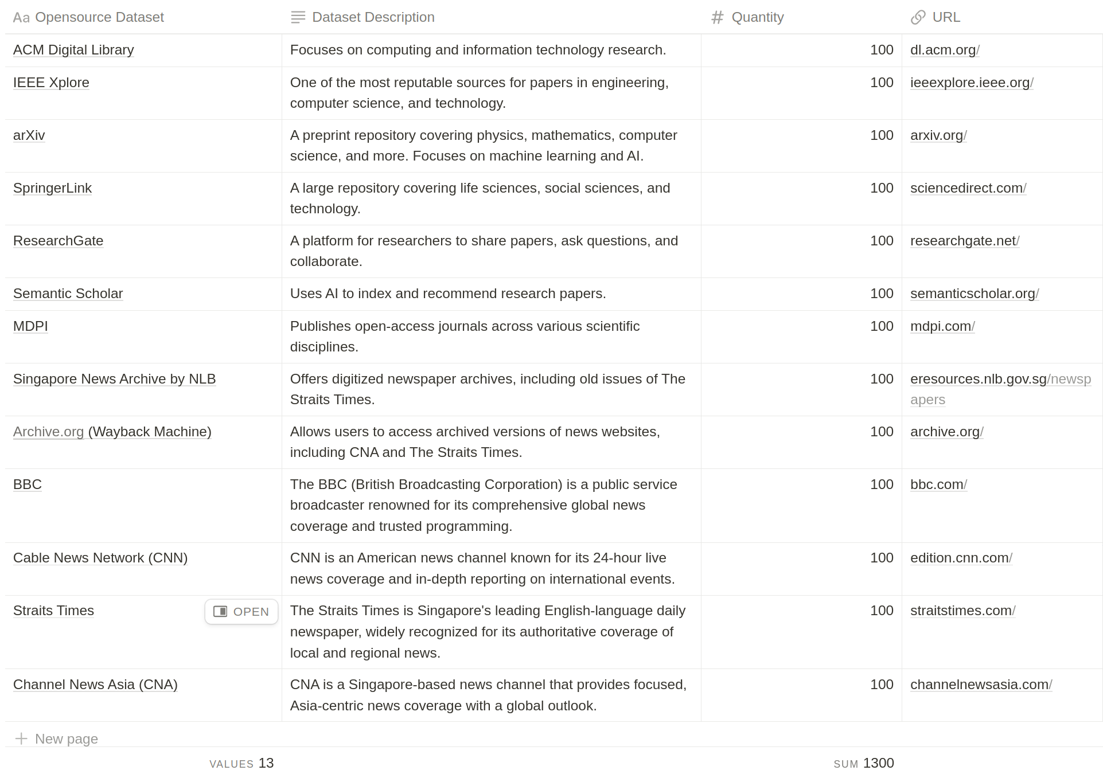
Dataset
Scrapping Open-source datasets from various sources:

Slide 6
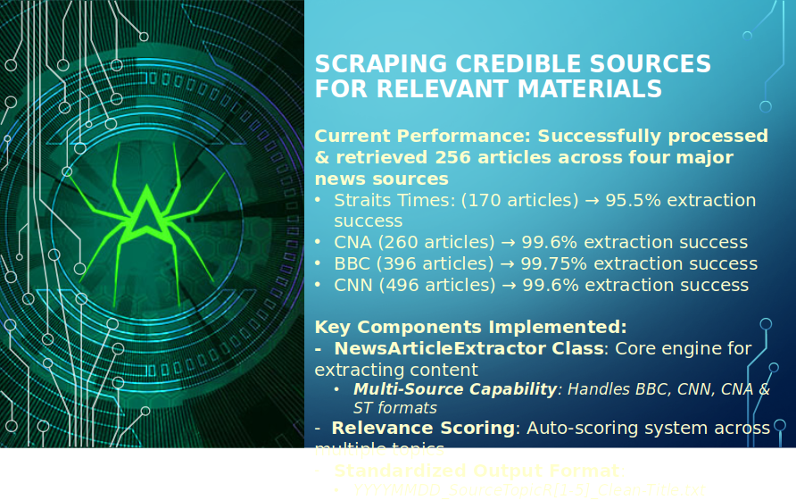
Dataset

Slide 7
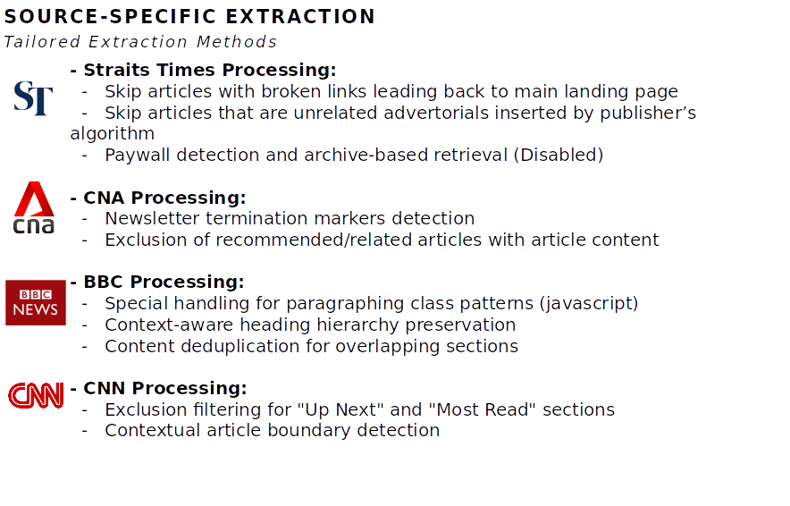
Dataset

Slide 8
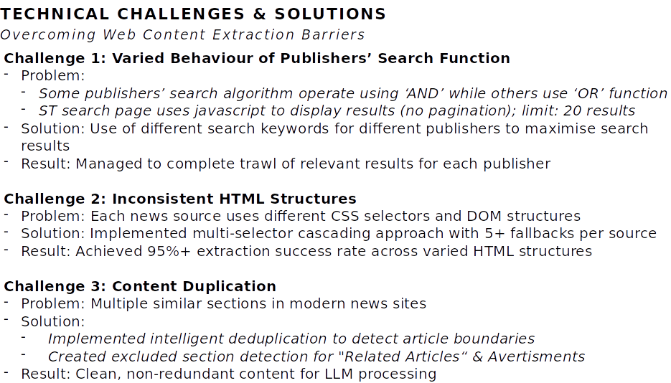
Dataset

Slide 9
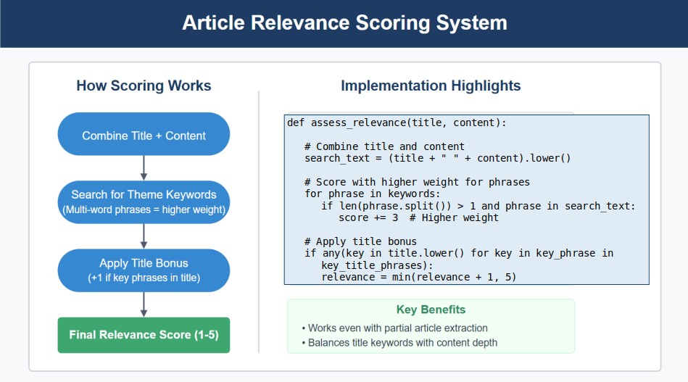
Dataset

Slide 10


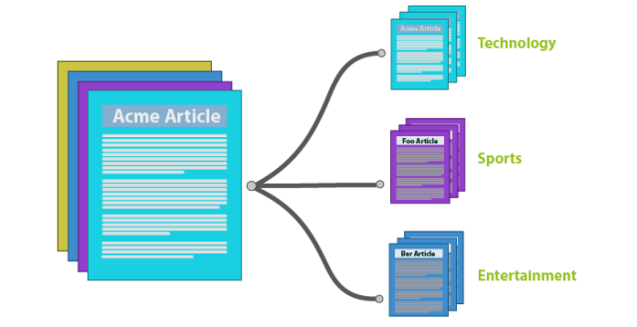
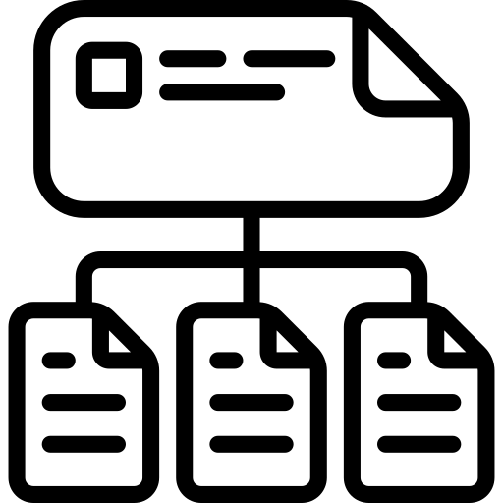








System Framework for PaperMatch
Periodic Scanning*
Document Workstream
Knowledge Workstream
Embeddings and metadata
Web Scrapper
Document Clustering
Sentence Chunking
Embedding Model
Query + Embedding
Vector
Database
<
<
Query + Context
User
Query
Prompt Template
Query Workstream
Generated News Summary + Recommended Research Solutions
LLM
(Llama2/Mistral)
*Knowledge Database should be updated periodically. However, we will exclude this feature for this project scope

Slide 11
Document Workstream
The Document Workstream focuses on automating the retrieval, processing, and categorization of academic research papers and news articles. This pipeline ensures seamless integration of both scholarly and media perspectives, providing researchers with structured insights.
Periodic Scanning*
Document Workstream
2
1
3
Document Clustering
Sentence Chunking
Web Scrapper
Web Scraper for Relevant URLs
A web scraping module will be developed to identify and collect URLs from selected research publication repositories and news sources.
Key Features:
Targeted Domains:
Research: ACM Digital Library, IEEE Xplore, arXiv, Papers with Code.
News: Major scientific news outlets (e.g., Nature, Science, TechCrunch).
Dynamic URL Extraction:
Uses BeautifulSoup/Selenium/Scrapy to navigate webpages and extract links to relevant research papers and news articles.
Identifies patterns in URL structures to filter out irrelevant pages.
Metadata Collection:
Extracts essential details (e.g., title, author, publication date, abstract) to facilitate later categorization.
Duplicate Filtering:
Implements a hash-based mechanism to remove duplicate URLs before processing.
Document Download and Clustering
Once URLs are collected, the next step involves downloading documents and categorizing them into research or news groups.
Download Function:
Automated PDF/HTML Fetching:
Downloads full-text documents using requests-based methods or APIs (where available).
Handles authentication and rate-limiting for paywalled content (if applicable).
File Format Standardization:
Converts various formats (PDF, HTML, TXT) into a unified text format for further processing.
Clustering Methodology:
Categorization of News Content:
Implements unsupervised learning techniques (e.g., k-means, DBSCAN, or hierarchical clustering) to group news articles based on themes.
Uses TF-IDF and topic modeling (LDA, BERT-based embeddings) to detect key topics and separate articles into categories (e.g., AI research, policy changes, industry trends).
Academic vs. Media Differentiation:
Uses rule-based classifiers and NLP models to distinguish between scientific papers and news reports.
Assigns confidence scores to ensure accuracy.
Sentence Chunking and Content Extraction
After downloading, the documents undergo text extraction and segmentation for structured analysis.
Sentence Chunking:
Text Segmentation:
Breaks long academic papers and news articles into meaningful sentence-level or paragraph-level chunks.
Uses NLTK, SpaCy, or Hugging Face models to segment text while preserving context.
Entity Recognition:
Extracts key entities (e.g., research topics, organizations, authors, keywords) using Named Entity Recognition (NER).
Content Extraction:
Key Information Identification:
Extracts abstracts, conclusions, research methodologies from academic papers.
Identifies headlines, quotes, and key takeaways from news articles.
Summarization Pipeline:
Utilizes state-of-the-art NLP models (e.g., BART, T5, Pegasus) to generate concise summaries for each document.

Slide 12
Query Workstream
The Query Workstream enables users to search for relevant academic research and media coverage using natural language queries. This pipeline processes user queries efficiently, retrieves relevant documents, and provides structured insights based on predefined templates.
1
<
<
2
User
Query
Prompt Template
Query Workstream
User Query Input
The user initiates the search by entering a natural language query into the system.
Example Query:
"Provide me the latest trends about deepfake and recommended research solutions on publication forums."
Key Features:
Intuitive Search Interface:
Supports free-text queries with natural language understanding (NLU).
Users can specify research domains, publication types, and media sources for more refined searches. (optional)
Query Preprocessing:
Uses tokenization, lemmatization, and stop-word removal to clean and standardize the input.
Identifies key entities (e.g., "deepfake," "research solutions") using Named Entity Recognition (NER).
Prompt Template for Query Processing
To ensure effective search results, the system utilizes predefined prompt templates for structuring the query before execution.
Prompt Template Format:
[User Query] → [Structured Prompt for Retrieval System]
Example transformation for the query: Input: "Provide me the latest trends about deepfake and recommended research solutions on publication forums."
Processed Prompt Template:
"Retrieve recent publications from IEEE Xplore, ACM Digital Library, and arXiv that discuss 'deepfake' in the last 12 months. Identify research solutions related to detection, mitigation, and ethical considerations. Provide key findings, methodologies, and direct links to papers."
Key Processing Steps:
Contextual Expansion:
Enhances the user query by adding structured retrieval conditions (e.g., time filters, research topics).
Query Routing:
Determines whether the query should be directed towards academic sources, media sources, or both.
Integration with Retrieval System:
Translates the prompt into API calls or database queries for retrieving relevant documents.

Slide 13
Knowledge Workstream
The Knowledge Workstream is responsible for transforming the structured outputs from the Document Workstream and Query Workstream into meaningful, retrievable knowledge representations. This is achieved through embeddings, vector databases, summarization via LLMs, and structured reporting for decision-makers.
1
Knowledge Workstream
Embeddings and metadata
2
Embedding Model
Query + Embedding
Vector
Database
Query + Context
User
4
3
Generated News Summary + Recommended Research Solutions
LLM
(Llama2/Mistral)
Generate Embedding Pairs
To facilitate efficient retrieval and semantic search, we convert processed documents (from academic publications and news articles) into vector embeddings using a Hugging Face embedding model (e.g., sentence-transformers/all-mpnet-base-v2).
Processing Steps:
Extract title, abstract, key insights, and metadata from academic publications.
Extract headlines, key narratives, and sentiment from news articles.
Use a pre-trained transformer model to generate embeddings for each document.
Generate paired embeddings to allow cross-referencing between academic and media insights.
Store Embeddings in a Vector Database
Once embeddings are generated, they are stored in a vector database or MongoDB (in JSON format) for efficient retrieval.
Options for Storage:
Pinecone / FAISS for high-performance vector searches.
MongoDB for structured storage in JSON format, enabling document retrieval based on metadata.
Summarized Outcomes Using LLMs
To generate actionable insights, we use LLMs such as Llama v3, Mistral, or Deepseek to summarize trends and recommend publications & GitHub links.
Processing Steps:
Retrieve top research papers and news articles based on query relevance.
Use LLM prompting to generate concise summaries of key insights.
Extract recommended research directions and potential solutions.
PDF Report Generation for Senior Management
To facilitate decision-making, the system compiles insights into a PDF report summarizing the top 5 news trends and 5 latest research directions.
Processing Steps:
Extract top 5 news trends and top 5 research directions.
Format insights into a structured management report.
Convert content into a PDF report using Python libraries (e.g., reportlab or pdfkit).

Slide 14
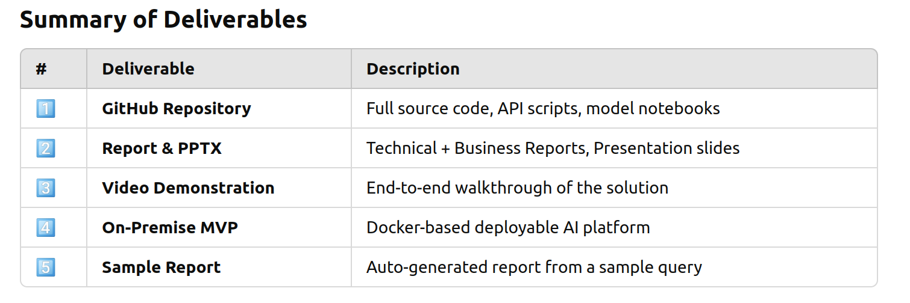

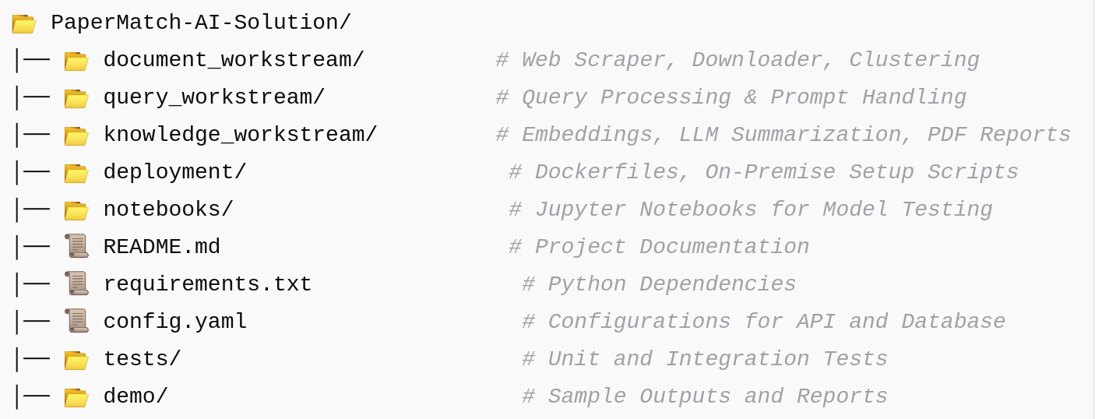
Project deliverables
The project deliverables encompass all critical components required to demonstrate, document, and deploy the solution, ensuring seamless integration and stakeholder alignment.
Final Outcome: A fully functional end-to-end AI system for automated research retrieval, media trend analysis, and executive reporting, ready for enterprise use.
Sample GitHub Repository

Slide 15
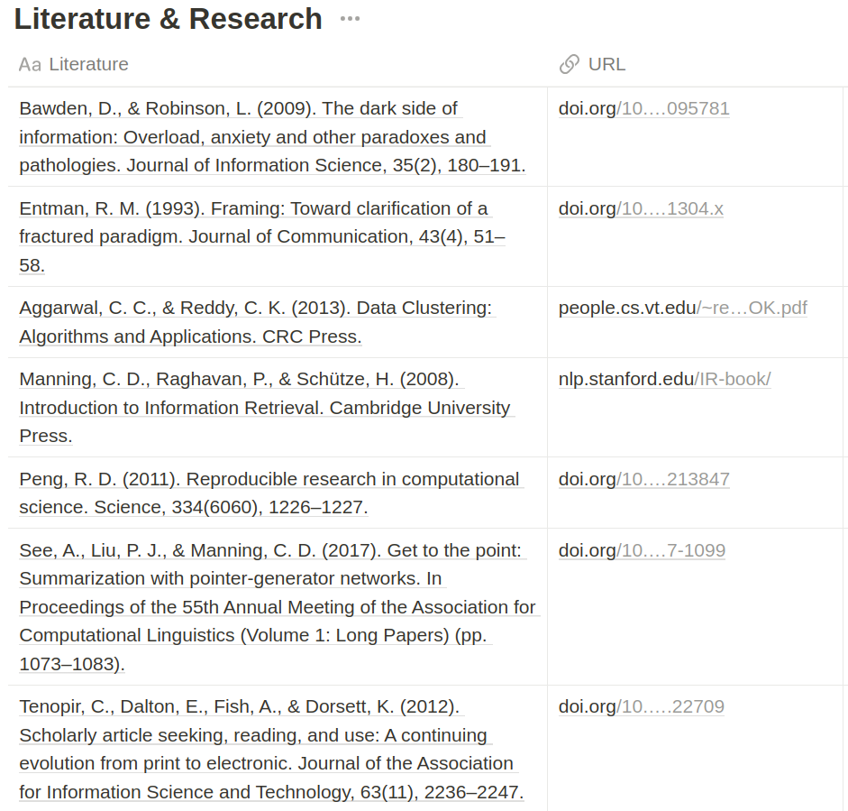
References

Slide 16
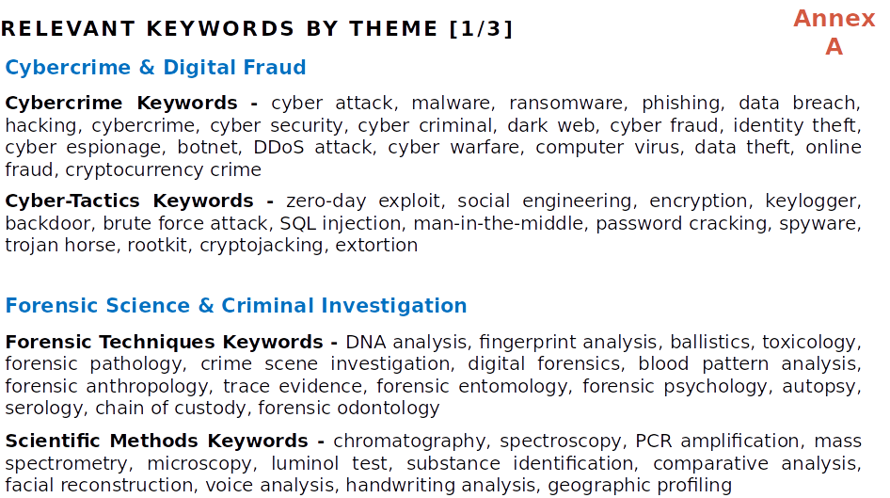
References

Slide 17
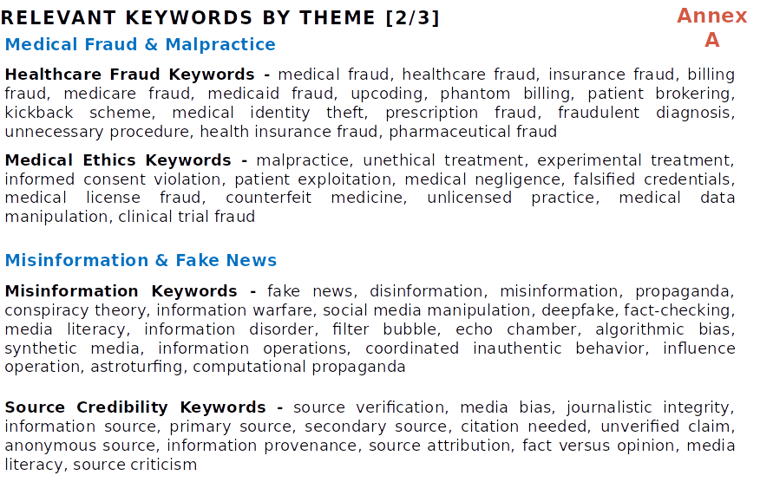
References

Slide 18
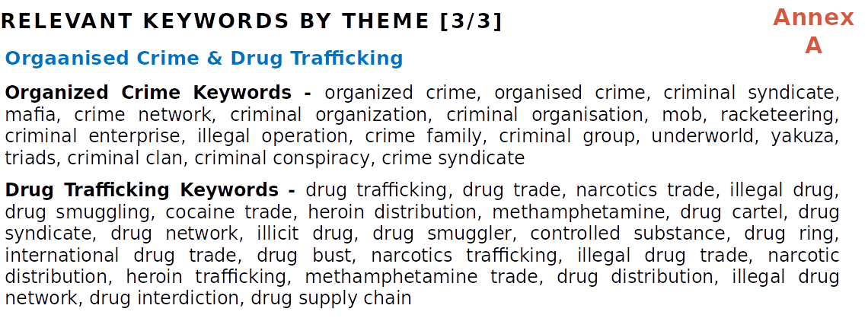
References

