Slide 1
MNE-BIDS and MNE-BIDS-Pipeline
Tutorial
Máté Aller
COGNESTIC 2026
23/09/2026

Slide 2
Outline
Brain Imaging Data Structure (BIDS)
MNE-BIDS
MNE-BIDS-Pipeline
Code demo throughout

Slide 3
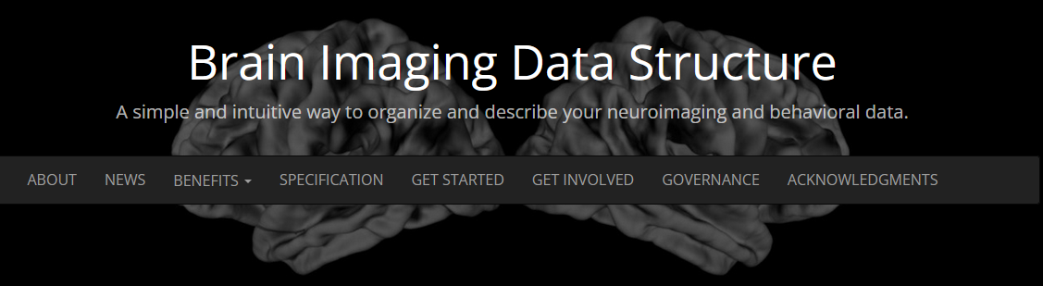
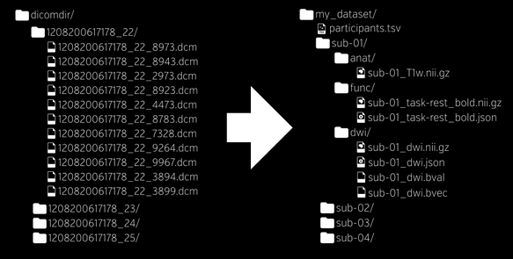
MEG, EEG, iEEG support included!
https://bids.neuroimaging.io/
https://bids-specification.readthedocs.io/en/stable/

Slide 4

https://mne.tools/stable/index.html

Slide 5
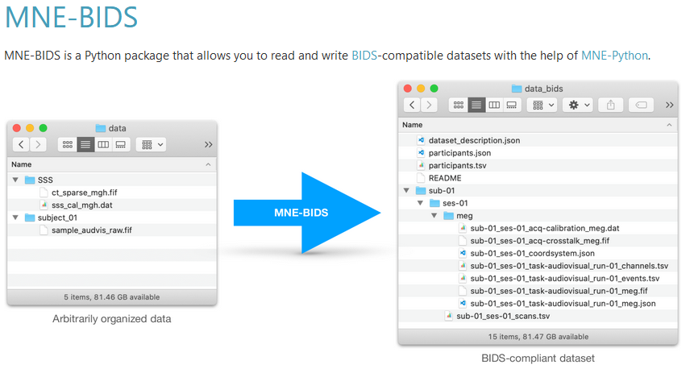
https://mne.tools/mne-bids/stable/index.html

Slide 6
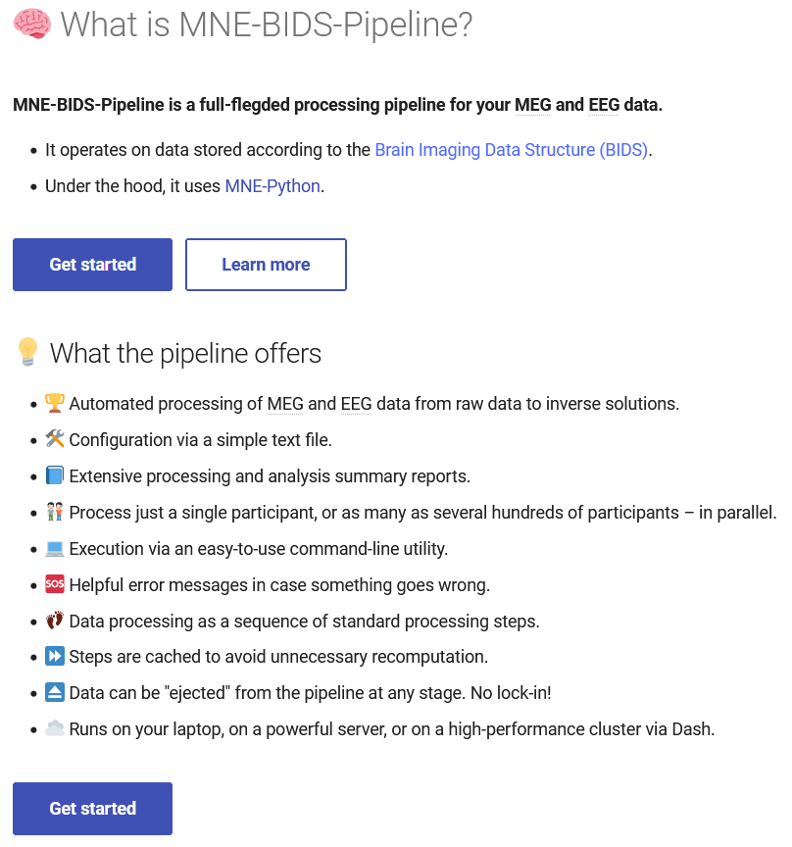
https://mne.tools/mne-bids-pipeline/stable/index.html

Slide 7
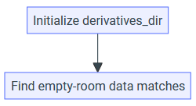




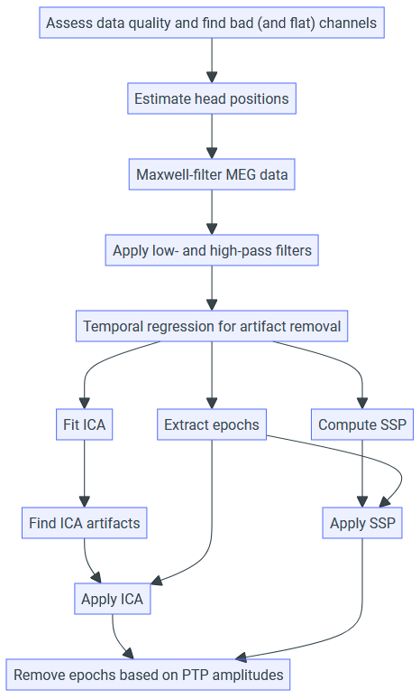
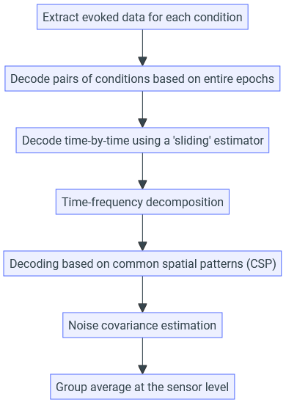
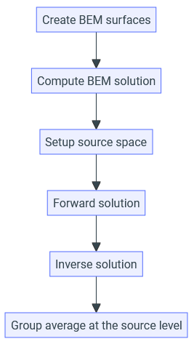
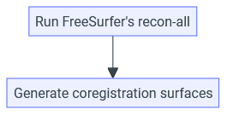

Slide 8
Data collection
Convert to BIDS format
Behavioural analysis
MNE-BIDS-Pipeline
Check M/EEG data quality
Semi-automatic, takes about 1 hour
Further, more specific analyses

