Slide 1
Functional/Effective Connectivity for fMRI
Rik Henson
MRC CBU, Cambridge

Slide 2
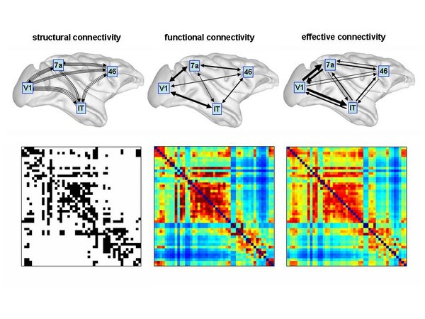
Structural, functional & effective connectivity
Structural/anatomical connectivity = presence of axonal connections / white matter tracks (eg, DWI)
Functional connectivity = statistical dependencies between regional time series (eg, ICA)
Effective connectivity = causal (direct/directed) interactions between populations (eg, DCM) (based on explicit network models)

Slide 3
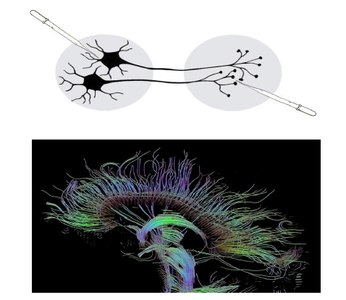
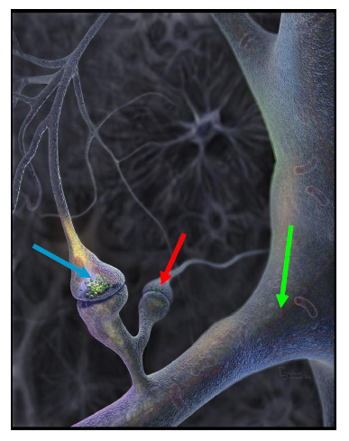
Structural vs Functional connectivity
Tracing studies
Tractography from DWI
But functionally, effect of one neuron on another can depend on:
Activity of a third (gating)
Rapid changes in plasticity

Slide 4
Functional vs Effective connectivity
No connection between B and C,
yet B and C correlated because of common input from A, eg:
A = V1 fMRI time-series
B = 0.5 * A + e1
C = 0.3 * A + e2
Correlations:
A B C
1
0.49 1
0.30 0.12 1
B
0.49
A
-0.02
Functional connectivity
²=0.5, ns.
0.31
C
Effective connectivity
Partial Correlation is approximate way

Slide 5
Functional Connectivity (in fMRI)
State-based connectivity
Time-Series Correlation (TSC), eg resting-state/movie, though could be spurious, e.g, cardio/respiratory; motion confounds..., or just reflection of structural connectivity...)
Multivariate (whole-brain, voxel-wise) decomposition, eg PCA, ICA
ROI(parcel)-based, pairwise connectivity
Task-Based connectivity
Beta-Series Regression (BSR) or Psycho-Physiological Interactions (PPI)
Network-based models
Dynamic Causal Modelling (DCM) (effective connectivity; not covered in notebooks)
Graph-theory summaries of functional networks

Slide 6
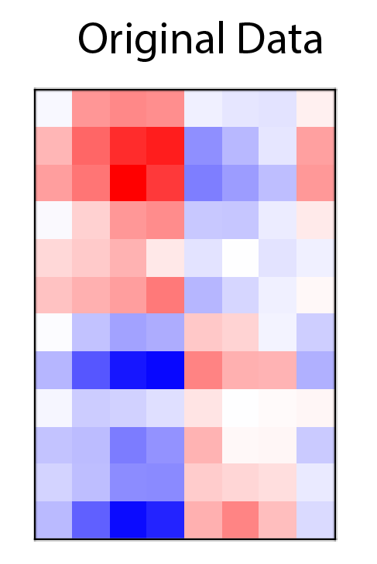
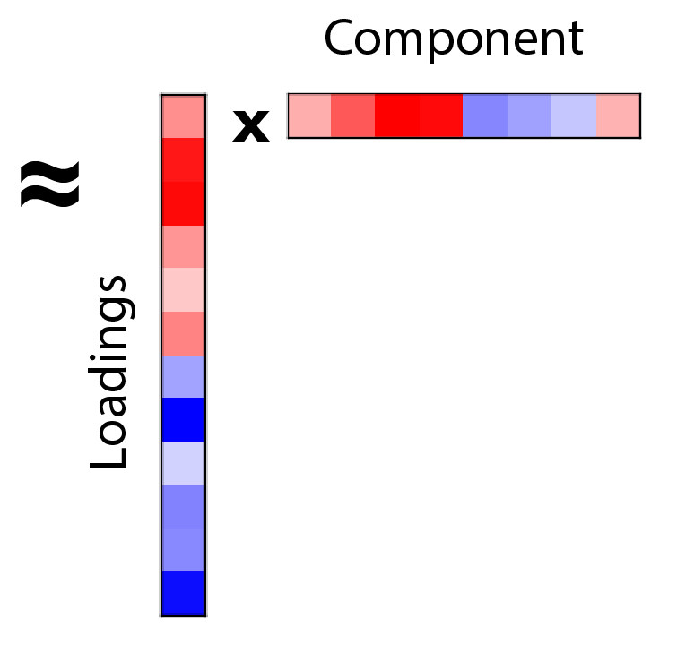
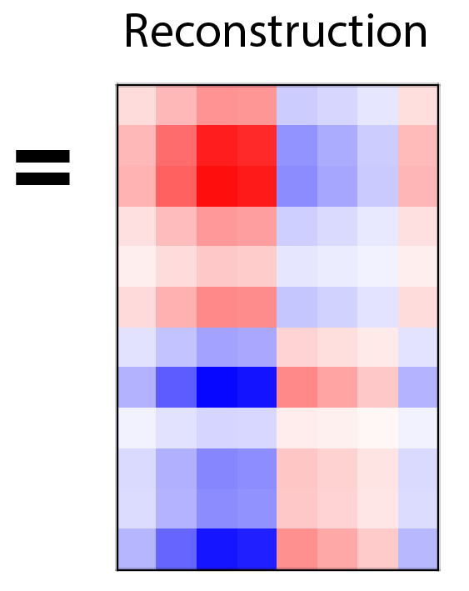
Matrix Factorisation (eg, SVD)
Voxels
Spatial “networks”
Scans (Time/Subjects)
Temporal “profile”
http://alexhwilliams.info/itsneuronalblog/2016/03/27/pca/

Slide 7
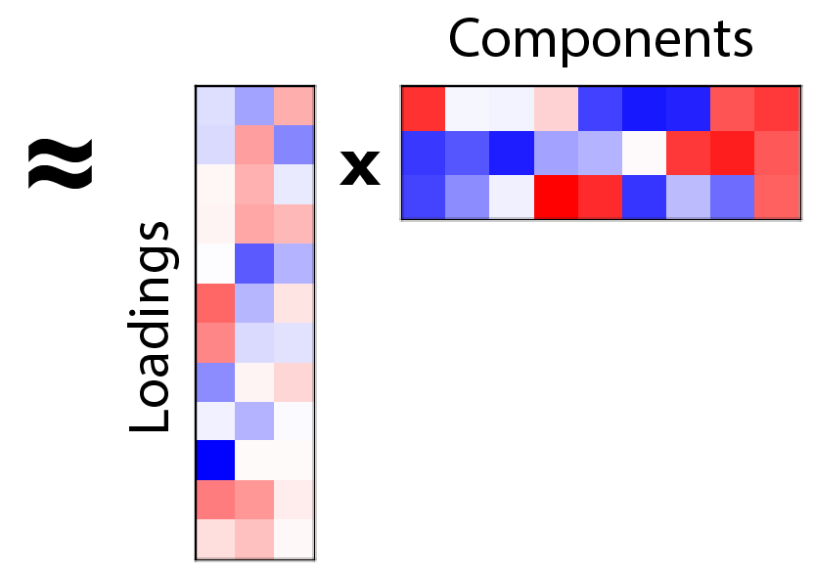
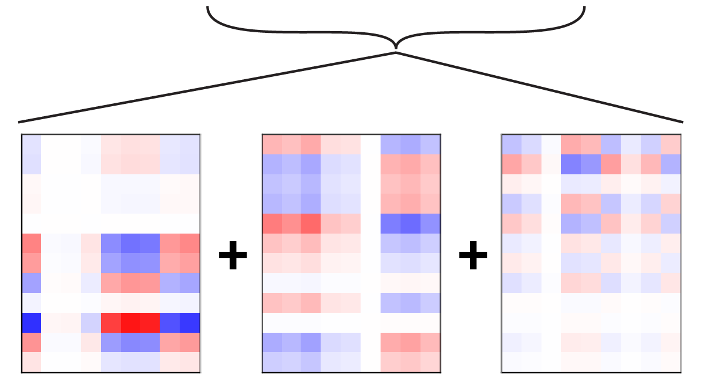



Matrix Factorisation (eg, SVD)
Voxels
Spatial “networks”
Scans (Time/Subjects)
Temporal “profile”
$λ$₁
$λ$₂
$λ$₃
http://alexhwilliams.info/itsneuronalblog/2016/03/27/pca/

Slide 8
Multivariate fC
PCA is an SVD of a covariance matrix, assuming orthogonal components (e.g, spatial patterns across voxels)
ICA assumes components are independent (usually across space with fMRI, but could be across time) and has been shown more effective in (re)producing characteristic resting-state networks (RSNs), and separating signal from noise

Slide 9
PCA vs ICA
Voxel 2
Voxel 1

Slide 10
Multivariate fC
PCA is an SVD of a covariance matrix, assuming orthogonal components (e.g, spatial patterns across voxels)
ICA assumes components are independent (usually across space with fMRI, but could be across time) and has been shown more effective in (re)producing characteristic resting-state networks (RSNs), and separating signal from noise
There are other types of matrix factorisation (e.g., non-negative, tensor-based) that have been tried, as well as various clustering techniques
Incidentally, while PCA is an SVD of the data covariance matrix (Y’Y), other techniques like CCA and PLS are SVDs of data-model covariance (Y’X)…

Slide 11
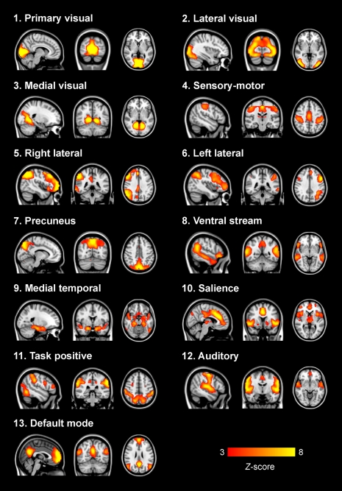
ICA RSNs
open.win.ox.ac.uk

Slide 12
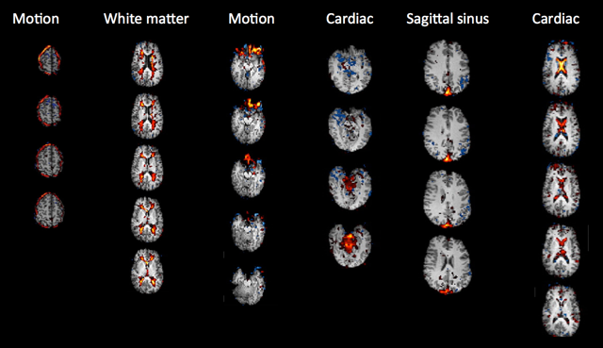
ICA RSNs
ICA Noise components
open.win.ox.ac.uk

Slide 13
Multivariate fC
Group ICA, concatenate subjects or used Tensor ICA (e.g., , eg MELODIC in FSL: https://fsl.fmrib.ox.ac.uk/fsl/fslwiki/MELODIC).
What signal/noise – eg FSL’s “FIX”, trained to separate signal and noise (or use multi-echo EPI and remove ICs that not linearly dependent on TE)
For resting-state, temporal ICs are arbitrary; for subjects performing same task, can correlate the temporal ICs with predicted regressors from design matrix (to get network-level maps)
For some very stimulating tasks like movie-watching (assumed to activate most of brain), one can correlate the timeseries across subjects for “inter-subject correlation” (ISC), or even “functional normalisation” of brains

Slide 14
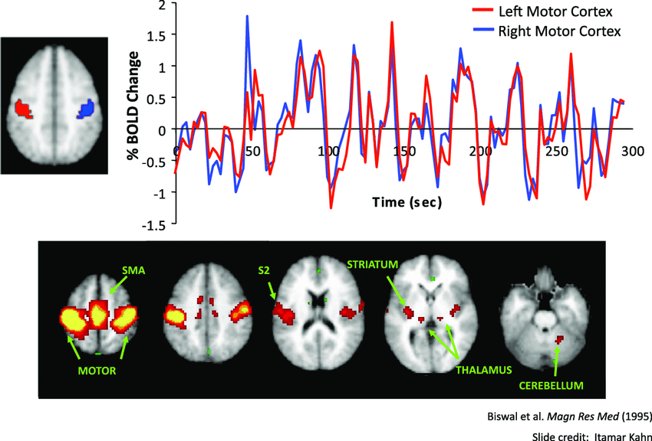
ROI-based fC
Rather than using a multivariate technique across all voxels, we can calculate pairwise fC between every pair of voxels or ROIs…
Such as from a “seed” to rest of brain:

Slide 15
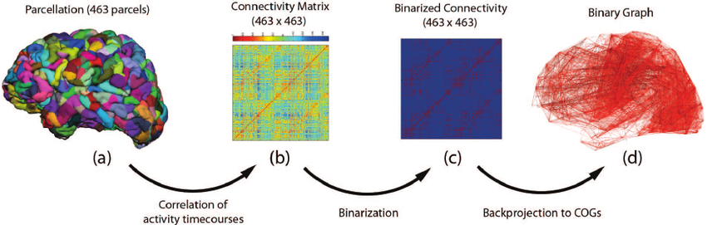
ROI-based fC
Rather than using a multivariate technique across all voxels, we can calculate pairwise fC between every pair of voxels or ROIs…
Or between every pair of ROIs in an Atlas, to construct a “connectome”:

Slide 16
ROI-based fC
Rather than using a multivariate technique across all voxels, we can calculate pairwise fC between every pair of voxels or ROIs
A common measure of fC is Pearson’s correlation coefficient (though other alternatives include partial correlation, mutual information, Granger, multi-dimensional similarity…)
However, the timeseries for any pair of voxels/ROIs can have a high correlation owing to non-interesting confounds like motion, breathing, etc…
…so we often need to “clean” the data first

Slide 17
Motion Artefacts
Add low (band-pass) filter (eg 0.1 Hz)?
Covary WM/CSF/Global Signal
“Scrubbing” (removing volumes with high motion), but ignores temporal autocorrelation
Rather than remove data, regress out motion parameters, including derivatives, second-order expansions (Volterra expansion), etc
Spikes = extreme values (high order expansion) – model as separate regressors
TR
CSF
6 motions
3 spikes
Highpass
WM
GS

Slide 18
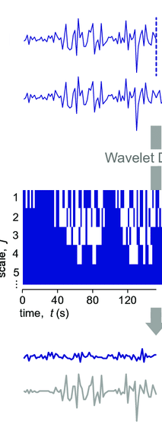
Motion Artefacts
Add low-pass filter (eg 0.1Hz)?
Covary WM/CSF/Global Signal
“Scrubbing” (removing volumes with high motion), but ignores temporal autocorrelation
Rather than remove data, regress out motion parameters, including derivatives, second-order expansions (Volterra expansion), etc
Spikes = extreme values (high order expansion) – model as separate regressors
Or define spikes in wavelet domain (but what threshold?)
Signal
Noise
Patel & Bullmore (2014) Neuroimage

Slide 19
Physiological Artefacts
High-pass filter, eg to 0.01Hz (since many biorhythms aliased to lower frequency)
If recorded physiological signals (eg cardiac, respiratory), then can adjust for (Fourier expansion of) those signals (RETROICOR)
PhysIO toolbox https://www.tnu.ethz.ch/en/software/tapas/documentations/physio-toolbox
Or can use mean (or first few principal components) of signal in CSF/WM (though care not correlated with GM signal)
CONN toolbox (Matlab/SPM): https://web.conn-toolbox.org/
“Global” artifacts, using “global signal regression” (eg across all ROIs)
Pros/Cons discussed in https://doi.org/10.1016/j.neuroimage.2016.11.052

Slide 20
Task-based fC
One way minimise confounds is to compare fC across two or more tasks/conditions. Two main approaches:
Beta-Series Correlation/Regression (BSR): correlate Betas (trial-wise parameter estimates from single-trial model) across ROIs, and compare correlation coefficients/regression slopes across conditions
Psycho-Physiological Interactions (PPIs): construct a model (GLM) of fMRI timeseries with regressors for 1) conditions (“psychological”), 2) timeseries from one ROI (seed) (“physiological”) and 3) the interaction between 1+2 (the key PPI term), and test significance of interaction term
See Masharipov et al 2024 for comparison: https://www.nature.com/articles/s42003-024-07088-3

Slide 21
1. BSR
One problem with BSR is how to estimate single-trial responses for event-related designs with short SOAs:
Bottom line: LSS better when scan noise higher than trial variability (normally the case); LSA better when trial variability higher than scan noise (see “efficiency” notebook)
http://dx.doi.org/10.1016/j.neuroimage.2015.11.009

Slide 22
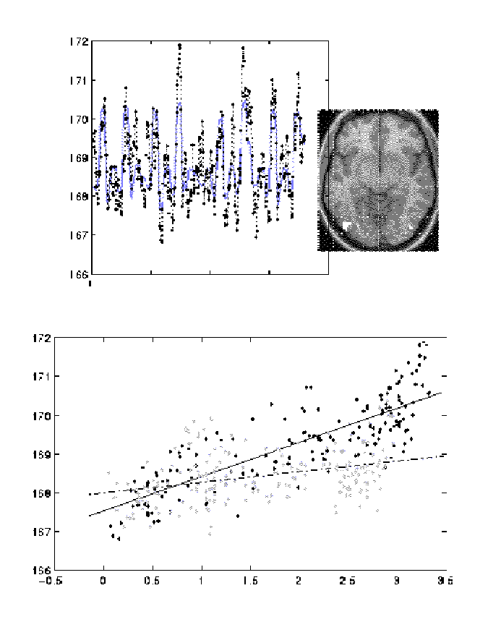
2. PPIs
Parametric, factorial design, in which one factor is psychological (eg attention)
...and other is physiological (viz. activity extracted from a brain region of interest)
SPM{Z}
V1 activity
time
Attention
(psy)
attention
V1
(phy)
V5 activity
no attention
V5
V1 activity

Slide 23
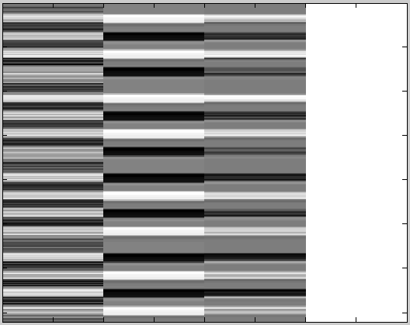
2. PPIs
0 0 1
SPM{Z}
V1 activity
time
attention
V5 activity
no attention
V1
(phy)
Att
(psy)
V1 x Att
(PPI)
V1 activity

Slide 24




2. PPI problem with brief psychological factors...
PPI term is:
True neural interaction is:
While:
when is low-frequency (e.g, blocked)...
...not case when high-frequency (e.g., event-related)
So PPI only really suitable for slow (blocked) designs (“gPPI” option, but no true deconvolution – need forward model like in DCM...)
(Similar problem with “Beta-series regression” – where short SOAs make separation of neural activity tricky...)
$$\left(Phy∙HRF)×(Psy ∙HRF\right)$$
$$(Phy×Psy)∙HRF$$
$$\left(Phy∙HRF)×(Psy ∙HRF\right)≈(Phy×Psy)∙HRF$$
$$Psy$$

Slide 25
Effective-connectivity: Definitions of Causality?
Direct experimental interventions (e.g, lesion, drugs)
Indirect experimental manipulations (e.g, PPI, DCM)
Network model inference (e.g, SEM, DCM)
Temporal precedence (e.g, Granger Causality, DCM)
…

Slide 26
Effective-connectivity: Definitions of Causality?
Direct experimental interventions (e.g, lesion, drugs)
Indirect experimental manipulations (e.g, PPI, DCM)
Network model inference (e.g, SEM, DCM)
Temporal precedence (e.g, Granger Causality, DCM)
…

Slide 27
Functional vs Effective connectivity
No connection between B and C,
yet B and C correlated because of common input from A, eg:
A = V1 fMRI time-series
B = 0.5 * A + e1
C = 0.3 * A + e2
Correlations:
A B C
1
0.49 1
0.30 0.12 1
B
0.49
A
-0.02
Functional connectivity
²=0.5, ns.
0.31
C
Effective connectivity
Partial Correlation is approximate way

Slide 28
3. Explicit Network Models of Causality
(Bivariate) correlations do not use an explicit network (graph) model
Can use partial correlation to adjust for all other connections within a graph (Smith et al, 2011; but often requires regularisation and can remove true connections)
Multivariate methods like Structural Equation Modelling (SEM) can test different network models, by simply comparing predicted with observed covariance matrices, but...
has no dynamical model (stationary covariances)
has no neural-BOLD model
cannot test some graphs, eg loops (no temporal definition of direction)
restricted to classical inference comparing nested models

Slide 29
Effective-connectivity: Definitions of Causality?
Direct experimental interventions (e.g, lesion, drugs)
Indirect experimental manipulations (e.g, PPI, DCM)
Network model inference (e.g, SEM, DCM)
Temporal precedence (e.g, Granger Causality, DCM)
…

Slide 30
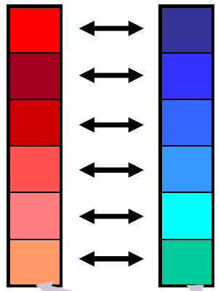
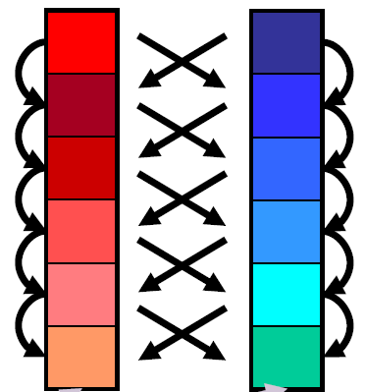
4. Temporal definition of Causality
Stationary
(correlations, SEM)
Dynamic
(Granger, DCM)
Time
(“unfolding” in time is one way to infer direction of connectivity)

Slide 31
4. Note on temporal causality and fMRI
Problem with time-based measures of connectivity arises with fMRI: BOLD timeseries is not direct reflection of Neural timeseries
(e.g, peak BOLD response in motor cortex can precede that in visual cortex in a visually-cued motor task, owing to different neural-BOLD mappings)
This compromises methods like Granger Causality and Multivariate Auto-Regressive models (MAR) that operate directly on fMRI data (Friston, 2010; Smith et al, 2011)
(Note that this does not preclude these methods (eg MAR) for MEG/EEG timeseries, assuming these are more direct measures of neural activity)

Slide 32
=> Development of DCM
Dynamic: based on first-order differential equations
- at level of neural activity, with separate haemodynamic model for fMRI
Causal: based on explicit directed graph models
Modelling: designed to test experimental manipulations
- “bilinear” approximation to interactive dynamics
4. (Estimated in a Bayesian context, allowing regularized estimation through priors, formal comparison of any number/type of models, etc...)

Slide 33
Rough comparison of popular methods?
 | Experimental modulation | Temporal/ Dynamical | Network model | Haemodynamic Model (for fMRI)
Correlation / ICA / PCA
BSR / PPI | Y
Granger |  | Y
SEM |  |  | Y
DCM | Y | Y | Y | Y

Slide 34
Other types of fC (not covered here)
Multi-dimensional (pattern-based) fC (e.g., Basti et al., 2020, https://doi.org/10.1016/j.neuroimage.2020.117179)
Dynamic fC (e.g moving windows or Hidden Markov Models, eg review: https://pmc.ncbi.nlm.nih.gov/articles/PMC3807588/)

