Slide 1
Prediction models for benefit income
Andy Baxter

Slide 2
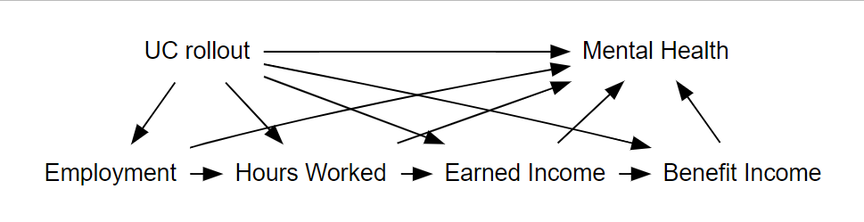
Predicting benefit receipt from UKMod data
The problem
Multiple pathways of impact of benefits receipt on mental health
Ideally a coefficient for each pathway would give an estimate for microsimulation process
Not all data are available in APS
Benefit amount received

Slide 3
Possible solution - Machine learning method
train_data_benefit_change <- train_data test_data_benefit_change <- test_data rc_income <- recipe(benefit_change ~ ., data = train_data_benefit_change) |> step_interact( ~ starts_with('gender_'):starts_with('children_') + starts_with('gender_'):starts_with('children_'):starts_with('emp_len_') + starts_with('children_'):starts_with('emp_len_') + student:starts_with('children_') + student:starts_with('caring_') + starts_with('marsta_') * starts_with('gender_') * starts_with('children_') ) wf_ln <- workflow() |> add_recipe(rc_income) |> add_model(mod_ln) mod_ln_lb <- fit(wf_ln, data = train_data_benefit_change)

Slide 4
The data
year | uc_income | lba_income | uc_receipt | age
2014 | 233.81 | 344.76 | Yes | 50
2014 | 233.81 | 344.76 | Yes | 40
2014 | 0.00 | 0.00 | No | 45
2014 | 0.00 | 0.00 | No | 42
2014 | 0.00 | 0.00 | No | 44
2014 | 0.00 | 0.00 | No | 36
2014 | 0.00 | 0.00 | No | 61
2014 | 0.00 | 0.00 | No | 60
2014 | 0.00 | 0.00 | No | 43
2014 | 0.00 | 0.00 | No | 55

Slide 5
Predictor variables
Age | Education | Children
Hours worked in week | Gender | Income
UK/EU citizen | Marital status | Housing responsibility
Disability | Region | Caring
Economic status/activity | Employment/length of employment
Student | Seeking work
These variables are common to UKMOD outputs and APS survey data

Slide 6
Possibility 1 - Predicting benefit types separately

Slide 7
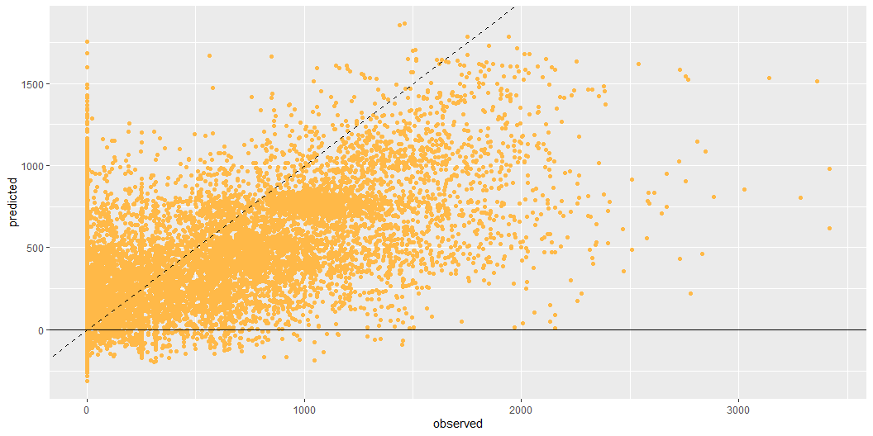
UC receipt
For this model, $R^{2}=0.475$ and root mean squared error $RMSE=313.6$

Slide 8
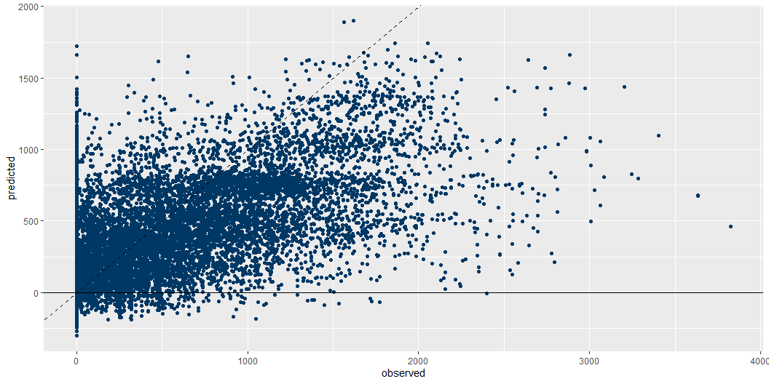
Legacy benefit receipt
For this model, $R^{2}=0.437$ and root mean squared error $RMSE=342.1$

Slide 9
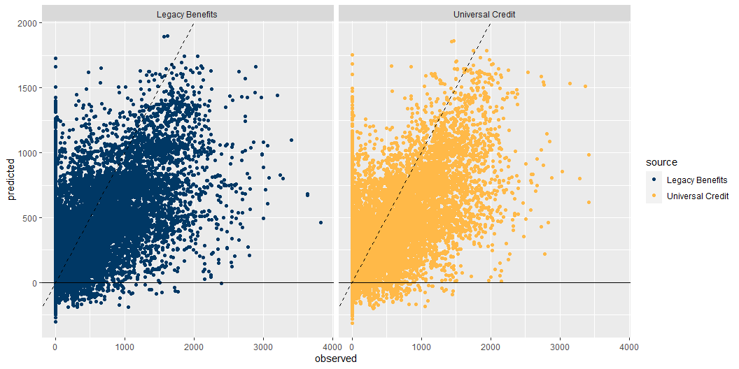
Plotting both income types

Slide 10
Possibility 2 - Predicting difference

Slide 11
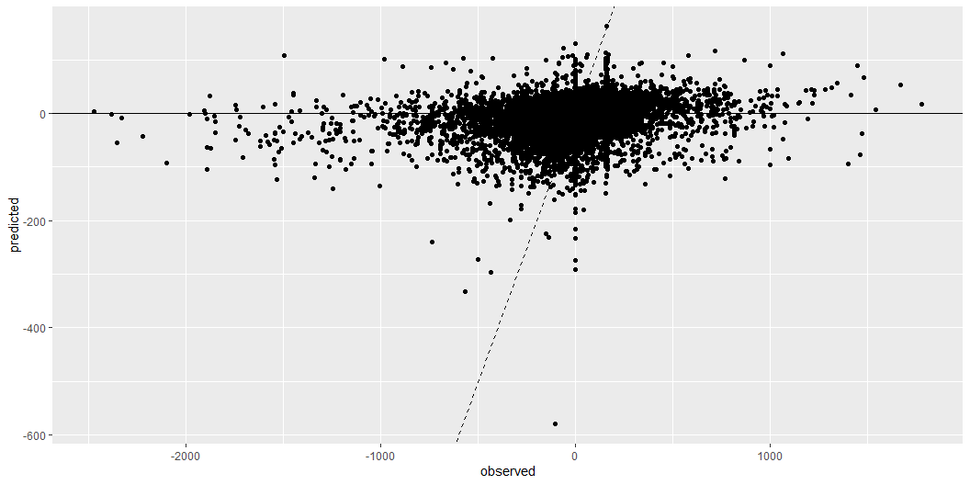
Possibility 2 - Predicting difference
For this model, $R^{2}=0.023$ and root mean squared error $RMSE=169.1$

Slide 12
Possibility 3 - Trichotomise

Slide 13
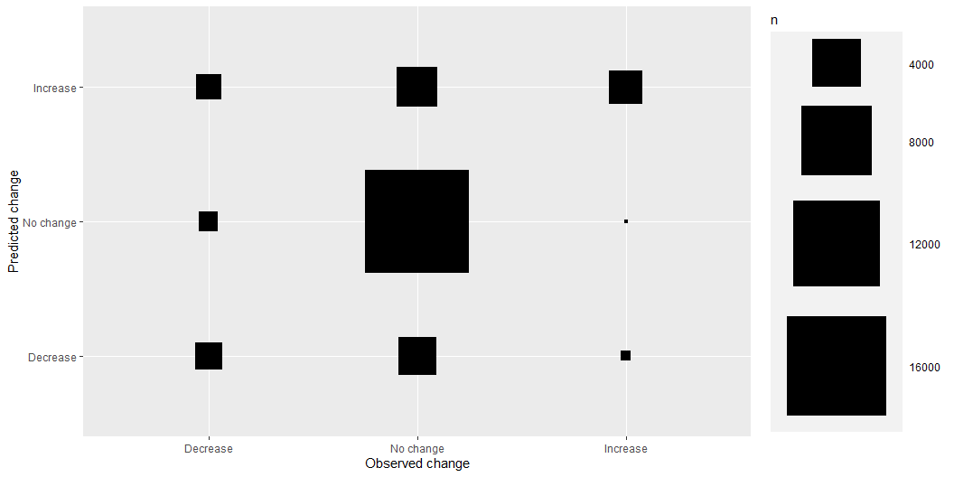
Possibility 3 - Trichotomise

Slide 14
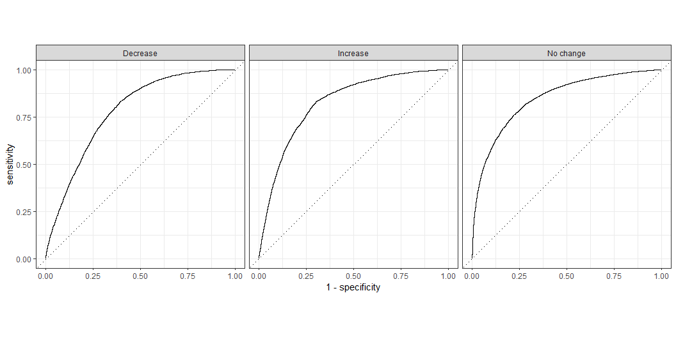
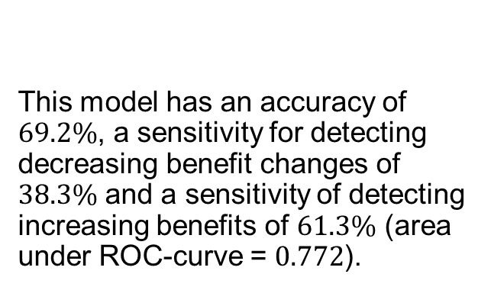
Accuracy
This model has an accuracy of $69.2\%$, a sensitivity for detecting decreasing benefit changes of $38.3\%$ and a sensitivity of detecting increasing benefits of $61.3\%$ (area under ROC-curve = $0.772$).
ROC curves

Slide 15
Proportions of predictions within each category of observed benefit change:
 | Prediction: Decrease | No change | Increase
Decrease | 38.3% | 26.2% | 35.5%
No change | 11.4% | 75.9% | 12.6%
Increase | 20.5% | 18.2% | 61.3%

