Slide 1

OneSitting
A small business goes fully digital in one sitting
Project Udyam Digital · Airtel Sync 2026 · Digital Track
AI advisor in the owner's language · transparent bundle quote · registry-checked KYC · live order tracker
Team FullBars · VIT
Machum Roy Choudhury · Cheralathan M
Code: github.com/MRC005/AIRTEL_SYNC

Slide 2

Leads are lost to process friction, not to lack of demand
Only 368 of 5,000 leads (7.4%) activate. 1,636 of the drops are visits, quotes, paperwork and install waits a digital journey can remove.
Leads
5,000
17.6 days
from lead to activation; every activated customer chased status 3 times
Contacted
3,406
↓ 827 waited for a visit that never came
6% → 28%
Needs assessed
1,974
↓ 385 lost to slow or confusing quotes
6-month churn rises with every status chase (1 call vs 5 calls). Waiting hurts loyalty, not just conversion
Quote accepted
861
↓ 273 gave up on paperwork
₹15,053
KYC complete
588
acquisition cost per activation, against a median bundle of ₹6,900/month
↓ 151 cancelled during a 10–14 day install
Activated
368
9.6% vs 2.0%
activation with vs without a GSTIN. A ₹41,700 CAC for no-GSTIN leads: needs a different, cheaper path
Drop reasons at each stage, smb_leads.csv (synthetic), Apr–Jun 2026. The other 2,385 drops are no-answer, not interested or price: the advisor still helps, but we do not count them.

Slide 3
Win offices first; serve micro shops with zero visits
Payback = acquisition cost ÷ monthly bundle value. Micro retail is 54% of leads but takes 8 months to pay back and churns 23% in 6 months.
Priority · segment
Share of leads
Activation
CAC / activation
Avg monthly value
Payback
6-mo churn
Bundle we lead with (tier-2 entry price)
1 Professional offices
25%
11.1%
₹10,695
₹6,796
1.6 mo
13.8%
Pro Office: fibre 300 + email & antivirus per user + cloud backup + 3 SIMs · ₹5,583/mo (12 staff) · 12 mo
2 Small multi-site
15%
11.0%
₹15,614
₹31,233
0.5 mo
10.8%
Branch Connect: fibre + failover + SD-WAN per site, POS, CCTV · ₹28,970/mo (5 sites) · 24 mo
3 Small manufacturers
6%
12.8%
₹15,324
₹19,980
0.8 mo
8.1%
Factory Secure: leased line + firewall + machine IoT + email · ₹14,312/mo · 24 mo
4 Micro retail & services
54%
4.1%
₹20,007
₹2,505
8.0 mo
22.7%
Dukaan Starter: fibre 100 + 1 SIM + website · ₹1,597/mo; with GSTIN, WhatsApp API instead of website · ₹2,297/mo
Digital-first
Assisted
Digital-only
Professional offices: one owner decides, single site, high GSTIN share (86%). The advisor can close them without a visit.
Multi-site & manufacturers: highest value, need a site survey. Advisor qualifies and quotes; partner or field closes.
Micro: never send a salesperson (CAC ₹20k vs ₹2.5k/month). Self-serve starter, AirFiber where no fibre, upsell after 3 months.

Slide 4
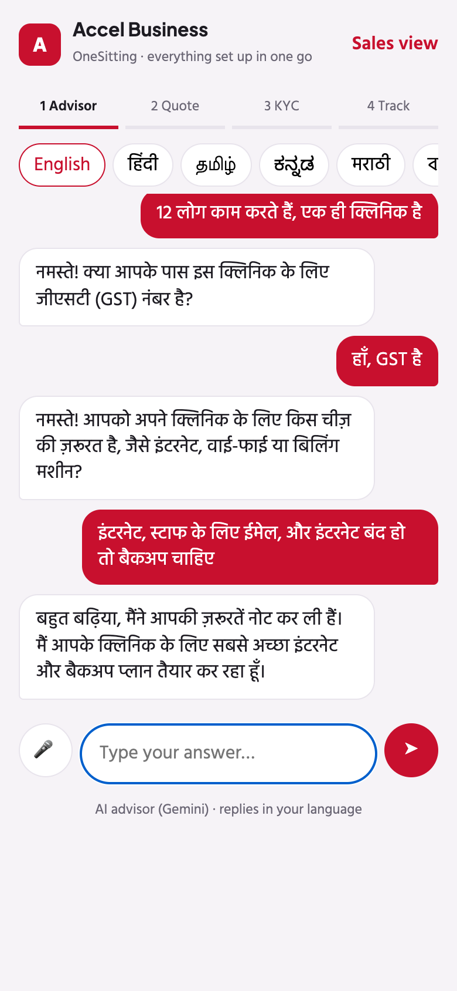
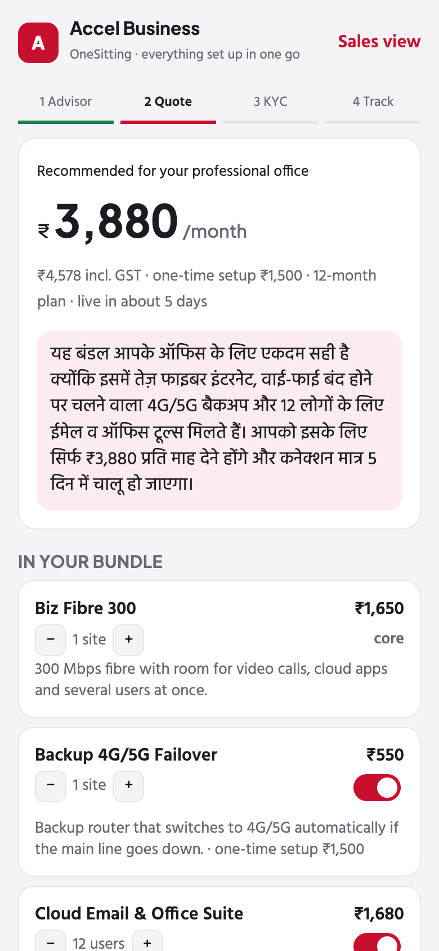
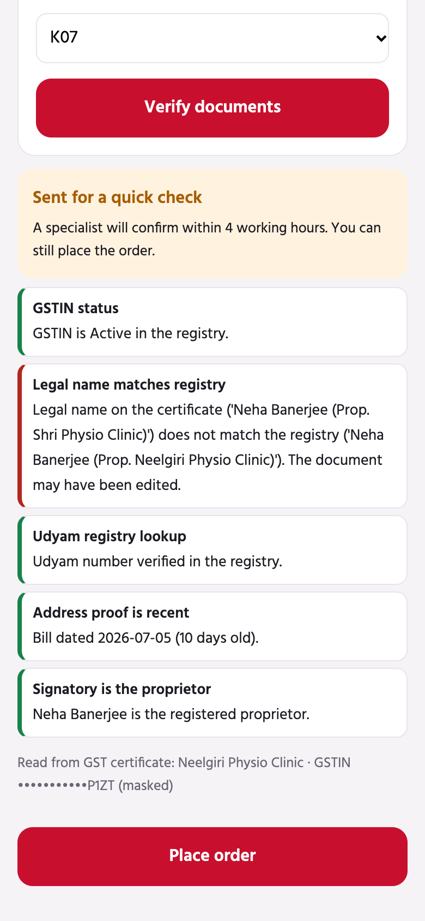
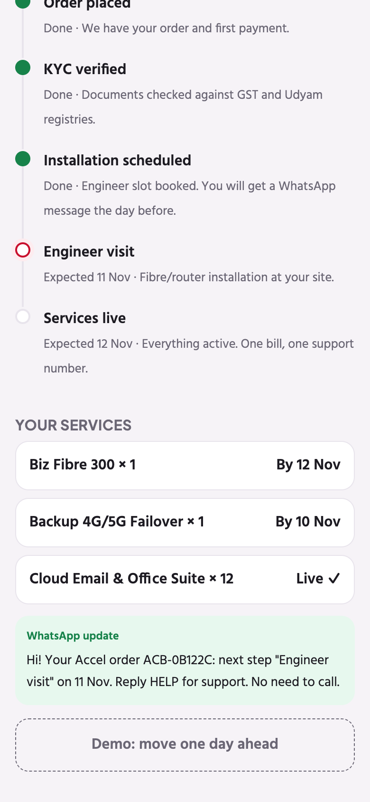
One sitting, on the phone, in the owner's language
Working prototype. The AI advisor talks; a rules engine picks products and prices, so it never quotes something the business cannot buy.
How the advisor decides
Gemini talks in the owner's own language and script (tested in Hindi and Tamil; the model also supports Kannada, Marathi, Bengali and more) and fills a business profile: type, staff, sites, city, GSTIN, needs.
A deterministic engine applies every catalogue rule: city tier, minimum staff and sites, GSTIN-only products and product dependencies. It swaps in the closest eligible product and says why.
Tested cases: no GSTIN → website instead of WhatsApp API; no fibre → 5G AirFiber; 5 staff asking for a leased line → fibre 300 + failover.
Why it matters: Tamil- and Kannada-preferring leads activate at 4–5% vs 8% for Hindi/English. A vernacular advisor targets that gap directly.
1 · Advisor asks ≤6 questions
in the owner's language
2 · One monthly price
toggle add-ons, see GST & setup
3 · Smart KYC in seconds
registry checks, plain-language fixes
4 · Order tracker
WhatsApp updates instead of calls

Slide 5
Smart KYC: seconds, not days, and private by design
OCR + registry checks replace physical document collection. Problems the owner can fix are returned to them; only real doubts reach a human.
Consent screen
(DPDP notice)
›
Image quality gate
blur · auto-straighten
›
OCR
OpenCV + Tesseract
›
GSTIN checksum
+ OCR auto-repair
›
GST & Udyam
registry lookup
›
Cross-document
rules → decision
Sample
What our checks found
Decision
DPDP Act 2023 choices
Consent first: a plain notice (purpose, data, retention, rights) before any upload; no upload API works without a consent ID.
Purpose limitation: KYC data is used only to verify and activate, never for marketing.
Minimisation: images are deleted as soon as fields are read; GSTIN, Udyam and ID numbers are masked in the UI and logs.
Retention & rights: verified fields kept for the contract plus the regulatory period; view, correct or withdraw from the app.
Next: DigiLocker pull and Aadhaar e-sign replace uploads entirely for most owners.
K01
GSTIN cancelled in registry; Udyam no. missing (OCR slip I→T auto-fixed)
Re-quote without GST products
K02
Certificate photographed 7° tilted → straightened, all checks pass
Approved
K04
GST certificate too blurry to read → ask for a retake
Owner fixes
K05
Udyam certificate missing; LLP signatory needs authorisation
Owner fixes
K06
GSTIN on document fails checksum (1 digit changed)
Manual review
K07
Legal name edited: ‘Shri’ vs registry ‘Neelgiri’ Physio Clinic
Manual review
K11
Utility bill 257 days old (limit 90)
Owner fixes
K03 K08 K09 K12
All checks pass (K10 after GSTIN OCR auto-repair)
Approved
Architecture: phone web app / WhatsApp / voice → FastAPI → advisor (Gemini + rules engine) · quote · Smart KYC · orders & tracker · sales view (propensity model)

Slide 6
Rivals sell products; nobody sells a finished setup
Based on each player's public SMB positioning (2025–26) and the provider mix in our 5,000 leads.
Player
Where they win
Gap OneSitting exploits
JioBusiness
Low entry price: 100 Mbps business broadband from about ₹801/mo with JioMeet and productivity tools
Connectivity-led plans; the owner still has to work out the rest of the stack
Vi Business
'Ready For Next' digital-readiness score; website builder, business email, device management
Assessment gives a score and suggestions, not an instantly priced, KYC-ready bundle
Tata Tele Business Services
SMB-only focus; Smartflo cloud telephony, SIP, managed security and internet
Communication-centric, sales-led buying journey
Local ISPs & resellers (21% of our leads)
Cheapest price, neighbourhood relationship, quick install
No bundle, SLA or single bill. Their customers activate with us at only 5.4%: price objections, not trust
Digital-first single-product apps
Instant online sign-up for one product (WhatsApp API, POS, website)
One product each: separate bills and support numbers for every tool
OneSitting (Accel Business)
Whole stack in one sitting: vernacular advisor, rules-safe bundle, registry KYC, tracker, one bill
Right to win: 1,890 leads already use Accel (mobile) and activate at 9.2%, the best of any provider group
Price is the #1 stated objection (621 drops). Our answer is value at a clear monthly price (Dukaan Starter at ₹1,597 vs ₹900 median current spend for micro), not a price war.

Slide 7
Impact: nearly double activations from the same leads
Conservative model on the Apr–Jun data: recover only part of each friction drop, then apply today's downstream conversion.
13.2%
₹8,400
+291
~₹9.6 cr
Field force and partners: the advisor adds to them
Partners own their pin codes: every digital sale in a partner's area pays them a commission, so they push the app instead of fighting it.
Humans get the right leads: the sales view ranks stalled leads by a propensity model. Calling the top 20% reaches 41% of all activations.
Field sales where visits add value: site surveys for multi-site and manufacturing; no visits for micro shops.
Referrals as a channel: referral leads activate at 14.8% at ₹4,100 CAC, the best of any source. Built-in 'refer a business' reward.
Rollout: M0–2 pilot in Pune (tier 1) and Jaipur (tier 2) for professional offices and GSTIN micro; M3–4 WhatsApp + voice; M5–6 national, multi-site via partners.
Key risk: GenAI errors. Mitigation: AI never sets products or prices; the rules engine does.
lead → activation
(from 7.4%)
CAC per activation
(from ₹15,053, same spend)
activations per
5,000 leads
extra annual
recurring revenue
Assumptions: recover 40% of visit drops, 60% of quote drops, 50% of paperwork drops, 30% of install cancellations. ARR at the ₹6,900 median bundle; four quarters. Pilot will measure each lever separately.
Metric (what we report weekly)
Today
12-mo target
Lead → activation conversion
7.4%
13%
Days from lead to activation
17.6
≤ 7 (≤ 5 micro)
Status chases per customer
3
≤ 0.5
Acquisition cost per activation
₹15,053
≤ ₹8,500
6-month churn
15.2%
≤ 10%

