Slide 1
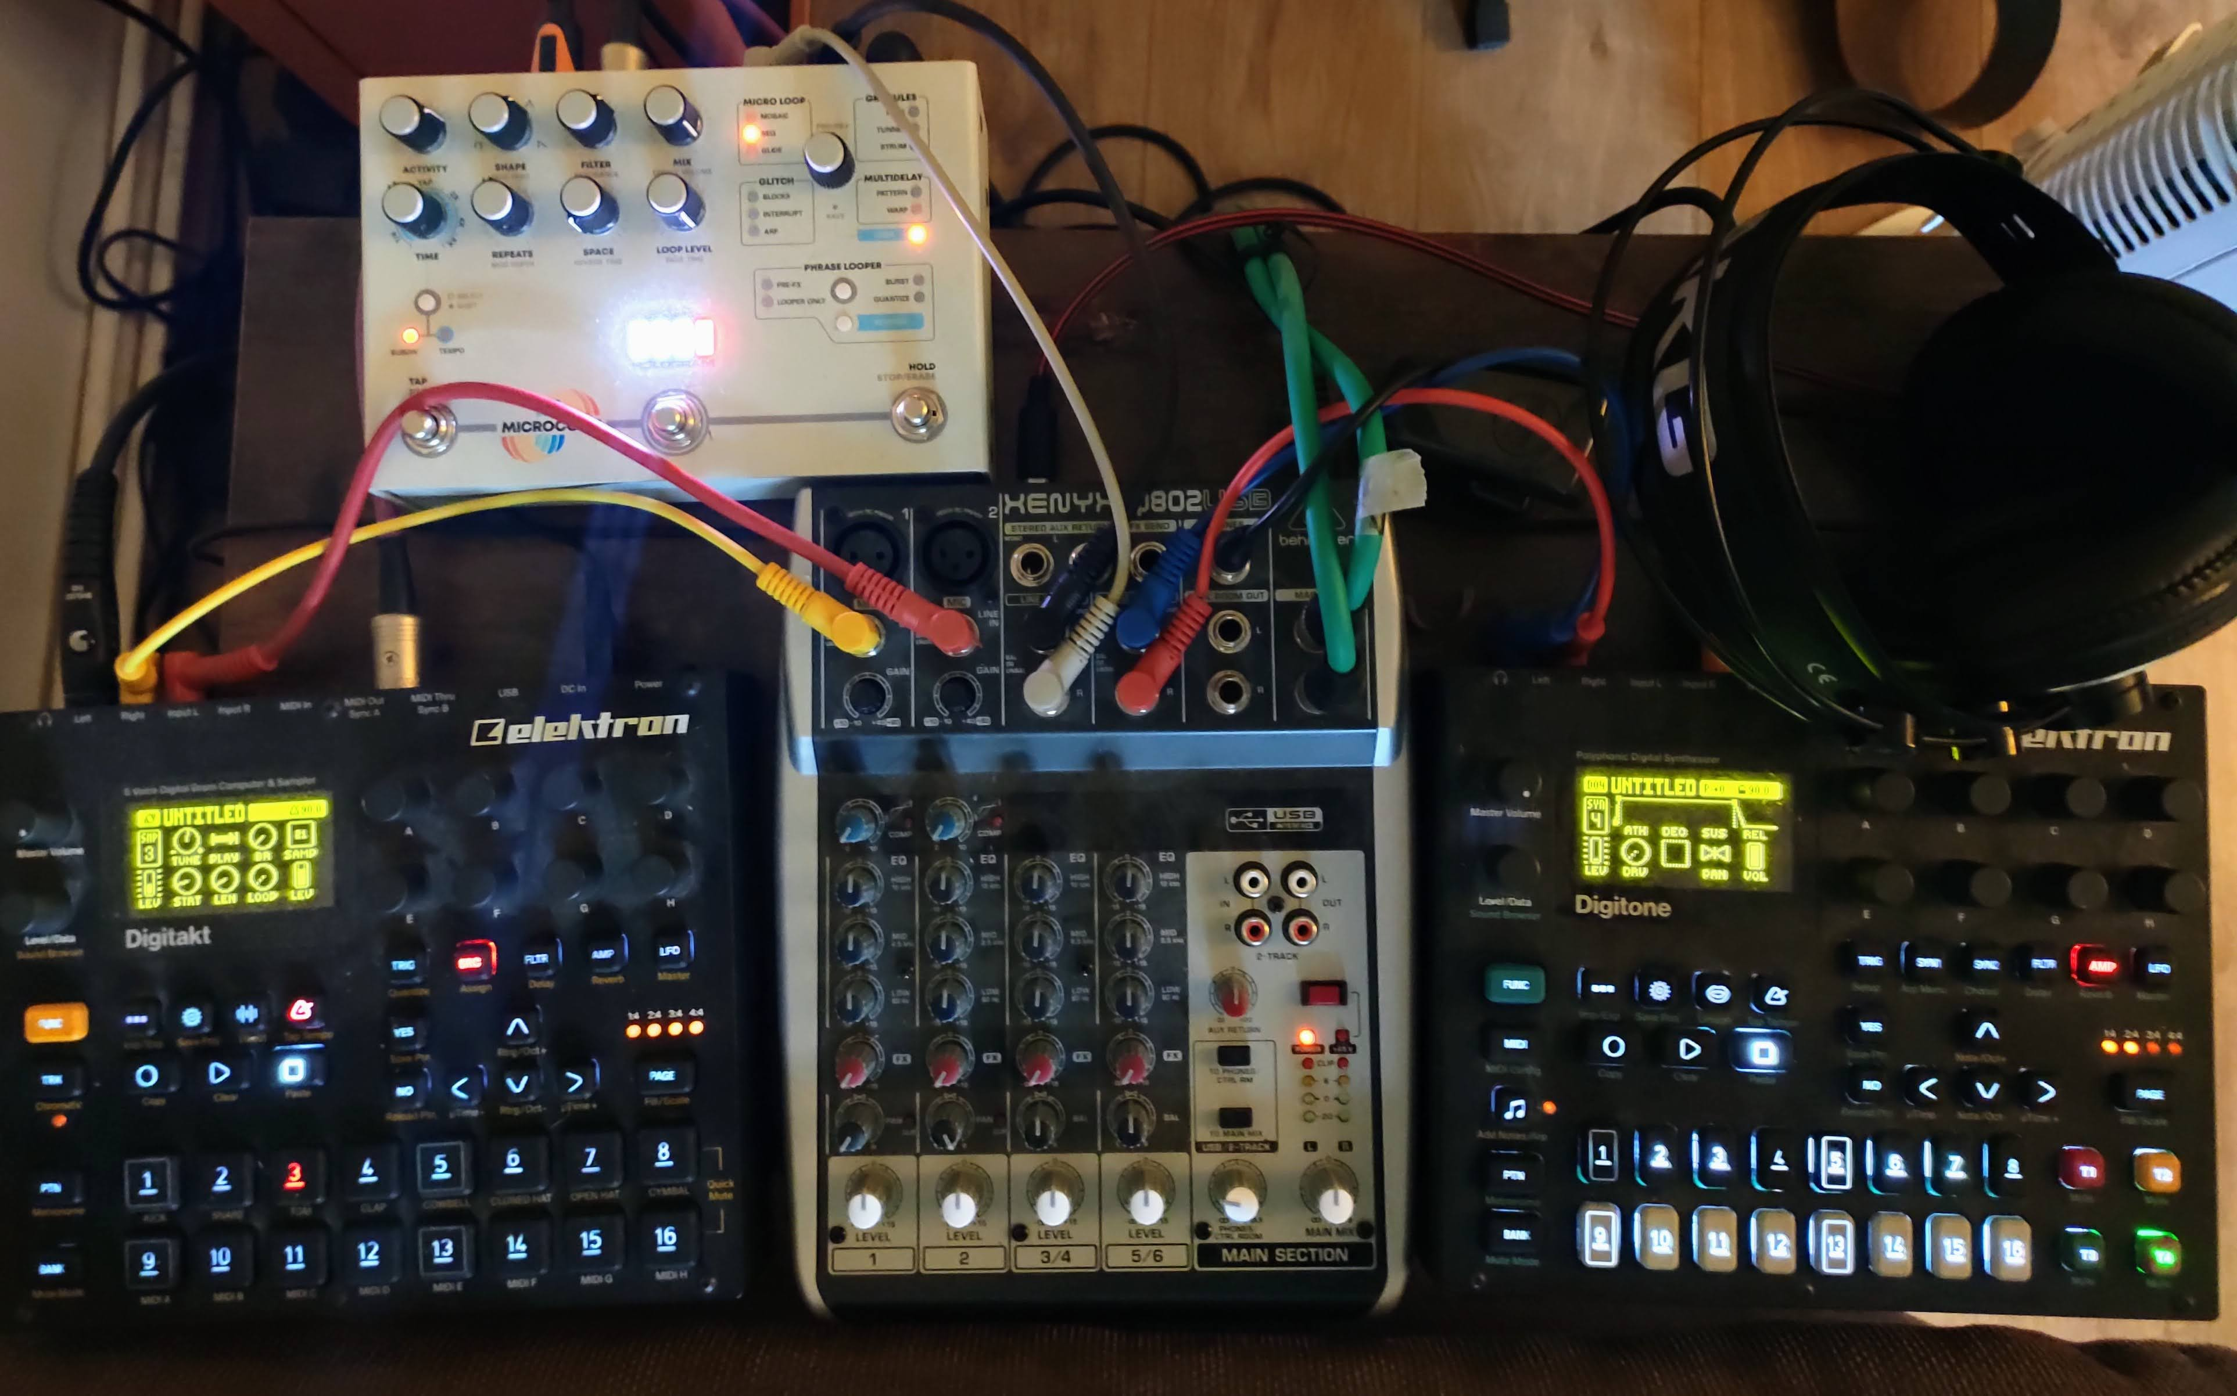
WHO AM I?
I don’t appreciate questions that expose existential dread
I occasionally make ambient / electronic music
I occasionally review immersive / interactive theatre
Canadian
Lived here for too long 12 years
Computer Science BSc
Epi / Public Health Masters
Software Engineer / Manager / Etc.

Slide 2
Research motivations
Personal:
Alleviating or reducing burden of disease
Grew up around ill-health. Seen the effects of co-morbidities and of novel medications
Work:
Translational Research
Prevention
Of disease
Of deterioration

Slide 3
Next big challenge
You are witnessing it! I’m 3 months into this career change
2 Challenges:
Gain deep understanding of multi-ancestry and disease progression
Use software engineering knowledge to speed up research, reduce errors, and improve reproducibility (not just for me).

Slide 4
Limerick
There once was a woman who was ill
She kept getting worse lil by lil
Someone figured out what was wrong,
A treatment came along
Now she can stop writing her will.
- Disease Progression

