Slide 1
Solving synthetic heart attacks in South Africa
Public Wellness Coalition

Slide 2
Academic questions​
What are the most predictive features of heart attack, and how do these differ between young and old people in South Africa?​
Is an age-specific heart attack predictor necessary to take into account potential aetiological differences in heart attacks between old and young people in South Africa?

Slide 3
Analysis plan

Slide 4
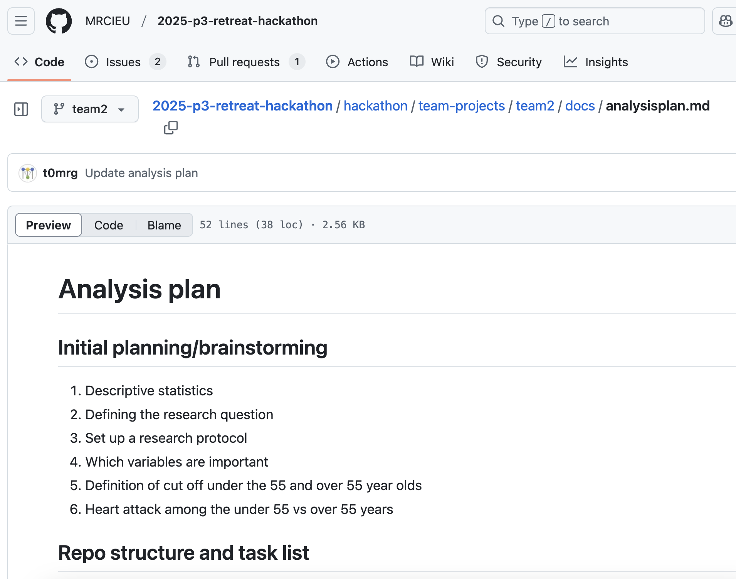
https://github.com/MRCIEU/2025-p3-retreat-hackathon/blob/team2/hackathon/team-projects/team2/docs/analysisplan.md

Slide 5
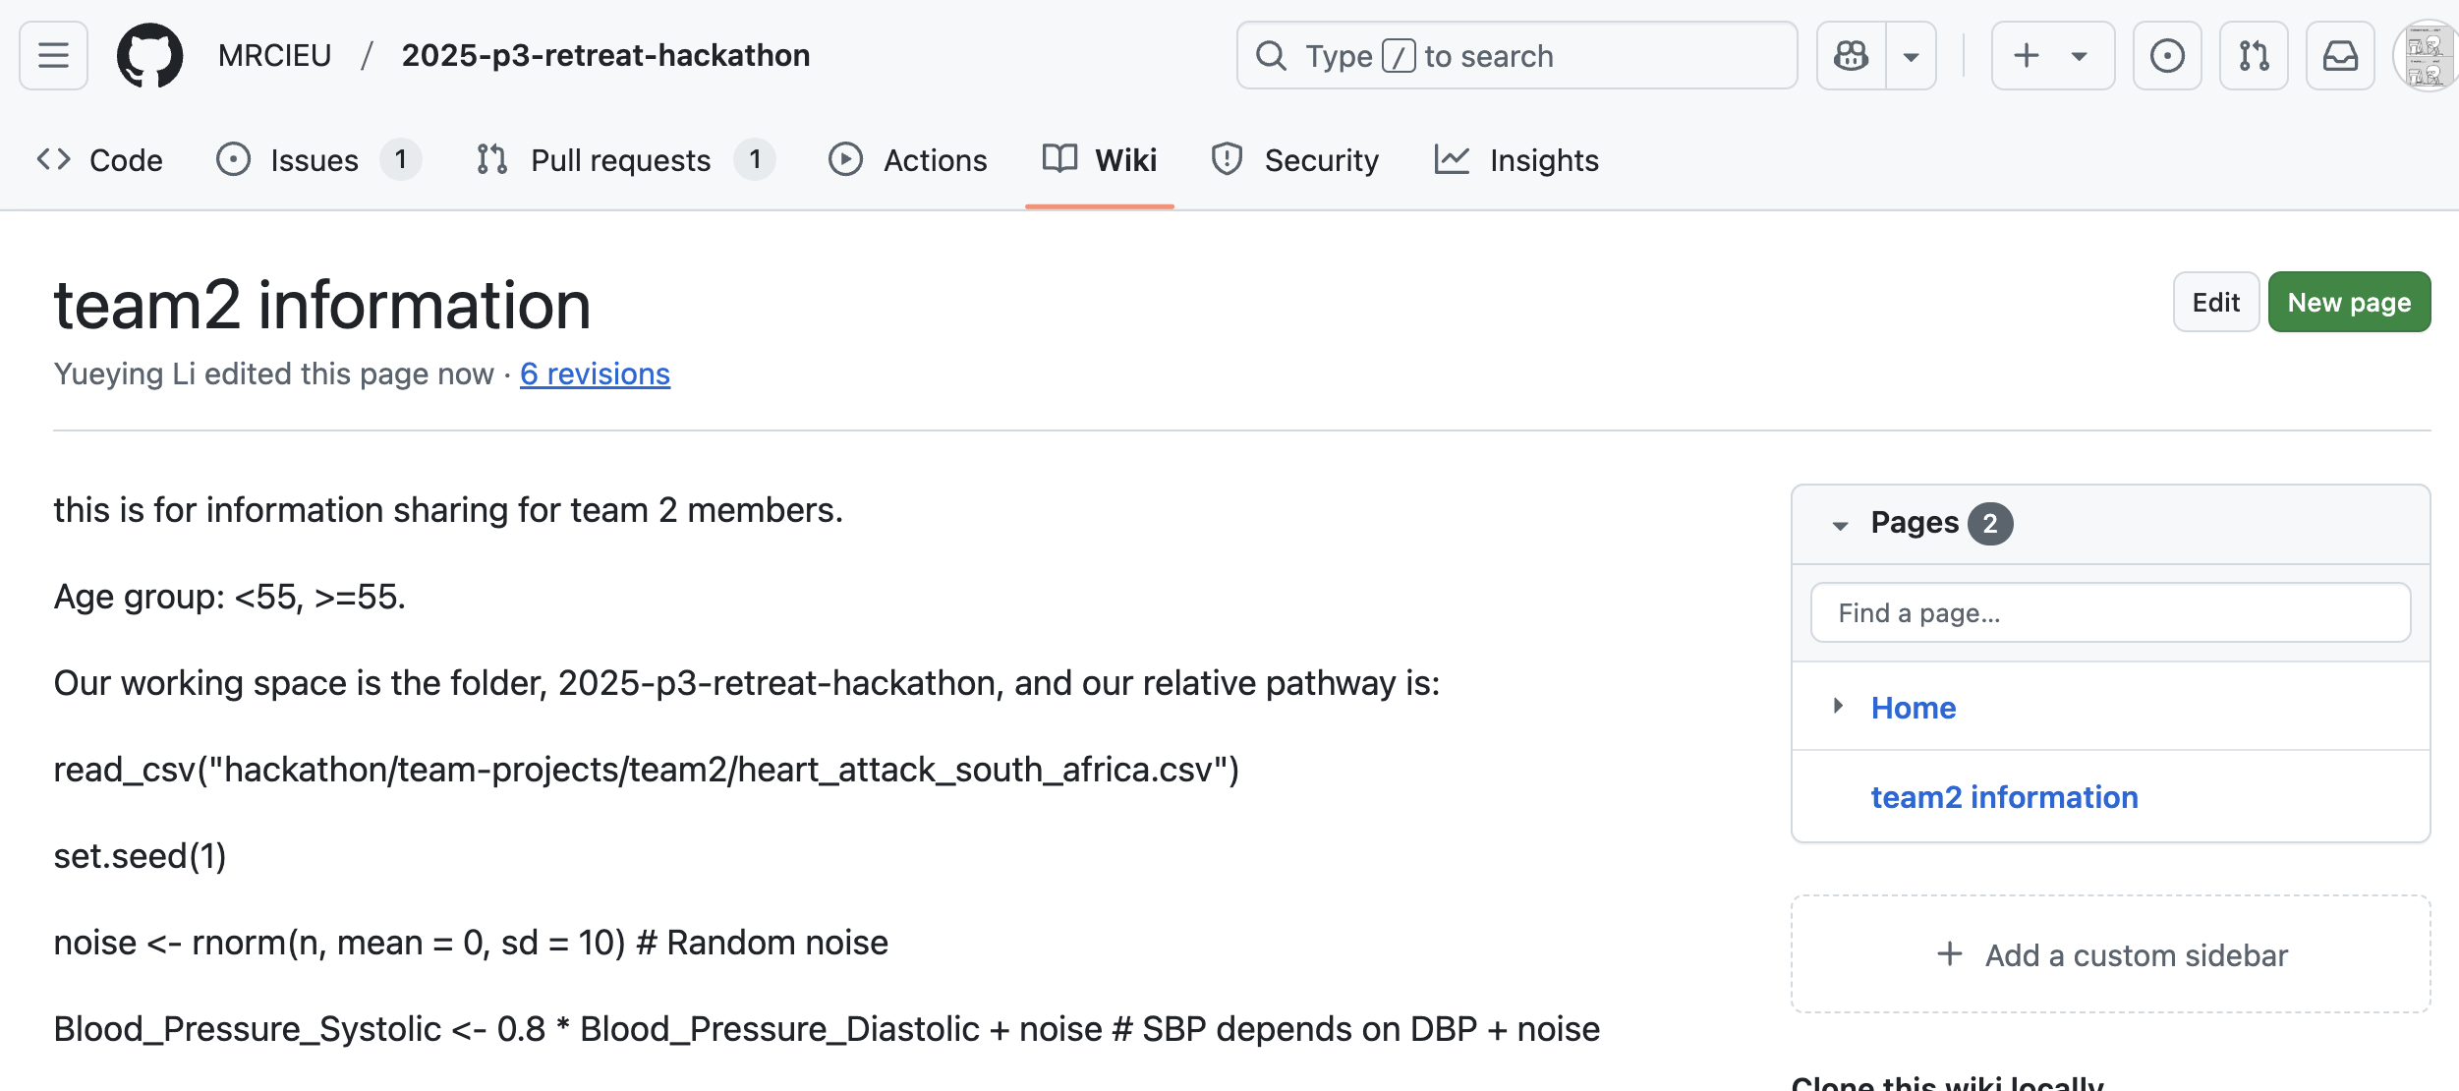
Simulate data
introduce a correlation between SBP and DBP, so that SBP should not appear as a significant predictor in a Lasso regression.

Slide 6
descriptive analysis

Slide 7
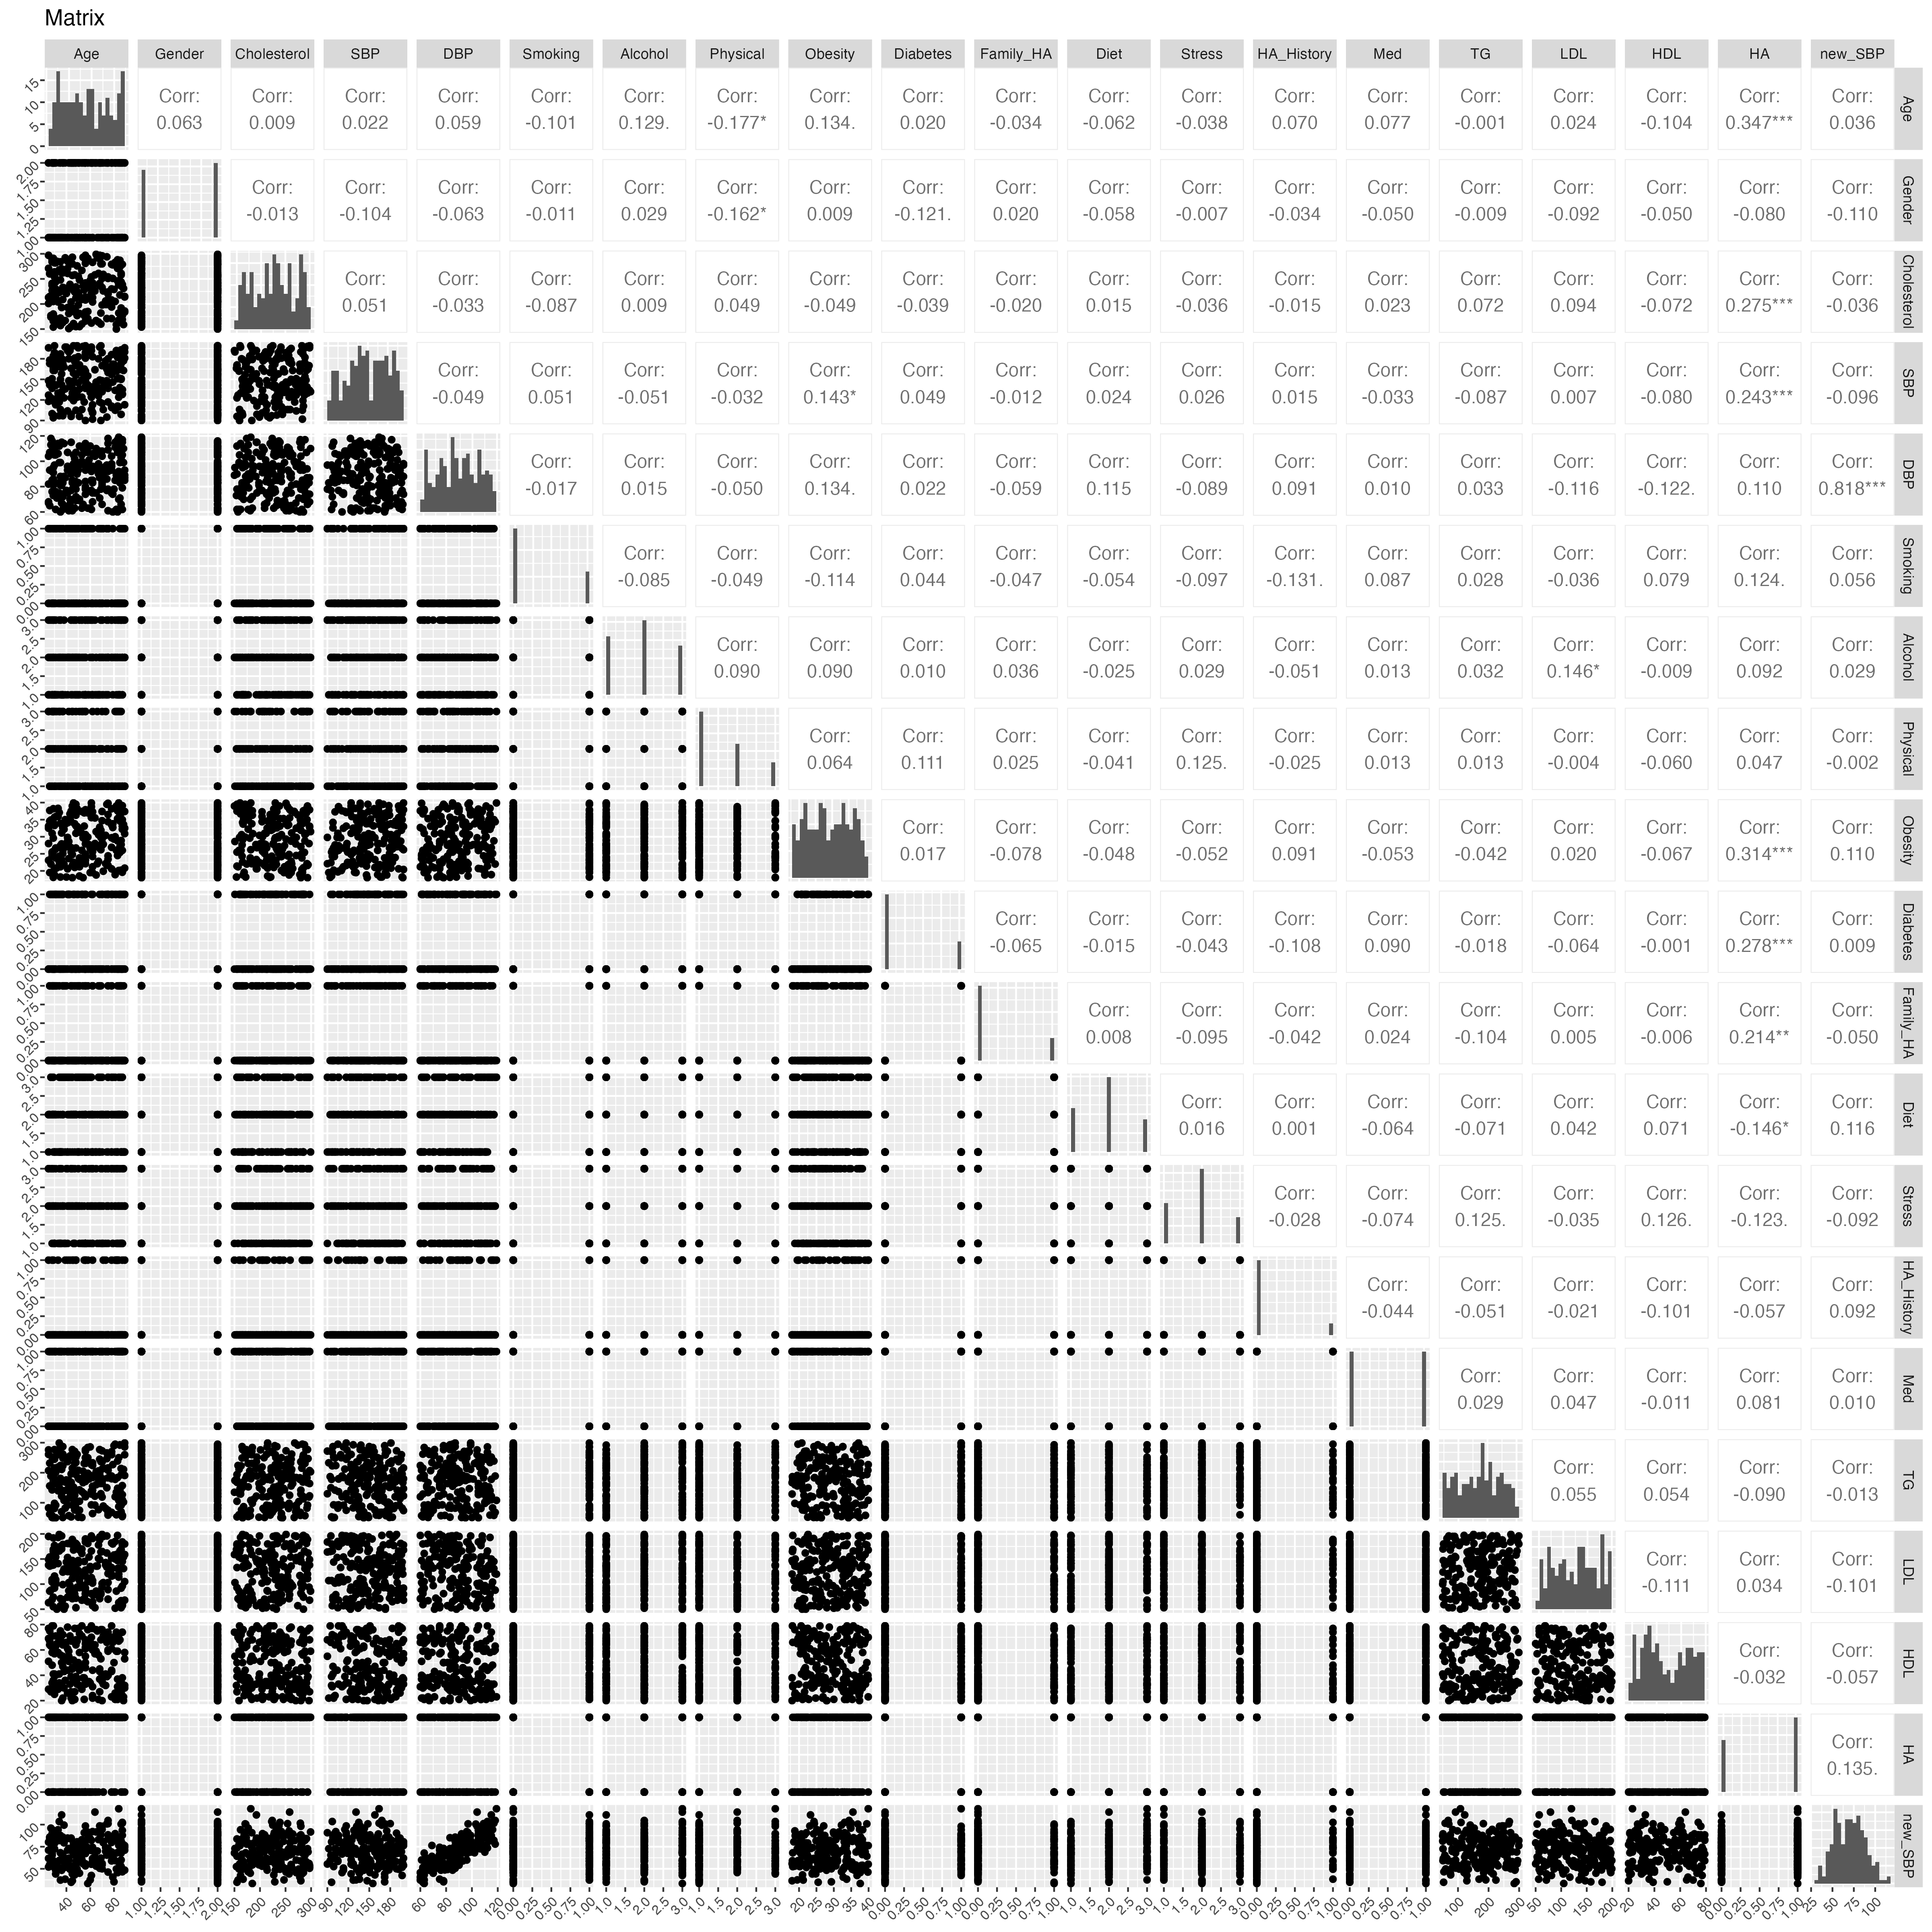
Pairwise correlation for the overall popluation

Slide 8
Prediction modelling results

Slide 9
preliminary
Load in packages
data loading

Slide 10
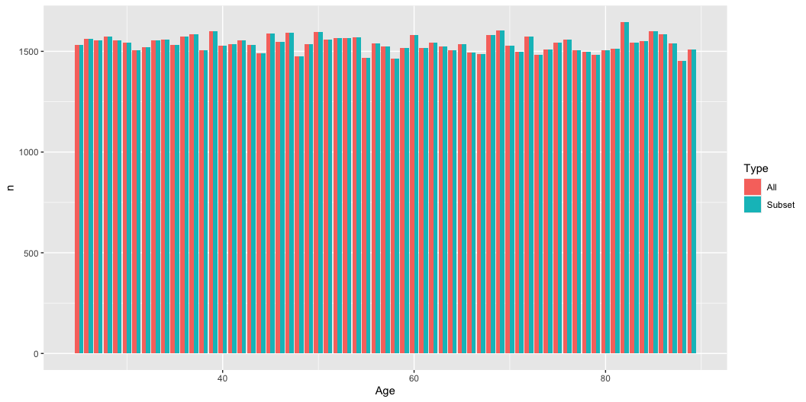
Subset for modelling
[1] "There are 100000 rows in the original dataset."
[1] "After removing missing values, there are 100000 rows remaining."
Check the distribution of age in the original dataset and the dataset after removing missing values.

Slide 11
Data splitting for training and testing
In the youger people,
[1] "There are 32539 participants in the train set."
[1] "There are 13946 participants in the test set."

Slide 12
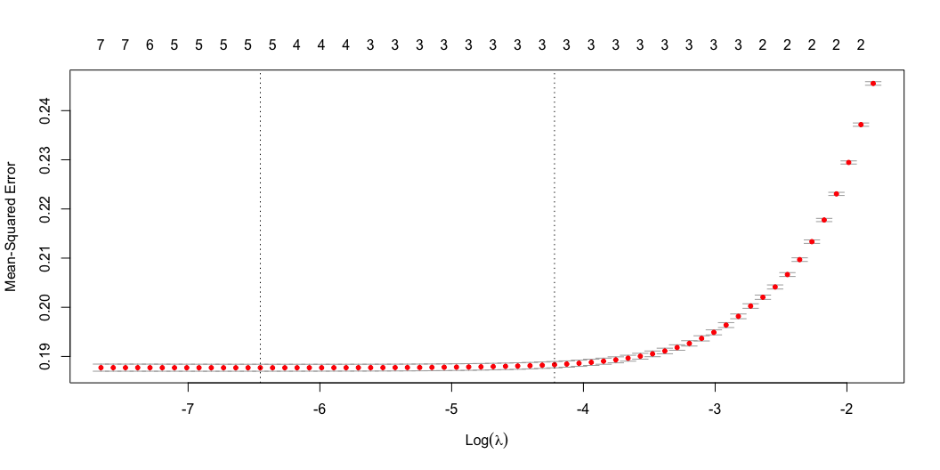
Lasso regression
Choose the best lambda using cross-validated Lasso and Ridge regression

Slide 13
[1] "the best lambda is 0.00157724222161081"
use the best lambda to fit the Lasso model
19 x 1 sparse Matrix of class "dgCMatrix" s0 (Intercept) -1.471991e+00 Age . Gender . Cholesterol_Level 3.725396e-03 Blood_Pressure_Systolic . Blood_Pressure_Diastolic 3.632325e-03 Smoking_Status . Alcohol_Intake . Physical_Activity . Obesity_Index 2.575869e-02 Diabetes_Status . Family_History_Heart_Disease . Diet_Quality . Stress_Level . Heart_Attack_History . Medication_Usage . Triglycerides_Level -2.229384e-05 LDL_Level 7.115754e-06 HDL_Level .

Slide 14
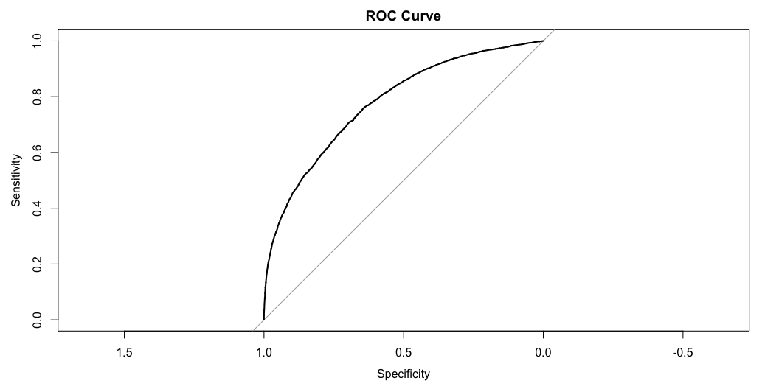
Prediction for the younger group using the model trained on younger individuals
[1] "Accuracy: 0.705291839954109"
[1] "AUC: 0.778087875778247"

Slide 15

Prediction for the older group using the model trained on younger individuals
[1] "Accuracy: 0.604353919461833"
[1] "AUC: 0.773898984757407"

Slide 16
Aetiological analysis results

Slide 17
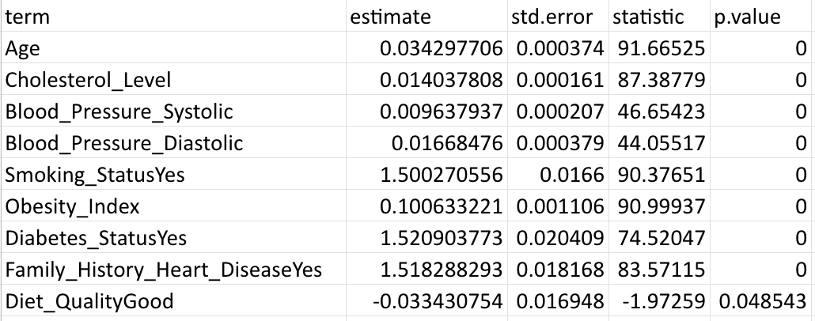

Slide 18
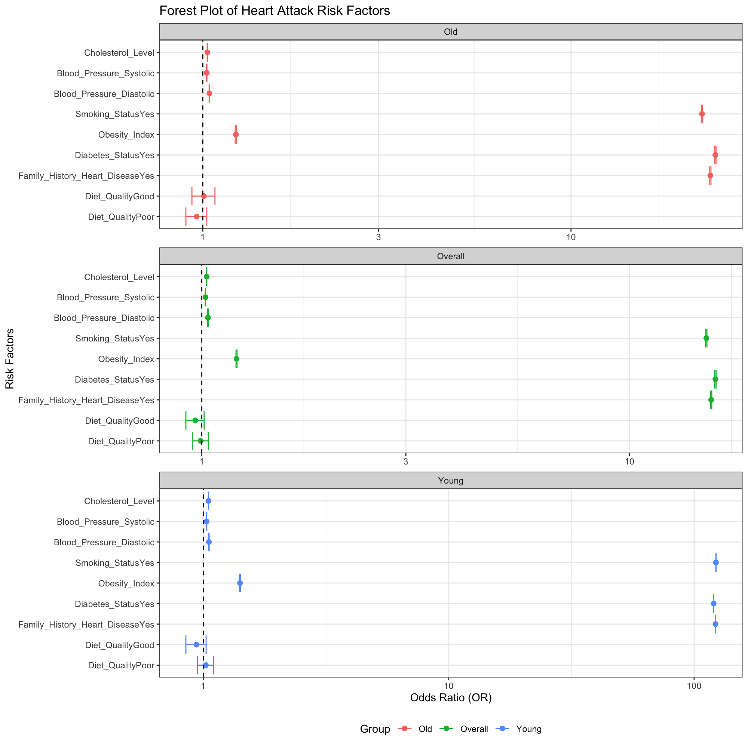

Slide 19
Lessons learned

Slide 20
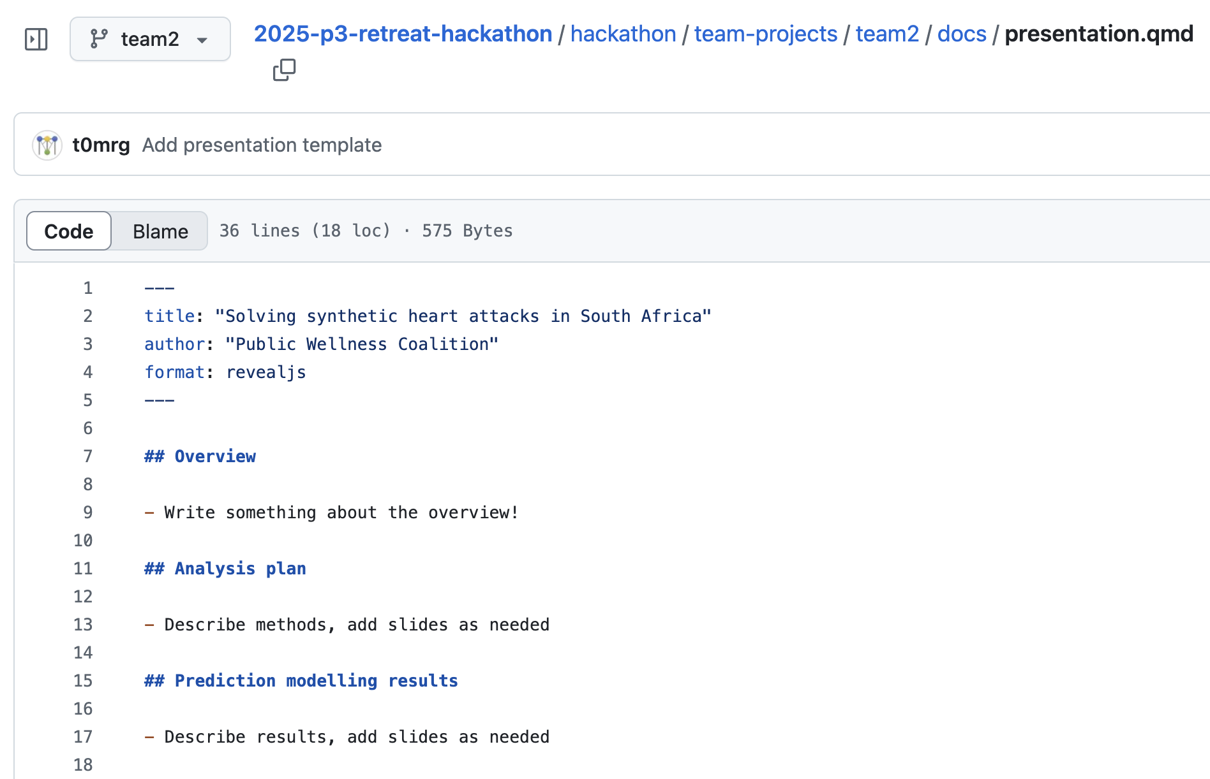
Template
Correspondence

