Slide 1
Prediction models
Yueying Li

Slide 2
preliminary
Load in packages
data loading
Rows: 100,000 Columns: 20 $ Patient_ID <dbl> 1, 2, 3, 4, 5, 6, 7, 8, 9, 10, 11, 12, 13… $ Age <dbl> 76, 39, 85, 45, 48, 27, 46, 77, 26, 54, 6… $ Gender <chr> "Female", "Female", "Male", "Female", "Ma… $ Cholesterol_Level <dbl> 156, 160, 254, 261, 206, 228, 278, 272, 1… $ Blood_Pressure_Systolic <dbl> 56.93546, 72.23643, 82.04371, 67.95281, 7… $ Blood_Pressure_Diastolic <dbl> 79, 88, 113, 65, 84, 100, 76, 112, 62, 72… $ Smoking_Status <chr> "No", "No", "Yes", "No", "No", "No", "No"… $ Alcohol_Intake <chr> "High", "Low", "Moderate", "High", "Low",… $ Physical_Activity <chr> "Sedentary", "Sedentary", "Highly Active"… $ Obesity_Index <dbl> 35.2, 21.3, 32.0, 36.4, 26.6, 28.7, 22.5,… $ Diabetes_Status <chr> "No", "No", "Yes", "No", "No", "No", "No"… $ Family_History_Heart_Disease <chr> "No", "No", "No", "Yes", "No", "No", "No"… $ Diet_Quality <chr> "Good", "Average", "Good", "Average", "Go… $ Stress_Level <chr> "High", "Medium", "Low", "Low", "High", "… $ Heart_Attack_History <chr> "No", "No", "No", "No", "No", "No", "Yes"… $ Medication_Usage <chr> "No", "Yes", "No", "Yes", "No", "Yes", "N… $ Triglycerides_Level <dbl> 264, 150, 220, 141, 221, 130, 257, 221, 2… $ LDL_Level <dbl> 141, 81, 124, 56, 186, 145, 156, 99, 103,… $ HDL_Level <dbl> 65, 42, 70, 38, 26, 26, 45, 44, 54, 63, 2… $ Heart_Attack_Outcome <dbl> 0, 0, 1, 1, 0, 0, 0, 1, 0, 0, 1, 1, 0, 1,…

Slide 3
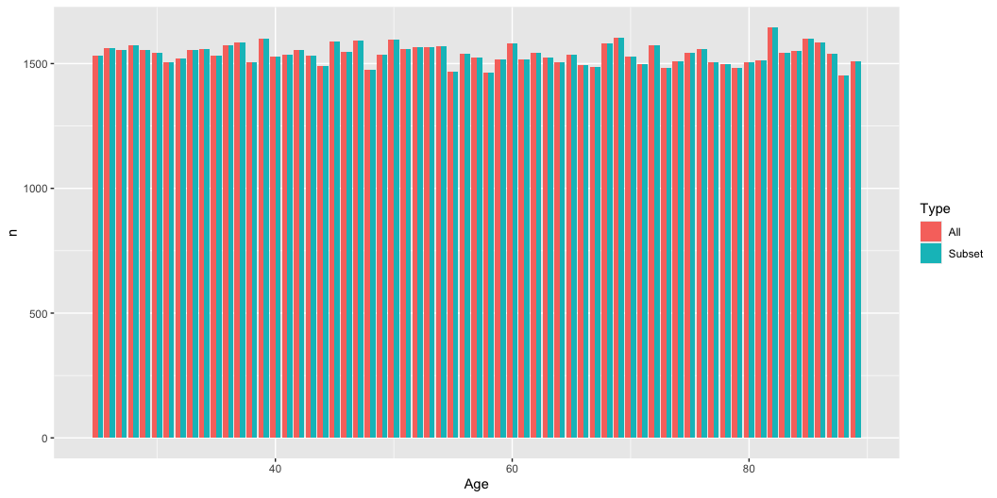
Subset for modelling
[1] 100000
[1] 100000
check the distribution of age

Slide 4
Data splitting for training and testing
[1] 32539
[1] 13946

Slide 5
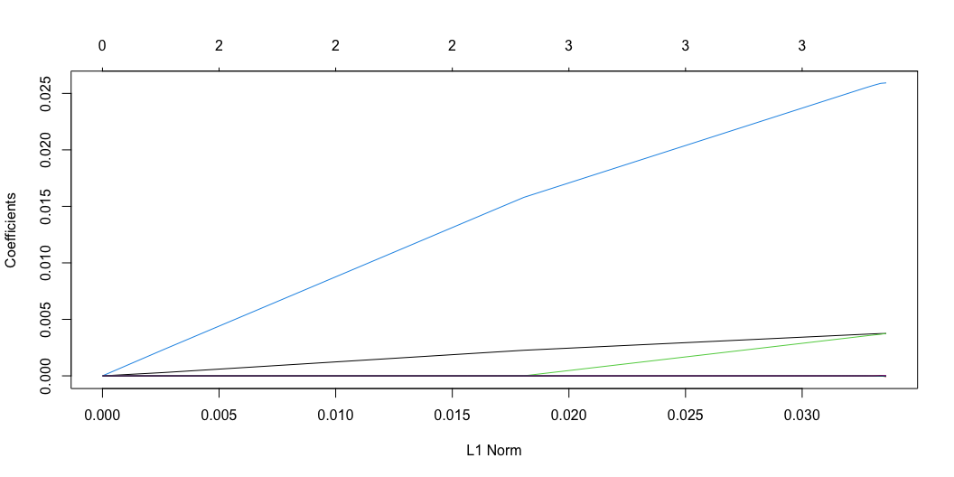
Lasso regression

Slide 6
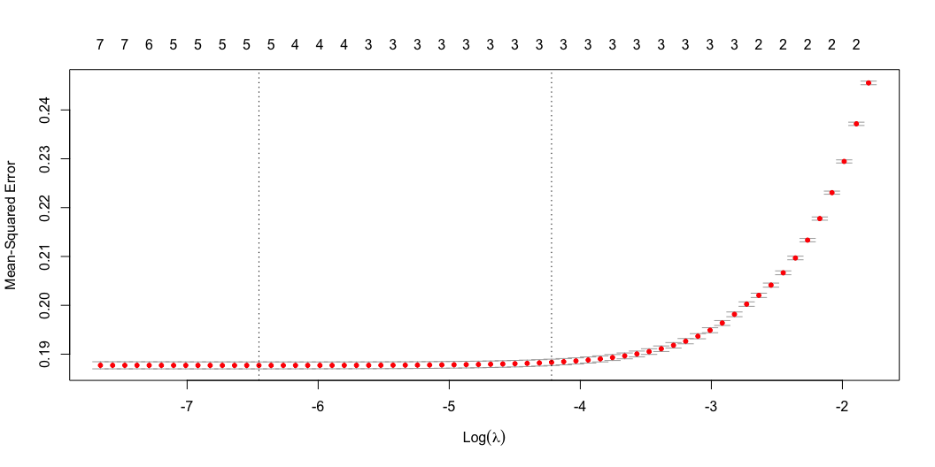
choose the best lambda

Slide 7
[1] 0.001577242
use the best lambda to fit the Lasso model
19 x 1 sparse Matrix of class "dgCMatrix" s0 (Intercept) -1.471991e+00 Age . Gender . Cholesterol_Level 3.725396e-03 Blood_Pressure_Systolic . Blood_Pressure_Diastolic 3.632325e-03 Smoking_Status . Alcohol_Intake . Physical_Activity . Obesity_Index 2.575869e-02 Diabetes_Status . Family_History_Heart_Disease . Diet_Quality . Stress_Level . Heart_Attack_History . Medication_Usage . Triglycerides_Level -2.229384e-05 LDL_Level 7.115754e-06 HDL_Level .

Slide 8
Prediction

Slide 9
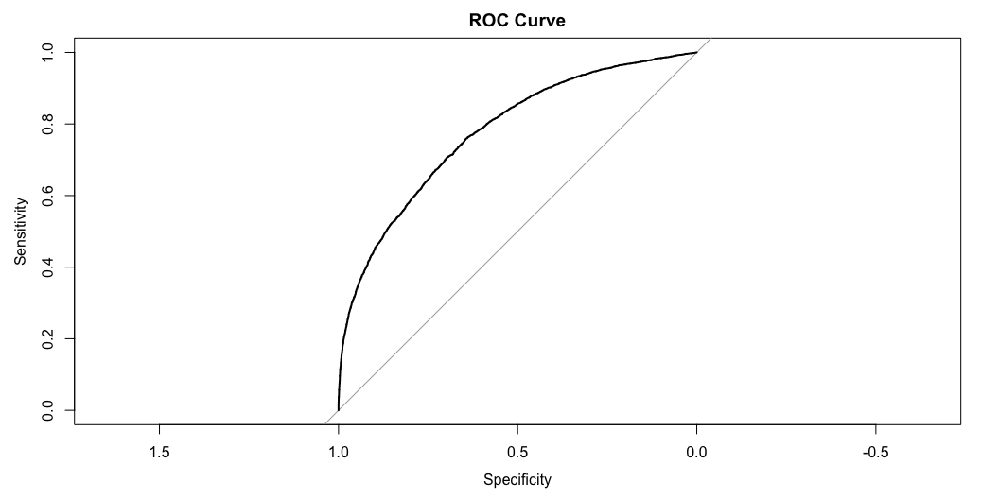
Prediction for the younger group
[1] "Accuracy: 0.705291839954109"
Confusion Matrix and Statistics Reference Prediction 0 1 0 6112 2337 1 1773 3724 Accuracy : 0.7053 95% CI : (0.6976, 0.7129) No Information Rate : 0.5654 P-Value [Acc > NIR] : < 2.2e-16 Kappa : 0.3938 Mcnemar's Test P-Value : < 2.2e-16 Sensitivity : 0.7751 Specificity : 0.6144 Pos Pred Value : 0.7234 Neg Pred Value : 0.6775 Prevalence : 0.5654 Detection Rate : 0.4383 Detection Prevalence : 0.6058 Balanced Accuracy : 0.6948 'Positive' Class : 0
[1] "AUC: 0.778087875778247"

Slide 10

Prediction for the older group
[1] "Accuracy: 0.604353919461833"
Confusion Matrix and Statistics Reference Prediction 0 1 0 13052 19239 1 1934 19290 Accuracy : 0.6044 95% CI : (0.6002, 0.6085) No Information Rate : 0.72 P-Value [Acc > NIR] : 1 Kappa : 0.2747 Mcnemar's Test P-Value : <2e-16 Sensitivity : 0.8709 Specificity : 0.5007 Pos Pred Value : 0.4042 Neg Pred Value : 0.9089 Prevalence : 0.2800 Detection Rate : 0.2439 Detection Prevalence : 0.6034 Balanced Accuracy : 0.6858 'Positive' Class : 0
[1] "AUC: 0.773898984757407"

