Slide 1
Epigenetic Epidemiology Update
Matthew Suderman
MRC Integrative Epidemiology Unit
Nov 1, 2021

Slide 2
EWAS
PMID | Journal | Variable | Tissue | Population | Cohort | Associations
34696705 | Epigenetics | risk preference | blood | 1656 age >50 | NICOLA study (Irish) | null
34689037 | Environ Int | residential greeness | blood | 982 adults | SAPALDIA (Swiss) | null
34670603 | Clin Epigenetics | BMI and WC | blood | 409 | multi-ethnic Asian | 116 (BMI) and 8 (WC)
34654479 | Clin Epigenetics | cognitive decline | blood | adults with mild cognitive impairment | ADNI cohort | 2
34596434 | Epigenomics | grandmaternal smoking during pregnancy | cord blood | n=161 grandchildren | IoW birth cohort | 23

Slide 3
Calling DNAm using nanopore sequencing
Liu Y, Rosikiewicz W, Pan Z, et al. DNA methylation-calling tools for Oxford Nanopore sequencing: a survey and human epigenome-wide evaluation. Genome Biol. 2021;22(1):295.
The method:
“Nanopore sequencing techniques detect DNA modifications via differences in the electric current intensity produced from a nanopore read of an unmodified base and that of a modified base.”
Current challenge:
“the capacity to detect modifications in different CpGs that are in close proximity to one another on a DNA fragment (i.e., non-singleton), as it is assumed that all CpGs within a 10-bp region share the same methylation status.”

Slide 4
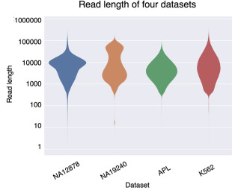
4 testing datasets
Performance metrics
Precision = PPV = TP/(TP + FP) Recall = Sensitivity = TP/(TP + FN) Accuracy = (TP + TN) / (TP + TN + FP + FN) F1 Score = 2 × (Recall × Precision) / (Recall + Precision) | Proportion of sites called methylated that are Proportion of methylated sites called as such Proportion of correctly called sites Balances recall and precision

Slide 5
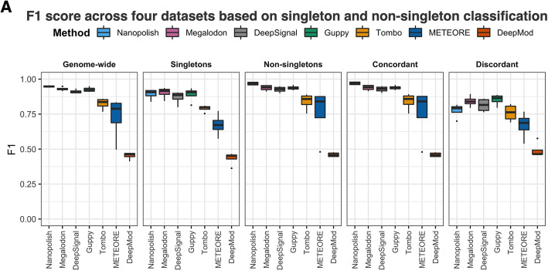
>10bp from
other CpGs
Non-singletons all with 100% or all with 0% DNAm
Non-singletons with a mix of 0% and 100% DNAm

Slide 6
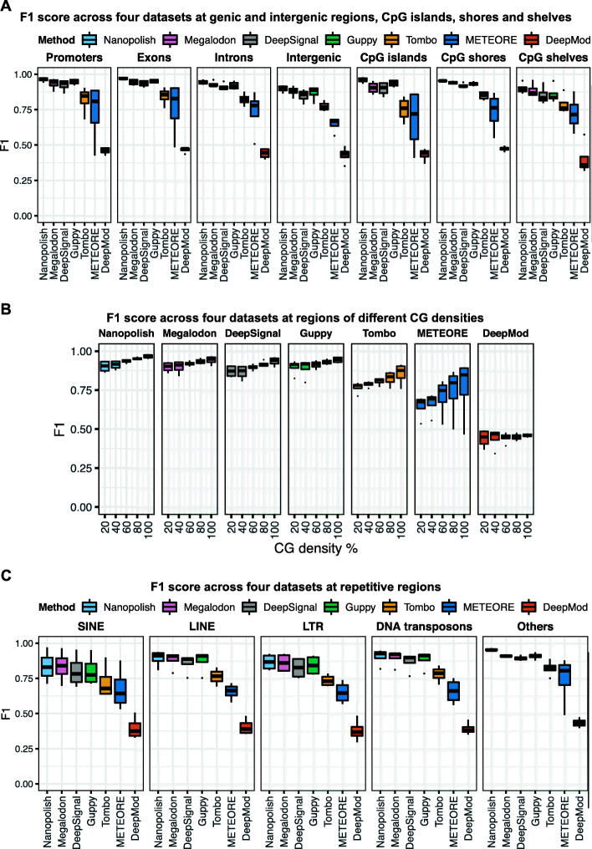

Slide 7
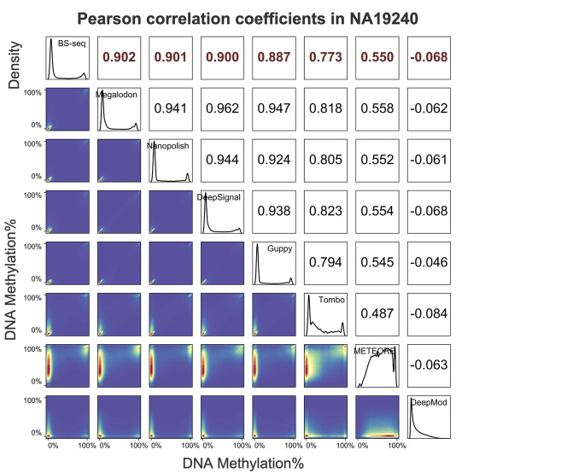
Finally, comparison to bisulfite sequencing for a range of methylation levels (i.e. not just 0% or 100%)
Highest with bisulfite is about R=0.9.
Nanopore methods have higher correlations as high as R=0.95.
This may be due to the presence of small amounts of 5hmC which BS-seq lumps together with 5mC.

Slide 8
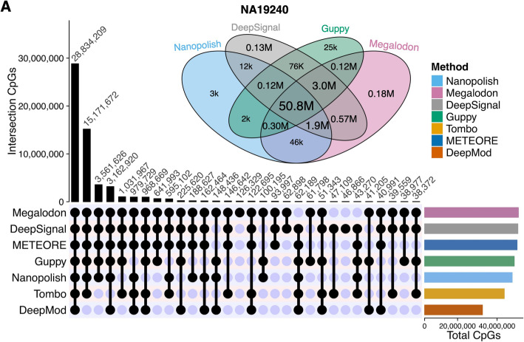
There are about 60 million CpG sites, about 30 million per strand.
Top 4 tools identify about 50 million in common.
‘identify’ = CpG site included in at least 3 reads

Slide 9
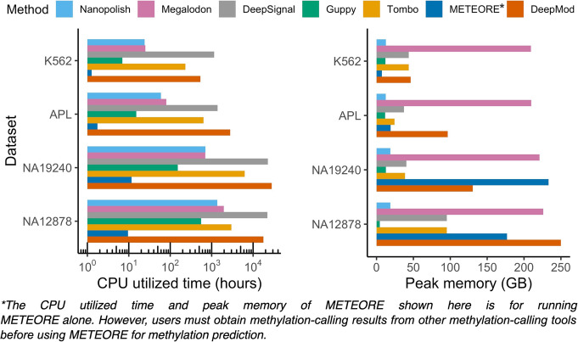
Among the top 4:
Nanopolish and Guppy consistently use the least memory and processing times.
… but still, we’re talking about 1000 hours of processing time for a single dataset.

Slide 10
Methods for small amounts of DNA
What percentage of reads align uniquely?
Han Y, Zheleznyakova GY, Marincevic-Zuniga Y, et al. Comparison of EM-seq and PBAT methylome library methods for low-input DNA. Epigenetics. 2021; 10.1080/15592294.2021.1997406.
PBAT = bisulfite conversion of unmethylated Cs to Ts with some optimizations to reduce DNA degradation
EM-seq = enzymatic conversion with very little DNA degradation (could be used to differentiate 5mC and 5hmC)
What percentage of reads are unique?

Slide 11
Testing associations with variance
Staley JR, Windmeijer F, Suderman M, Lyon MS, Davey Smith G, Tilling K. A robust mean and variance test with application to high-dimensional phenotypes. Eur J Epidemiol. 2021;10.1007/s10654-021-00805-w.
Most methods for testing associations with variance produce inflated statistics when applied to non-normally distributed data.
Exceptions are Brown-Forsythe test and JLSsc, implemented here:
https://github.com/jrs95/jlst

Slide 12
Peaking inside the black box
Watson DS. Interpretable machine learning for genomics. Hum Genet. 2021;1-15.
Problem Highly complex models do not advance knowledge and cannot be trusted.
Aims of interpretable machine learning (iML)
Audit – to uncover and quantify biases (eg. social inequalities in healthcare)
Validate – evaluate the generalizability of models
Discover – evaluate model and data generating processes to obtain better models
Methods of iML
Variable importance
Local linear approximators (e.g. LIME)
Rule lists (e.g. decision trees)
Challenges
Ambiguous targets/goals (e.g. to understand models or underlying natural system)
Error rate control (e.g. bootstrapping becomes unstable at high dimensions)
Variable granularity (e.g. lots of genes so might want to model pathways … but what is a pathway?)

