Slide 1
Epigenetic Epidemiology Update
Matthew Suderman
MRC Integrative Epidemiology Unit
May 10, 2021

Slide 2
EWAS of exposures
PMID | Exposure | Tissue | Study population | Associations
33890633 | Assisted reproductive technology | Blood | N=303 ART vs 1188 adolescents | None
33890479 | Migration | Blood | N=712 Ghanaians (RODAM Study) | 13
33872906 | Phthalates in maternal blood | Cord blood | N=203 | 2
33862401 | Residential greenness | Blood | N=479 Australian women | 1

Slide 3
EWAS of traits
PMID | Trait | Tissue | Study population | Associations
33939316 | BMI | Blood | N=2266 Chinese adults | 4 of which 3 were associated with non-small lung cancer incidence
33931109 | Kidney function (eGFR) | Blood | N=5428 (WHI, MESA, JHS) and N=8109 for replication (HyperGEN, GS, CATHGEN) | 93 (13 replicated) with almost no overlap between EA and AA ethnic groups
33902726 | Alzheimer’s disease | Prefrontal cortex | N=1000 of which 642 females | 381 (females), 76 (males), 14 sex interactions
33883019 | Cognitive abilities | Blood | N=535 Swedish twins around age 65 | 6
33883000 | Myocardial infarction | Blood | N=297 cases and 298 controls | 34
33867313 | Covid-19 severity | Blood | N=194 mild and 213 severe | 44 (no ACE2 or TMPRSS2)

Slide 4
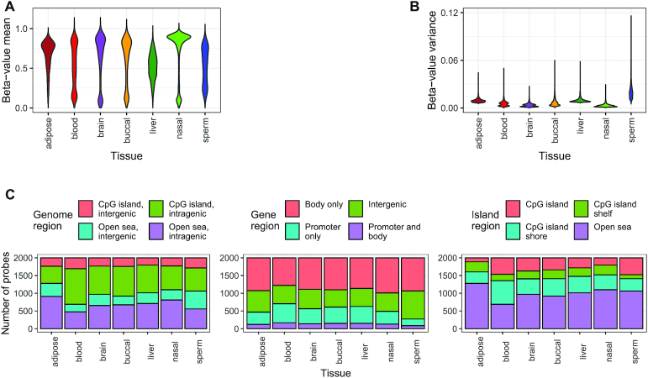
DNAm variance
Maden SK, Thompson RF, Hansen KD, Nellore A. Human methylome variation across Infinium 450K data on the Gene Expression Omnibus. NAR Genom Bioinform. 2021 Apr 22;3(2):lqab025.
“We collectively analyzed 35 360 Illumina Infinium HumanMethylation450K DNAm array samples published on the Gene Expression Omnibus.”

Slide 5
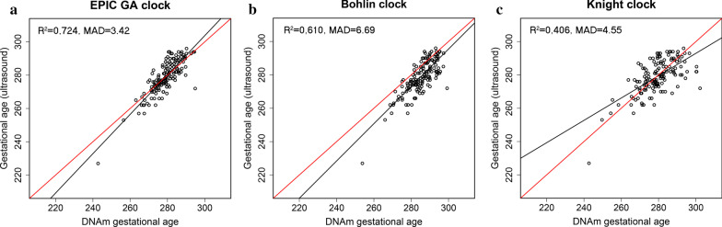
A new gestational age clock
Haftorn KL, et al. An EPIC predictor of gestational age and its application to newborns conceived by assisted reproductive technologies. Clin Epigenetics. 2021 Apr 19;13(1):82.
- the restricting the EPIC clock to 450k CpG sites had little effect on performance
- no age acceleration observed in ART newborns

Slide 6
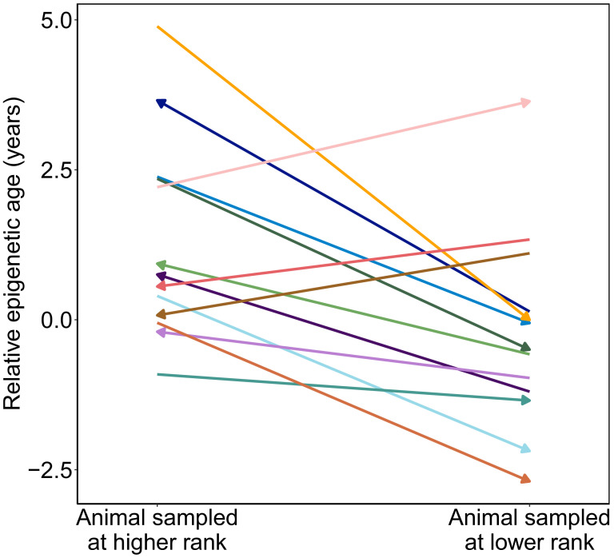
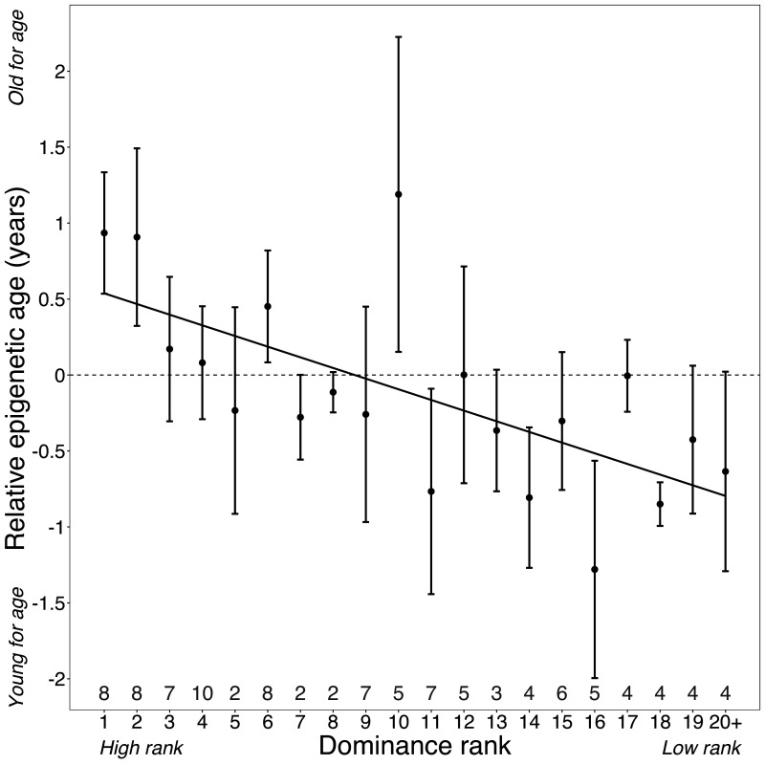
High social rank and DNAm age
Anderson JA, et al. High social status males experience accelerated epigenetic aging in wild baboons. Elife. 2021 Apr 6;10:e66128.
“Our results argue that achieving high rank for male baboons - the best predictor of reproductive success - imposes costs consistent with a 'live fast, die young' life-history strategy.”

Slide 7

Theories about aging and epigenetics
Oh ES, Petronis A. Origins of human disease: the chrono-epigenetic perspective. Nat Rev Genet. 2021 Apr 26.
“Cytosine modifications display deterministic temporal rhythms, which may drive ageing and complex disease.”
Schumacher B, Pothof J, Vijg J, Hoeijmakers JHJ. The central role of DNA damage in the ageing process. Nature. 2021 Apr 28.
“DNA damage is a major driver of age-associated epigenetic changes.”

Slide 8
The chrono-epigenetic perspective: linear and cyclical variation
Two patterns of epigenetic variation
linear development, differentiation, drift
cyclical diurnal epigenetic oscillations in “mouse liver and lung, human neutrophils, California poplar leaves and synchronized mouse myotubes”
DNA methylation may synchronize “internal circadian clock and external cues”
Light → DNAm → behavior in mice (Azzi, et al. Nat Neurosci 2014)
DNAm → circadian periodicity in single cells (Li et al. eLife 2020)

Slide 9
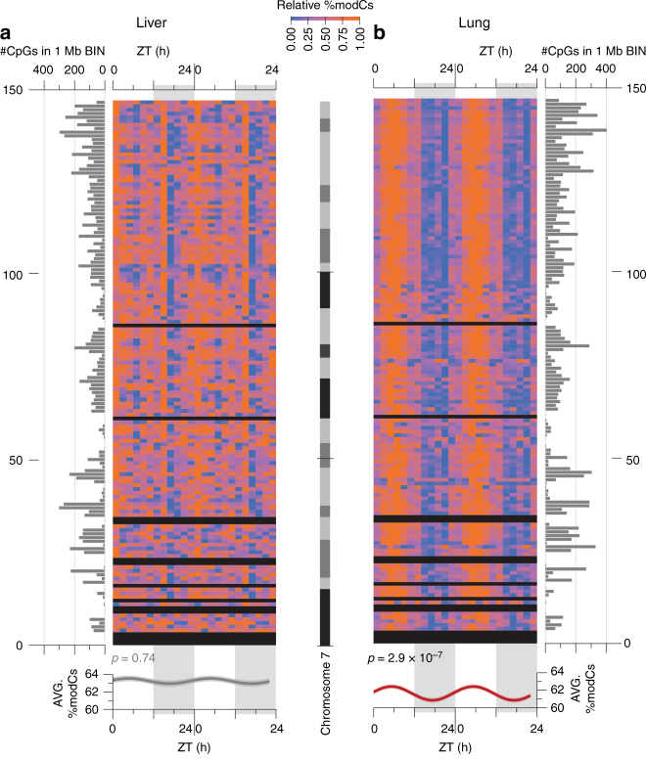
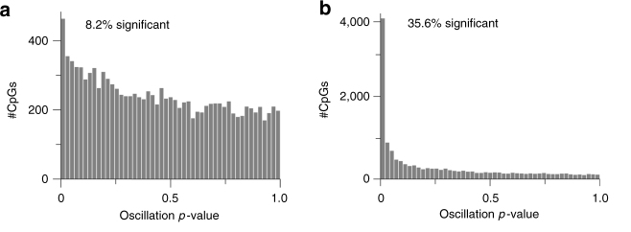
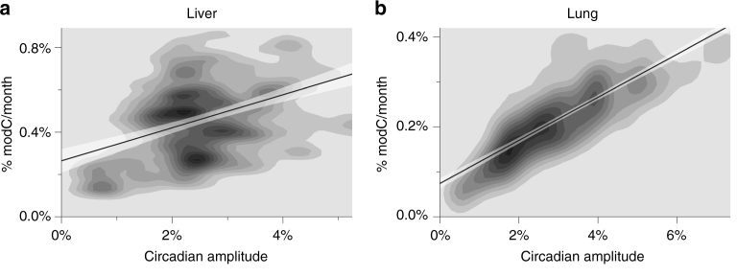
Chrono-epigenetic perspective: cyclical variation in mouse
Modification densities of variable cytosines across chr7
P-values of ‘oscillating EWAS’
Liver
Lung
CpG circadian amplitude vs age effect
Oh et al. Nat Commun 2018

Slide 10
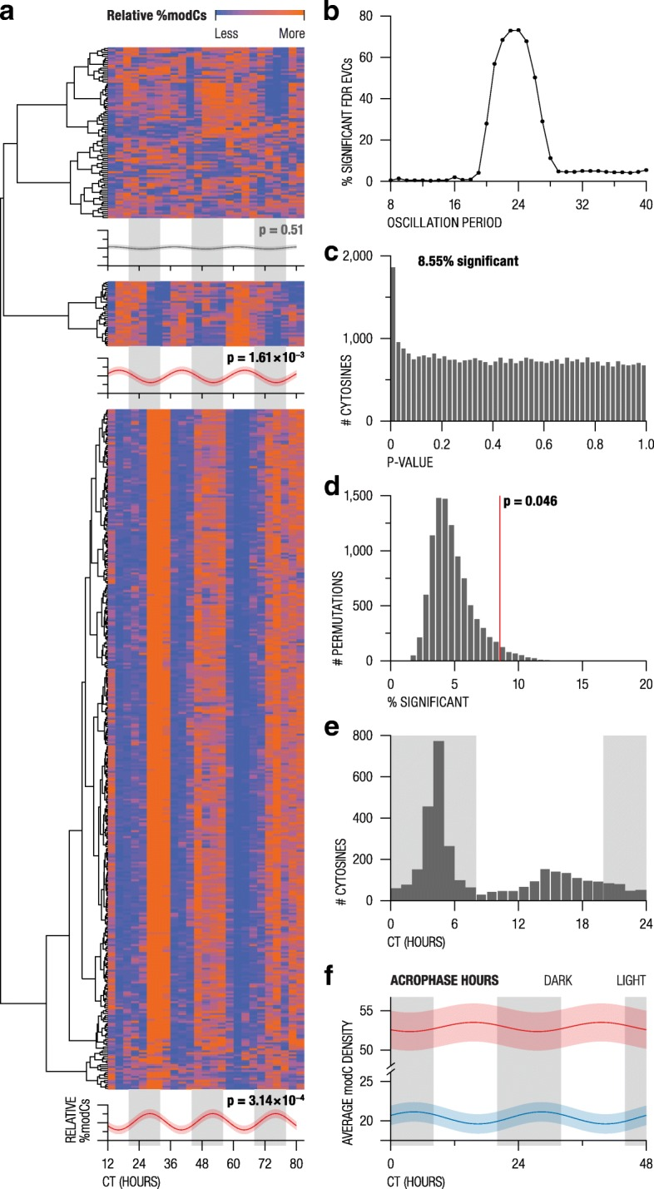

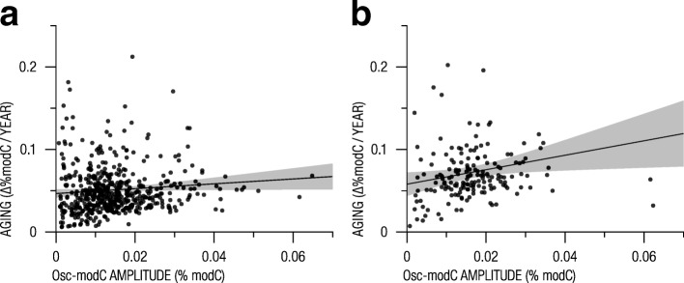
Chrono-epigenetic perspective: cyclical variation in human neutrophils
Clustering of variable cytosines
Distribution of cytosine periods
P-values of ‘oscillation EWAS’
GSE80417
CpG circadian amplitude vs age effect
GSE40279
Oh et al. Genome Biol. 2019

Slide 11
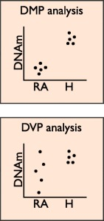
Chrono-epigenetic perspective: methylation variability and disease
Increased DNAm variation associated with a few diseases, e.g.
Rheumatoid arthritis (Webster et al. Genome Med 2018)
Type 1 diabetes (Paul et al. Nat Commun 2016)
Major depressive disorder (Oh et al. Biol Psychiatry 2015)
But unclear how this increased variability
leads to a specific disease.
Possibly the result of changes in oscillatory patterns?
e.g. acrophase (time of peak), amplitude, period length

Slide 12
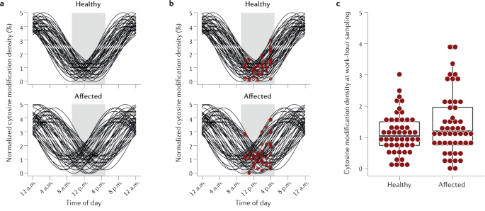
Chrono-epigenetic perspective: methylation variability
Simulation show that disrupting oscillatory patterns could produce variance differences

Slide 13
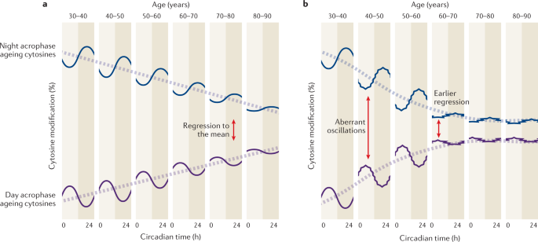
Chrono-epigenetic perspective: accelerated DNAm aging
Normal aging
Accelerated aging
Hypothesis: “Recurring mini-desynchronies and other mismatches between internal–external rhythms may slowly but persistently change the cyclical epigenetic parameters. With time, such hardly quantifiable routine life events may accumulate to eventually manifest as bona fide disease risk factors.”

Slide 14
Chrono-epigenetic perspective: chrono-EWAS
Samples collected at multiple times to
Identify inter-individual variation
Identify oscillatory inter-individual variation and model oscillations
Frequency?
Strengths
Increases power so need smaller sample size
Requires reduced genome coverage (just ‘variable’ sites)
Challenges
Cell counts oscillate
Heterogeneity of oscillations within ‘cell types’

Slide 15
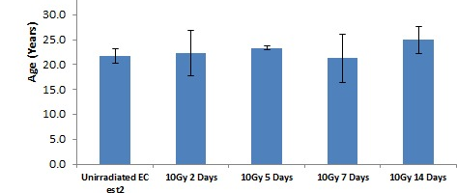
DNA damage perspective (on DNAm age)
DNA damage increases with age and:
“DNMT1 localizes to sites of DNA repair”
“many chromatin remodellers regulate the assembly of distinct repair machineries … which may leave epigenetic marks”
“DNA methylation patterns are altered during homologous recombination repair”
Not a fair fight as the DNA damage paper is about aging in general with one small section on epigenetic aging. However:
“our results reveal that cellular ageing is … independent of DNA damage response and telomere length” (Lowe et al. Oncotarget 2016)

