Slide 1
Epigenetic Epidemiology Update
Matthew Suderman
MRC Integrative Epidemiology Unit
Feb 28, 2022

Slide 2
EWAS
pmid | journal | variable | cell type | population | assocs
35177594 | Transl Psychiatry | PTSD | saliva | 1135 US veterans | 3
35205218 | Genes (Basel) | alcohol intake with and without CVD | blood | 446 Korean Genome and Epidemiology Study | unclear
35213289 | Epigenetics | response to blood pressure treatment | blood | 200 Finnish men from GENRES cohort | null
35163587 | Int J Mol Sci | air pollution (PM2.5B[a]P and NO2) | blood | 125 police in 3 location in Czech Republic | null
35169479 | Evol Med Public Health | nullparity and breastfeeding | blood (age 20-22) | nulliparous (n=176), pregnant (n=69), breastfeeding (n=60), parous (n=87) | 828 and 1107
35207690 | J Pers Med | asthma acquisition in adolescence and after | blood (age 10) | Isle of Wight Birth Cohort | 205
35196023 | Sci Transl Med | amyotrophic lateral sclerosis | blood | 6763 patients vs 2943 controls | 45 (9 of 39 DNAm-based proxies of ALS risk factors)
35169870 | Diabetologia | type-2 diabetes in 7-10 years | blood | 1250 cases and 1950 controls from 5 cohorts | 76

Slide 3
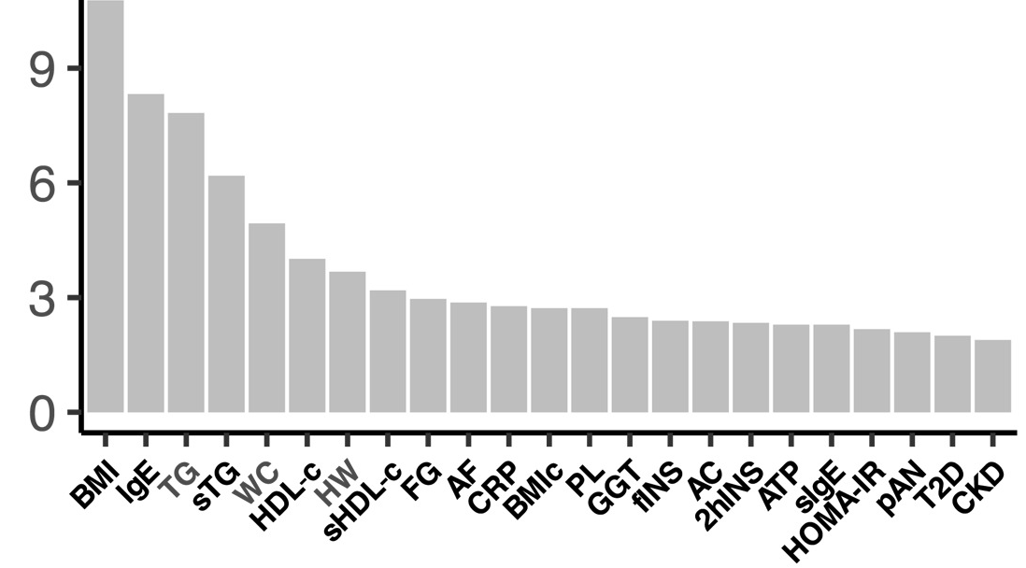
EWAS = (CpG site + DNAm proxy)-wide association study
Hop, P. J., … Mill, J. (2022). Genome-wide study of DNA methylation shows alterations in metabolic, inflammatory, and cholesterol pathways in ALS. Science translational medicine, 14(633), eabj0264.
45 DMPs between ALS cases and controls
45 DMPs enriched in associations from 23 EWAS (from the EWAS catalog!)
Fig 2B
-log10(enrichment p-value)
23 EWAS traits

Slide 4
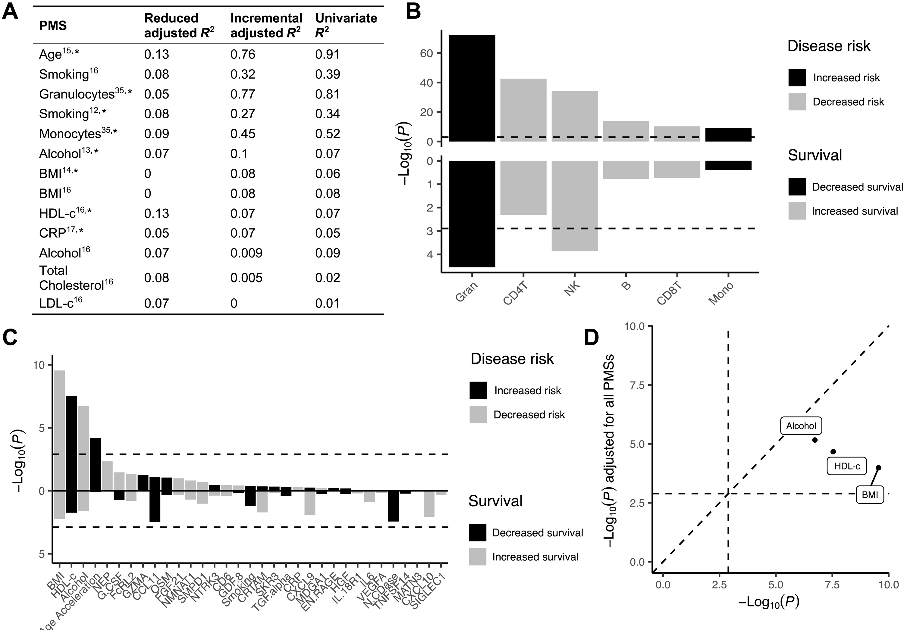
EWAS = (CpG site + DNAm proxy)-wide association study, cont.
Fig 3
Tested DNAm proxy differences between cases and controls
39 DNAm proxies
Proxies with best replication of underlying trait (Figure 3A)
Cell count estimates and disease (Figure 3B)
Proxies and disease (Figure 3C)
Proxies independently associated with disease (Figure 3d)
BMI, implicated in EWAS enrichment and by DNAm proxy, is known to be clinically important in ALS.

Slide 5
Instead of clock acceleration, consider differences between clocks
Barrett, J. E., et al. (2022). Susceptibility to hormone-mediated cancer is reflected by different tick rates of the epithelial and general epigenetic clock. Genome biology, 23(1), 52.
Data DNAm of cervical cytology samples from 869 healthy women, 442 women with breast cancer and 289 with ovarian cancer
Methods Created 3 epigenetic clocks in healthy women to index chronological age
Immune (CpG sites that change with age in immune but not in epithelial cells)
Epithelial (CpG sites that change with age in epithelial but not in immune cells)
General (any CpG sites)
Results (Epithelial clock-General clock) differs between cancer cases and controls
“Our findings imply that there are multiple epigenetic clocks, many of which are tissue-specific, and that the differential tick rate between these clocks may be an informative surrogate measure of disease risk.”

Slide 6
Epigenetic clocks and social determinants of health
Raffington, L., & Belsky, D. W. (2022). Integrating DNA Methylation Measures of Biological Aging into Social Determinants of Health Research. Current environmental health reports, 10.1007/s40572-022-00338-8.
-- possibly of interest to Sarah Watkins and Nancy Krieger --

Slide 7
Research software quality
Gardner, P. P., et al (2022). Sustained software development, not number of citations or journal choice, is indicative of accurate bioinformatic software. Genome biology, 23(1), 56.
Survey of over 500 bioinfomatic tools
What predicts ‘software accuracy’? (in terms of the tool is estimating/predicting/indexing/etc)
Not software speed
Not author reputation
Not journal impact
Not number of citations
Not age
Yes Github-derived statistics and high version numbers
“Our findings indicate that accurate bioinformatic software is primarily the product of long-term commitments to software development … ”

Slide 8
Biological system potentially useful for molecular epidemiology
Rhodes, K., Barr, K. A., Popp, J. M., Strober, B. J., Battle, A., & Gilad, Y. (2022). Human embryoid bodies as a novel system for genomic studies of functionally diverse cell types. eLife, 11, e71361.
Embryoid bodies: “three-dimensional aggregates of stem cells that, when grown under certain conditions, spontaneously develop into a variety of cell types”
Findings Authors show that cells from embryoid bodies closely resemble cells produced in vivo during development.
Conclusions
“findings suggest that embryoid bodies are a useful model to study gene regulation across individuals with different genetic backgrounds”
“embryoid bodies could be used to explore how exposure to different environmental factors during early development affect disease-related outcomes in adulthood in different individuals”

