Slide 1
Epigenetic Epidemiology Update
Matthew Suderman
MRC Integrative Epidemiology Unit
Sept 20, 2021

Slide 2
EWAS (only 11!)
pmid | journal | variable | sample | tissue | Finding
34515027 | Elife | CHD at 10 years followup | 982 Kadoori study | blood | 2 sites
34516295 | Environ Health Perspect | 9 pesticides | 1170 Agricultural health study | blood | 162 sites
34425644 | Environ Int | polybrominated diphenyl ethers | 397 women | blood | 15 (1 site breast cancer in blood)
34482817 | BMC Genom Data | preterm birth in last 3-5 years | 182 mothers | blood | null
34461807 | Epigenetics | diet (balanced/veg/starch) | 573 women EDEN | blood | null
34427971 | Aging Cell | methylation variability with age | 493 twins | blood | 3084 sites in males (37% replicated), 0 in females
34415308 | Hum Mol Genet | mitochondrial copy number | 6182 (5 cohorts) | blood | 21 sites
34429407 | Nat Commun | maternal smoking | 1700 PACE | placenta | 443 sites (only 2 in cord)
34523531 | Environ Pollut | maternal synthetic phenols | 202 EDEN | placenta | 596 sites
34507616 | Clin Epigenetics | prenatal risk (low/physical/psychological) | 542 preterm infants | buccal cells | 2 sites; 15 with cumulative risk
34473906 | Pediatr Pulmonol | infant RSV immunoprophylaxis | 429 preterm infants | nasal epithelia at age 6 | 3 sites

Slide 3
Predicting CHD
Si J, Yang S, Sun D, et al. Epigenome-wide analysis of DNA methylation and coronary heart disease: a nested case-control study. Elife. 2021;10:e68671.
Blood methylation for n=982 from China Kadoorie Biobank (n=512K adults)
n=494 CHD cases identified during 10-year follow-up.
2 CpG sites differentially methylated
cg23398826 SNX30 associated with blood pressure (SBP and DBP); SNX30 linked by GWAS to DBP
cg02386575 IMPDH2/QRICH1 associated with age and with maternal obesity in pregnancy
These two sites belonged to WGCNA module with 23 CpG other differentially methylated sites (p < 1.1e-4 for each).

Slide 4
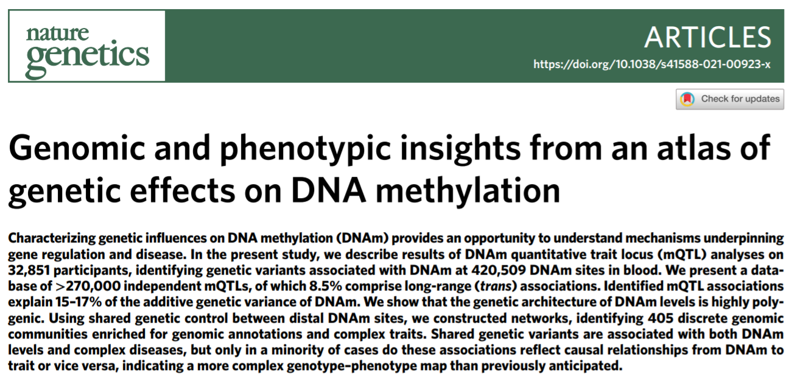
Congratulations!

Slide 5
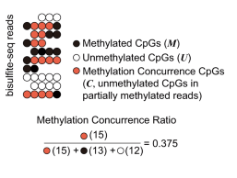
Changes in methylation cause changes in gene expression
Shi J, Xu J, Chen YE, et al. The concurrence of DNA methylation and demethylation is associated with transcription regulation. Nat Commun. 2021;12(1):5285.
Aim to identify regions where DNMT or TET are actively changing methylation.
‘methylation concurrence ratio’ = the sum of partially methylated fragments’ weights divided by the sum of all fragments’ weights in that region.

Slide 6
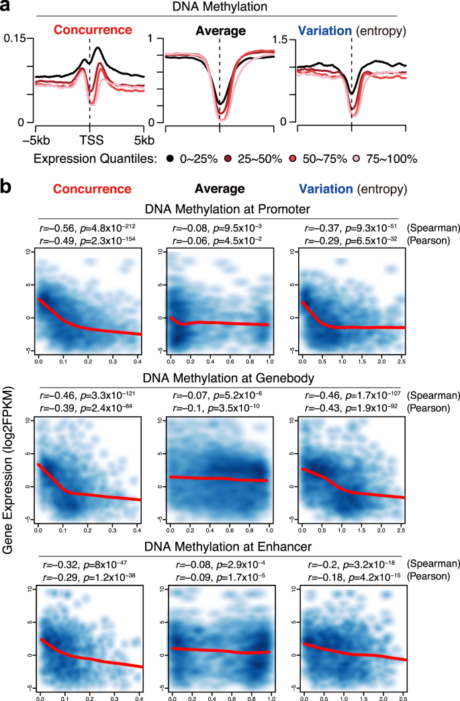
Changes in methylation cause changes in gene expression
“elevated methylation concurrence in tumors is associated with the repression of 40~60% of tumor suppressor genes, which cannot be explained by promoter hypermethylation alone.”

Slide 7
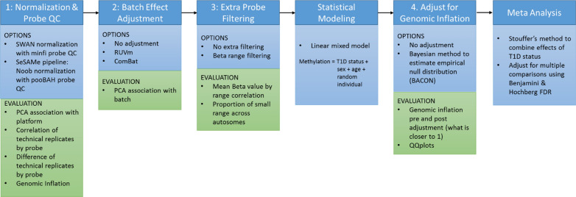
Harmonizing 450k and EPIC
Vanderlinden LA, Johnson RK, Carry PM, et al. An effective processing pipeline for harmonizing DNA methylation data from Illumina's 450K and EPIC platforms for epidemiological studies. BMC Res Notes. 2021;14(1):352.

Slide 8
Harmonizing 450k and EPIC
Conclusions
“we recommend including technical replicates in the study design to aid in assessing the quality of pre-processing steps”
“normalization and probe filtering had the biggest effect on data harmonization”
“correcting for genomic inflation also helped with harmonization”
“results of the single model were qualitatively similar to the meta-analysis”

