Slide 1
Epigenetic Epidemiology Update
Matthew Suderman
MRC Integrative Epidemiology Unit
May 23, 2022

Slide 2
EWAS
PMID | Journal | Variable | Tissue | Sample | Associations
35513368 | Transl Psychiatry | behavior at 18m | cord blood | 256 | 2 male-specific
35505416 | Clin Epigenetics | maternal iron levels | cord blood | 1,286 (ALSPAC and GenR) | 2
35501310 | Transl Psychiatry | childhood trauma | blood | 602 with severe mental illness | 1
35500859 | Environ Res | gaseous air pollution | blood | 8,397 (ARIC and WHI) | 3
35536696 | Am J Respir Crit Care Med | lung function | blood | 17,503 (many cohorts) | 1267 (294 ancestry-specific; 395 non-smokers)
35504910 | Nat Commun | C-reactive protein | blood | 22,774 (many cohorts) | 1511
35546478 | Aging Cell | mortality | Blood | 15,013 (many cohorts) | 163 (European) and 17 (African)
35477560 | Clin Epigenetics | panic disorder | blood | 268 | null
35568878 | Clin Epigenetics | sex differences | blood | 1,171 | 396
35475137 | Alzheimers Dement (Amst) | 282 proteins | blood | 1,064 | 26 site with 45 proteins

Slide 3

A new book on EWAS
A Review of High-Dimensional Mediation Analyses in DNA Methylation Studies
DNA Methylation Imputation Across Platforms
Workflow to Mine Frequent DNA Co- methylation Clusters in DNA Methylome Data
BCurve: Bayesian Curve Credible Bands Approach for the Detection of Differentially Methylated Regions
Predicting Chronological Age from DNA Methylation Data: A Machine Learning Approach for Small Datasets and Limited Predictors
Application of Correlation Pre-Filtering Neural Network to DNA Methylation Data: Biological Aging Prediction
Differential Methylation Analysis for Bisulfite Sequencing (BS-Seq) Data
Quantification Methods for Methylation Levels in Illumina Arrays
Evaluating Reliability of DNA Methylation Measurement
Accurate Measurement of DNA Methylation: Challenges and Bias Correction
Using R for Cell-Type Composition Imputation in Epigenome-Wide Association Studies
Cell Type-Specific Signal Analysis in Epigenome-Wide Association Studies
Controlling Batch Effect in Epigenome-Wide Association Study
DNA Methylation and Atopic Diseases
Meta-Analysis for Epigenome-Wide Association Studies
Increase the Power of Epigenome-Wide Association Testing Using ICC-Based Hypothesis Weighting

Slide 4
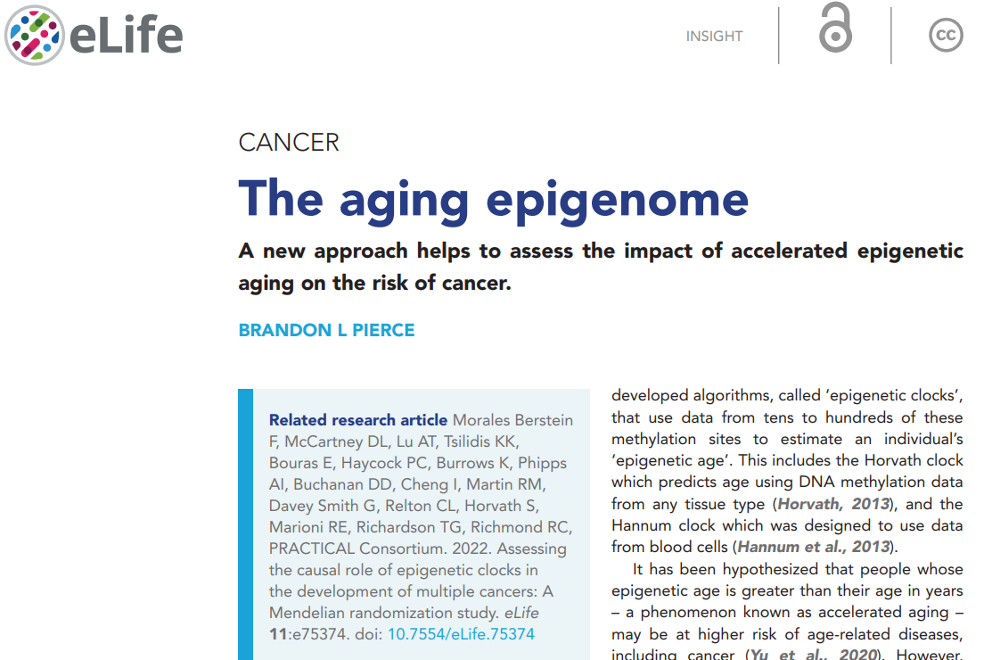
“Insight” article on Fernanda Morales Berstein et al. in eLife

Slide 5
Does ELA modify genetic effects on DNAm?
Carreras-Gallo N, Cáceres A, Balagué-Dobón L, et al. The early-life exposome modulates the effect of polymorphic inversions on DNA methylation. Commun Biol. 2022;5(1):455. Published 2022 May 12.
Data
n=1,009 blood samples from children (Human Early Life Exposome (HELIX))
Inversion status at 8p23.1, 16p11.2, and 17q21.31 (from SNP arrays)
DNA methylation in blood
Early life adversity (ELA)
Genomic inversion

Slide 6
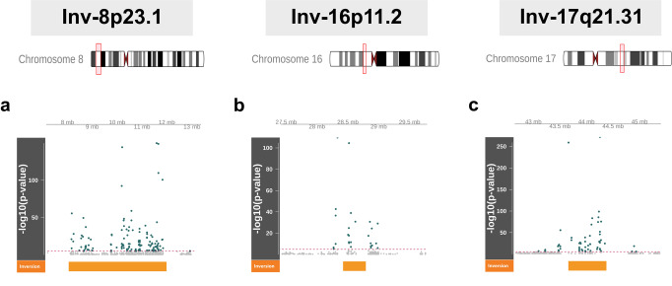
Does ELA modify genetic effects on DNAm? cont.
Flanking DNAm sites (<1Mb) associated with inversion
129 of 848 sites 27 or 401 sites 58 of 666 sites

Slide 7
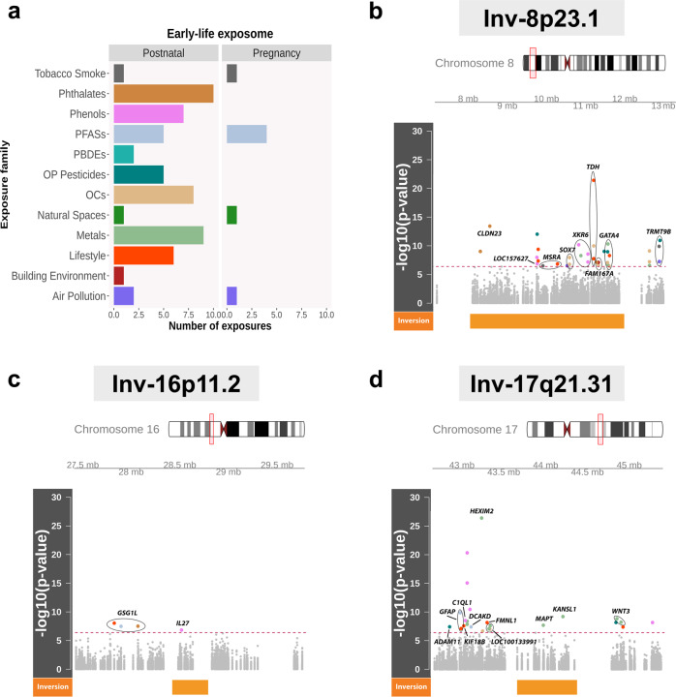
Does ELA modify genetic effects on DNAm? cont.
Some DNAm associations moderated by ELA

Slide 8
Does ELA modify genetic effects on DNAm? cont.
Top inversion-ELA interactions
Exposure | Exposure family | Period | Inversion | CpG | Gene symbol | Effect | P-value
Lead | Metals | Postnatal | 17q21.31 | cg19655070 | HEXIM2 | −0.043 | 4.5E-27
Meat intake | Diet | Postnatal | 8p23.1 | cg01489256 | TDH | 0.0156 | 3.8E-22
MEPA | Phenols | Postnatal | 17q21.31 | cg06368300 |  | 0.0077 | 5.1E-21
MEPA | Phenols | Postnatal | 17q21.31 | cg11178337 |  | 0.0189 | 9E-16
MBzP | Phthalates | Postnatal | 8p23.1 | cg06671706 | CLDN23 | 0.0173 | 3.8E-14
DETP | OP Pesticides | Postnatal | 8p23.1 | cg17526103 |  | 0.0038 | 9.5E-13
DMTP | OP Pesticides | Postnatal | 8p23.1 | cg17120402 |  | 0.0065 | 1.2E-11

Slide 9
How well does DNAm predict all-cause mortality?
Huan, T. … Levy, D. (2022). Integrative analysis of clinical and epigenetic biomarkers of mortality. Aging cell, e13608.
Data
15 cohort studies (n=15,013)
DNAm blood
Over 10 years, 4314 deaths of which 1235 CVD and 868 cancer
Results
EWAS identified163/17 CpG sites associated with all-cause mortality in Europeans/Africans
DNAm all-cause predictor improved 5% (from C-index=0.71 to 0.76) over clinical risk factors for cancer deaths
MR identified 15 putative causal CpG sites for longevity

Slide 10
Do plasma protein levels predict Alzheimer’s risk?
Hillary, R. F., …, Marioni, R. E. (2022). Genome- and epigenome-wide studies of plasma protein biomarkers for Alzheimer's disease implicate TBCA and TREM2 in disease risk. Alzheimer's & dementia (Amsterdam, Netherlands), 14(1), e12280.
Methods
GWAS and EWAS of 282 AD-associated proteins (n~1000)
Protein variance explained by genotype and DNAm by Bayesian penalised regression
Protein-AD associations assessed by Mendelian randomization and co-localisation
Results
64 genetic loci and 26 DNAm sites associated with 45 proteins
Proteins TBCA and TREM2 associated lower AD risk

Slide 11
Are DNAm scores associated with major depressive disorder?
Barbu, M. C … McIntosh, A. M. (2022). Complex trait methylation scores in the prediction of major depressive disorder. EBioMedicine, 79, 104000.
Data
Published EWAS: BMI, smoking, alcohol consumption, educational attainment, high-density lipoprotein (HDL) and total cholesterol
DNAm ALSPAC (n=565) and Generation Scotland (n=9502)
Methods
Calculate DNAm scores from EWAS ‘top’ associations
Test associations between scores and phenotypes
Test associations between scores and major depressive disorder

Slide 12
Are DNAm scores associated with major depressive disorder? cont.
Results
All scores associated with target trait (β=0.078-2.533)
All scores associated with MDD (β= 0.053-0.145)
Educational attainment score and alcohol consumption score remained associated with MDD after adjusting for BMI, smoking, alcohol

Slide 13
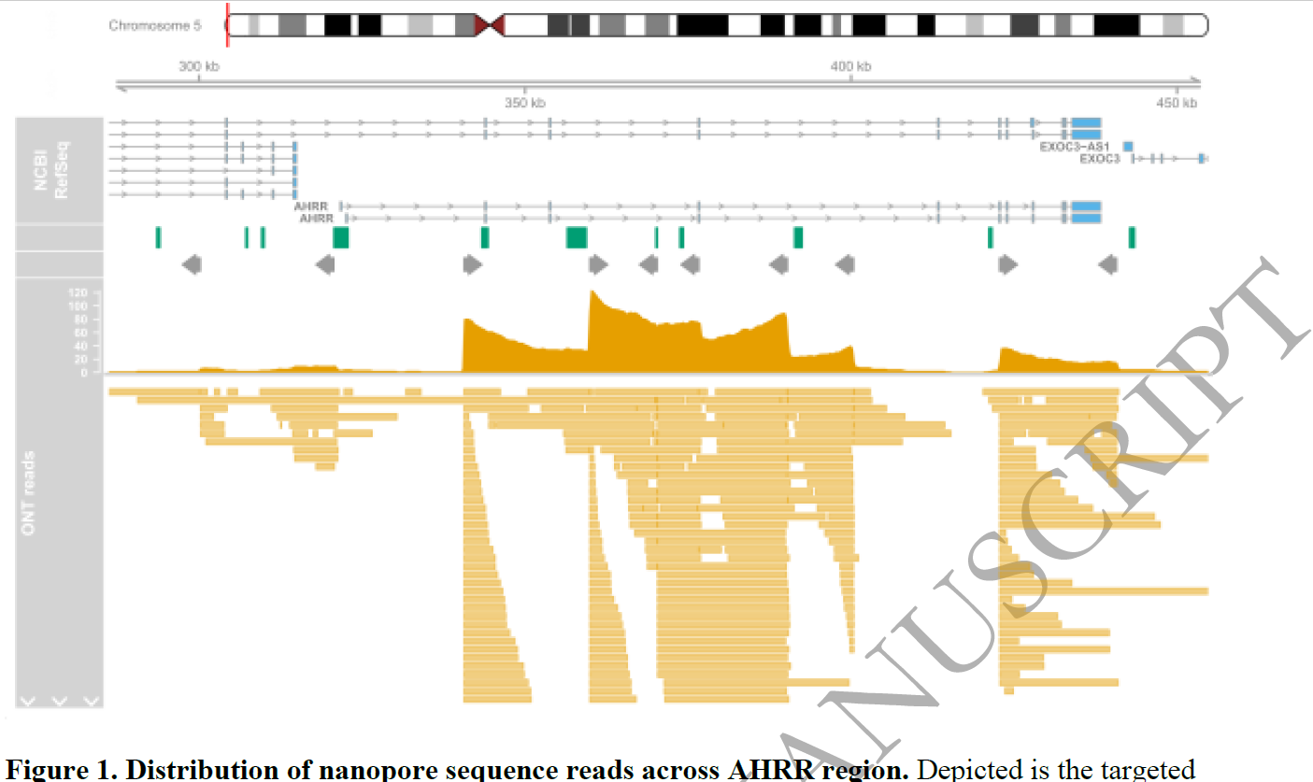
Is nanopore ready for epigenetic epidemiology?
Flynn, R., … Mill, J., & Hannon, E. (2022). Evaluation of nanopore sequencing for epigenetic epidemiology: a comparison with DNA methylation microarrays. Human molecular genetics, ddac112.
EPIC arrays
Nanopore targeted 3 regions (lengths ~20kb, 9kb, 140kb AHRR; 1779 CpG sites)
Correlation of DNAm levels = 0.94
50kb

Slide 14
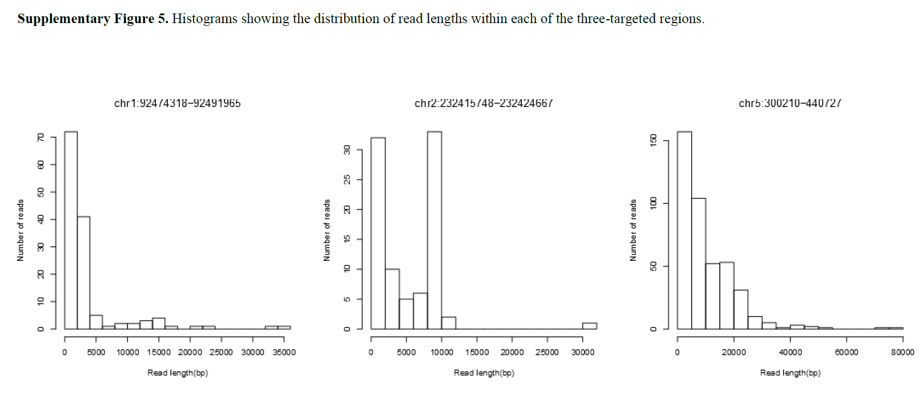
Is nanopore ready for epigenetic epidemiology? cont.

Slide 15
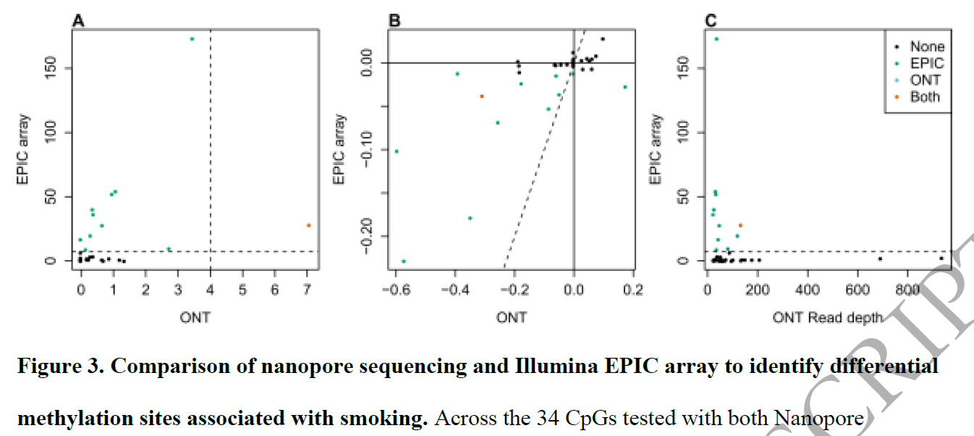
Is nanopore ready for epigenetic epidemiology? cont.
EPIC:-log10 p-value vs ONT:read depth
-log10 p-values
mean differences

Slide 16
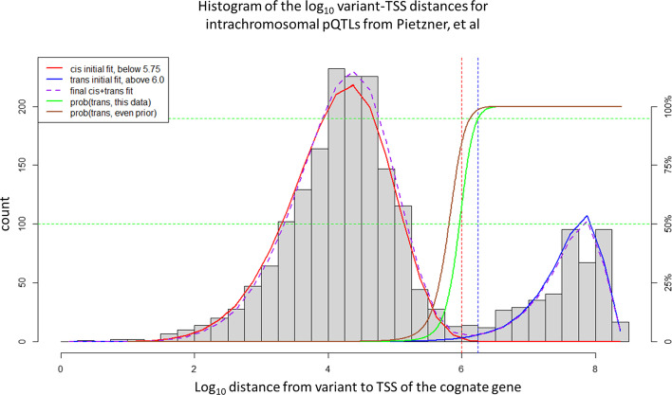
What does cis actually mean?
Fauman, E. B., & Hyde, C. (2022). An optimal variant to gene distance window derived from an empirical definition of cis and trans protein QTLs. BMC bioinformatics, 23(1), 169.
The two distributions roughly cross 1 Mb, i.e. 1Mb defines cis!

