Slide 1
Epigenetic Epidemiology Update
Matthew Suderman
MRC Integrative Epidemiology Unit
Jan 31, 2022

Slide 2
EWAS: prenatal exposure
pmid | journal | variable | tissue | population | assocs
34937578 | Clin Epigenetics | exclusive breastfeeding | cord blood | ALSPAC (~900) | 13 (females); 2 (males)
35046013 | BMJ Open Diabetes Res Care | GDM before 24w | cord blood | 84 before 24w vs 78 after vs 60 normal | null
34835636 | Nanomaterials (Basel) | maternal cadmium | cord blood | 384 MOCEH (South Korea) | 1
35032864 | Environ Int | phthalates during pregnancy | male placenta | 202 | null
EWAS: predict childhood phenotype
pmid | journal | variable | tissue | population | assocs
34895032 | World J Biol Psychiatry | neurodevelopmental delay | cord blood | South African Drakenstein Child Health Study (161) | 3
34899183 | Front Mol Neurosci | early vs late diagnosis of autism | maternal blood; cord blood; placenta | EARLI (215;133;213) | null
34857876 | Pediatr Res | chronic lung disease in preterm infants | placenta | 423 | 49

Slide 3
EWAS: infant exposure
pmid | journal | variable | tissue | population | assocs
34836312 | Nutrients | breastfeeding duration | blood | 243 (age 9-15 months) | 6
EWAS: childhood phenotype
pmid | journal | variable | tissue | population | assocs
35000590 | Clin Epigenetics | cardiometabolic disease risk factors | blood | 293 Gambian (7-9y) | blood pressure; fasting insulin; triglycerides; LDL-cholesterol
35000590 | Clin Epigenetics | cardiometabolic disease risk factors | blood | 698 Indian (5-7y) | insulin sensitivity;insulinogenic index;HDL-cholesterol
34995380 | Clin Exp Allergy | asthma acquired during adolescence and adulthood | blood | Isle of Wight birth cohort (n1456;age 10,18,26) | 4 (females in adolescence); 4 (females in adulthood)

Slide 4
EWAS: exposure in adulthood
pmid | journal | variable | tissue | population | assocs
34857913 | Mol Psychiatry | alcohol consumption | blood | Generation Scotland (8161) | 2504
34880450 | Mol Psychiatry | anti-depressant use | blood | Generation Scotland (6428) and Netherlands Twin Register (2449) | 2
34930449 | Clin Epigenetics | previous pre-eclampsia | blood | Young Finns study (836) | 14
34886889 | Clin Epigenetics | smoking | blood | 72 (whole genome bisulfite sequencing + RNA-seq) | 2440 DMRs
35028889 | Neurocrit Care | cerebral edema and intracranial hypertension after traumatic brain injury | ventricular cerebrospinal fluid | 89 patients x 3 time points | 1
EWAS: disease prediction
pmid | journal | variable | tissue | population | assocs
35039093 | Clin Epigenetics | atherosclerosis | blood 5-12 years before diagnosis | 391 African Americans (GENOA) | 4

Slide 5
EWAS: adulthood phenotype
pmid | journal | variable | tissue | population | assocs
34895303 | Clin Epigenetics | aortic diameter in Marfan syndrome | blood | 190 patients | 28
34937574 | Clin Epigenetics | BMI | blood | Womens Health Initiative (3977); Atherosclerosis Risk in Communities (3520) | 22
35028426 | Wellcome Open Res | brain inflammation (serum S100β) | blood | Lothian birth cohort (722, mean age 72.5) | null
35039062 | Genome Biol | cognitive function | blood | Generation Scotland (9162) | 3
35036834 | Epigenet Insights | Hispanic | blood | 31 H vs 163 non-H firefighters | 76
34887417 | Nat Commun | kidney function (glomerular filtration rate; alubmin-to-creatinine ratio) | blood | 33.6K (GFR); 15K (UACR) | 69;7

Slide 6
EWAS: adulthood phenotype …
pmid | journal | variable | tissue | population | assocs
35033200 | Clin Epigenetics | lung function | blood | 250 Puerto Rican and 148 Mexican American | 5 (not in Europeans)
34996616 | J Allergy Clin Immunol | lung function | blood | RHINESSA (671 adults) | 23 (women); 2 (men)
34944472 | Biomolecules | prostate cancer aggressiveness (Gleason score) | blood | 280 African American patients | null
34992238 | Mol Psychiatry | PTSD severity | blood | 429 soldiers (blood before and after combat PTSD) | 4
34887389 | Nat Commun | serum urate | blood | 12.4K | 100 (esp SLC2A9)
34915915 | Clin Epigenetics | severe acute pancreatitis | blood | 175 blood samples from 61 patients and 24 from controls | 565 (59 with severity)
34966975 | J Neural Transm | sex | blood | 134 schizophrenia patients | ‘several'

Slide 7
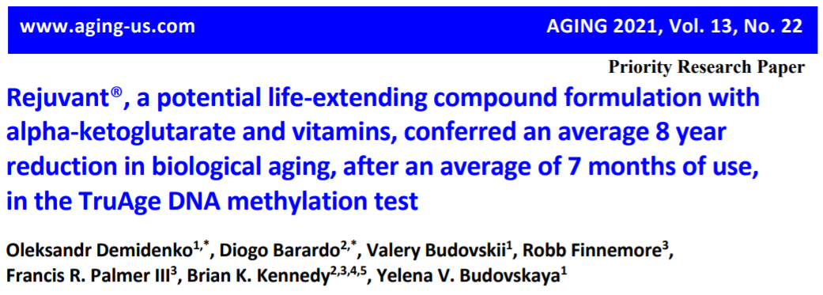
The search continues for possible interventions that delay and/or reverse biological aging, resulting in extended healthspan and lifespan. Interventions delaying aging in animal models are well established; however, most lack validation in humans. The length of human lifespan makes it impractical to perform survival analysis. Instead, aging biomarkers, such as DNA methylation (DNAm) clocks, have been developed to monitor biological age. Herein we report a retrospective analysis of DNA methylation age in 42 individuals taking Rejuvant®, an alpha-ketoglutarate based formulation, for an average period of 7 months. DNAm testing was performed at baseline and by the end of treatment with Rejuvant® supplementation. Remarkably, individuals showed an average decrease in biological aging of 8 years (p-value=6.538x10-12). Furthermore, the supplementation with Rejuvant® is robust to individual differences, as indicated by the fact that a large majority of participants decreased their biological age. Moreover, we found that Rejuvant® is of additional benefit to chronologically and biologically older individuals. While continued testing, particularly in a placebo-controlled design, is required, the nearly 8-year reversal in the biological age of individuals taking Rejuvant® for 4 to 10 months is noteworthy, making the natural product cocktail an intriguing candidate to affect human aging.

Slide 8
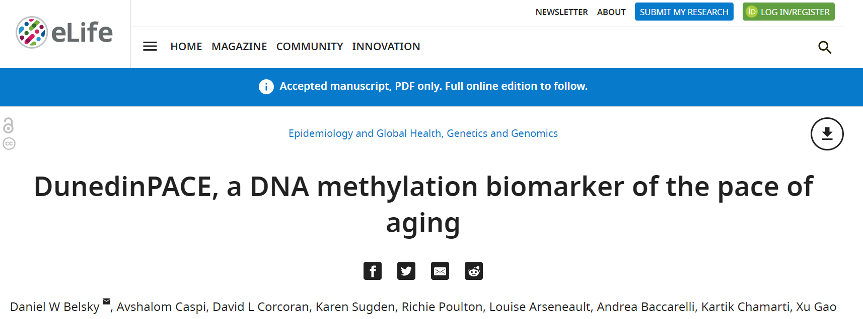
DunedinPOAM – predict change in aging biomarkers across 12 years
DunedinPACE – predict change in aging biomarkers across 20 years
Aging biomarkers: Body mass index (BMI), Waist-hip ratio (WHR), Glycated hemoglobin, Leptin, Blood pressure (mean arterial pressure), Cardiorespiratory fitness (VO2Max), Forced vital capacity ratio (FEV1/FVC), Forced expiratory volume in one second (FEV1), Total cholesterol, Triglycerides, High density lipoprotein (HDL), Lipoprotein(a), Apolipoprotein B100/A1 ratio, estimated Glomerular Filtration Rate (eGFR), Blood Urea Nitrogen (BUN), High Sensitivity C-reactive Protein (hs-CRP), White blood cell count, mean periodontal attachment loss (AL), and the number of dental-caries-affected tooth surfaces (tooth decay). “In analysis of incident morbidity, disability, and mortality, DunedinPACE and added incremental prediction beyond GrimAge.”

Slide 9
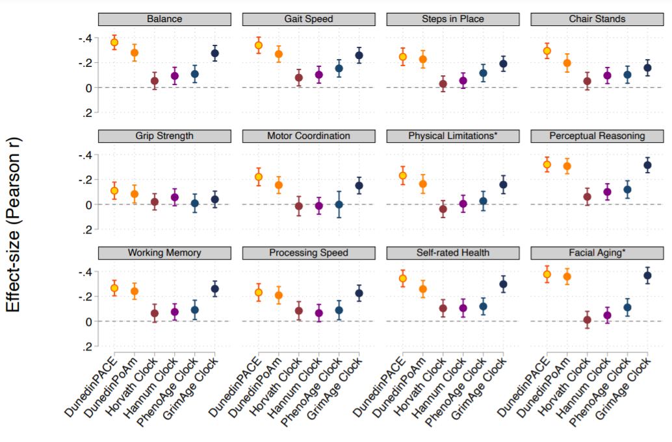
DunedinPACE and measures of biological age (Understanding Society)

Slide 10
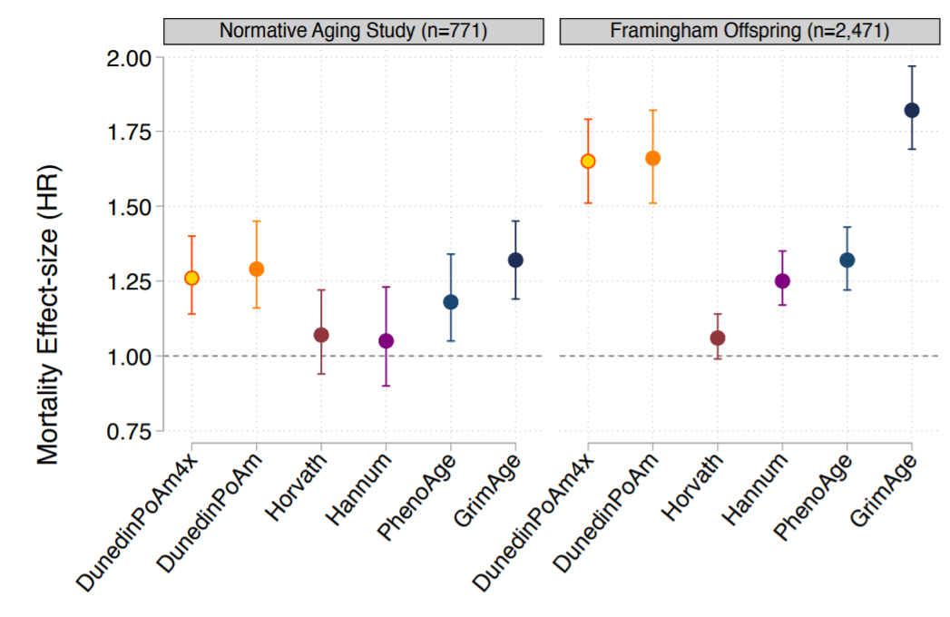
DunedinPACE and mortality

Slide 11
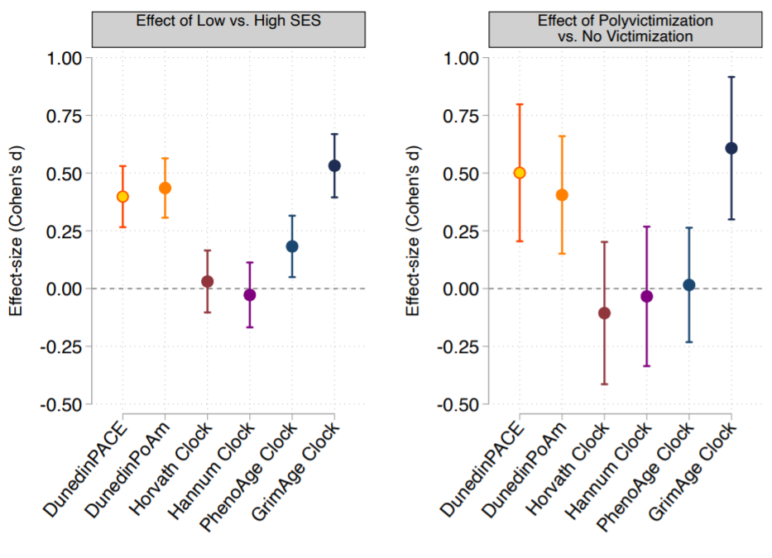
DunedinPACE, SES and victimization (E-Risk)

Slide 12
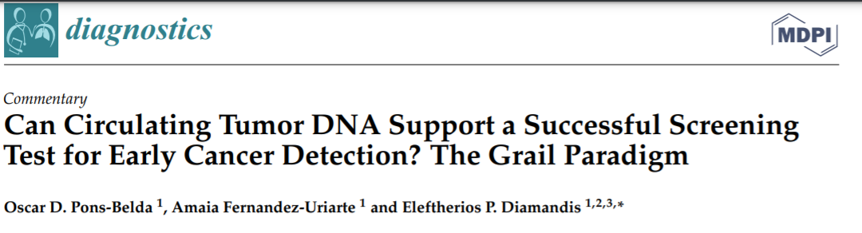
Circulating tumor DNA (ctDNA) is a new pan-cancer tumor marker with important applications for patient prognosis, monitoring progression, and assessing the success of the therapeutic response. Another important goal is an early cancer diagnosis. There is currently a debate if ctDNA can be used for early cancer detection due to the small tumor burden and low mutant allele fraction (MAF). We compare our previous calculations on the size of detectable cancers by ctDNA analysis with the latest experimental data from Grail's clinical trial. Current ctDNA-based diagnostic methods could predictably detect tumors of sizes greater than 10-15 mm in diameter. When tumors are of this size or smaller, their MAF is about 0.01% (one tumor DNA molecule admixed with 10,000 normal DNA molecules). The use of 10 mL of blood (4 mL of plasma) will likely contain less than a complete cancer genome, thus rendering the diagnosis of cancer impossible. Grail's new data confirm the low sensitivity for early cancer detection (<30% for Stage I-II tumors, <20% for Stage I tumors), but specificity was high at 99.5%. According to these latest data, the sensitivity of the Grail test is less than 20% in Stage I disease, casting doubt if this test could become a viable pan-cancer clinical screening tool.

Slide 13
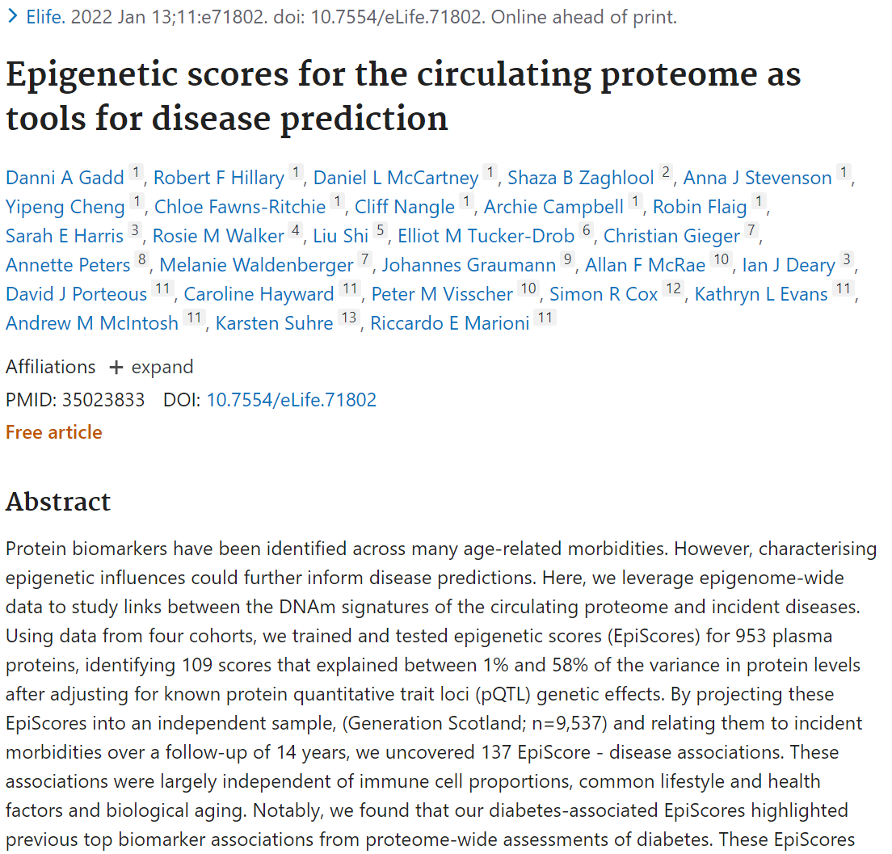

Slide 14
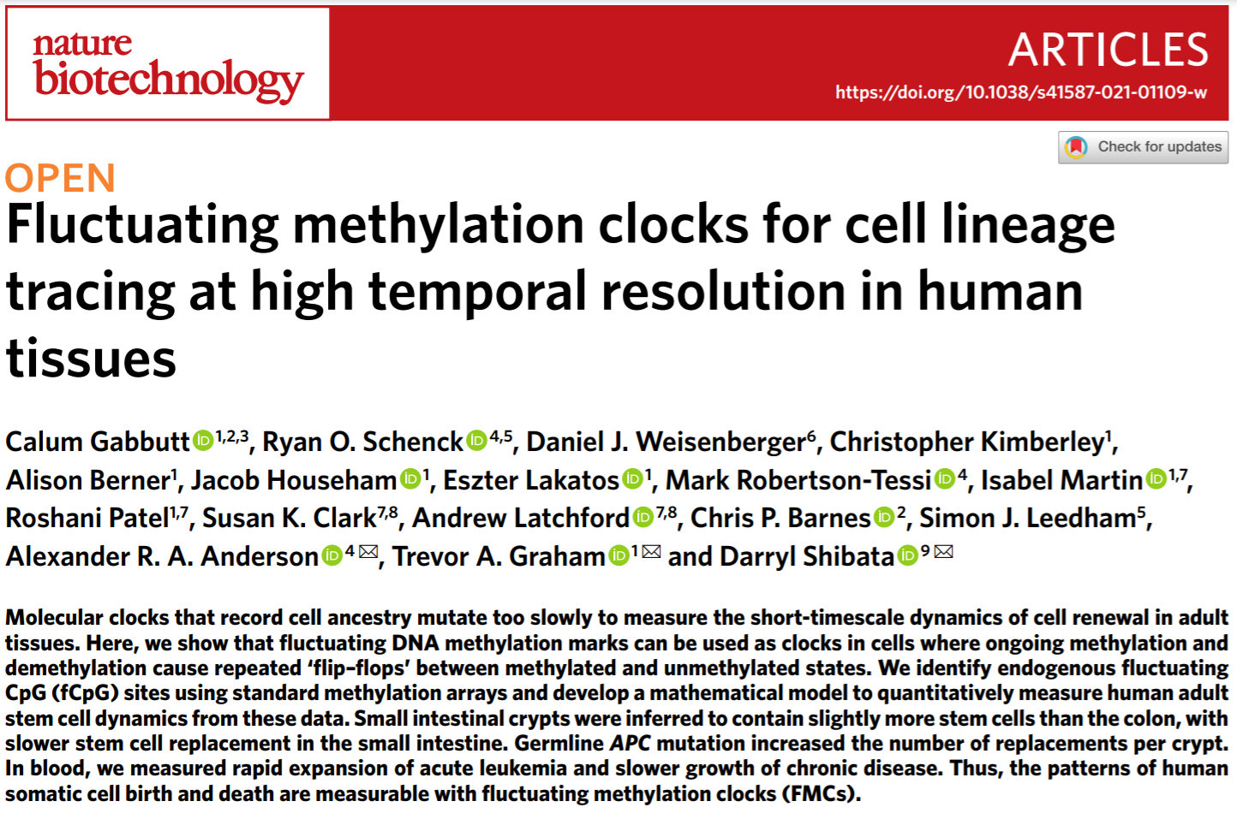

Slide 15
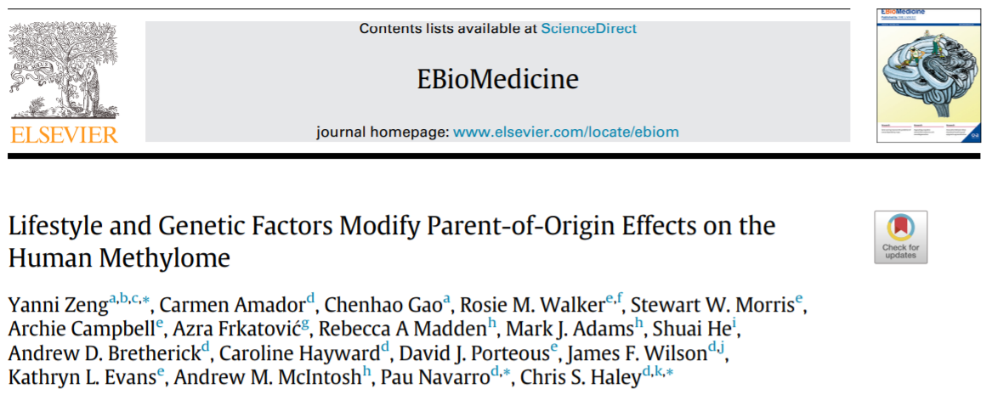
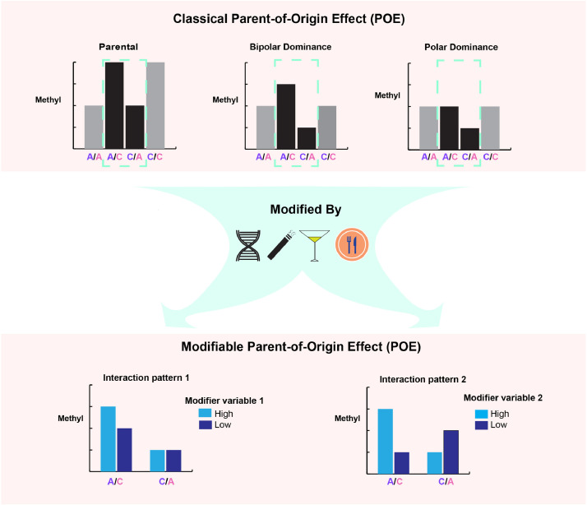
lifetime smoking status and genetically-determined expression of TET2, SIRT1 and KDM1A were found to significantly modify the POE on the three CpGs

Slide 16
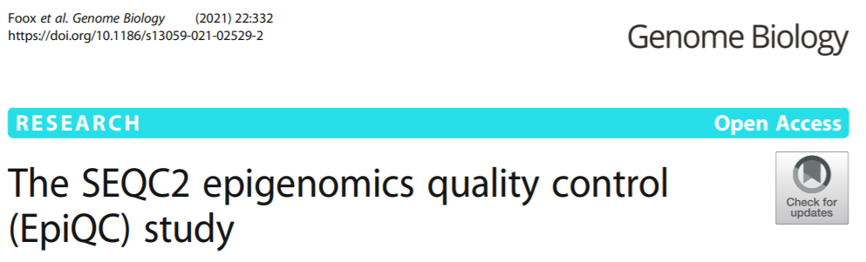
Summary
We recommend the use of bwa-meth for reference-based alignment of bisulfite data, followed by MethylDackel for methylation estimation
We provide estimates of how many reads are required per protocol to reach 20× mean coverage
Enzymatic deamination reactions (EMSeq) are as efficient or better as bisulfite methods
The concordance of nanopore sequencing … (r = 0.92) has improved considerably …
For normalization of microarray data, non-sample variance is best minimized using a combination of Funnorm and RCP
We propose using the SNPs on the 850k array to calculate a data-driven threshold for classifying and filtering out low-varying microarray sites
Beta values from microarrays and base-level methylation estimates from sequence data are highly comparable.
“Each sample is processed in multiple replicates by three
whole-genome bisulfite sequencing (WGBS) protocols (TruSeq DNA methylation, Accel-NGS MethylSeq, and SPLAT),
oxidative bisulfite sequencing (TrueMethyl),
enzymatic deamination method (EMSeq),
targeted methylation sequencing (Illumina Methyl Capture EPIC),
single-molecule long-read nanopore sequencing from Oxford Nanopore Technologies, and
850k Illumina methylation arrays.”

