Slide 1
Epigenetic Epidemiology Update
Matthew Suderman
MRC Integrative Epidemiology Unit
Sept 5, 2022

Slide 2
EWAS of diseases/phenotypes
PMID | Journal | Variable | Tissue | Sample | Associations
35998020 | Clin Transl Med | breast cancer | circulating DNA (WGBS) | 123 cases vs 40 controls | AUC=0.967
35995800 | Nat Commun | Braak Lewy body stage | frontal cortex | 322 discovery; 200 replication | 4 sites
36029471 | J Crohns Colitis | inflammatory bowel disease | whole blood | 343 cases vs 295 controls | 137
35998097 | J Crohns Colitis | inflammatory bowel disease | whole blood | 309 cases vs 243 controls | 224 sites
35982059 | Nat Commun | Alzheimers disease | whole blood | 427 cases vs 857 controls | 5 sites
36036794 | Environ Health Perspect | activities of daily living disability | whole blood | 212 cases vs controls | 85
35945220 | Nat Commun | 4058 plasma proteins | whole blood | 774 | 2928 CpG-proteins
35879030 | Clin Psychopharmacol Neurosci | recent psychosis | whole blood | 61 cases vs 47 controls | 2912

Slide 3
EWAS of exposures
PMID | Journal | Variable | Tissue | Sample | Associations
36046194 | iScience | prenatal maternal depression | peripheral blood | 915 women Singaporean longitudinal birth cohort study | associations only for mother of female (replicated in ALSPAC)
35965483 | J Gerontol A Biol Sci Med Sci | calorie restriction | whole blood | 197 of which 1/3 calorie restricted | null
EWAS of disease risk
PMID | Journal | Variable | Tissue | Sample | Associations
35987900 | Sci Rep | melanoma risk | pre-diagnostic whole blood | 183 cases vs 183 controls from NOWAC | null
35947335 | Geroscience | type 2 diabetes risk | pre-diagnostic whole blood | 132 cases vs 132 controls | 107 sites
35979830 | AIDS | plasma sCD14 (predicts HIV mortality) | whole blood | 1075 with HIV | 118 sites (10 predic survival)

Slide 4
EWAS of exposure in children
PMID | Journal | Variable | Tissue | Sample | Associations
36012217 | Int J Mol Sci | trauma | whole blood | 236 mothers and 232 children (African American) | 1 site in children
35977396 | Am J Clin Nutr | intake of mothers milk | buccal cells at age 5.5 | 143 with low birthweight (<1500g) | 2 sites
35930640 | Sci Adv | BCG vaccination | monocytes | 67 vax vs 63 at 14 months | 2836 sites

Slide 5
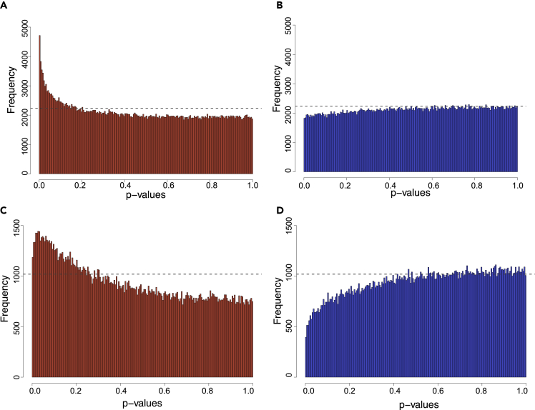
Depression in pregnancy is offspring sex-specific
EWAS
Kee MZL, … Meaney MJ. Fetal sex-specific epigenetic associations with prenatal maternal depressive symptoms. iScience. 2022 Aug 4;25(9):104860.
Depression in pregnant mothers is associated with DNA methylation … but only if the fetus is female?!
Singaporean longitudinal birth cohort study
Female child Male child
ALSPAC (antenatal)

Slide 6
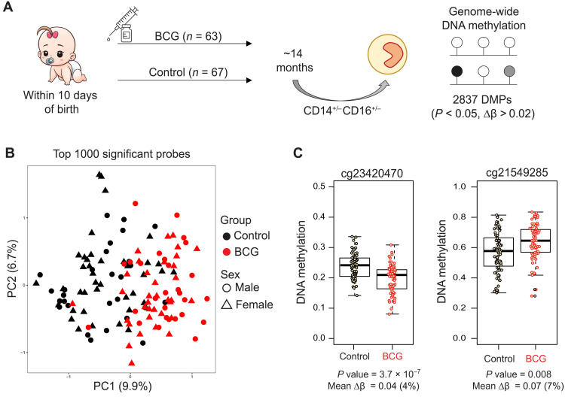
DNAm effects of vaccination
EWAS
2. EWAS
Bannister, S., et al. (2022). Neonatal BCG vaccination is associated with a long-term DNA methylation signature in circulating monocytes. Science advances, 8(31), eabn4002.
Immediate effects In vitro model
Effects 12 months later EWAS of human monocytes at 14 months
Validation Mouse model 4 weeks after vaccination
NEED TO READ IN DETAIL

Slide 7
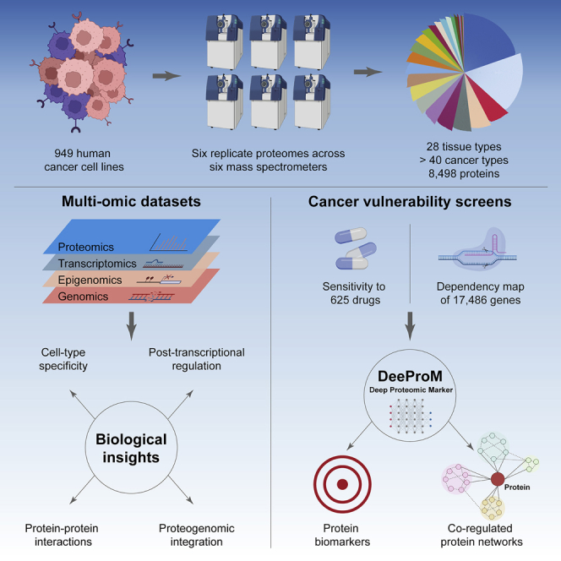
Cancer proteome reference
Proteomes
Gonçalves, E., et al. (2022). Pan-cancer proteomic map of 949 human cell lines. Cancer cell, 40(8), 835–849.e8.
https://cellmodelpassports.sanger.ac.uk

Slide 8
Detecting breast cancer from circulating DNA
Detection
Gao, Y., et al. (2022). Whole-genome bisulfite sequencing analysis of circulating tumour DNA for the detection and molecular classification of cancer. Clinical and translational medicine, 12(8), e1014.
Data
123 BC cases vs 40 controls
Whole genome bisulfite sequencing
15 site model = AUC 0.967 for discriminating early BC from controls

Slide 9
Predicting breast cancer resistance
Prediction
Ogunleye, A. Z., et al. (2022). Interpretable Machine Learning Models to Predict the Resistance of Breast Cancer Patients to Doxorubicin from Their microRNA Profiles. Advanced science (Weinheim, Baden-Wurttemberg, Germany), 9(24), e2201501.
Data. clinical, biospecimen, RNA, DNAm, miRNA, copy number, SNPs, isoform expression
Methods. 16 machine learning algorithms
= 8 x 16 = 128 different models
Results.
Only 2 of the 128 models are predictive
Best model was classification and regression tree (CART) on 4 miRNAs
Did not consider multi-omic models?

Slide 10
Benchmark for multi-omic classification methods
Prediction
Leng, D., Zheng, L., Wen, Y., Zhang, Y., Wu, L., Wang, J., Wang, M., Zhang, Z., He, S., & Bo, X. (2022). A benchmark study of deep learning-based multi-omics data fusion methods for cancer. Genome biology, 23(1), 171.
Methods:16 deep learning data fusion methods
Data: single cell and multi-omic datasets (TCGA)
Aims: classify and cluster (cancer subtypes)
https://github.com/zhenglinyi/DL-mo

Slide 11
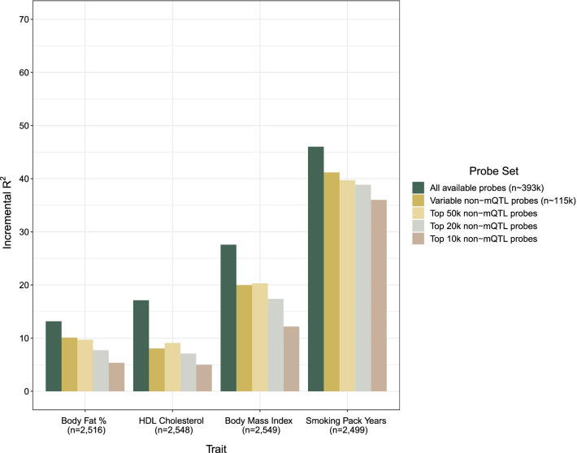
Factors influence model performance
Prediction
Hillary, R. F., et al. (2022). Identification of influential probe types in epigenetic predictions of human traits: implications for microarray design. Clinical epigenetics, 14(1), 100.
Which factors affect performance of DNAm models?
Number of methylation sites measured
Variance of methylation sites
mQTL status
Answers
Number of sites
Methylation between 10-90%

Slide 12
Commentary on polygenic risk scores
Prediction
Herzig, A. F., Clerget-Darpoux, F., & Génin, E. (2022). The False Dawn of Polygenic Risk Scores for Human Disease Prediction. Journal of personalized medicine, 12(8), 1266.
Some recurring arguments:
Gene-environment interactions Polygenic risk can be wildly inaccurate when environment is ignored
e.g. Consider a genetic variant associated with increased alcohol intake. In some populations, this will also be associated with increased BMI and therefore be associated breast cancer risk (but take away alcohol and risk disappears)
Polygenic risk is not equivalent to clinical utility
Recommend direction of attempts like the omnigenic model.

Slide 13
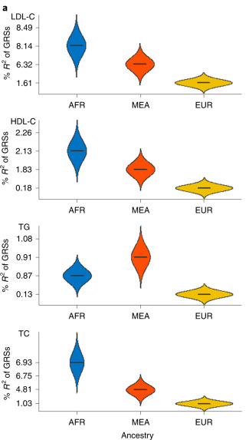
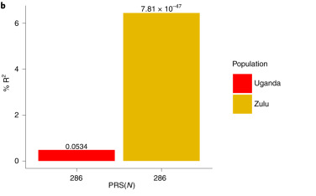
Africa is heterogeneous
Prediction
Kamiza, A. B., et al. (2022). Transferability of genetic risk scores in African populations. Nature medicine, 28(6), 1163–1166.
Phenotypes. Lipid traits (total cholesterol, LCL-C, HDL-C, triglycerides)
PRS Discovery. African Americans in Million Veteran Program
Test. Ugandan and South African Zulu cohorts

Slide 14
Would you like to teach this year?!
Epigenetic Epidemiology short course 8 - 10 May 2023
Advanced Epigenetic Epidemiology short course 18 - 19 May 2023
New! Machine learning module in the Medical Statistics and Data Science MSc programme Jan 26 – April 27 2023
Introduction to machine learning Machine learning algorithms Machine learning tools and environments Assessing performance (Valerio Maggio) Ethical issues (Helen Smith) Common challenges, pitfalls and limitations Interpreting black box models Automated causal inference

