Slide 1
Epigenetic Epidemiology Update
Matthew Suderman
MRC Integrative Epidemiology Unit
Oct 4, 2021

Slide 2
EWAS
pmid | journal | variable | tissue | population | associations
34585950 | Epigenomics | depression | placenta | 301 pregnancies | 16
 |  | stress |  |  | 2
34569420 | Epigenetics | sex | cord blood | 179 | 2119
 |  |  | placenta | 229 | 2281
 |  |  | umbilical artery | 229 | 3405
34529553 | Epigenetics | endocrine disrupting chemicals in maternal blood | cord blood | 142 in the Duisberg Birth Cohort Study | 32
34583751 | Clin Epigenetics | vaping | saliva | 117 smokers;117 non-smokers;116 non-smoking vapers | null
34541665 | J Child Psychol Psychiatry | sex differences in depression | blood | 487 age 9-17 (MBD-seq) | "a substantial number" in monocytes
34561420 | Transl Psychiatry | conduct disorder | saliva | 51 cases; 59 controls | 1 DMR
34556110 | BMC Med Genomics | waist circumference | blood | 210 from 73 families (STANISLAS Family Study) | 1
 |  | waist-to-hip ratio |  |  | null
34584077 | Nat Commun | MZ twinning | blood | 3046 MZ vs 3396 DZ from six cohorts | 843

Slide 3
DNAm signature of MZ twinning
van Dongen, J., Gordon, S.D., McRae, A.F. et al. Identical twins carry a persistent epigenetic signature of early genome programming. Nat Commun 12, 5618 (2021).
“MZ twinning rarely runs in families, the prevalence is similar across the world over time (3–4 per 1000 births), and stable with the mother’s age. A prevailing hypothesis, therefore, is that MZ twinning occurs at random.”
243 CpG sites
Cohort | total | MZ twins | DZ twins | % female | Age, mean (SD) | Tissue
NTR | 1957 | 924 | 1033 | 65.3 | 34.9 (11.3) | Blood
E-Risk | 1164 | 470 | 694 | 48.9 | 18 (0.4) | Blood
FTC | 1708 | 559 | 1149 | 63.7 | 38.6 (20.2) | Blood
TwinsUK | 492 | 395 | 97 | 100 | 58 (10.1) | Blood
BSGS | 356 | 134 | 222 | 48.9 | 21.4 (14.1) | Blood
NTR | 765 | 564 | 201 | 48.8 | 9.6 (1.8) | Buccal

Slide 4
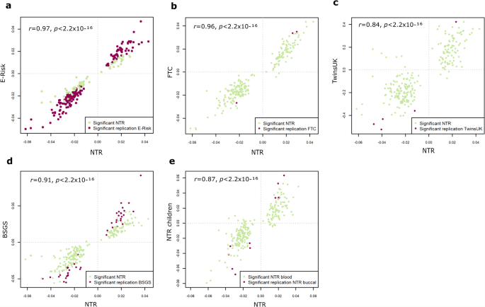
DNAm signature of MZ twinning
Replication of 243 site associations
axes = effect size
p-value < 0.05/243

Slide 5
DNAm signature of MZ twinning
EWAS of total sample (n=5723): 843 CpG site associations
Heritable (57% vs 19% expected; SNP heritability 14% vs 7% expected)
Mean MZ correlation = 0.58 vs Mean DZ correlation = 0.20
45% of MZ-hypomethylated near telomeres
11% in meta-stable epialleles
41% of MZ-hypermethylated near centromeres
6% in meta-stable epialleles
TF binding indicates early embryonic development
Detecting MZ: AUC = 0.77-0.8 (in independent data)

Slide 6
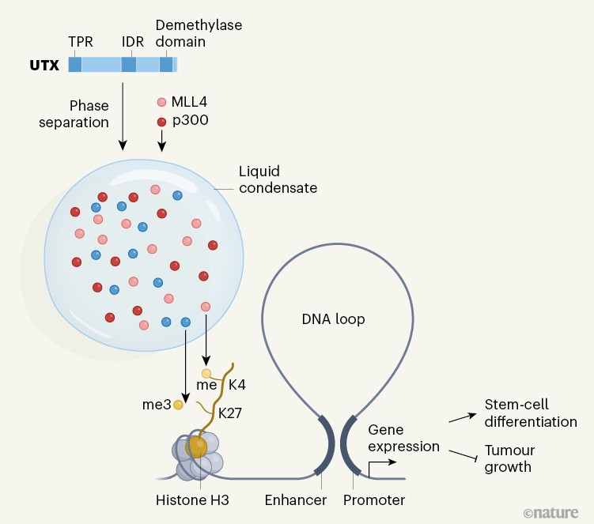
A new ‘platform’ for chromatin modification
Shi B, Li W, Song Y, et al. UTX condensation underlies its tumour-suppressive activity. Nature. 2021;597(7878):726-731.
Lara-Astiaso D, Huntly BJP. Protein condensates provide a platform for controlling chromatin. Nature. 2021;597(7878):642-644.
Known about UTX
Chromosome X but escapes inactivation
Removes H3K27me3
Binds to complex that activates enhancers by modifying histone marks
Mutated in many cancers (more male cancers than female)
Mutations mainly cause truncation before IDR and demethylase domains
Restoration of IDR inhibits proliferation

Slide 7
A new ‘platform’ for chromatin modification
Shi B, Li W, Song Y, et al. UTX condensation underlies its tumour-suppressive activity. Nature. 2021;597(7878):726-731.
Lara-Astiaso D, Huntly BJP. Protein condensates provide a platform for controlling chromatin. Nature. 2021;597(7878):642-644.
New
Intrinsically disordered region (IDR)
Liquid–liquid phase separation
Protein condensate
Condensate includes histone modifiers that activate enhancers
Activates tumor suppression and embryonic stem-cell differentiation
Swapping in other IDRs modifies ability to form condensates and activate enhancers

Slide 8
Long-read sequencing
Sakamoto Y, Zaha S, Suzuki Y, Seki M, Suzuki A. Application of long-read sequencing to the detection of structural variants in human cancer genomes. Comput Struct Biotechnol J. 2021;19:4207-4216.
Sections
Studies of SV in human cancer genomes using long-read sequencing - mostly about methods for detecting different types of structural variation
Transposable elements and SVs - methods development still early
DNA methylation and SVs - accuracy of methylation calling from the long-read sequencing had high concordance with the short-read sequencing
Haplotype phasing and SVs - should use a combination of short-read and long-read sequencing

Slide 9
Long-read sequencing
Sakamoto Y, Zaha S, Nagasawa S, et al. Long-read whole-genome methylation patterning using enzymatic base conversion and nanopore sequencing. Nucleic Acids Res. 2021;49(14):e81.
Bisulfite treatment is too destructive
EMseq:
TET enzyme converts mC and hmC to protected caC
APOBEC enzyme converts unmethylated C to U
nanoEM: EMseq with nanopore long-read sequencing
as little as 10ng of DNA (vs 500ng for WGBS/Illumina arrays)
3.4–7.6 kb reads
90% reads aligned
WGBS vs Emseq vs nanoEM (R ~ 0.9 for individual CpG sites)

