Slide 1
Epigenetic Epidemiology Update
Matthew Suderman
MRC Integrative Epidemiology Unit
Oct 18, 2021

Slide 2
EWAS
pmid | journal | variable | tissue | population | associations
34600028 | Genomics | exposure to the great Chinese Famine at birth | blood | 79 exposed adults; 105 controls | null
34596421 | Epigenomics | maternal hyperglycemia | cord blood | 430 (Gen3G cohort, European) | 1
34633450 | J Clin Endocrinol Metab | maternal hyperglycemia | cord tissue | 830 (Chinese) | null

Slide 3
Dependency structure within multi-variable predictors
Palla G, Pollner P, Börcsök J, Major A, Molnár B, Csabai I. Hierarchy and control of ageing-related methylation networks. PLoS Comput Biol. 2021;17(9):e1009327.
Consider Horvath’s 353-CpG site model of age:
DNAm age = intercept + H₁ cg₁ + H₂ cg₂ + … + H₃₅₃ cg₃₅₃
Consider increasing methylation at CpG i by ∆.
This will change DNAm age.
Naively, we might say change ∆ DNAm age will be = H_{i} ∆
However, considering what we know about dependencies between CpG sites, changing CpG i will likely produce changes in other CpG sites …

Slide 4
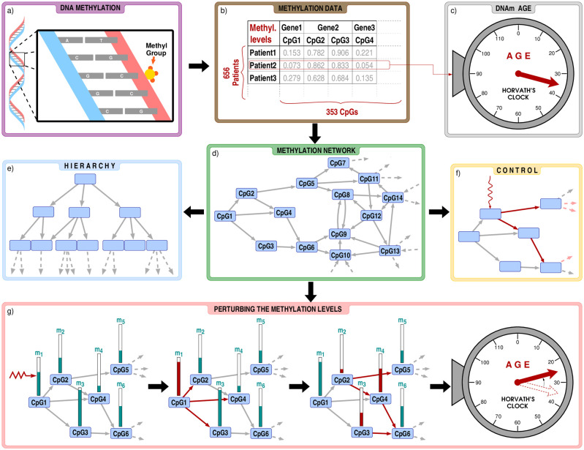
Notes:
Fig 1
Flow chart of our analysis.a) Our study is based on cytosine methylation, a phenomenon where a methyl group is attached to a CpG dinucleotide in the DNA. b) We focus on the methylation level of the 353 CpG dinucleotides appearing in Horvath’s clock, using the data from Ref. [28], listing altogether 656 patients. c) By plugging in the methylation levels of a given patient into Horvath’s clock, we obtain the DNAm age, which is in strong correlation with the chronological age, but is also affected by e.g., the health status. d) Using Lasso-regression, we construct a methylation network between the CpG dinucleotides. In order to seek for key influential nodes in the system we analyse the hierarchical (panel e) and control properties (panel f) of the network. g) In addition, we also investigate how would the change of the methylation levels affect the estimated age when the perturbations are transmitted over the methylation network.

Slide 5
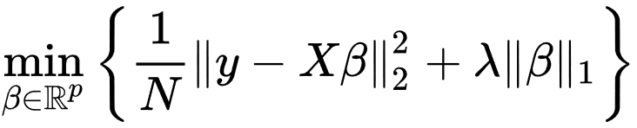
Dependency structure, cont.
For each CpG site cg_{i}, apply LASSO to create a predictor of cg_{i} from the other 352 CpG sites.
CpG1
β₁ ≠ 0
β₂ ≠ 0
CpG2
cg_{i}=CpG4
β₃ = 0
CpG4

Slide 6
Dependency structure, cont.
Propagating DNAm changes
Changing methylation of CpG1 induces changes in methylation at CpG sites 2, 3 and 4.
These induce changes in CpG sites 4, 5 and 6.
Once we have determined all CpG site changes, we recalculate DNAm age to determine how the change at CpG site 1 influences DNAm age, ∆ DNAm age for CpG 1.
Using this method, we can calculate ∆ DNAm age for each CpG site.

Slide 7
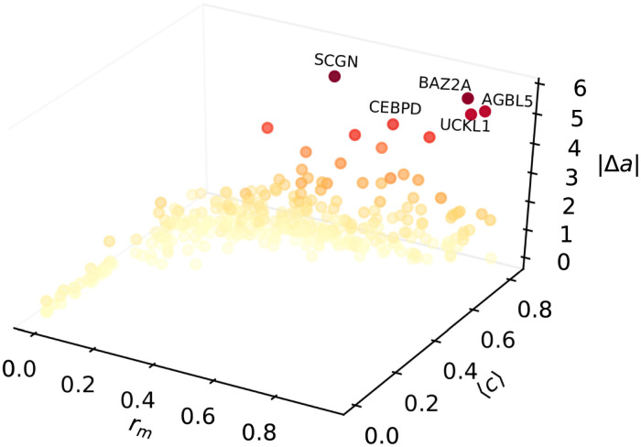
Dependency structure, cont.
Each point represents a CpG site.
The coloring and vertical axis show their ∆ DNAm age.
The other axes show network metrics (see Methods)

Slide 8
Dependency structure, cont.
Conclusions and further work
Clock CpG sites form a hierarchy with certain sites influencing many other sites (more than seen in a random set of CpG sites – see Methods)
However, these influential sites don’t necessarily control aging
“the network between the 850,000 CpG dinucleotides of current microarrays was not feasible, however, extension of the work on larger CpG dinucleotide networks is subject of further research”
Some questions
Does this approach have practical use? It is a new kind of ‘importance metric’.
Could we use it to build better, more robust predictors?
Would it be better to apply MR with mQTLs as instruments to construct the network?

Slide 9
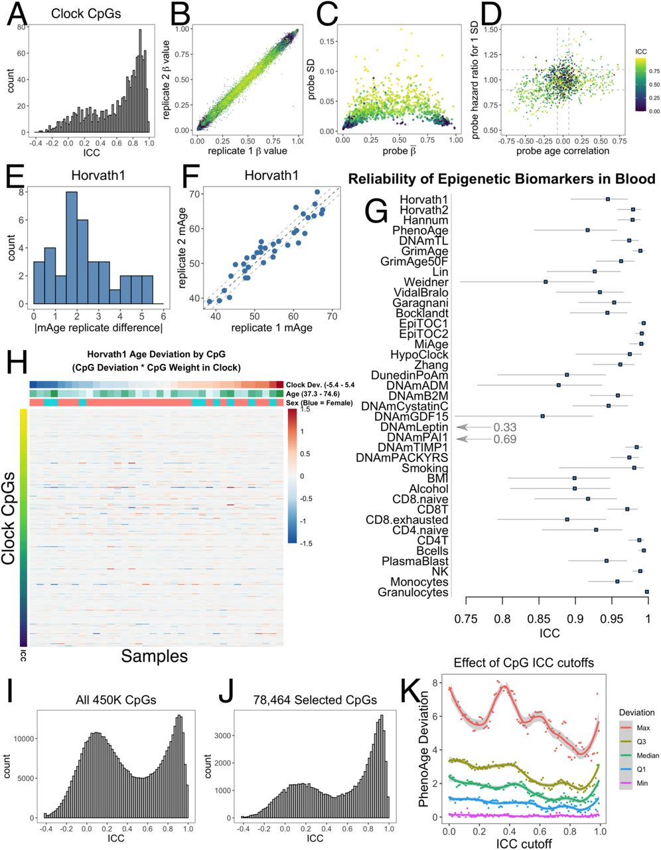
Improving reliability with noisy measurements
Albert T. Higgins-Chen … Morgan E. Levine. A computational solution for bolstering reliability of epigenetic clocks: Implications for clinical trials and longitudinal tracking bioRxiv 2021.04.16.440205

Slide 10
Improving reliability, cont.
Solution? Train on CpG sites that satisfy a given ICC cutoff.
Example: regenerated PhenoAge with different ICC cutoffs
X-axis = ICC cutoff
Y-axis = amount of deviation between technical replicates
Conclusion: ICC > 0.9 is an optimal cutoff but the improvement is modest.

Slide 11
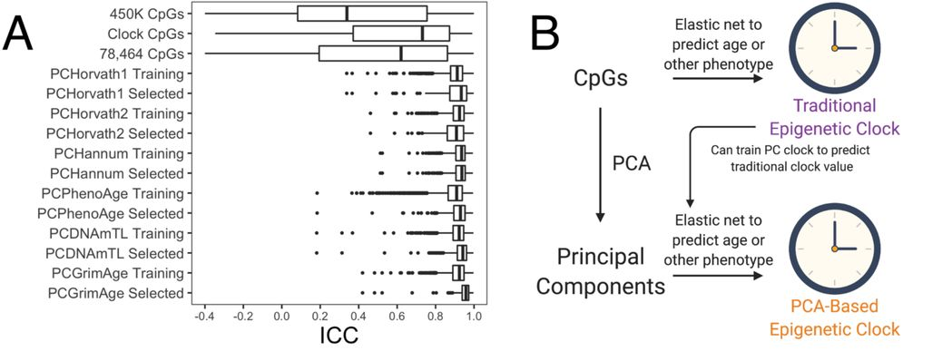
Improving reliability, cont.
Problem: Elastic net assumes measurements are noiseless.
Solution? Perform principal components analysis on the DNA methylation data, apply elastic net to the principal components.

Slide 12
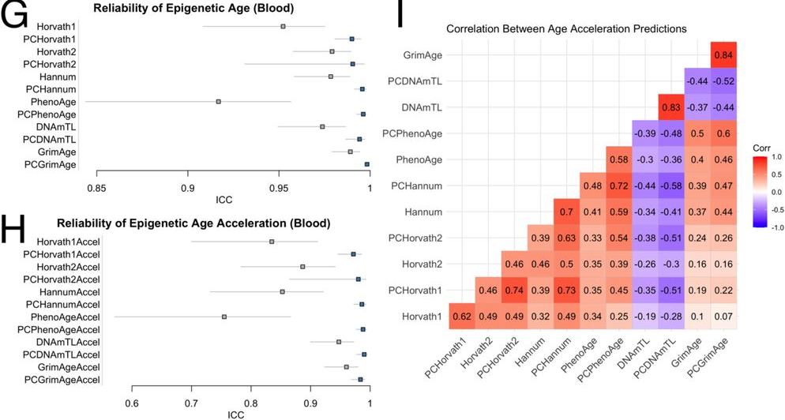
Improving reliability, cont.
Result: reliability goes up (G+H),
but we can get quite different age accelerations from original clocks (I)

Slide 13
Improving reliability, cont.
Other findings
PC clocks are reliable in saliva and brain
PC clocks preserve relevant aging and mortality signals
PC clocks show improved stability in long- and short-term longitudinal data
PC clocks show improved stability in an in vitro model of aging
Can we adapt this approach for modelling something that does not influence DNA methylation at most CpG sites? e.g. alcohol intake

Slide 14
Adversarial networks for improved prediction
Khandakar Tanvir Ahmed, Jiao Sun, Sze Cheng, Jeongsik Yong, Wei Zhang. Multi-omics Data Integration by Generative Adversarial Network. bioRxiv 2021.03.13.435251
Idea: Create better predictors by learning modelling relationships between omics and using these models to generate synthetic training data that ‘enhance’ these relationships.
Generative adversarial networks (GANs) have been used to ‘improve’ data in imaging applications.
two neural networks, one ‘generative’ and the other ‘discriminative’.
The ‘generative’ network attempts to produce synthetic data that looks like the training data.
The ‘discriminative’ network attempts to distinguish between original and synthetic data.
Learning is competitive. The ‘generative’ network tries to fool the ‘discriminative’ network. The ‘discriminative’ network tries not to be fooled.

Slide 15
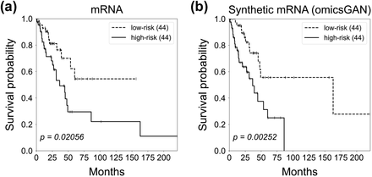
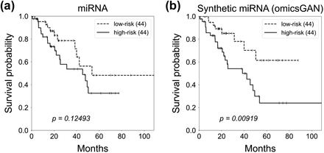
Adversarial networks, cont.
omicsGAN
Builds GANs from two matching omic datasets and an interaction network between them (e.g., mRNA expression, miRNA expression, and miRNA-mRNA interaction network)
Use GANs to generate synthetic datasets
Fit prediction models to synthetic datasets

