Slide 1
Epigenetic Epidemiology Update
Matthew Suderman
MRC Integrative Epidemiology Unit
Mar 14, 2022

Slide 2
EWAS
pmid | journal | variable | cell type | population | assocs
35236238 | Epigenetics | Mediterranean diet during pregnancy | cord blood | 2802 pregnancies (PACE consortium) | 1
35237744 | Epigenet Insights | prenatal stress | cord blood | 358 | null
35266797 | Environ Health Perspect | pregnancy perfluoroalkyl | cord blood; peripheral blood | 266; 160 | 435 (6 replicated)
35236959 | Mol Psychiatry | antipsychotic drugs | caudate nucleus | 296 | null (by wgbs, many gene expression differences by rna-seq)

Slide 3
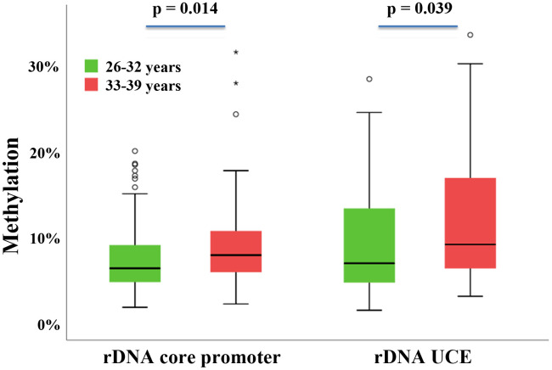
Epigenetics: Oocyte ribosomal DNA methylation increases with age
Potabattula, et al. (2022). Ribosomal DNA methylation in human and mouse oocytes increases with age. Aging, 14(3), 1214–1232.
Ribosomal DNAm in nearly all tissues and cell types known to be associated with age, except oocytes until now … (note that oocytes do not divide as women age, so these DNAm increases must be de novo)
UCE=upstream control element
Notes:
Age associations with dnam in oocyte genomes vs blood are not the same.
A ribosome is molecular ‘machine’ that performs protein synthesis in the cell.

Slide 4
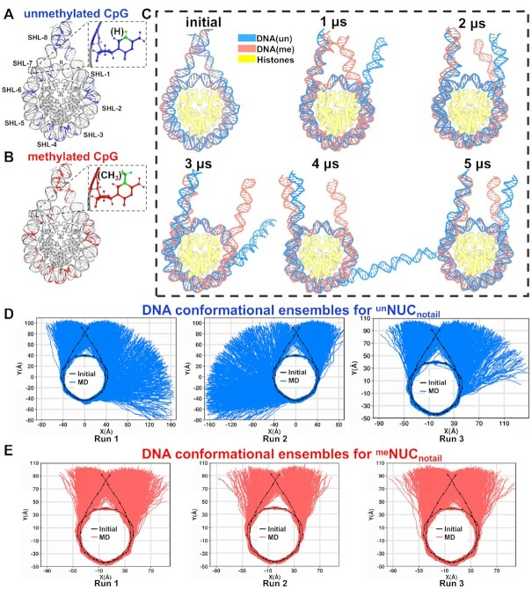
Epigenetics: how DNAm is repressive
Li, S., Peng, Y., Landsman, D., & Panchenko, A. R. (2022). DNA methylation cues in nucleosome geometry, stability and unwrapping. Nucleic acids research, 50(4), 1864–1874.
Methylated DNA wraps itself more tightly around nucleosomes by slightly untwisting itself allowing tighter bends and increased number of interactions between the DNA and the nucleosome.
Notes:
methylation induces pronounced changes in geometry for both linker and nucleosomal DNA, leading to a more curved, under-twisted DNA, narrowing the adjacent minor grooves, and shifting the population equilibrium of sugar-phosphate backbone geometry. These DNA conformational changes are associated with a considerable enhancement of interactions between methylated DNA and the histone octamer, doubling the number of contacts at some key arginines. H2A and H3 tails play important roles in these interactions, especially for DNA methylated nucleosomes. This, in turn, prevents a spontaneous DNA unwrapping of 3-4 helical turns for the methylated nucleosome with truncated histone tails, otherwise observed in the unmethylated system on several microseconds time scale.

Slide 5
Methods: improvement on SVA?
Jumentier, B., Caye, K., Heude, B., Lepeule, J., & François, O. (2022). Sparse latent factor regression models for genome-wide and epigenome-wide association studies. Statistical applications in genetics and molecular biology, 21(1).
How to handle unknown confounding in EWAS?
Existing methods
non-sparse: SVA, CATE, Ridge LFMM (ridge regression with latent factors built-in)
sparse: LASSO
New proposed method: Sparse LFMM (lasso with latent factors built-in)
Notes:
Ridge LFMM is like ridge regression but adds

Slide 6
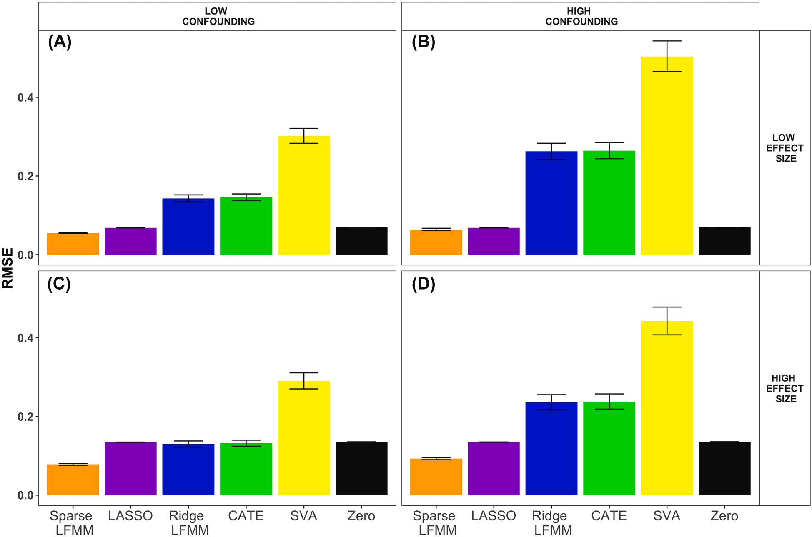
Error of EWAS effect estimates (simulated data)
Note:
Unlike the other methods, LASSO is applied without any attempt to adjust for confounding.
‘Zero’ is the method where effect estimates are always 0
Notes:
Zero = method that estimates all effects to be zero

Slide 7
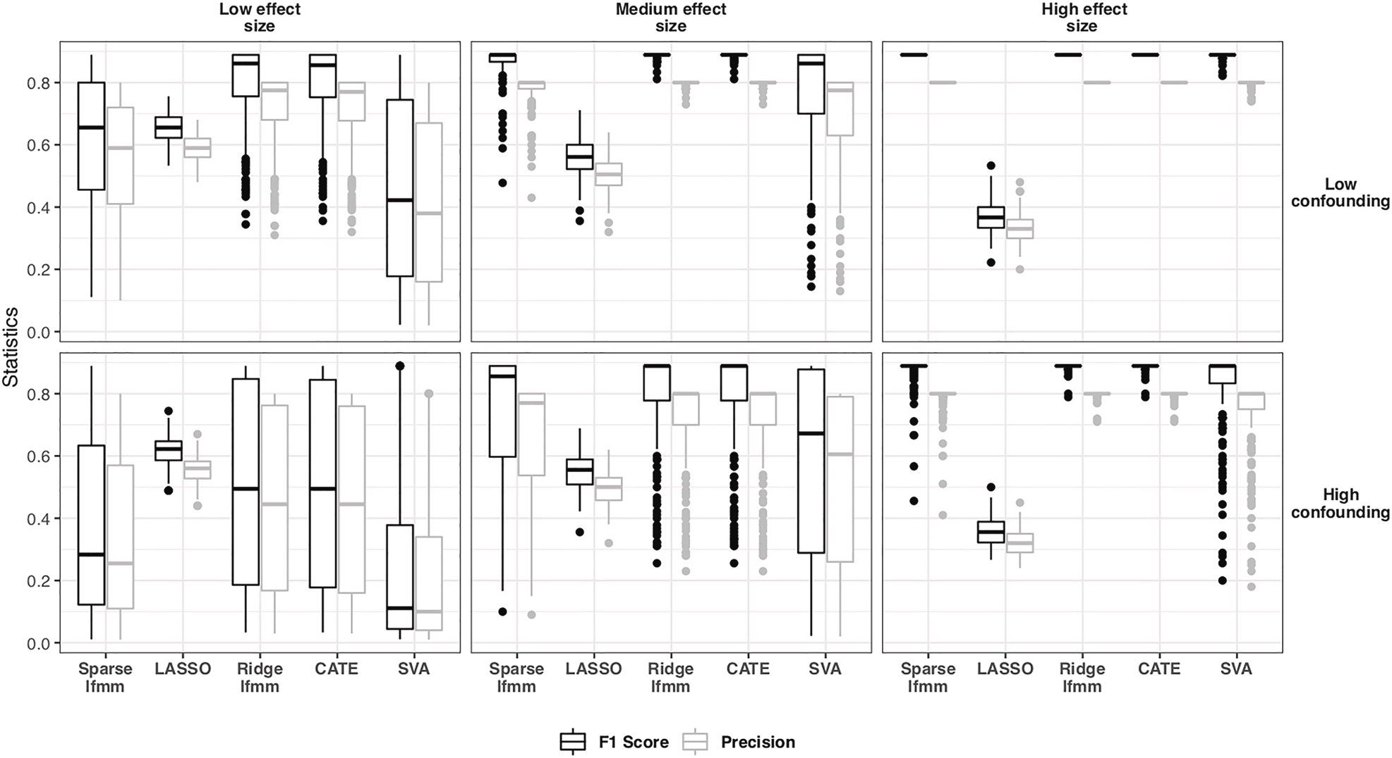
Precision and recall of DMP calling (simulated data)
Precision
= tp/(tp+fp)
Recall
= tp/(tp+fn)
F1-score
= tp/(tp+(fp+fn)/2)
Notes:
Precision = tp /(tp + fp) = proportion of sites called DMPs that are DMPs
Recall = tp/(tp + fn) = proportion of DMPs that are called DMPs
F1-score = tp/(tp + (fp+fn)/2) = harmonic mean of precision and recall

Slide 8
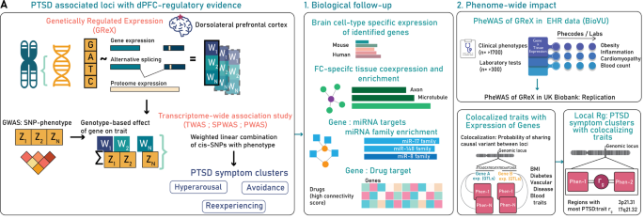
Genetic multi-omics study of PTSD in Million Veteran Program
Pathak, et al. (2022). Genetically regulated multi-omics study for symptom clusters of posttraumatic stress disorder highlights pleiotropy with hematologic and cardio-metabolic traits. Molecular psychiatry, 10.1038/s41380-022-01488-9.
Data for N=186,689
30 unique genes

Slide 9
Some highlights you might have missed …

Slide 10
DNAm age: aging acceleration = difference between two clocks
Barrett, J. E., et al. (2022). Susceptibility to hormone-mediated cancer is reflected by different tick rates of the epithelial and general epigenetic clock. Genome biology, 23(1), 52.
Data DNAm of cervical cytology samples from 869 healthy women, 442 women with breast cancer and 289 with ovarian cancer
Methods Created 3 epigenetic clocks in healthy women to index chronological age
Immune (CpG sites that change with age in immune but not in epithelial cells)
Epithelial (CpG sites that change with age in epithelial but not in immune cells)
General (any CpG sites)
Results (Epithelial clock-General clock) differs between cancer cases and controls
“Our findings imply that there are multiple epigenetic clocks, many of which are tissue-specific, and that the differential tick rate between these clocks may be an informative surrogate measure of disease risk.”

Slide 11
Methods: research software quality
Gardner, P. P., et al (2022). Sustained software development, not number of citations or journal choice, is indicative of accurate bioinformatic software. Genome biology, 23(1), 56.
Survey of over 500 bioinfomatic tools
What predicts ‘software accuracy’? (in terms of the tool is estimating/predicting/indexing/etc)
Not software speed
Not author reputation
Not journal impact
Not number of citations
Not age
Yes Github-derived statistics and high version numbers
“Our findings indicate that accurate bioinformatic software is primarily the product of long-term commitments to software development … ”

Slide 12
Prediction: poly-methylation vs poly–genetic scores
Thompson, et al. (Eran Halperin UCLA) Methylation risk scores are associated with a collection of phenotypes within electronic health record systems. medRxiv 2022.02.07.22270047
Data
n=831 samples in the UCLA Health biobank
607 variables (medications, diagnoses, lab tests) from electronic health records
Methods
10-fold cross validation
Lasso, Ridge regression and Elastic net
Baseline model: age, sex, BMI, methylation-based cell-type proportions, ancestry, genetic PCs, smoking
Methylation model: + CpG sites
Genetic model: + genotypes

Slide 13
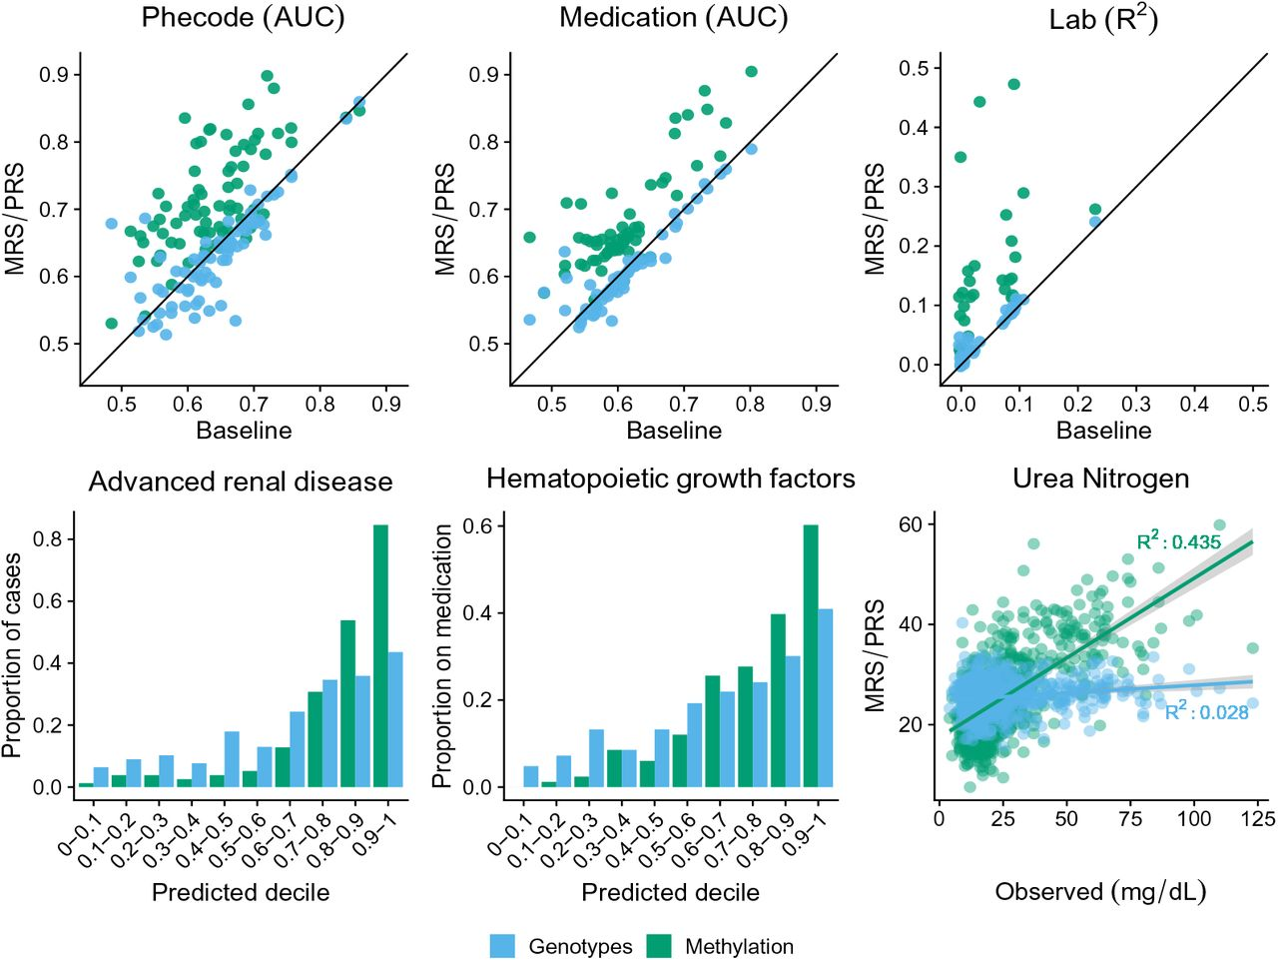
Poly-methylation vs poly–genetic scores, cont.
Thompson, et al. (Eran Halperin UCLA) Methylation risk scores are associated with a collection of phenotypes within electronic health record systems. medRxiv 2022.02.07.22270047
DNAm improves on base model 54 medications 29 labs 56 Phecodes
Genotype improvement for 8 medications 3 labs 11 Phecodes

Slide 14
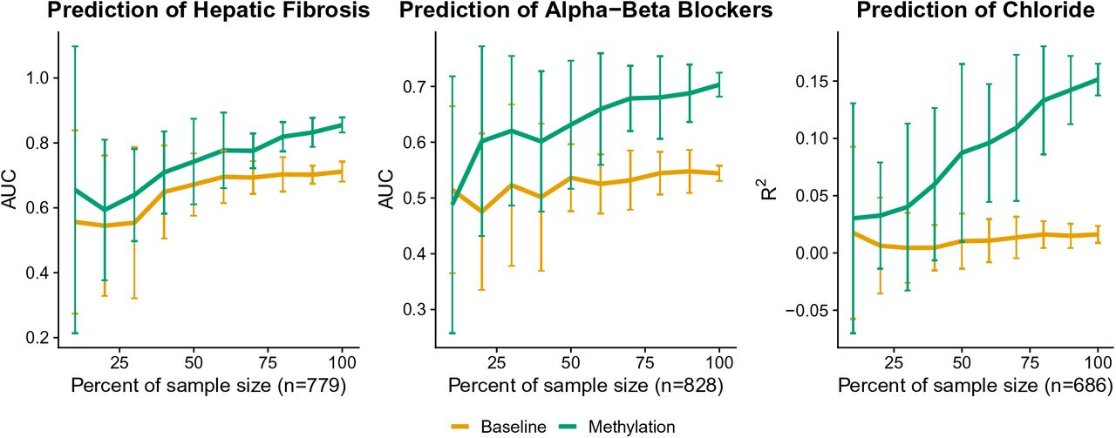
Poly-methylation vs poly–genetic scores, cont.
Thompson, et al. (Eran Halperin UCLA) Methylation risk scores are associated with a collection of phenotypes within electronic health record systems. medRxiv 2022.02.07.22270047
Accuracy of DNAm scores will increase with larger sample size.

Slide 15
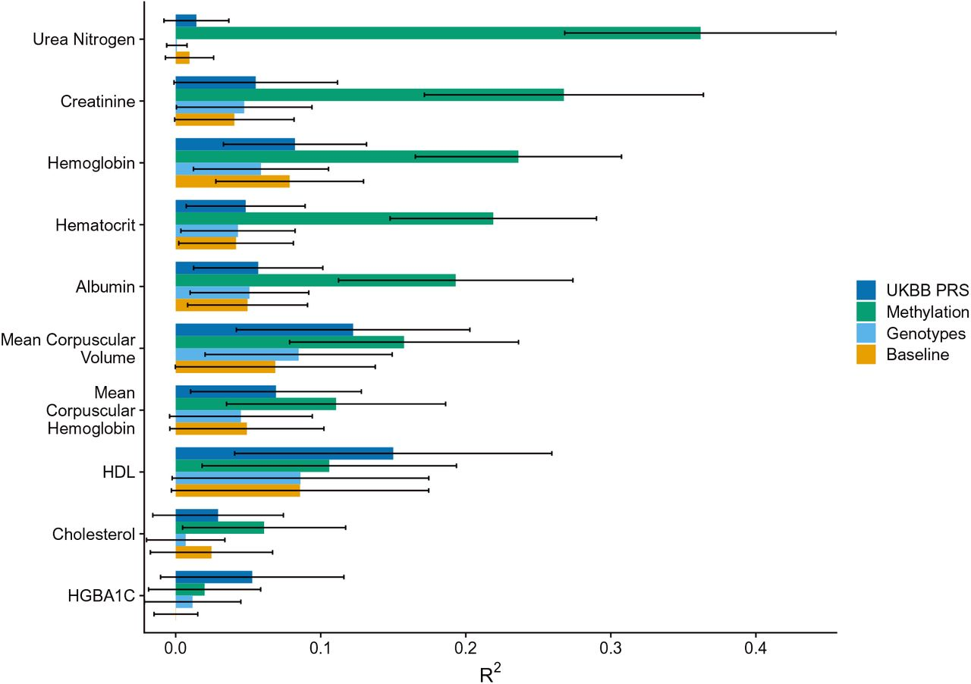
Poly-methylation vs poly–genetic scores, cont.
Thompson, et al. (Eran Halperin UCLA) Methylation risk scores are associated with a collection of phenotypes within electronic health record systems. medRxiv 2022.02.07.22270047
Accuracy of genotype will improve with larger sample size … but DNAm on small sample size still much better
(independent data n=541)

Slide 16
Cancer: how early does cancer start?
Williams, et al (2022). Life histories of myeloproliferative neoplasms inferred from phylogenies. Nature, 602(7895), 162–168.
Data
Whole genome sequencing
Of 1000 clonal haematopoietic colonies
From 12 patients with myeloproliferative neoplasms
Results
Reconstructed phylogenies from 580K somatic mutations
Driver mutations estimated to occur early (in utero – childhood)
- ‘drivers’ obtained from the literature
- assume mutations acquired at a constant rate
“Our study suggests that early driver mutation acquisition and life-long growth and evolution underlie adult myeloproliferative neoplasms, raising opportunities for earlier intervention and a new model for cancer development.”

