Slide 1
Epigenetic Epidemiology Update
Matthew Suderman
MRC Integrative Epidemiology Unit
Feb 14, 2022

Slide 2
EWAS (adult blood)
pmid | journal | variable | population | assocs
35077545 | Hum Mol Genet | mtDNA genetic variants | 926 Young Finns Study | 19 sites
35063012 | Clin Epigenetics | bladder cancer recurrence | 603 patients (US) | 2528
35109748 | Epigenetics | education; income; deprivation | 1618 European cancer survivors | 130 of which 25 replicated in 258 African ancestry
35119793 | Stress Health | cortisol | 118 offspring of Kosovo Rehabilitation Centre for Torture Victims | null
35123963 | Environ Res | brominated flame retardant exposure | 336 E3N cohort (France) | 253

Slide 3
EWAS (cord blood)
pmid | journal | variable | population | assocs
35063426 | Environ Res | prenatal pollution | 384 Italian birth cohort | 250 (8 replicated)
35104326 | Diabetes Care | maternal glucose and insulin | 1.5-3.5K from 8 birth cohorts | 2 sites in TXNIP
35145228 | Mol Psychiatry | cognitive ability | 2196-3300 from 8 cohorts (PACE) | null
EWAS (disease-free breast tissue)
pmid | journal | variable | population | assocs
35139887 | Clin Epigenetics | breast cancer risk | 146 women | 1698 (MethylCap)
See next slide for details …

Slide 4
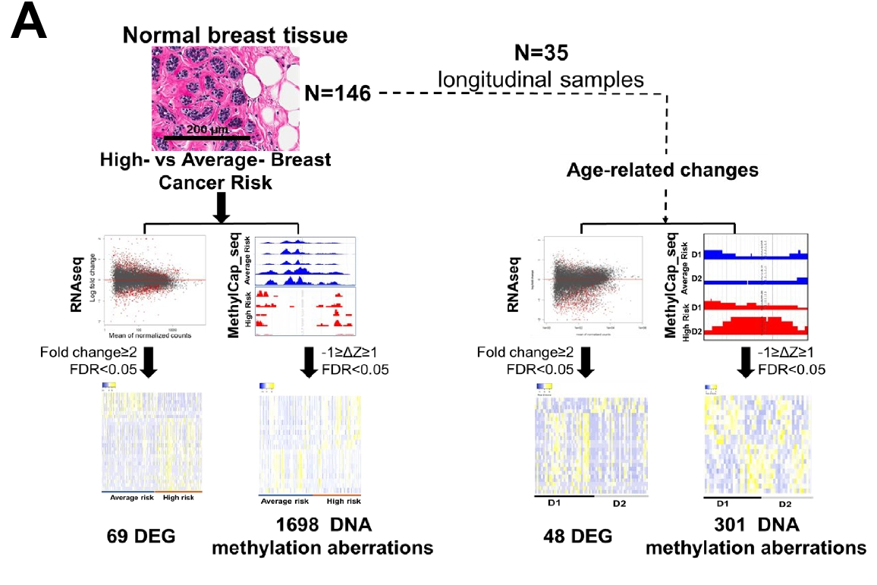
Predicting breast cancer risk
Marino, et al (Indiana University). Aberrant epigenetic and transcriptional events associated with breast cancer risk. Clinical epigenetics, 14(1), 21.
Population All healthy women
Risk Tyrer-Cuzick risk score: BRCA genes, a low penetrance gene and personal risk factors (e.g. family history) - high risk >= 20% - avg risk < 20%
MethylCap-seq Capture and sequence methylated DNA fragments. Diff DNAm = Diff read count
Of 69 DEGs, 8 differentially methylated

Slide 5
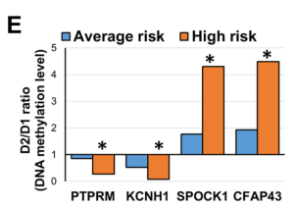
Predicting breast cancer risk, cont.
Marino, et al (Indiana University). Aberrant epigenetic and transcriptional events associated with breast cancer risk. Clinical epigenetics, 14(1), 21.
35 women with two samples, 1-10 years apart (mean = 3.2 years)
D2/D1 ratio (DNAm time 2/DNAm time 1) enriched with ‘age’ genes
D2/D1 ratio larger in high risk at four genes

Slide 6
Poly-methylation vs poly–genetic scores
Thompson, et al. (Eran Halperin UCLA) Methylation risk scores are associated with a collection of phenotypes within electronic health record systems. medRxiv 2022.02.07.22270047
Data
n=831 samples in the UCLA Health biobank
607 variables (medications, diagnoses, lab tests) from electronic health records
Methods
10-fold cross validation
Lasso, Ridge regression and Elastic net
Baseline model: age, sex, BMI, methylation-based cell-type proportions, ancestry, genetic PCs, smoking
Methylation model: + CpG sites
Genetic model: + genotypes

Slide 7
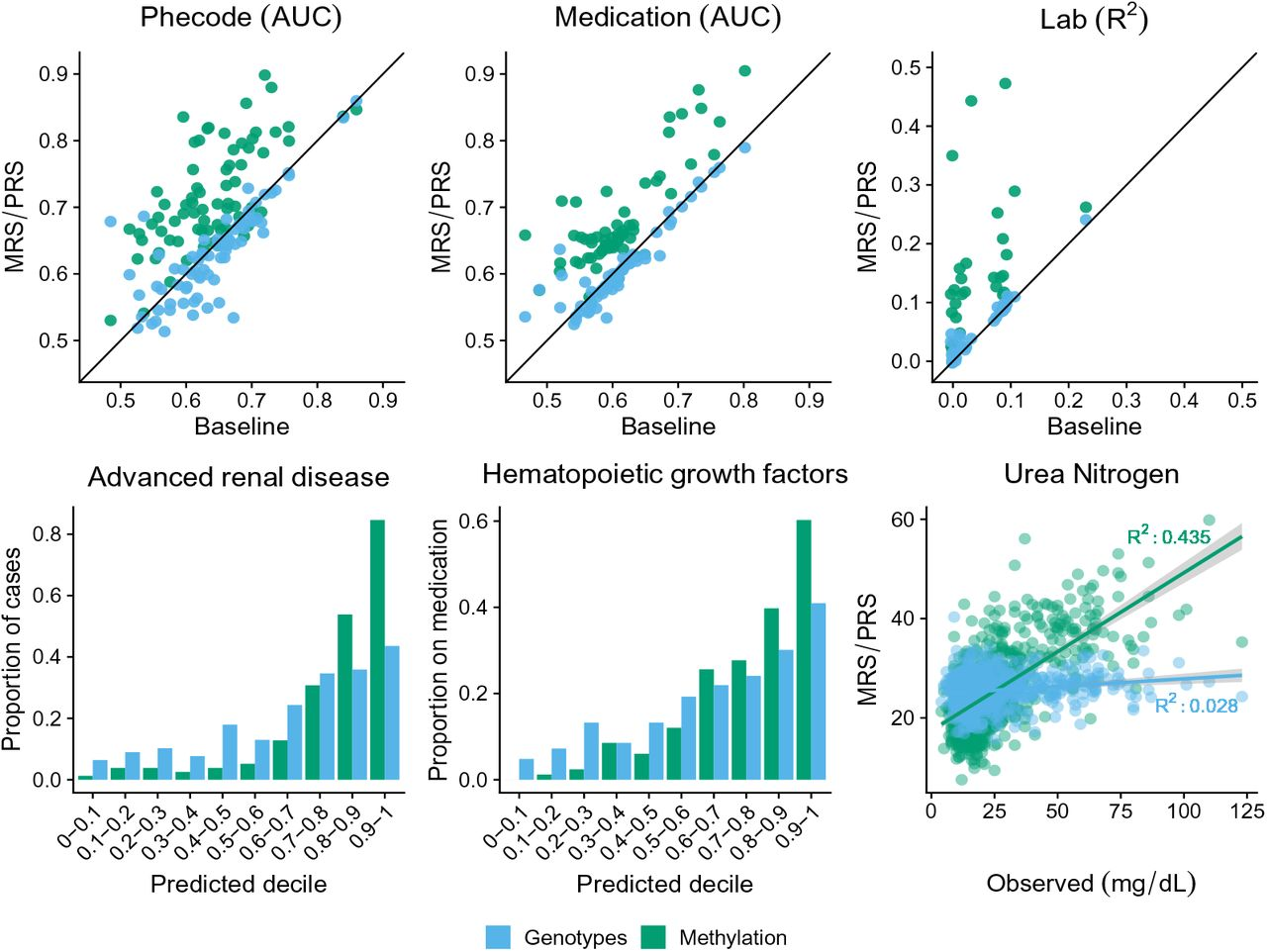
Poly-methylation vs poly–genetic scores, cont.
Thompson, et al. (Eran Halperin UCLA) Methylation risk scores are associated with a collection of phenotypes within electronic health record systems. medRxiv 2022.02.07.22270047
DNAm improves on base model 54 medications 29 labs 56 Phecodes
Genotype improvement for 8 medications 3 labs 11 Phecodes

Slide 8
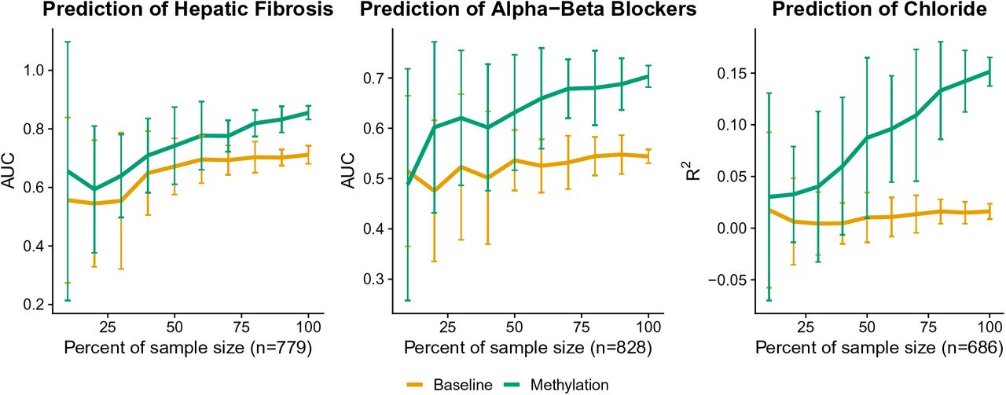
Poly-methylation vs poly–genetic scores, cont.
Thompson, et al. (Eran Halperin UCLA) Methylation risk scores are associated with a collection of phenotypes within electronic health record systems. medRxiv 2022.02.07.22270047
Accuracy of DNAm scores will increase with larger sample size.

Slide 9
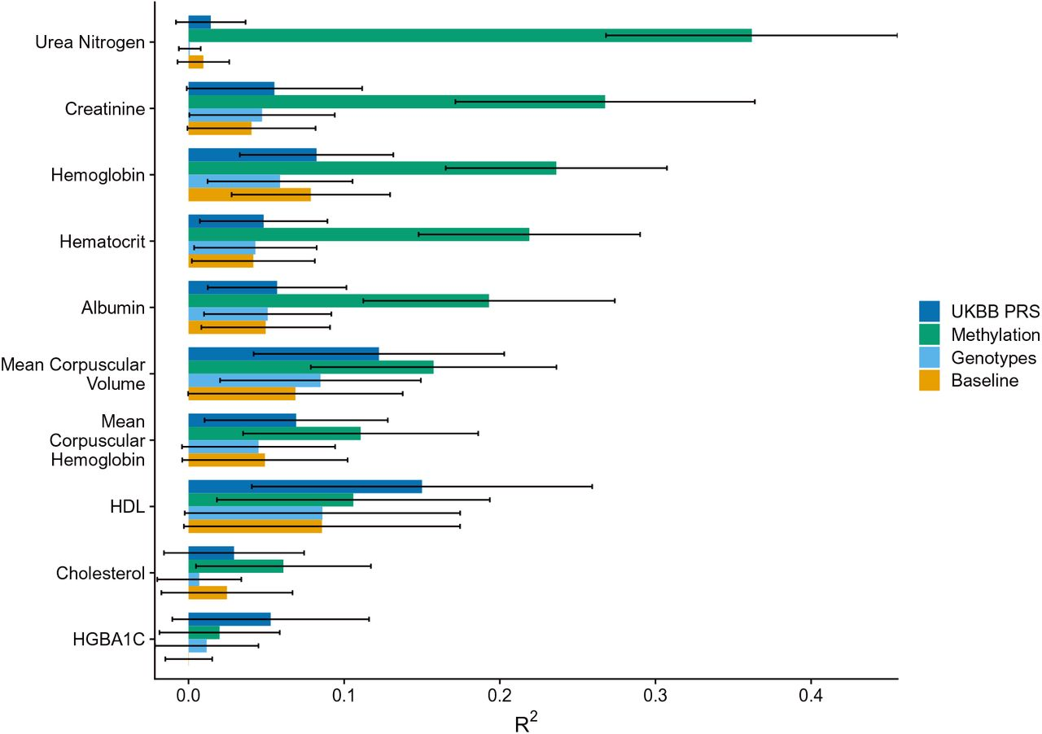
Poly-methylation vs poly–genetic scores, cont.
Thompson, et al. (Eran Halperin UCLA) Methylation risk scores are associated with a collection of phenotypes within electronic health record systems. medRxiv 2022.02.07.22270047
Accuracy of genotype will improve with larger sample size … but DNAm on small sample size still much better
(independent data n=541)

Slide 10
Technologies to watch
Eisenstein M. (2022). Seven technologies to watch in 2022. Nature, 601(7894), 658–661.
Fully finished genomes – repetitive regions
Protein structure solutions – function prediction
Quantum simulation – quantum computation
Precise genome manipulation – move from gene disruption to repair
Targeted genetic therapies – delivery to more tissue types
Spatial multi-omics – add spatial information to single-cell omics
CRISPR-based diagnostics – “Sabeti and her colleagues have developed tools for CRISPR-based detection of more than 169 human viruses at once” Conspicuously missing – long-read sequencing

Slide 11
How early does cancer start?
Williams, et al (2022). Life histories of myeloproliferative neoplasms inferred from phylogenies. Nature, 602(7895), 162–168.
Data
Whole genome sequencing
Of 1000 clonal haematopoietic colonies
From 12 patients with myeloproliferative neoplasms
Results
Reconstructed phylogenies from 580K somatic mutations
Driver mutations estimated to occur early (in utero – childhood)
- ‘drivers’ obtained from the literature
- assume mutations acquired at a constant rate
“Our study suggests that early driver mutation acquisition and life-long growth and evolution underlie adult myeloproliferative neoplasms, raising opportunities for earlier intervention and a new model for cancer development.”

Slide 12
Alcohol intake and colorectal cancer
Zhou, et al. Alcohol consumption, DNA methylation and colorectal cancer risk: Results from pooled cohort studies and Mendelian randomization analysis. International journal of cancer, 10.1002/ijc.33945.
Alcohol consumption --> CRC risk (OR = 1.79, 95% CI: 1.23-2.61) by two-sample MR
Alcohol-related CpG sites in COLCA1/COLCA2 gene --> CRC risk (P < 8.20 × 10-4)
Risk allele of the eQTL (rs3087967) and mQTL (rs11213823) in COLCA1/COLCA2 interacts with alcohol consumption to increase CRC risk (P = .027 and P = .016)
Possibly an example where DNAm will outperform self-reported exposure?

Slide 13
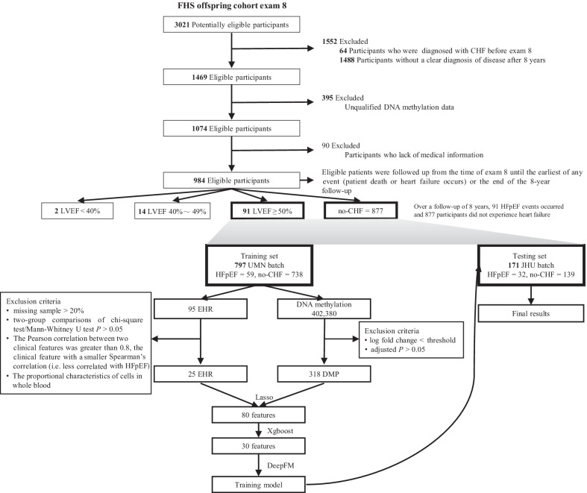
Predicting heart failure
Zhao, et al. A deep learning model for early risk prediction of heart failure with preserved ejection fraction by DNA methylation profiles combined with clinical features. Clinical epigenetics, 14(1), 11.
HFmeRisk = 25 CpG sites
+ 5 clinical features
AUC = 0.9

