Slide 1
Molecular Epidemiology Update
Jan 17, 2023
Oliva, M., Demanelis, K., Lu, Y. et al. DNA methylation QTL mapping across diverse human tissues provides molecular links between genetic variation and complex traits. Nat Genet 55, 112–122 (2023).
Matthew Suderman

Slide 2
Background
Genetic variation strongly associated with many traits
Effects likely mediated by gene expression
~25% gene expression explained by genetic variation
gene expression is strongly associated with DNA methylation, especially in the gene promoter
~20% DNA methylation explained by genetic variation
However, gene expression and DNA methylation are highly tissue-specific.
Understanding the etiology of complex traits requires eQTL and meQTL catalogs derived in a variety of different tissues.
Most mQTL studies have been conducted in peripheral blood.

Slide 3
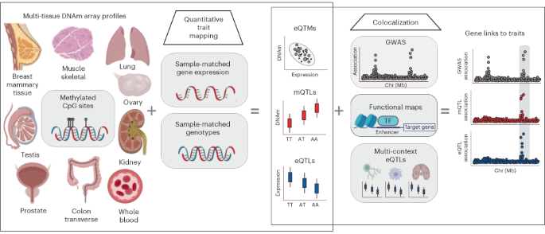
Overview
424 donors
987 samples with DNAm
3872 samples with gene expression
495 samples with DNAm, gene expression and genotype
eGTEx

Slide 4
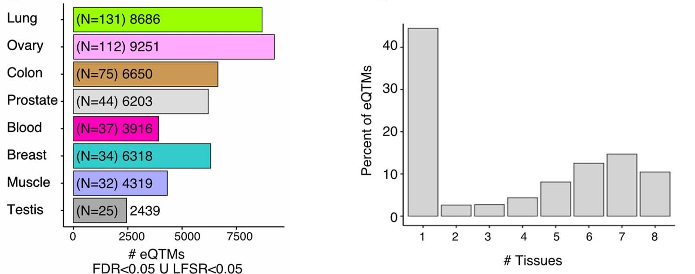
DNAm-gene expression associations often tissue-specific
eQTM = CpG site associated with gene expression
Number eQTMs per tissue
eQTM tissue counts
~45%
~35%

Slide 5
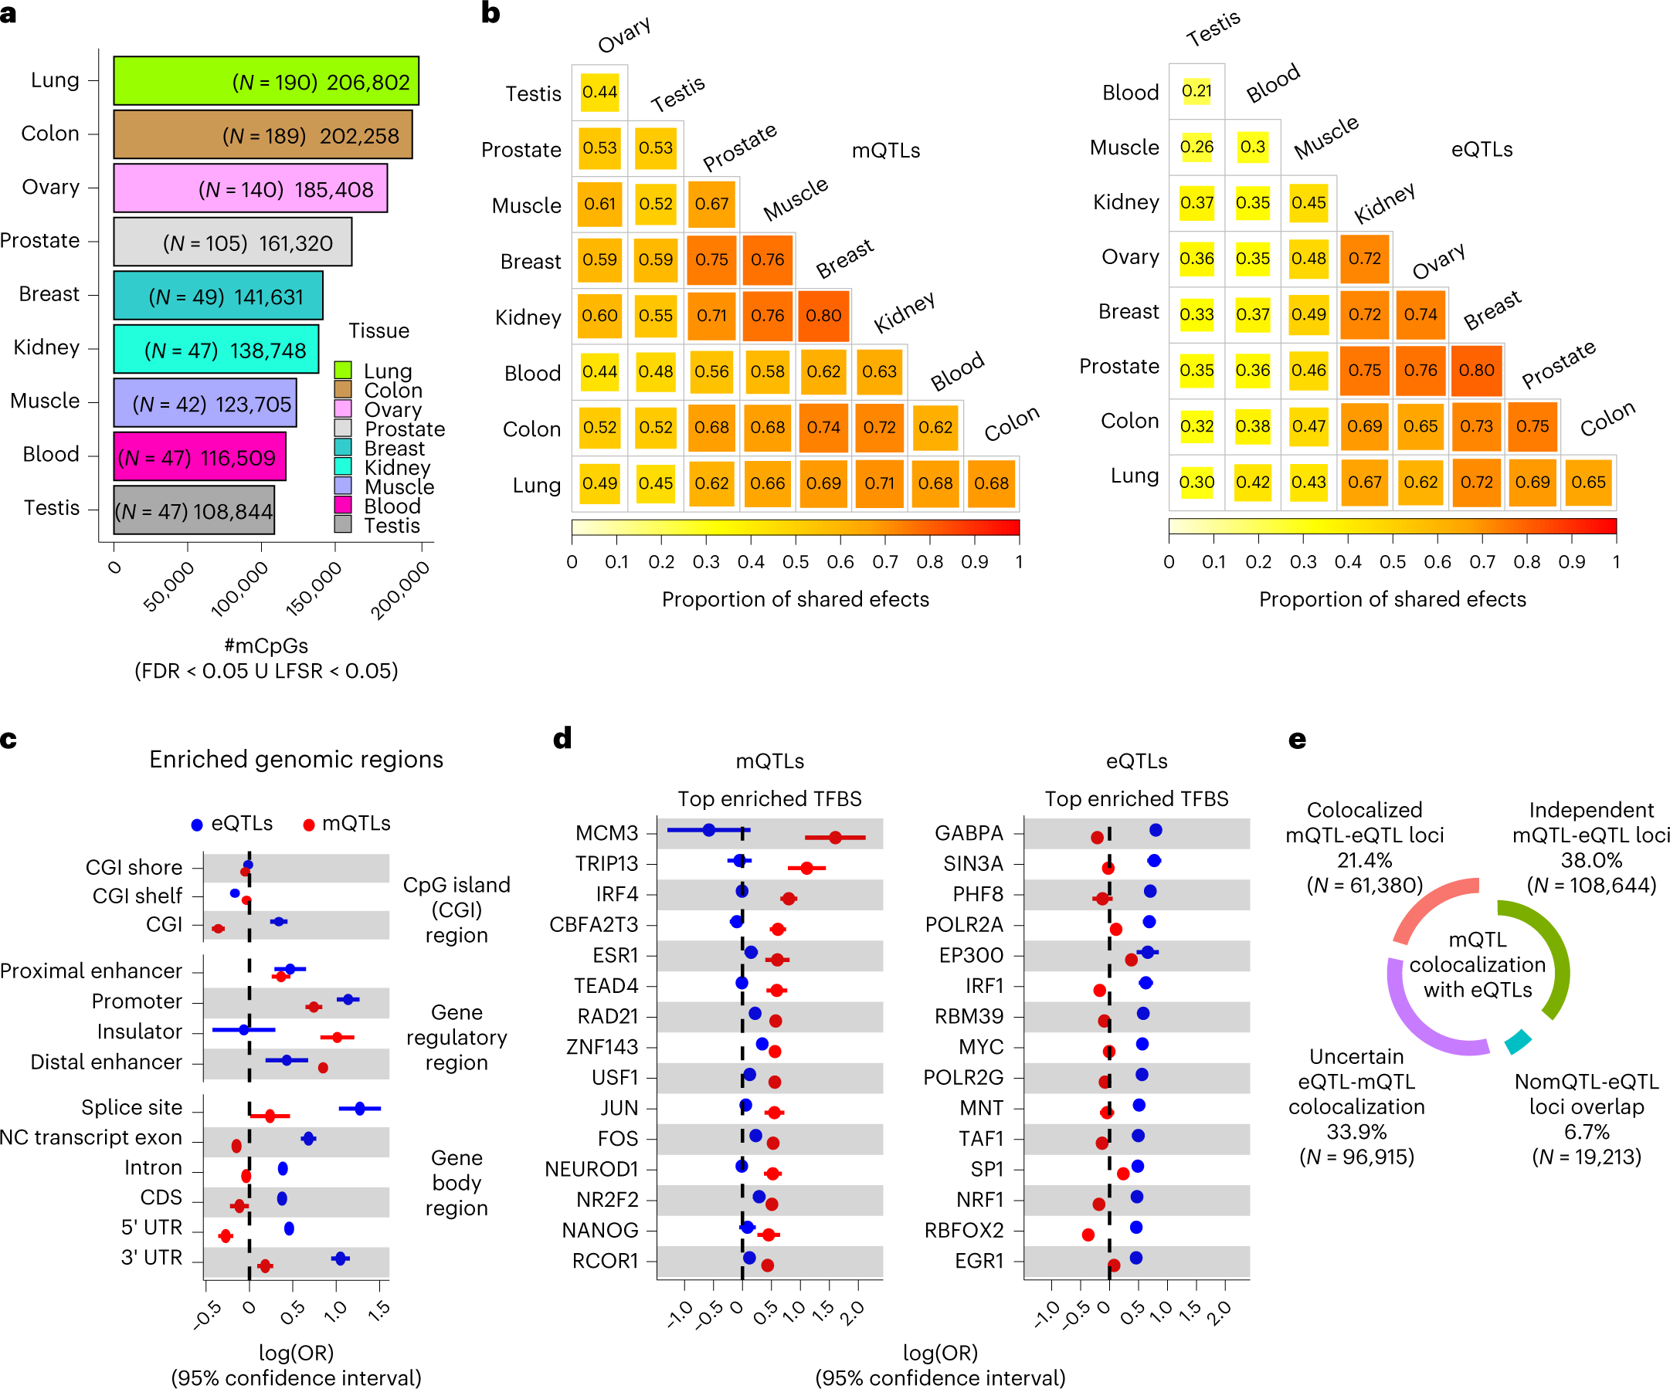
Genetic regulation of DNA methylation often tissue-specific
mQTL = genetic variant associated with DNA methylation
eQTL = genetic variant associated with gene expression
mCpG = CpG site associated with genetic variation
Number mCpGs
Correlation of mQTL effects
Correlation of eQTL effects
41% are novel
mQTL correlations similar or higher than for eQTLs

Slide 6
eQTLs and mQTLs often located in different functional regions
Genic regions
Transcription-factor binding site enrichments

Slide 7
… in fact, genetic co-regulation of DNA methylation and gene expression appears uncommon
About 21% of CpG-gene pairs colocalise (i.e. share a common causal variant)
(where pairs were drawn from CpG sites with mQTLs and genes with eQTLs)

Slide 8
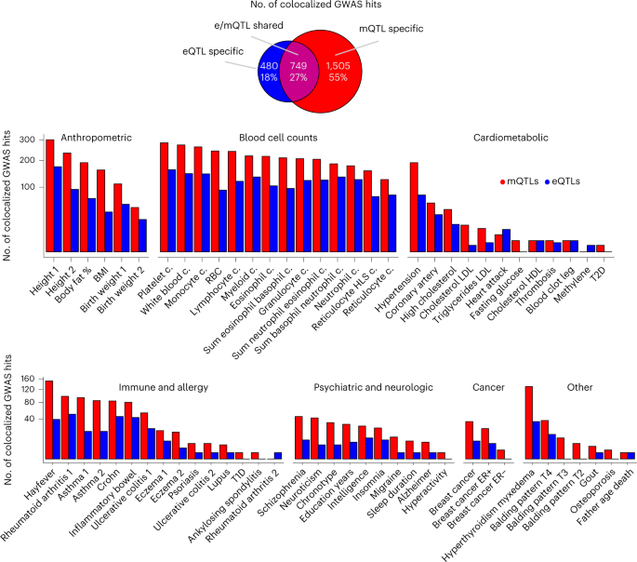
Complex traits
Overall
Colocalization more likely with DNA methylation than gene expression
87 GWAS
286K mCpGs
2254 mCpGs share a casual variant with 83 traits
compared to (just blood)
116 GWAS
420K mCpGs
1373 mCpGs share causal variant with 71 traits
(Min et al. Nat Genet 2021)
So multiple tissues only slightly better but not a lot. Power?

Slide 9
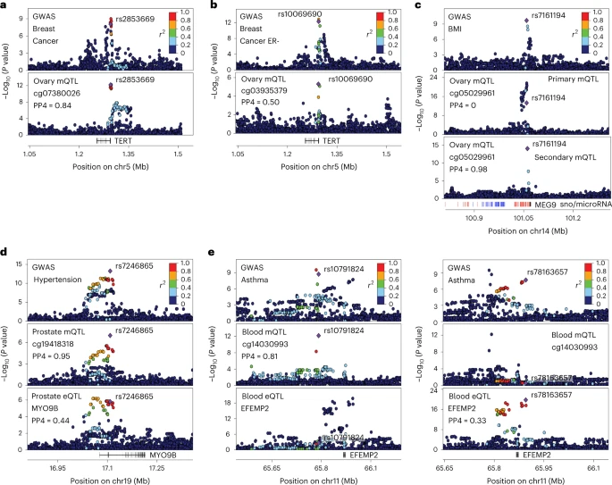
Genetic regulation of DNAm facilitates the fine-mapping of trait-associated variants and characterization of regulatory mechanisms
Several examples where having mQTL information improves ability to discover regulatory relationships with traits.

Slide 10
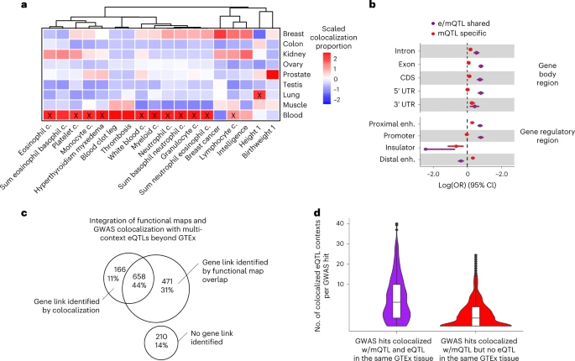
Trait-linked mQTLs exhibit molecular regulatory pleiotropy and enrichment in trait-relevant tissues
Enrichments of tissue-specific mQTLs in specific GWAS
mQTLs that do not colocalize with an eQTL have a different enrichments relative to gene regions
For eQTLs lacking colocalization with a GWAS, a relationship could be inferred via eQTMs and other functional evidence to an mCpG that colocalizes.
--- seems complicated …

Slide 11
Conclusions
This study confirms previous findings and additionally that
About half of eQTMs are tissue-specific
By investigating a wide range of tissues, we can dramatically increase the number of observed mQTLs
eQTL effects tend to be more tissue-specific than mQTL effects
Genetic variants influencing gene expression tend to be different from those influencing DNA methylation
However, by investigating both gene expression and DNA methylation, we are in a much better position to discover causal pathways from genotype to trait

