Slide 1
Epigenetic Epidemiology Update
Matthew Suderman
MRC Integrative Epidemiology Unit
August 15, 2022

Slide 2
EWAS of exposures in adults
PMID | Journal | Variable | Tissue | Sample | Associations
35888152 | Life (Basel) | food group intake | blood | 1261 adults in KORA FF4 study | 0-9 DMPs per food group
35850911 | Clin Epigenetics | menopausal hormone therapy | blood | 186 postmenopausal women from the ELITE RCT | 2 DMPs
35879377 | Sci Rep | vitamin D supplementation | blood | 277 healthy elderly adults from Sweden | 1 DMP
35798818 | Sci Rep | 3 months post COVID-19 infection | blood | 104 cases vs 73 controls from Norway | 3 DMPs
35762681 | Epilepsia | ketogenic diet | blood taken at weeks 0/4/12 | 58 adults with epilepsy | 100 DMPs
35732753 | Sci Rep | exposure to heavy metals | blood | 855 adults | 7 DMPs

Slide 3
EWAS of phenotypes and disease in adults
PMID | Journal | Variable | Tissue | Sample | Associations
35943854 | Brain | cerebral small vessel disease | blood | 9732 adults from 14 studies | 12 DMPs
35882828 | J Endocrinol Invest | waist-to-hip ratio | blood | 60 twin pairs from Qingdao Twin Registry | 92 DMPs (p < 1e-4)
35836279 | Clin Epigenetics | insulin resistance | blood | 136 non-diabetic African American men | 3 DMPs
35723298 | Curr Issues Mol Biol | fatty liver index | blood | 322 in the Korean Genome and Epidemiology Study cohort | null
35843982 | Genome Med | visceral fat mass | subcutaneous adipose tissue | 538 TwinsUK participants | 1181 DMPs
35837683 | Psychiatr Genet | age of schizophrenia onset | blood | 138 adults with schizophrenia | 4
35769265 | Front Cell Dev Biol | Paget disease of bone severity | blood | 232 from the PISM trial | 100 DMPs
35933486 | Nat Commun | COVID-19 severity | blood | 574 | 530 DMPs
35717949 | Thromb Haemost | ischemic stroke risk | blood | 252 cases vs 43 controls | 957 DMPs (697 replicated)

Slide 4
EWAS in childhood
PMID | Journal | Variable | Tissue | Sample | Associations
35904121 | Hum Mutat | 65 genetic neurodevelopmental disorders | blood | 3-191 cases vs 4231 controls | 279-151848 DMPs
35790973 | Clin Epigenetics | sleep duration and quality | cord blood and peripheral blood (age 4-13) | 1681-3658 from 11 cohorts | 2 DMPs in cord blood
35899434 | Hum Mol Genet | longitudinal socioeconomic position in childhood | blood at age 7 | 946 in ALSPAC | 62 DMPs
35734807 | Dev Psychopathol | sensation-seeking at 11-14 | blood at age 15-17 | 905 ALSPAC children | null

Slide 5
EWAS of neonatal samples
PMID | Journal | Variable | Tissue | Sample | Associations
35717575 | Hum Mol Genet | acute lymphoblastic leukemia risk | neonatal blood | 808 cases vs 919 controls | 1 DMP mediates genetic risk
35858526 | Placenta | maternal asthma | placenta | 223 women from PRISM | 10 DMPs
35836289 | Clin Epigenetics | maternal prenatal stress | infant saliva | 114 pregnancies | 5 DMPs
35771992 | Am J Clin Nutr | maternal physical activity | placenta | 298 mothers | 2-8 DMPs
35764815 | Pediatr Res | neonatal inflammation | placenta and neonatal blood spots | 318-354 from ELGAN | 0-111 DMPs
35708509 | Diabetes Care | maternal pregnancy glycemic index and load | cord blood | 2003 from 3 cohorts | 41 DMPs
35749371 | PLoS One | maternal prenatal diet and lifestyle intervention | cord blood | 645 | null
35768464 | NPJ Genom Med | IVF embryo culture | cord blood | 106 | null
35837690 | Epigenetics | prenatal socioeconomic position | cord blood | 455 white; 493 Pakistani from Born in Bradford | 16 DMPs
35918756 | Epigenetics Chromatin | prenatal vitamin intake | cord blood and placenta | 314 cord; 158 placenta | null

Slide 6
High-dimensional mediation via dimension reduction
Methods
Perera, C., Zhang, H., Zheng, Y., Hou, L., Qu, A., Zheng, C., Xie, K., & Liu, L. (2022). HIMA2: high-dimensional mediation analysis and its application in epigenome-wide DNA methylation data. BMC bioinformatics, 23(1), 296.
Example problem: Does DNA methylation mediate the effect of prenatal smoking on asthma risk?
Typical solution: Mediation analysis applied to DMPs found in EWAS of both prenatal smoking and asthma.
Limitations: considers mediators independently rather than jointly, no adjustment for multiple tests beyond the EWAS, regression methods may not be ‘efficient’ for large numbers of mediators
HIMA2 steps
Sure independence screening to identify candidate CpG sites
(de-biased) lasso to estimate regression coefficients for mediation
Calculate FDR for mediation effect significance (accounting for steps 1 and 2)

Slide 7
Genome-wide gene expression regulation via dimension reduction
Methods
Where have I heard that before?!
Ke, H., Ren, Z., Qi, J., Chen, S., Tseng, G. C., Ye, Z., & Ma, T. (2022). High-dimension to high-dimension screening for detecting genome-wide epigenetic and noncoding RNA regulators of gene expression. Bioinformatics (Oxford, England), btac518.
Problem: Building a model for each gene from all CpG sites is not efficient. Need to reduce number of candidate CpG sites first.
Solution: Screening based on robust partial correlation (reduces both genes and CpGs simultaneously)
R package
https://github.com/kehongjie/rPCor

Slide 8
Predicting cancer risk from blood
Prediction
Espín-Pérez, A., Brennan, K., Ediriwickrema, A. S., Gevaert, O., Lossos, I. S., & Gentles, A. J. (2022). Peripheral blood DNA methylation profiles predict future development of B-cell Non-Hodgkin Lymphoma. NPJ precision oncology, 6(1), 53.
Data
Patients followed 16 years to monitor NHL development
278 blood samples collected at baseline
Model
Linear model of 135 CpG sites
Performance
Mostly independent of the epigenetic mitotic clock
Accuracy = 85% for patients with ‘high’ mitotic clock score
Accuracy = 78% for patients with ‘low’ mitotic clock score

Slide 9
Explainable deep learning?
Prediction
Liu, L., Meng, Q., Weng, C., Lu, Q., Wang, T., & Wen, Y. (2022). Explainable deep transfer learning model for disease risk prediction using high-dimensional genomic data. PLoS computational biology, 18(7), e1010328.
Aim: derive a polygenic risk score from exom sequencing data
Challenges for deep learning in genomics
High dimensions
Biological interpretability
Solution?
Feature importance Identify short list of candidate genes harboring predictive genetic variants
Learn PRS Apply deep transfer learning to derive PRS based on candidate genes and their genetic variants

Slide 10
Explainable deep learning? continued
Prediction
1. Feature importance
By gene
to ensure interpretability
to allow more complex interactions between variants linked to the same gene
Estimate ‘gene importance’ to prediction
not just screening, importance scores used in PRS derivation
Importance = difference between including vs excluding region from predictor
Importance estimated using
deep learning (allows non-linear relationships)
within a cross validation frame (to reduce over-fitting)
2. Learn PRS
“DNNs built from feature screening are combined based on the idea of transfer learning and a background node is further added to capture the infinitesimal effects.”

Slide 11
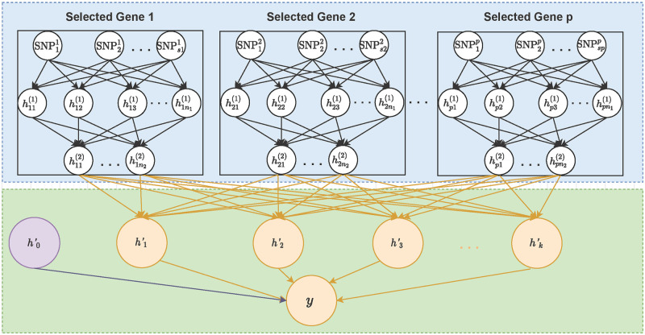
Explainable deep learning? continued
Prediction
2. Learn PRS
“DNNs built from feature screening are combined based on the idea of transfer learning and a background node is further added to capture the infinitesimal effects.”
Omitting discussion of evaluation because applied to a small dataset (n=800) and not to really widely studied phenotypes.
Very similar to Grimage! Build gene-level models and then use those models in a final model.

Slide 12
Cell-of-origin from cell-free DNA using nanopore sequencing
Nanopore
Katsman, E., Orlanski, S., Martignano, F., Fox-Fisher, I., Shemer, R., Dor, Y., Zick, A., Eden, A., Petrini, I., Conticello, S. G., & Berman, B. P. (2022). Detecting cell-of-origin and cancer-specific methylation features of cell-free DNA from Nanopore sequencing. Genome biology, 23(1), 158.
Have shown how to use low-depth, short-read ONT sequencing to estimate copy number variation in ctDNA of cancer patients.
“Here, we perform a feasibility study of ONT sequencing for circulating tumor DNA (ctDNA) detection by comparing methylation and several fragmentation features to matched Illumina samples and comparable Illumina-based datasets.”
If ‘short-read’, then why ONT? Because input to ONT does not require amplification so copy number and methylation is less likely to be biased.

Slide 13
Cell-of-origin from cell-free DNA using nanopore sequencing, cont.
Nanopore
Estimate blood cell counts from cell-free DNA using Illumina Beadchip cell type references
Estimate tumour DNA proportion
Genetic estimate from known tumor copy number alterations
Methylation estimate 1 from including DMPs between lung and plasma
Methylation estimate 2 from including DMPs between lung cancer and plasma
… further evidence supplied that cfDNA driving these estimates was from tumors

Slide 14
What is a cell type?
Biology
Zeng H. (2022). What is a cell type and how to define it? Cell, 185(15), 2739–2755.
“This review provides:
an overview of the basic principles of cell types rooted in evolution and development and
discusses approaches to characterize and classify cell types and
… investigate how they contribute to the organism's function,
using the mammalian brain as a primary example.
I propose a roadmap toward a conceptual framework and knowledge base of cell types …”
On my reading list: this question is no longer theoretical now that we are analysing single-cell omic data.

Slide 15
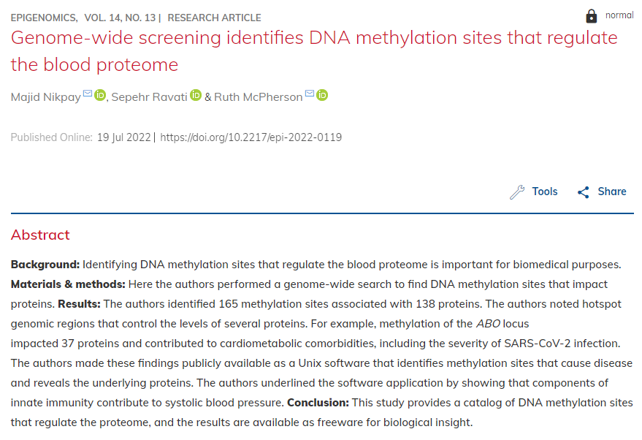
pQTMs
Paywall

Slide 16
Other papers of interest I didn’t get to
Galkin, F., Kochetov, K., Mamoshina, P., & Zhavoronkov, A. (2021). Adapting Blood DNA Methylation Aging Clocks for Use in Saliva Samples With Cell-type Deconvolution. Frontiers in aging, 2, 697254.
Liu, H. … Shu, Y., & Susztak, K. (2022). Epigenomic and transcriptomic analyses define core cell types, genes and targetable mechanisms for kidney disease. Nature genetics, 54(7), 950–962.
Pilsner, J. R. … Balzer, L. B. (2022). Sperm epigenetic clock associates with pregnancy outcomes in the general population. Human reproduction (Oxford, England), 37(7), 1581–1593.
Breeze, C. E., Wong, J., Beck, S., Berndt, S. I., & Franceschini, N. (2022). Diversity in EWAS: current state, challenges, and solutions. Genome medicine, 14(1), 71.
Jacobsen, K. K., Schnohr, P., Jensen, G. B., & Bojesen, S. E. (2022). AHRR (cg05575921) Methylation Safely Improves Specificity of Lung Cancer Screening Eligibility Criteria: A Cohort Study. AACR, 31(4), 758–765.
Garg, P., Jadhav, B., Lee, W., Rodriguez, O. L., Martin-Trujillo, A., & Sharp, A. J. (2022). A phenome-wide association study identifies effects of copy-number variation of VNTRs and multicopy genes on multiple human traits. American journal of human genetics, 109(6), 1065–1076.

