Slide 1
Epigenetic Epidemiology Update
Matthew Suderman
MRC Integrative Epidemiology Unit
Nov 29, 2021

Slide 2
EWAS
PMID | Journal | Variable | Tissue | Population | Cohort | Associations
34798907 | Clin Epigenetics | metals (As, Ba, Cd, Cr, Cs, Cu, Hg, Mg, Mn, Pb, Se, and Zn) measured in maternal blood | cord blood | 361 | Project Viva | 2 (p < 0.05 at 6-10y)
34750344 | Transl Psychiatry | maternal depression | cord blood | 248 | South African Drakenstein Child Health Study | 3 sites
34717175 | Environ Int | air pollution (PM2.5 and 13 particulates) | blood | 695 men mean age 75 | Normative Aging Study | 2717 (PM2.5); 3173 (Pb); etc.
34809630 | Respir Res | pulmonary function (FEV1,FVC) | blood | 60 middle age MZ twin pairs | Qindao Twin Repository | Null 112 at p < 1e-4
34774679 | Genomics | type 2 diabetes; fasting plasma glucose; hbA1c | blood | 316 | Chinese National Twin Registry | 1 (TXNIP) with FPG and HbA1c
34738878 | Epigenetics | cortical volume | blood (6 years before MRI) | 672 | Generation Scotland | 4 sites
34732242 | Clin Epigenetics | sex | skeletal muscle | 369 | Gene SMART, FUSION, GSE38291 | 57K sites
34732130 | BMC Genomics | physical activity and cardiovascular disease | blood monocytes | 1065 | MESA | 23 (3 mediators)
34775485 | Neuropsychopharmacology | alcohol use disorder | anterior cingulate cortex (ACC), Brodmann Area 9 (BA9), caudate nucleus (CN), ventral striatum (VS), and putamen (PUT) | 111 |  | 2 (CN); 18 (VS)

Slide 3
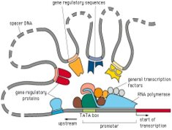
Characterising trans genomic regulation across tissues
Winick-Ng, et al. (2021). Cell-type specialization is encoded by specific chromatin topologies. Nature, 599(7886), 684–691.
Aim. To identify regions of the genome that regulate one another by through contact
Methods.
Hi-C – ligate DNA in contact and sequence Well understood, popular method but not good for rare cell types, single cells and multi-contacts.
GAM – sequence thin slices of tissue (fragments in contact more likely to appear in the same slice). Can be applied to tissue microdissections to target rare cell types and differences across tissues.

Slide 4
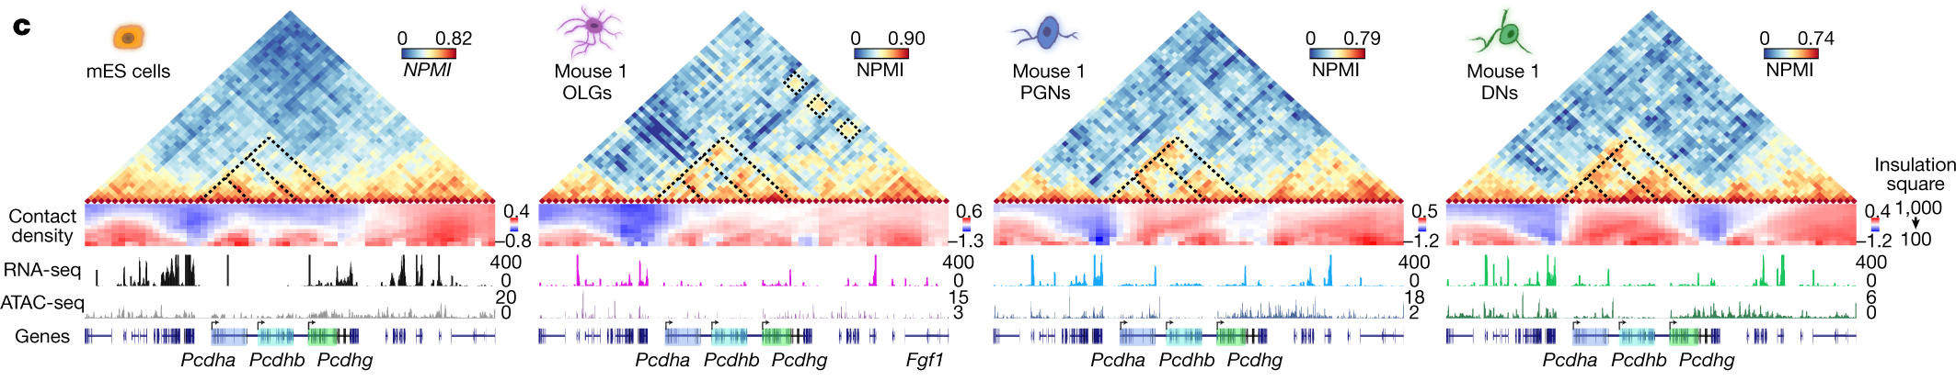
Characterising trans genomic regulation across tissues, cont.
Example GAM output
Heatmap matrices show level of contact between regions (red indicates more)
Dashed boxes highlight cell-type differences
“Contact density” = amount of contact with other regions (red indicates more)
“Topologically Associating Domains” (TADs) = densely interacting regions of the genome (correspond to heatmap clusters)

Slide 5
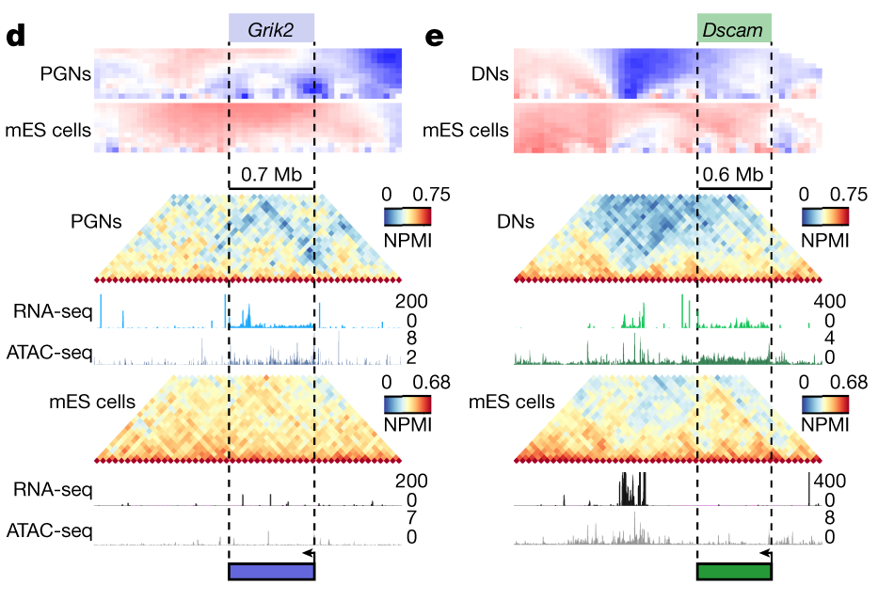
Characterising trans genomic regulation across tissues, cont.
Long neuronal genes “melt” in brain cells
Long genes tend to produce many isoforms which are necessary for specialized processes in the brain.
Figure compares neurons (PGNs and DNs) to embryonic stem cells (mES).
Chromatin containing Grik2 and Dscam is ‘closed’ in mES cells as shown by the high contact densities. The chromatin ‘opens’ or ‘melts’ in neurons.

Slide 6
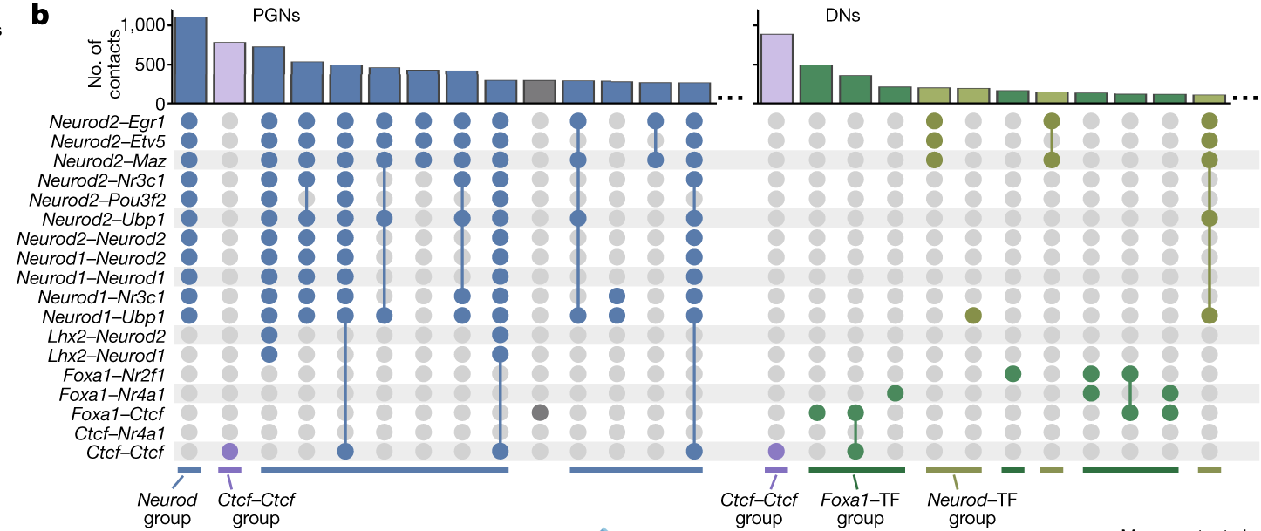
Characterising trans genomic regulation across tissues, cont.
Identified contact differences between two different kinds of neurons (PGNs and DNs)
Identified transcription factor binding sites (TFS) in each differential contact region
Enumerated pairs of transcription factor binding sites brought into contact in each neuron type
High-frequency pairs of TFs very tissue-specific

Slide 7
Early detection of gastric cancer
Ren, J, et al. (2021). Genome-Scale Methylation Analysis of Circulating Cell-Free DNA in Gastric Cancer Patients. Clinical chemistry, hvab204.
Problem Circulating cell-free DNA provides low levels of DNA making it challenging to generate high-quality DNA methylation profiles.
Proposed solution – for GC with the CpG island methylated phenotype (CIMP) Methylated CpG tandems amplification and sequencing (MCTA-Seq)
perform bisulfite conversion
go fishing for DNA fragments that contain “CGCGCGG” (i.e. methylated CpG islands)
sequence the result
detect gastric cancer in circulating cell-free DNA when specific CpG islands appear methylated

Slide 8
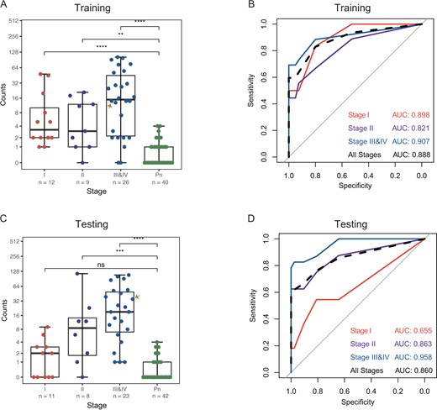
Early detection of gastric cancer, cont.
Training
Identified 153 CpG sites highly methylated in cancer (stages I-IV) compared to controls (Pn).
Counts = number of times the 153 CpG sites discovered to be methylated in a sample
Testing
Stage I AUC = 0.655
Stage II AUC = 0.863
Stages >II AUC = 0.958
Interestingly, test performed equally well for CIMP and non-CIMP tumors

Slide 9
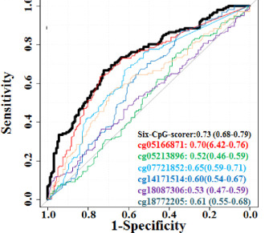
Distinguishing liver cancer from liver disease in blood
Li, K., et al. (2021). A CpG Methylation Signature as a Potential Marker for Early Diagnosis of Hepatocellular Carcinoma From HBV-Related Liver Disease Using Multiplex Bisulfite Sequencing. Frontiers in oncology, 11, 756326.
Training set: 442
Testing set: 212
34 candidate CpG sites identified from previous EWAS
LASSO identifies 6-CpG site model in training set
AUC in testing = 0.73 Backwards selection (why?!) applied to 6-CpG site score and clinical variables = age + sex + afp + 6-CpG site score AUC = 0.84 … 6-CpG site score biggest contributor

Slide 10

Early detection of colorectal cancer in …
Shao, X., et al. (2021). Combined detection of stool-based methylation indicators for early screening of colorectal neoplasm. American journal of translational research, 13(10), 11597–11607.
304 stool samples from
129 CRC patients (15% stage I, 33% stage II, 43% stage III, 9% stage IV)
65 colorectal adenoma patients, 63 patients with polyps, 47 normal controls
7 genes determined to be methylated or unmethylated
by MethylLight (rtPCR of bisulfite treated DNA)
Best single-gene performer TFP12 (AUC = 0.875)
Backward selection (again?!) used to build a logistic regression model of CRC vs not
AUC = 0.982
… in the training data
… with no break-down by stage to evaluate early/late detection

