Slide 1

Journal club
14th April 2019
Nancy (presenting) & Matt (everything else)

Slide 2
EWAS
Variable DNA methylation in neonates mediates the association between prenatal smoking and birth weight.
Hannon E, Schendel D, Ladd-Acosta C, Grove J, Hansen CS, Hougaard DM, Bresnahan M, Mors O, Hollegaard MV, Bækvad-Hansen M, Hornig M, Mortensen PB, Børglum AD, Werge T, Pedersen MG, Nordentoft M; iPSYCH-Broad ASD Group, Buxbaum JD, Daniele Fallin M, Bybjerg-Grauholm J, Reichenberg A, Mill J.
Philos Trans R Soc Lond B Biol Sci. 2019 Apr 15;374(1770):20180120.
Environmental factors influence the epigenetic signature of newborns from mothers with gestational diabetes.
Andersen E, Altıntaş A, Andersson-Hall U, Holmäng A, Barrès R.
Epigenomics. 2019 Apr 10.
Longitudinal Epigenome-Wide Methylation Study of Cognitive Decline and Motor Progression in Parkinson's Disease.
Chuang YH, Lu AT, Paul KC, Folle AD, Bronstein JM, Bordelon Y, Horvath S, Ritz B.
J Parkinsons Dis. 2019 Apr 3.
Pregnancy lipidomic profiles and DNA methylation in newborns from the CHAMACOS cohort.
Tindula G, Lee D, Huen K, Bradman A, Eskenazi B, Holland N.
Environ Epigenet. 2019 Apr 1;5(1):dvz004.
Notes:
1) Smoking and role of DNAm as mediator [discuss proj] - EWAS and DMR - tested the hypothesis that DNA methylation mediates the relationship between maternal smoking and lower birth weight, finding evidence that methylomic variation at three DMPs may link exposure to outcome. These findings complement an expanding literature on the epigenomic consequences of prenatal exposures and obstetric factors, confirming a link between the maternal environment and gene regulation in neonates.
2) GD - "We profiled the DNA methylation signature of blood from lean, obese and GDM mothers and their respective newborns … newborns from GDM mothers showed a marked distinct epigenetic profile compared with newborns of both lean and obese mothers. Analysis of variance in DNA methylation levels between newborns showed higher variance in the GDM group. "
3) DNA methylation studies in Parkinson's disease (PD) thus far have focused on disease susceptibility but not progression. Loked at 232 PD patients - information on cognitive and motor function was collected using the Mini-Mental State Examination (MMSE) and Unified Parkinson's Disease Rating Scale (UPDRS). Found associations of blood DNAm in Parkinsons Disease with cognitive and motor progression.
4) CHAMACOS - "92 metabolites in plasma samples of pregnant women at ~26 weeks gestation"
"The majority of the observed relationships were negative, suggesting that higher lipid metabolites during pregnancy are associated with lower methylation levels at genes related to fetal
development. These results further elucidate the complex relationship between early life exposures, maternal lipid metabolites, and infant epigenetic status." <- discuss lipids US work

Slide 3
Single gene studies
DNA methylation-reprogrammed oxytocin receptor underlies insensitivity to oxytocin in pre-eclamptic placental vasculature.
Fan X, Xu T, Ding H, Li H, Yang Y, He Y, Tang J, Liu Y, Chen X, Chen J, Tao J, Xu Z, Gao Q.
J Cell Mol Med. 2019 Apr 4.
This study found that OXT‐induced vascular contractions were significantly decreased in pre‐eclamptic placental vasculature.
ERα Gene Promoter Methylation in Cognitive Function and Quality of Life of Patients With Alzheimer Disease.
Li KX, Sun Q, Wei LL, Du GH, Huang X, Wang JK.
J Geriatr Psychiatry Neurol. 2019 Apr 4:891988719835325.
Study aimed to investigate the effects of oestregen recepter a (ERα) gene promoter metyhlation on the cognitive function and quality of life in patients with AD.
"ERα promoter methylation is related to impaired cognitive function and QOL of patients with AD by inhibiting ERα mRNA expression and transcription."
Notes:
1) PE -> looked at human placentas (n=45 controls, 42 cases) - revealed the pathophysiological changes and its underlying mechanisms of oxytocin-induced vasoconstrictions in placental vessels under pre-eclamptic condition..... Found that oxytocin-induced contractions were significantly decreased in human pre-eclamptic placental vasculature, associated with a deactivated transcription of oxytocin receptor gene......This study was first to reveal that a hyper-methylation of CpG islands in oxytocin receptor gene promoter, leading to a relatively low pattern of oxytocin receptor expression, was responsible for the decreased sensitivity of oxytocin in pre-eclamptic placental vessels.
2) AD -> n=132 cases 135 healthy controls. This study aims to investigate the effects of estrogen receptor α (ERα) gene promoter methylation on the cognitive function and quality of life (QOL) of patients with AD. The methylation group showed a decrease in ERα mRNA expression. The MMSE and ADL scores were indicative of a worse cognitive function in the methylation group. The ERα promoter methylated patients showed a higher rate of abnormal ADL score, while patients in the nonmethylation group enjoyed a better QOL -> the ERα promoter methylation is related to impaired cognitive function and QOL of patients with AD by inhibiting ERα mRNA expression and transcription.

Slide 4
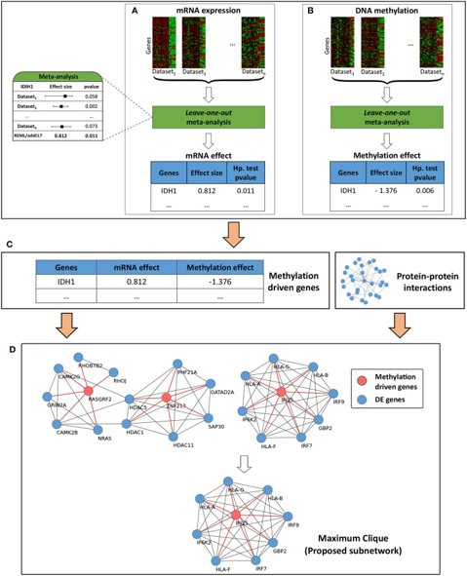
Methods
A Multi-Cohort and Multi-Omics Meta-Analysis Framework to Identify Network-Based Gene Signatures.
Shafi A, Nguyen T, Peyvandipour A, Nguyen H, Draghici S. Front Genet. 2019 Mar 19;10:159.
"Although massive amounts of condition-specific molecular profiles are being accumulated...meaningful interpretation of these data remains a major challenge...we propose a novel multi-cohort and multi-omics meta-analysis framework...to identify robust molecular subnetworks that capture the key dynamic nature of a given biological condition"
meta-analyse mRNA datasets
meta-analyse DNA methylation datasets
identify 'methylated driven genes' -> genes with mRNA associations and DNA methylation associations
overlay methylation-driven genes onto a protein-protein interaction network identifying highly connected subnetworks ('cliques' - "genes that are part of a clique are more likely to be functionally related")
use these genes to cluster samples in an independent dataset to determine their predictive/prognostic/detection power.
Notes:
The problem: horizontal meta-analysis (i.e., combining sample-unmatched studies of the same data type) is unable to combine studies coming from multiple data types. Hence, it is not suitable for the identification of the mechanism of action of a given disease. Additionally, vertical meta-analysis (i.e., combining sample-matched studies from multiple data type) accounts for the heterogeneity that may arise across different omic layers BUT requires each data type to be available for each individual patient, which is expensive and impractical for the studies with large sample sizes.
The proposed solution: we propose a multi-cohort and multi-omics meta-analysis framework that identifies network-based signatures using independent mRNA and DNA methylation studies available in the public repositories. The identified signatures are evaluated based on their ability to distinguish patients with different survival profiles on independent validation datasets.
Understanding the mechanism of action for a given disease from these vast resources and subsequently identifying reliable biomarkers that can predict the patients' clinical outcome has become a major challenge.
Numerous computational methods have been proposed that aim to address the above-mentioned challenge by integrating known interactions between the genes and subsequently identifying network-based markers using different strategies.
DNA methylation has been recognized to play a crucial role in cancer progression (Esteller, 2008; Parrella, 2010). An increasing number of computational approaches have been published in recent years for the identification of methylation-based biomarkers (Gevaert et al., 2015; Hao et al., 2017; Hong et al., 2017; Shafi et al., 2018). However, to the best of our knowledge, none of the current approaches is able to identify network-based gene signatures considering the data heterogeneity among the independent DNA methylation and gene expression studies. The approach presented in this manuscript bridges this gap.
multi-cohort and multi-omics meta-analysis framework that is able to integrate unmatched mRNA and DNA methylation data obtained from many different independent studies, and subsequently identify network-based signatures that can capture putative mechanisms of a given disease.

Slide 5
Mouse studies
Intra-individual methylomics detects the impact of early-life adversity.
Jiang S, Kamei N, Bolton JL, Ma X, Stern HS, Baram TZ, Mortazavi A.
Life Sci Alliance. 2019 Apr 1;2(2). pii: e201800204.
"DNA methylation from buccal cells of individual rats before and immediately after exposure to one week of typical or adverse life experience. We find that whereas inter-individual changes in DNA methylation reflect the effect of age, DNA methylation changes within paired DNA samples from the same individual reflect the impact of diverse neonatal experiences."
Remodeling of epigenome and transcriptome landscapes with aging in mice reveals widespread induction of inflammatory responses.
Benayoun BA, Pollina EA, Singh PP, Mahmoudi S, Harel I, Casey KM, Dulken BW, Kundaje A, Brunet A.
Genome Res. 2019 Apr;29(4):697-709.
"Here, we generated chromatin maps and transcriptomes from four tissues and one cell type from young, middle-aged, and old mice-yielding 143 high-quality data sets."
"machine-learning analysis showed that specific epigenomic states could predict transcriptional changes during aging."
"Pathways mis-regulated during mouse aging across tissues, notably innate immune pathways, were also mis-regulated with aging in other vertebrate species-African turquoise killifish, rat, and humans-indicating common signatures of age across species."

Slide 6
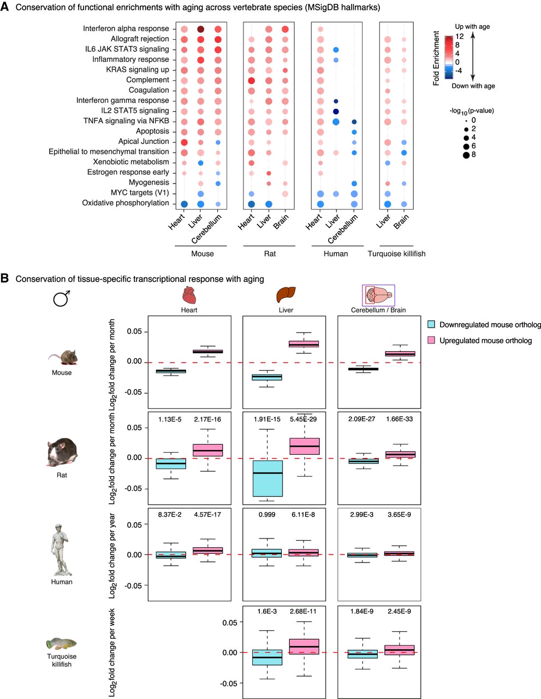
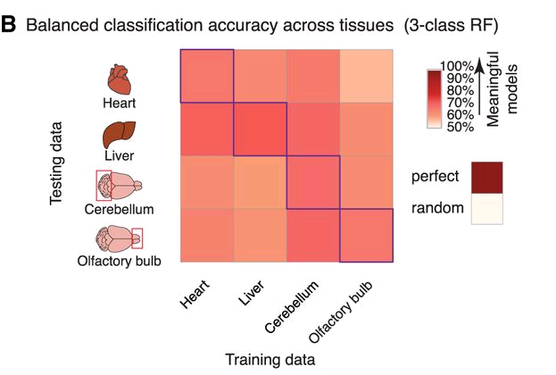
Remodeling of epigenome and transcriptome landscapes with aging in mice reveals widespread induction of inflammatory responses.​
Benayoun BA, Pollina EA, Singh PP, Mahmoudi S, Harel I, Casey KM, Dulken BW, Kundaje A, Brunet A.​
Genome Res. 2019 Apr;29(4):697-709.​
Figure 5. Conservation of findings across vertebrates
Pathways enriched with genes associated with aging
Figure 3 Gene expression associations with age can be predicted with epigenetic marks (H3K4me3, H3K27ac).
In vertebrates, aging differences of genes associated with aging in mice.
Prediction is better than random in all cases but the most robust predictions appear in liver.
Notes:
The largest multi-tissue epigenomic and transcriptomic data set for vertebrate aging
The problem: Aging is accompanied by the functional decline of tissues. However, a systematic study of epigenomic and transcriptomic changes across tissues during aging is missing.
Solution: Here, we generated chromatin maps and transcriptomes from four tissues and one cell type from young, middle-aged, and old mice—yielding 143 high-quality data sets. We focused on chromatin marks linked to gene expression regulation and cell identity: histone H3 trimethylation at lysine 4 (H3K4me3), a mark enriched at promoters, and histone H3 acetylation at lysine 27 (H3K27ac), a mark enriched at active enhancers. Epigenomic and transcriptomic landscapes could easily distinguish between ages, and machine-learning analysis showed that specific epigenomic states could predict transcriptional changes during aging.
ML: To understand how age-related changes in the epigenome predict age-related transcriptional changes, we took advantage of ML: neural networks [NNETs], support vector machines [SVMs], gradient boosting [GBM], and random forests [RFs]) -> trained models to discriminate between transcriptional changes with age—up-regulated, down-regulated, or unchanged gene expression.
Pointers:
All machine-learning algorithms assigned genes to the correct transcriptional change with age 67%–81% of the time on average, significantly above that of a random classification (50%)
Models derived using tree-based algorithms (GBM and RF) performed slightly better than other models (69%–81% vs 67%–75%)
The accuracy was similar whether validation was performed within or across tissues
These observations suggest that genes that are misregulated with age share common epigenomic signatures, even if these genes and loci are different across tissues
Models trained with only static or dynamic features also had predictive power, but models trained with both types of features performed better
Pathways misregulated during mouse aging across tissues, notably innate immune pathways, were also misregulated with aging in other vertebrate species—African turquoise killifish, rat, and humans—indicating common signatures of age across species. This resource identifies chromatin and transcriptional states that are characteristic of young tissues, which could be leveraged to restore aspects of youthful functionality to old tissues.

Slide 7
More mouse studies
Somatic expression of piRNA and associated machinery in the mouse identifies short, tissue-specific piRNA.
Perera BPU, Tsai ZT, Colwell ML, Jones TR, Goodrich JM, Wang K, Sartor MA, Faulk C, Dolinoy DC.
Epigenetics. 2019 Apr 8:1-18.
"Piwi-interacting RNAs (piRNAs) are small non-coding RNAs that associate with PIWI proteins for transposon silencing via DNA methylation and are highly expressed and extensively studied in the germline."
Show that "piRNAs are expressed in several somatic tissues" including brain, liver, kidney, and heart.
DNA (de)methylation in embryonic stem cells controls CTCF-dependent chromatin boundaries.
Wiehle L, Thorn GJ, Raddatz G, Clarkson CT, Rippe K, Lyko F, Breiling A, Teif VB.
Genome Res. 2019 Apr 4. pii: gr.239707.118.
Knockdown of Tet1 and Tet2 in mouse embryonic stem cells resulted in "changes in nucleosome positioning, CTCF binding, DNA methylation and gene expression". CTCF binding tended to be lost where DNA methylation-related nucleosome loss occurred, preferentially where 5hmC but not 5fC was observed. At loss sites DNA methylation changes tended to 'spread' resulting in the reduction of expression in neighboring genes.

Slide 8
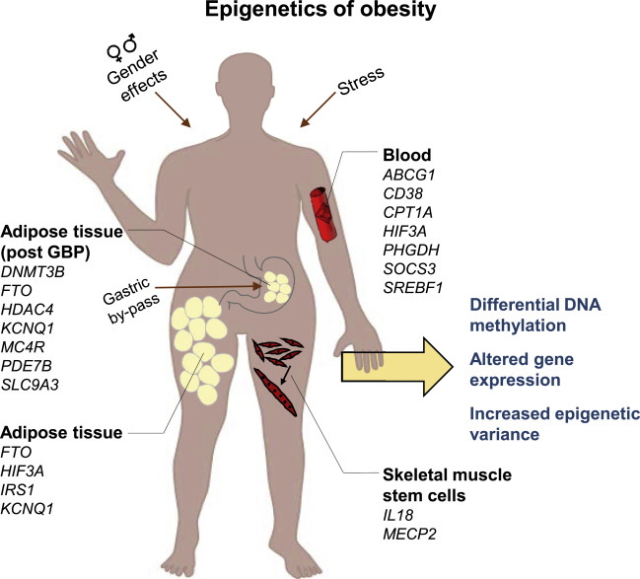
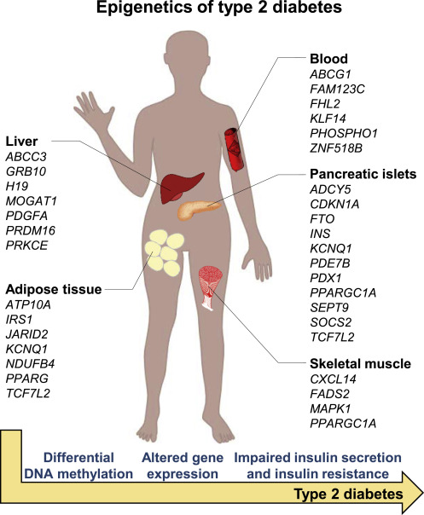
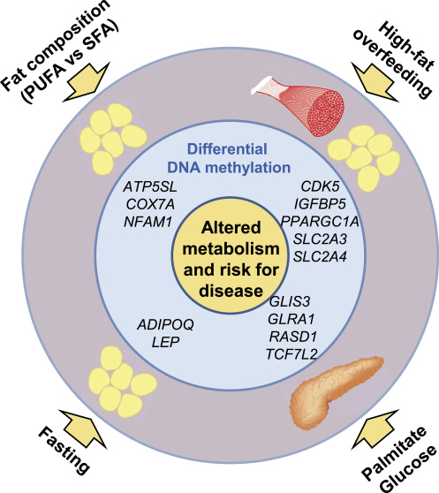
Take-home message: illustrations in scientific papers should be contracted out to qualified artists.
Reviews
Ling and Rönn, Epigenetics in Human Obesity and Type 2 Diabetes, Cell Metabolism (2019), https://doi.org/10.1016/j.cmet.2019.03.009
Tom Richardson - "an excellent review"
Different Diets and Nutrients Are Associated with Differential DNA Methylation in Human Tissues Including Adipose Tissue, Skeletal Muscle, and Pancreatic Islets
Obesity Is Associated with Differential DNA Methylation and Increased Epigenetic Variability
Type 2 Diabetes Is Associated with Differential DNA Methylation in Human Tissues
Notes:
"there is a huge need to dissect the molecular mechanisms such as epigenetics, which may cause diabetes."
"...so-called [EWAS] are based on...450,000 CpG sites, which is about 1.5% of all the CpG sites of the human genome...there is likely many more discoveries to be made now as sequencing-based methods of higher coverage are becoming more available and cost efficient...the human epigenome is still a black box, waiting to be discovered."
"...additional challenges, the most important being the fact that the epigenome is tissue specific, or even cell specific, and that it changes over time..."
"Almost all the knowledge we have concerning epigenetic dysregulation in relation to human obesity and T2D has emerged during the last 10 years. With that in mind, the advancements are tremendous, and for future perspectives, the research field holds unlimited possibilities."
Discussion -> larger cohorts are needed- tissue/cell-specific nature of epigenetic information – more human biopsies are desirable. Several studies report small, but significant, changes on a group level, whereas a paired study design is harder to find. As metabolic diseases are heterogeneous in nature, the interindividual variation is large, and several small changes may act together to influence the phenotype. The use of single-cell types would allow to better connect the epigenome to the transcriptome and to define the extent of alterations needed in DNA methylation to affect gene expression. Moreover, mQTL studies and CITs have linked SNPs via significant differences in DNA methylation to differential gene expression in human tissues.

